Slide 1
I-80 & MIDDLE ROAD
INTERCHANGE RECONSTRUCTION

Slide 2
PROJECT HISTORY
City was awarded a $500,000 federal grant to prepare an Interchange Justification Report (IJR) in 2005
Engineering consultant was selected in 2006
Preparation of the IJR begin in 2007
Final approval of the IJR received on January 22, 2015
City was awarded $750,000 federal grant to acquire right-of-way at the southeast corner of the interchange in 2017. City match was $187,000.
City was awarded $1.56M RISE grant in March 2022 to support reconstruction of the interchange due to FG80
Development project

Slide 3
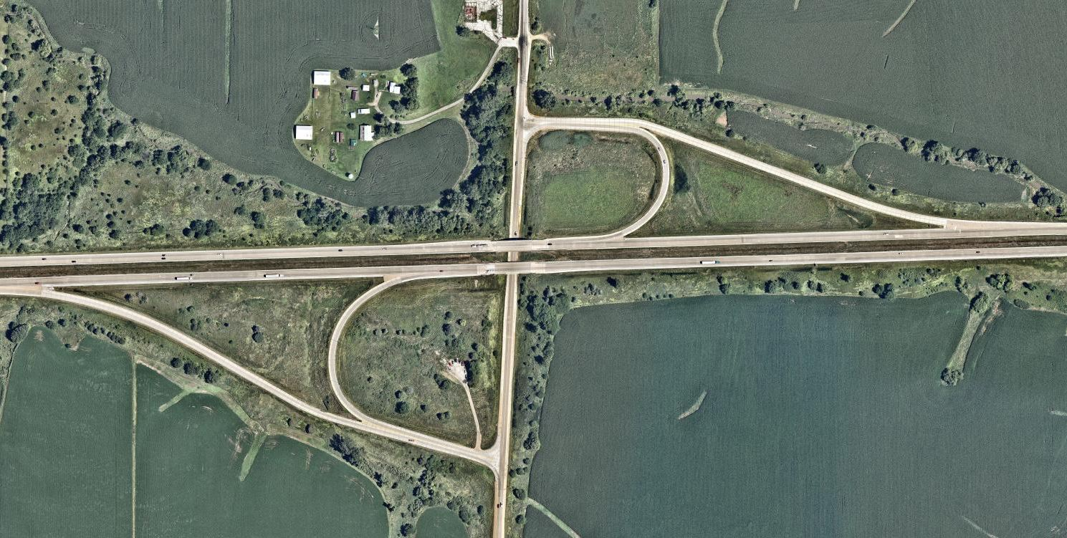
EXISTING CONFIGURATION
Two Quadrant Partial Cloverleaf

Slide 4
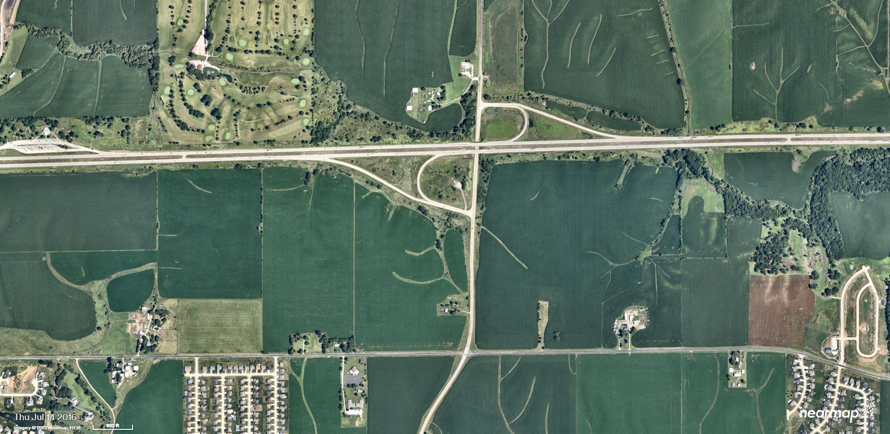
Area growth
2016

Slide 5
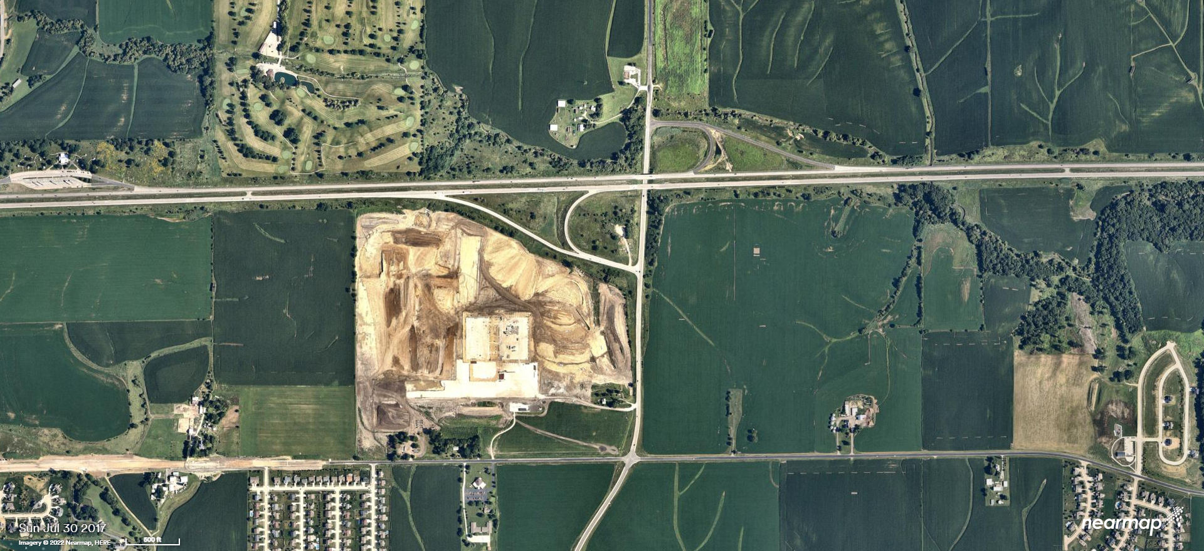
Area growth
2017

Slide 6
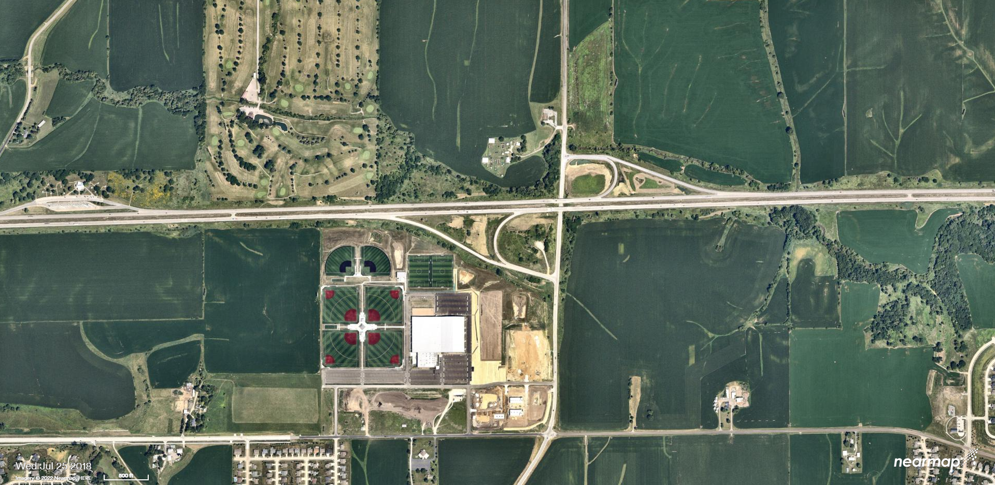
Area growth
2018

Slide 7
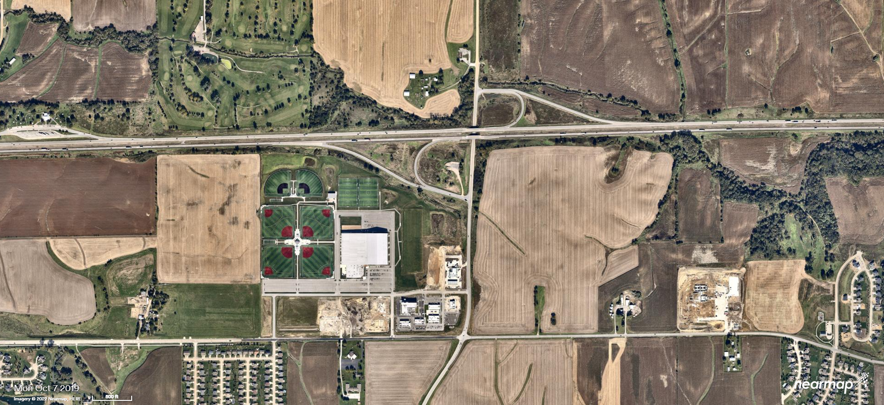
Area growth
2019

Slide 8
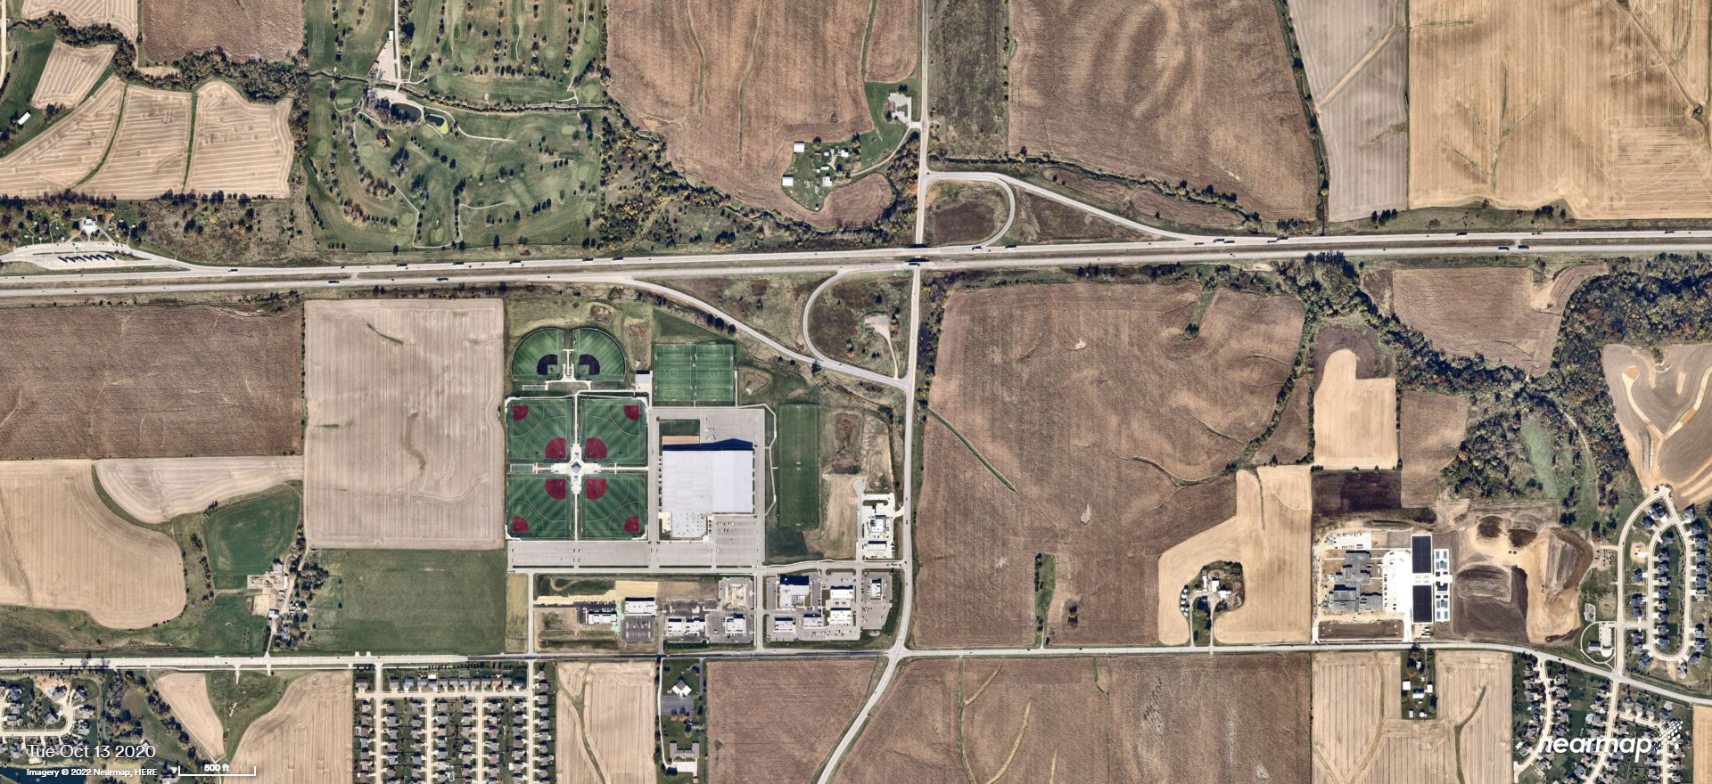
Area growth
2020

Slide 9
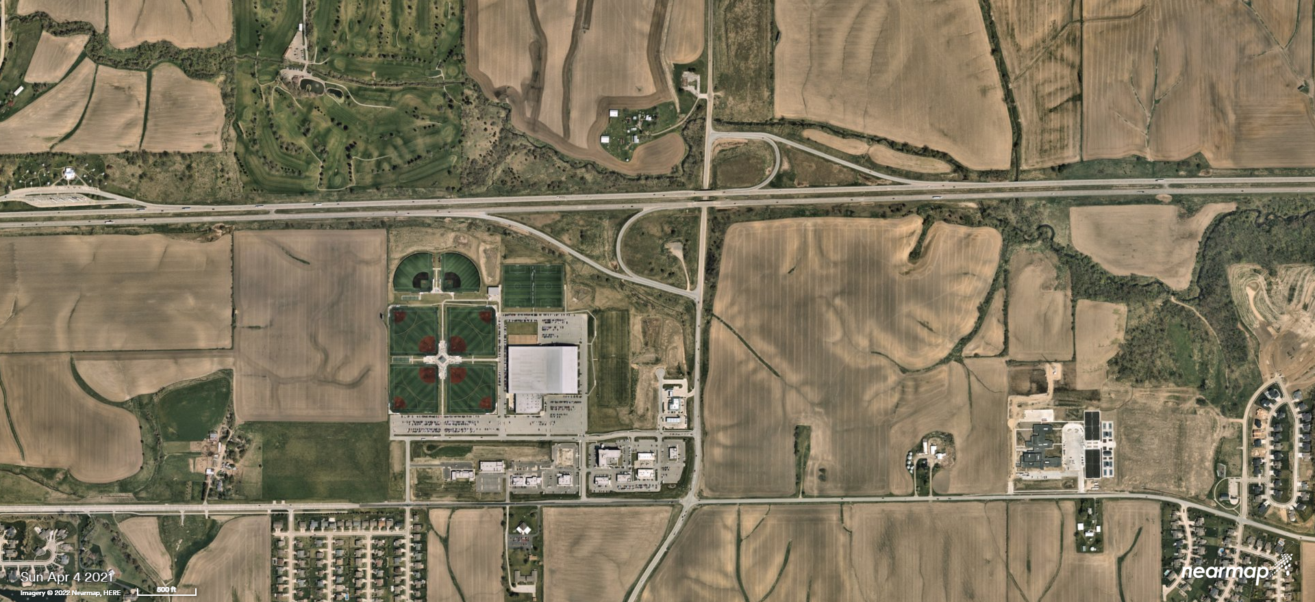
Area growth
2021

Slide 10
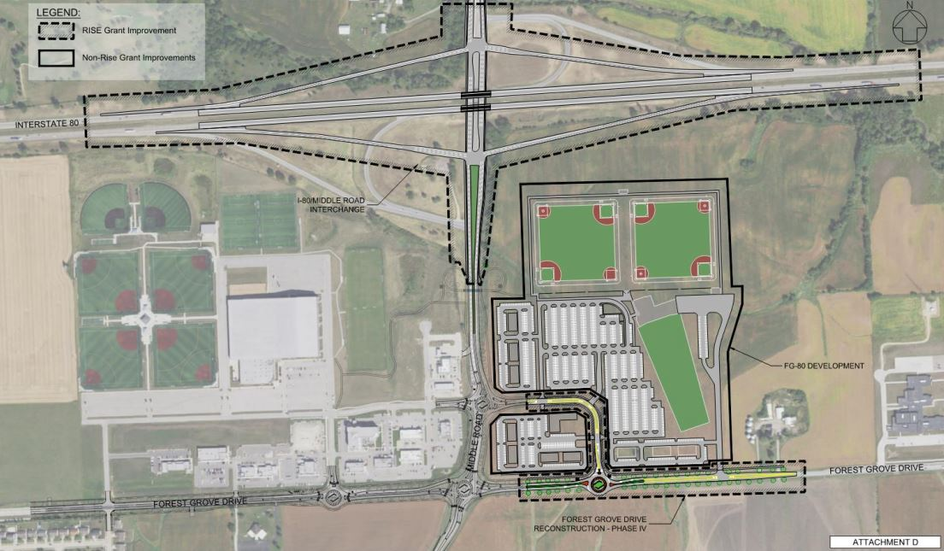
Area growth
FG80 DEVELOPMENT & COMPRESSED DIAMOND INTERCHANGE

Slide 11
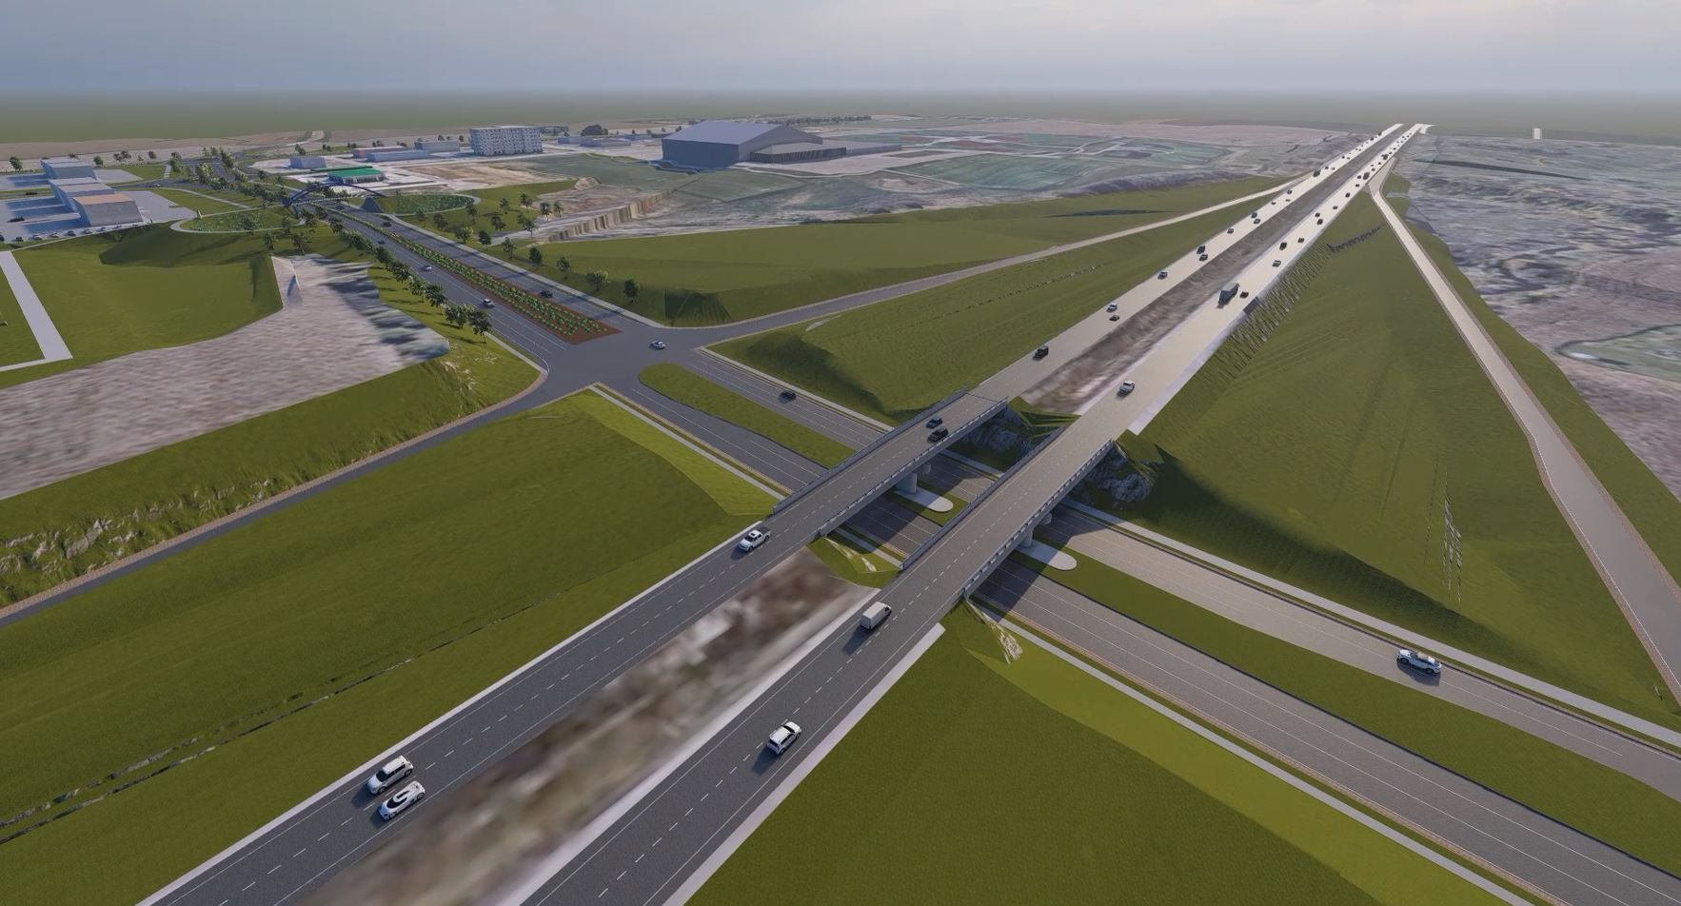
Area growth
FG80 DEVELOPMENT & COMPRESSED DIAMOND INTERCHANGE

Slide 12
Traffic & SAFETY
Interstate 80 at Middle Road
2010 AADT – 27,600
2014 AADT – 30,900
2018 AADT – 33,700
Middle Road south of I-80
2010 AADT – 6,100
2014 AADT – 6,400
2018 AADT – 7,700
2022 AADT – 11,700
Existing configuration has extremely short acceleration lanes – made worse by increasing traffic
1% - 2% annual increase in traffic along I-80
Massive increase in traffic on Middle Road after opening of TBK Bank Sports Complex and associated commercial areas
FG80 Development on east side of Middle Road is projected
to double the existing traffic at full buildout (2025)
to approximately 22,000 AADT

Slide 13
Capital investments
& timeline
2022 - 2023
Forest Grove Drive & Middle Road Reconstruction ($11.5M - City)
FG80 Development ($75+M – Developer & City)
2024
Middle Road Pedestrian Bridge ($5.3M – City)
2025
I-80 & Middle Road Interchange Reconstruction ($45.8M – DOT)

Slide 14
QUESTIONS?
THANK YOU!

