Slide 1
Revitalize Iowa’s Sound Economy Program
Iowa Transportation Commission Workshop
April 11, 2022

Slide 2
Revitalize Iowa’s Sound Economy Program
Created in 1985
Purpose: To promote economic development through roadway improvements.
Eligible development shall have value-adding activities that feed new dollars into the economy
Available to cities and counties through an application program

Slide 3
Available Funding and Application Summary
Available Funding
Funded annually with dedicated state motor fuel and special fuel tax revenues
Application Summary for SFY2022
Total number of projects awarded: 9
Total project costs: $30,967,957
Total amount awarded: $15,586,157
 | CITY | COUNTY
Average funding generated monthly | $905,101 | $452,550
SFY 2022 current Road Use Tax Revenue (as of 2/28/2022) | $8,197,854.15 | $4,098,927.07
Current Unobligated Balance (as of 2/28/2022) | $3,927,189.87 | $1,073,816.20

Slide 4
Immediate Opportunity Project Evaluation Criteria
Growth Potential
Average wages meet at least 100% laborshed wage
Quality of Jobs
No pattern of violations
In-state suppliers
Impact on import substitution
Few Iowa competitors
Operating expenditures spent in Iowa
Out-of-state sales
Hiring preferences to Iowa residents

Slide 5
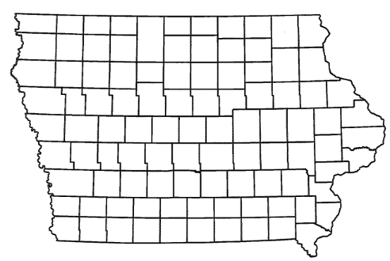
List of Immediate Opportunity Applications Recommended
PROJECT NAME
SPONSOR
JOBS
TOTAL PROJECT COST
PERCENT PARTICIPATION
RECOMMENDED AMOUNT
Amendment: Reduce the grant, remove 100th Street improvements and construct additional intersection improvements to County Road M-66 and 100th Street. | Audubon County | N/A | $297,525 | 80% | $238,020

Slide 6
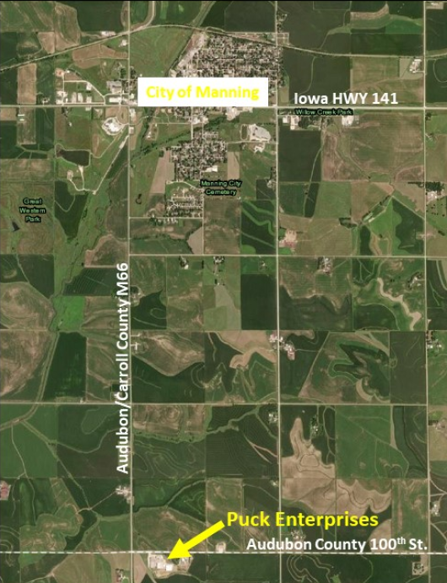
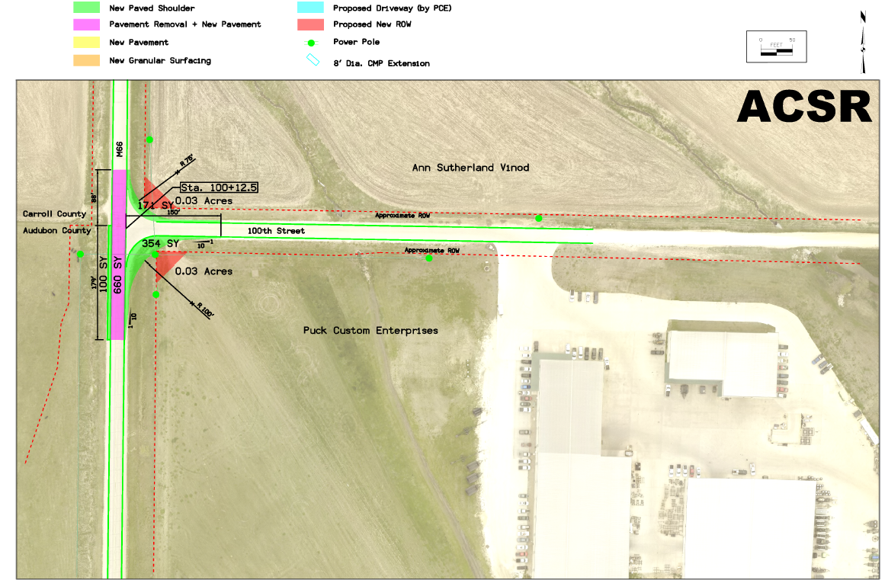
Audubon County - Amendment
(Immediate Opportunity)
An amendment to reduce the grant awarded on August 10, 2021, remove 100th Street improvements and construct additional intersection improvements to County Road M-66 and 100th Street located south of Manning. This amendment is necessary to provide improved access to the proposed expansion of Puck Enterprises, a liquid manure application equipment manufacturer.
Total Cost: $297,525
Requested: $238,020 (80%)

Slide 7
Local Development Project Evaluation Criteria
Development Potential (35 points)
Economic impact and Cost Effectiveness (20 points)
Local Commitment and Initiative (33 points)
Transportation Need and Justification (4 points)
Local Economic Need (6 points)

Slide 8
List of Local Development Applications Recommended
PROJECT NAME
SPONSOR
SCORE
TOTAL PROJECT COST
PERCENT PARTICIPATION
RECOMMENDED AMOUNT
Paving approximately 2,470 feet of Alicia Avenue and construction of a left-turn lane on 225th Street. | Sioux City | 66 | $2,661,056 | 50% | $1,330,528
Reconstruction of approximately 1,960 feet of 9th Street NE. | Altoona | 45 | $3,018,414 | 50% | $1,509,207

Slide 9
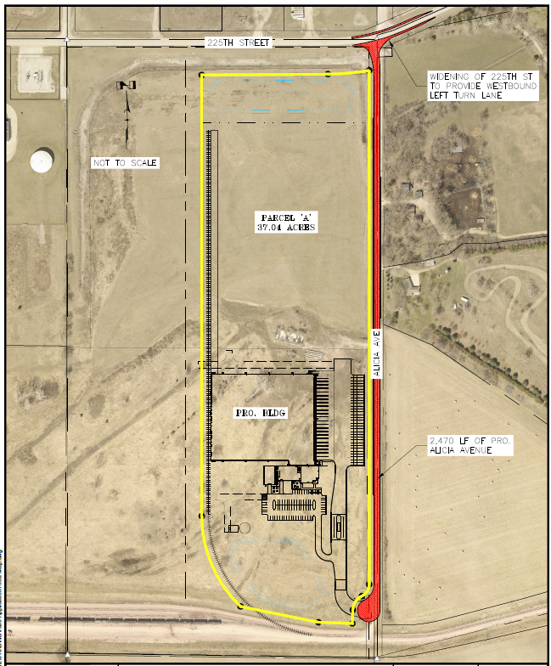
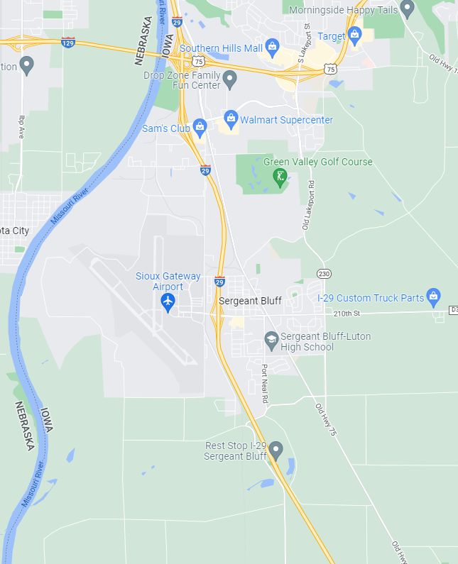
Sioux City
(Local Development)
Paving approximately 2,470 feet of Alicia Avenue and construction of a left-turn lane on 225th Street located on the south side of town. This project will provide access to 37 acres for warehousing purposes .
Total Cost: $2,661,056
Requested: $1,330,528 (50%)

Slide 10
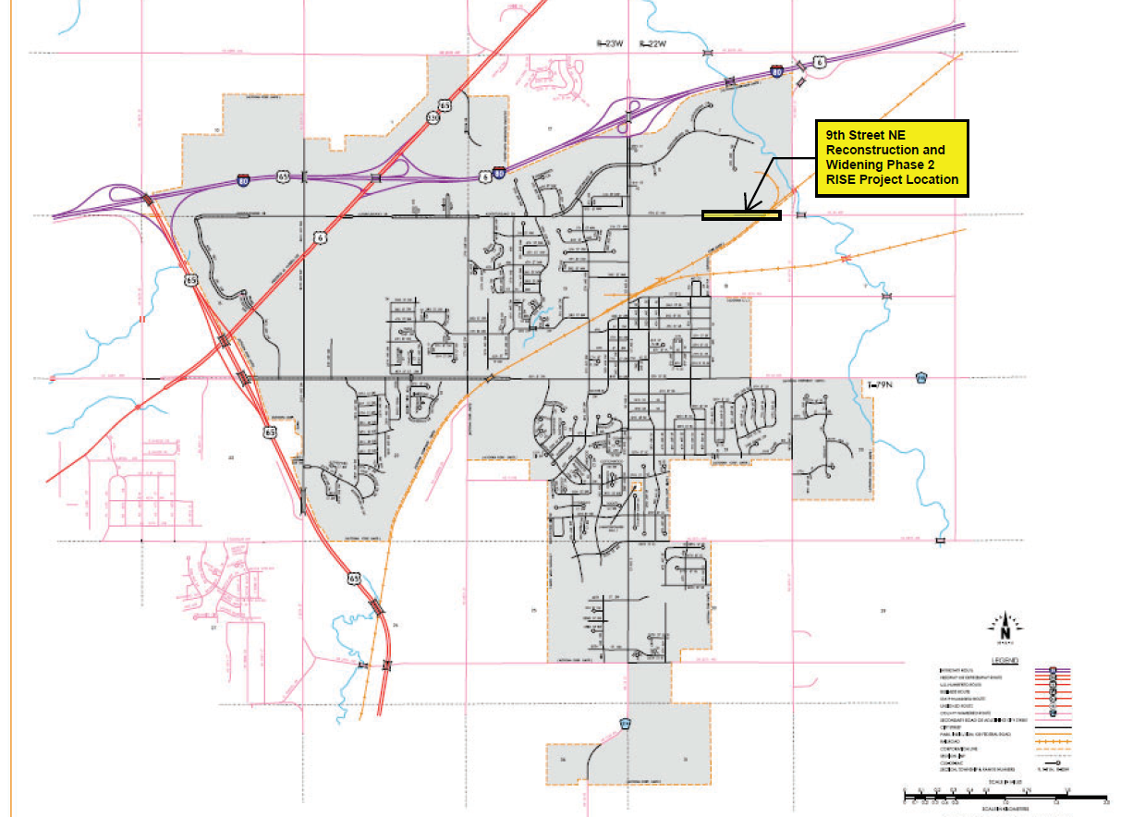
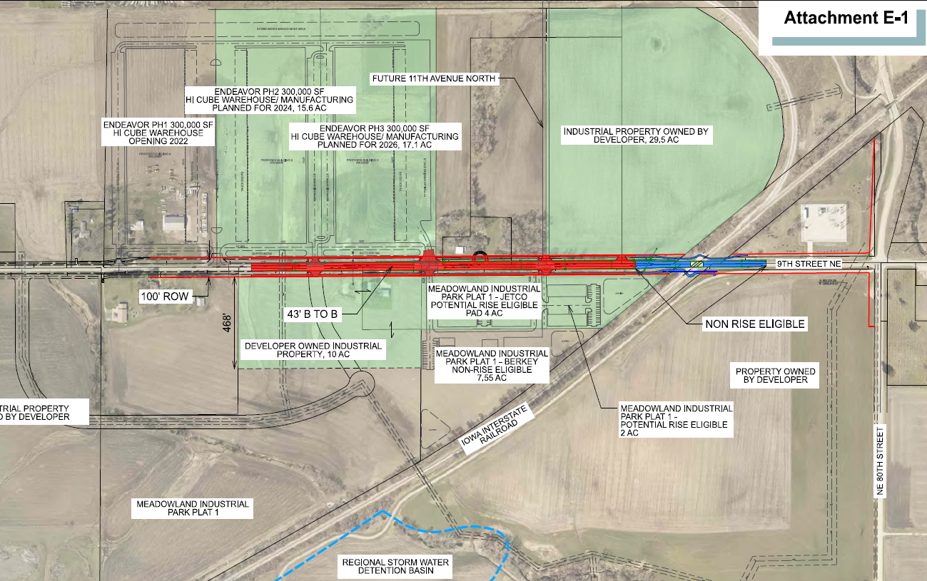
Altoona
(Local Development)
Reconstruction of approximately 1,960 feet of 9th Street NE located on the northeast side of town. This project is necessary to provide improved access to six lots totaling more than 78 acres for warehousing and industrial purposes.
Total Cost: $3,018,414
Requested: $1,509,207 (50%)

Slide 11
QUESTIONS?
Craig Markley, Systems Planning Bureau
craig.markley@iowadot.us
515-239-1027

