Slide 1
State Transportation Plan & State Freight Plan
2022 Updates
Commission Workshop
April 11, 2022

Slide 2
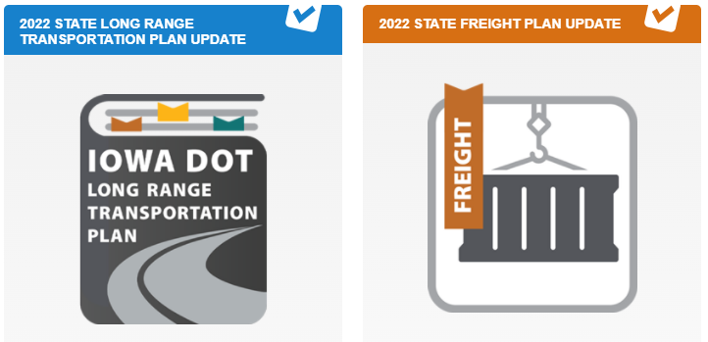
Discussion items
Public comment period
Summary of public input
Next steps

Slide 3
Public comment period
45-day comment period, February 21 – April 7
Full draft documents were posted online
Availability of plans and public comment period was advertised (media release, social media, stakeholder distributions, etc.)
Comments accepted through multiple means (via webpage, e-mail, mail, phone)
Final comment period intended to supplement earlier public/stakeholder input efforts

Slide 4
Public comment period
570 unique visitors to the webpage
17 written comments received
Limited media coverage from online publications

Slide 5
Summary of public input
Areas of interest
Multimodal accessibility and mobility / public health
Rightsizing and consideration of non-highway modes
Multidisciplinary safety planning (beyond engineering)
Freight regulations and permitting
Miscellaneous project interests
Highway coalition expressing interest in 4-laning

Slide 6
Summary of public input
Overall, public input throughout plan development strongly supported the ultimate direction of the both plans
Technical corrections have been made
No substantive changes to plan content presented previously

Slide 7
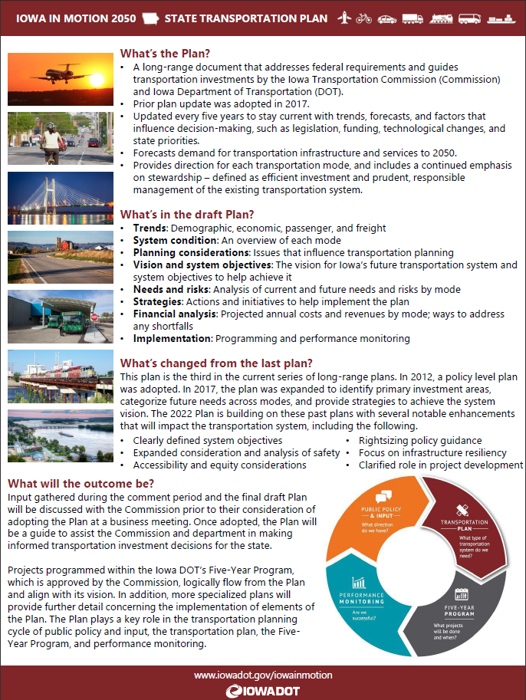
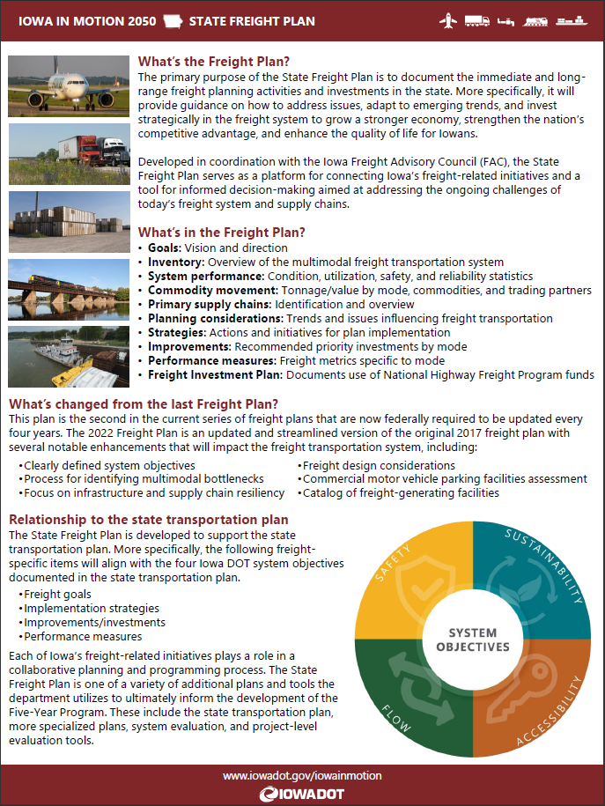
Plan summaries
4-page plan summaries have been shared

Slide 8
Next steps
Prepare plans for publishing
Present final plans:
SFP for information at May workshop
SLRTP for adoption at May business meeting

Slide 9
THANK YOU
Garrett.Pedersen@iowadot.us

