Slide 1
2024-2028 Highway Program Development
April 10, 2023

Slide 2
April 10, 2023
Overview
Revisit previously discussed Decision Points
Review 2024-2028 Highway Program Balance
Summarize 2024-2028 Highway Program Objectives
Review Line Item Targets for Programming
Discuss detailed project lists

Slide 3
April 10, 2023
Commission Program Development Schedule (2024-2028)
April 2023
Develop the Draft 2024-2028 Highway Program
Action Item: Line Item Targets for Programming
Action Item: 2024-2028 Highway Program Objectives
May 2023
Present the Draft 2024-2028 Iowa Transportation Improvement Program to the public
(including all previous program approvals and draft 2024–2028 Highway Program)
June 2023
Action Item: Approve the 2024–2028 Iowa Transportation Improvement Program

Slide 4
Decision Points
April 10, 2023 as presented on March 23, 2023
Should projects in the 2024-2027 program continue to be programmed with cost/schedule updates?
To the maximum extent possible, continue with programmed projects but consider rescheduling scenario to balance the Program.
Prioritize keeping stewardship/safety projects on schedule
How should the Program be balanced?
Maintain stewardship levels
Develop a scenario for consideration:
Reschedule some non-stewardship projects based on criteria discussed at March 14 workshop
Include underfunded projects and consider additional funding opportunities in overall program funding strategy

Slide 5
Reschedule Projects
April 10, 2023 as presented on March 23, 2023
Reschedule projects using the following criteria:
Statewide equity
Length of time a project has been considered for programming
Has the project been rescheduled in the past?
Purpose of the project
Is the project under construction?
Are there other partners in the project?
What are the current conditions/need for the project
Avoid reducing stewardship and safety targets

Slide 6
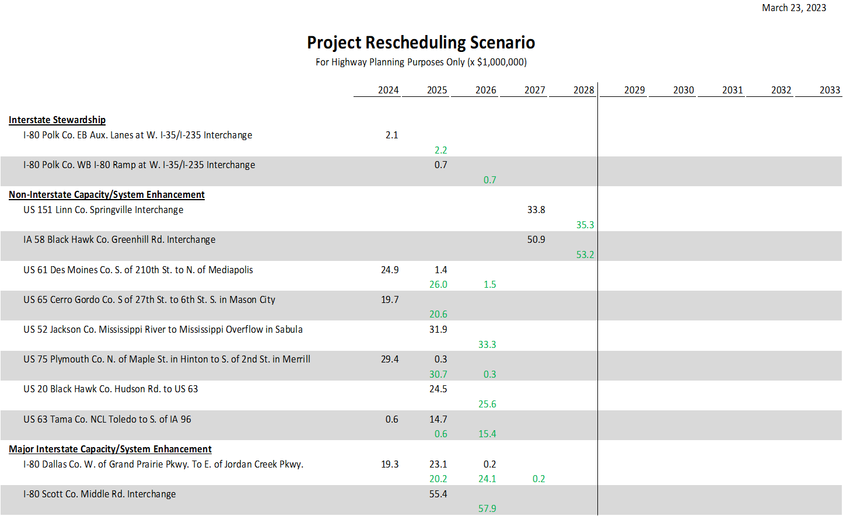
April 10, 2023 as presented on March 23, 2023

Slide 7
Rescheduling Scenario Summary
April 10, 2023 as presented on March 23, 2023
Maintains stewardship and safety targets
Currently programmed projects remain in program
No projects delayed more than one year
Includes projects from each District (statewide)
Programmed dollars for projects rescheduled in this scenario make up approximately 8 percent of the total program
Only 12 of the 623 projects in the program are rescheduled in this scenario

Slide 8
Underfunded Projects
April 10, 2023 as presented on March 23, 2023
Recommendation:
Consider identifying a few projects as not fully funded in the Program.
Identify projects that would have a good opportunity for receiving funding through other sources.
Highlight those projects in the Program to be transparent and indicate they could be delayed if additional funding not received.
Justification:
There are other sources of funding available such as discretionary grants at the federal level.
The Iowa DOT has had success in securing other funding and those opportunities are greater now than in the past.
Showing projects as not fully funded will help those projects compete for funding by demonstrating the critical need for funds.

Slide 12
April 10, 2023
Potential FY 2024-2028 Highway Program Objectives
Update to shift to the System Objectives of the new State Long Range Transportation Plan
Safety
Maintain increasing funding levels for safety
Sustainability
Maintain increasing Interstate funding levels for pavement reconstruction, modernization, bridges, pavement patching/maintenance, rest areas, and other miscellaneous projects
Maintain increasing funding levels for non-interstate pavement modernization
Maintain increasing funding levels for non-interstate bridge modernization
Invest in additional stewardship projects
Transfer of jurisdiction for portions of primary roadways to cities and counties
Accessibility
Invest in truck parking at Interstate Rest Areas
Invest in corridor improvements
Flow
Invest in intelligent transportation systems infrastructure
Invest in Super-2 improvements
Invest in operational and Integrated Corridor Management improvements

Slide 13
April 10, 2023
as shown on March 14, 2023
Draft 2024-2028 Iowa Highway Program Line Items

Slide 14
April 10, 2023
Explanation of Highway Program Changes

Slide 15
Next Steps
April 10, 2023
April 2023
Action Item: Line Item Targets for Programming
Action Item: 2024-2028 Highway Program Objectives
May 2023
Present the Draft 2024-2028 Iowa Transportation Improvement Program to the public
(including all previous program approvals and draft 2024–2028 Highway Program)
June 2023
Action Item: Approve the 2024–2028 Iowa Transportation Improvement Program

