Slide 1
Welcome to Cedar Rapids!
Iowa DOT Commission Meeting
April 9, 2024

Slide 2
Cedar Rapids – Vibrant Business Hub
Investment in CR offers outsized ROI as significant Iowa jobs center
Existing industry realizes significant advantage from location in Cedar Rapids
Cedar Rapids well positioned for future above-trend growth

Slide 3
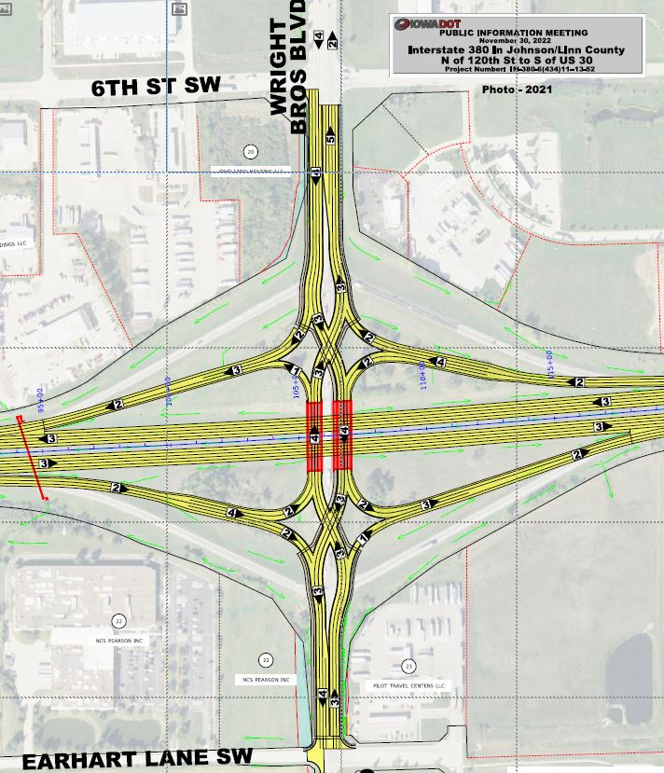
Wright Brothers Blvd Interchange at I-380
Critical infrastructure improvement
Increases safety and capacity
Major consideration for business location and development

Slide 4
Southwest Growth Area

Slide 5
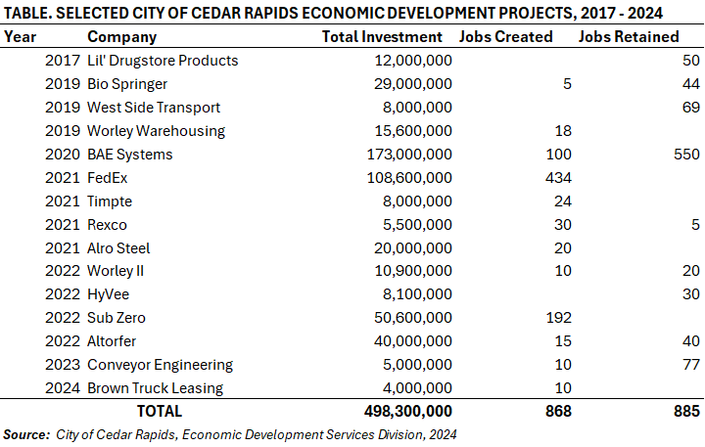
Southwest Growth Area

Slide 6
Southwest Growth Area
Strong growth trends in market
Alignment with target industries:
Logistics & Distribution
Food & Bio
Manufacturing
Total economic impact:
868 jobs created
885 jobs retained
Nearly $500M in Capital Expenditures

Slide 7
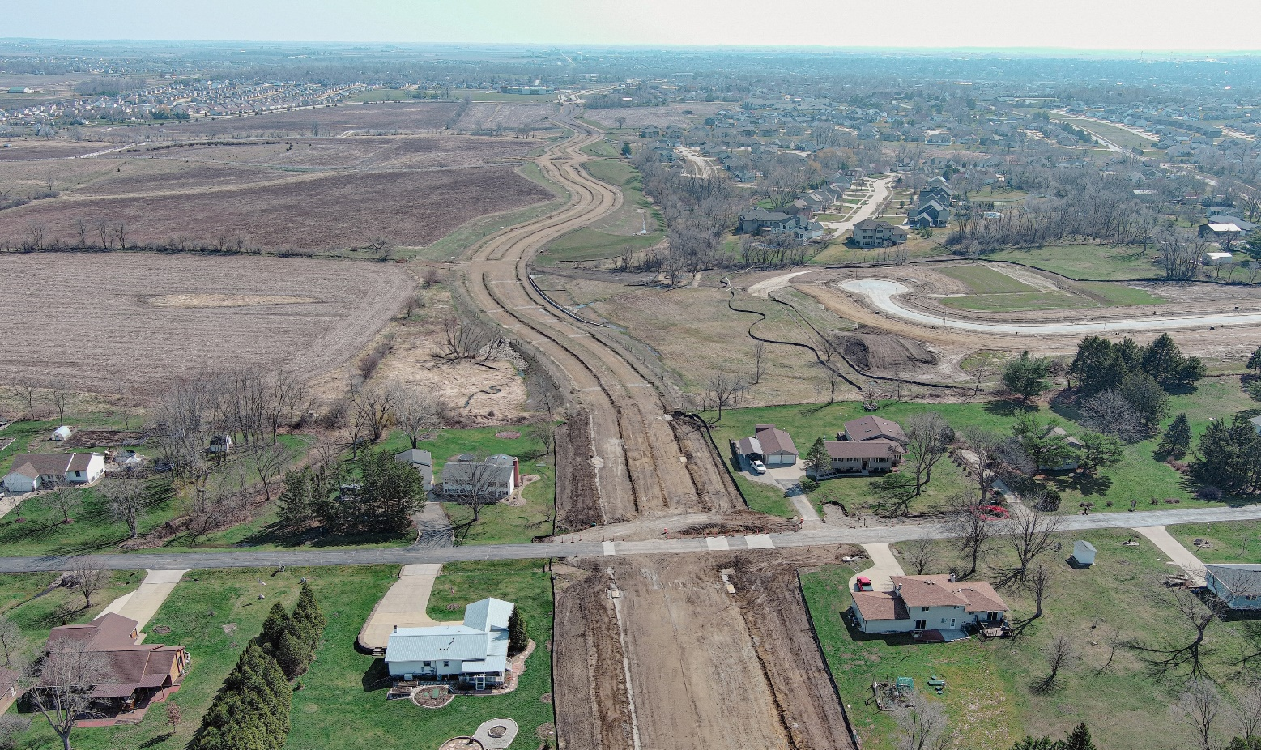
Tower Terrace Road
Continued partnership with Hiawatha, Robins, Marion, Linn County, Corridor Metropolitan Planning Organization, and Iowa DOT
Final phase of C Avenue NE to Alburnett Road segment to begin Summer 2024 and be complete Spring 2025

Slide 8
Thank You
Presented by:
Tiffany O’Donnell
Mayor
t.odonnell@cedar-rapids.org
319.286.5051
Bill Micheel, AICP
Director, Economic & Development Services
w.micheel@cedar-rapids.org
319.286.5725

