Slide 1
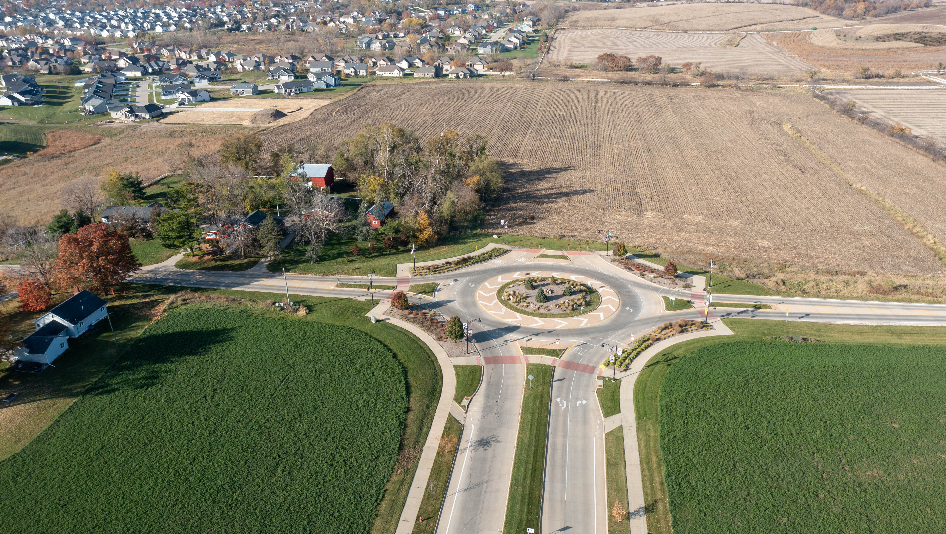
Tower Terrace Road
Phase 7 Improvements Project

Slide 2
Iowa DOT District 6, Location & Environment Bureau, and Local Systems Bureau have been extremely helpful in our regional planning efforts for Tower Terrace Road.
Partnership
Corridor MPO, Cedar Rapids, Hiawatha, Robins, Marion, and Linn County
NEPA study nearing completion for remaining segments (28E Agreement)
$5M CPF grant through Congresswoman Hinson for design & ROW acquisition
Consultant selected and in contract negotiations
Notes:
Mayor Nick starts out with this slide and recognizes the other Mayors in the partnership.

Slide 3
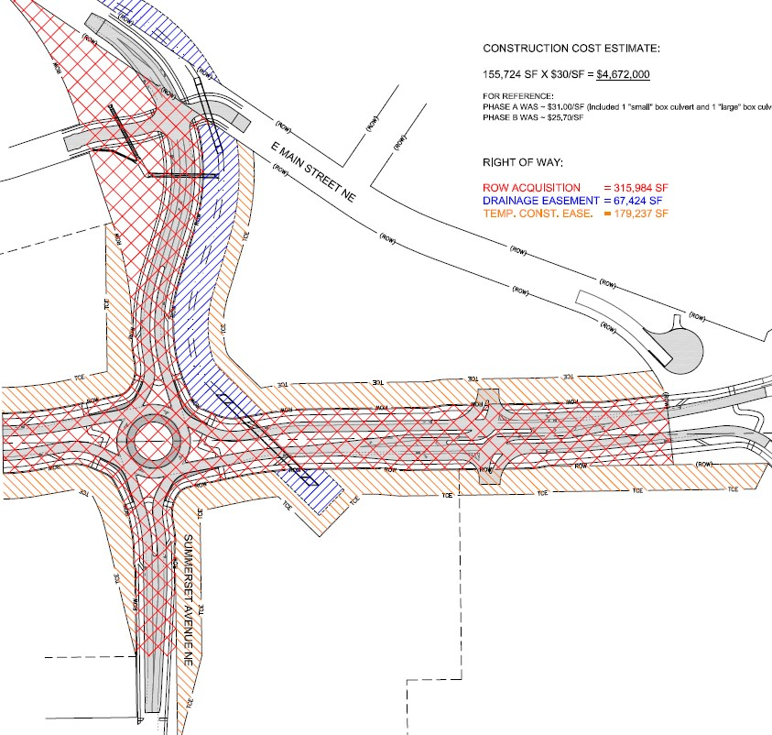
Tower Terrace Road Investments
$72M Spent; $56M Remaining
Phases Include:
Summerset to C Ave = $6M
C Ave to Alburnett Rd = $15M
Edgewood Rd to Center Pnt Rd = $5M
Alburnett Rd to Winslow Rd =$13M
I-380/Tower Terrace Rd DDI = $20M
Winslow Rd to S 35th St = $8M
Design, NEPA, and ROW – Ph 7 = $8M
S 35th St to 0.4 mi NE = $5M
Construction – Ph 7 = $48M

Slide 4
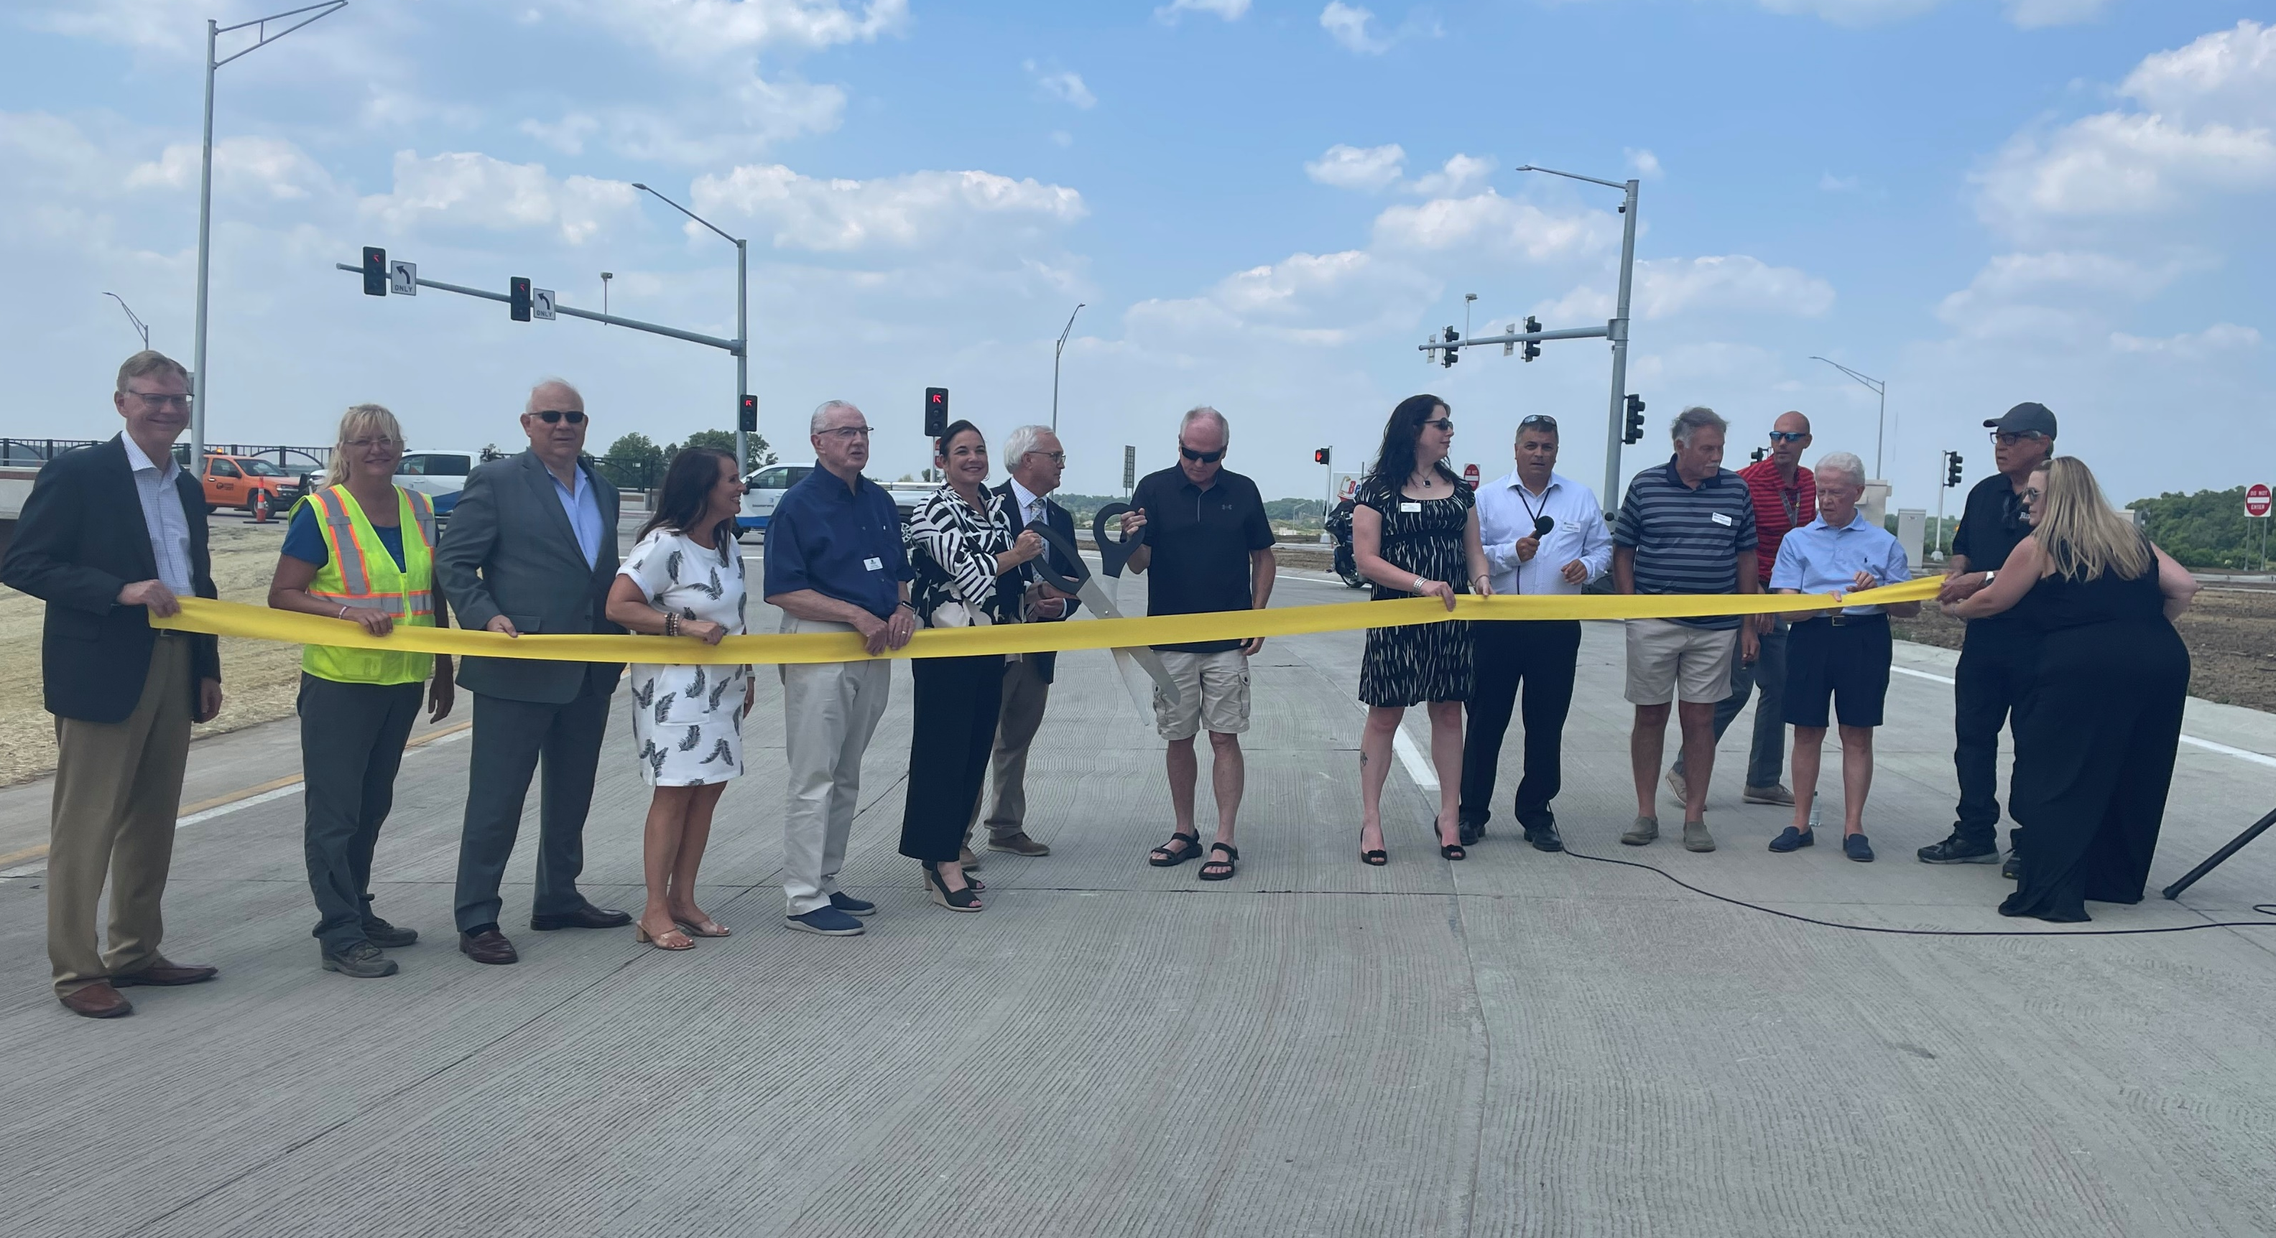
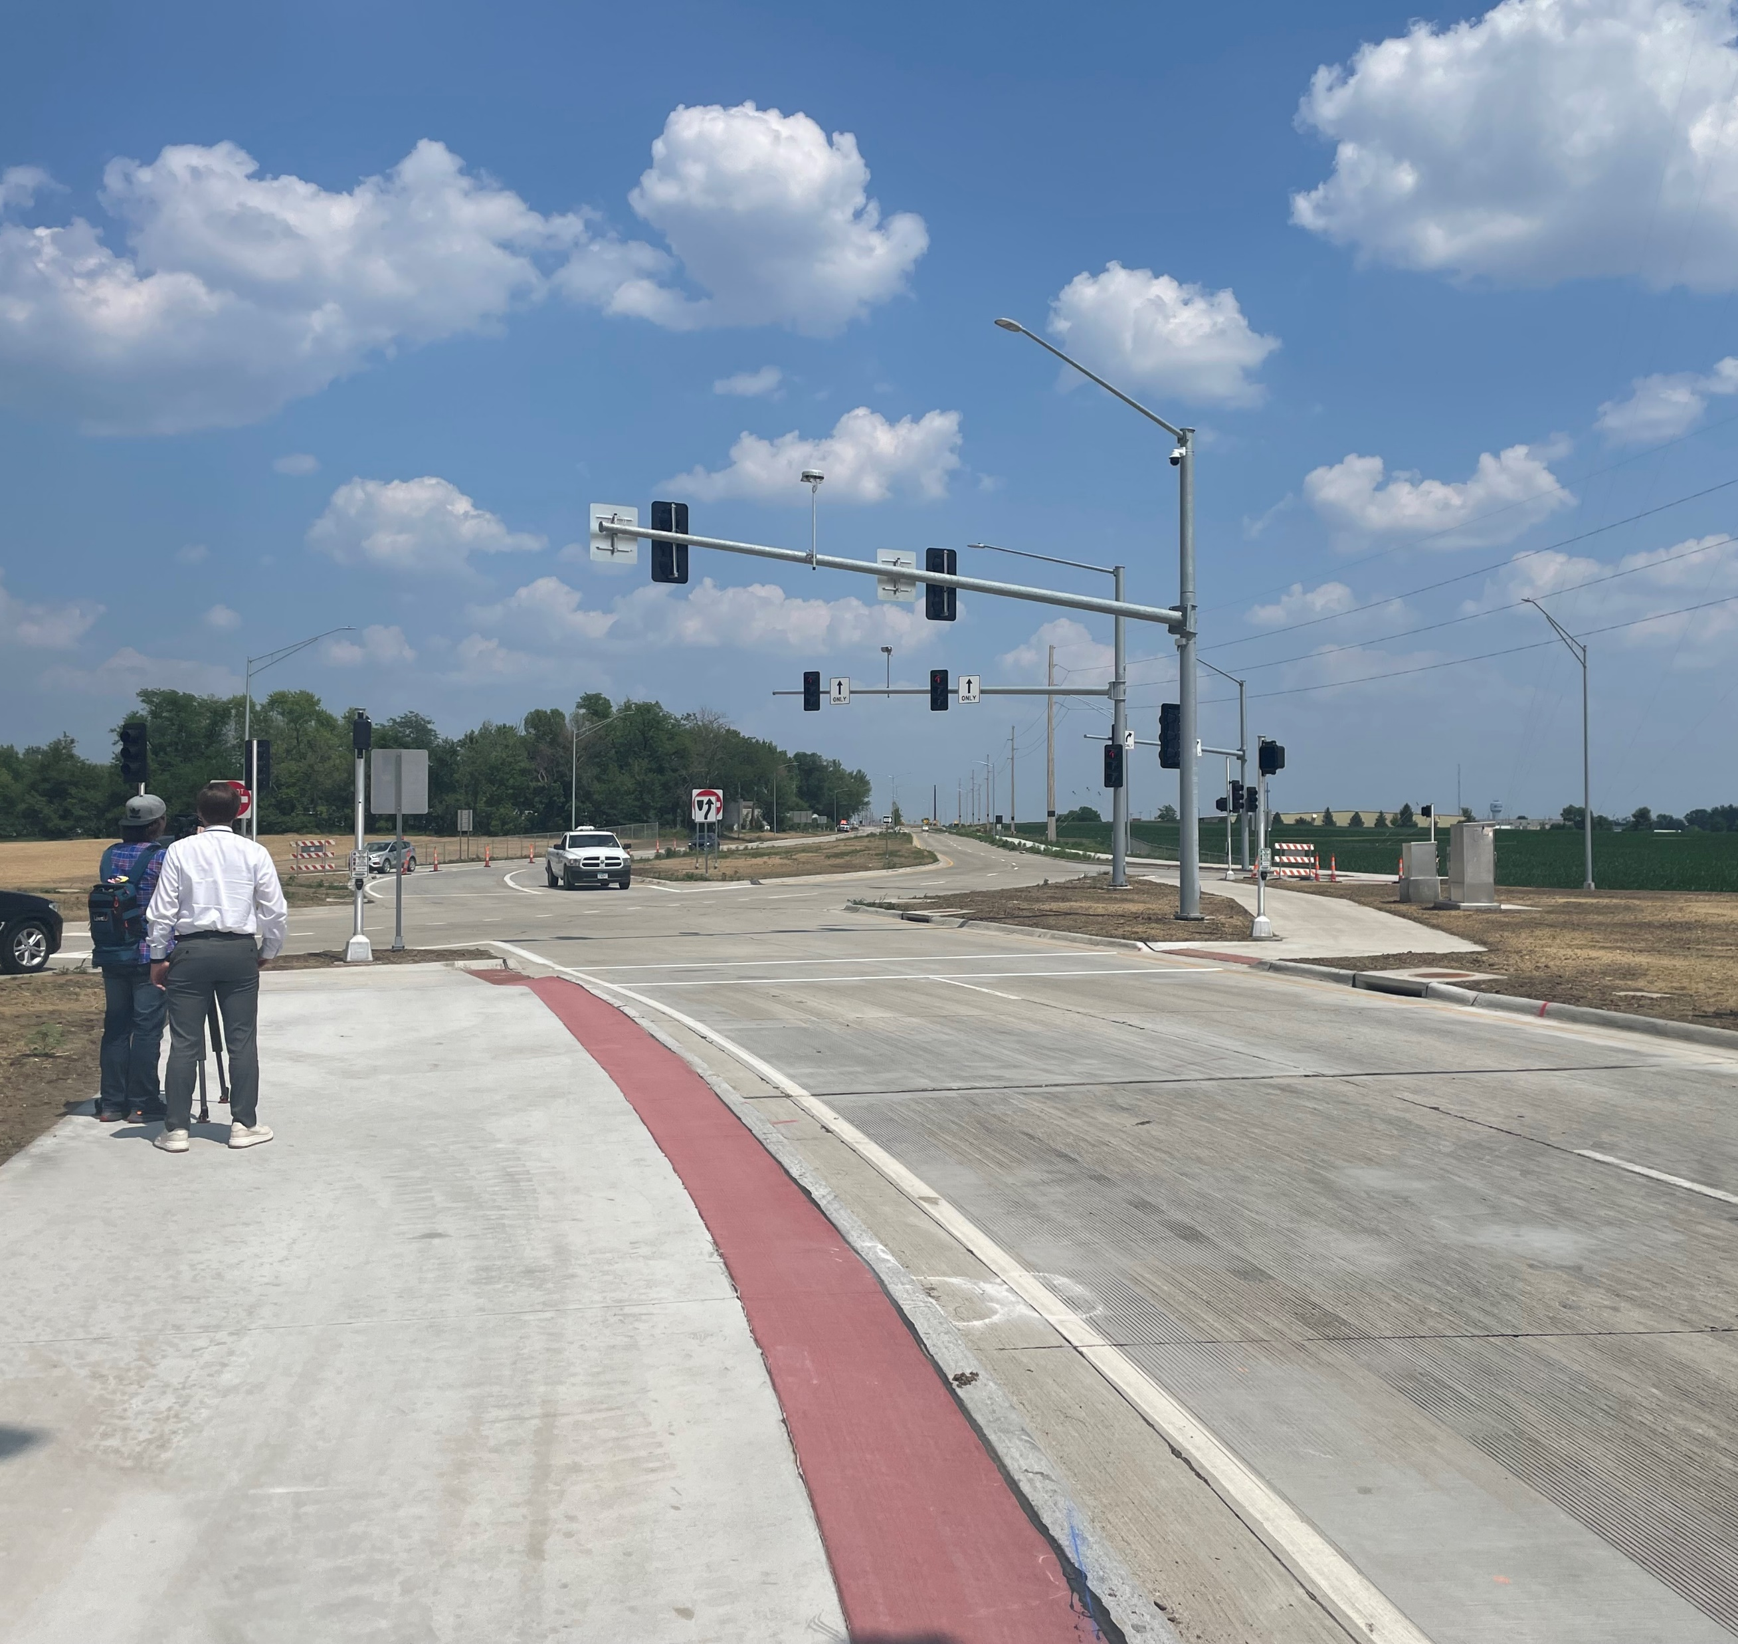
I-380 & Tower Terrace Road Interchange
Thank you for Iowa DOT’s leadership in providing direct access to I-380 from Tower Terrace Road!

Slide 5
Ph 7 Corridor Limits = I-380 to IA 13 = 8.3 mi
(3.7 miles underfunded by $53.5M)

Slide 6
Tower Terrace Road
Initial Cross Section

Slide 7
Tower Terrace Road
Future Cross Section

Slide 8
Purpose & Need for Tower Terrace Road
Provide a continuous east/west arterial route connecting I-380 to IA 13 that:
Improves east/west reliability and reduces road network congestion;
Boyson Road looking east to C Avenue
Eastbound backups during PM peak hour
Notes:
Include a photo of traffic backing up on Boyson, Main, or elsewhere that will be relieved once TTR is completed.
Only three other arterial roadways exist in the metro that stretch from west to east ends. US 30 (9 miles south of TTR), Mt Vernon Road (5.5 miles south of TTR), and IA Highway 100 (2-3 miles south of TTR). Tower Terrace Road will provide for an overpass at the Canadian National Rail crossing, thus allowing for a route without conflict with the railroad.

Slide 9
Overpass improves emergency response times
Purpose & Need for Tower Terrace Road
Provide a continuous east/west arterial route connecting I-380 to IA 13 that:
Improves east/west reliability and reduces road network congestion;
Improves safety;
Roundabouts at major intersections are safer than traditional traffic signals

Slide 10
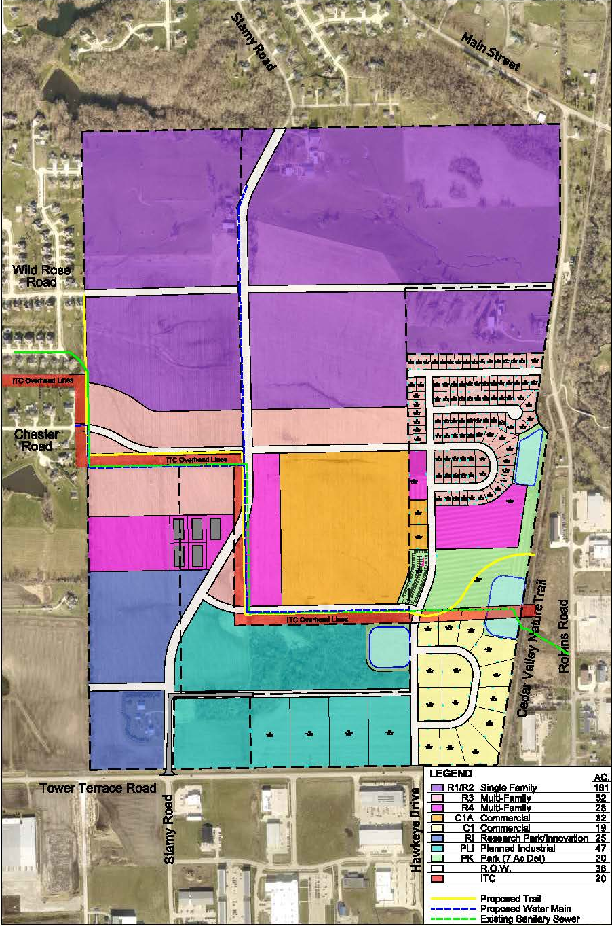
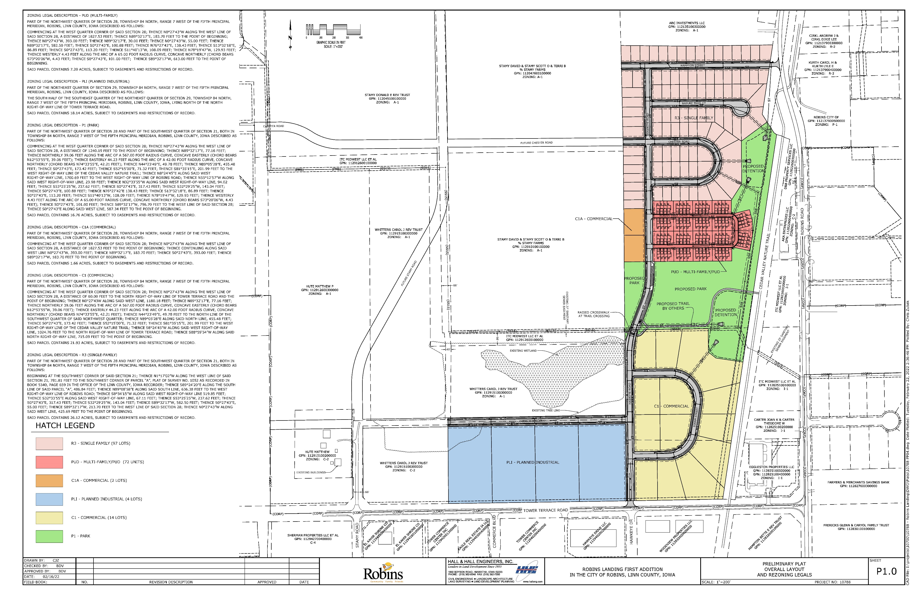
Purpose & Need for Tower Terrace Road
Provide a continuous east/west arterial route connecting I-380 to IA 13 that:
Improves east/west reliability and reduces road network congestion;
Improves safety;
Sustains existing and supports new economic development; and
Notes:
Cities of Marion and Robins are planning for, and implementing in-fill development along the corridor that could create thousands of new jobs and homes.

Slide 11
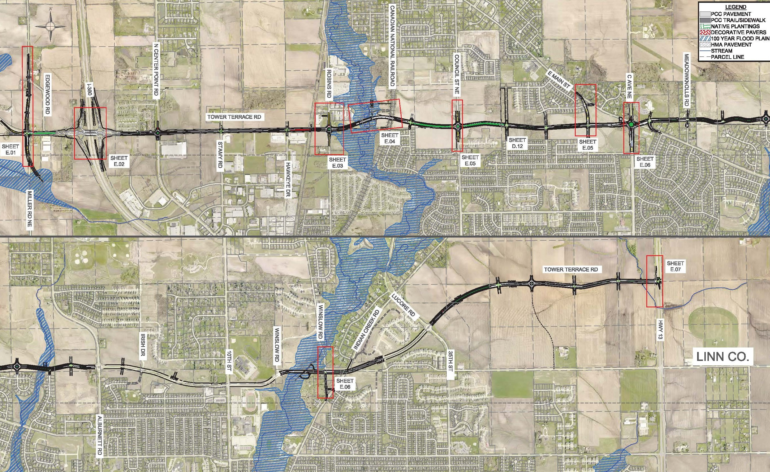
Purpose & Need for Tower Terrace Road
Provide a continuous east/west arterial route connecting I-380 to IA 13 that:
Improves east/west reliability and reduces road network congestion;
Improves safety;
Sustains existing and supports new economic development; and
Provides multi-modal system linkage.
Notes:
10’ wide paths on each side of TTR linking the Cedar Valley Nature Trail with the Indian Creek Trail system. Corridor also includes a bike lane that can later be converted into a through lane when traffic increases demand for additional capacity.

Slide 12
Discretionary Grant Program Funding Applications
RAISE = Submitted Feb 2024
2023 MPDG/RURAL (not funded)
Safety = 3
State of Good Repair = 3
Economic Impacts = 3
Resiliency/Environ = 2
Equity/Multimodal = 3
Innovation = 1
BCA = Reviewer made revisions to BCA leaving it less than 1:1 (awaiting additional details from USDOT)
Economic Impacts include significant travel time costs savings

Slide 13
We Request DOT’s Help
1. Future Funding Requests (ICAAP, RISE, TSIP, U-STEP)
2. Letters of Support from Commissioners for RAISE App
Notes:
Once RAISE is in place, we will be preparing and submitting applications for ICAAP, RISE, and Traffic Safety funding through Iowa DOT’s normal submittal processes. The funding will focus on construction related activities. Applications will be timed with the detailed schedule tied to the RAISE grant, if successful.

Slide 14
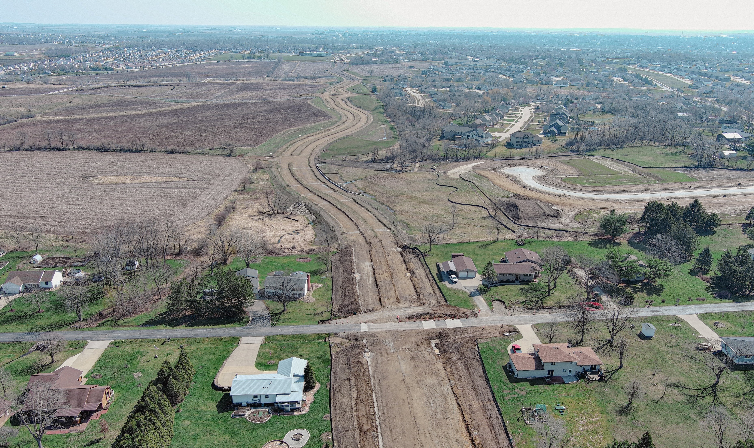
Thank You!

