Slide 1
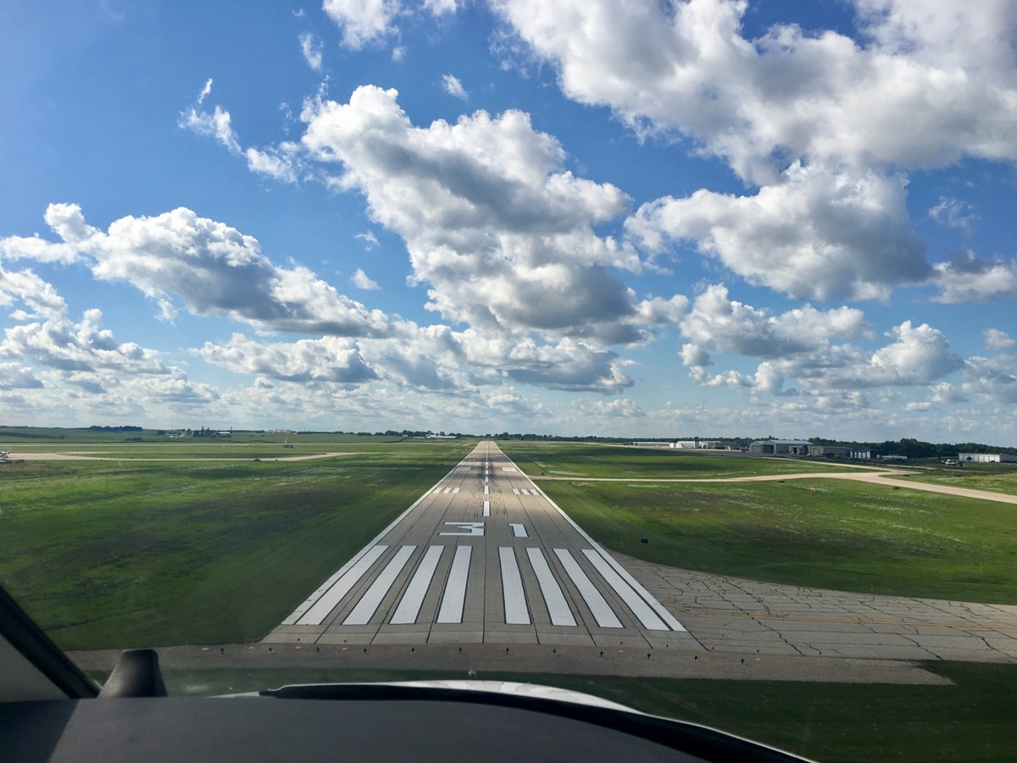

FY2024 Commercial Service Vertical Infrastructure
Grant Amendment
Shane Wright
Aviation Program Manager
4/8/2024

Slide 2
CSVI Program
The Commercial Service Vertical Infrastructure (CSVI) program provides funding for landside development and renovation of terminals, hangars, maintenance buildings, and fuel facilities at commercial service airports.
Appropriated funds are distributed to the commercial service airports by formula with no local match required.
    50% evenly split between the airports
    40% based on enplanements
    10% based on cargo activity
One airport requesting to make amendments
2
2

Slide 3
CSVI Project Amendments
Dubuque
  Requesting to amend the FY2023 and FY2024 CSVI grant awards to include passenger terminal building security improvements.
  Security needs and local project prioritization prompted the change.
  Requesting to utilize past years unexpended CSVI funds on the amended FY24 application.

Slide 4



Questions?
Shane.Wright@iowadot.us
515-239-1048

