Slide 1
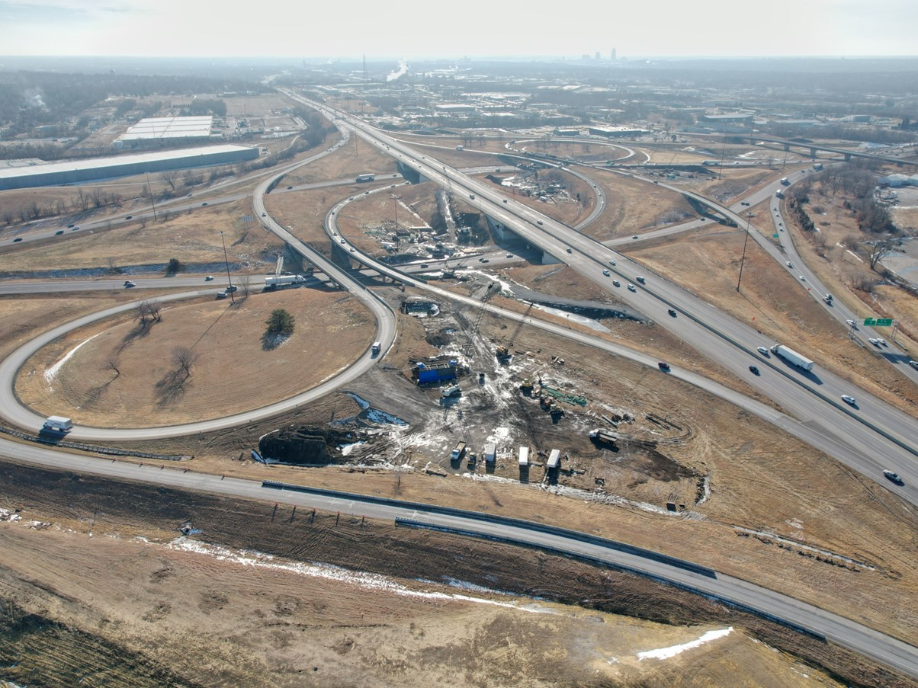


2025-2029 Highway Program Development
April 8, 2024
3/2/2023

Slide 2
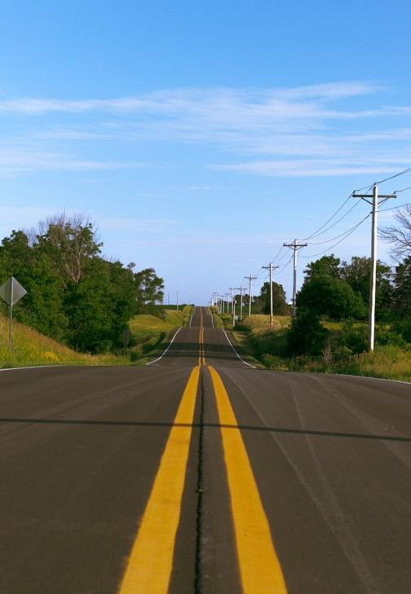

Agenda
TOPIC 1
Highway Program Analysis
TOPIC 2
Determine Highway Program Objectives
TOPIC 3
Explanation of Highway Program Changes
TOPIC 4
Next Steps

Slide 3
April 8, 2024
Highway Program Development Schedule (2025-2029)
April 2024
  Develop the Draft 2025-2029 Highway Program
  Action Item: 2025-2029 Highway Program objectives
May 2024
  Present the Draft 2025-2029 Iowa Transportation Improvement Program to the public (including all previous Program approvals and Draft 2025-2029 Highway Program)
June 2024
  Action Item: Approve the 2025-2029 Iowa Transportation improvement Program

Slide 4
April 8, 2024 as presented on March 21, 2024
2025-2029 Iowa Highway Program
Decision Points
Should projects in the 2025-2028 Program continue to be programmed with cost/schedule updates?
    Proceed with programmed projects.
What modifications to the Program should be considered?
  Adjust non-Interstate pavement and bridge stewardship targets?
  Proceed with shifting some of the bridge stewardship increase to pavement stewardship.
Allocate some available Program balance funding on additional Interstate pavement stewardship.
  Add projects to the Program from the Program Candidates list?
  Provide a funding scenario for Commission consideration.

Slide 5
April 8, 2024 as presented on March 21, 2024
2025-2029 Iowa Highway Program
Decision Points (continued)
3. How should Program be balanced?
  One option to balance 2028 and 2029 could be to advance some 2029 Interstate Stewardship projects to 2028?
  - Proceed with advancing some 2029 Interstate pavement stewardship to 2028.

Slide 6
Topic 1
Highway Program Analysis

Slide 7
April 8, 2024 as presented on March 21, 2024
2025-2034 Underfunded Projects
($ in millions)
(For Highway Planning Purposes Only)

Slide 8
April 8, 2024 as presented on March 21, 2024
2025-2034 Stewardship Target Rescheduling Scenario
($ in millions)
(For Highway Planning Purposes Only)

Slide 9
April 8, 2024 as presented on March 21, 2024
2025-2034 Stewardship Target Increase Scenario
($ in millions)
(For Highway Planning Purposes Only)

Slide 10
April 8, 2024 as presented on March 21, 2024
2025-2034 Project Addition Scenario
($ in millions)
(For Highway Planning Purposes Only)

Slide 11
April 8, 2024 as presented on March 21, 2024
2025-2034 Highway Program Analysis
($ in millions)
(For Highway Planning Purposes Only)

Slide 12
Topic 2
Determine Highway Program Objectives

Slide 13
April 8, 2024 as presented on March 21, 2024
Potential 2025-2029 Highway Program Objectives
    Projects in the 2025-2028 Highway Program will continue to be programmed with cost and schedule updates
    System Objective: Safety
      Maintain increasing funding levels for safety
      Advance statewide centerline rumble strip implementation
      Expand enhanced pavement markings to non-interstate highways
    System Objective: Sustainability
      Maintain increasing Interstate funding levels for pavement reconstruction, modernization, bridges, pavement patching/maintenance, rest areas, and other miscellaneous projects
      Maintain increasing funding levels for non-interstate pavement modernization
      Maintain increasing funding levels for non-interstate bridge modernization
      Invest in additional stewardship projects
      Transfer jurisdiction of portions of primary roadways to cities and counties
    System Objective: Accessibility
      Invest in truck parking at Interstate Rest Areas
      Invest in vault toilets at parking only sites
      Complete installation of adult changing stations at modernized rest areas
      Invest in corridor improvements
    System Objective: Flow
      Invest in intelligent transportation systems infrastructure
      Invest in Super-2 improvements
      Invest in operational and Integrated Corridor Management improvements

Slide 14
Topic 3
Explanation of Highway Program Changes

Slide 15
April 8, 2024
Explanation of Highway Program Changes

Slide 16
Topic 4
Next Steps

Slide 17
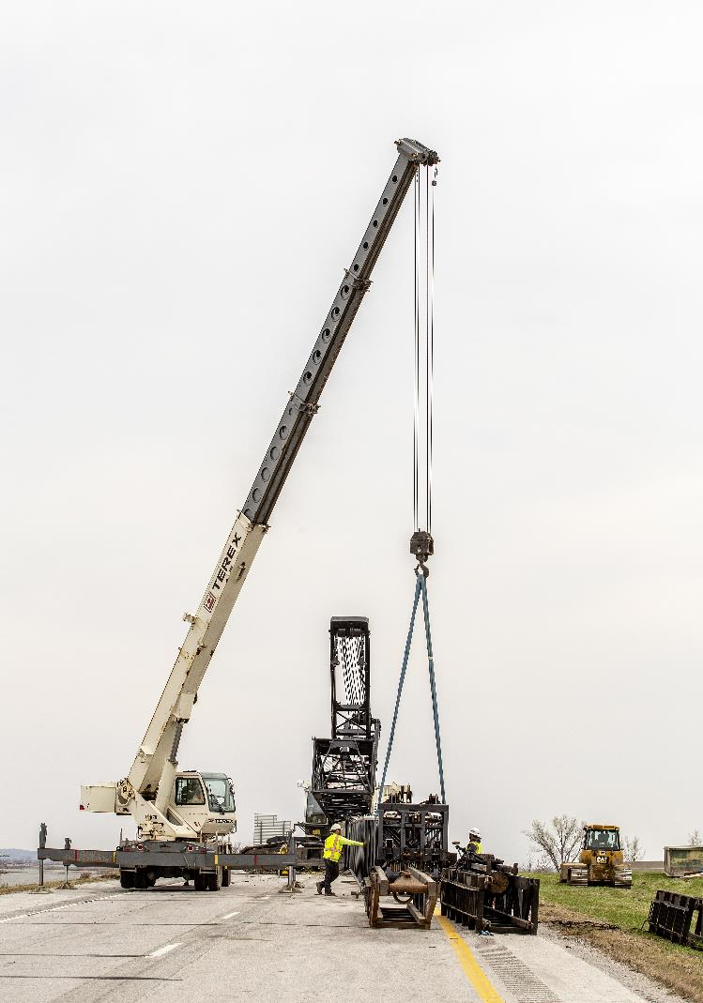
Next Steps
Present the Draft 2025-2029 Iowa Transportation Improvement Program to the public (including all previous Program approvals and Draft 2025-2029 Highway Program)

Slide 18
Questions?

