Slide 1
State Recreational Trails Program
Funding Recommendation

Slide 2
State Recreational Trail Program
Created in 1988
Available to cities, counties, state agencies, local governments, or non-profit organizations through an application program
Purpose is to establish recreational trails in Iowa for the use, enjoyment and participation of the public.

Slide 3
Project Evaluation Criteria
Need in terms of population to be served and existing trails in the area (25 points)
Compatibility with local, areawide, regional or statewide plans (15 points)
Benefits of multiple uses and recreational opportunities (20 points)
Quality of the site (25 points)
Economic benefits to the local area (10 points)
Special facilities for disabled users (5 points)
Project is "shovel ready“ and will be completed by 6-30-2022 (25 points)
Projects with cash match (5 points)

Slide 4
Available Funding and Application Summary
Available Funding:
FY 2020 Legislative appropriation from the Rebuild Iowa Infrastructure Fund: $1,500,000
Application Summary:
Total number of projects: 25
Total project costs: $22,628,466
Total amount requested: $10,428,240

Slide 5
List of Applications Recommended
PROJECT NAME | SPONSOR | SCORE | TOTAL PROJECT COST | REQUESTED AMOUNT (% of Total Project Cost) | RECOMMENDED AMOUNT (% of Total Project Cost)
Raccoon River Valley Trail to High Trestle Trail Connector Phase III Construction | Dallas County Conservation Board | 118 | $569,000 | $392,610 (69%) | $392,610 (69%)
Iowa River Trail from Steamboat Rock to Edgington Avenue Paving | Hardin County | 116 | $1,115,136 | $375,000 (34%) | $375,000 (34%)
Heart of Iowa Nature Trail Paving from 560th Avenue to South Skunk River Bridge | Story County Conservation | 115 | $1,077,000 | $530,000 (49%) | $530,000 (49%)
Tatonka Ska Trace Rail Trail Phase III(a) | Dickinson County | 110 | $612,356 | $268,620 (44%) | $202,390 (33%)
Jump to applications not recommended for funding

Slide 6
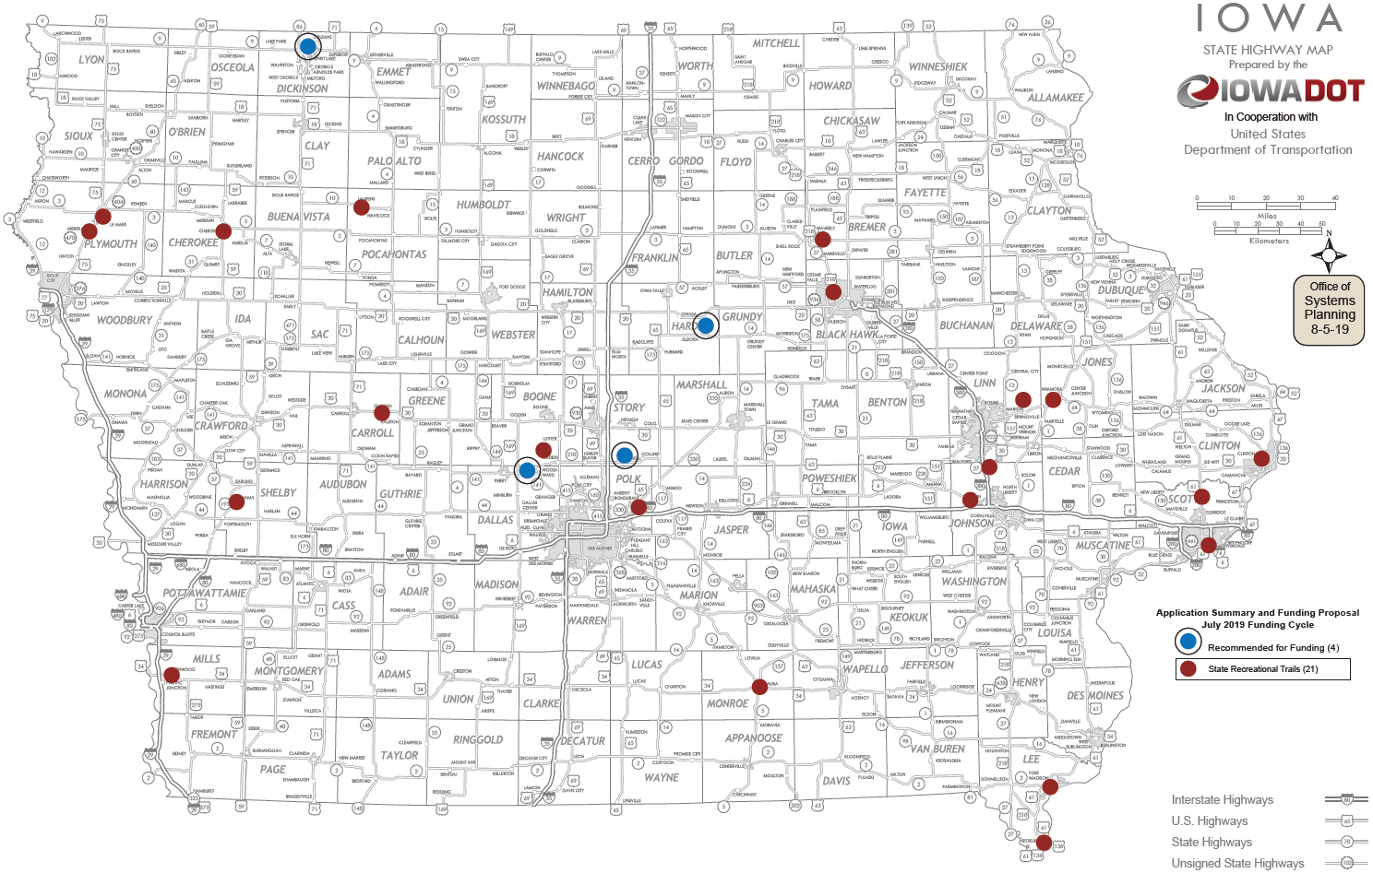
Map of Applications Received

Slide 7
QUESTIONS?
Craig Markley, Systems Planning Bureau
craig.markley@iowadot.us
515-239-1027

Slide 8
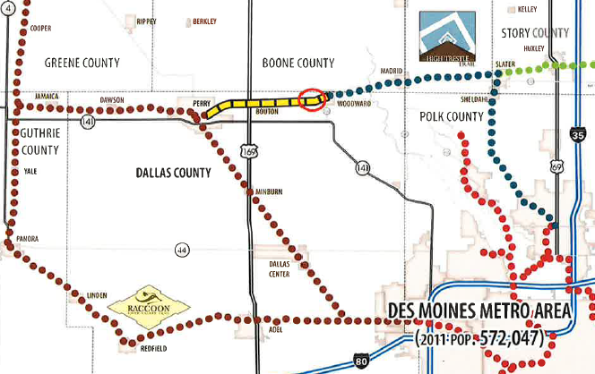
Raccoon River Valley Trail to High Trestle Trail Connector Phase III Construction (Dallas County Conservation Board)
This project is a 1-mile paved segment of the connector trail from Quinlan Avenue to R Avenue in Dallas County between Bouton and Woodward. Upon completion of all phases of construction, the 9-mile connector trail will link the Raccoon River Valley Trail and the High Trestle Trail between Perry and Woodward.
Total Cost: $569,000
Requested: $392,610 (69%)
Return to List of Applications Recommended

Slide 9
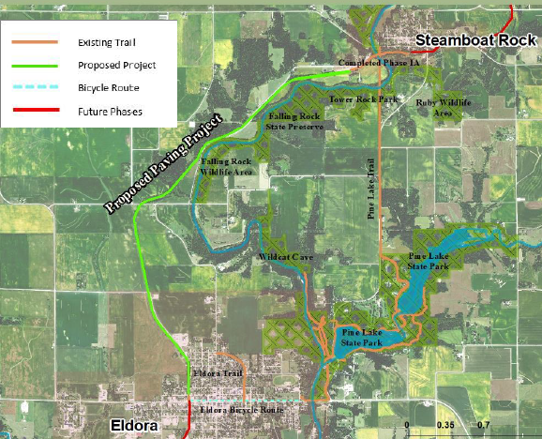
Iowa River Trail from Steamboat Rock to Edgington Avenue Paving (Hardin County and Hardin County Trail Committee)
This project is a 4.4-mile paved trail segment within a former railroad corridor from south of D-35 in Steamboat Rock to Edgington Avenue in Eldora connecting to the Eldora Trail which leads to the Pine Lake State Park Trail (Hardin County Trail). A soft trail will also be completed adjacent to the paved trail.
Total Cost: $1,115,136
Requested: $ 375,000 (34%)
Return to List of Applications Recommended

Slide 10
Heart of lowa Nature Trail Paving from 560th Avenue to South Skunk River Bridge (Story County Conservation)
This project paves a 3.32-mile segment of the existing granular Heart of Iowa Nature Trail from 560th Avenue in Huxley eastward through the south side of Cambridge to the South Skunk River bridge in Story County. Dating back to 1991, the 23-mile Heart of Iowa Nature trail extends from Slater to Melbourne on former a former railroad corridor and is being paved in segments.
Total Cost: $1,077,000
Requested: $ 530,000 (49%)
Return to List of Applications Recommended

Slide 11
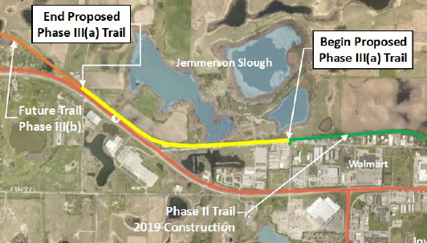
Tatonka Ska Trace Rail Trail Phase III(a) (Dickinson County Trails Board)
This project is a 1.1-mile paved recreational trail on the former Iowa & Northwestern Railroad from Hudson Avenue near 15th Street in Spirit Lake west to 219th Avenue. This section will connect to completed Phase I & II segments of Tatonka Ska Trace and the larger Iowa Great Lakes Spine Trail. This project is part of a multi-phase rail trail that will span 37 miles and connect eight northwest Iowa towns joining the Ed Winkel Memorial Trail west of Allendorf and continuing to Sibley for a total of 43 miles.
Total Cost: $612,356
Requested: $268,620 (44%)
Return to List of Applications Recommended

Slide 12
List of Applications Not Recommended for Award
PROJECT NAME | SPONSOR | SCORE | TOTAL PROJECT COST | REQUESTED AMOUNT (% of Total Project Cost) | RECOMMENDED AMOUNT (% of Total Project Cost)
Rolling Prairie Trail Extension | Waverly | 105 | $294,000 | $220,000 (75%) | $0
George Wyth State Park Trail Replacement Phase I | Iowa DNR | 100 | $268,000 | $201,000 (75%) | $0
South Riverfront Corridor Trail | Keokuk | 98 | $808,529 | $506,397 (63%) | $0
Connecting Fort Madison! Phase 4 | Fort Madison | 96 | $415,180 | $285,000 (69%) | $0
Grant Wood Trail Gap Connection West of Paralta | Linn County Conservation | 95 | $2,022,000 | $650,000 (32%) | $0
Return to List of Applications Recommended

Slide 13
List of Applications Not Recommended for Award
PROJECT NAME | SPONSOR | SCORE | TOTAL PROJECT COST | REQUESTED AMOUNT (% of Total Project Cost) | RECOMMENDED AMOUNT (% of Total Project Cost)
Albia Trail Blue Route | Albia | 94 | $700,000 | $350,000 (50%) | $0
Clear Creek Trail Extension from Half Moon Avenue SW to F.W. Kent Park | Johnson County Conservation Board | 92 | $680,000 | $172,740 (25%) | $0
U.S. 65/Gay Lea Wilson Trail Underpass at Brick Street | Bondurant | 92 | $2,679,574 | $400,000 (15%) | $0
Magnetic Park Trail | Cherokee | 91 | $604,670 | $250,000 (41%) | $0
High Trestle to City of Boone Trail Phase I | Boone County Conservation | 87 | $418,000 | $308,000 (74%) | $0
Return to List of Applications Recommended

Slide 14
List of Applications Not Recommended for Award
PROJECT NAME | SPONSOR | SCORE | TOTAL PROJECT COST | REQUESTED AMOUNT (% of Total Project Cost) | RECOMMENDED AMOUNT (% of Total Project Cost)
13th Avenue North Corridor Trail | Clinton | 87 | $837,912 | $400,000 (48%) | $0
Wapsipinicon Trail Phase 2 | Jones County Conservation Board | 87 | $438,406 | $195,261 (45%) | $0
Castek Park Trail Rehabilitation and Paving | Swisher | 86 | $42,400 | $30,000 (71%) | $0
I-74 Mississippi River Bridge Letdown Structure and Pedestrian Bridge | Bettendorf | 86 | $1,941,000 | $1,000,000 (52%) | $0
Return to List of Applications Recommended

Slide 15
List of Applications Not Recommended for Award
PROJECT NAME | SPONSOR | SCORE | TOTAL PROJECT COST | REQUESTED AMOUNT (% of Total Project Cost) | RECOMMENDED AMOUNT (% of Total Project Cost)
Plywood Trail Stage 1 | Le Mars | 83 | $3,255,000 | $2,000,000 (61%) | $0
Pocahontas County Trail Phase I Prairie Park Trail | Laurens | 83 | $503,482 | $250,000 (50% | $0
Plywood Trail Stage 2 | Merrill | 77 | $732,000 | $549,000 (75%) | $0
Northland Park Trail Phase I | Glidden | 74 | $218,120 | $163,590 (75%) | $0
Shelby County Comprehensive Trails Project Phase I | Shelby County | 72 | $491,750 | $368,813 (75%) | $0
Return to List of Applications Recommended

Slide 16
List of Applications Not Recommended for Award
PROJECT NAME | SPONSOR | SCORE | TOTAL PROJECT COST | REQUESTED AMOUNT (% of Total Project Cost) | RECOMMENDED AMOUNT (% of Total Project Cost)
1st Street Multi-Use Path Phase II | Long Grove | 69 | $416,288 | $312,209 (75%) | $0
Glenwood Trail and Trail Head Project | Glenwood | 68 | $1,488,663 | $250,000 (17%) | $0
Return to List of Applications Recommended

