Slide 1
Revitalize Iowa’s Sound Economy Program

Slide 2
Revitalize Iowa’s Sound Economy Program
Created in 1985
Purpose: To promote economic development through roadway improvements.
Eligible development shall have value-adding activities that feed new dollars into the economy
Available to cities and counties through an application program

Slide 3
Available Funding and Application Summary
Available Funding
Funded annually with dedicated state motor fuel and special fuel tax revenues
Application Summary for SFY2020
Total number of projects awarded: 3
Total project costs: $4,345,480
Total amount awarded: $1,644,750
 | CITY | COUNTY
Average funding generated monthly | $972,943 | $486,471
SFY 2020 estimated Road Use Tax Revenue for July 2019 | $972,943 | $486,471
Estimated Unobligated Balance | $17,738,546 | -$689,529

Slide 4
Local Development Project Evaluation Criteria
Development Potential (35 points)
Economic impact and Cost Effectiveness (20 points)
Local Commitment and Initiative (33 points)
Transportation Need and Justification (4 points)
Local Economic Need (6 points)

Slide 5
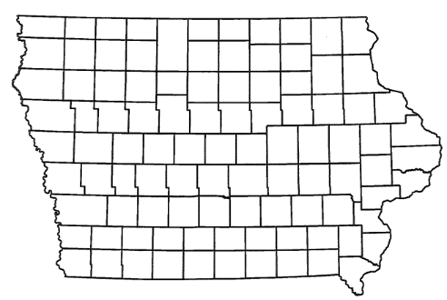
List of Local Development Applications Recommended
TOTAL PROJECT COST
PERCENT PARTICIPATION
RECOMMENDED AMOUNT
PROJECT NAME
SPONSOR
SCORE
Construction of approximately 1,600 feet of SW 28th Street. | City of Des Moines and the Des Moines Airport Authority | 60 | $2,576,812 | 50% | $1,288,406

Slide 6
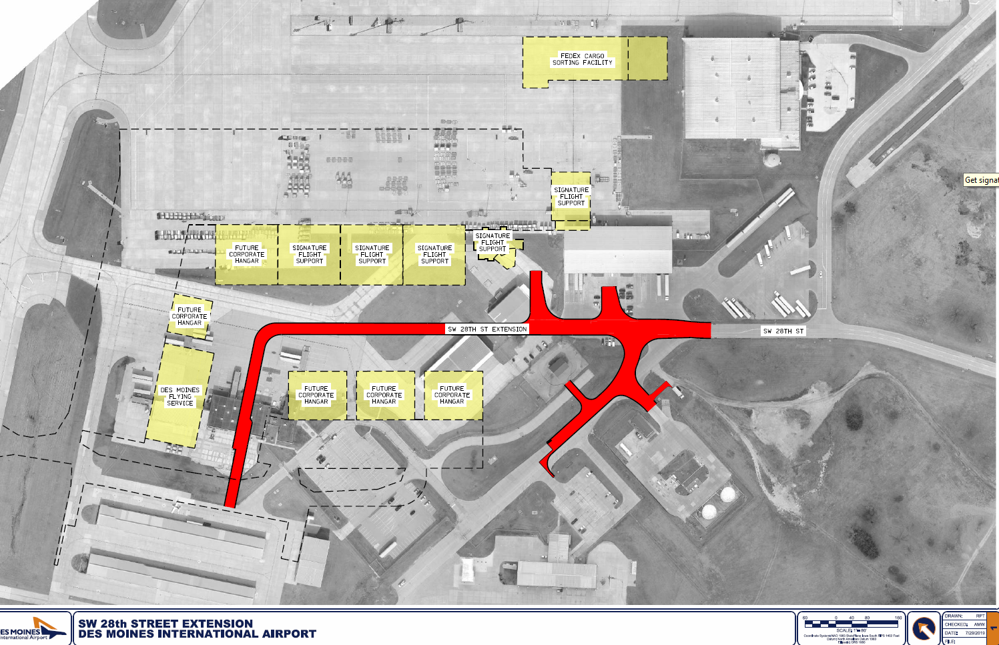
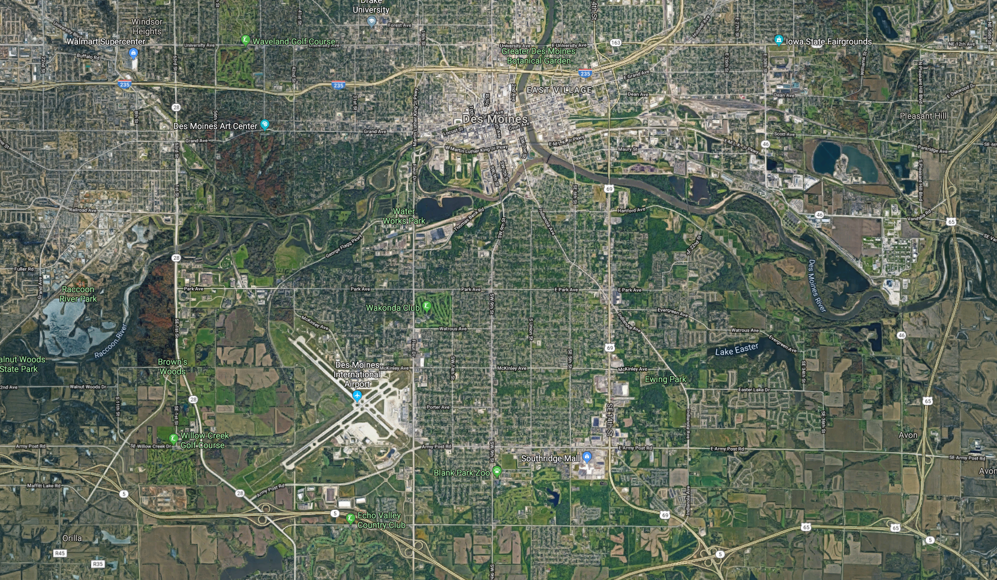
Des Moines
(Local Development)
Construction of approximately 1,600 feet of SW 28th Street located on the southwest side of town. This project is necessary to provide access to the expanded Des Moines International Airport for industrial and airport purposes.
Total Cost: $2,576,812
Requested: $1,288,406 (50%)

Slide 7
QUESTIONS?
Craig Markley, Systems Planning Bureau
craig.markley@iowadot.us
515-239-1027

