Slide 1
Revitalize Iowa’s Sound Economy Program

Slide 2
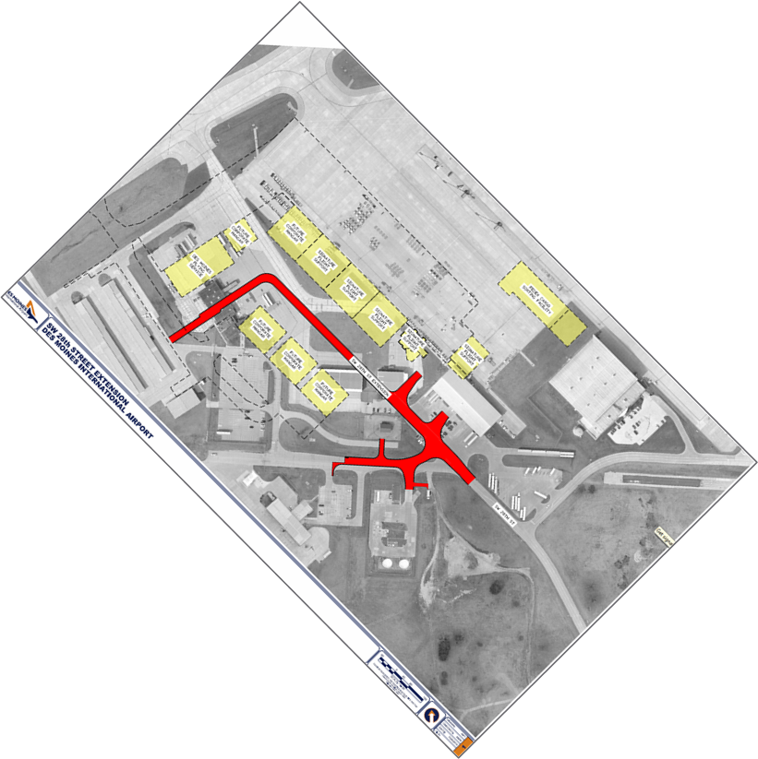
Local Development Application Recommended for Award
PROJECT NAME
SPONSOR
SCORE
TOTAL PROJECT COST
PERCENT PARTICIPATION
RECOMMENDED AMOUNT
Construction of approximately 1,600 feet of SW 28th Street. | City of Des Moines and the Des Moines Airport Authority | 60 | $2,576,812 | 50% | $1,288,406

