Slide 1
Revitalize Iowa’s Sound Economy Program
Iowa Transportation Commission Business Meeting
August 11, 2020

Slide 2
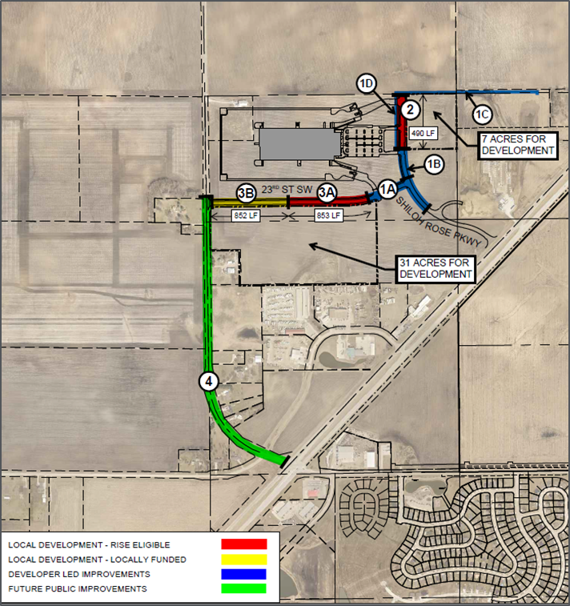
List of Local Development Applications Recommended
PROJECT NAME
SPONSOR
SCORE
TOTAL PROJECT COST
PERCENT PARTICIPATION
RECOMMENDED AMOUNT
Construction of approximately 490 feet of Shiloh Rose Parkway and 853 feet of 23rd Street SW. | Bondurant | 70 | $2,130,063 | 50% | $1,065,032

