Slide 1
COVID-19 Transportation Funding Impact Update
Transportation Commission Workshop
August 11, 2020

Slide 2
Update
Travel trends
US total rail carloads
Commercial air service passenger counts
Vehicular traffic
Vehicle sales
Funding
State Road Use Tax Fund
Federal funding update

Slide 4
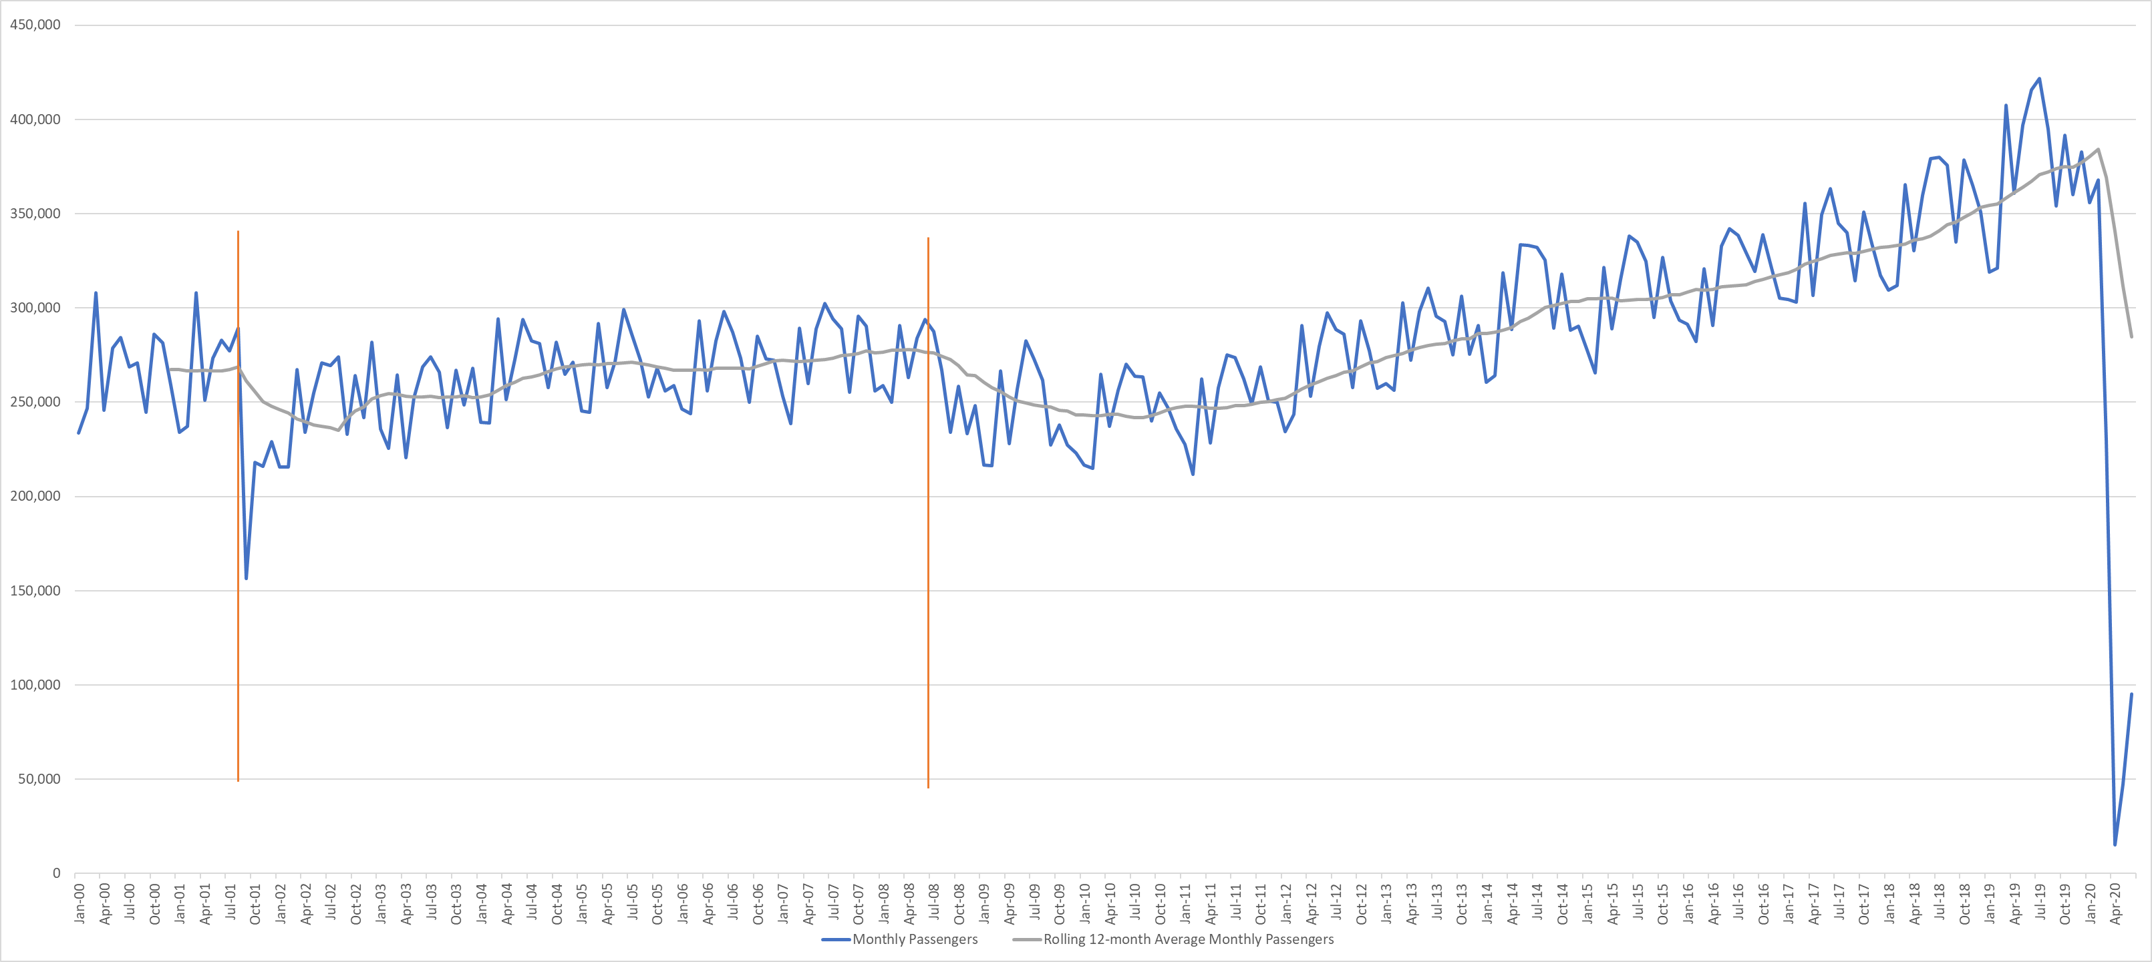
Monthly Passenger Counts at Iowa’s Eight Commercial Service Airports
(through June 2020)
9/11
2008 Recession
COVID-19

Slide 5
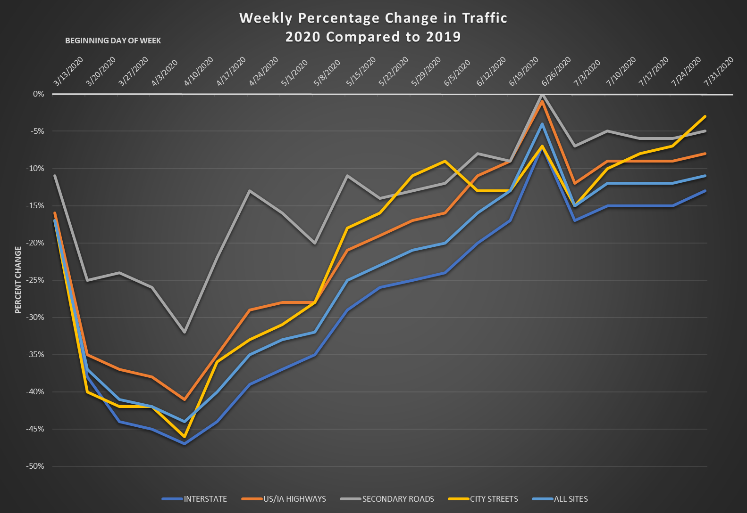
The weeks beginning June 26, 2020, and July 3, 2020, will be outliers due to the July 4 holiday. The July 4 holiday typically sees low traffic volumes and the 2019 holiday is reflected in the 6/26/20 data and the 2020 holiday will be reflected in the 7/3/30 data.

Slide 6
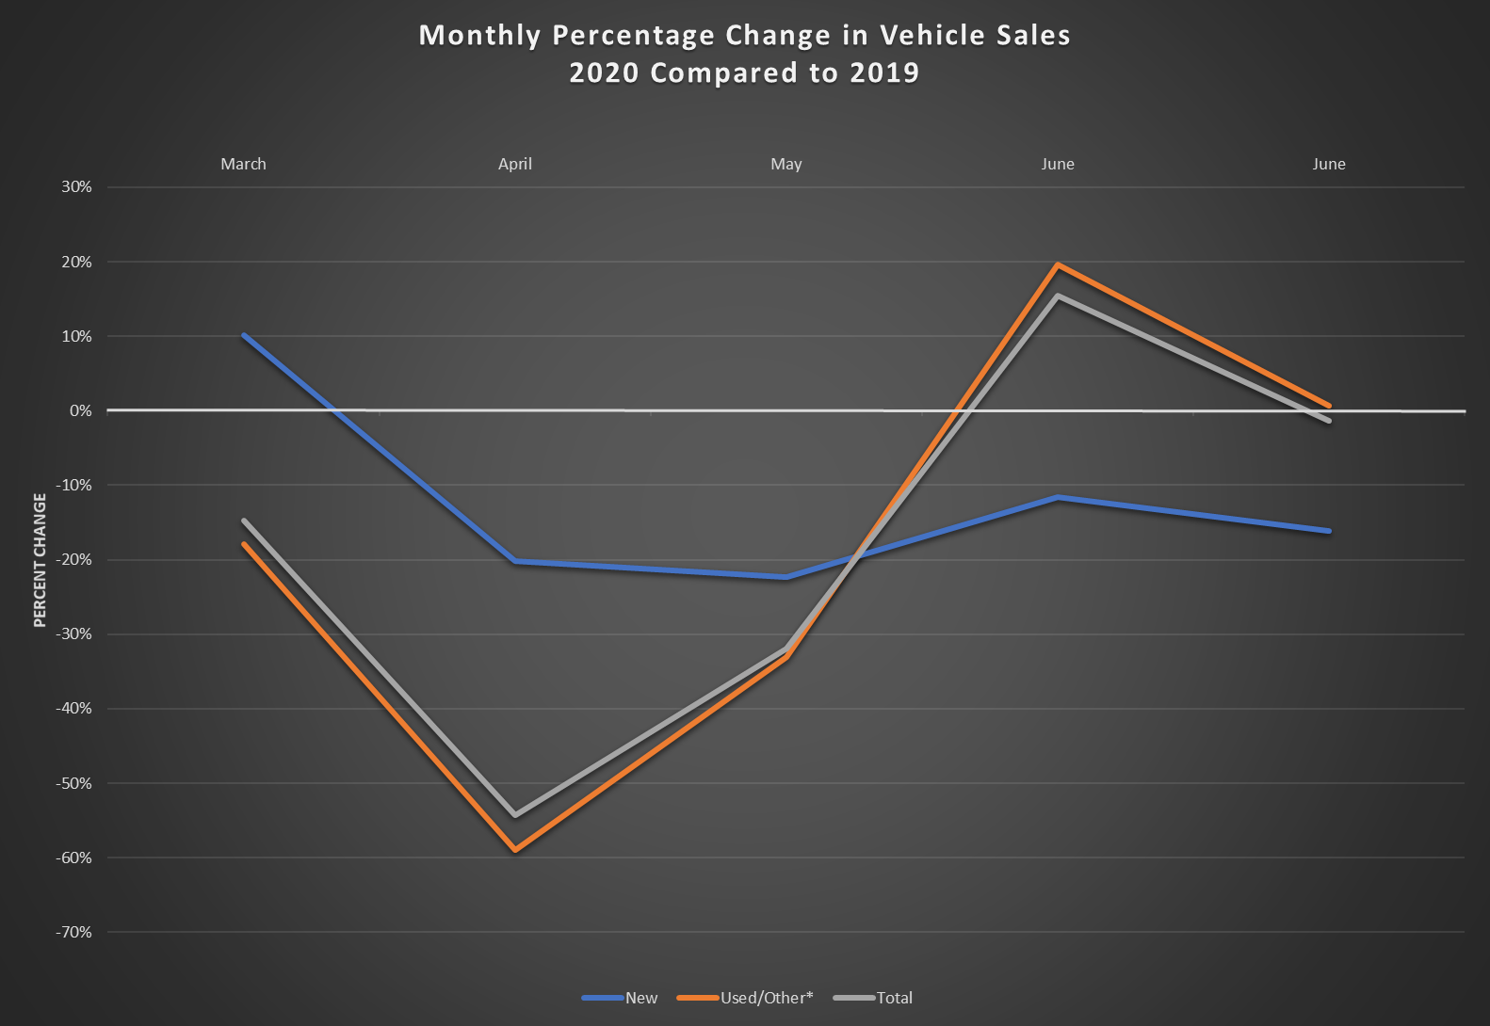
* Used/Other also includes new resident vehicles and vehicles transferred due to inheritance, foreclosure, abandoned, gifts, etc.

Slide 7
Road Use Tax Fund
Funding sources
Fuel tax revenue down with reduced travel
Fee for New Registration revenue down with reduced vehicle sales
Annual vehicle registration revenue down slightly

Slide 8
Road Use Tax Fund (cont.)
Monthly Funding Impacts
June allocation of RUTF (actual): -$25 million
Generally reflective of April collections
July allocation of RUTF (actual): +$18 million (had estimated -$1 million)
COVID-19 impact is offset by a fuel tax deposit timing situation.
August allocation of RUTF (actual): -$6 million (had estimated -$28 million)
September allocation of RUTF (est.): -$19 million (had estimated -$25 million)
October allocation of RUTF (est.): -$17 million (had estimated -$20 million)

Slide 9
Road Use Tax Fund (cont.)
Long-Term Estimated Impacts
June 2020 through Oct. 2020 Impact: -$50 million (had estimated -$100 million)
Nov. 2020 through June 2021 Impact: -$96 million (had estimated -$118 million)
Reasons for Changes
Vehicle sales did not drop as significantly as data originally showed. Much of the drop was due to delayed processing as a result of COVID-19 office closures.
Fuel tax
Diesel tax is helping offset lower gasoline tax
Fuel tax receipts may still not fully reflect lower travel trends

Slide 10
Federal Funding Update
Reauthorization – no additional action
FFY 2021 Appropriation – passed the full House
COVID-19 Relief Package
House passed bill on May 15, 2020
Senate proposal released July 27, 2020
Negotiations failed by self-imposed August 7, 2020 deadline
Primary issue: whether to provide financial aid to state and local governments

Slide 11
Questions?

