Slide 1
U.S. Highway 30 Coalition of Iowa
Iowa Department of Transportation Commission Public Input Session
August 10, 2021

Slide 2
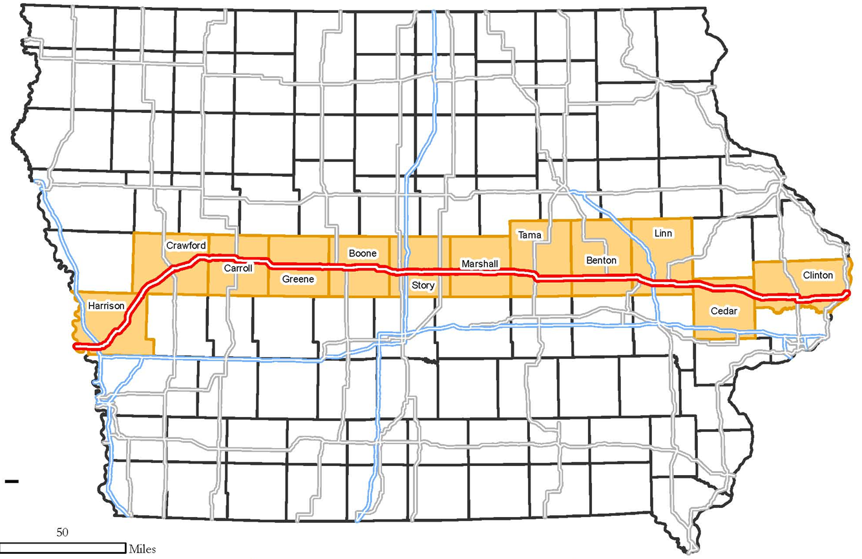
U.S. Highway 30 Corridor

Slide 3
East-West Highway Corridor Population Trend
Corridor | 2010 Census Population | 2019 Census Estimates | Percent Change 2010-2019
 | 1,013,966 | 1,107,320 | 8.43%
 | 541,356 | 555,524 | 2.55%
 | 476,419 | 477,611 | 0.25%
 | 181,454 | 179,481 | -1.09%
 | 238,887 | 221,543 | -7.83%
State of Iowa | 3,046,355 | 3,155,070 | 3.45%
Source: 2010 U.S. Census Bureau, 2019 U.S. Census Bureau ACS Estimates
Notes:
Updated

Slide 4
East-West Highway Corridor Businesses
Corridor | 2012 Number of Companies | Percent of Total Iowa Companies
 | 91,885 | 35.46%
 | 41,560 | 16.04%
 | 28,961 | 11.18%
 | 16,451 | 6.35%
 | 22,093 | 8.53%
State of Iowa | 259,121 | ---
Source: U.S. Census Bureau, 2012 Survey of Business Owners
Notes:
No new survey data for this information (same)

Slide 5
East-West Highway Corridor Employment Trend
Corridor | 2010 Employment | 2019 Employment | Percent Change 2010-2019 | 2019 Percent of Total Employment
 | 538,804 | 586,628 | 8.88% | 36.35%
 | 280,285 | 287,187 | 2.46% | 17.79%
 | 239,494 | 246,285 | 2.76% | 15.26%
 | 87,513 | 86,339 | -1.36% | 5.35%
 | 122,937 | 113,809 | -7.42% | 7.05%
State of Iowa | 1,553,594 | 1,613,902 | 3.88% | ---
Source: 2010 U.S. Census Bureau, 2019 American Community Survey 5-Year Estimates
Notes:
Updated

Slide 6
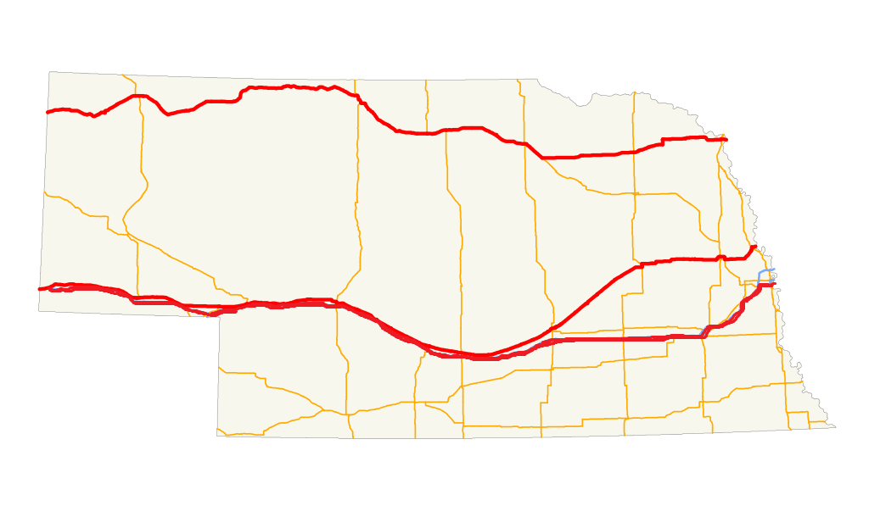
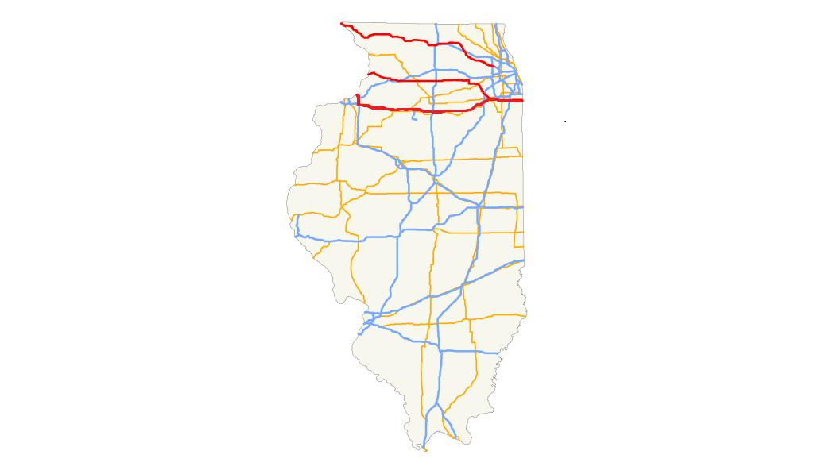
Nebraska vs. Illinois Population
State
Nebraska | 301,318 | 83,520 | 1,013,632
Illinois | 6,739,791 | 7,371,462 | 6,399,241
Source: 2019 American Community Survey 5-Year Estimates
Notes:
Updated

Slide 7
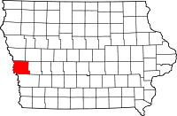
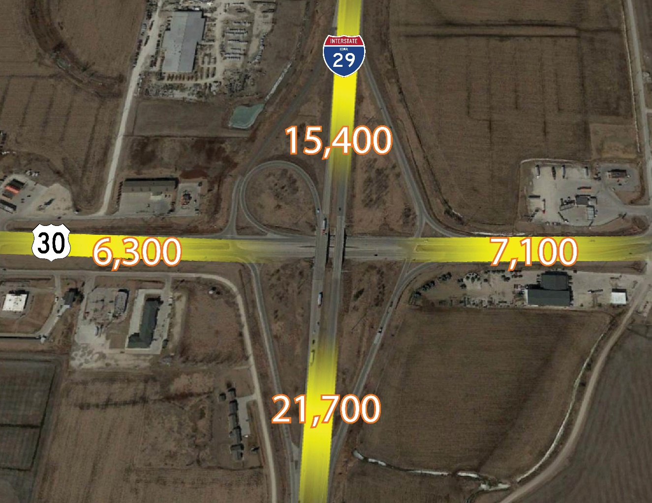
U.S. 30 in Harrison County
U.S. 30 and U.S. 29
Source: Iowa Department of Transportation, 2016
Notes:
Updated

Slide 8
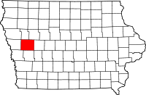
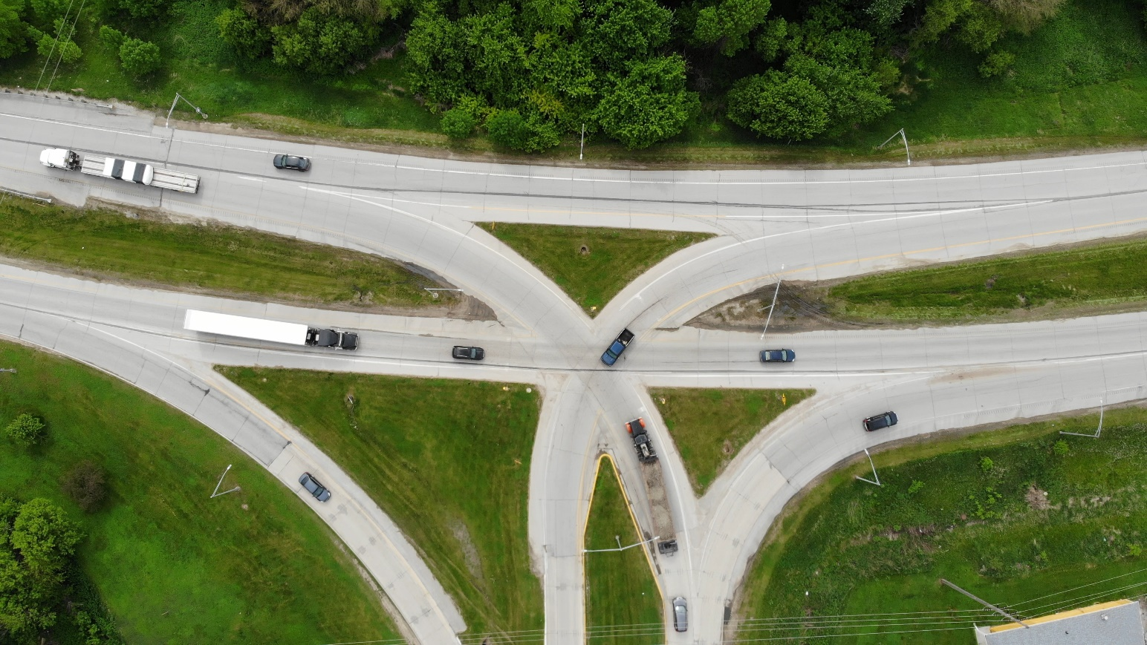
U.S. 30 in Crawford County
U.S. 30 and U.S. 59
9,000
8,800
9,800
City of Denison
Source: Iowa Department of Transportation, 2016
Notes:
Updated

Slide 9
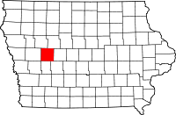
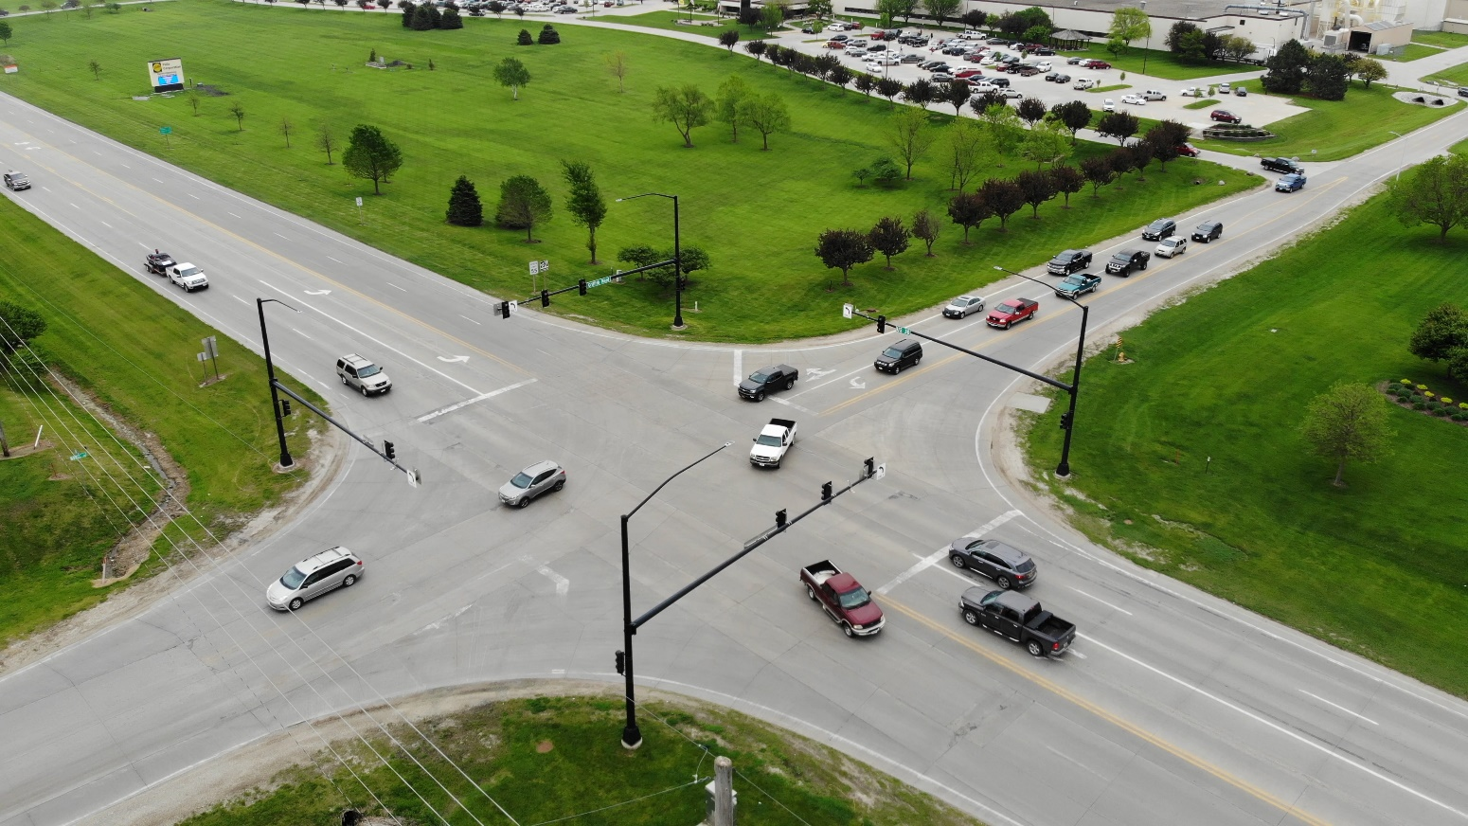
U.S. 30 in Carroll County
U.S. 30 and Griffith Road
9,100
3,360
1,590
8,800
City of Carroll
Source: Iowa Department of Transportation, 2016
Notes:
Updated

Slide 10
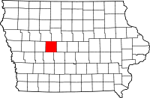
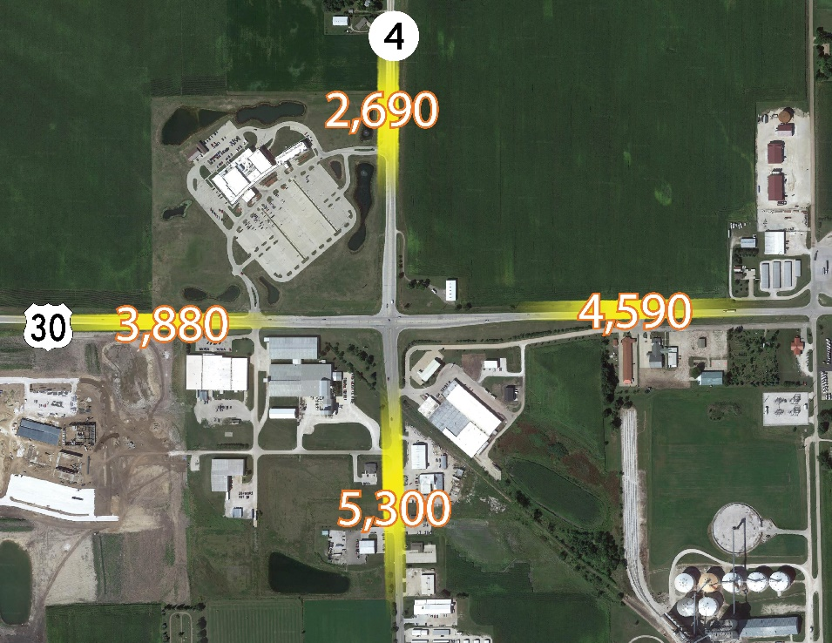
U.S. 30 in Greene County
U.S. 30 and Iowa 4 Jefferson
Source: Iowa Department of Transportation, 2016
Notes:
1st needs updated and fixed to 2016 numbers

Slide 11
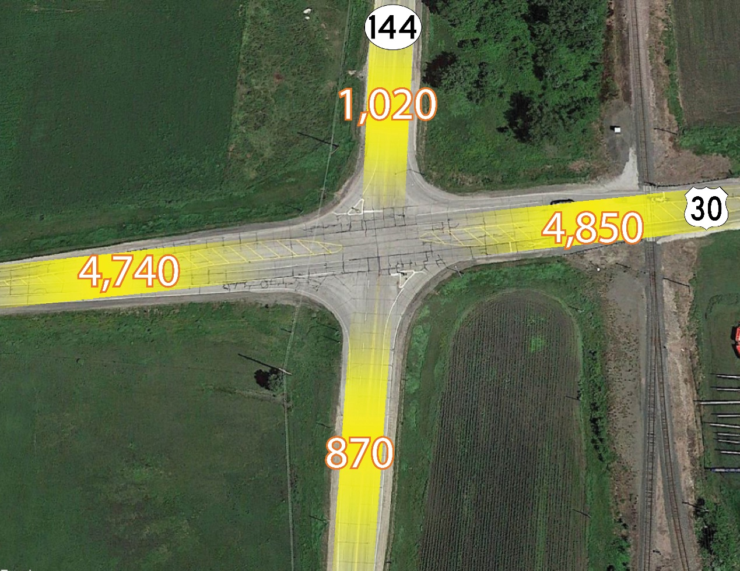
U.S. 30 in Greene County
U.S. 30 and Hwy 144
City of Grand Junction
Source: Iowa Department of Transportation, 2016
Notes:
Needs fixed, changed to 2016 numbers

Slide 12
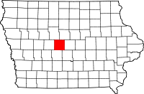
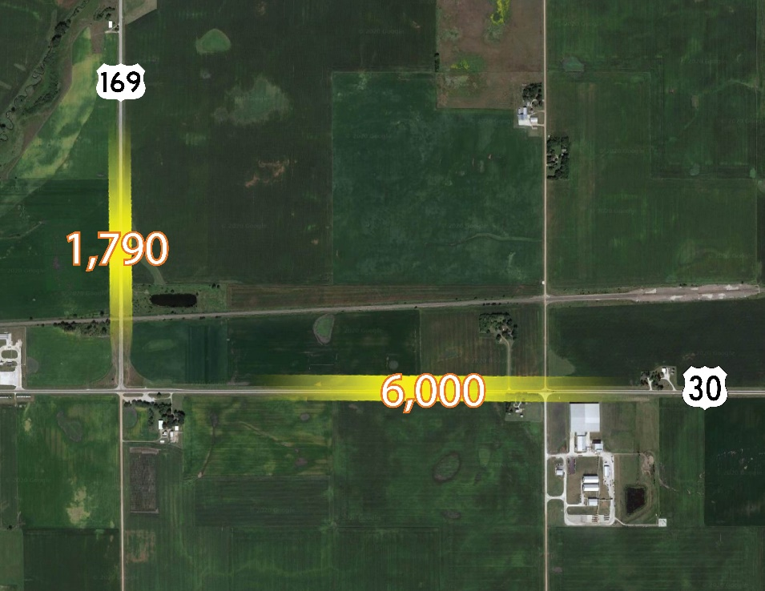
U.S. 30 in Boone County
U.S. 30 and 169 North
End of 4-lane U.S. Highway 30 in Western Iowa
Source: Iowa Department of Transportation, 2015
Notes:
1st needs updated and fixed to 2016 numbers

Slide 13
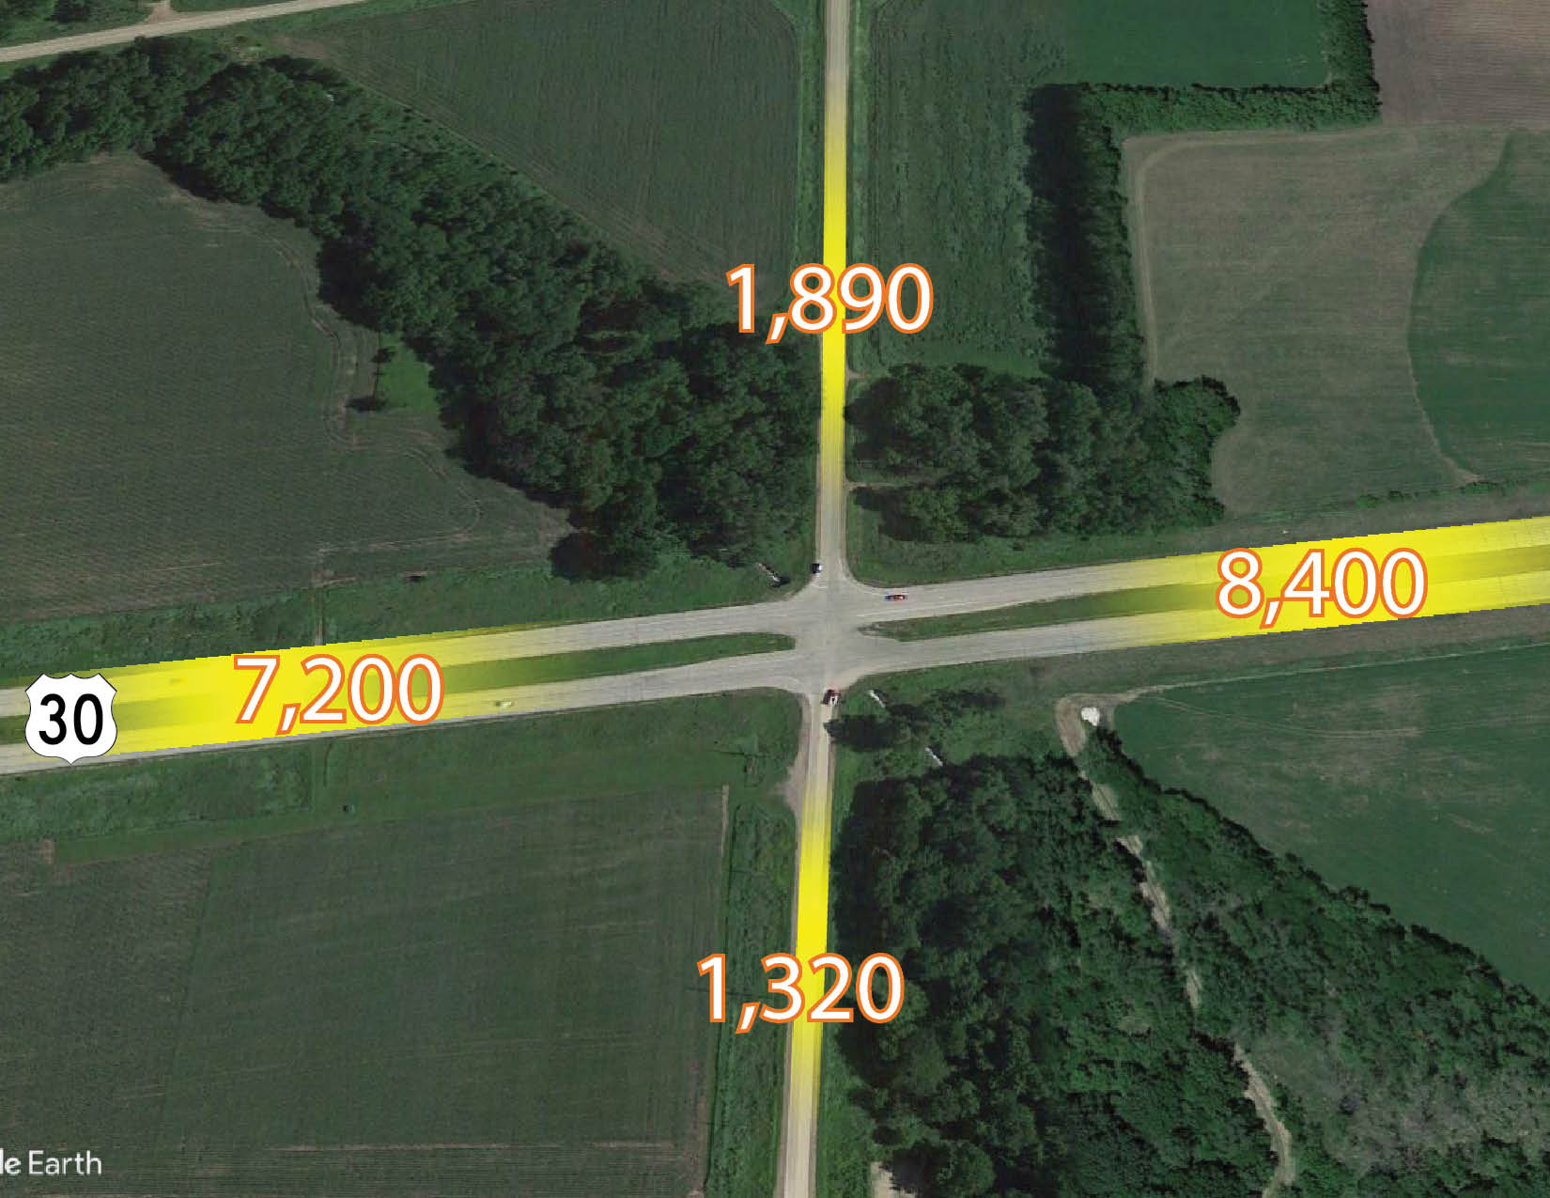
U.S. 30 in Boone County
U.S. 30 and L Avenue
Source: Iowa Department of Transportation, 2015
Notes:
Updated

Slide 14
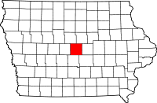
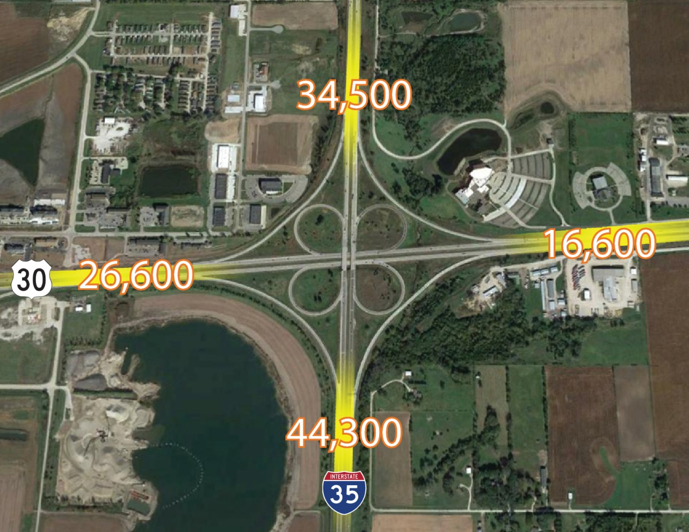
U.S. 30 in Story County
U.S. 30 and I 35
City of Ames
Source: Iowa Department of Transportation, 2015
Notes:
Updated

Slide 15
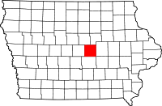
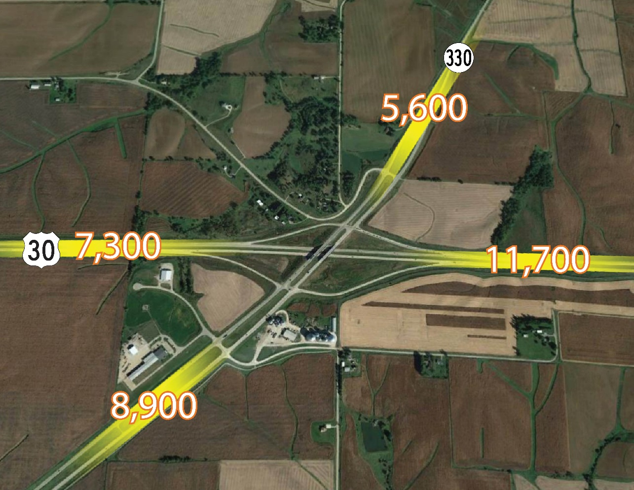
U.S. 30 in Marshall County
U.S. 30 and Hwy 330
Source: Iowa Department of Transportation, 2017
Notes:
Calculate change, updated

Slide 16
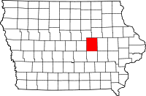
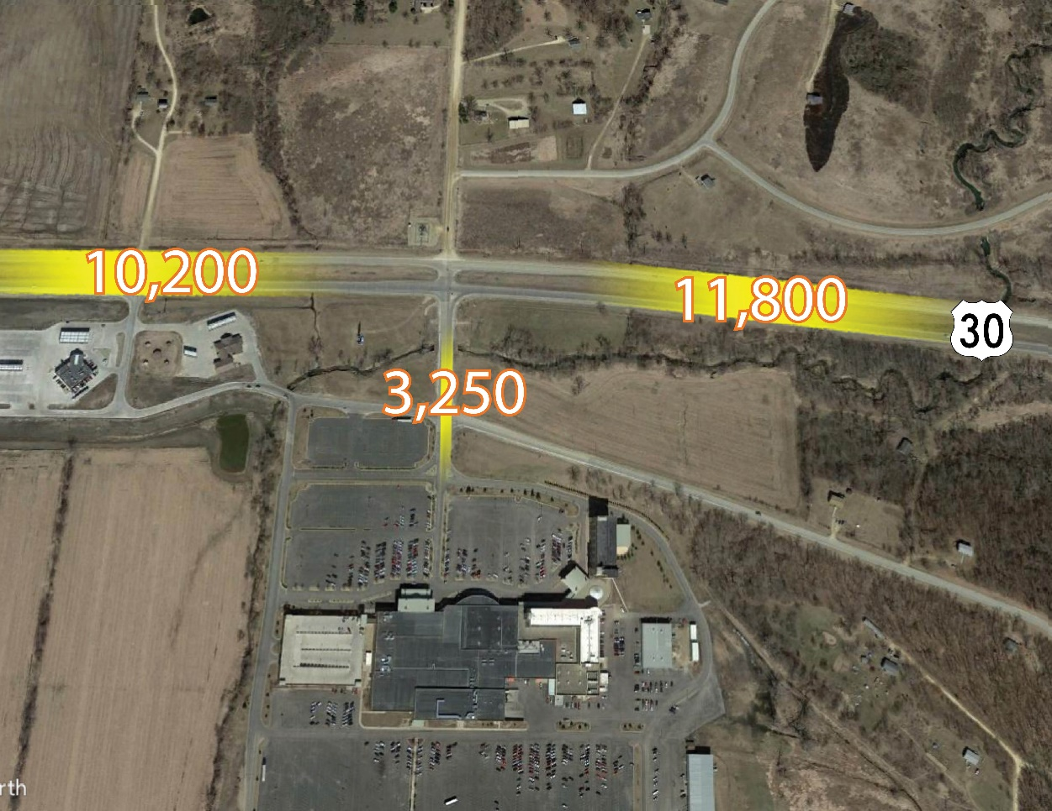
U.S. 30 in Tama County
U.S. 30 and F Avenue
Meskwaki Settlement
Source: Iowa Department of Transportation, 2017
Notes:
Updated

Slide 17
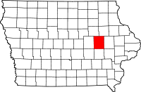
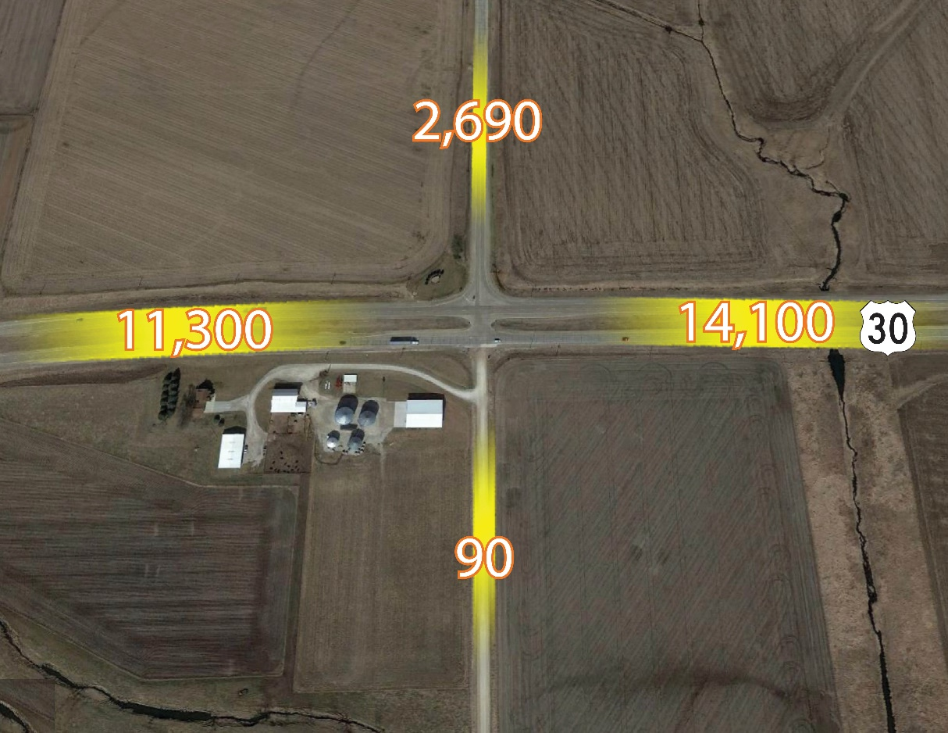
U.S. 30 in Benton County
U.S. 30 and 33rd Avenue
Source: Iowa Department of Transportation, 2017
Notes:
Updated

Slide 18
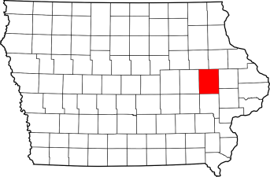
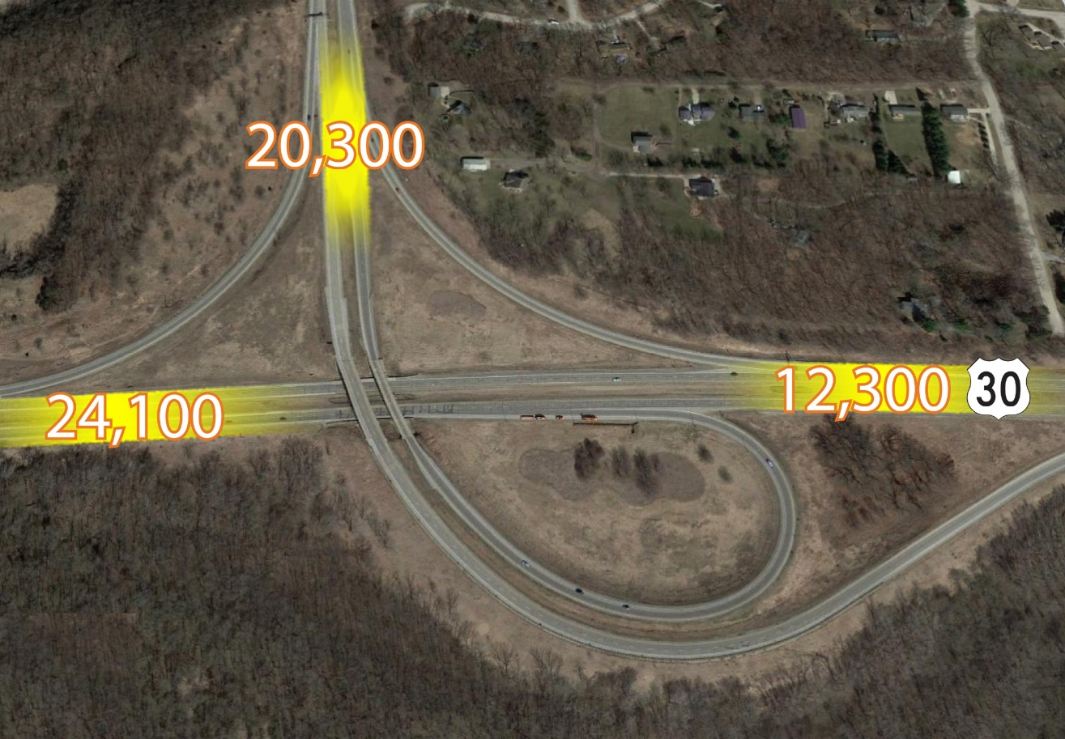
w
U.S. 30 in Linn County
U.S. 30 and U.S. 151
City of Cedar Rapids
Source: Iowa Department of Transportation, 2017
Notes:
Updated

Slide 19
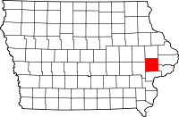
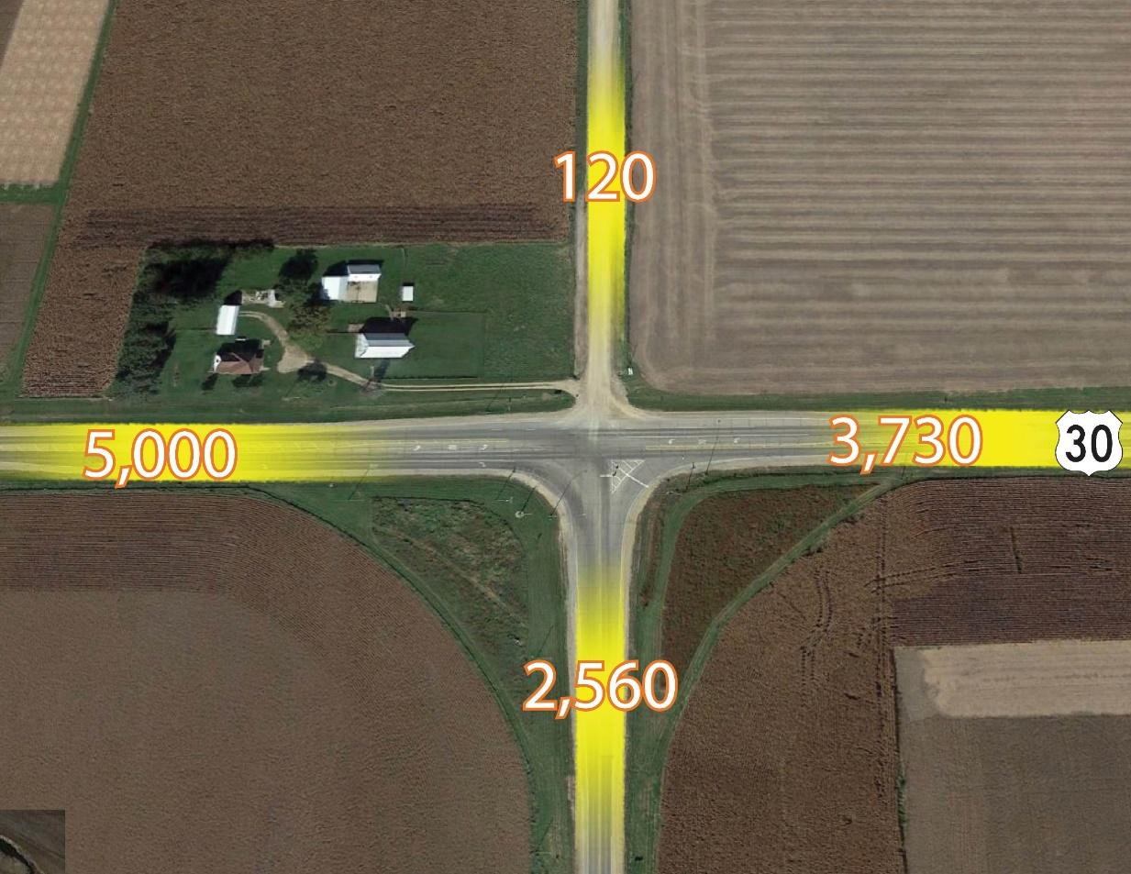
U.S. 30 in Cedar County
U.S. 30 and Hwy 38
Source: Iowa Department of Transportation, 2018
Notes:
Updated

Slide 20
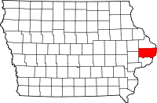
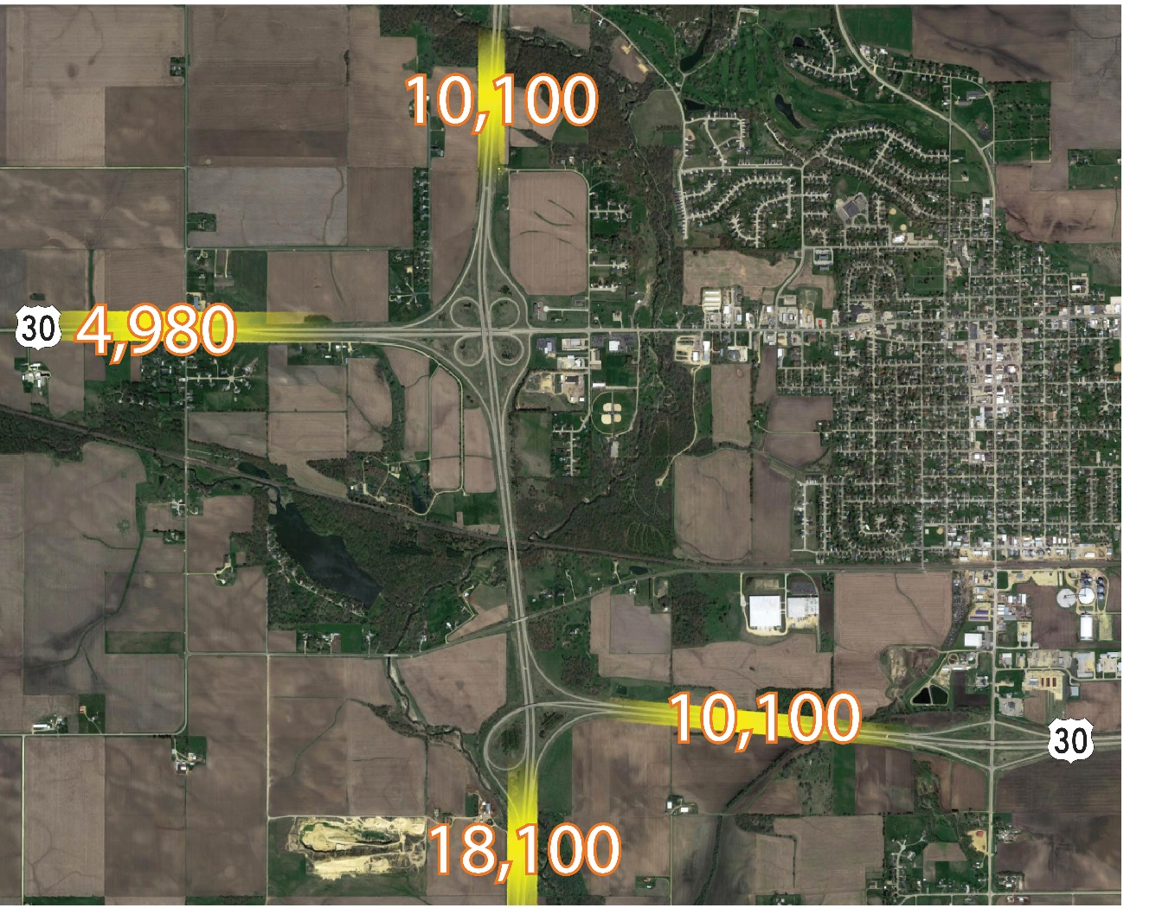
U.S. 30 in Clinton County
U.S. 30 and Hwy 61
City of DeWitt
Source: Iowa Department of Transportation, 2018
Notes:
Updated

Slide 21
Thank you!
Priorities and Future US 30 Projects:
Lisbon to Dewitt - 4 Lane
Missouri Valley Bypass
Carroll to US 169
Mt. Vernon/Lisbon Bypass
US 30 and US 218 Four-lane
US 30 and IA 21 Interchange
US 30 and S14 Grade Separation in Nevada

Slide 22
THANK YOU!

