Slide 1
US 30-Grant Road Intersection Improvements
A top 60 intersection for crashes in Iowa
Left Turn movement was the top crash contributor
Improvements made:
Extended bridge under US 30 to the south in order to expand roadway
Expanded roadway to the south for east bound traffic
Added dedicated left turn lanes at US 30 and Grant Road
Extended the continuous two-way turn lane from the east to the US 30 and Grant Road intersection
Improved turning radiuses
Improved traffic signals

Slide 2
US 30-Grant Road Intersection Improvements
Construction Period - April, 2019 to October, 2019
Construction Cost - $1,455,565.45
DOT Funding:
Traffic Safety Improvement Program (State) $500,000
Urban-State Traffic Engineering Program (State) $400,000
ROW Purchase $462,833

Slide 3
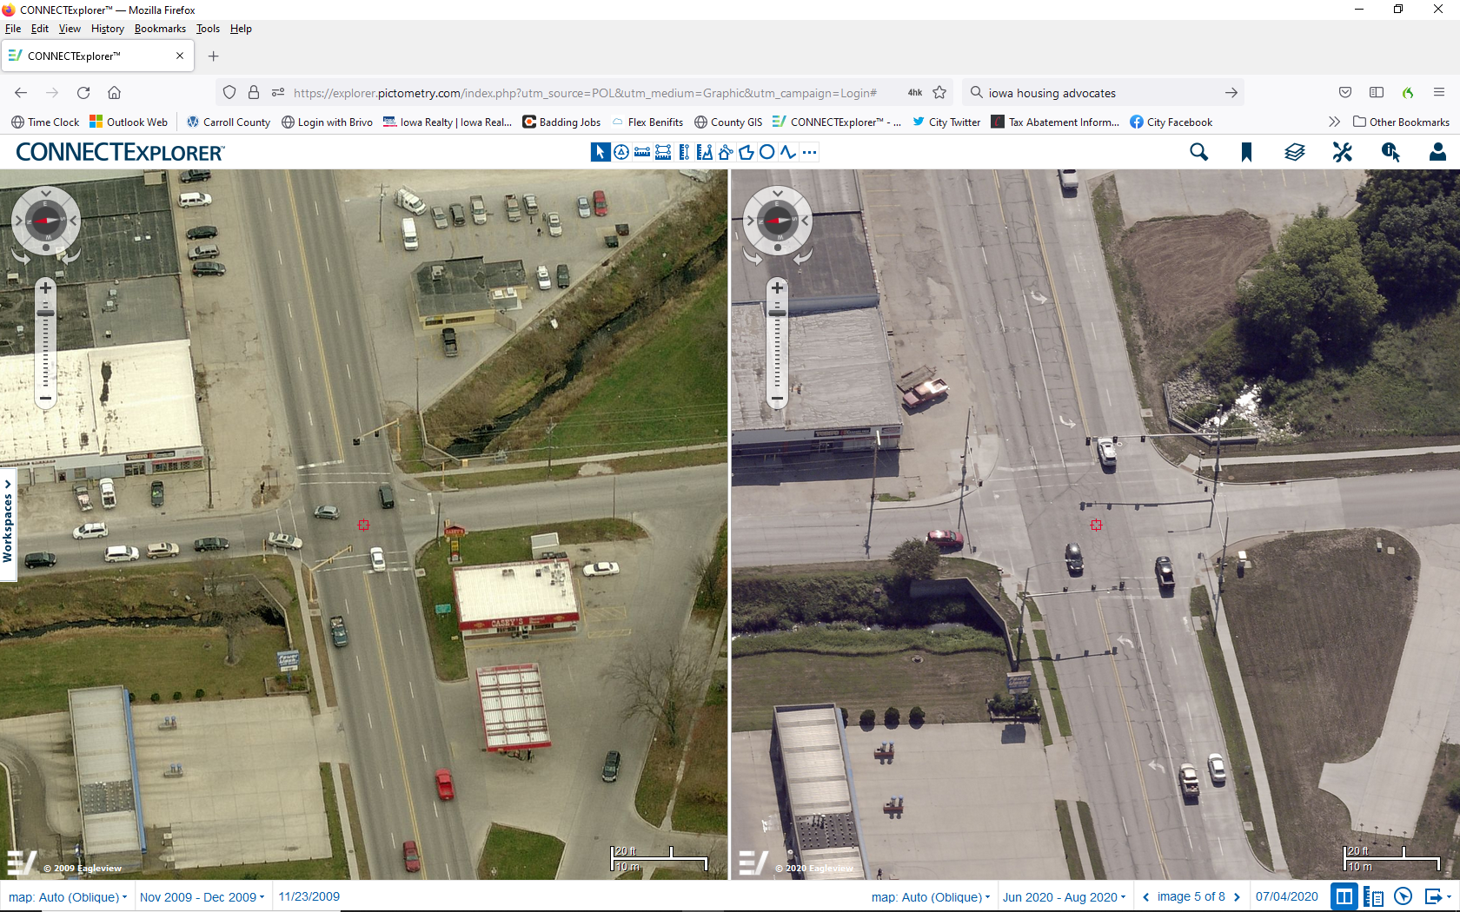
US 30-Grant Road Intersection Improvements
Before
After

Slide 4
Other Transportation Investments
High Ridge Road: 8th Street to 18th Street – Asphalt resurfacing - May, 2016 to June, 2017
Construction Cost - $1,180,008.61
DOT Funding – Surface Transportation Program (Federal) $480,000
Third Street: US 71 to Grant Road – Asphalt resurfacing with milling - August, 2017 to April, 2018
Construction Cost - $779,257.58
DOT Funding – Surface Transportation Program (Federal) $623,406.06

Slide 5
Other Transportation Investments
West Street: 7th Street to 18th Street and Grant Road: Middle Raccoon River to UPRR – Asphalt resurfacing with milling – July, 2020 to November, 2020
Construction Cost - $1,092,325.45
DOT Funding – Surface Transportation Block Grant (Federal) $413,760.95
Total State and Federal Transportation Investment in Carroll 2016-2021
2,880,000.01

Slide 6
Four Lane US 30
The City of Carroll is a member of the US 30 Coalition
Making US 30 a four lane is:
Good for business
Good for citizens
Good for the community
The City of Carroll strongly supports making US 30 a four lane highway!

