Slide 1
Iowa Department of Transportation Commission
Public Input Meeting
Carroll
August 10, 2021

Slide 2
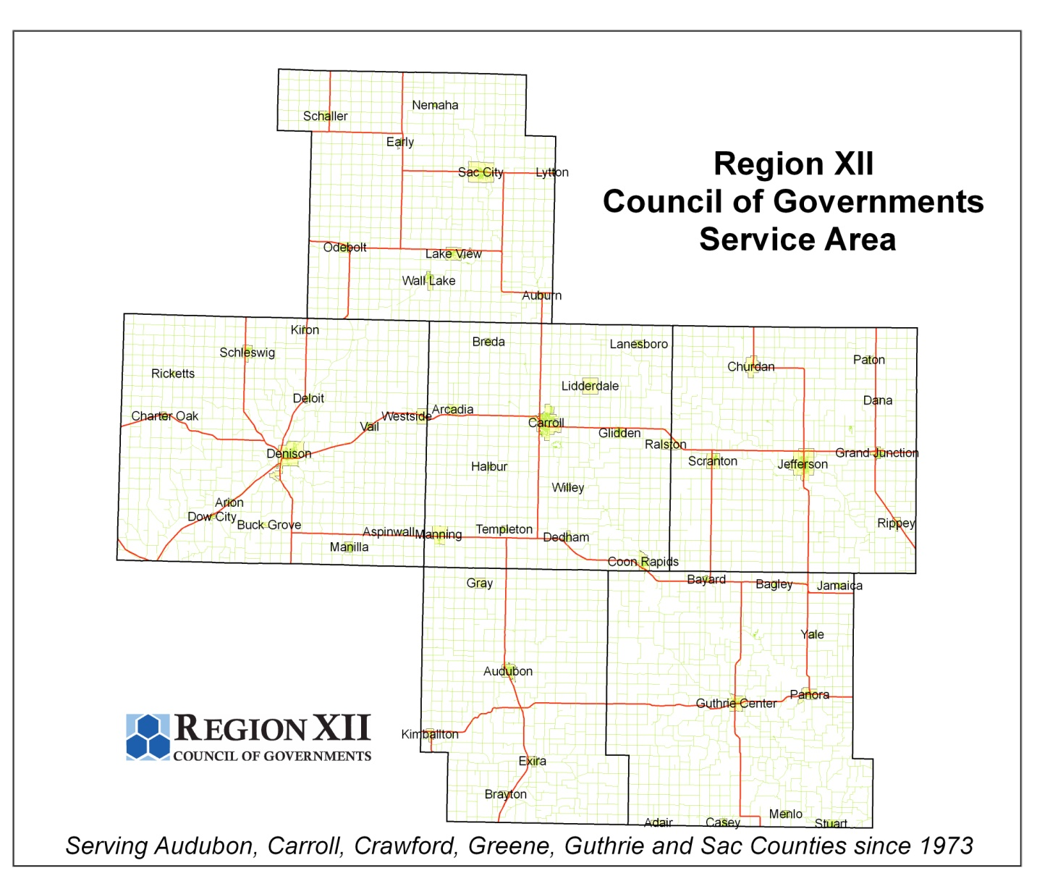

Slide 3
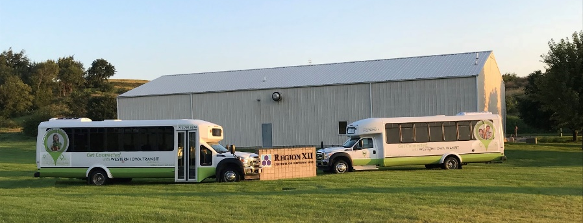
Region XII COG Profile
Organized 1973
6 Counties
56 Cities
74,671 People
Local Assistance
Economic Development
Community Development
Housing
Planning
Solid Waste
Western Iowa Transit –1977

Slide 4
Regional Planning Affiliation
Policy Council - 24 Members
Executive Board – 6 Members
Technical Advisory Committee – 9 Voting Members and Ex-Officio Members
Transit Roundtable XII Committee
Bike-Ped Roundtable Committee
County Transportation Stakeholder Committees

Slide 5
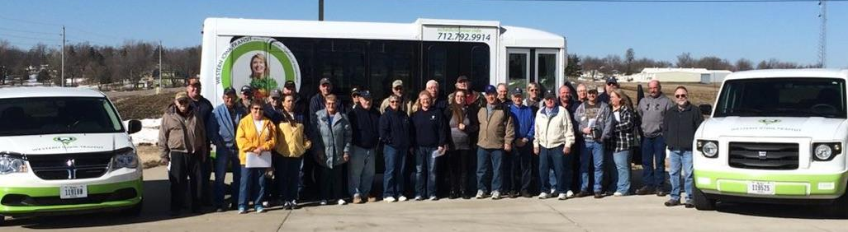
Western Iowa Transit
Transit Employees
Transit Director + Admin 4
Full time drivers 19
Part-time drivers 6
Services
General Public
Persons with Disabilities
Seniors
Medicaid
Schools/HeadStart/Job Corps
Commuters

Slide 6
Western Iowa Transit

Slide 7
The COG and COVID-19
Local Assistance Division continued to provide services to Local Governments and Clients every day.
Western Iowa Transit
10 of 34 Drivers were Active (April 2020)
Revenue Miles were 21% (April 2020)
Rides 19% of normal (April 2020)
Implemented Staff Retention Methods
Increased Safety Measures
Transported Positive Covid-19 Patients for Treatment

Slide 8
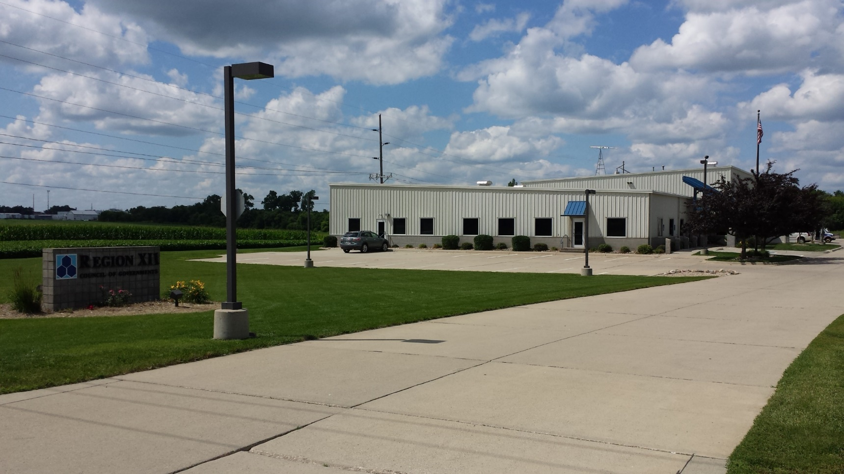
Region XII Headquarters 1009 East Anthony, Carroll

Slide 9
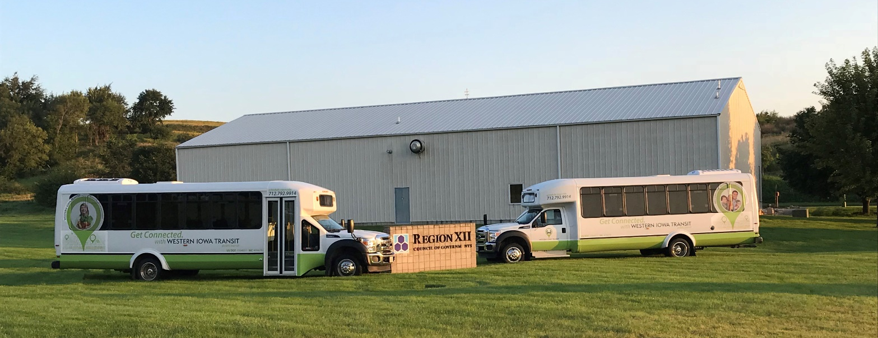
Western Iowa Transit, Denison
Satellite Storage Facility, 1999
STBG Funded
ICAAP Funded Van Pools to Tyson Foods from 2009-2015
1st IEDA Funded CareerLink Shuttle Service to Monogram Foods
2nd Shuttle Service to Midwest Industries in Ida Grove

Slide 10
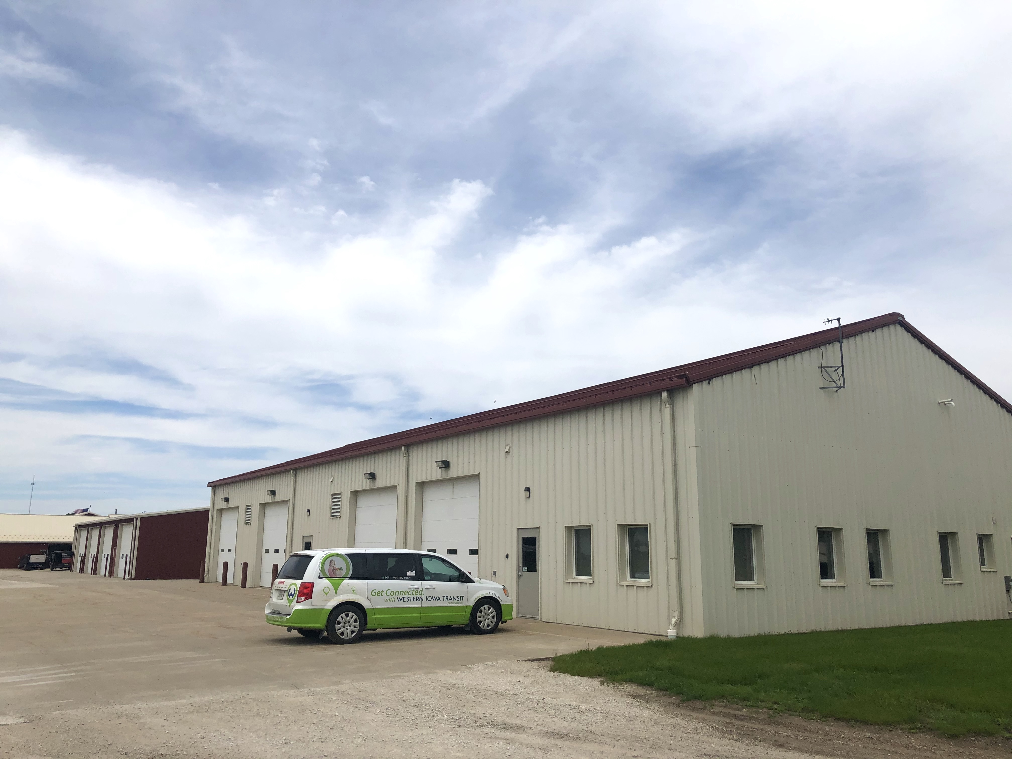
Western Iowa Transit, Jefferson
Satellite Storage Facility, 2003
STBG Funded
Adjacent to Greene County Secondary Road Facility

Slide 11
RPA Transportation Funding
Surface Transportation Block Grant Funding: $2,200,000 Annually
Regional Transportation Alternatives Program Funding: $104,000 Annually
Current Projects

Slide 12
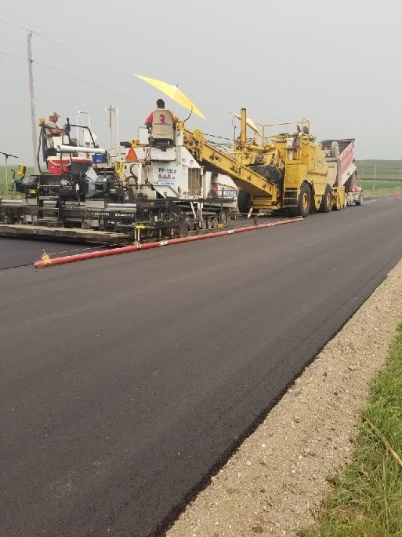
Carroll County
Carroll County Olympic Avenue
FY 21 STBG Project
$2.8 Million Project
$750,000 in STBG Funds
Resurfacing from Dedham to US HWY 30
Paved Shoulders

Slide 13
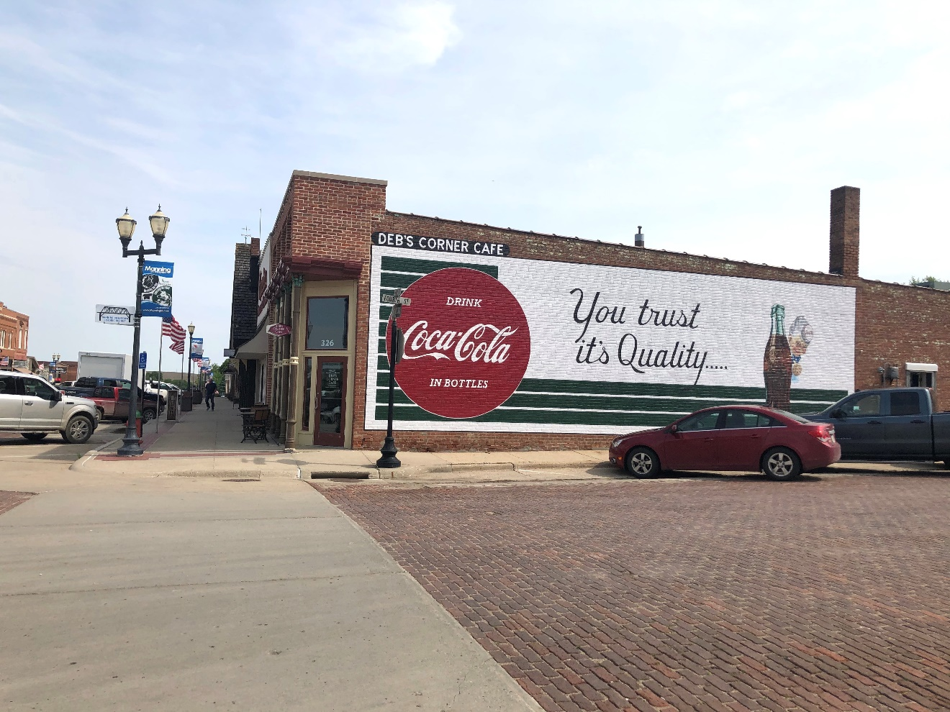
Manning
Iowa Great Place
2013 SRTS Statewide Grant
2013 State Rec Trail Grant
2016 RISE Grant
2021 Regional TAP and Statewide SRTS Trail Grant Award

Slide 14
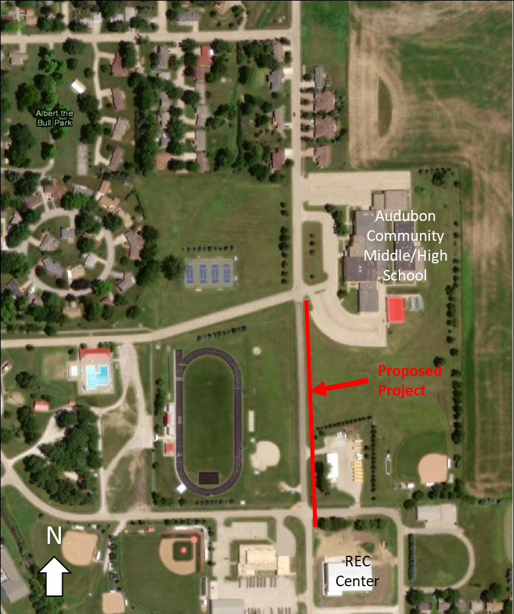
Audubon
REC Center Link Trail
$140,000 Project
$70,00 Regional TAP Funding
$42,000 Statewide TAP Funding (SRTS)

Slide 15
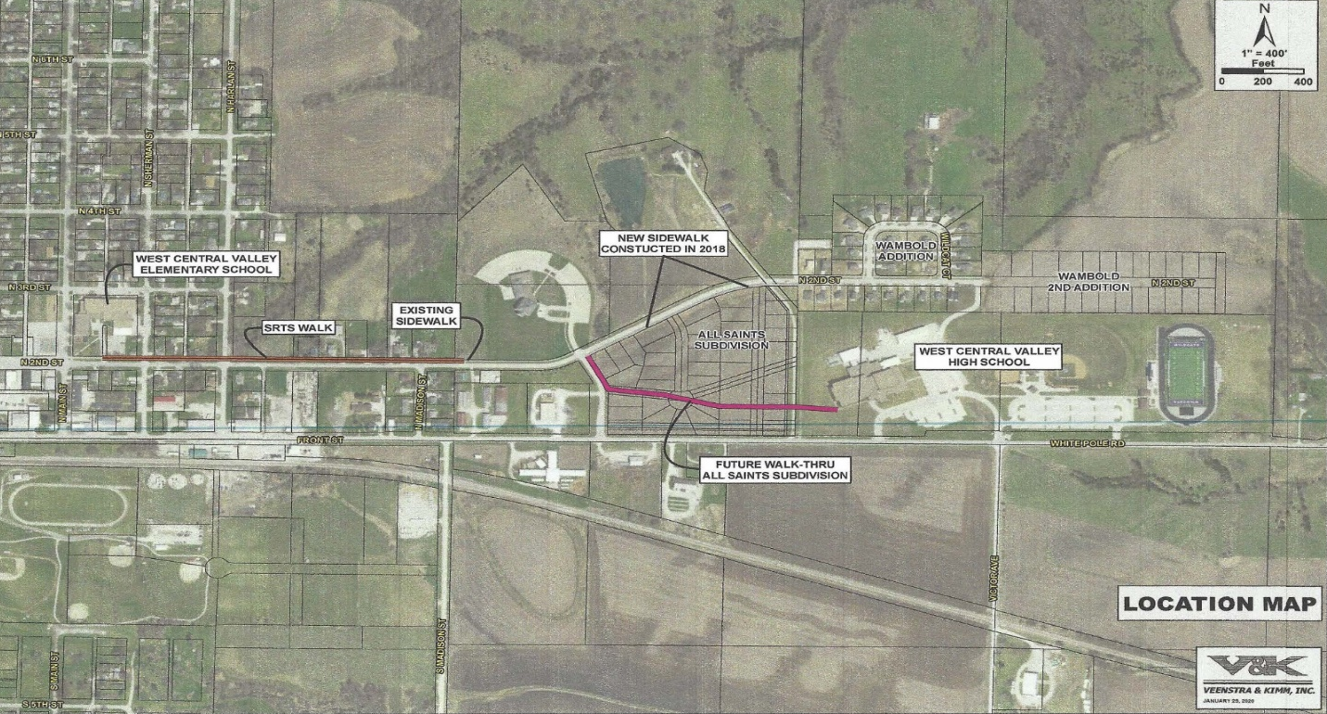
Stuart
West Central Valley School Trail
$270,000 Project
$135,000 Regional TAP Funding
$81,000 Statewide TAP Funding (SRTS)

Slide 16
Future Transportation Priorities and Projects

Slide 17
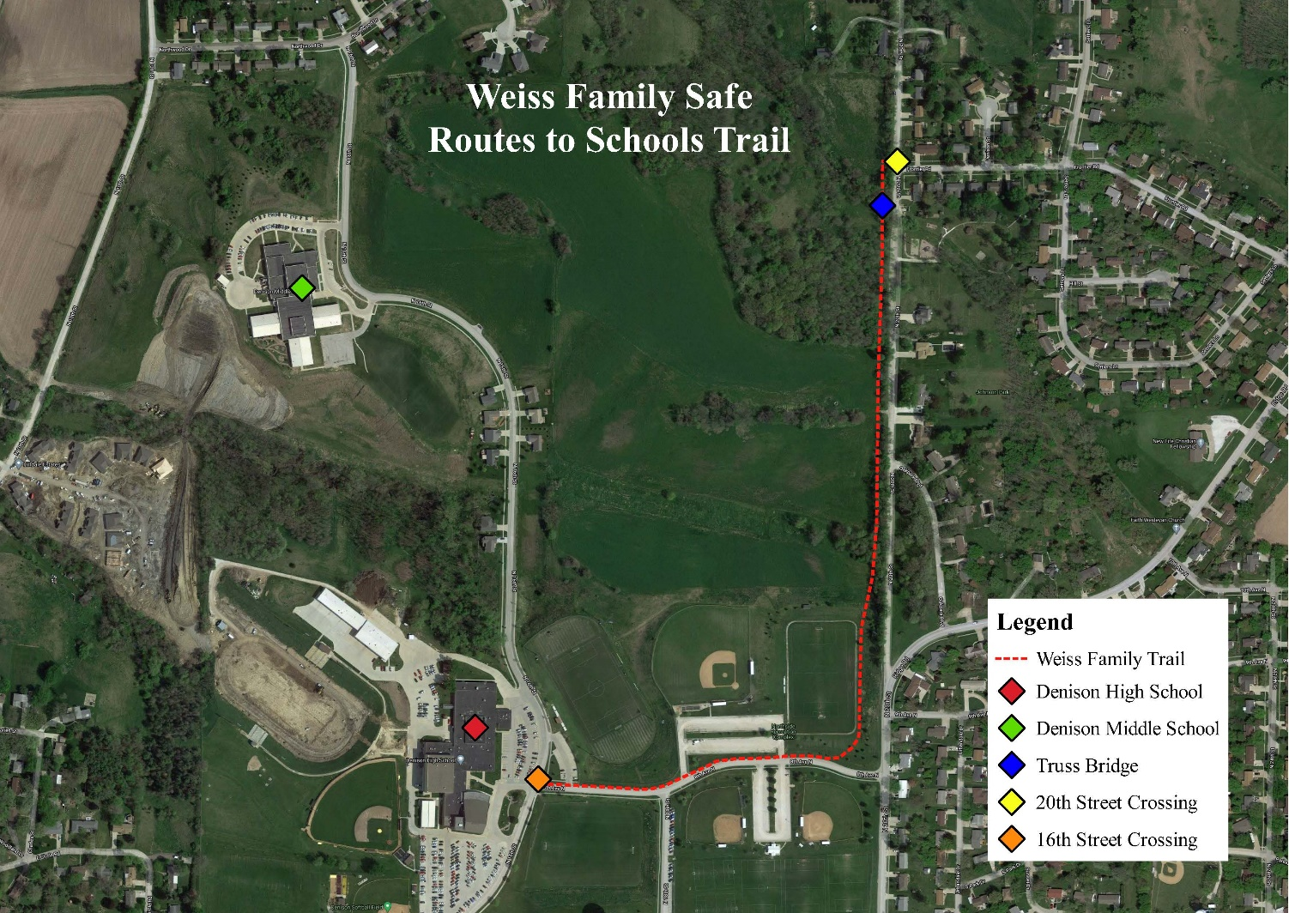
Denison
Weiss Family Safe Routes to School Trail
$400,000 Project
$200,000 Regional TAP Funding - Programmed
Statewide TAP Funding (SRTS) Request – October 2021

Slide 18
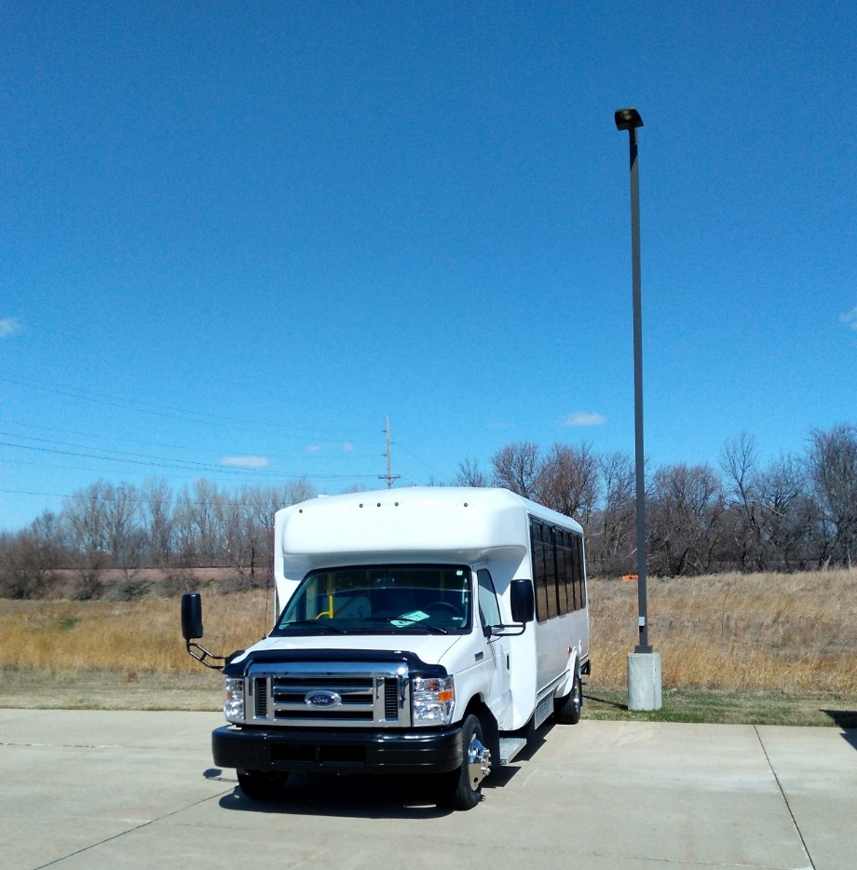
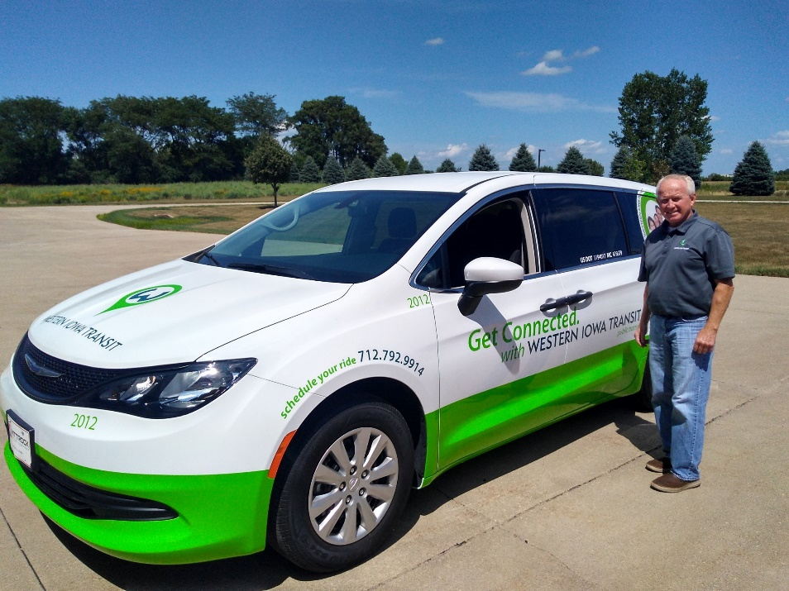
Western Iowa Transit

Slide 19
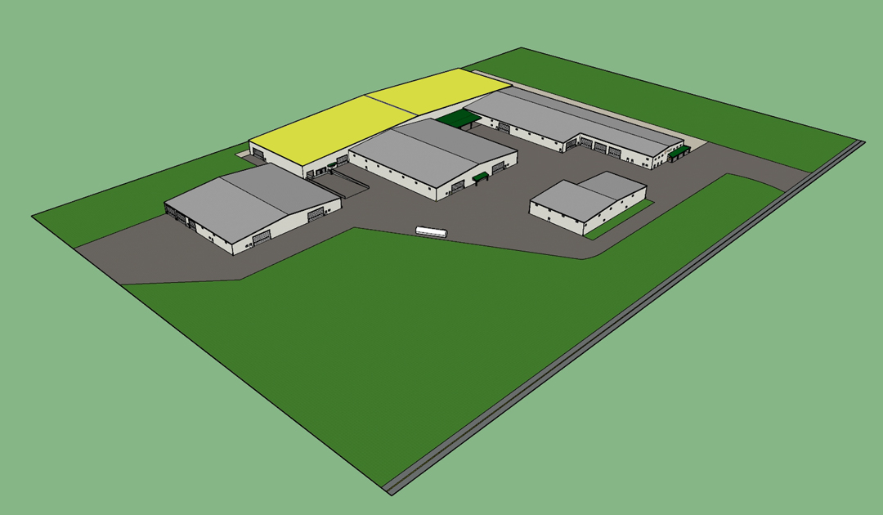
Audubon County RISE
2021 Audubon County RISE Application
Puck Enterprises
40 New Jobs
$7.5 Million Capital Investment
100,000 Square Foot Plant Expansion

Slide 20
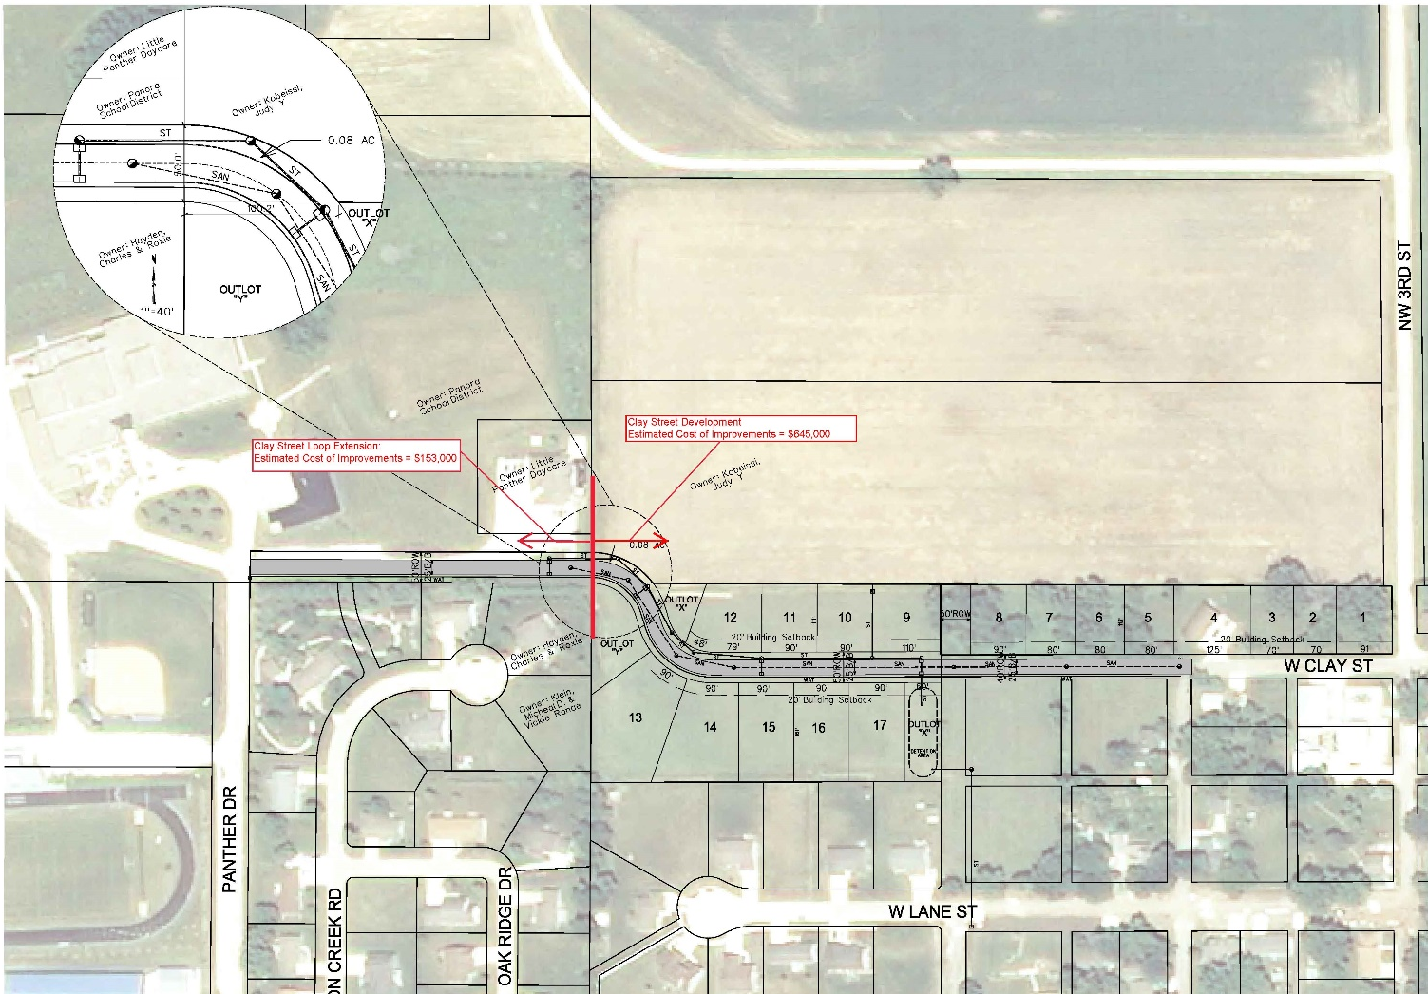
Housing - RISE
Critical for New Housing Developments in Rural Iowa
Needed for Workforce and Affordable Housing

Slide 21
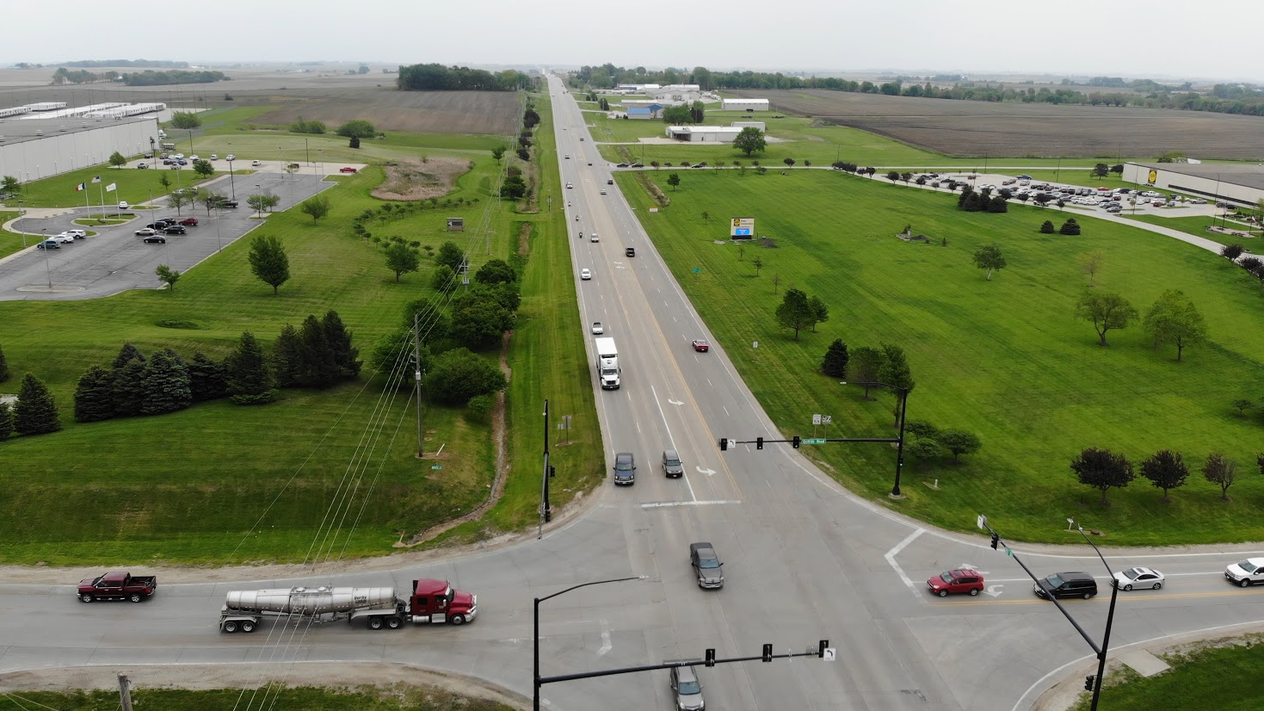
US Highway 30 – 4 Lane
US 30 and Griffith Road
Carroll to Glidden: 8000 – 9000 AADT
Over 1,500 Employees
Source: Photography by Fiscus
Notes:
American Home Shield (1524 HWY 30 East)
Total Number of Employees: 425
Core-Mark/ Farner Bocken Company (1751 HWY 30 East)
Over 100 Trucks per Day
Feld Fire Equipment (113 Griffith Road)
Pella Corporation (HWY 30 East)
􀂃 Shipping Information: 20 – 25 Loads Daily; approximately ½ use Griffith Road
Collins Aerospace (HWY 30 East)
􀂃 Total Number of Employees: 140

Slide 22
THANK YOU!
Rick Hunsaker, Executive Director
Region XII Council of Governments
Carroll, IA 51401
712-792-9914
rhunsaker@region12cog.org
www.region12cog.org

