Slide 1
Revitalize Iowa’s Sound Economy Program
Iowa Transportation Commission Business Meeting
August 10, 2021

Slide 2
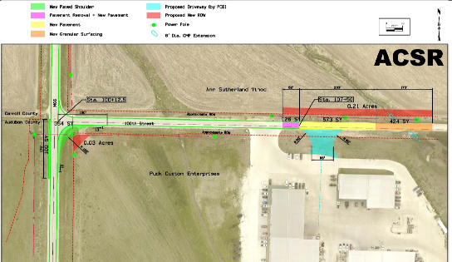
List of Immediate Opportunity Applications Recommended
PROJECT NAME
SPONSOR
JOBS
TOTAL PROJECT COST
PERCENT PARTICIPATION
RECOMMENDED AMOUNT
Paving of approximately 285 feet of 100th Street, grading 173 feet of 100th Street and intersection improvements to County Road M-66 and 100th Street located south of Manning. | Audubon County | 30 | $327,066 | 80% | $261,653

