Slide 1
Revitalize Iowa’s Sound Economy Program
Iowa Transportation Commission Workshop
August 9, 2021

Slide 2
Revitalize Iowa’s Sound Economy Program
Created in 1985
Purpose: To promote economic development through roadway improvements.
Eligible development shall have value-adding activities that feed new dollars into the economy
Available to cities and counties through an application program

Slide 3
Available Funding and Application Summary
Available Funding
Funded annually with dedicated state motor fuel and special fuel tax revenues
Application Summary for SFY2021
Total number of projects awarded: 17
Total project costs: $44,111,996
Total amount awarded: $20,091,153
 | CITY | COUNTY
Average funding generated monthly | $970,179 | $485,089
SFY 2022 current Road Use Tax Revenue (as of 6/30/2021) | $10,861,211.31 | $5,430,605.66
Current Unobligated Balance (as of 6/30/2021) | $1,253,324.00 | $4,320,875.71

Slide 4
Immediate Opportunity Project Evaluation Criteria
Growth Potential
Average wages meet at least 100% laborshed wage
Quality of Jobs
No pattern of violations
In-state suppliers
Impact on import substitution
Few Iowa competitors
Operating expenditures spent in Iowa
Out-of-state sales
Hiring preferences to Iowa residents

Slide 5
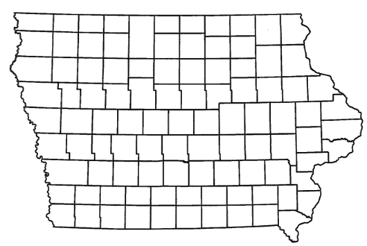
List of Immediate Opportunity Applications Recommended
PROJECT NAME
SPONSOR
JOBS
TOTAL PROJECT COST
PERCENT PARTICIPATION
RECOMMENDED AMOUNT
Paving of approximately 285 feet of 100th Street, grading 173 feet of 100th Street and intersection improvements to County Road M-66 and 100th Street located south of Manning. | Audubon County | 30 | $327,066 | 80% | $261,653

Slide 6
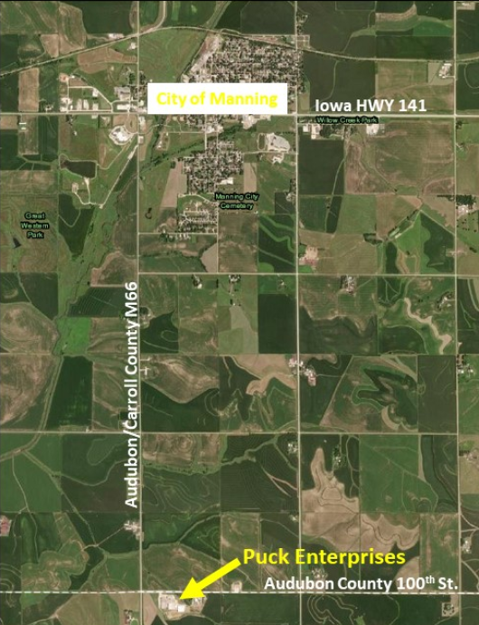
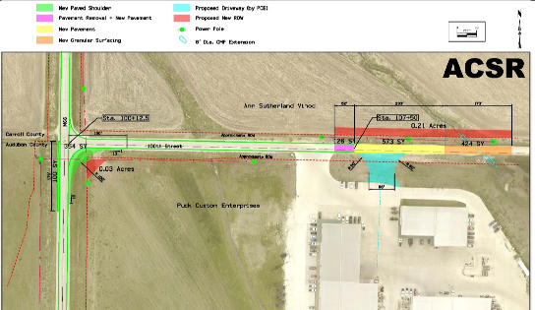
Audubon County
(Immediate Opportunity)
Paving of approximately 285 feet of 100th Street, grading 173 feet of 100th Street and intersection improvements to County Road M-66 and 100th Street located south of Manning. This improvement is necessary to provide improved access to the proposed expansion of Puck Enterprises, a liquid manure application equipment manufacturer.
Total Cost: $327,066 RISE Cost/Job Assisted: $8,721.77
Requested: $261,653 (80%) Capital Investment/RISE $: $28.91
Jobs Created: 30 Company Average Wages: $20.00 (107% of laborshed)

Slide 7
QUESTIONS?
Craig Markley, Systems Planning Bureau
craig.markley@iowadot.us
515-239-1027

