Slide 1
COVID-19 Relief Recreational Trails Program
Funding Recommendation

Slide 2
COVID-19 Relief Recreational Trails Program
Available to federal, state, and local government agencies.
Eligible projects include:
Construction of new recreational trails;
Maintenance, resurfacing and restoration of existing recreational trails;
Development and rehabilitation of trailside and trailhead facilities and trail linkages;
Acquisition of easements and fee simple title to property for recreational trails or recreational trail corridors.

Slide 3
Project Evaluation Criteria
Degree to which the project provides development of trail linkages including ties to other trails. (40 points)
How the project aligns with the Iowa Bicycle and Pedestrian Long-Range Plan and other adopted trail plans. (20 points)
Current status of the project toward the required NEPA compliance and project readiness for development. (20 points)
Degree to which the project will use program grant funds to leverage other public or private investments. (10 points)
Degree of commitment to continue operation and maintenance of the project after the project is complete. (10 points)

Slide 4
Available Funding and Application Summary
Available Funding:
Allocation: $5,000,000
Application Summary:
Total number of projects: 83
Total project costs: $109,588,981
Total amount requested: $70,058,972

Slide 5
List of Applications Recommended
PROJECT NAME | SPONSOR | SCORE | TOTAL PROJECT COST | REQUESTED AMOUNT (% of Total Project Cost) | RECOMMENDED AMOUNT (% of Total Project Cost)
Reconstruction of American Discovery Trail in George Wyth State Park from Kreig’s Crossing to George Wyth Shelter | Iowa Department of Natural Resources | 67 | $745,580 | $684,754 (92%) | $684,754 (92%)
Raccoon River Valley Trail Rehabilitation from Redfield to Linden | Dallas County Conservation Board | 66 | $1,476,000 | $776,000 (53%) | $776,000 (53%)
Sauk Rail Trail Rehabilitation from Swan Lake State Park to Kittyhawk Avenue | Carroll County Conservation Board | 65 | $1,150,186 | $900,186 (78%) | $900,186 (78%)
A list of all applications received has been provided and will be available on the Iowa DOT website following the workshop.

Slide 6
List of Applications Recommended
PROJECT NAME | SPONSOR | SCORE | TOTAL PROJECT COST | REQUESTED AMOUNT (% of Total Project Cost) | RECOMMENDED AMOUNT (% of Total Project Cost)
Great Western Trail Renovation Phase 1 | Warren County Conservation Board | 62 | $752,000 | $637,000 (85%) | $637,000 (85%)
Prairie Springs and Prairie Farmer Recreational Trails Rehabilitation | Howard County Conservation Board | 61 | $1,294,497 | $1,061,832 (82%) | $1,061,832 (82%)
Prairie River Trail System Fort Dodge to Badger Connection | Webster County Conservation Board | 60 | $3,660,000 | $1,000,000 (27%) | $940,228 (26%)
A list of all applications received has been provided and will be available on the Iowa DOT website following the workshop.

Slide 7
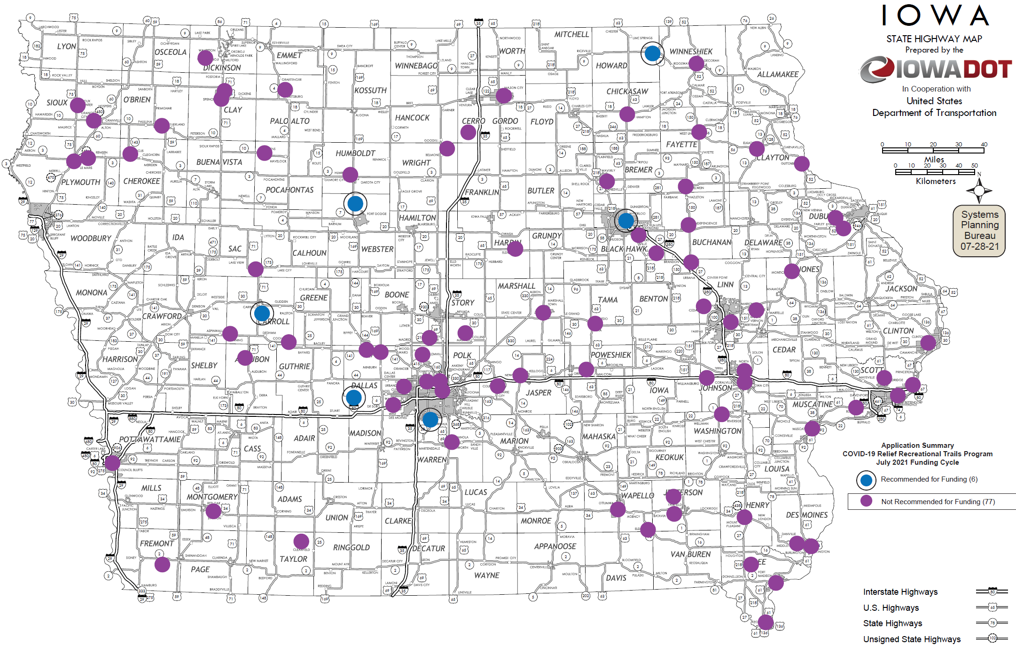
Map of Applications Received

Slide 8
QUESTIONS?
Scott Flagg
Federal/State Recreational Trail Program Manager
Scott.Flagg@iowadot.us

Slide 9
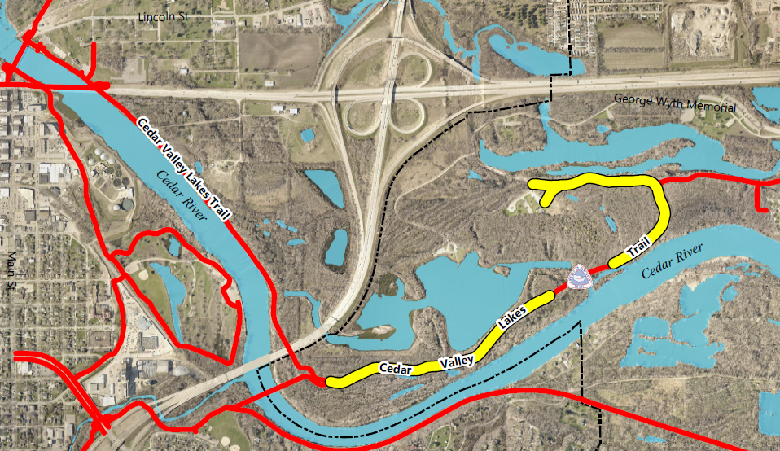
Reconstruction of American Discovery Trail in George Wyth State Park from Kreig’s Crossing to George Wyth Shelter
(Iowa Department of Natural Resources)
Reconstruct 1.3 miles of the American Discovery Trail in George Wyth State Park from Kreig’s Crossing to George Wyth Shelter.
Total Cost: $745,580
Requested: $684,754 (92%)
Return to List of Applications Recommended

Slide 10
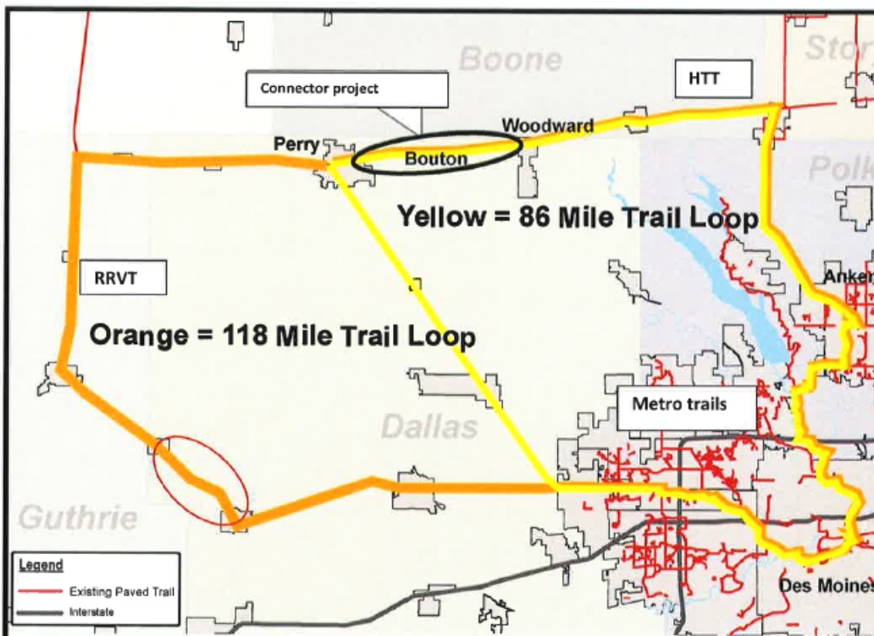
Raccoon River Valley Trail Rehabilitation from Redfield to Linden
(Dallas County Conservation Board)
Repair and rehabilitate over five miles of trail surfaces and bridges S, T, U, V, and W from Redfield to Linden.
Total Cost: $1,476,000
Requested: $776,000 (53%)
Return to List of Applications Recommended

Slide 11
Sauk Rail Trail Rehabilitation from Swan Lake State Park to Kittyhawk Avenue (Carroll County Conservation Board)
Resurface 3.3 miles of the Sauk Rail Trail from Swan Lake State Park through the city of Carroll to Kittyhawk Avenue.
Total Cost: $1,150,186
Requested: $900,186 (78%)
Return to List of Applications Recommended

Slide 12
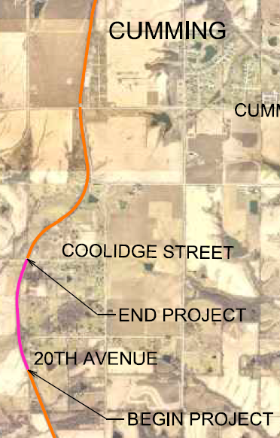
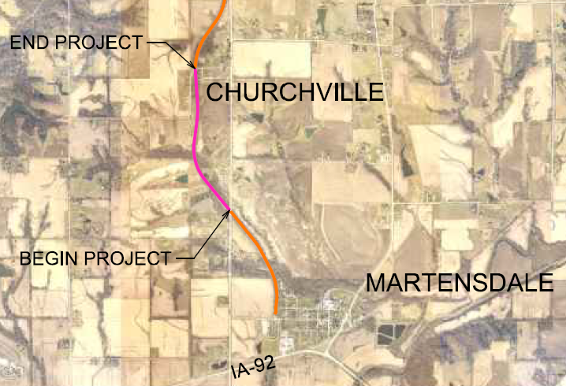
Great Western Trail Renovation Phase 1
(Warren County Conservation Board)
Reconstruction of two trail segments: south of Cumming and north of Martensdale.
Total Cost: $752,000
Requested: $637,000 (85%)
Return to List of Applications Recommended

Slide 13
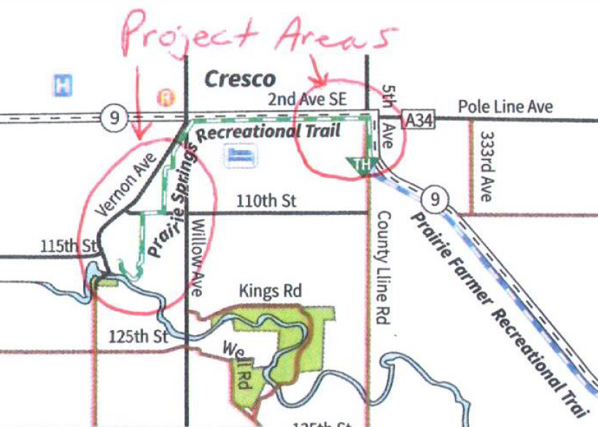
Prairie Springs and Prairie Farmer Recreational Trails Rehabilitation
(Howard County Conservation Board)
Rehabilitation of Prairie Springs Trail form 7th Avenue SW in Cresco to Prairie’s Edge Nature Center in Vernon Springs and the Prairie Farmer Trail form the Cresco east city limits to the Howard/Winneshiek county line.
Total Cost: $1,294,497
Requested: $1,061,832 (82%)
Return to List of Applications Recommended

Slide 14
Prairie River Trail System Fort Dodge to Badger Connection
(Webster County Conservation Board)
Connection from Fort Dodge to Badger expanding trail system to Rogers Sports Complex, and John F. Kennedy Memorial Park.
Total Cost: $3,660,000
Requested: $1,000,000 (27%)
Recommended: $940,228 (26%)
Return to List of Applications Recommended

