Slide 1
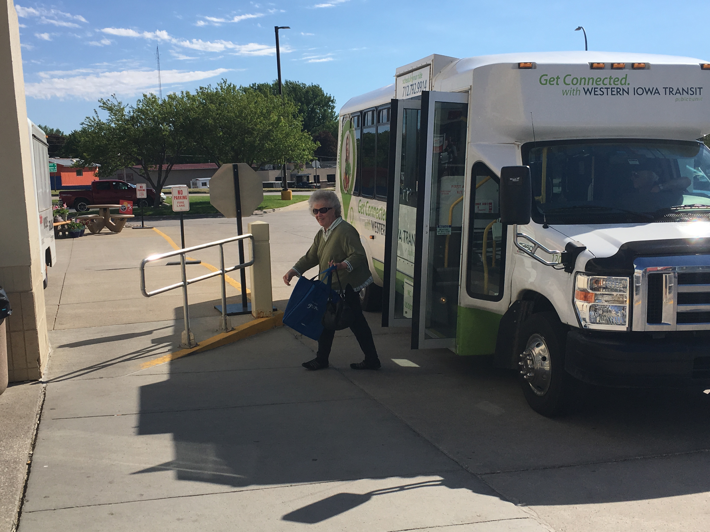

FY 2022 Public Transit Infrastructure Grant Program
August 9, 2021

Slide 2

Public Transit Infrastructure Grant Program
Program created by 2006 General Assembly
Funds vertical infrastructure projects for public transit
All 35 public transit systems are eligible

Slide 3
Project Evaluation Criteria
No more than 40-percent of the available funding can be awarded to an individual transit system
Structural integrity of existing facilities
Safety enhancements to existing facilities
New facilities that enhance the life of the transit fleet or optimize transit service
Projects should be “shovel ready” and capable of completion in 18 months

Slide 4
Available Funding and Application Summary
Available Funding:
  Annual appropriation: $1,500,000
  Underrun/withdrawals: $0
  Funds available: $1,500,000
Application Summary:
  Total number of projects: 12
  Total project costs: $33,375,155
  Total amount requested: $4,222,285

Slide 5
List of Applications Recommended
PROJECT NAME | SPONSOR | TOTAL PROJECT COST | REQUESTED AMOUNT (% of Total Project Cost) | RECOMMENDED AMOUNT (% of Total Project Cost)
New HVAC system Phase III | Ames (CyRide) | $414,435 | $331,548 (80%) | $331,548 (80%)
Replace Sliding Doors | Sioux City | $40,000 | $32,000 (80%) | $32,000 (80%)
Rehabilitate existing office building | Region 5 | $225,000 | $158,640 (71%) | $158,640 (71%)
Washington County minibus admin and bus storage facility | Region 10 | $590,570 | $472,456 (80%) | $472,456 (80%)
West Burlington Bus Storage facility | Region 16 | $715,598 | $400,000 (56%) | $400,000 (56%)
Cedar Rapids transit fleet maintenance facility | Cedar Rapids | $718,500 | $600,000 (84%) | $105,356 (14%)
Jump to applications not recommended for funding

Slide 6
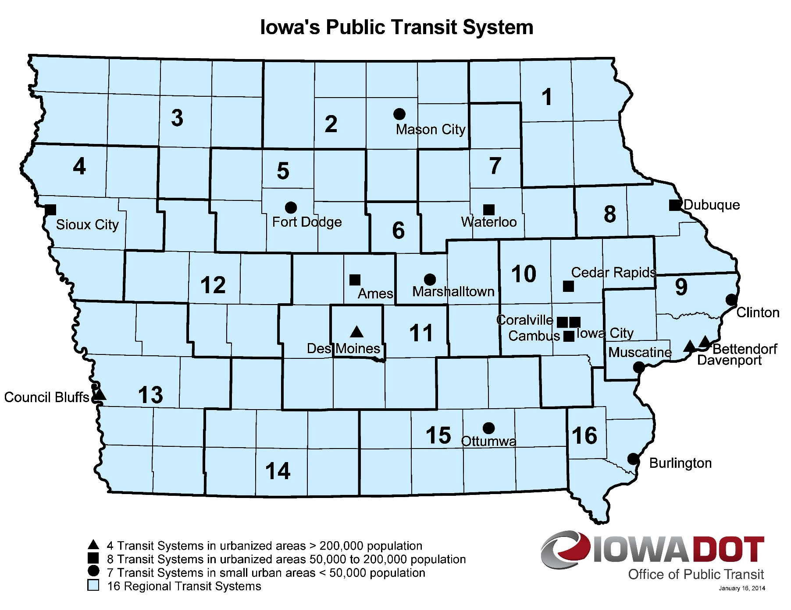
Map of Applications Received
Application received
Application recommended for funding
Notes:
18 Transit Systems

Slide 7

QUESTIONS?
Sree Mitra
Transit Program Manger
Sreeparna.mitra@iowadot.us
For more information on Iowa’s public transit and intercity bus programs, visit
www.iowadot.gov/transit

Slide 8
New HVAC systems – Ames (CyRide)
This project will replace outdated HVAC equipment at three separate areas of the CyRide bus maintenance facility.
Tire Shop HVAC Improvements (built in 2002, the HVAC for this area is 19 years old) Project improves air quality by improving space temperature and humidity control, increasing ventilation, and upgrading controls).
Paint Booth & Body Shop (built in 1983, the HVAC for this area is 38 years old. Project improve the air quality and interior environment of the paint and body shop by upgrading and supplementing the exhaust system that removes pollutants from the shop area during maintenance operations and improving space temperature as well as humidity control with the replacement of air conditioning equipment.).
Total Cost: $414,435
Recommended: $331,548 (80%)
2002 Tire Room Ventilation Equipment
1983 Paint Booth & Body Shop Exhaust Equipment
Return to List of Applications Recommended

Slide 9
Sioux City Sliding Door Replacement Project
The project will replace two sets of automatic sliding doors that are past their useful life. These are original doors installed in 2003. The door manufacturer, Besam, no longer makes this type of door, and there are no replacement parts available. During the past several years, the doors have broken down several times requiring service calls from the closest vendor, which is located in Sioux Falls, South Dakota
Total Cost: $40,000
Recommended: $32,000 (80%)
Return to List of Applications Recommended

Slide 10
Pathfinders Office Rehabilitation Project
This project will rehabilitate the existing office building located at
602 1st Avenue South, which has significant water damage and masonry deterioration.
Total Cost: $225,000
Recommended: $158,640 (71%)
Loose roof membrane, sitting water and dirt
Return to List of Applications Recommended
Corrosion at mechanics access basement

Slide 11
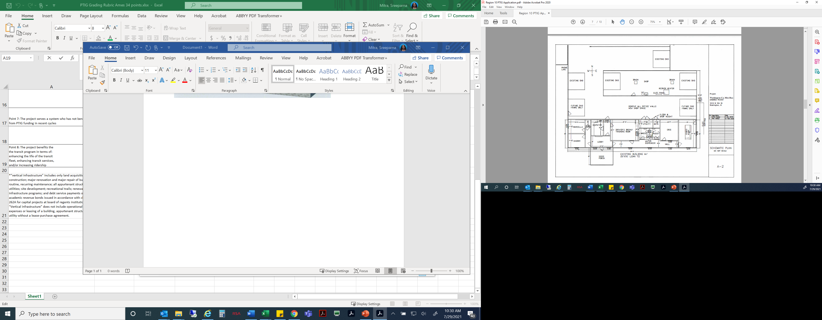
Washington County minibus admin and bus storage facility
This project will rehabilitate the existing office building located at
602 1st Avenue South, which has significant water damage and masonry deterioration.
Total Cost: $590,570
Recommended: $472,456 (80%)
Loose roof membrane
Return to List of Applications Recommended
Corrosion at mechanics access basement

Slide 12
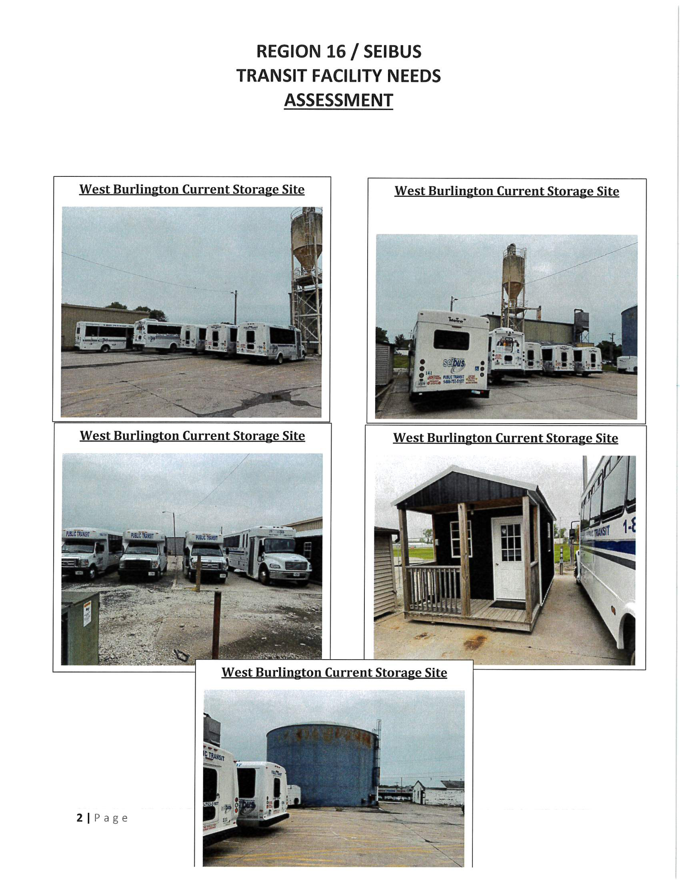
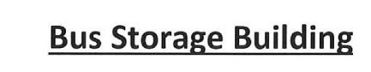
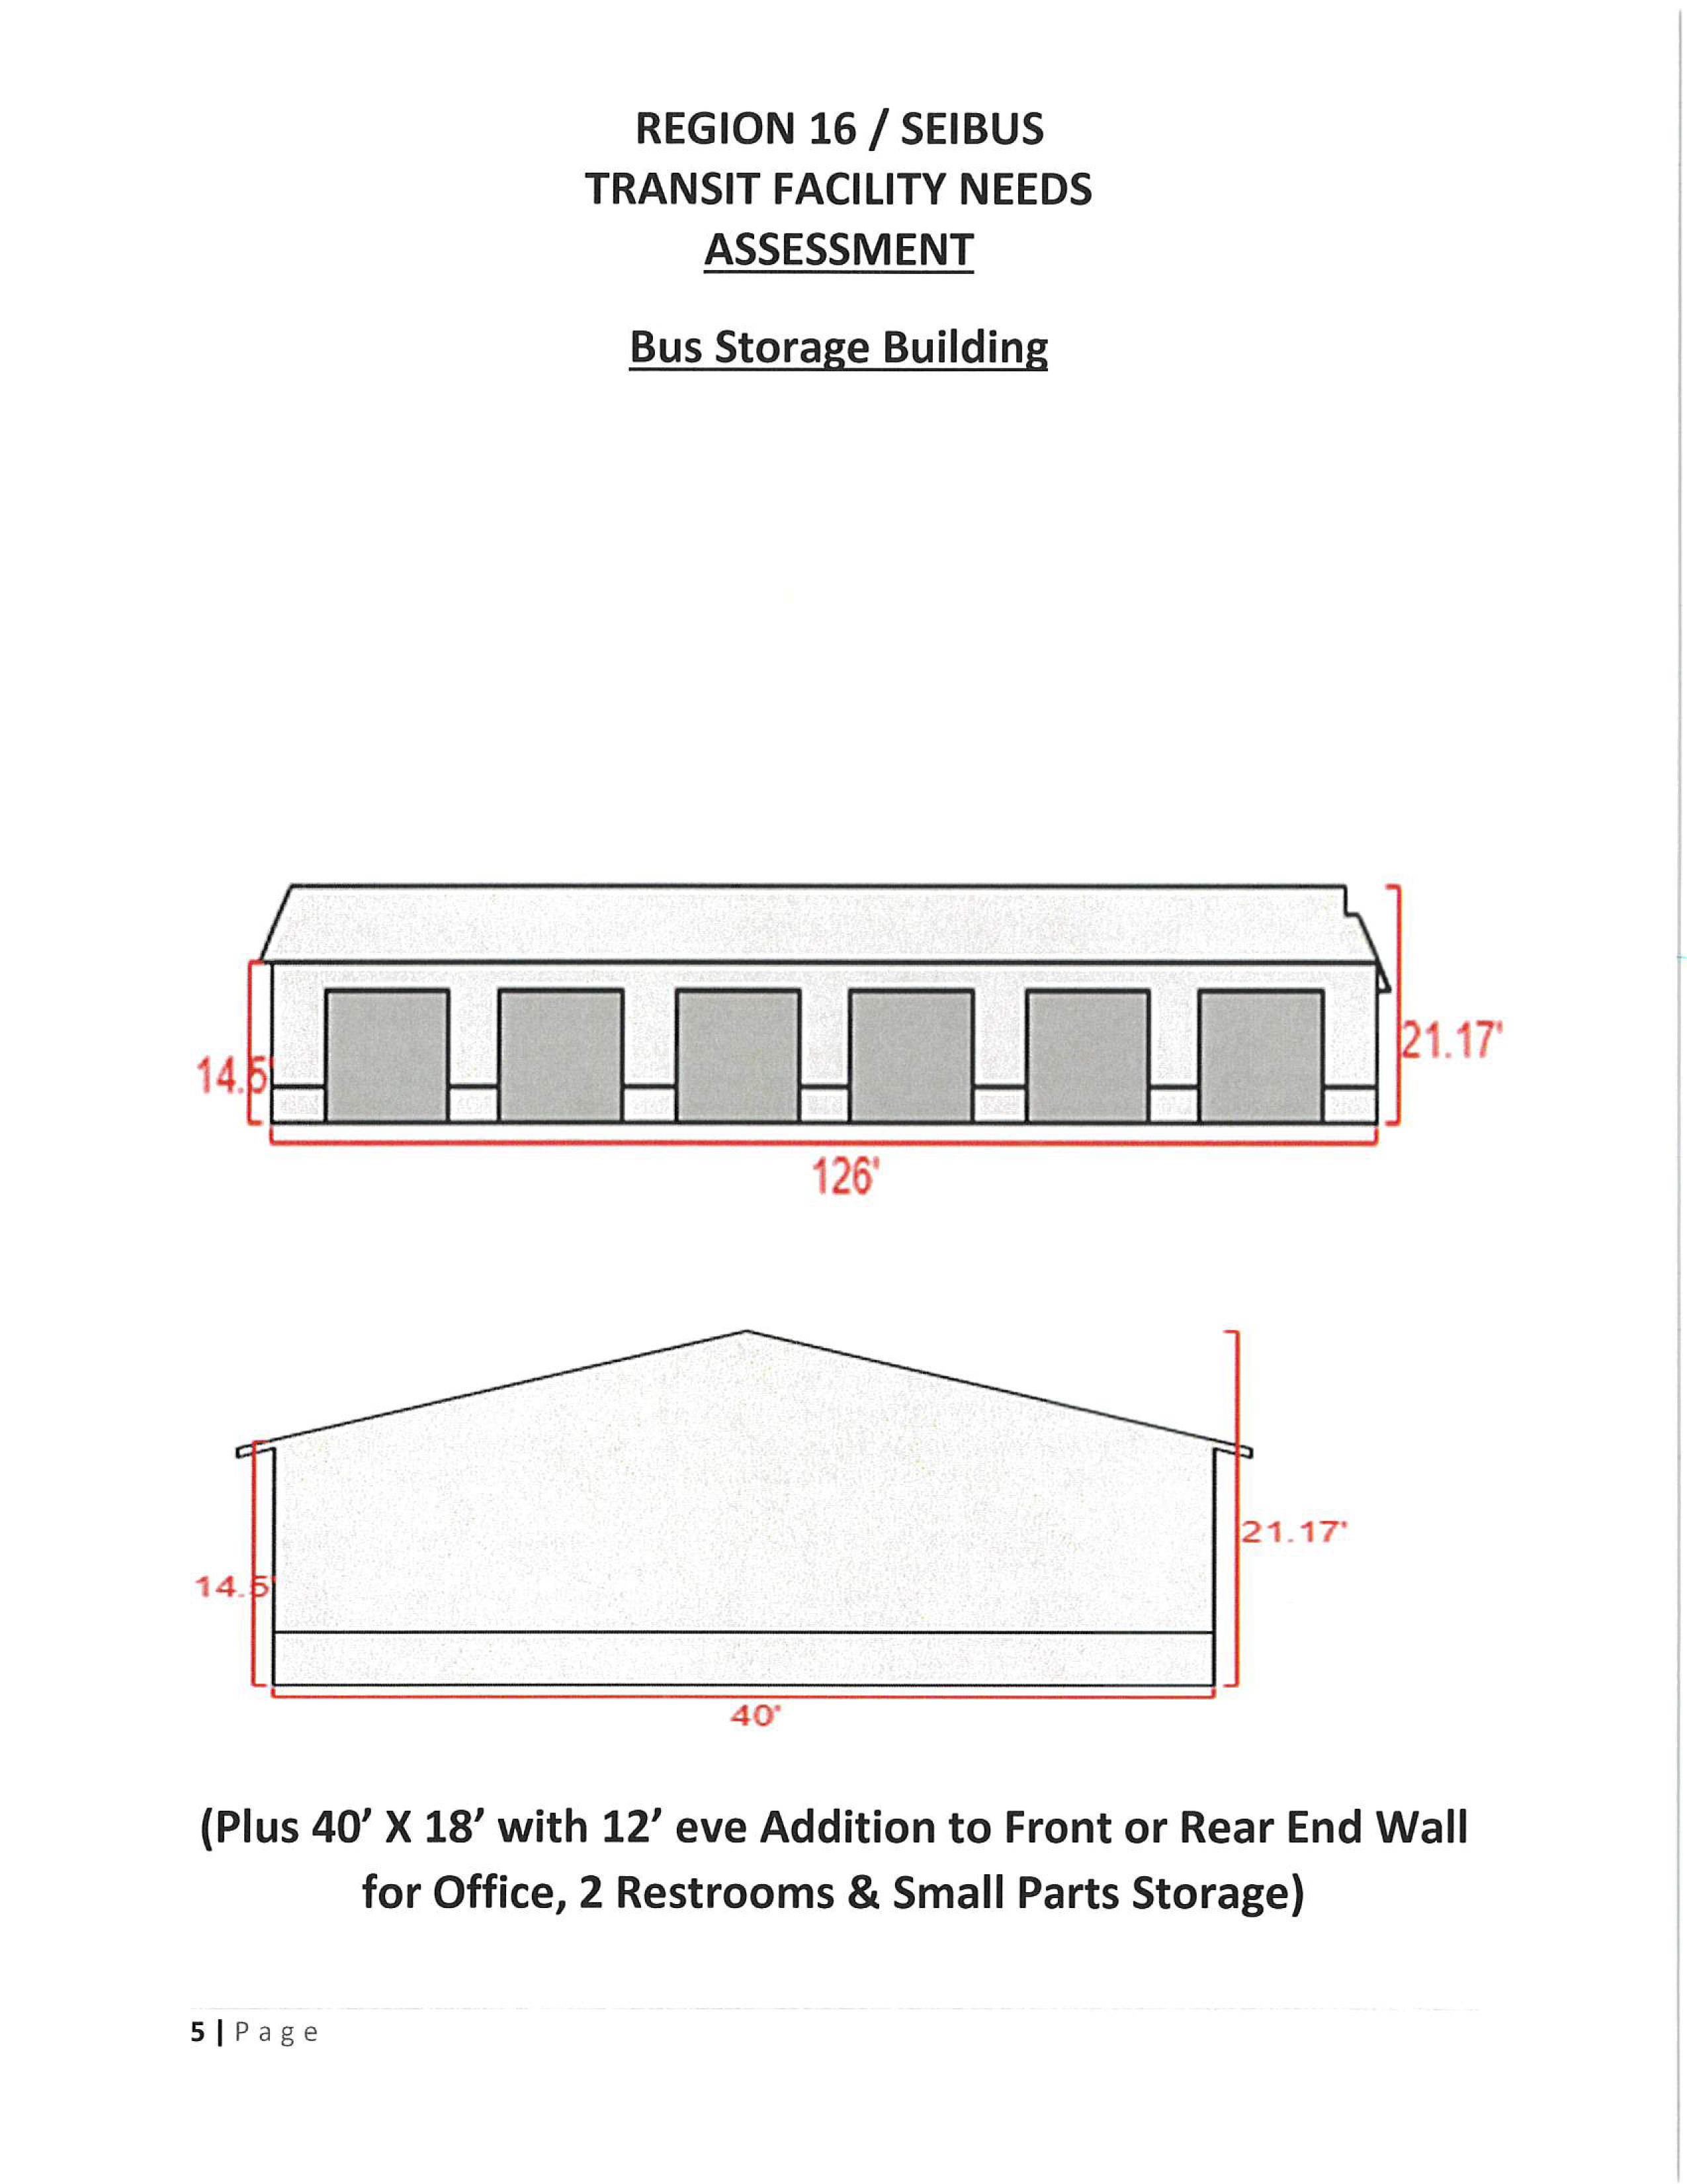
West Burlington
Vehicle Storage Facility
Currently Region 16 stores approximately 90% of its vehicles outside and uncovered. The West Burlington storage facility is requesting supplemental funds to provide for substantial increases in building costs to their FY20 project to improve vehicle storage needs for Region 16 Public Transit area of Southeast Iowa.
Total Additional Cost: $715,598
Requested: $400,000 (56%)
Return to List of Applications Recommended

Slide 13
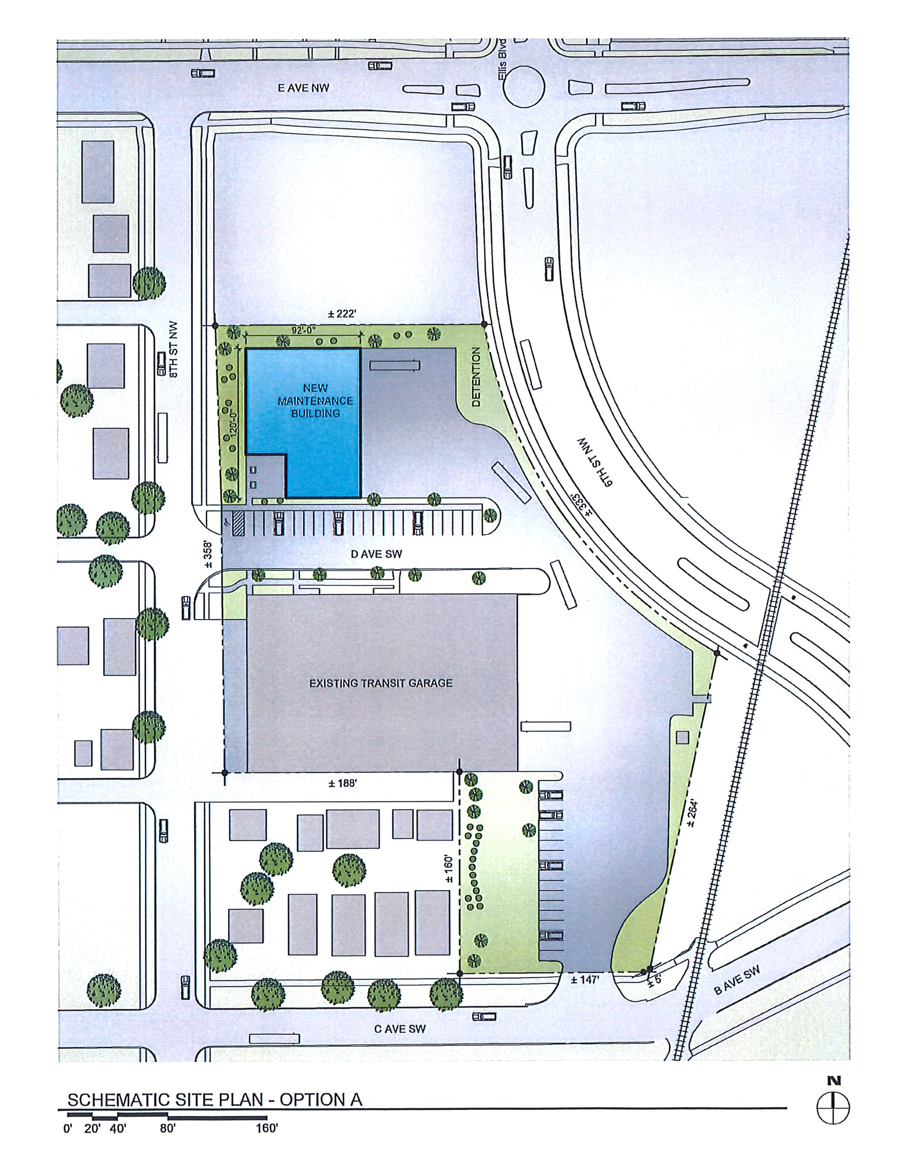
New Bus Storage and Administrative Facility –Cedar Rapids (FY21 project)
The proposed transit fleet maintenance facility would be constructed just north of the existing bus garage to replace Cedar Rapids’ large-parts/tire storage building, outdoor storage area, and several parking spots when demolition for the 6th St & Ellis Blvd NW connector project begins later this summer. The road construction project will take approximately 8,800 square feet of useable storage space from the existing transit garage property, and there is no room on site to replace any of that lost storage capacity.
Total Additional Cost: $718,500
Recommended: $105,356 (14%)
Return to List of Applications Recommended

Slide 14
List of Applications
Not Recommended for Award
PROJECT NAME | SPONSOR | TOTAL PROJECT COST | REQUESTED AMOUNT (% of Total Project Cost) | RECOMMENDED AMOUNT (% of Total Project Cost)
LED conversion and efficiency upgrade | Burlington | $100,000 | 65,000 (65%) | 0
Phase 1 of new Operations and Maintenance (O&M) facility | Des Moines DART | $25,217,750 | $600,000 (2.4%) | 0
Bus Wash | Region 4 | $298,042 | $238,433 (80%) | 0
Boone Bus Parking Project | HIRTA | $275,000 | $220,000 (80%) | 0
Bus Storage expansion | Region 13 | $630,260 | $504,208 (80%) | 0
Building purchase | Region 15 | $630,260 | $504,208 (80%) | 0
Return to List of Applications Recommended

