Slide 1
Corridor Preservation
Renewal
U.S. 63 Oskaloosa northwest bypass
From U.S. 63 to IA163
Project # NHSX-063-3(93)—3H-62
First Letting July 2023
Transportation Commission Workshop
August 10, 2021

Slide 2
What is a corridor preservation?
Corridor preservation is not a legal encumbrance on the property or an exercise of eminent domain, but is instead a right of notice.
Corridor preservation avoids inconsistent development of property needed for highway right-of-way, by allowing us to receive notice of intended development of property within the proposed right-of-way and giving us the opportunity to take action to acquire it before the development occurs.

Slide 3
Legal authority for corridor preservation
Section 306.19(5) of the Iowa Code,
DOT is authorized to “notify a city or county that a road under the jurisdiction or control of the department will be established, improved, relocated, or maintained and that the department may need to acquire additional right-of-way or property rights within an area described by the department.”

Slide 4
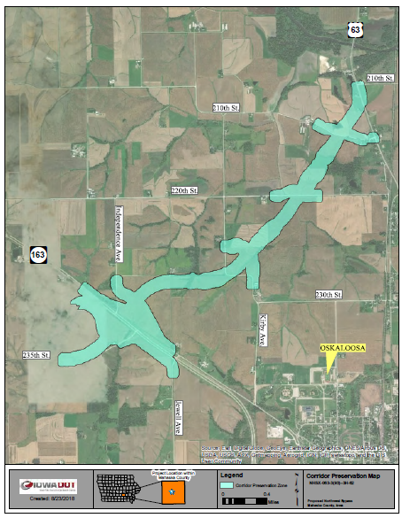
CPZ Renewal U.S. 63
From U.S. 63
To a new IA 163 interchange
CPZ was approved September 20, 2018
CPZs are valid for 3 years
Renew for 3 years

Slide 5
Iowa DOT process for Commission approval (Next steps for renewal)
This proposed CPZ Renewal will be finalized in September
Presented at the September business meeting.
Formal action will be requested.
If approved, we follow the usual and required process for formal notice established by section 306.19(5),
Written notice to the affected city or county.
Published notice in the newspaper.
Notice to all affected property owners.

Slide 6
Questions?
Thank You
Bryan Bradley
Location and Environment Bureau
bryan.bradley@iowadot.us
(515) 239-1787

Slide 7
How it works – Iowa DOT notice requirements
Section 306.19(5) requires we do the following to establish a corridor preservation zone (CPZ):
File notice with the city or county. We must give the city or county in which the property is located written notice that we may need to acquire the property for highway purposes. The notice must include a map describing the property that may need to be acquired.
Publish notice. Within seven days of filing the notice, we must publish a notice in a newspaper of public record that includes a description and map of the property that may need to be acquired, and explains that it may restrict the grant or approval of building permits, subdivision plats, or zoning changes.
Once established, a CPZ is valid for three years, and we may re-establish it every three years.

Slide 8
How it works – city or county notice requirements
Once we properly establish a CPZ, section 306.19(5) requires a city or county to give us 30 days notice of any of the following involving property within the CPZ:
An application for a building permit for construction valued at $25,000 or more.
Submission of a subdivision plat.
A proposed change in zoning.
The city or county cannot grant the application or approve the subdivision plat or zoning change until it has given us the 30 day notice and the 30 day period for action has expired without any action by us.

Slide 9
How it works – Iowa DOT options after notice from the city or county
Section 306.19(5) requires we do all of the following if we want to continue to preserve the property:
Give the city or county notice it intends to proceed with acquisition of the property. We must, before the 30 day notice period expires, give the city or county written notice that we intend to acquire all or part of the property or property rights affecting the CPZ.
Initiate acquisition of the property. Within ten days of giving the city or county notice of intent to proceed, we must begin the process of acquiring the property or property rights from the affected persons.
If we do not provide notice of intent to proceed, the city or county may grant the building permit or approve the subdivision plat or zoning change.

