Slide 1
Iowa DOT Transportation Commission
August 9, 2022
Sioux City, Iowa
Notes:
Michelle

Slide 2
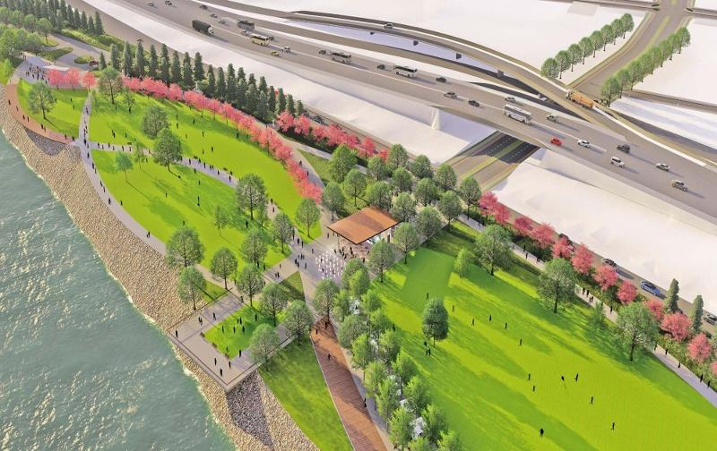
Presenters
Michelle Bostinelos, Executive Director – SIMPCO
David Carney,P.E., Public Works Director – City of Sioux City
Mark Nahra, P.E., Woodbury County Engineer
Marty Dougherty, Economic & Community Development Director – City of Sioux City
Mike Collett, Assistant City Manager, Airport & Transit Director – City of Sioux City
Barbara Sloniker, Executive Vice President – Siouxland Chamber of Commerce
Notes:
Michelle

Slide 3
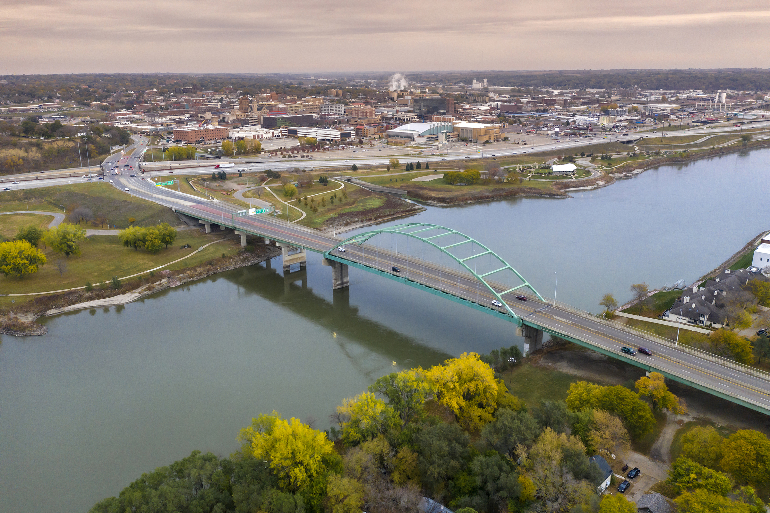
Overview
Gordon Drive Viaduct
Southbridge Interchange & Business Park
Sioux Gateway Airport/Brigadier General Bud Day Field
Regional Trails
Photo Credit: Howard R. Green
Notes:
Michelle

Slide 4
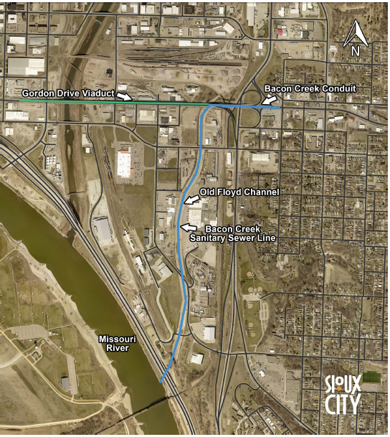
Gordon Drive Viaduct
Originally constructed in 1936
Improved in 1963 and 1966
Iowa’s longest grade separation
Length: 3970 ft.
Width: 56 ft. wide
Replacement will be in conjunction with Bacon Creek conduit which was built in 1909
Key arterial in transportation rich zone
Pedestrians
Vehicles
Railroads
Carries 25,000 vehicles daily
Structure is in critical need of replacement
Estimated cost of replacement: $110 million
Notes:
Dave
Thank you for meeting and working with us
The IDOT spent $5 million in the mid 2000s to repave the driving surface and address some structural issues.
Structure in critical need of replacement (fracture critical)

Slide 5
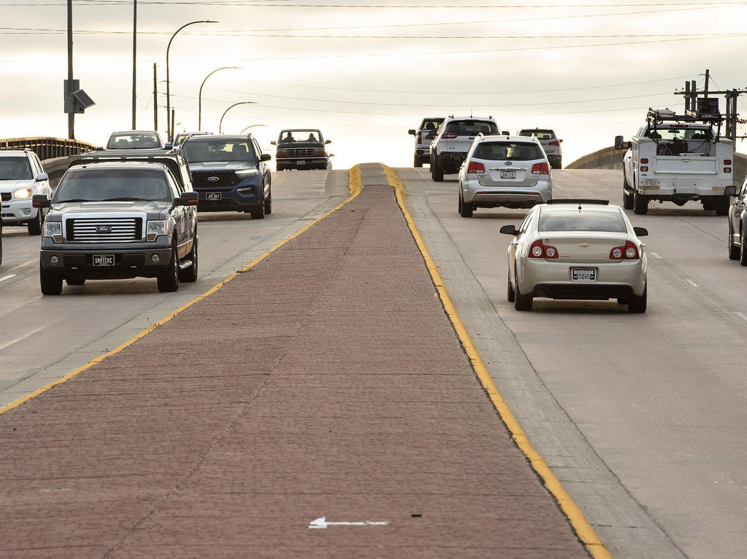
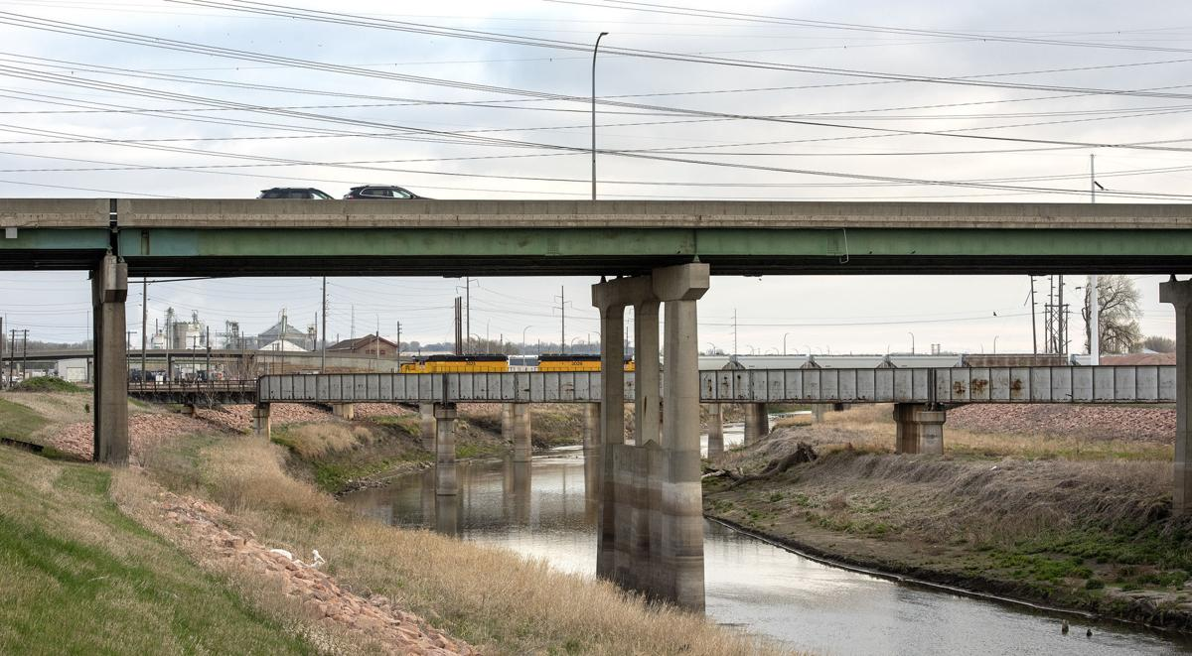
Gordon Drive Viaduct
Serves as a regional connection for emergency services, economic development, and overall mobility for vehicles, pedestrians, and rail
Connects east and west sides of Sioux City
Critical to get funding in place now
Partners should make every effort to take advantage of Federal funding through IIJA
Photo Credit: Sioux City Journal
Notes:
Dave
This should be the highest priority bridge replacement in Iowa

Slide 6
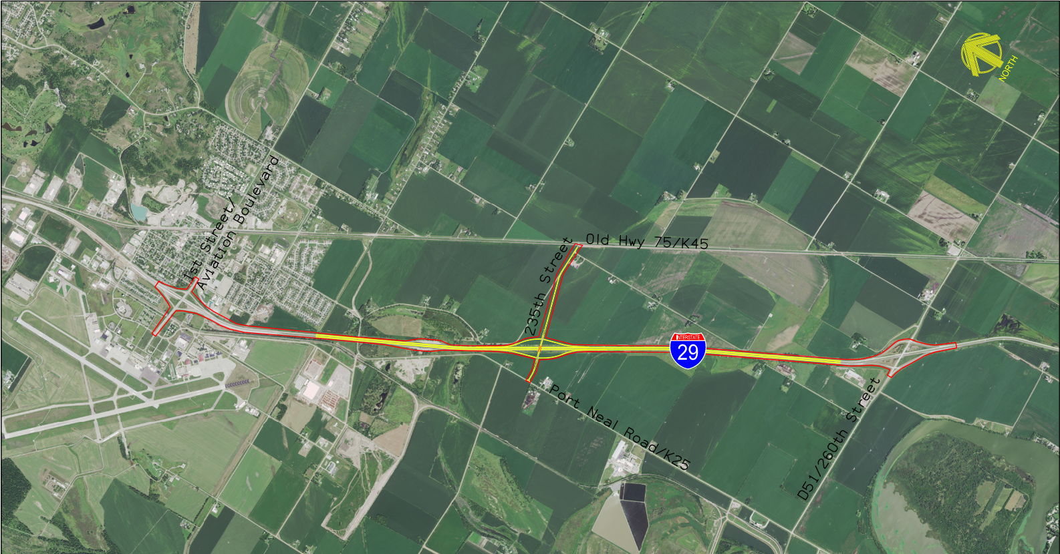
Southbridge Interchange
Proposed interchange on I-29 located south of Sioux City between Airport/Sergeant Bluff and Port Neal interchanges
Submitted IJR to FHWA on October 15, 2021
Estimated $25 million for land acquisition and construction
FY 2027 Right-of-Way acquisitions
FY 2028 Construction of interchange and approach roads
Currently waiting for FHWA to approve Interchange Justification Report
Notes:
Mark

Slide 7
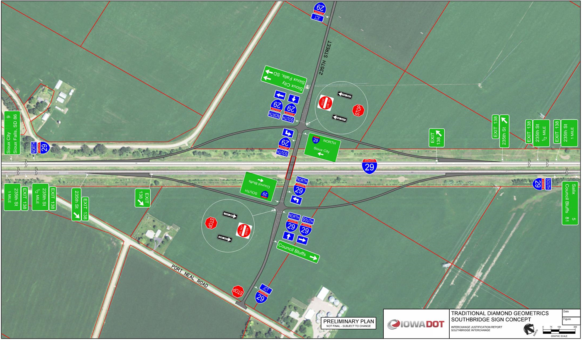
Southbridge Interchange
Once the IJR is approved, Woodbury County will be requesting that Iowa Transportation Commission direct staff to draft a 28E agreement for design and construction of the interchange.
The County requests that the Iowa DOT undertake consultant selection, project design, right of way needs determination and acquisition, and construction administration.
The County will also be requesting assistance in obtaining any available federal or state funds to assist with construction costs.
Notes:
Mark

Slide 8
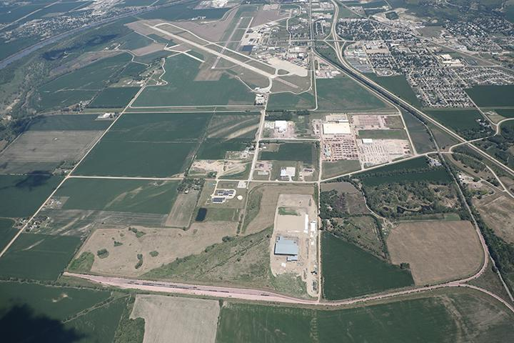
Southbridge Business Park
Notes:
Marty
RISE Grants
Alicia Ave (new)
Andrew Ave (new)
255th Street/CF Industries Drive improvements (2016)
Al Haynes Drive
260th Street

Slide 9
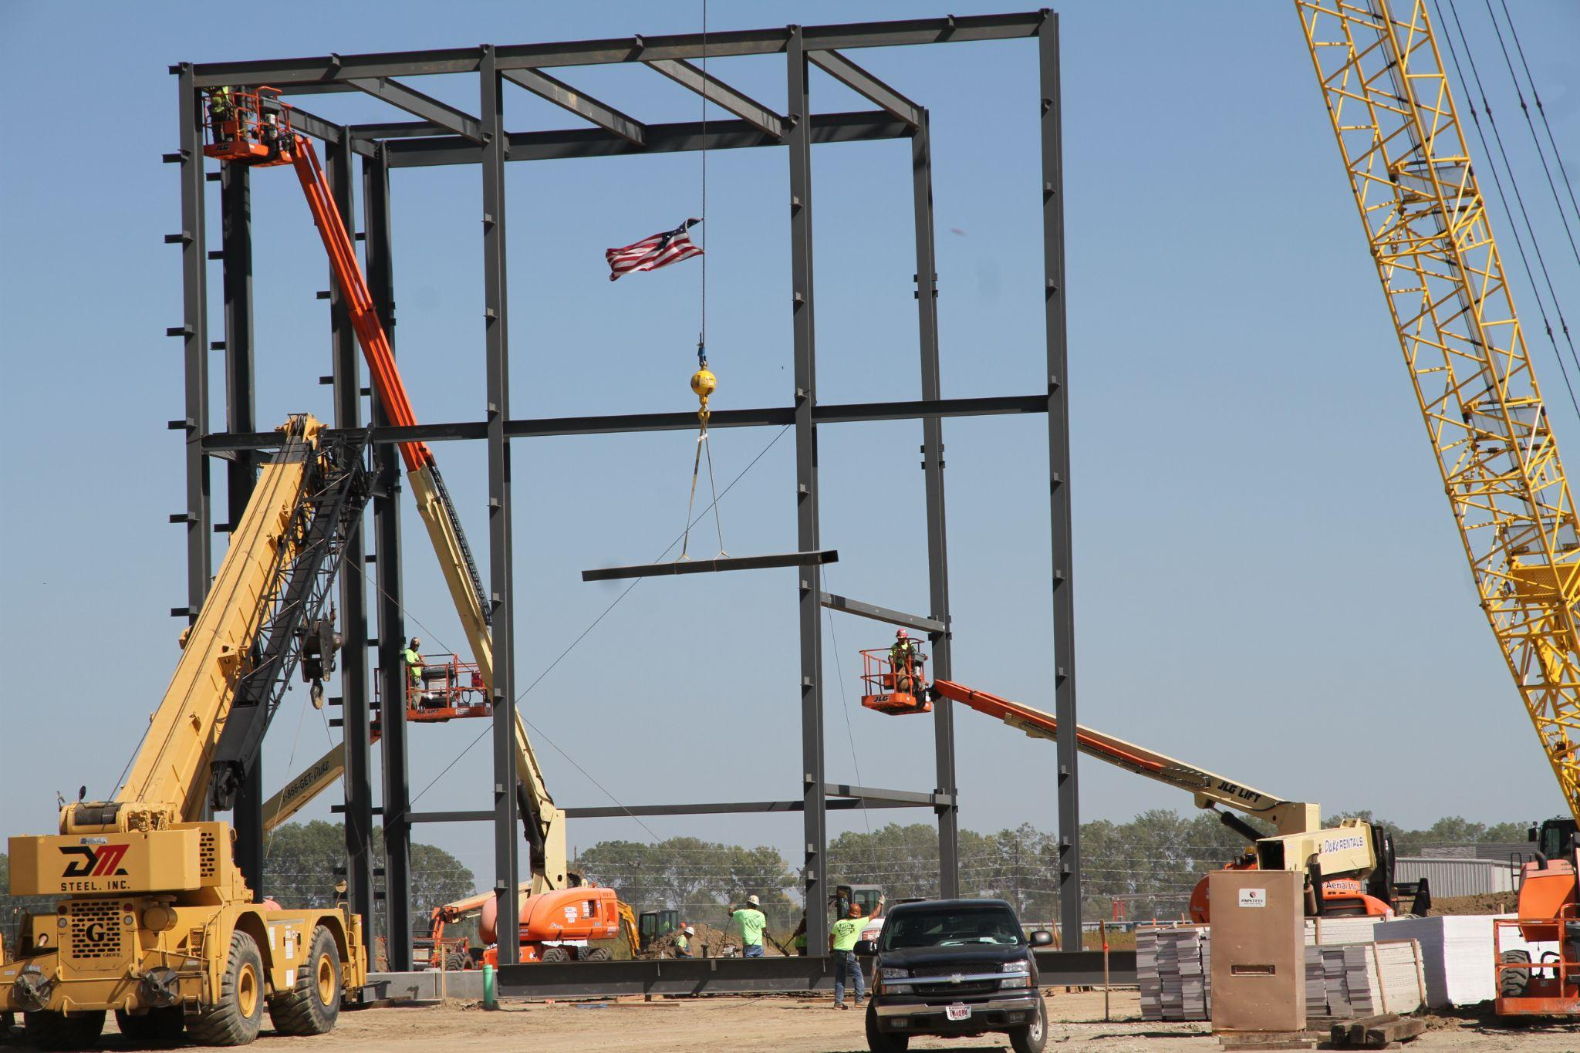
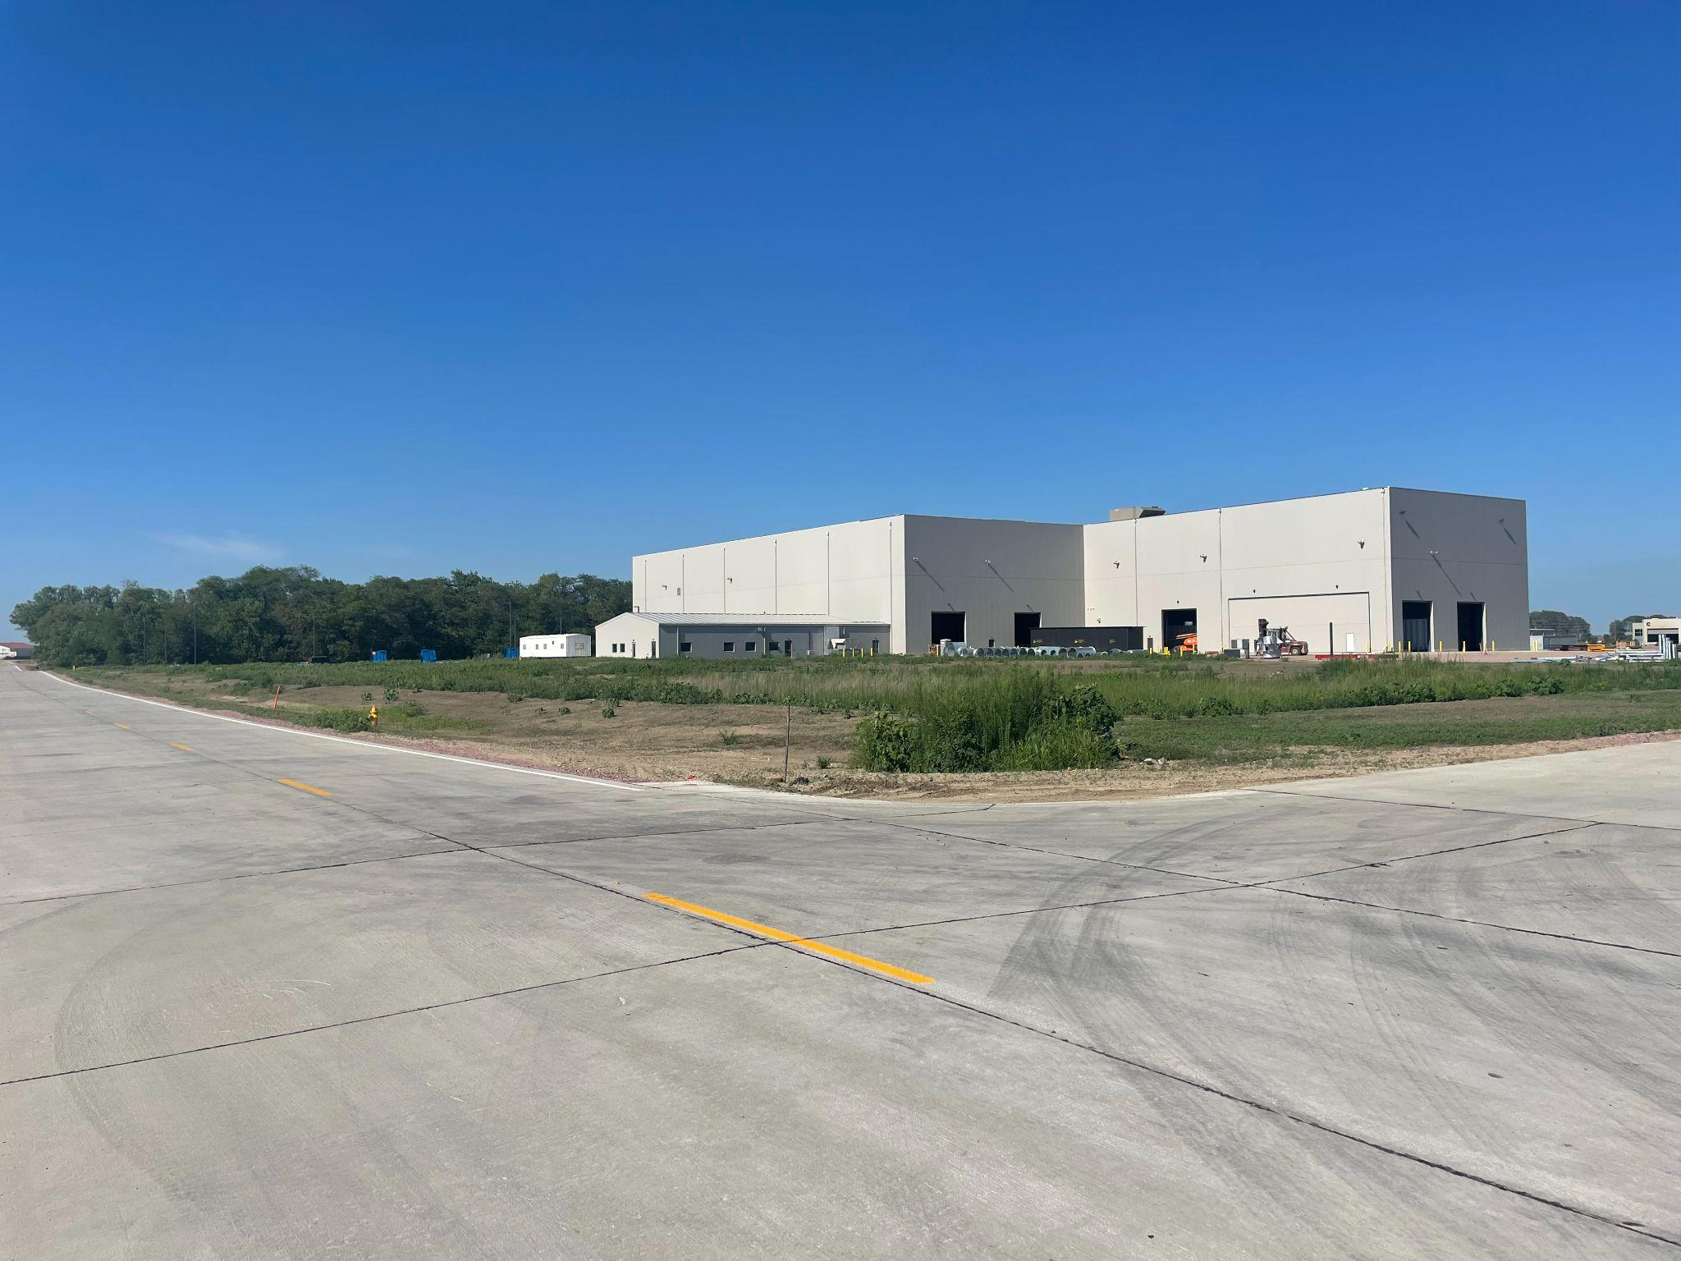
Southbridge Business Park
Sabre Industries Galvanizer Expansion
101,000 SF
76 new jobs
$25M capital investment
Andrew Avenue
$1.3M road improvement
50% RISE
Notes:
Marty
RISE Grants
Alicia Ave (new)
Andrew Ave (new)
255th Street/CF Industries Drive improvements (2016)
Al Haynes Drive
260th Street

Slide 10
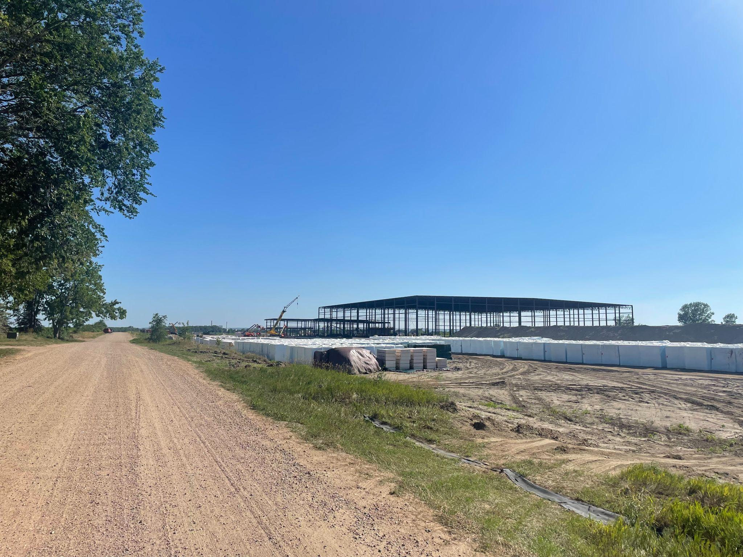
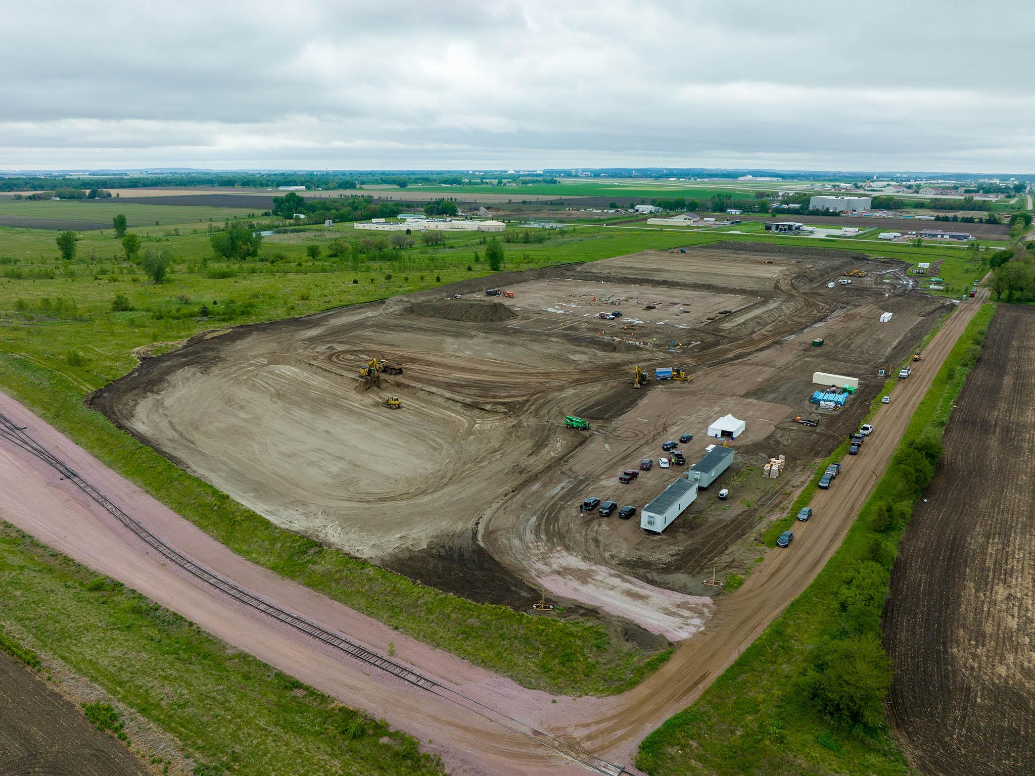
Southbridge Business Park
Cold-Link new cold storage facility
185,000 SF (Phase II - addn 300,000 SF)
60 new jobs
$56M capital investment
Alicia Avenue
$2.6M road improvement
80% RISE
Industrial Rail Spur
$1.375M new rail spur
50% RRLG grant
Notes:
Marty
RISE Grants
Alicia Ave (new)
Andrew Ave (new)
255th Street/CF Industries Drive improvements (2016)
Al Haynes Drive
260th Street

Slide 11
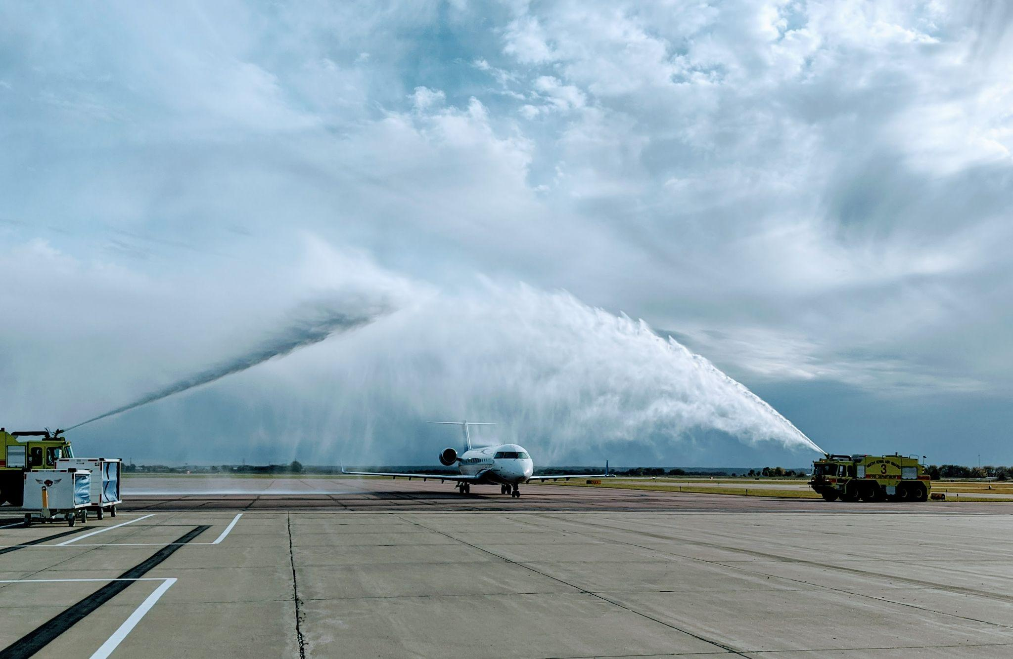
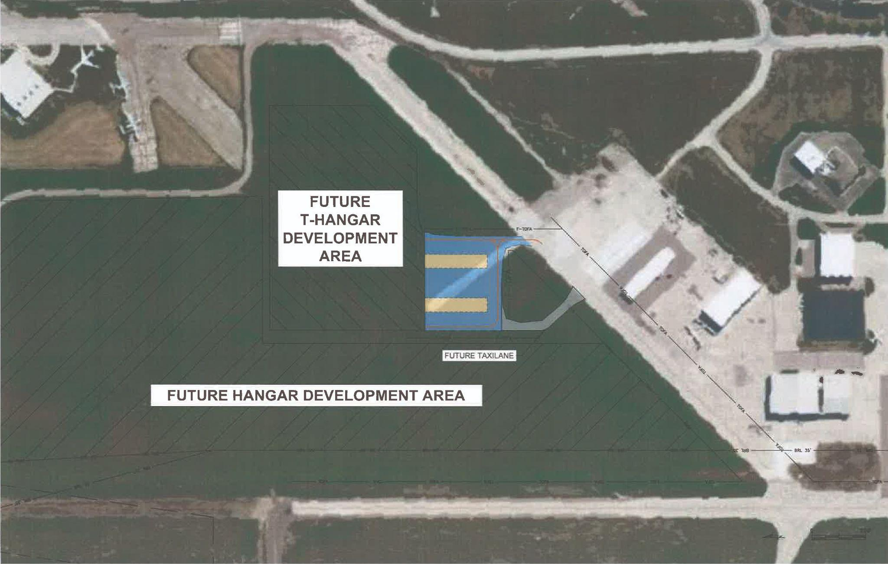
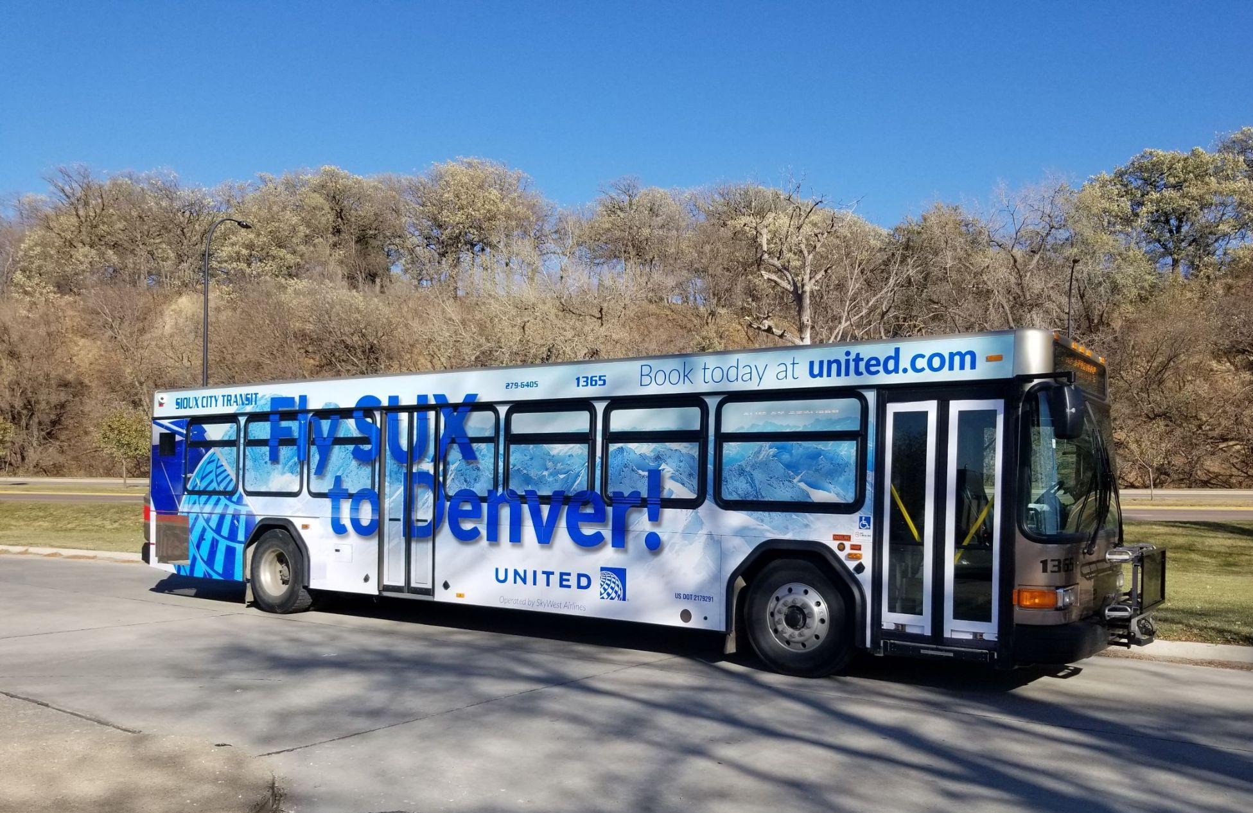
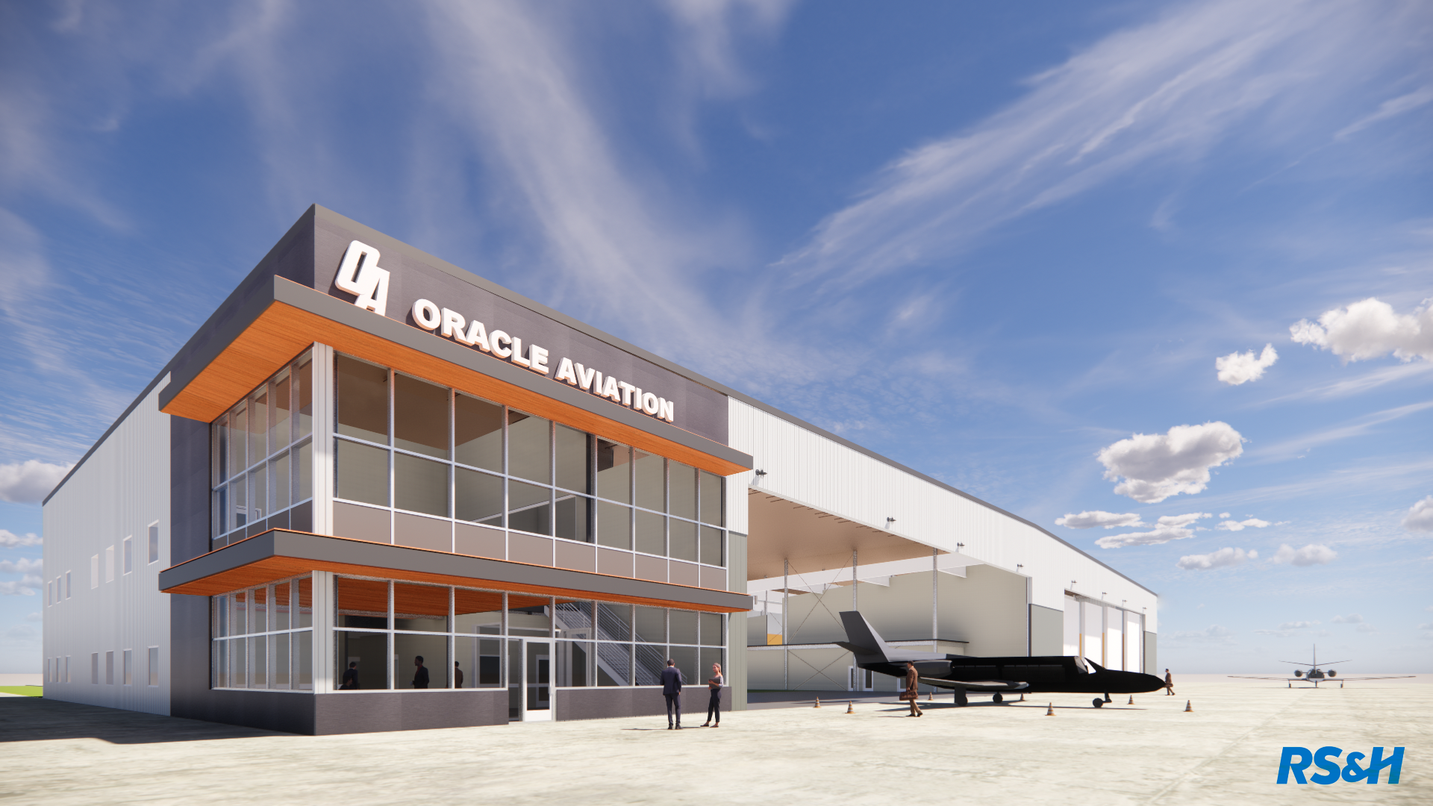
Sioux Gateway Airport/Brig Gen Bud Day Field
Recently received $3.15 million grant from the Iowa Commercial Aviation Infrastructure Fund (ICAIF) for the development of the north t-hangar project
Commercial Service Vertical Infrastructure (CSVI) funding
Air Service Development (ASD) funding for marketing
Airport Improvement Program (AIP) funding
Essential Air Service
Chicago
Denver
Recent activity
Runway 13-31 rehabilitation
Oracle Aviation
Revv Aviation
Notes:
Mike

Slide 12
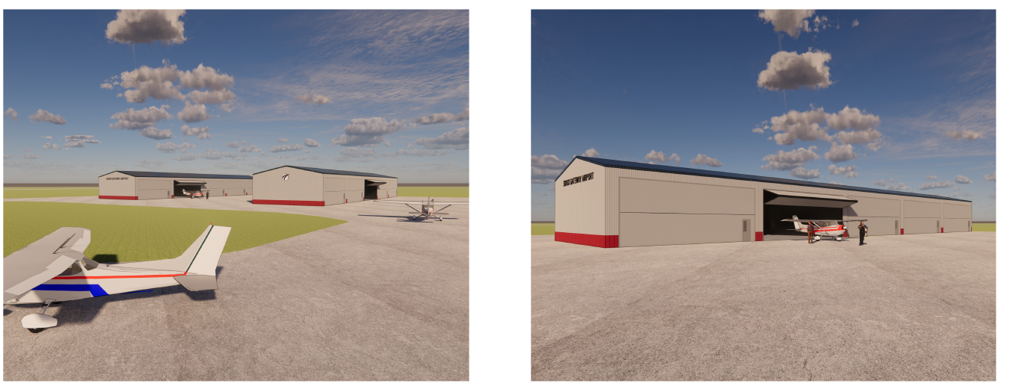
Sioux Gateway Airport/Brig Gen Bud Day Field
Notes:
Mike

Slide 13
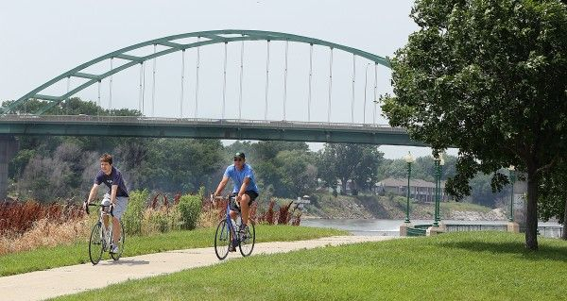
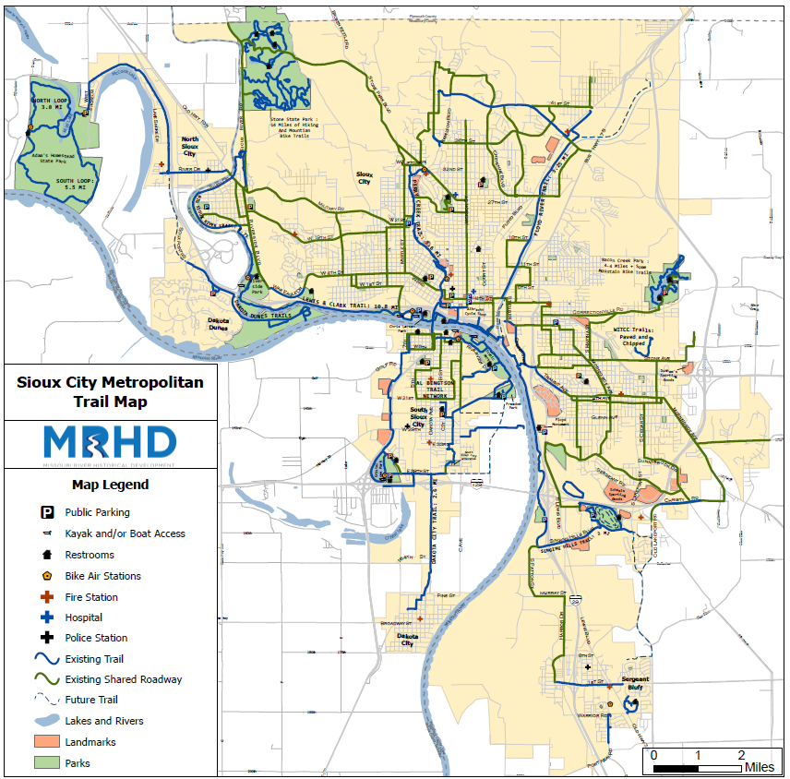
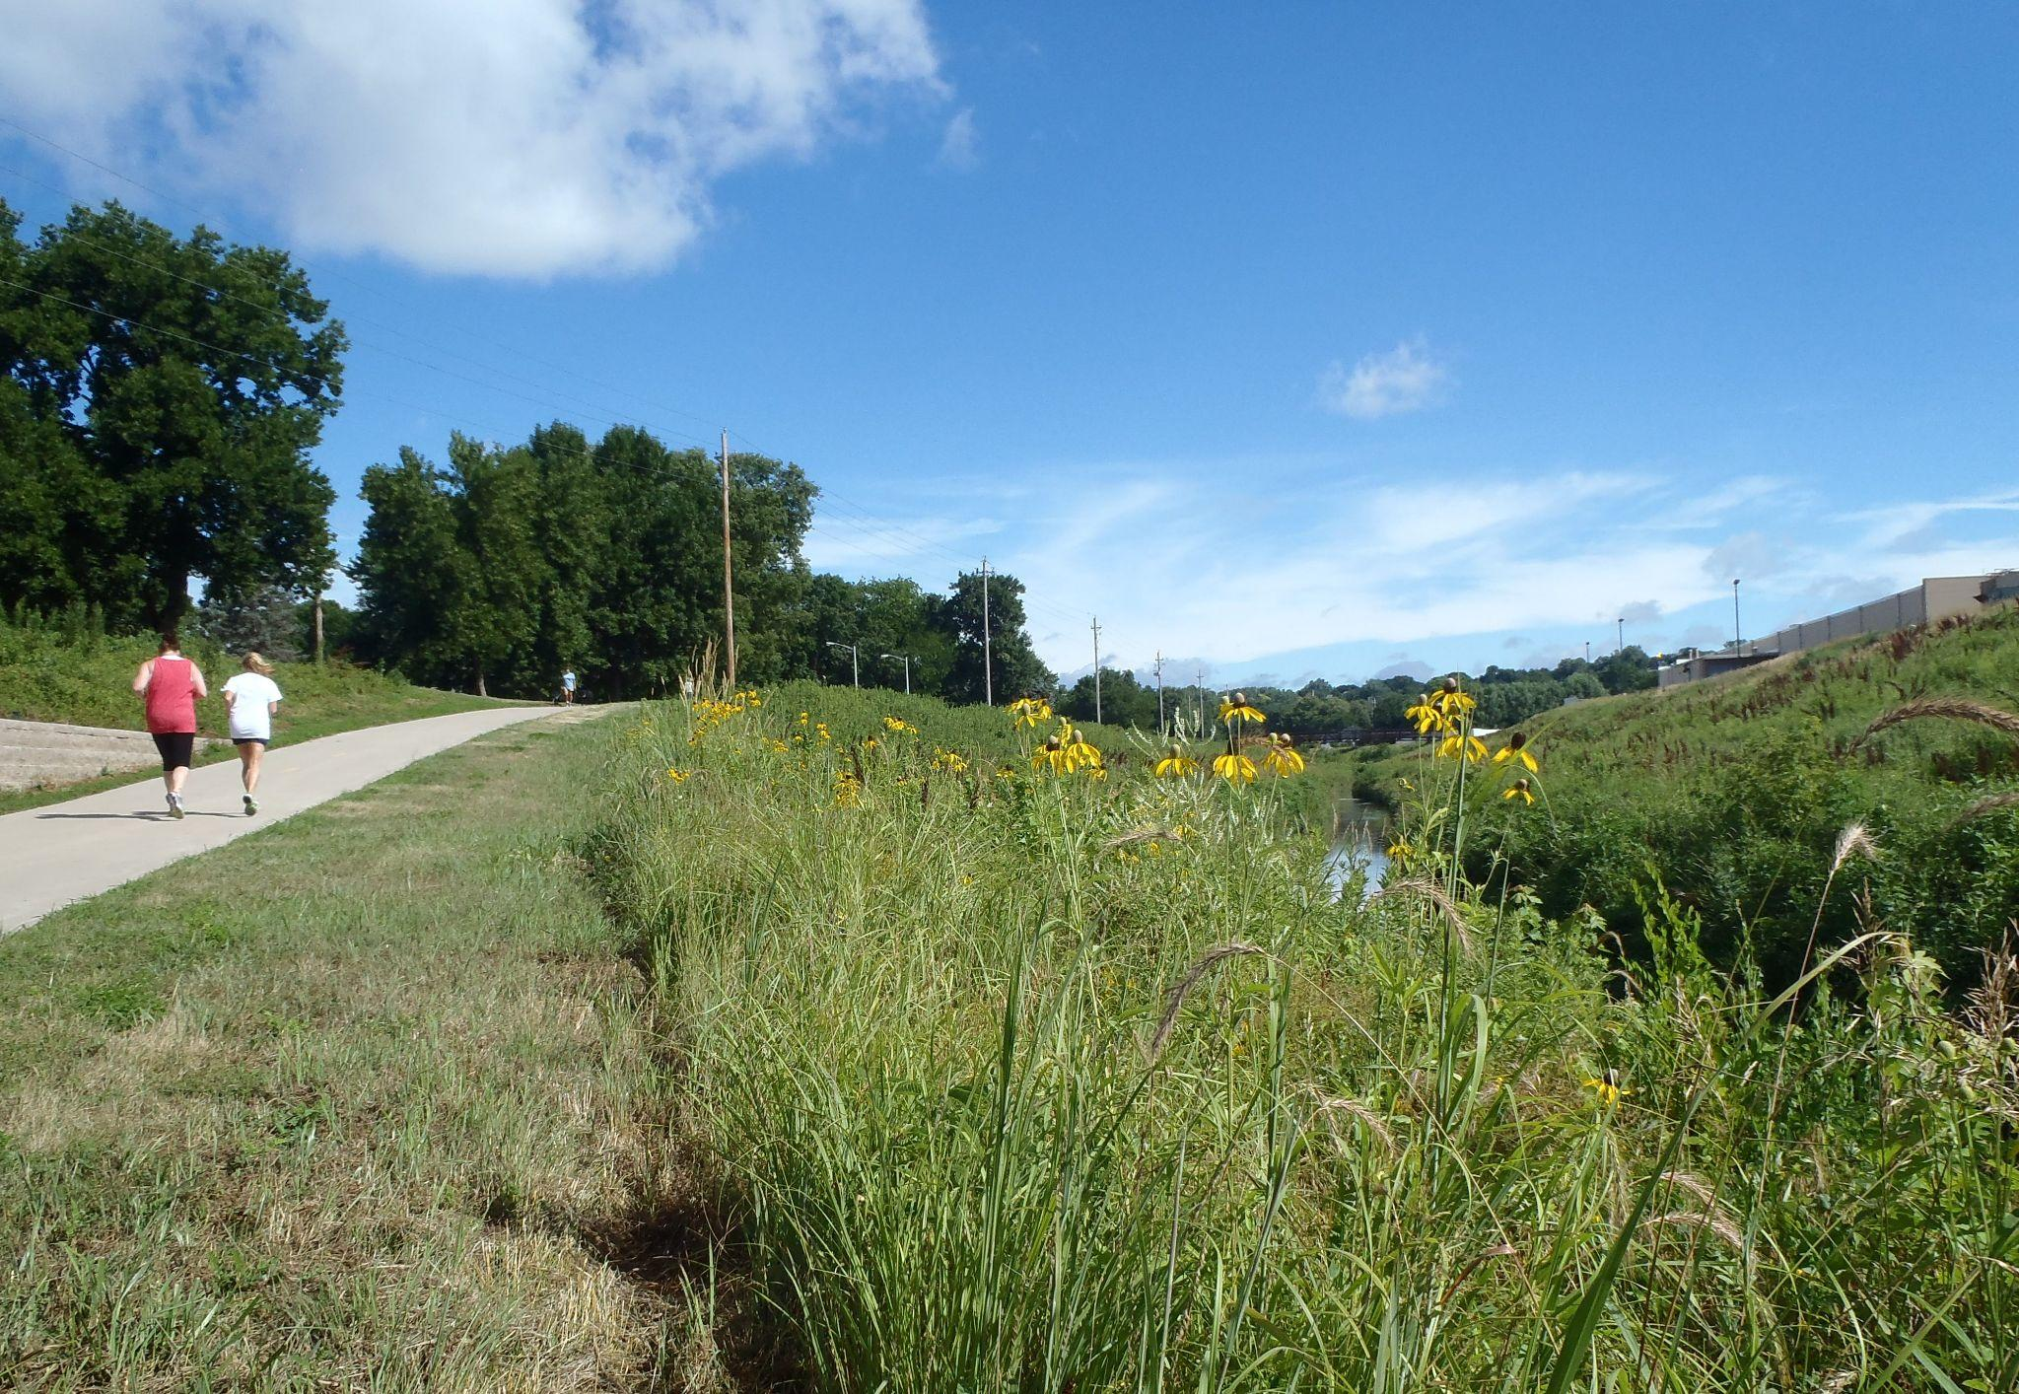
Trails
Sioux City trails - 34.6 miles
Priorities
Close gaps
Create larger regional trail system
Add 25.9 miles of trails
Destination Iowa - $7 million award
Connect Sergeant Bluff, Sioux City, Hinton, Merrill, & Le Mars
Plywood Trail
Cone Mountain Bike Park
9 miles of trails
Beginner to advanced
Construction planned for 2023
Notes:
Barbara
Trails are MUST HAVE quality of life amenity
Tri-state trail system-makes us unique
Link to regional trail systems in Nebraska and South Dakota
Destination Iowa
1st project awarded - 1st submitted - deadline at 12:01 am
$100 Million overall - 3 categories - we did Outdoor Recreation Fund is $40 million overall - we got $7 million
Funding is on a reimbursement basis
5 trials which includes 8 projects
project timeline - all completed by Spring 2026
start in Fall 2022 with Plywood Phase 1 - followed by Spring 2023 Plywood Phase 2
Spring 2023 - Cone Park Mountain Bike Park - IMBA - nothing like it anywhere near here - Bentonville
Summer 2023 with Big Sioux River pedestrian bridge (connects Iowa to SD)
Spring 2024 - Loess Hills - Sgt Bluff and Sioux City
Spring 2025 - Plywood Phase 3 Hinton
Thank you for Plywood Trail funding earlier this year- $300,000 - you will hear from them later
Cone Mountain Bike Park
$2.8 million project
Nothing like this close - Bentonville, AR
IMBA designing it
pump track

Slide 14
Thank You!
Mark Nahra, P.E.
Woodbury County
mnahra@woodburycountyiowa.gov
Mike Collett
City of Sioux City
mcollett@sioux-city.org
Barbara Sloniker
Siouxland Chamber of Commerce
bsloniker@siouxlandchamber.com
Contact:
Michelle Bostinelos
SIMPCO
MBostinelos@simpco.org
David Carney, P.E.
City of Sioux City
dcarney@sioux-city.org
Marty Dougherty
City of Sioux City
mdougherty@sioux-city.org
Notes:
Michelle

