Slide 1
A Bicycle & Pedestrian Trail Project Between Plymouth & Woodbury Counties
August 2022

Slide 2
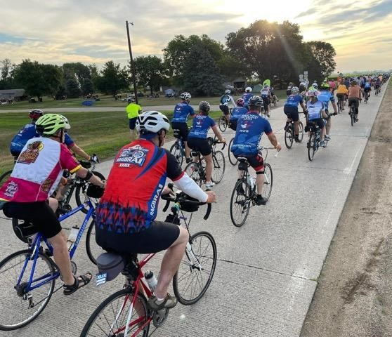
BACKGROUND
Sioux City represents the largest Iowa community without a trail connection to a neighboring Iowa town.
PlyWood Trail will provide a long-desired connection between the communities of Le Mars, Merrill, Hinton and Sioux City across two major rivers to two adjoining States.
PlyWood Trail Advisory Board and Executive Committee formed in 2015 to advance the development of the Trail.
Trails are an essential piece of growing communities – health and well-being, quality of life, economic and workforce development….
RAGBRAI 2022 – Leaving Sgt. Bluff

Slide 3
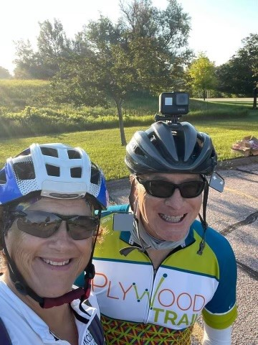
People want: Water and Trails
The Opportunity:
To create an extraordinary, unique regional Tri-State
Trail network.

Slide 4
Fundraising – Where We Are Today
$5,018,300 commitment from Destination Iowa Grant Program
$1M commitment from Le Mars Betterment Foundation
$2M commitment from Wells Enterprises and Mike & Cheryl Wells
$150K from Schuster Trucking and Steve & Danna Schuster
$875K from the City of Sioux City
$300,000 IDOT Fed Rec Trails Grant
$25,000 from Greg and Teri Grupp
$25,000 from Empirical Foods
In addition, several individual donors along with Plymouth County Cyclists have stepped up, including members of the Trail committee.

Slide 5
Trail Design
Trail Segments:
Connection 1 - Le Mars to Merrill
Connection 2 - Merrill to Hinton
Connection 3 - Hinton to Sioux City
Completed trail will be 16 miles

Slide 6
Connection 1 – Le Mars to Merrill (1a)
Connection 1 (Phase 1a) – work started in Merrill for bridge, ¼ mile trail & trailhead in 2022
Funding complete
Anticipate completion spring of 2023

Slide 8
Connection 1 – Le Mars to Merrill (1b)
Connection 1 (Phase 1b) – 3-mile concrete trail connecting Le Mars and Merrill
Funding complete
Bid and kickoff early 2023
Anticipate completion fall of 2023

Slide 9
Phase 1b Trail Location

Slide 10
Connection 3 – Sioux City to Hinton
Connection 3 – 6.6-mile concrete trail connecting Sioux City to Hinton
City of Sioux City funding via Destination Iowa and private donors
Letting December 2024 - spring 2025 construction

Slide 11
Connection 2 – Merrill to Hinton
Connection 2 – 6-mile concrete trail
Route still being determined – east side or west side of Hwy 75
Large bridge in Merrill, multiple smaller bridges along the route, grade separated crossing north of Hinton
Completion – TBD dependent on cost and fundraising.

Slide 12
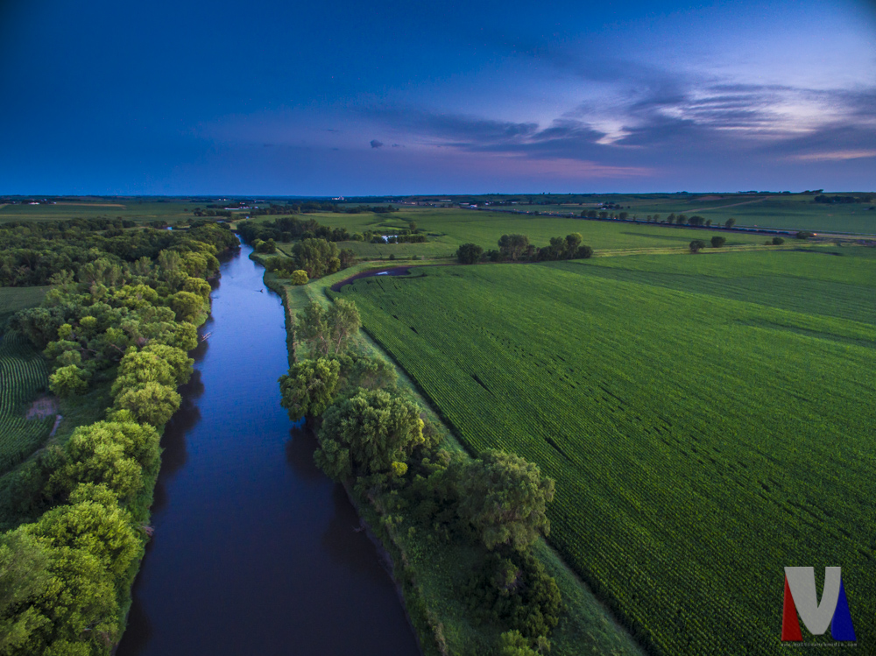
Need IDOT input for Connection 2 – Merrill to Hinton
Determine best corridor to follow
Hwy 75 grade separated crossing near Merrill
Multiple bridge crossings between Merrill and Hinton
Hwy 75 grade separated crossing north of Hinton
Floyd River Valley, looking toward Hinton

Slide 13
Contact Information
PlyWood Trail, Inc.
PO Box 31
Le Mars, IA 51031-0031
plywoodtrail@gmail.com
plywoodtrail.org
The PlyWood Trail Foundation is recognized as a 501(c)(3) non-profit organization, EIN 81-1756903.

