Slide 1
Revitalize Iowa’s Sound Economy Program
Iowa Transportation Commission Business Meeting
August 9, 2022

Slide 2
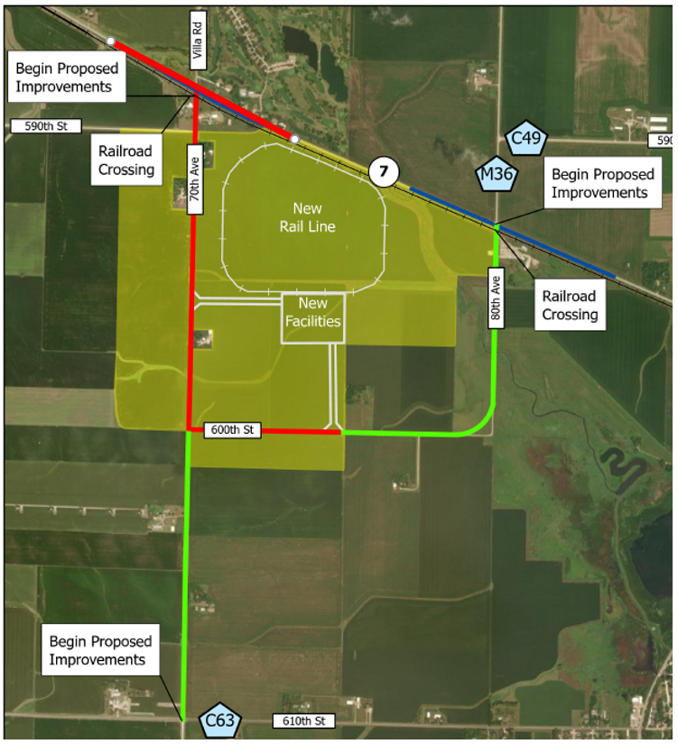
List of Local Development Applications Recommended
PROJECT NAME
SPONSOR
SCORE
TOTAL PROJECT COST
PERCENT PARTICIPATION
RECOMMENDED AMOUNT
Paving of approximately 6,020 feet of 70th Avenue and 2,640 feet of 600th Street and construction of turn lanes at Iowa 7 and 70th Avenue located northwest of Storm Lake. | Buena Vista County | 73 | $6,565,982 | 50% | $3,282,991

Slide 3
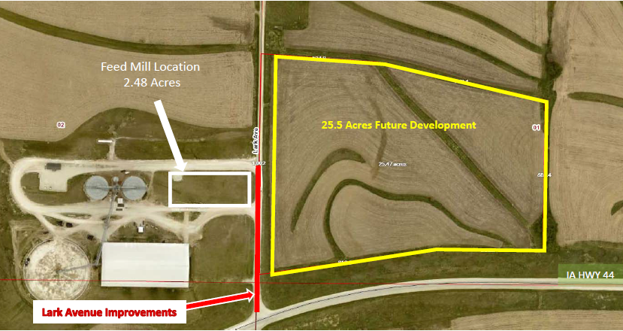
List of Local Development Applications Recommended
PROJECT NAME
SPONSOR
SCORE
TOTAL PROJECT COST
PERCENT PARTICIPATION
RECOMMENDED AMOUNT
Paving of approximately 815 feet of Lark Avenue located northeast of Hamlin. | Audubon County | 67 | $736,139 | 50% | $368,070

