Slide 1
Revitalize Iowa’s Sound Economy Program
Iowa Transportation Commission Workshop
August 9, 2022

Slide 2
Revitalize Iowa’s Sound Economy Program
Created in 1985
Purpose: To promote economic development through roadway improvements.
Eligible development shall have value-adding activities that feed new dollars into the economy
Available to cities and counties through an application program

Slide 3
Available Funding and Application Summary
Available Funding
Funded annually with dedicated state motor fuel and special fuel tax revenues
Application Summary for SFY2023
Total number of projects awarded: 1
Total project costs: $1,884,147
Total amount awarded: $942,074
 | CITY | COUNTY
Average funding generated monthly | $905,101 | $452,550
SFY 2023 estimated Road Use Tax Revenue for August 2022 | $1,810,202 | $905,100
Current Unobligated Balance (as of 6/30/2022) | $3,035,552.34 | $2,836,997.97

Slide 4
Local Development Project Evaluation Criteria
Development Potential (35 points)
Economic impact and Cost Effectiveness (20 points)
Local Commitment and Initiative (33 points)
Transportation Need and Justification (4 points)
Local Economic Need (6 points)

Slide 5
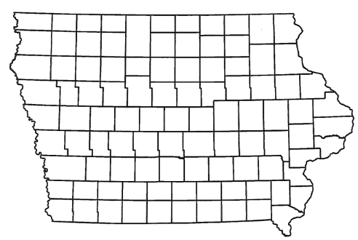
List of Local Development Applications Recommended
PROJECT NAME
SPONSOR
SCORE
TOTAL PROJECT COST
PERCENT PARTICIPATION
RECOMMENDED AMOUNT
Paving of approximately 6,020 feet of 70th Avenue and 2,640 feet of 600th Street and construction of turn lanes at Iowa 7 and 70th Avenue located northwest of Storm Lake. | Buena Vista County | 73 | $6,565,982 | 50% | $3,282,991
Paving of approximately 815 feet of Lark Avenue located northeast of Hamlin. | Audubon County | 67 | $736,139 | 50% | $368,070

Slide 6
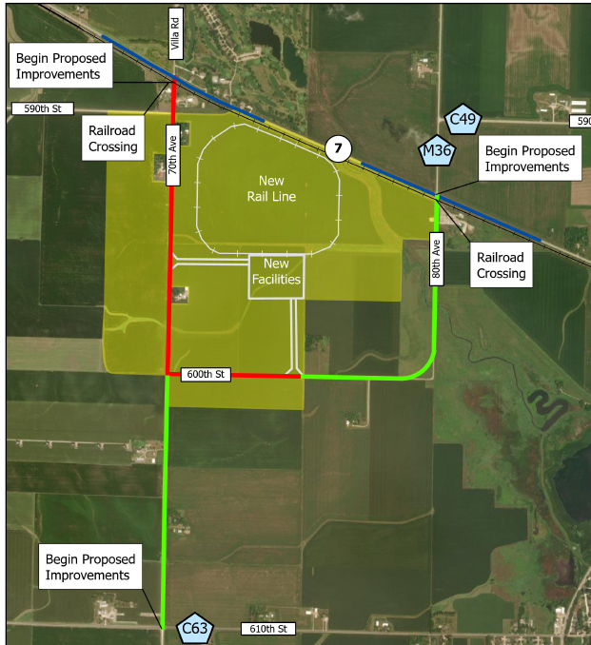
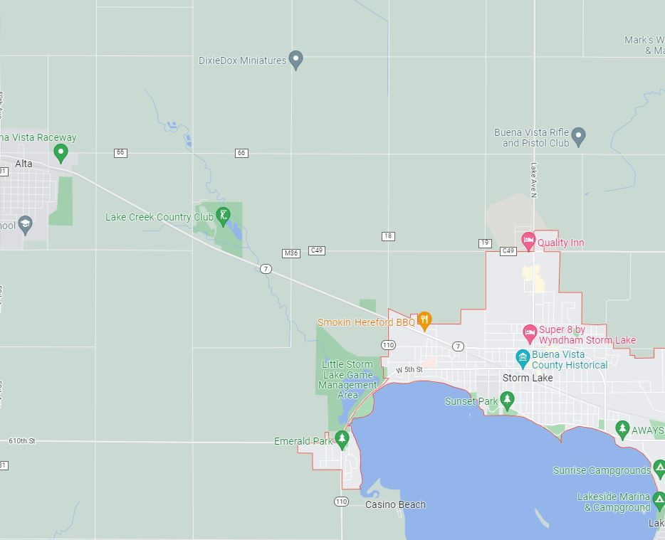
Buena Vista County
(Local Development)
Paving of approximately 6,020 feet of 70th Avenue and 2,640 feet of 600th Street and construction of turn lanes at Iowa 7 and 70th Avenue located northwest of Storm Lake. This project will provide improved access to more than 650 acres for industrial purposes.
Total Cost: $6,565,982
Requested: $3,282,991 (50%)

Slide 7
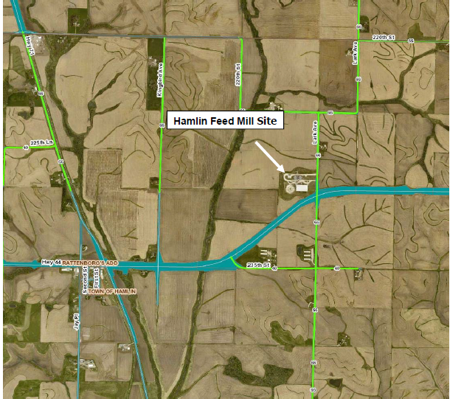
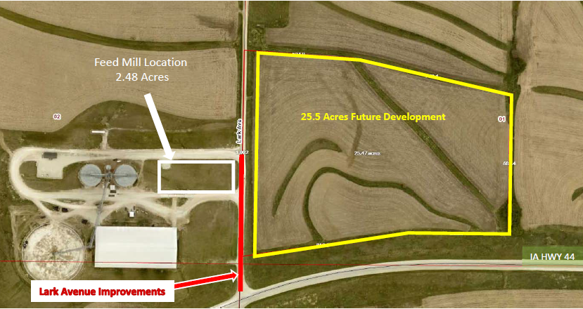
Audubon County
(Local Development)
Paving of approximately 815 feet of Lark Avenue located northeast of Hamlin. This project will provide improved access to more than 27 acres for industrial purposes.
Total Cost: $736,139
Requested: $368,070 (50%)

Slide 8
QUESTIONS?
Craig Markley, Systems Planning Bureau
craig.markley@iowadot.us
515-239-1027

