Slide 1
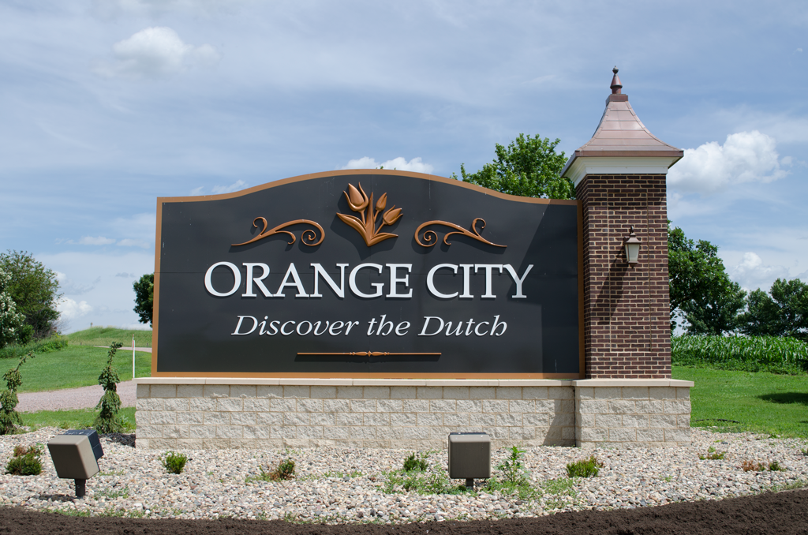
Iowa Transportation Commission Meeting
August 9, 2022

Slide 2
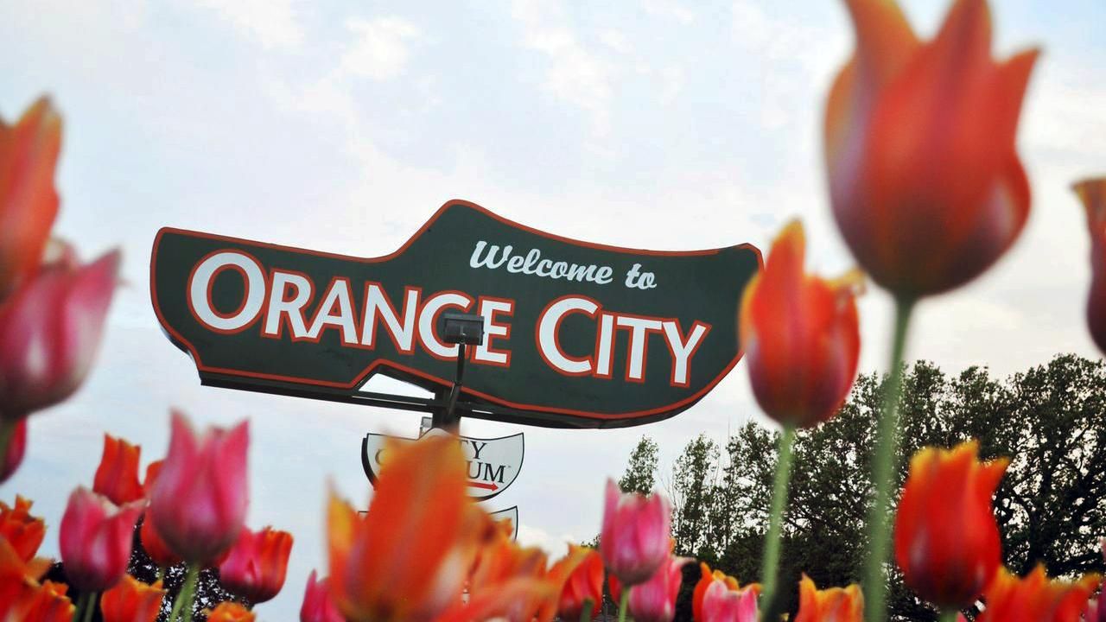

Slide 3
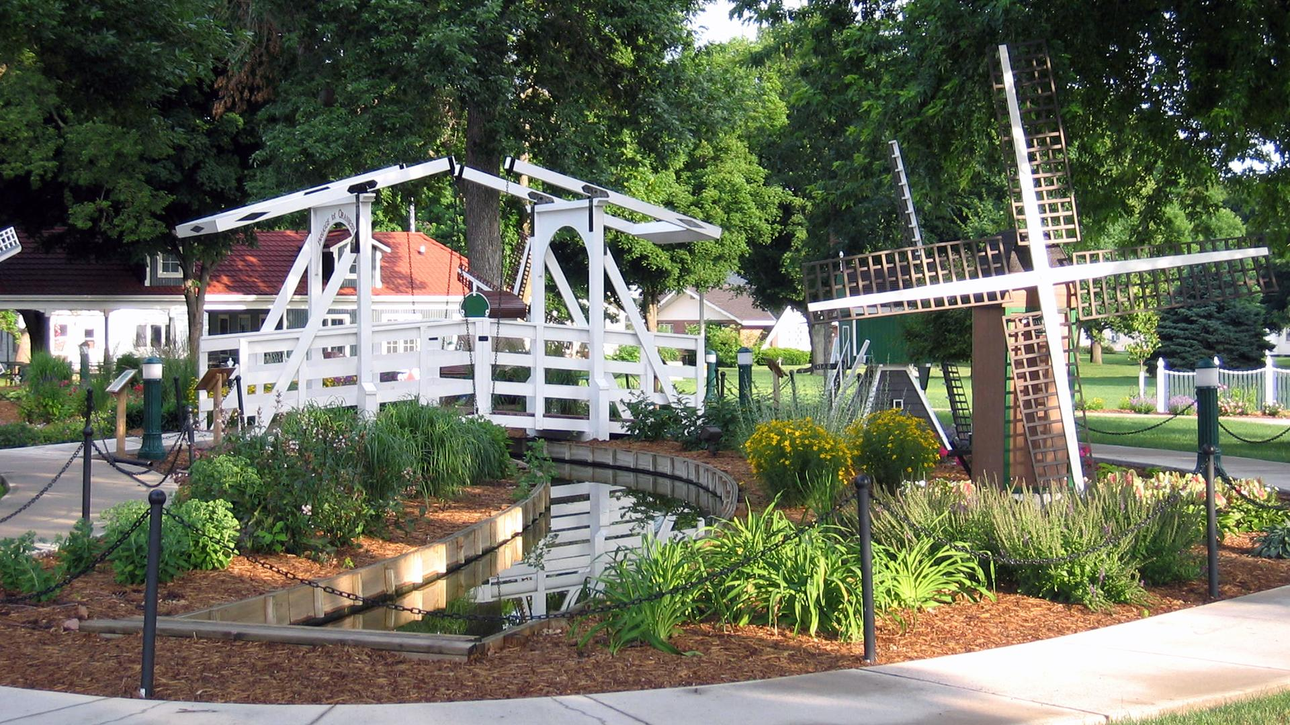

Slide 4
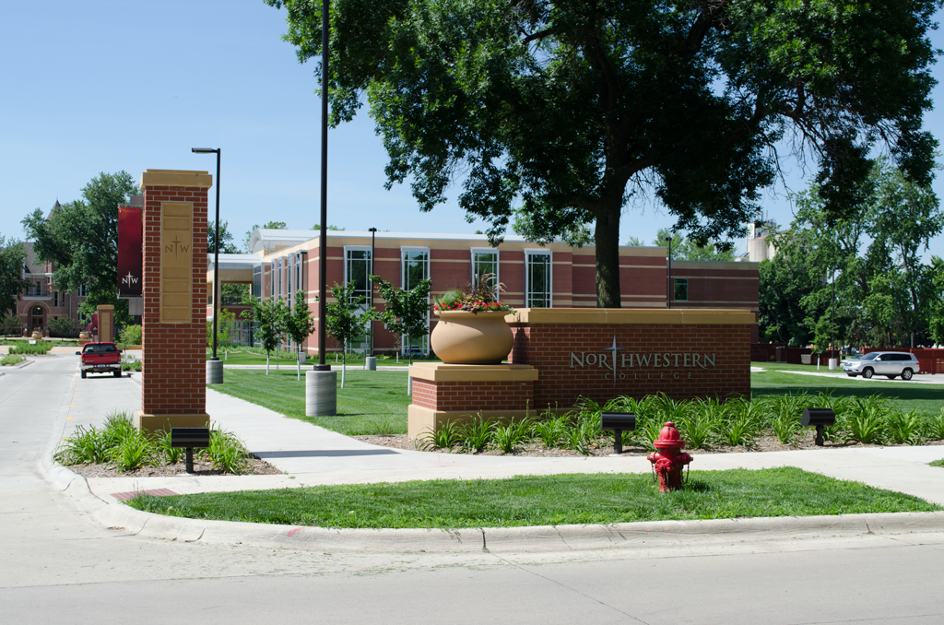

Slide 5
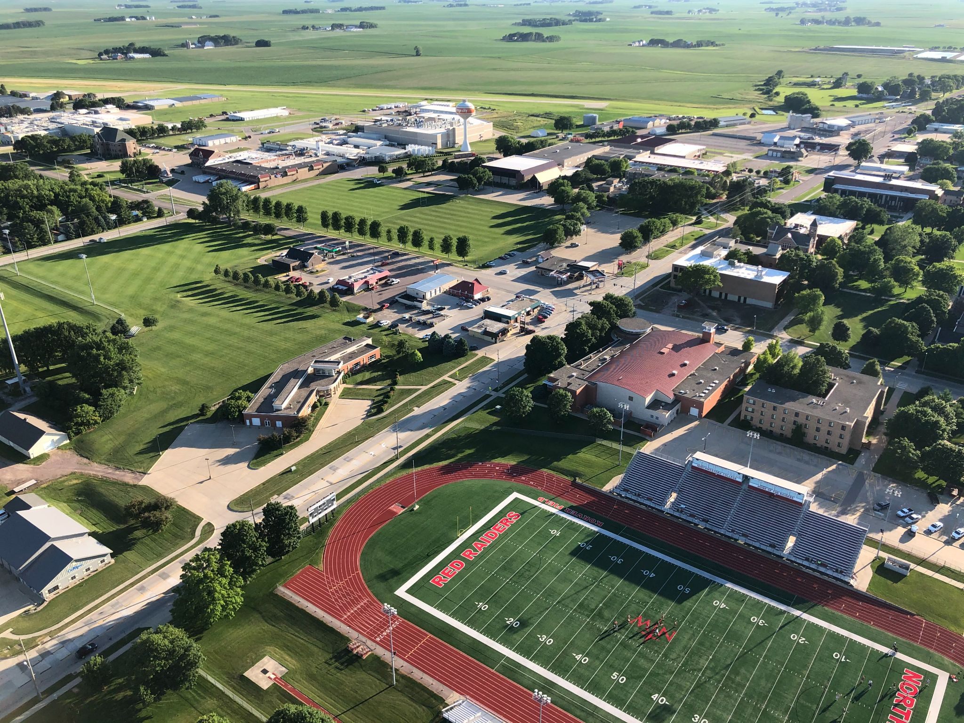

Slide 6
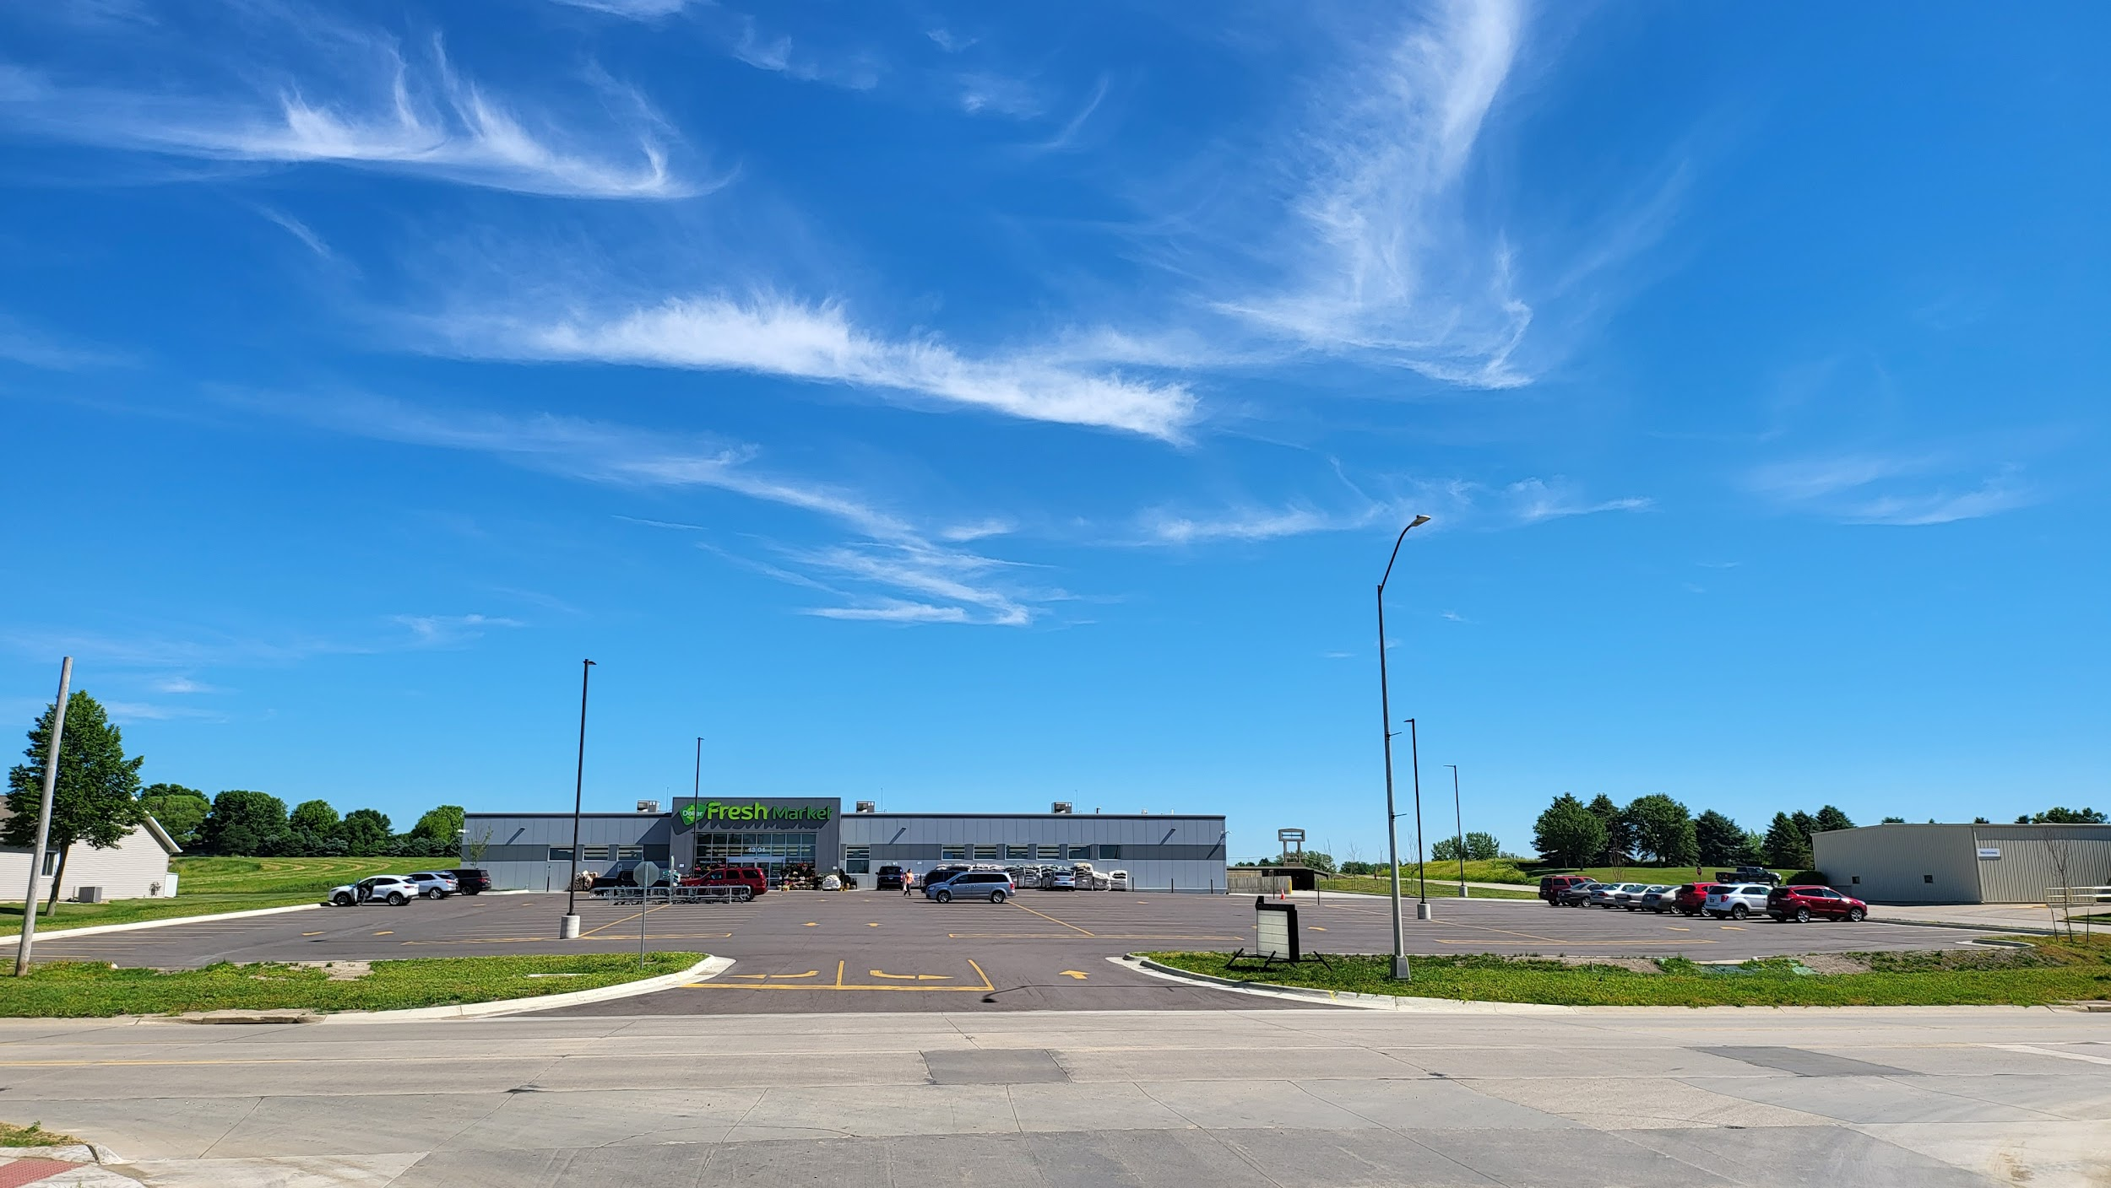
Dollar Fresh

Slide 7
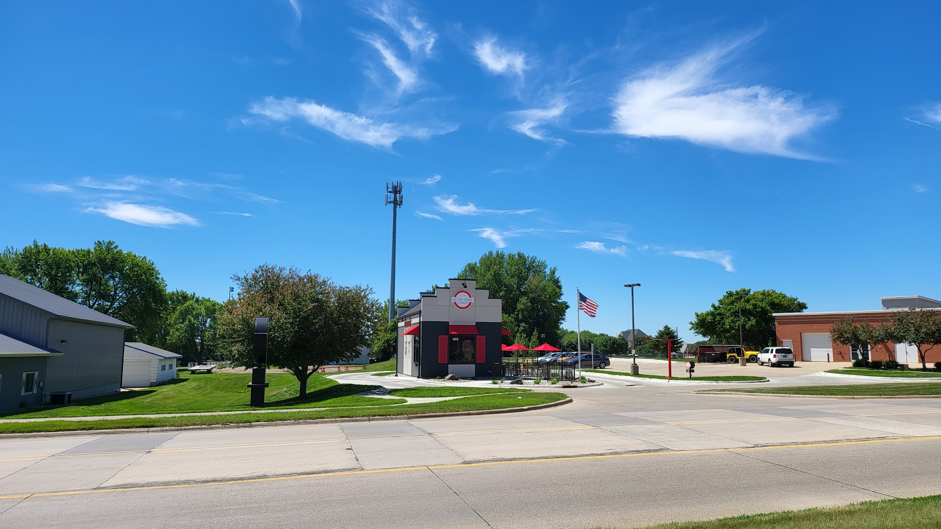
Scooter’s Coffee

Slide 8
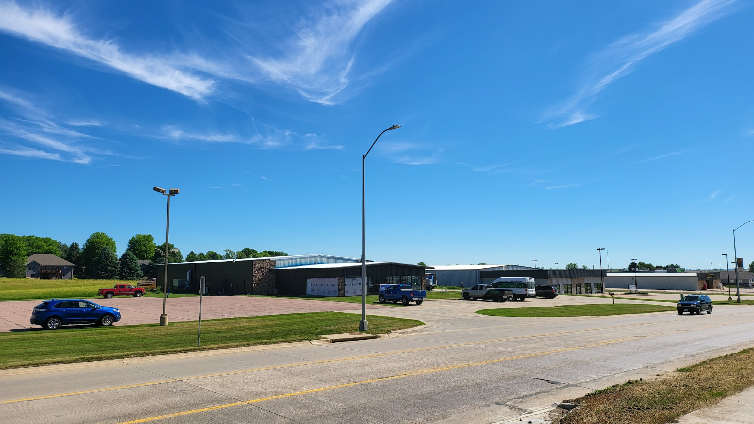
D&L Plumbing & Heating Development

Slide 9
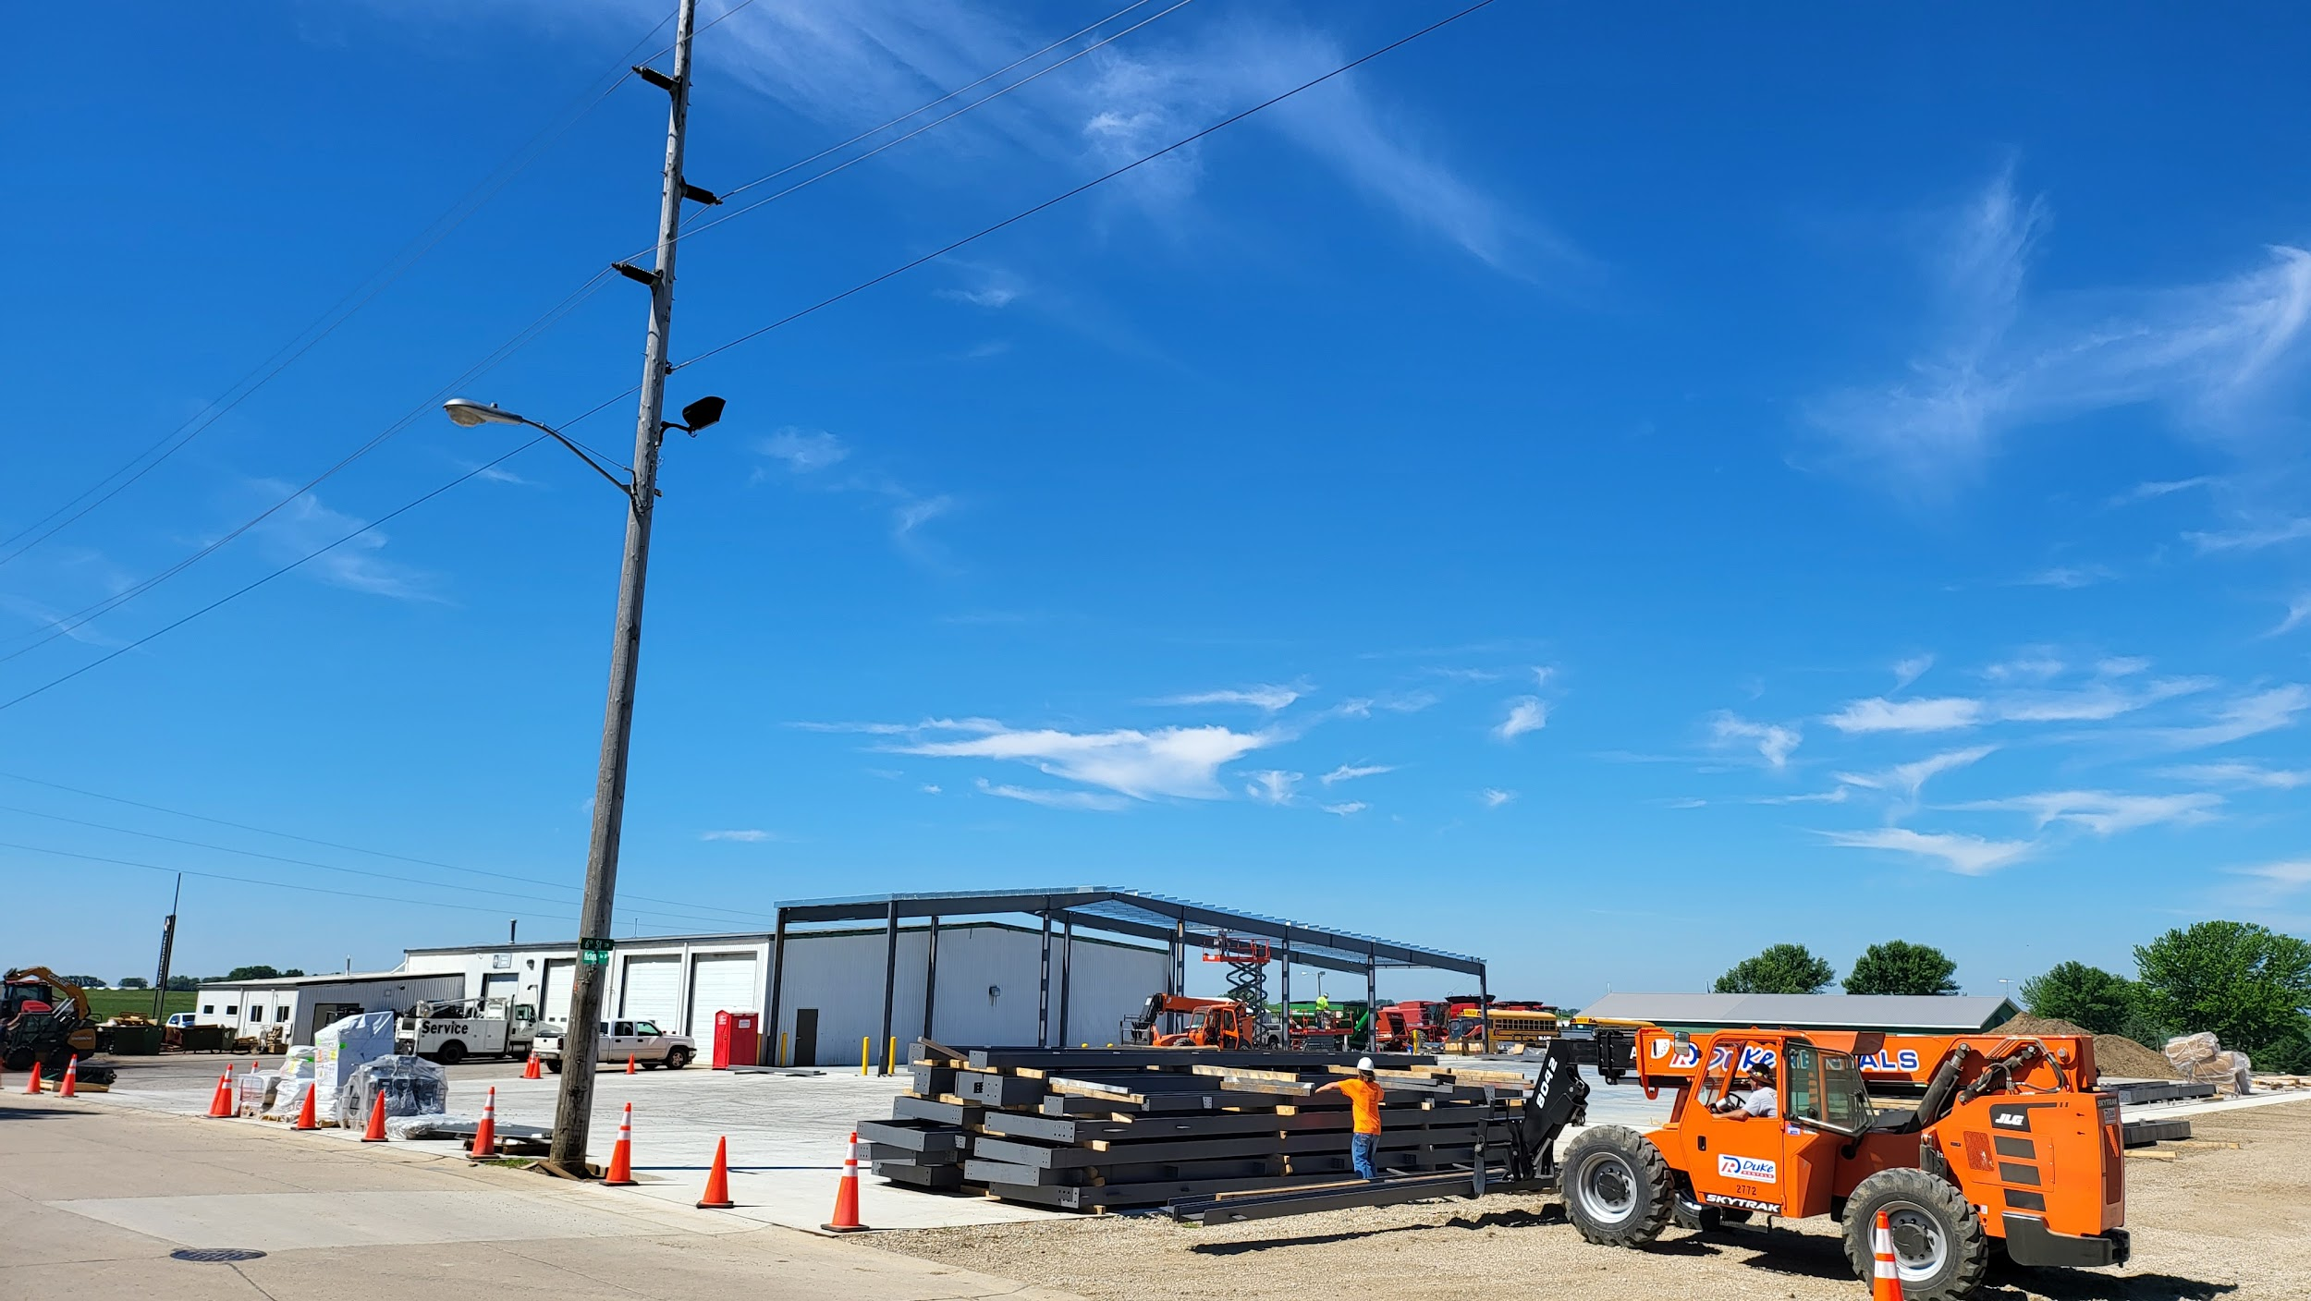
Town & Country
Implement Expansion

Slide 10
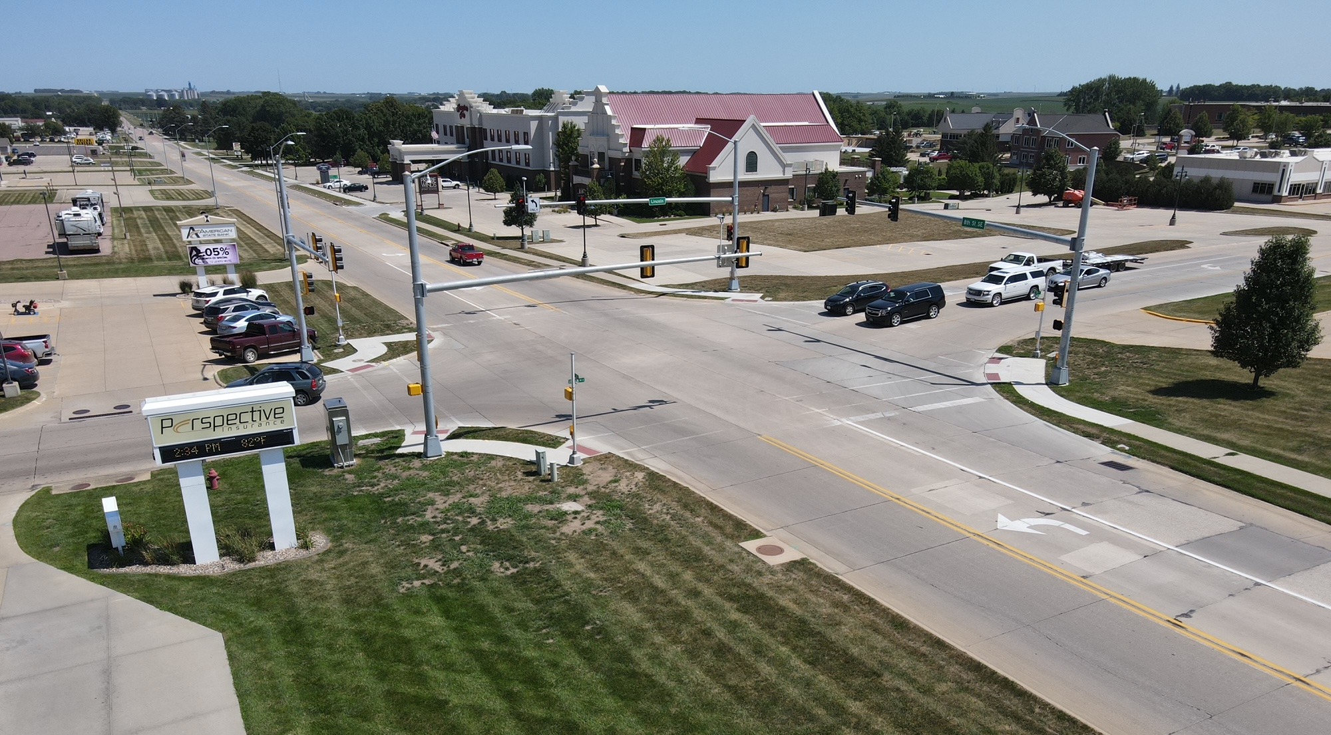
Lincoln Ave Signal Light
TSIP Funding

Slide 11
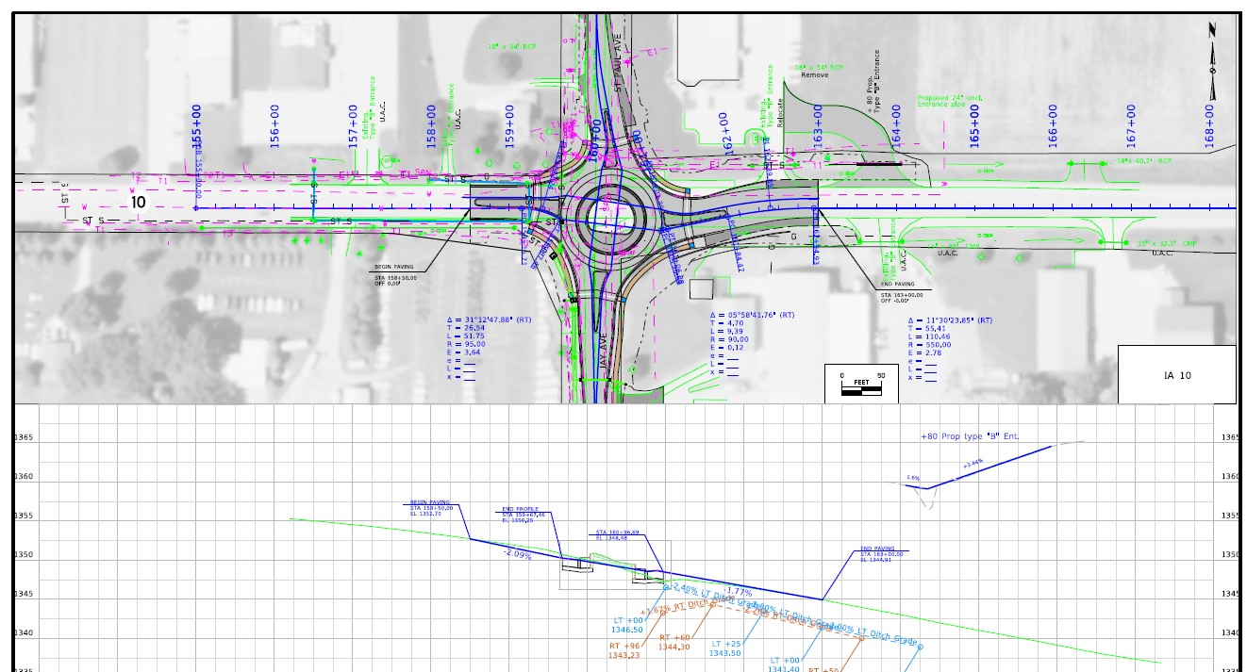
Highway 10 Roundabout

Slide 12
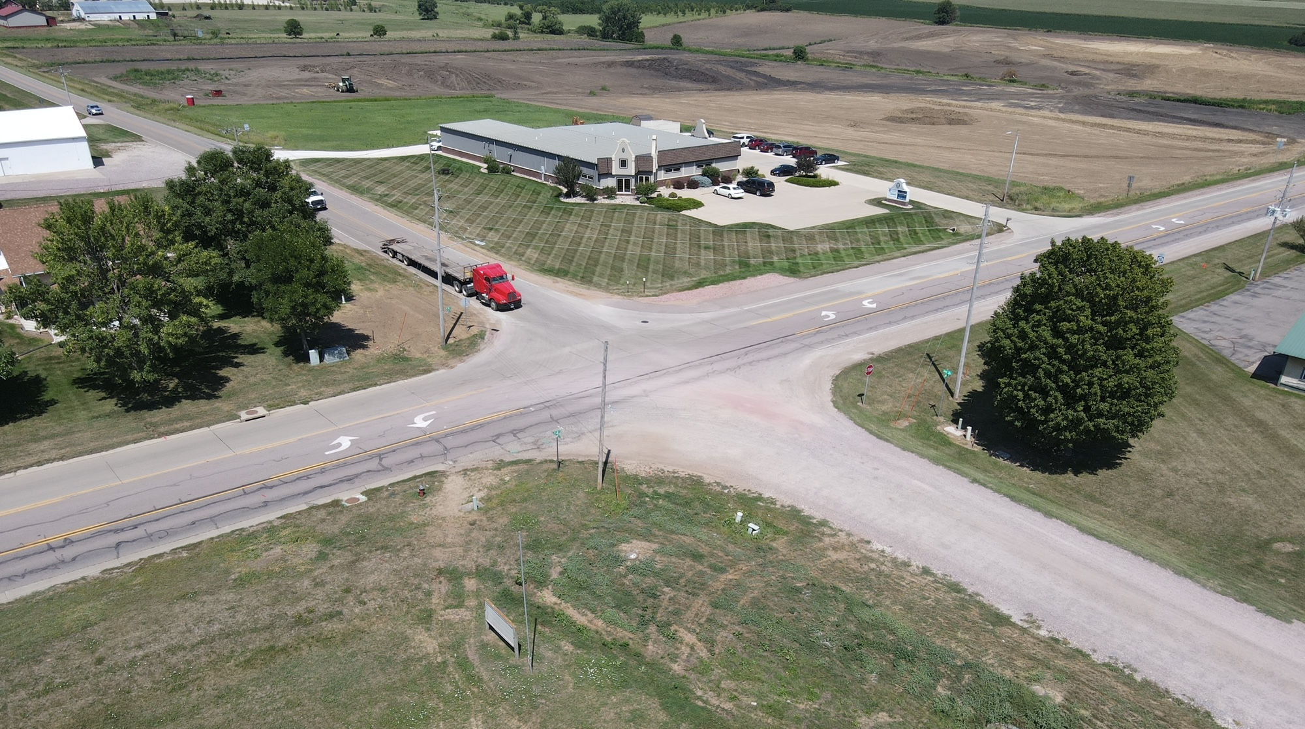
Highway 10 Roundabout

Slide 13
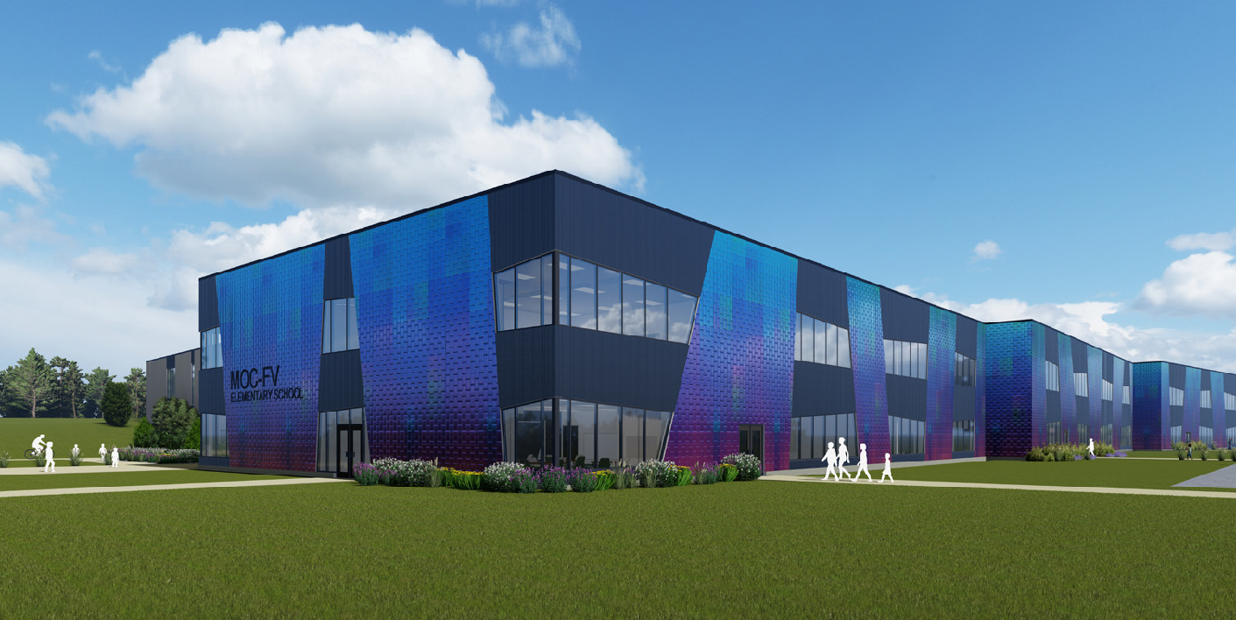
MOC/FV New Elementary School

Slide 14
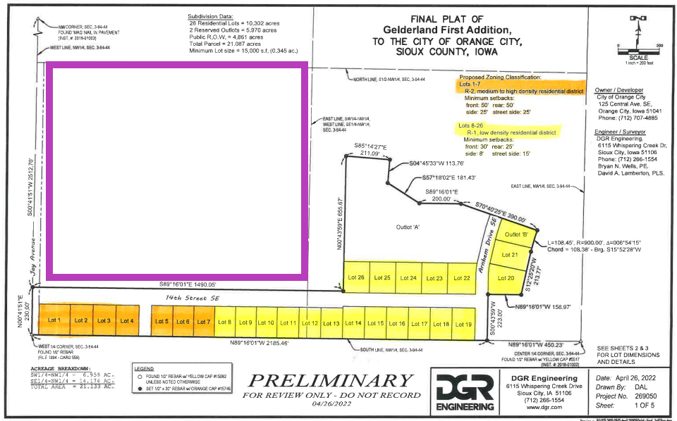
MOC-FV Elementary School
Project
Gelderland Addition

Slide 15
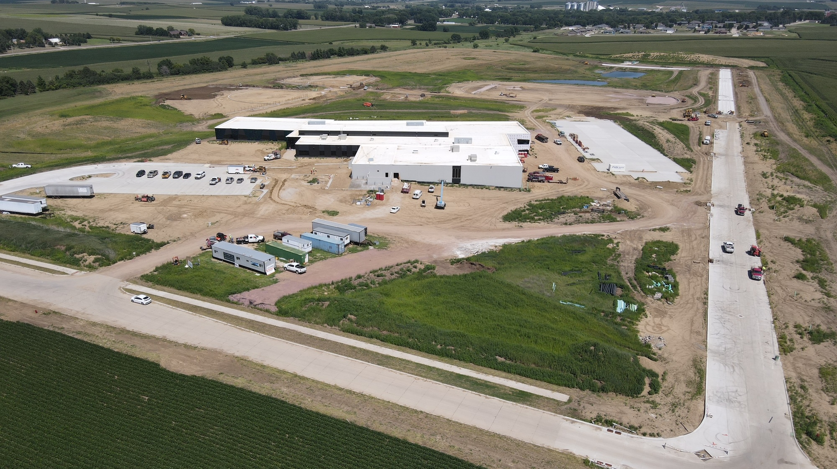
MOC/FV Elementary & Gelderland Addition

Slide 16
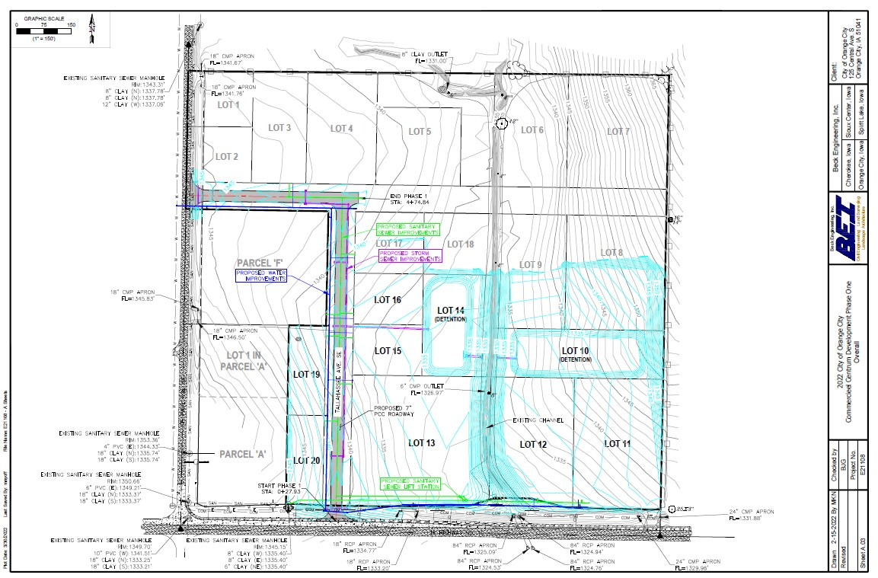
Commercieel Centrum

Slide 17
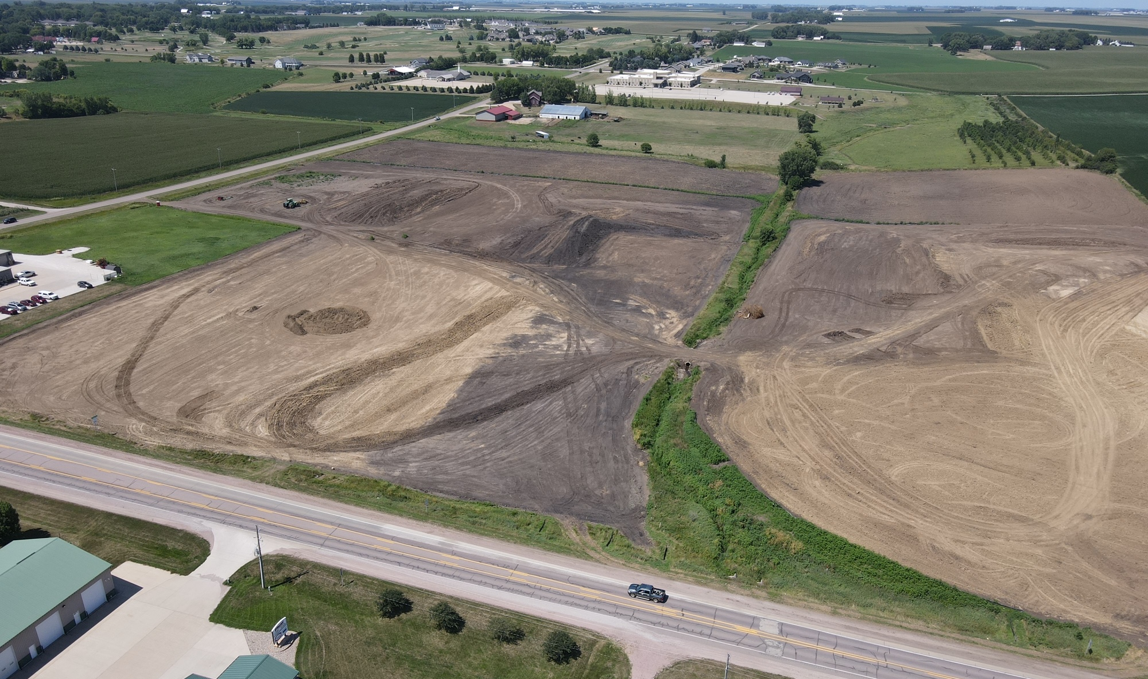
Commercieel Centrum

Slide 18
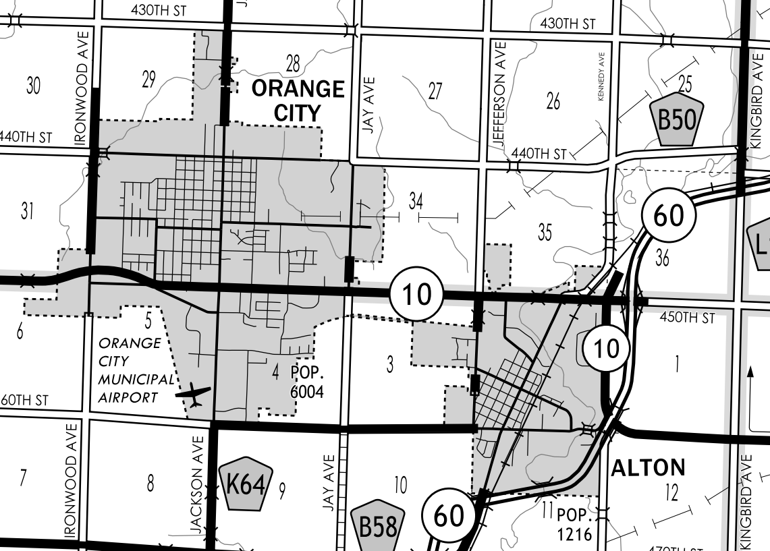
Highway 10 – OC/Alton
TEAP Study

Slide 19
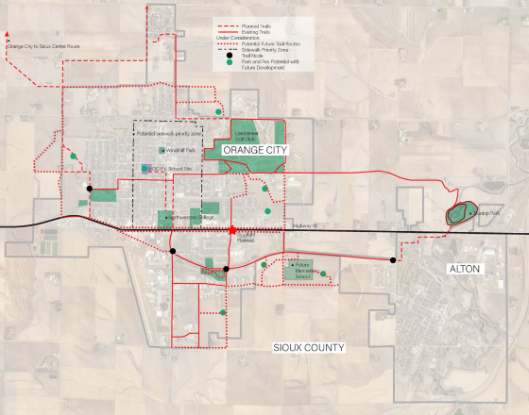
Highway 10
Trails, Streetscape

Slide 20
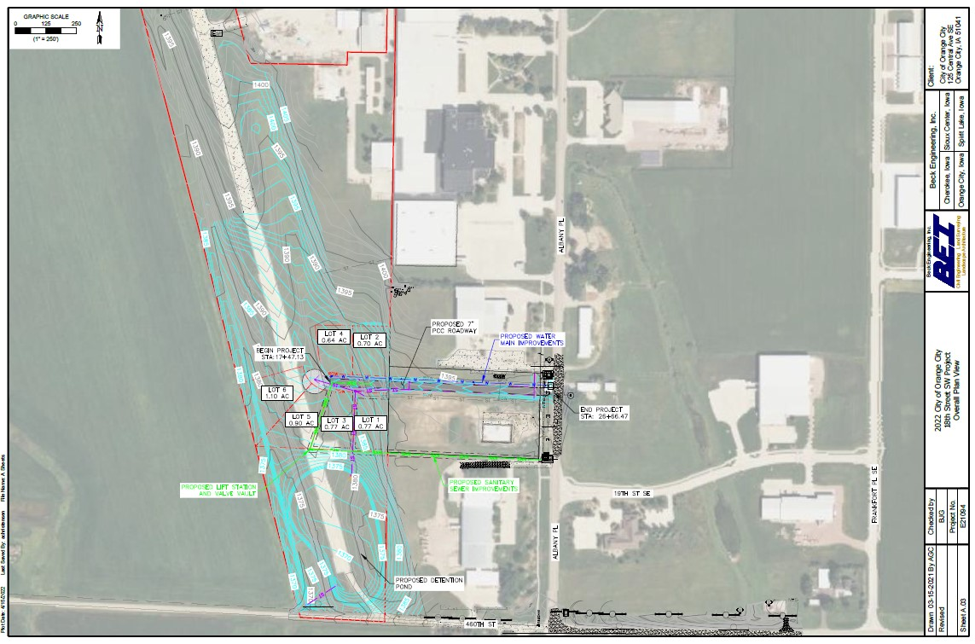
18th St SW Airport Redevelopment
RISE Grant Application

Slide 21
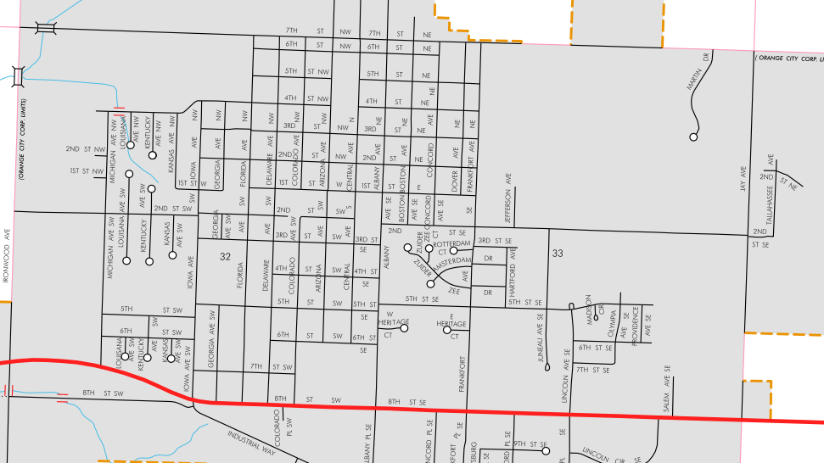
7th St N Overlay
Regional Surface Transportation

Slide 22
Thank You!

