Slide 1
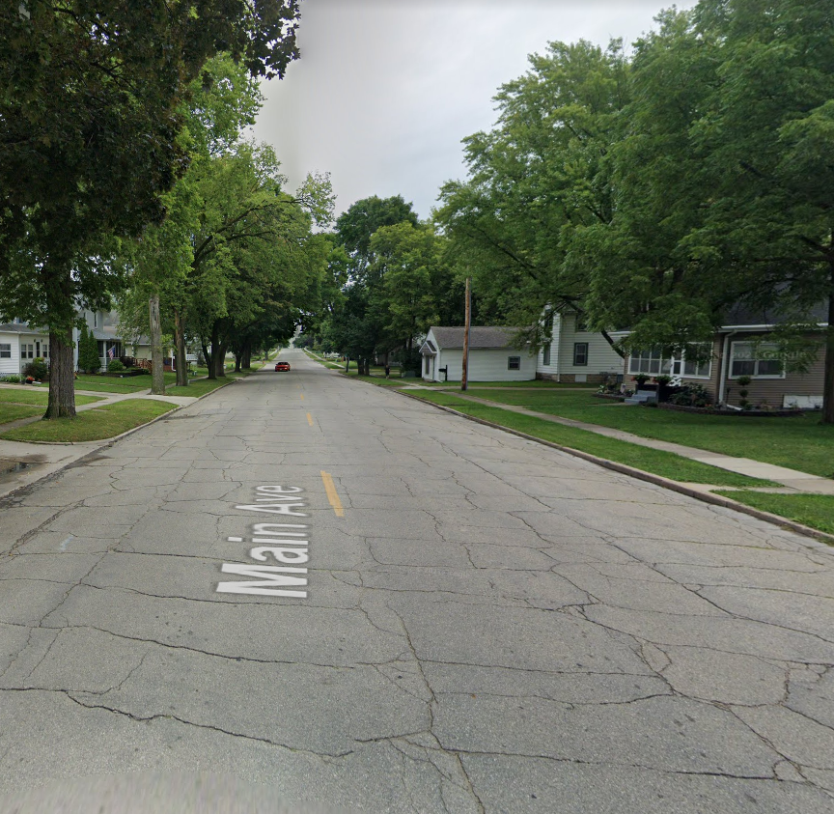
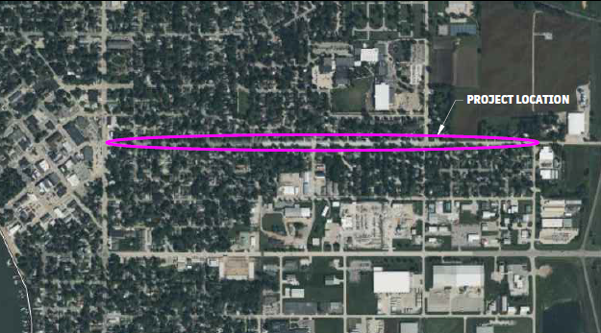
East main avenue street reconstruction

Slide 2
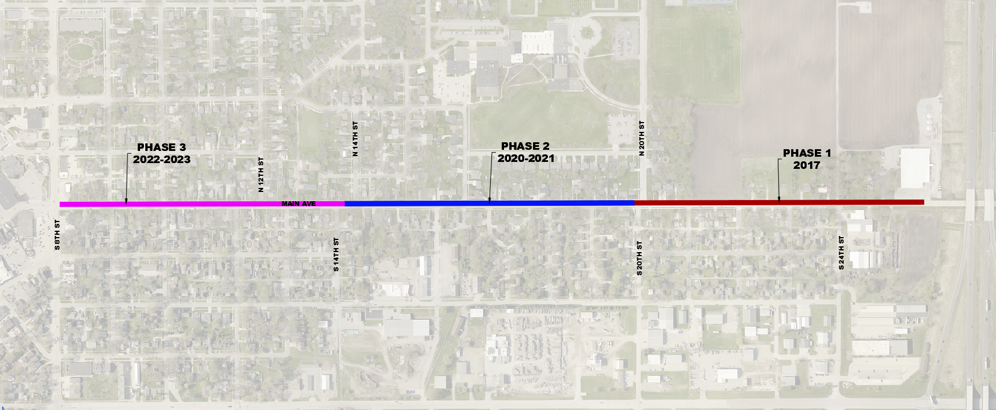
Three Phase Project

Slide 3
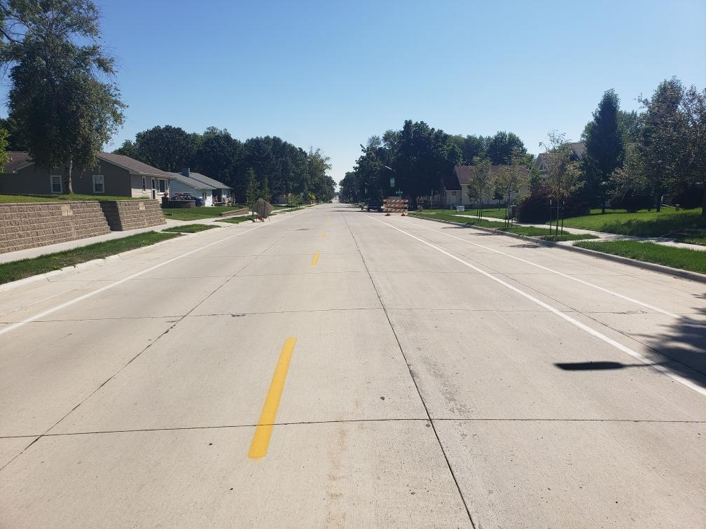
Scope
Municipal Utilities
4,300 LF Sanitary Sewer
4,700 LF Water Main
Drainage Improvements
4,800 LF Storm Sewer
48 Storm Sewer Intakes
4,500 SY of Sidewalks
Street Paving
On Street Bike Lanes
26,800 SY of 43’ Wide PCC
19 Street Lights

Slide 4
Funding and Costs
Construction Funding
Local
Special Assessments
Transportation Alternative Program (TAP): $70,000
Surface Transportation Block Grant (STBG)-SWAP: $1,000,000
Surface Transportation Program (STP): $450,000
Federal American Rescue Plan Act (ARPA)
Total Construction Costs
Total Project Bids: $5,348,000
Total Estimated Final Construction Cost: $4,958,000

Slide 5
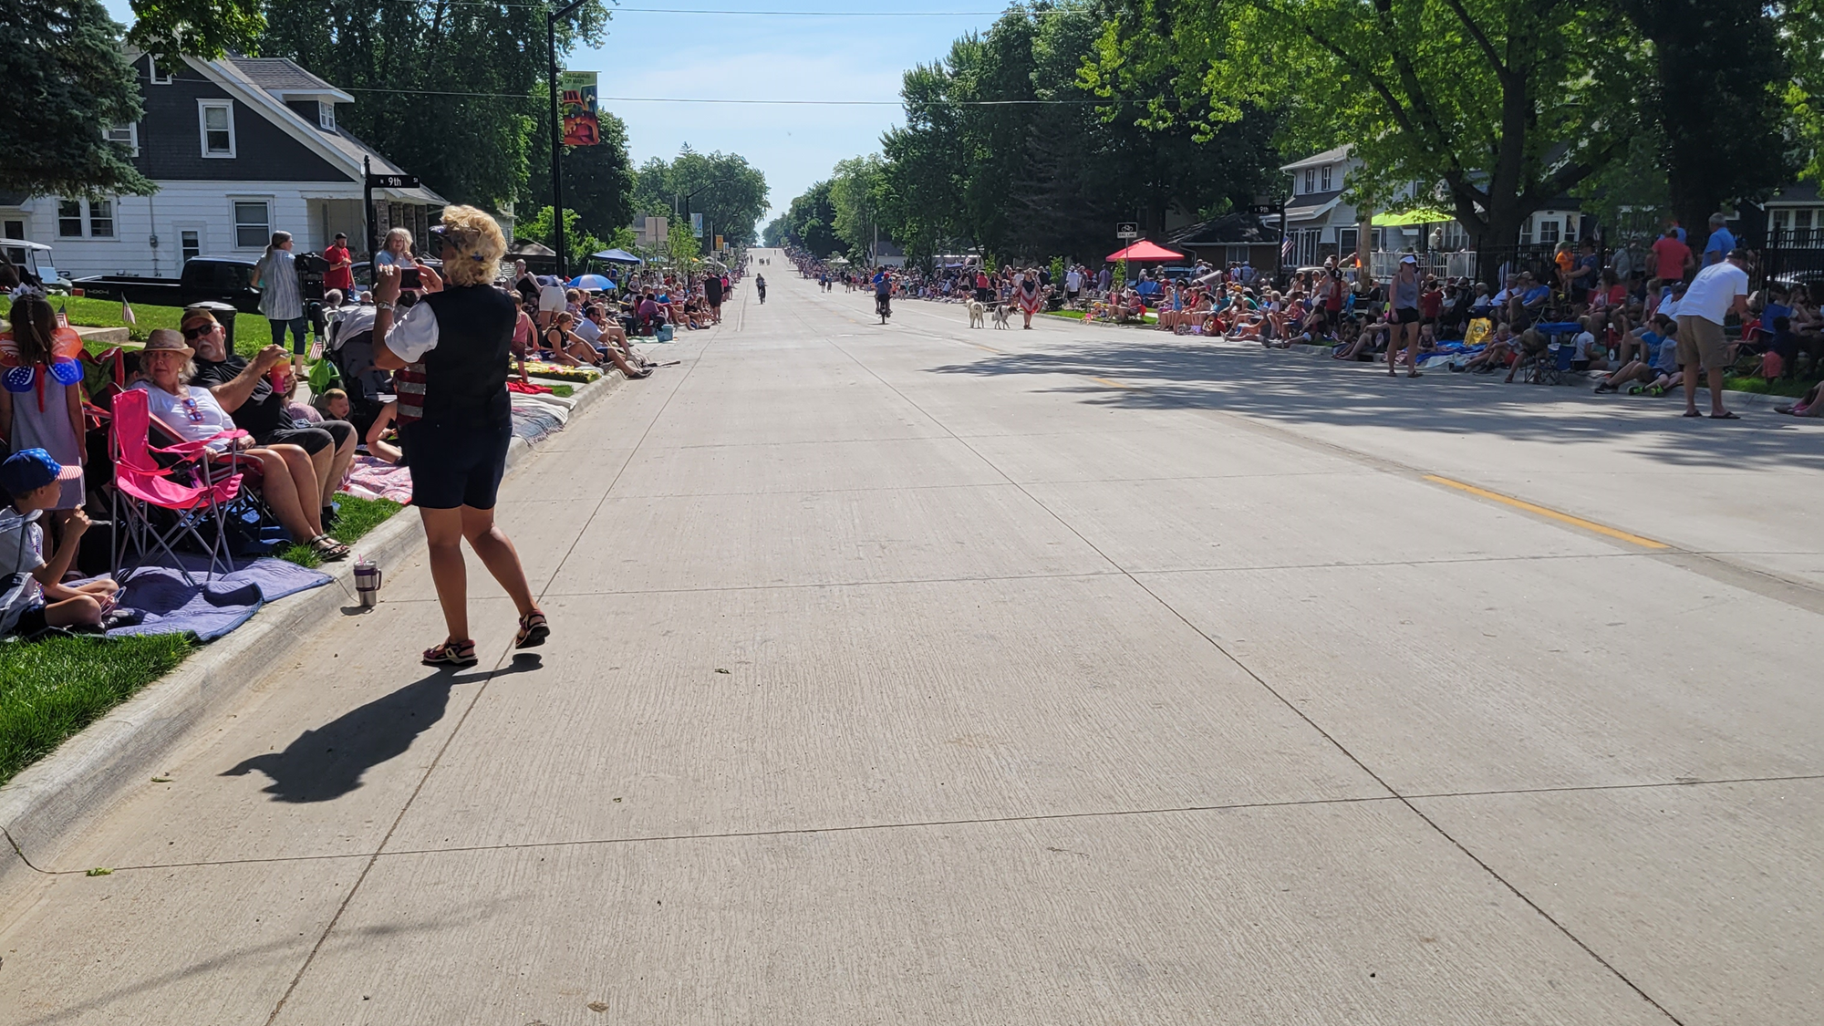
Questions?

