Slide 1
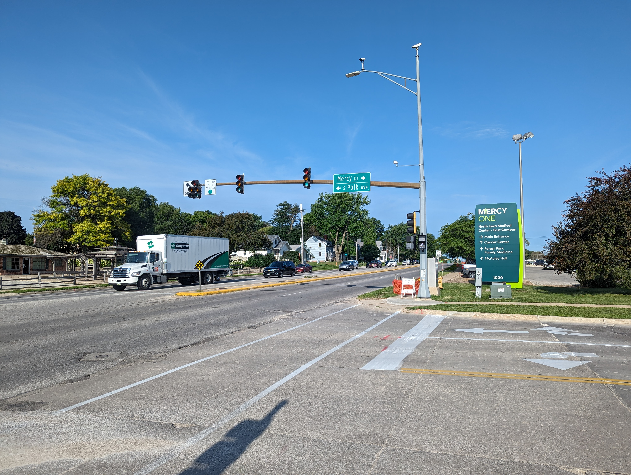
Iowa Highway 122 MercyOne Corridor Part of the Hwy 122 Corridor Improvements
Iowa DOT Commission – August 8, 2023

Slide 2
What’s new in Mason City
Several exciting projects in Mason City
Destination Iowa trail projects are underway across the city
Planned Riverwalk along Willow Creek in the downtown area
Completed Multi-Purpose Arena in former Department Store in the Mall
Developing 93 multi-unit and upper story living spaces in the vibrant downtown, creating a total of 228 new housing units downtown over a 3-year period
Planned New Energy Blue and Dow Chemical facility will process 275KT of corn stover per year, to produce agriculture based plastics

Slide 3
IA 122 Projects
City of Mason City

Slide 4
IA 122 Projects
2010 Project:
5-lane, full reconstruction
Added center two way left turn lane
Approximately 0.36 miles
Improved Cheslea Creek crossing

Slide 5
IA 122 Projects
2018/2019 Project:
4-lane, full reconstruction
Added bike lanes in each direction
Approximately 0.90 miles
Improved mobility through the corridor

Slide 6
IA 122 Projects
IA 122 West Project:
Future conversion to urban section with roundabouts
Approximately 2.6 miles
Presented to Commission on October 11, 2022

Slide 7
IA 122 Projects
IA 122 Mercy Project:
Connects two recently constructed segments
Approximately 0.7 miles
Average Daily Traffic of about 18,000 vehicles per day
Improves pavement condition and drainage in a busy corridor in front of a Regional Medical Center

Slide 8
Proposed Project
Corridor in front of MercyOne North Iowa Medical Center, from just west of Pierce Ave. to Monroe Ave.
Complete Reconstruction of the 4-lane pavement, median, turn lanes and sidewalks, for 0.70 miles
Replacement of Traffic Signals at 4 intersections
Removal and Replacement of Storm Sewer System
Possible Replacement of City Owned Utilities
City of Mason City hired WHKS for Preliminary Design, up to 30%, of the Iowa Highway 122 MercyOne Corridor
City Council approved a 5-year program which included this project

Slide 9
IA 122 Mercy Corridor

Slide 10
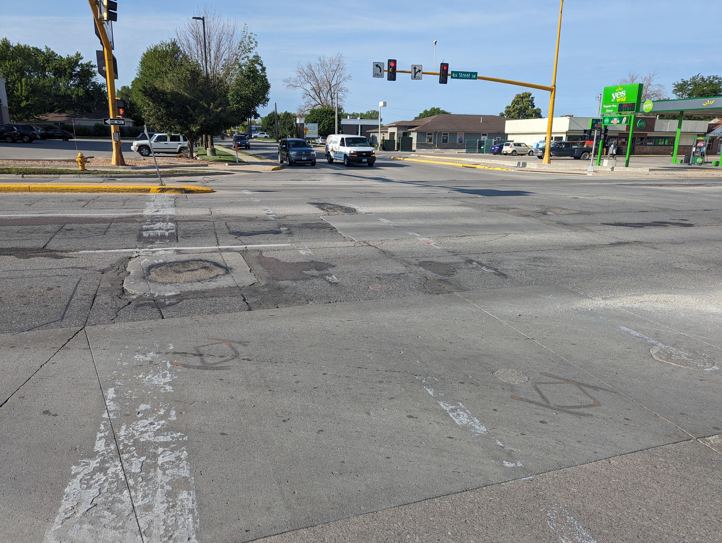
Project Opportunities
Upgrade sidewalk facilities to meet ADA compliance
Improve the operation and look of the current drainage system
Replace or upgrade aging infrastructure
Lighting can be enhanced from operational and aesthetic standpoints
Improve access to currently underdeveloped properties along the corridor

Slide 11
Project Coordination
Project Partners
City of Mason City
MercyOne North Iowa Medical Center
Mason City Fire Department
Local Businesses
Iowa DOT District 2 Staff
Mason City Police Department
Area EMS Organizations
Coordinating design with the US Highway 65 project design team
US Highway 65, south of IA 122, is being designed by DOT Staff
Construction of US Highway 65 is slated to begin in Fall of 2024
An Iowa Highway 122 Public Information Meeting was held on July 20, 2023
Iowa Highway 122 will be presented to the Mason City Council on August 15, 2023

Slide 12
Estimated Project Costs
Item | Estimated Cost
Admin., Engineering, Legal | $868,000
Construction Engineering | $1,152,000
Construction | $10,600,000
Total | $12,620,000

Slide 13
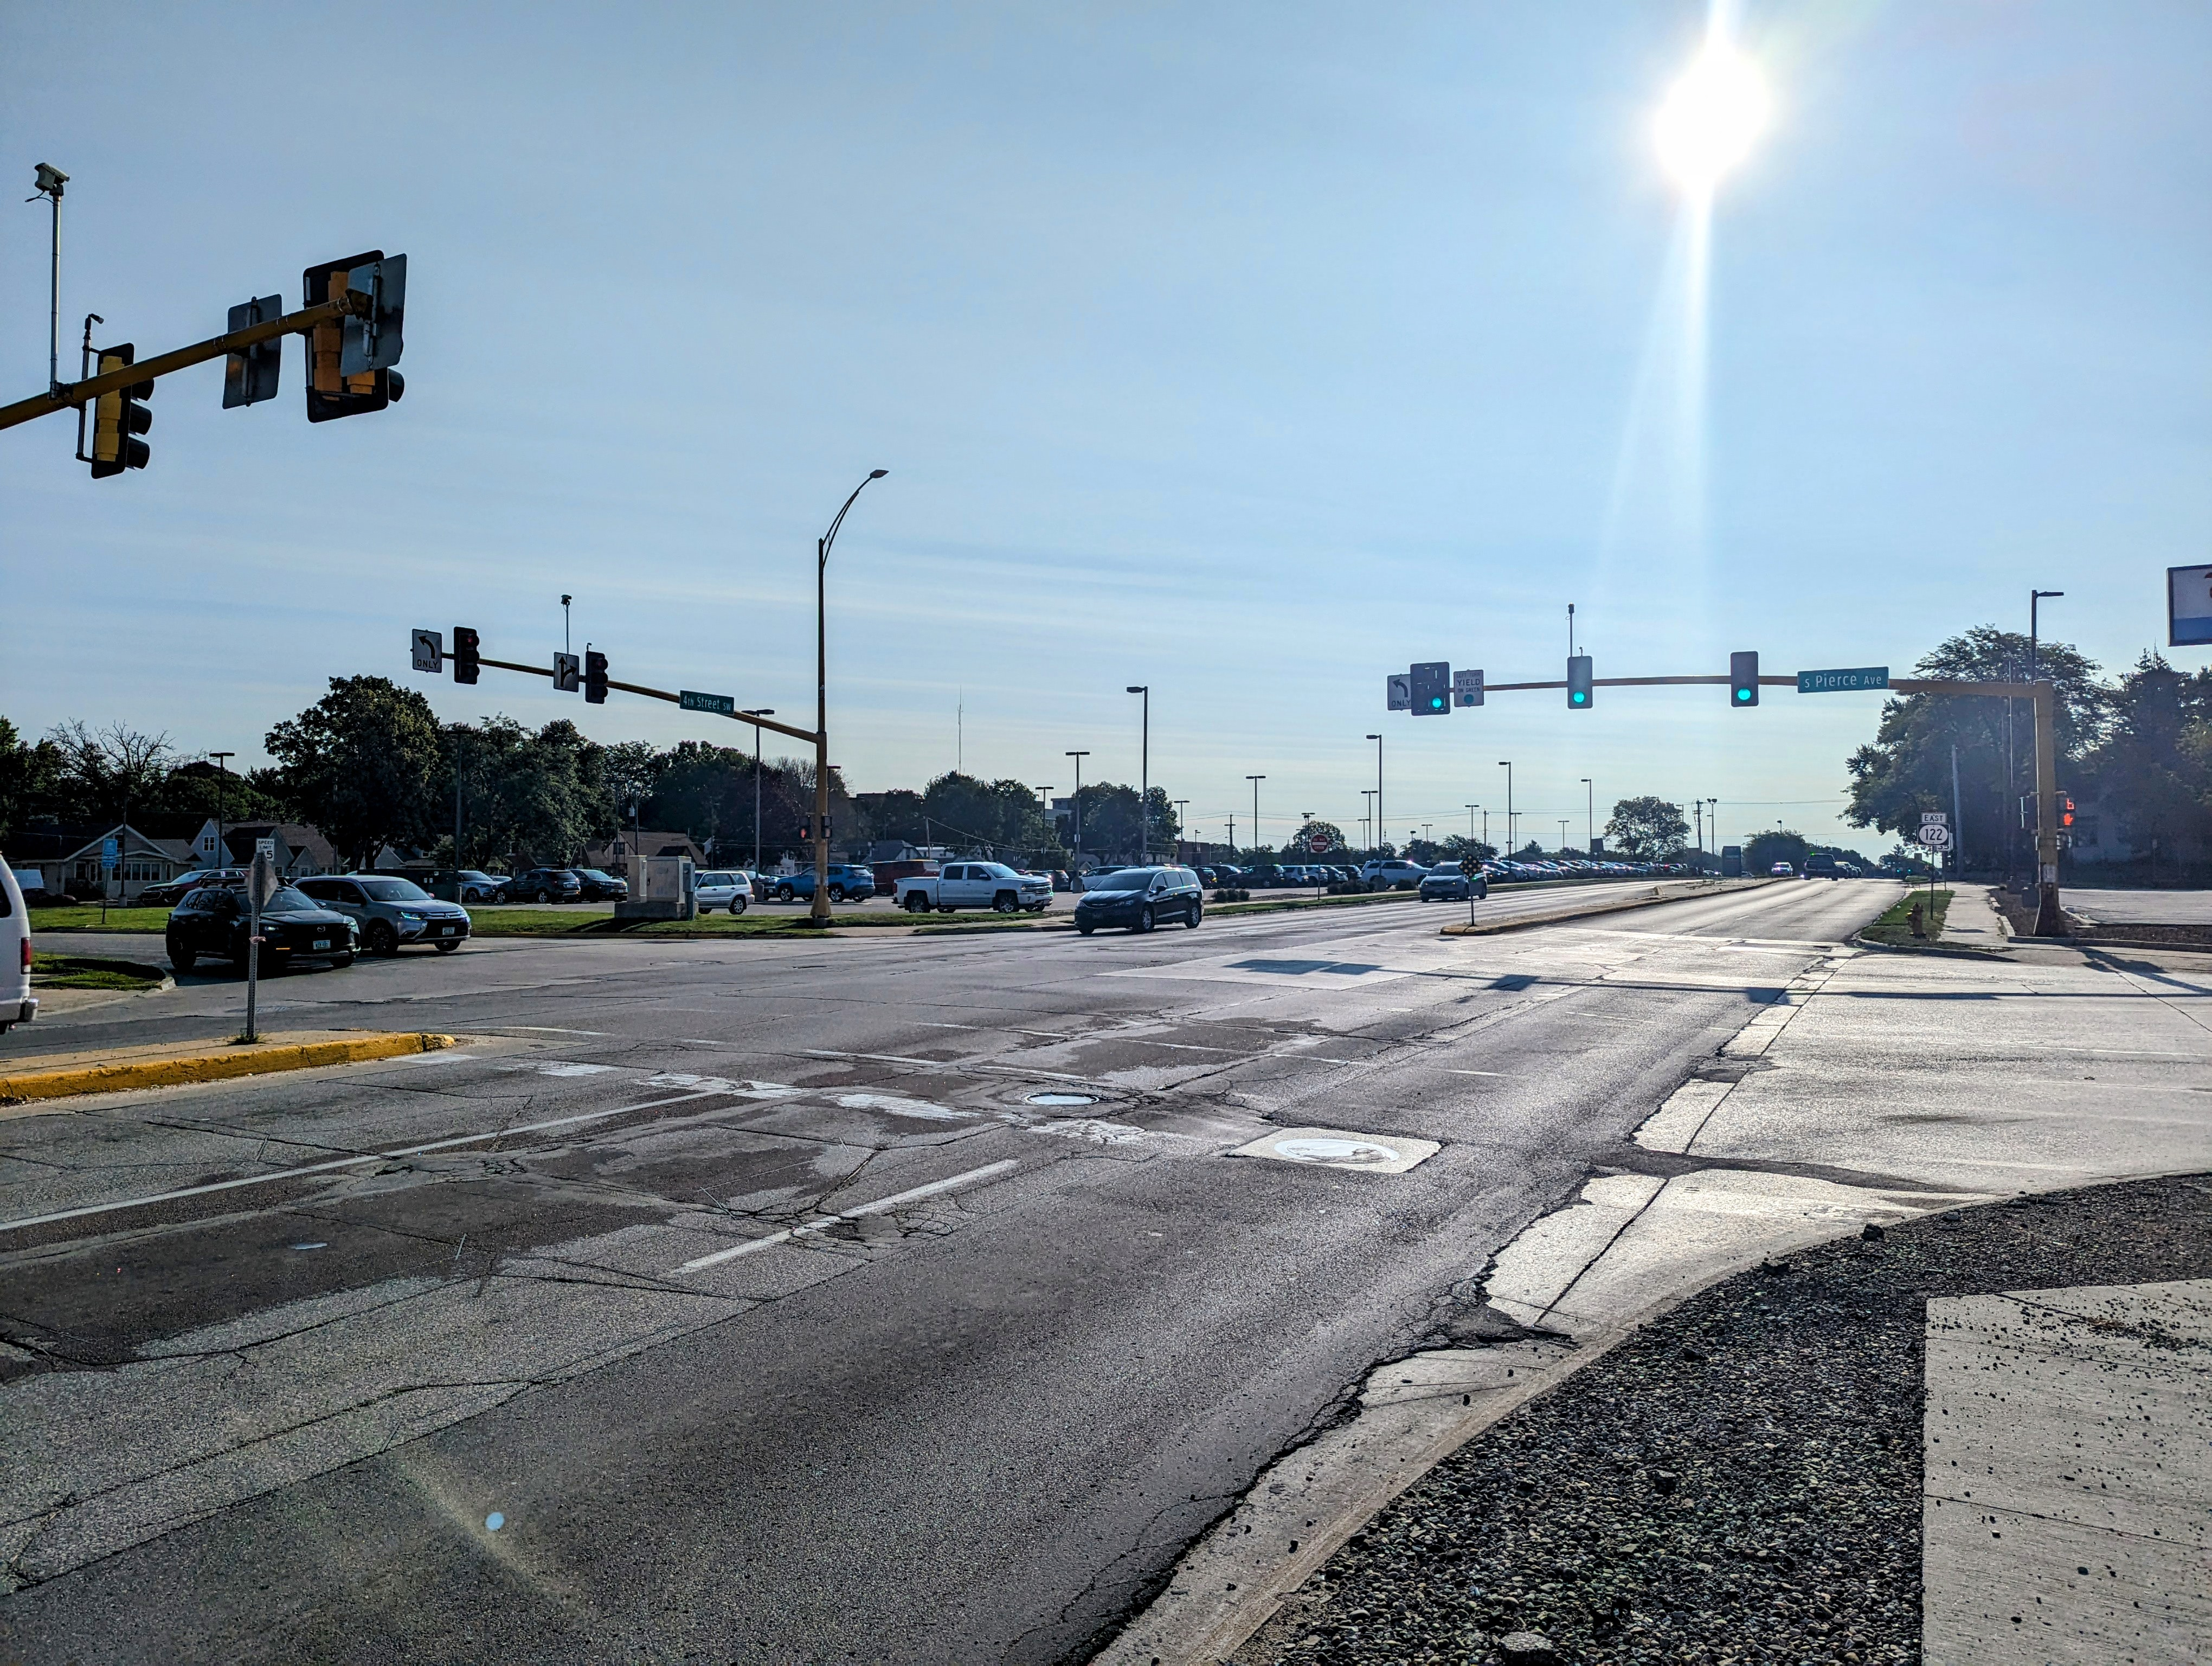
Project Schedule
Iowa DOT Commissioners Meeting – August 8, 2023
Begin Final Design – September 2023
Letting – January 2025
Construction – 2025 to 2026

Slide 14
Iowa DOT and City of Mason City Partnership
28E Pre-Design Agreement between DOT and Mason City; City paying consultant fees for Preliminary Design
City is leading the design of this project, with assistance from the DOT
City is funding the design fees
City and DOT will fund construction of the project
City led the development of the IA 122 West Corridor Study, with input and assistance from the DOT

Slide 15
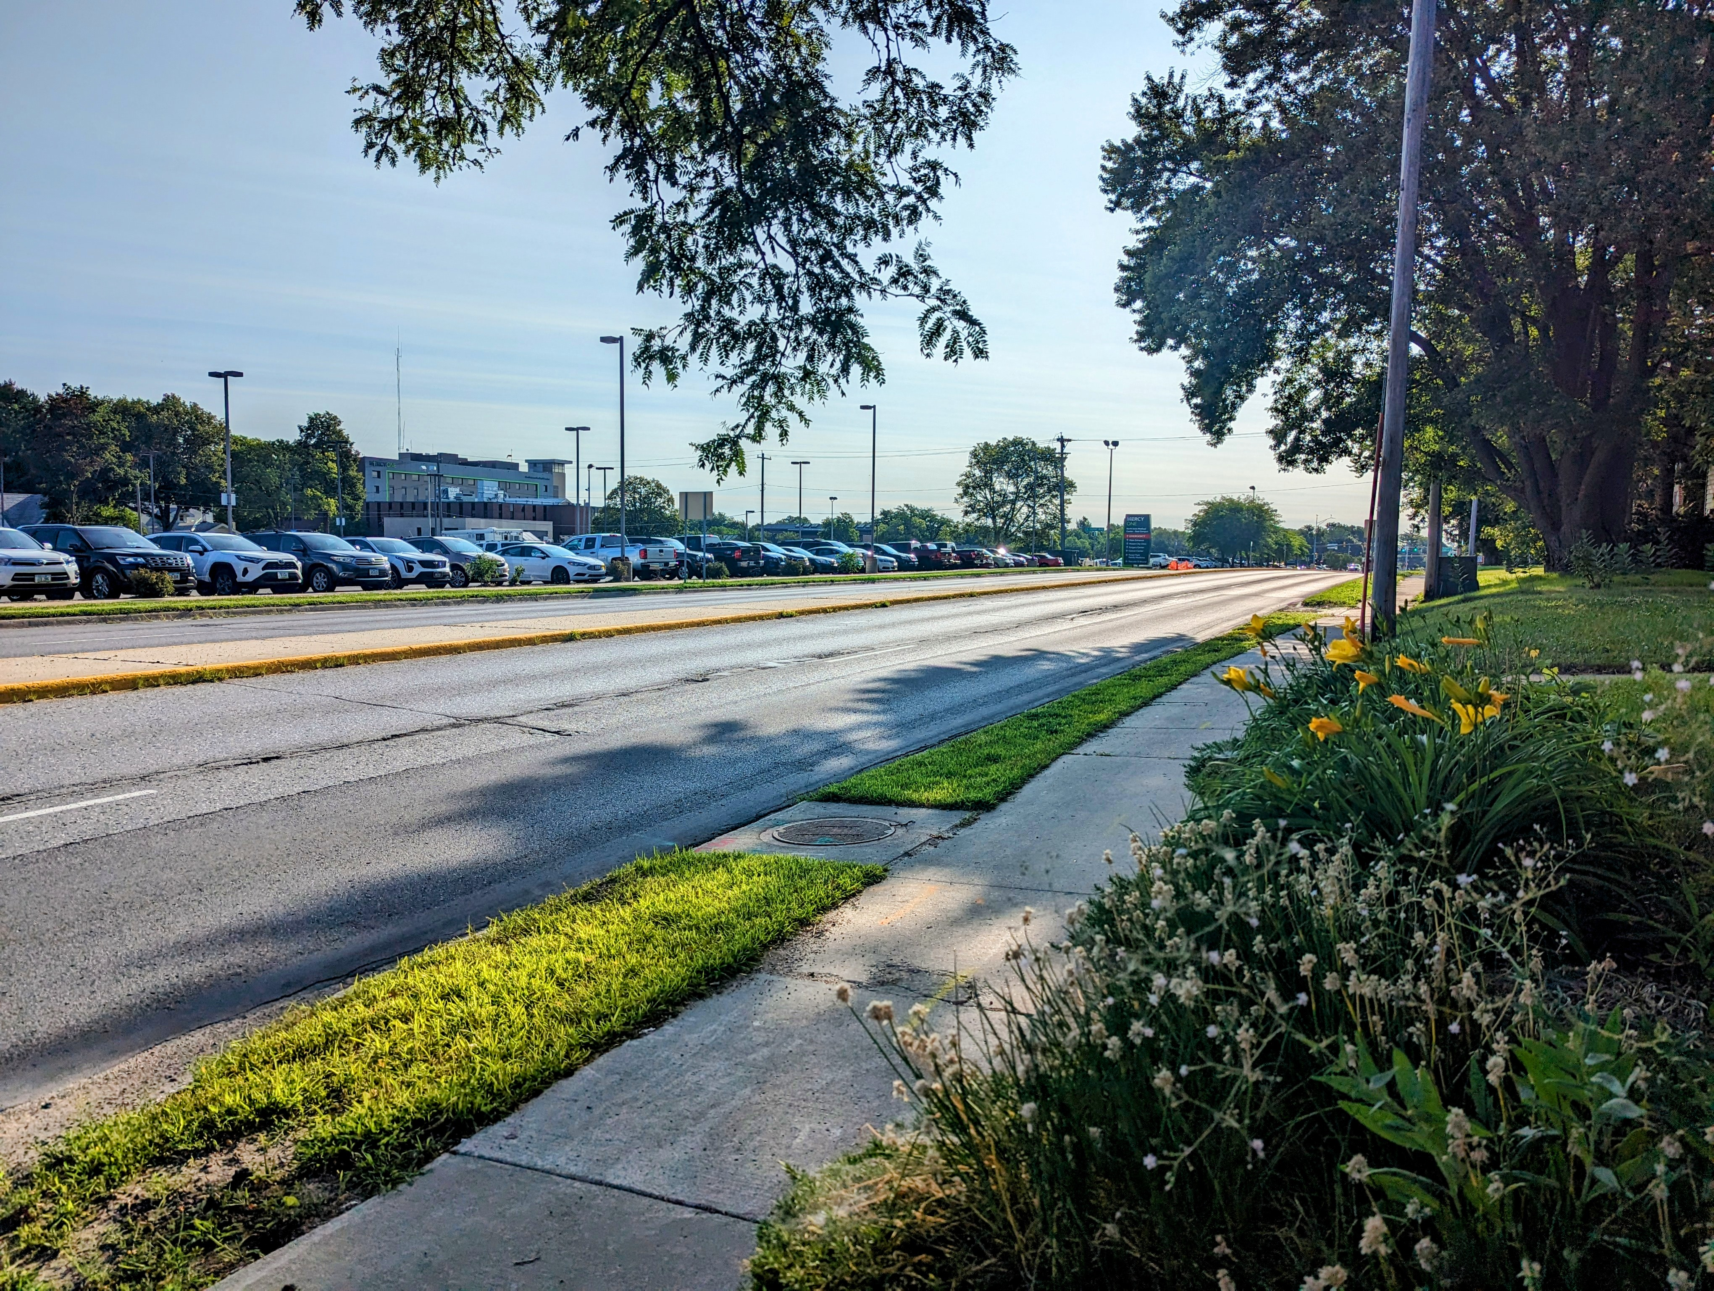
Thank you!
Speakers:
Bill Schickel, Mason City Mayor
Aaron Burnett, Mason City Administrator
10 First Street NW
Mason City, IA 50401
(641) 421-3600
aburnett@masoncity.net
Fouad Daoud, President and CEO WHKS & Co.
1412 6th Street SW
PO Box 1467
Mason City, IA 504025
(641) 423-8271
fdaoud@whks.com

