Slide 1
2020 Annual Meeting

Slide 3
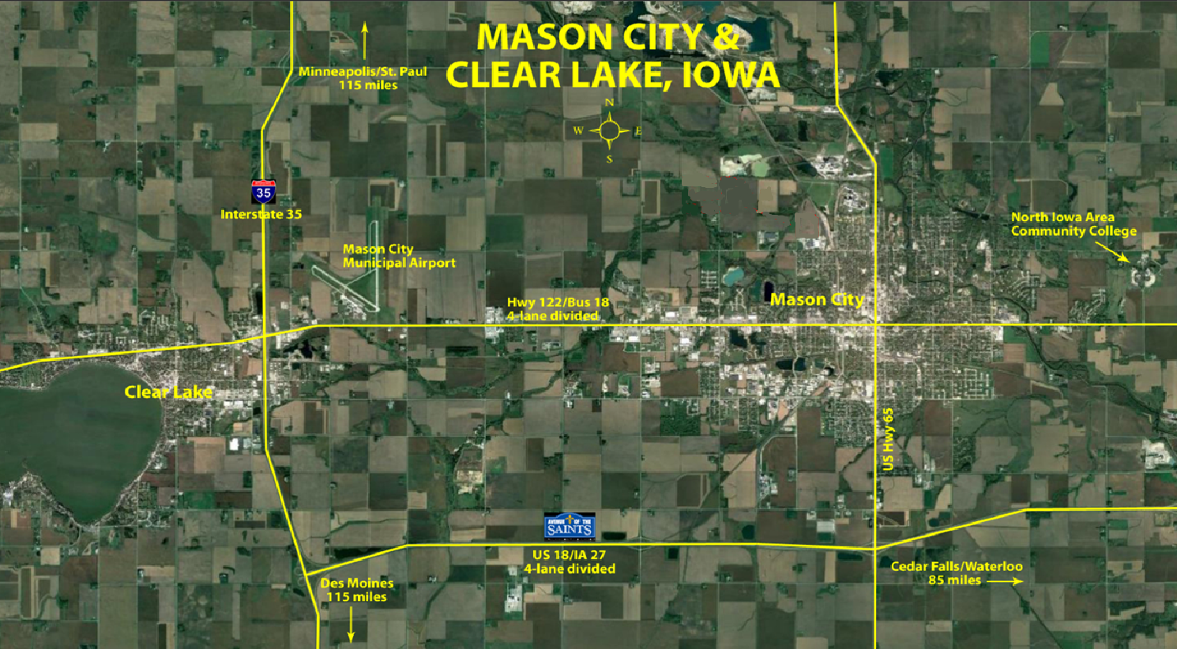

Slide 4
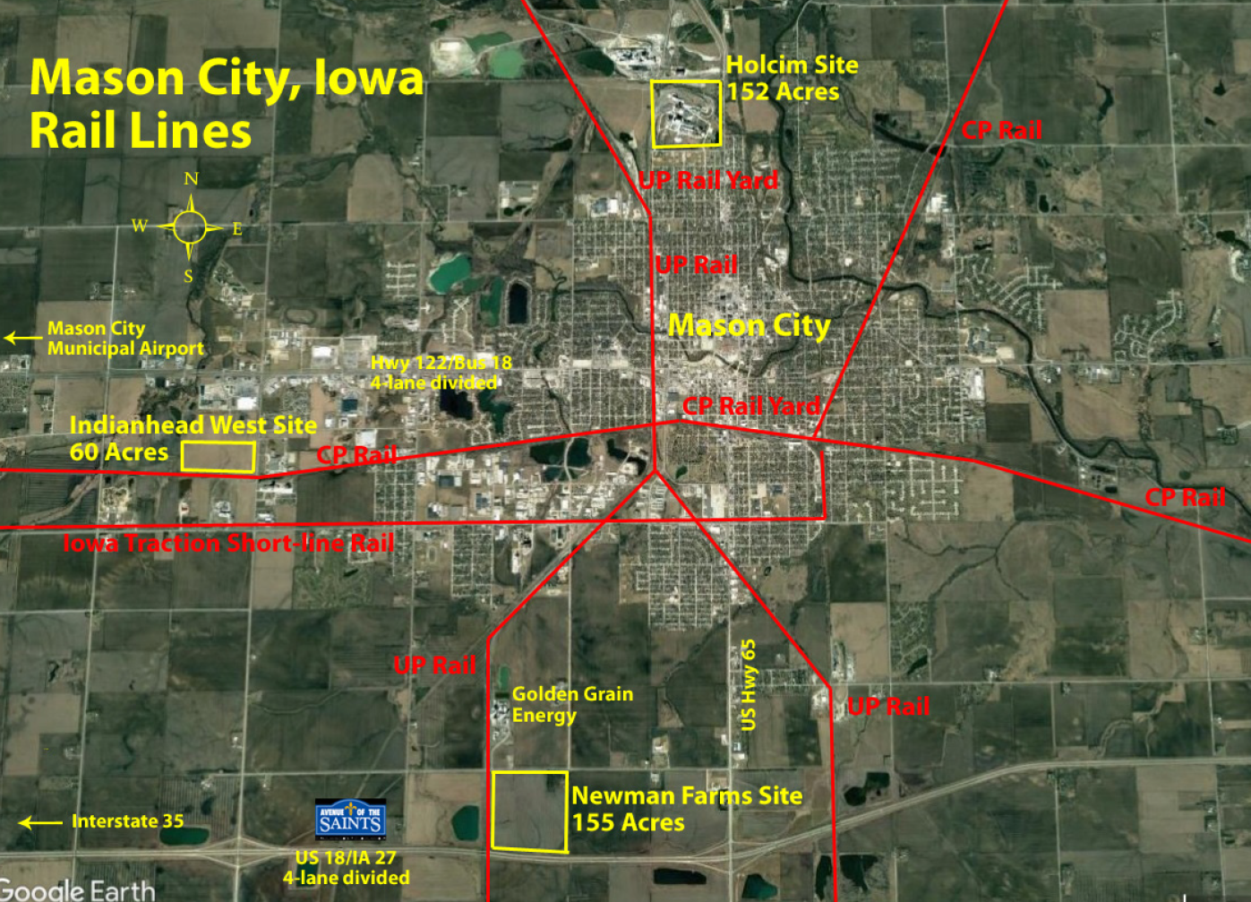

Slide 5
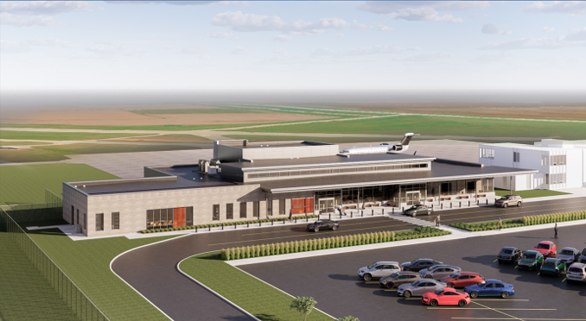

Slide 6
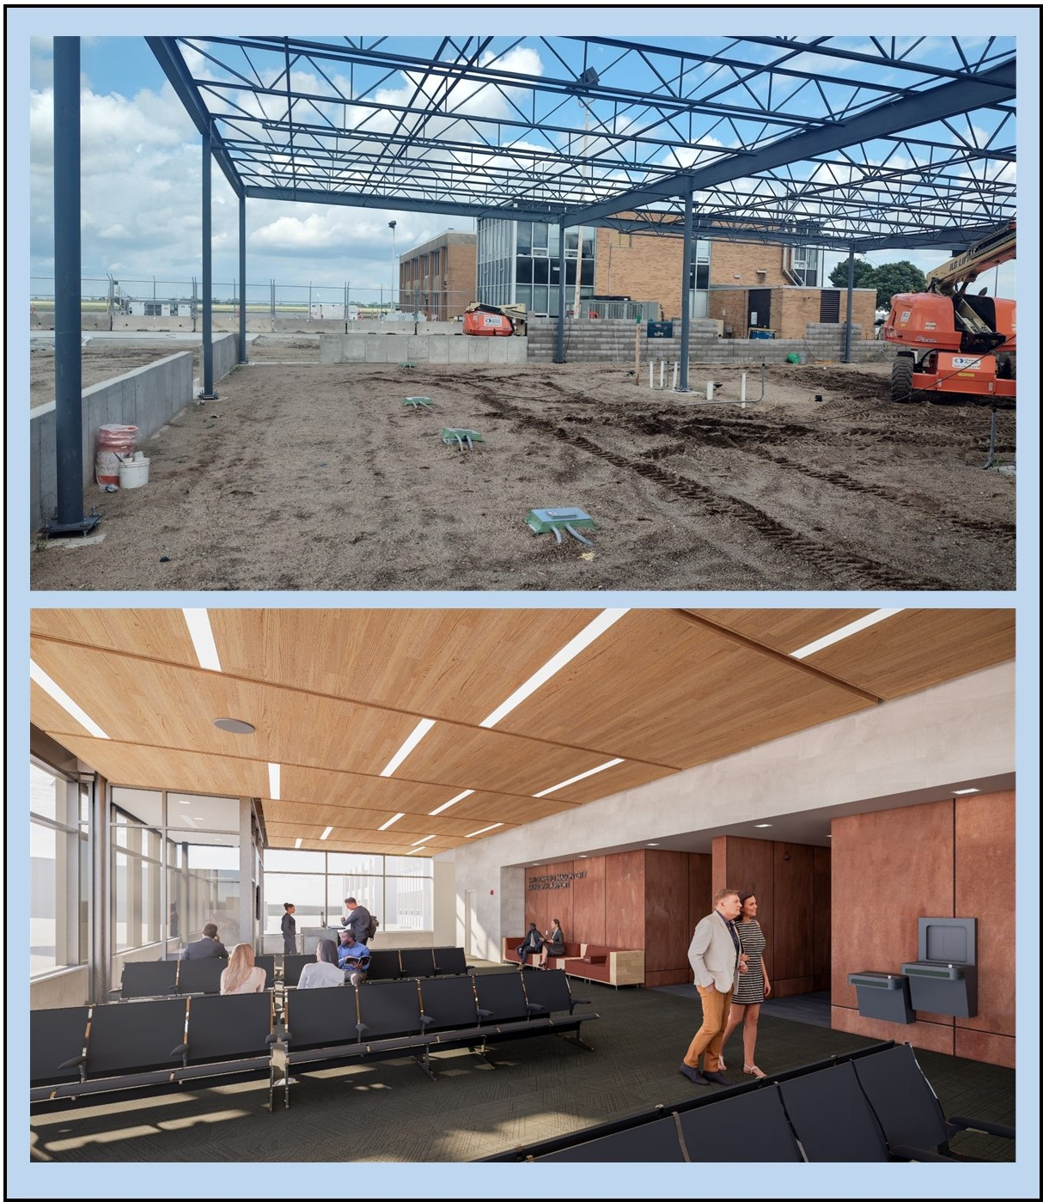
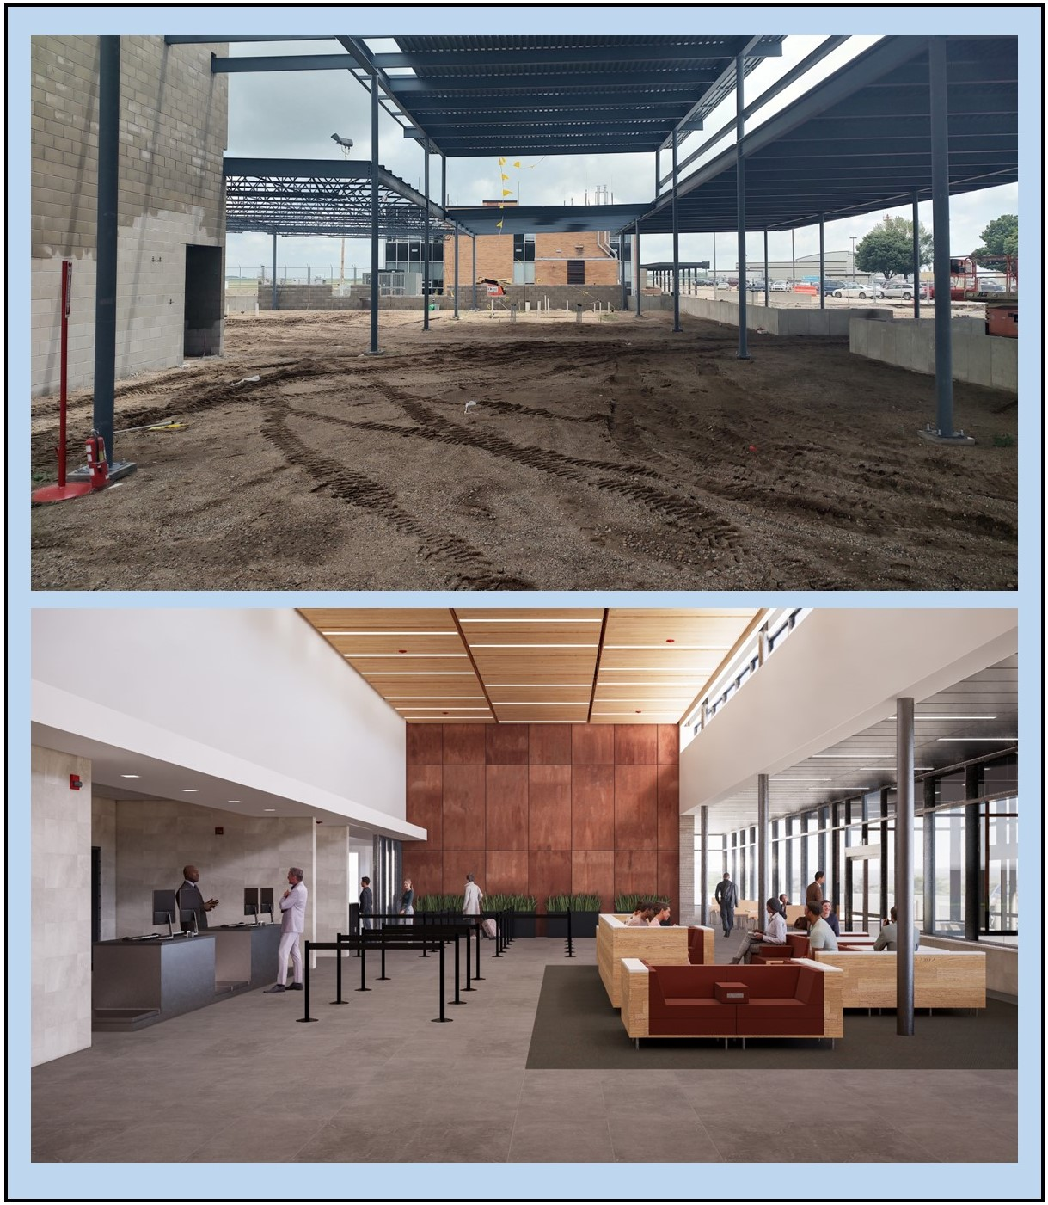

Slide 7
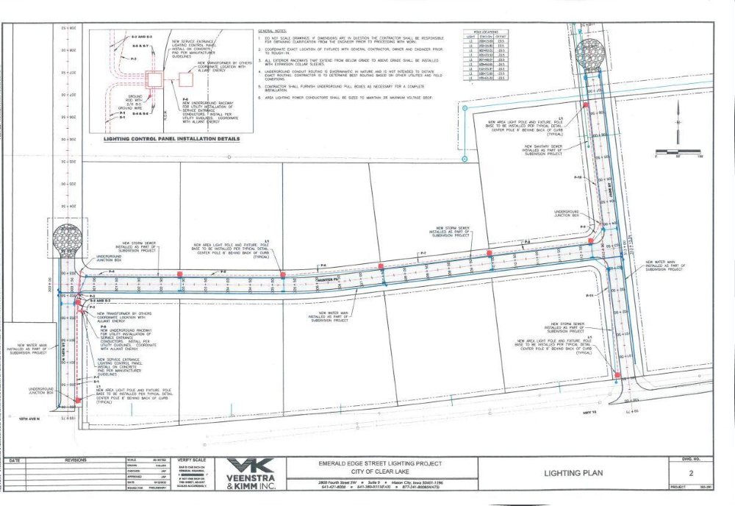
Project Opportunity Areas
Bio-fuels/Bio-technology
Warehouse and Distribution
Advanced Manufacturing Projects
Food Processing
Holcim Brownfield Site Redevelopment

Slide 8
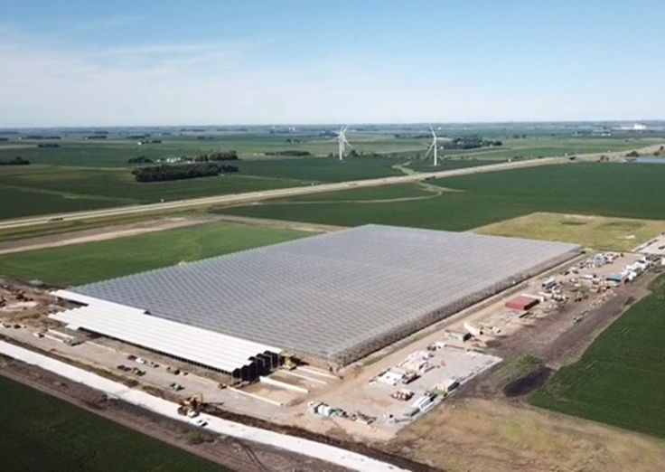
Local Business Growth
Stellar Mfg Expansion
Sukup Manufacturing
Kraft-Heinz Expansion
Golden Grain Expansion
Cargill Expansion
Courtway Park Redevelopment
Fairfield Inn
Old Dominion Distribution Facility
Boulevard Restaurant
Trucking Prospect
Bushel Boy
EVCO Mfg
Pritchard Co HQ
Legacy Golf Course
Farm & Home Publishing
Old Navy, Ross, Five Below

Slide 9
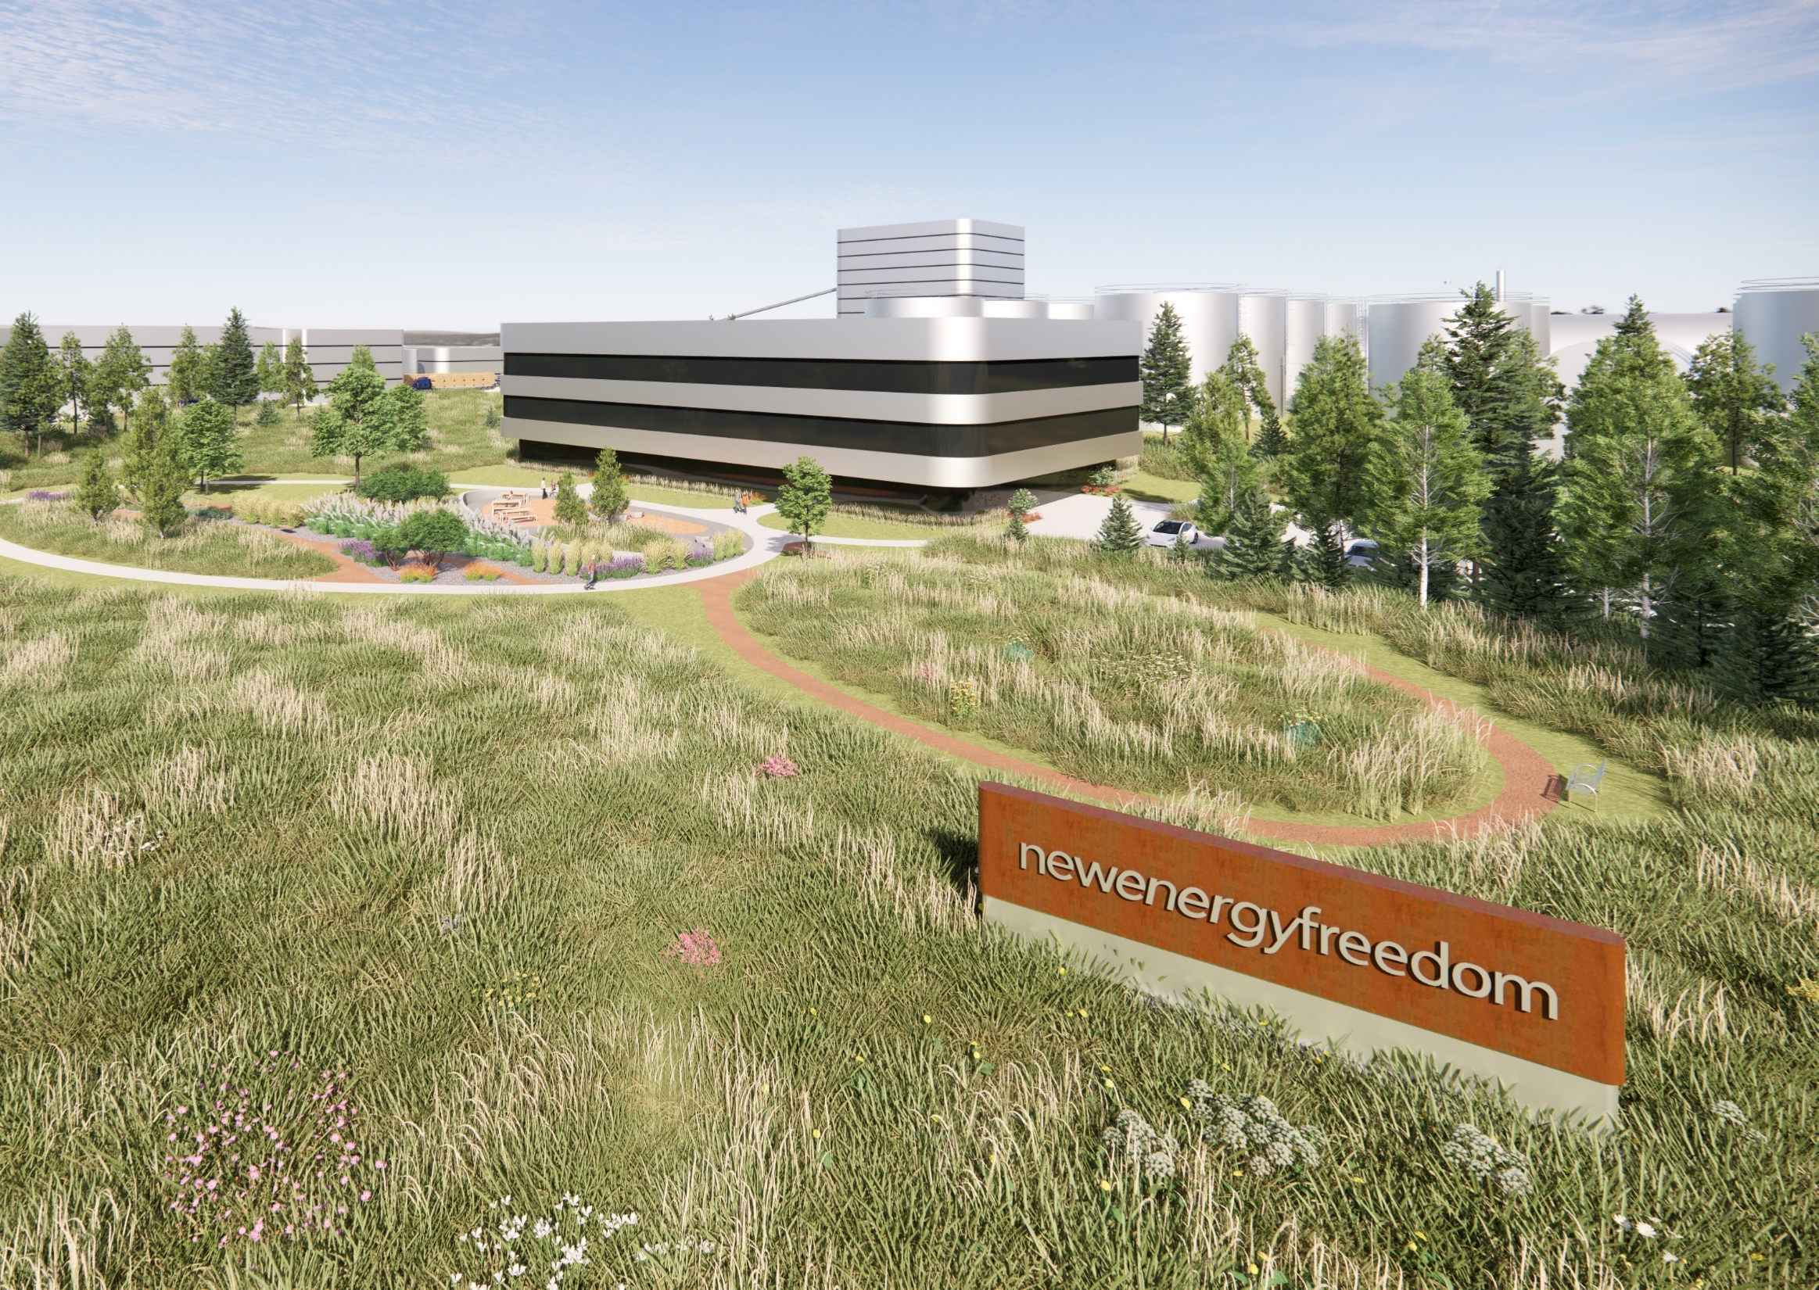
New Energy Freedom
$350m Project
100 new jobs
$80,000 average wage
Cellulosic Ethanol Manufacturing
Research & Development of renewable plastics/materials

Slide 10
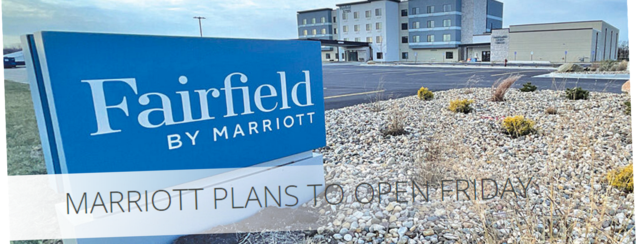
Development Opportunities
Courtway Park Clear Lake

Slide 11
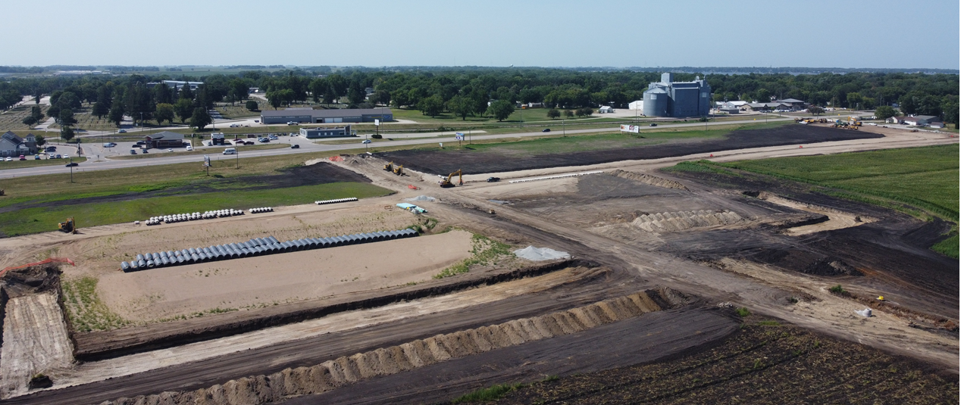
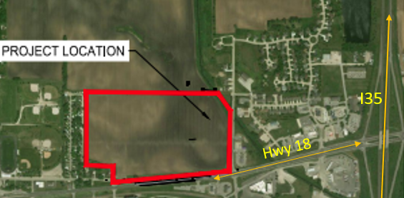
Development Opportunities
Emerald Edge Clear Lake

Slide 12
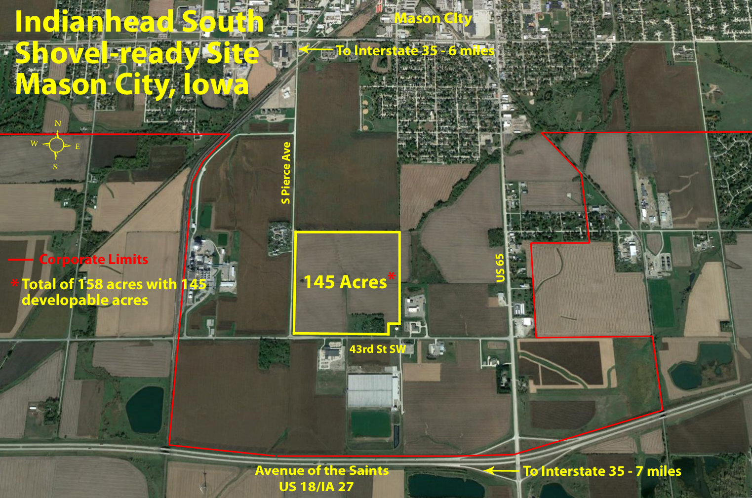
Development Opportunities
Mason City Industrial Park

Slide 13
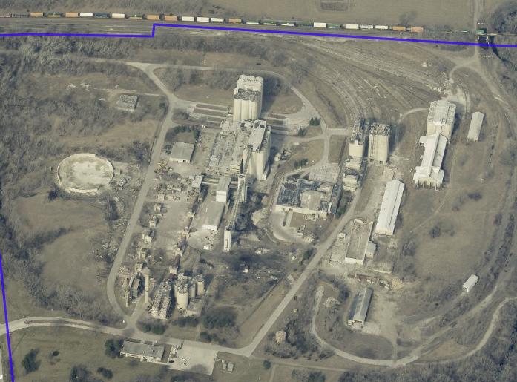
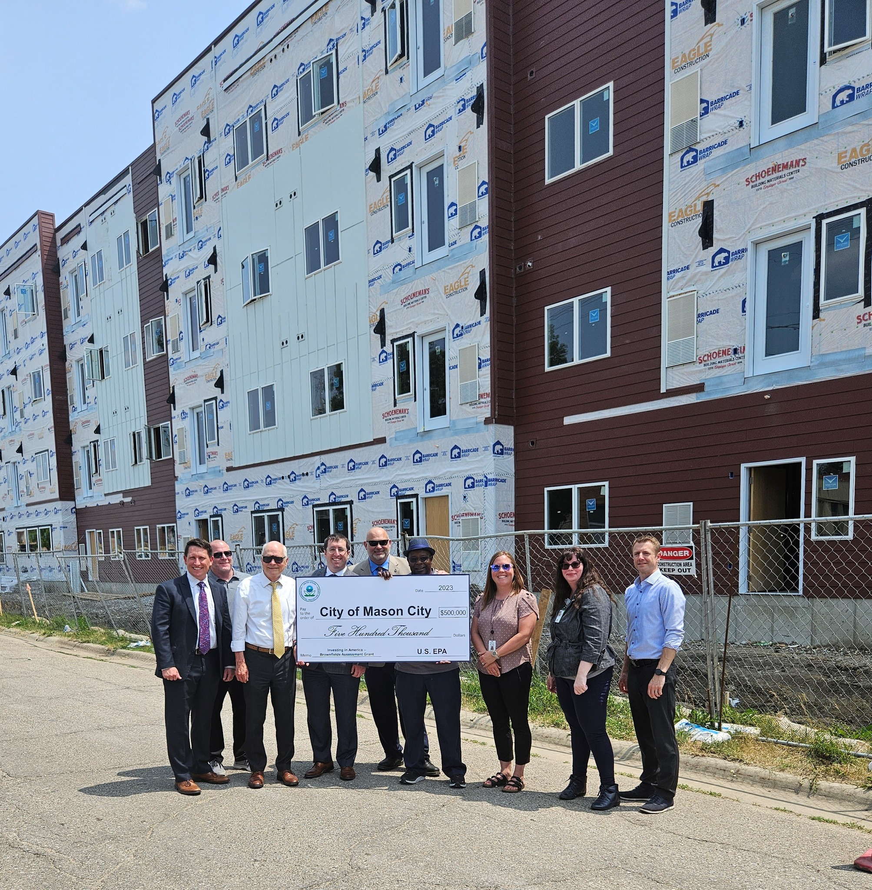
Brownfield Redevelopment

Slide 14
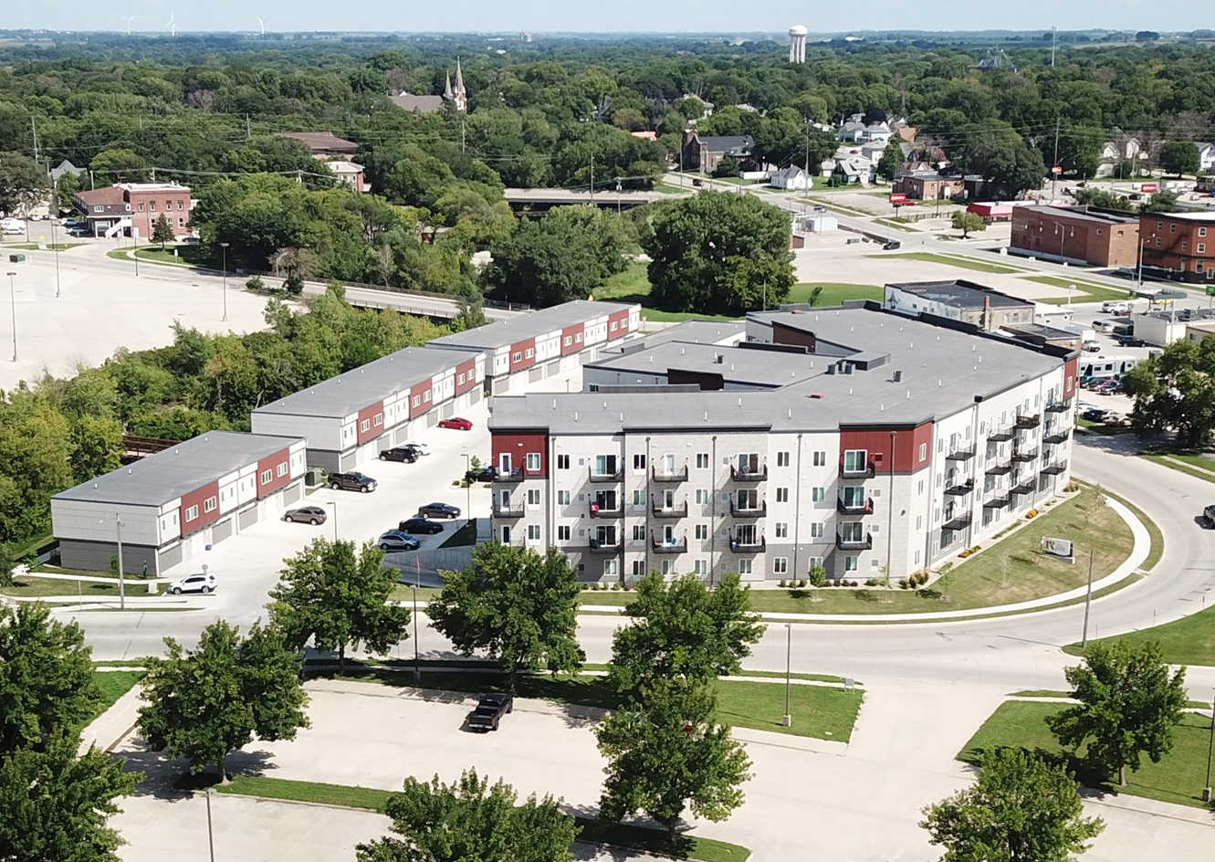
Housing Successes
Talon Downtown Mason City Apartments
Phase 1 – 133-unit apartment and townhomes
Phase 2 – 93-unit apartments
South Shore – 16 single-family, 8 twinplex homes
Federal Ave Row Homes – 11-units
Numerous Upper Story Conversions

Slide 15
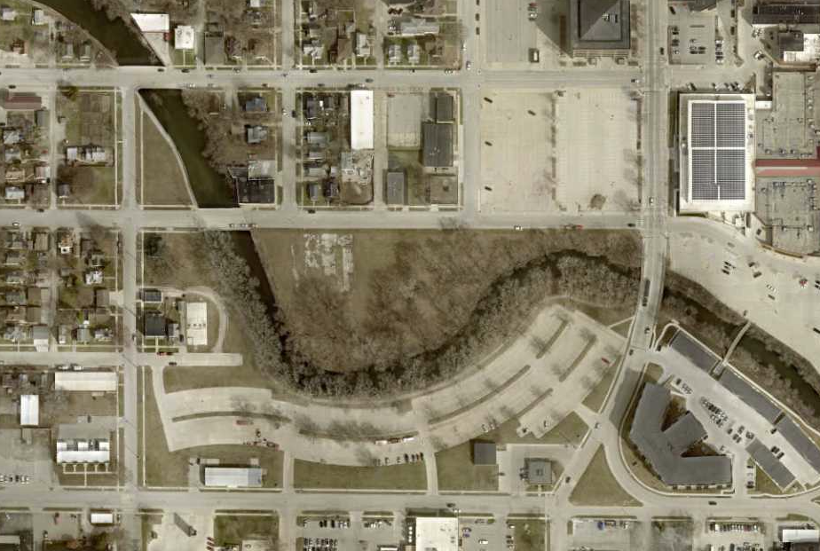
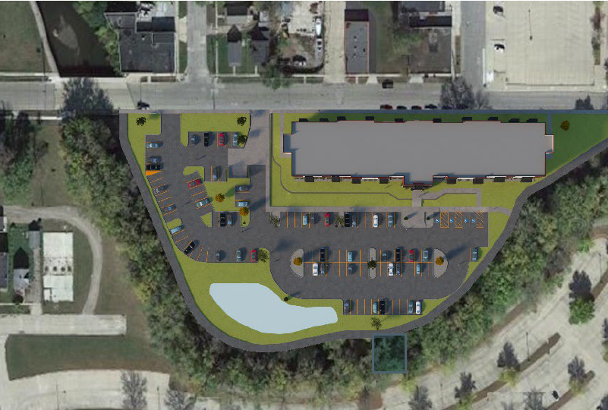

Slide 16
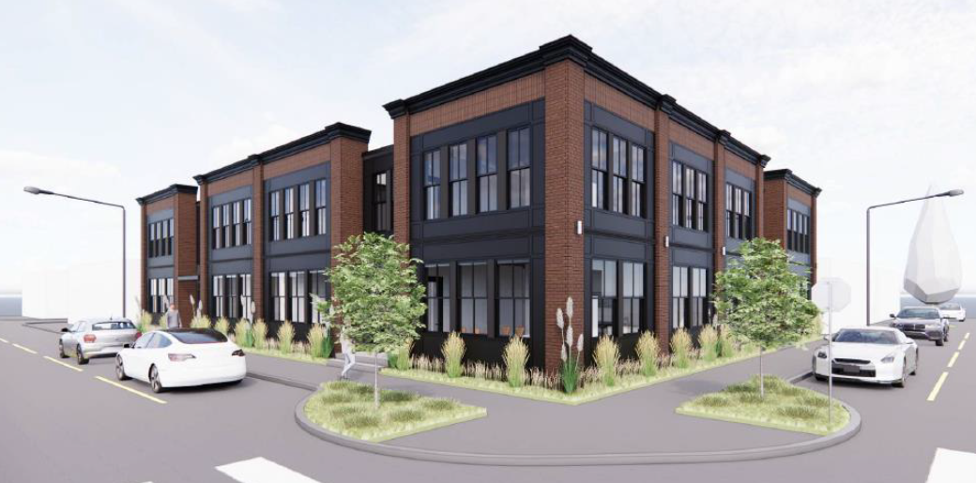

Slide 18
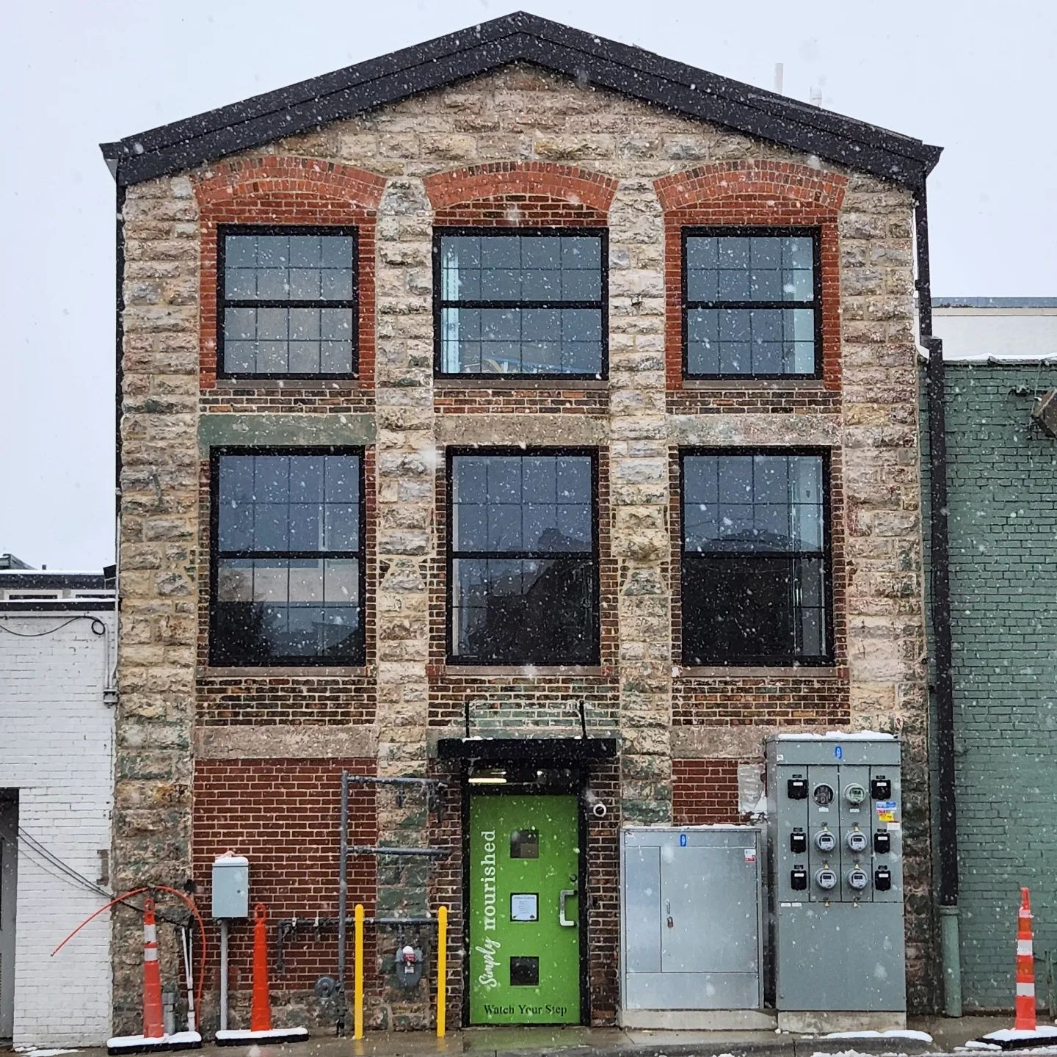
WHAT’S NEXT
South Shore Estates
Emerald Place
Delaware Ave Apartments
Pebble Creek Apartments
Kirk Redevelopment
Mason City Housing Plan
Mason City Rehabilitation Grant
YWCA Housing Conversion
Private Developments
Numerous subdivision and multifamily projects in discussion

Slide 19
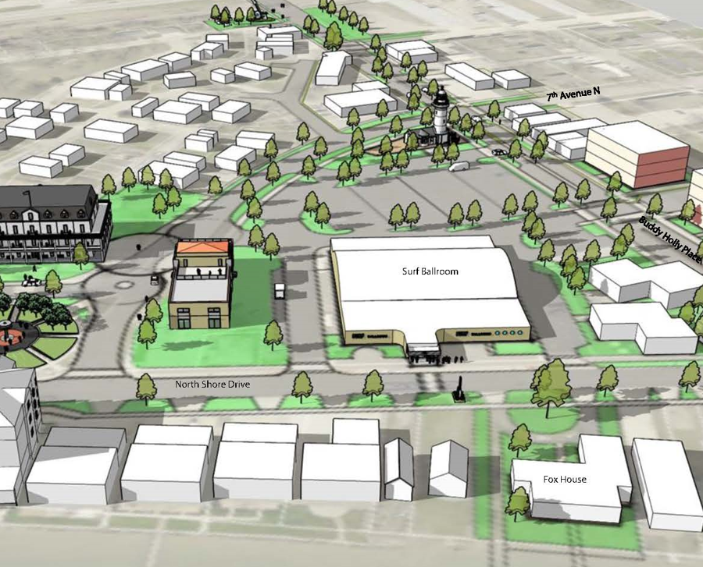

Slide 20
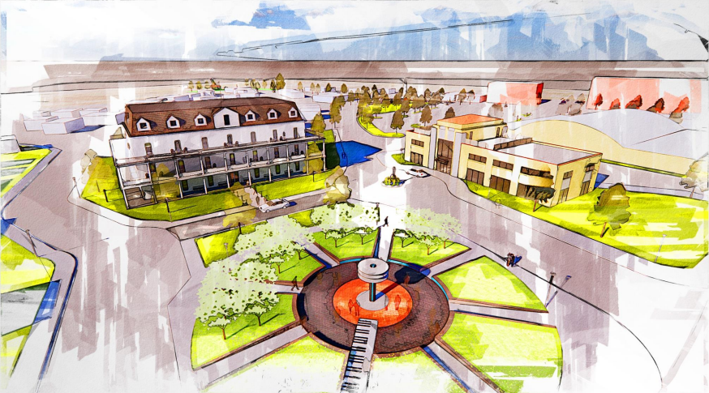

Slide 22
High Line Singletrack

Slide 23
Bike Park and Pump Track (The Railyard)
Varying difficulty and texture (dirt, asphalt, concrete) navigated by riders via body movement vs. pedaling
The Railyard Bike Park
Rogers, Arkansas
Facebook: TheRailyardAR
Website: rogersar.gov/RailyardBikePark

Slide 24
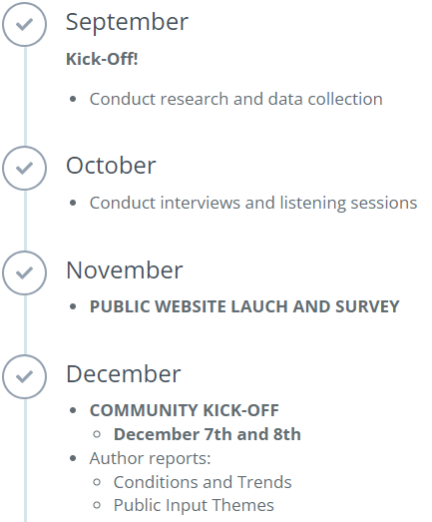
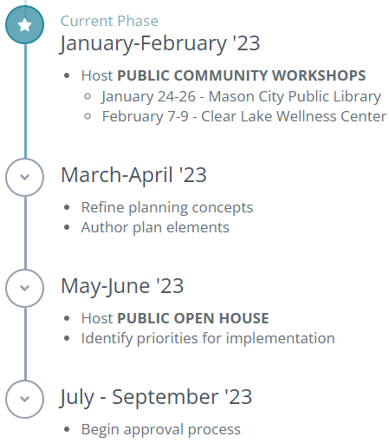
North Iowa Corridor Comp Plan

Slide 25
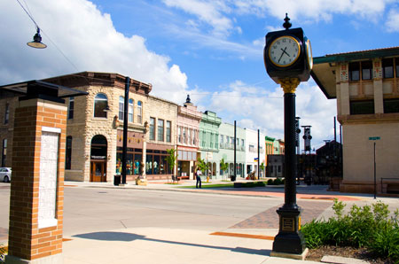
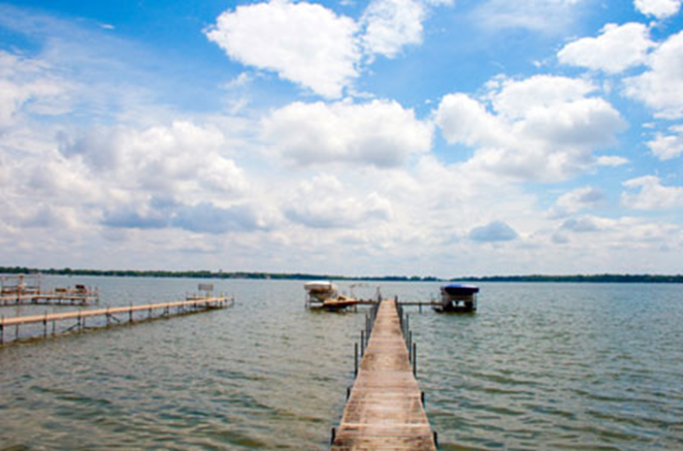
www.NorthIowaCorridor.com
www.ThisisNorthIowa.com
rdgusa.mysocialpinpoint.com/north-iowa-corridor-plan
Chad Schreck
President & CEO
cschreck@northiowacorridor.com
641-423-0315

