Slide 1
Transportation Trends Update
Transportation Commission Workshop
August 7, 2023

Slide 2
Overview
US total rail carloads
Commercial air service passenger counts
Vehicular traffic

Slide 3
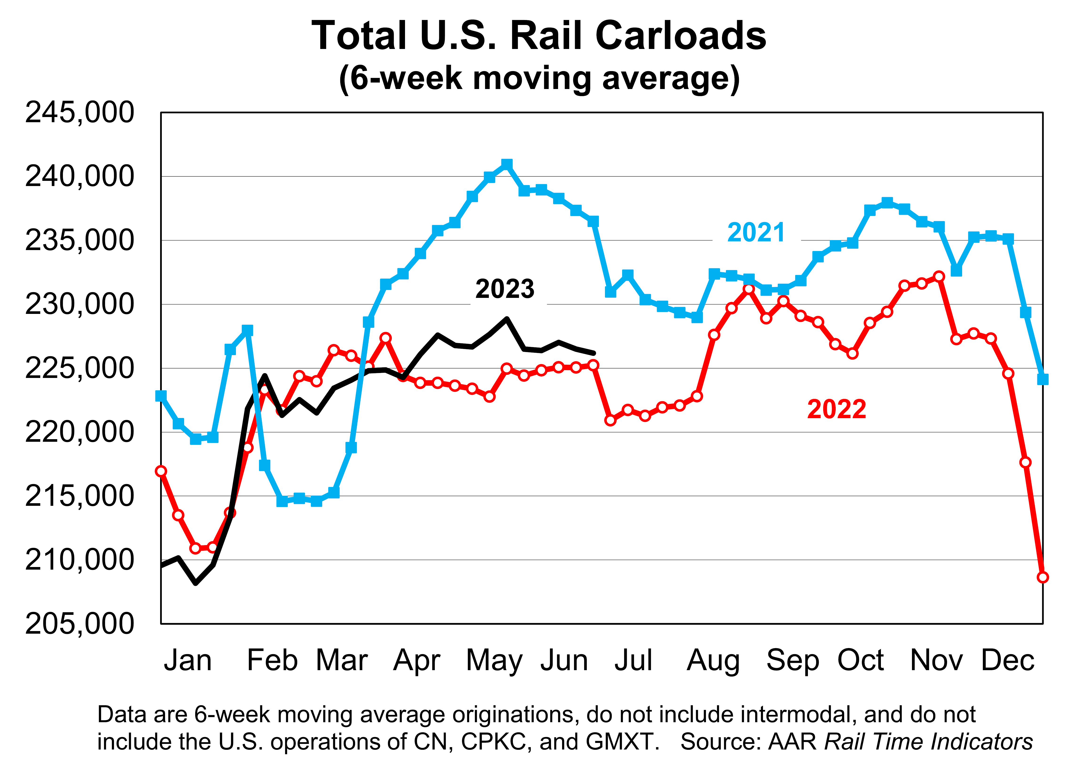

Slide 4
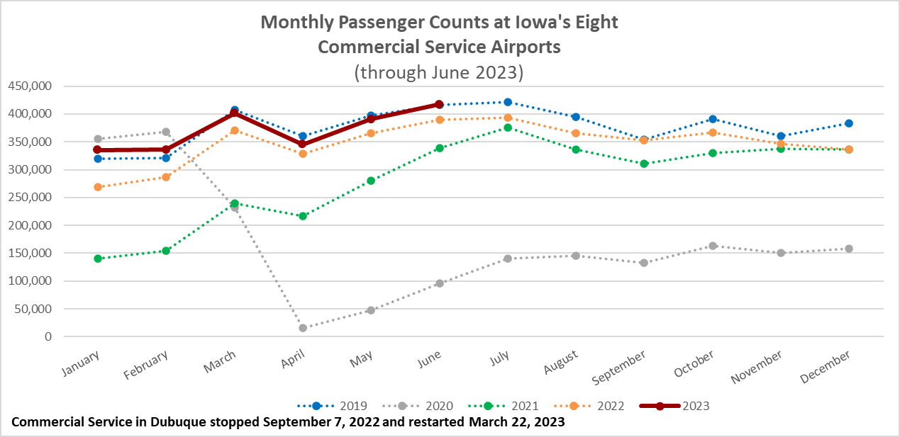

Slide 5
Monthly State Vehicle Miles of Travel
(through June 2023)

Slide 6
Questions?

