Slide 1
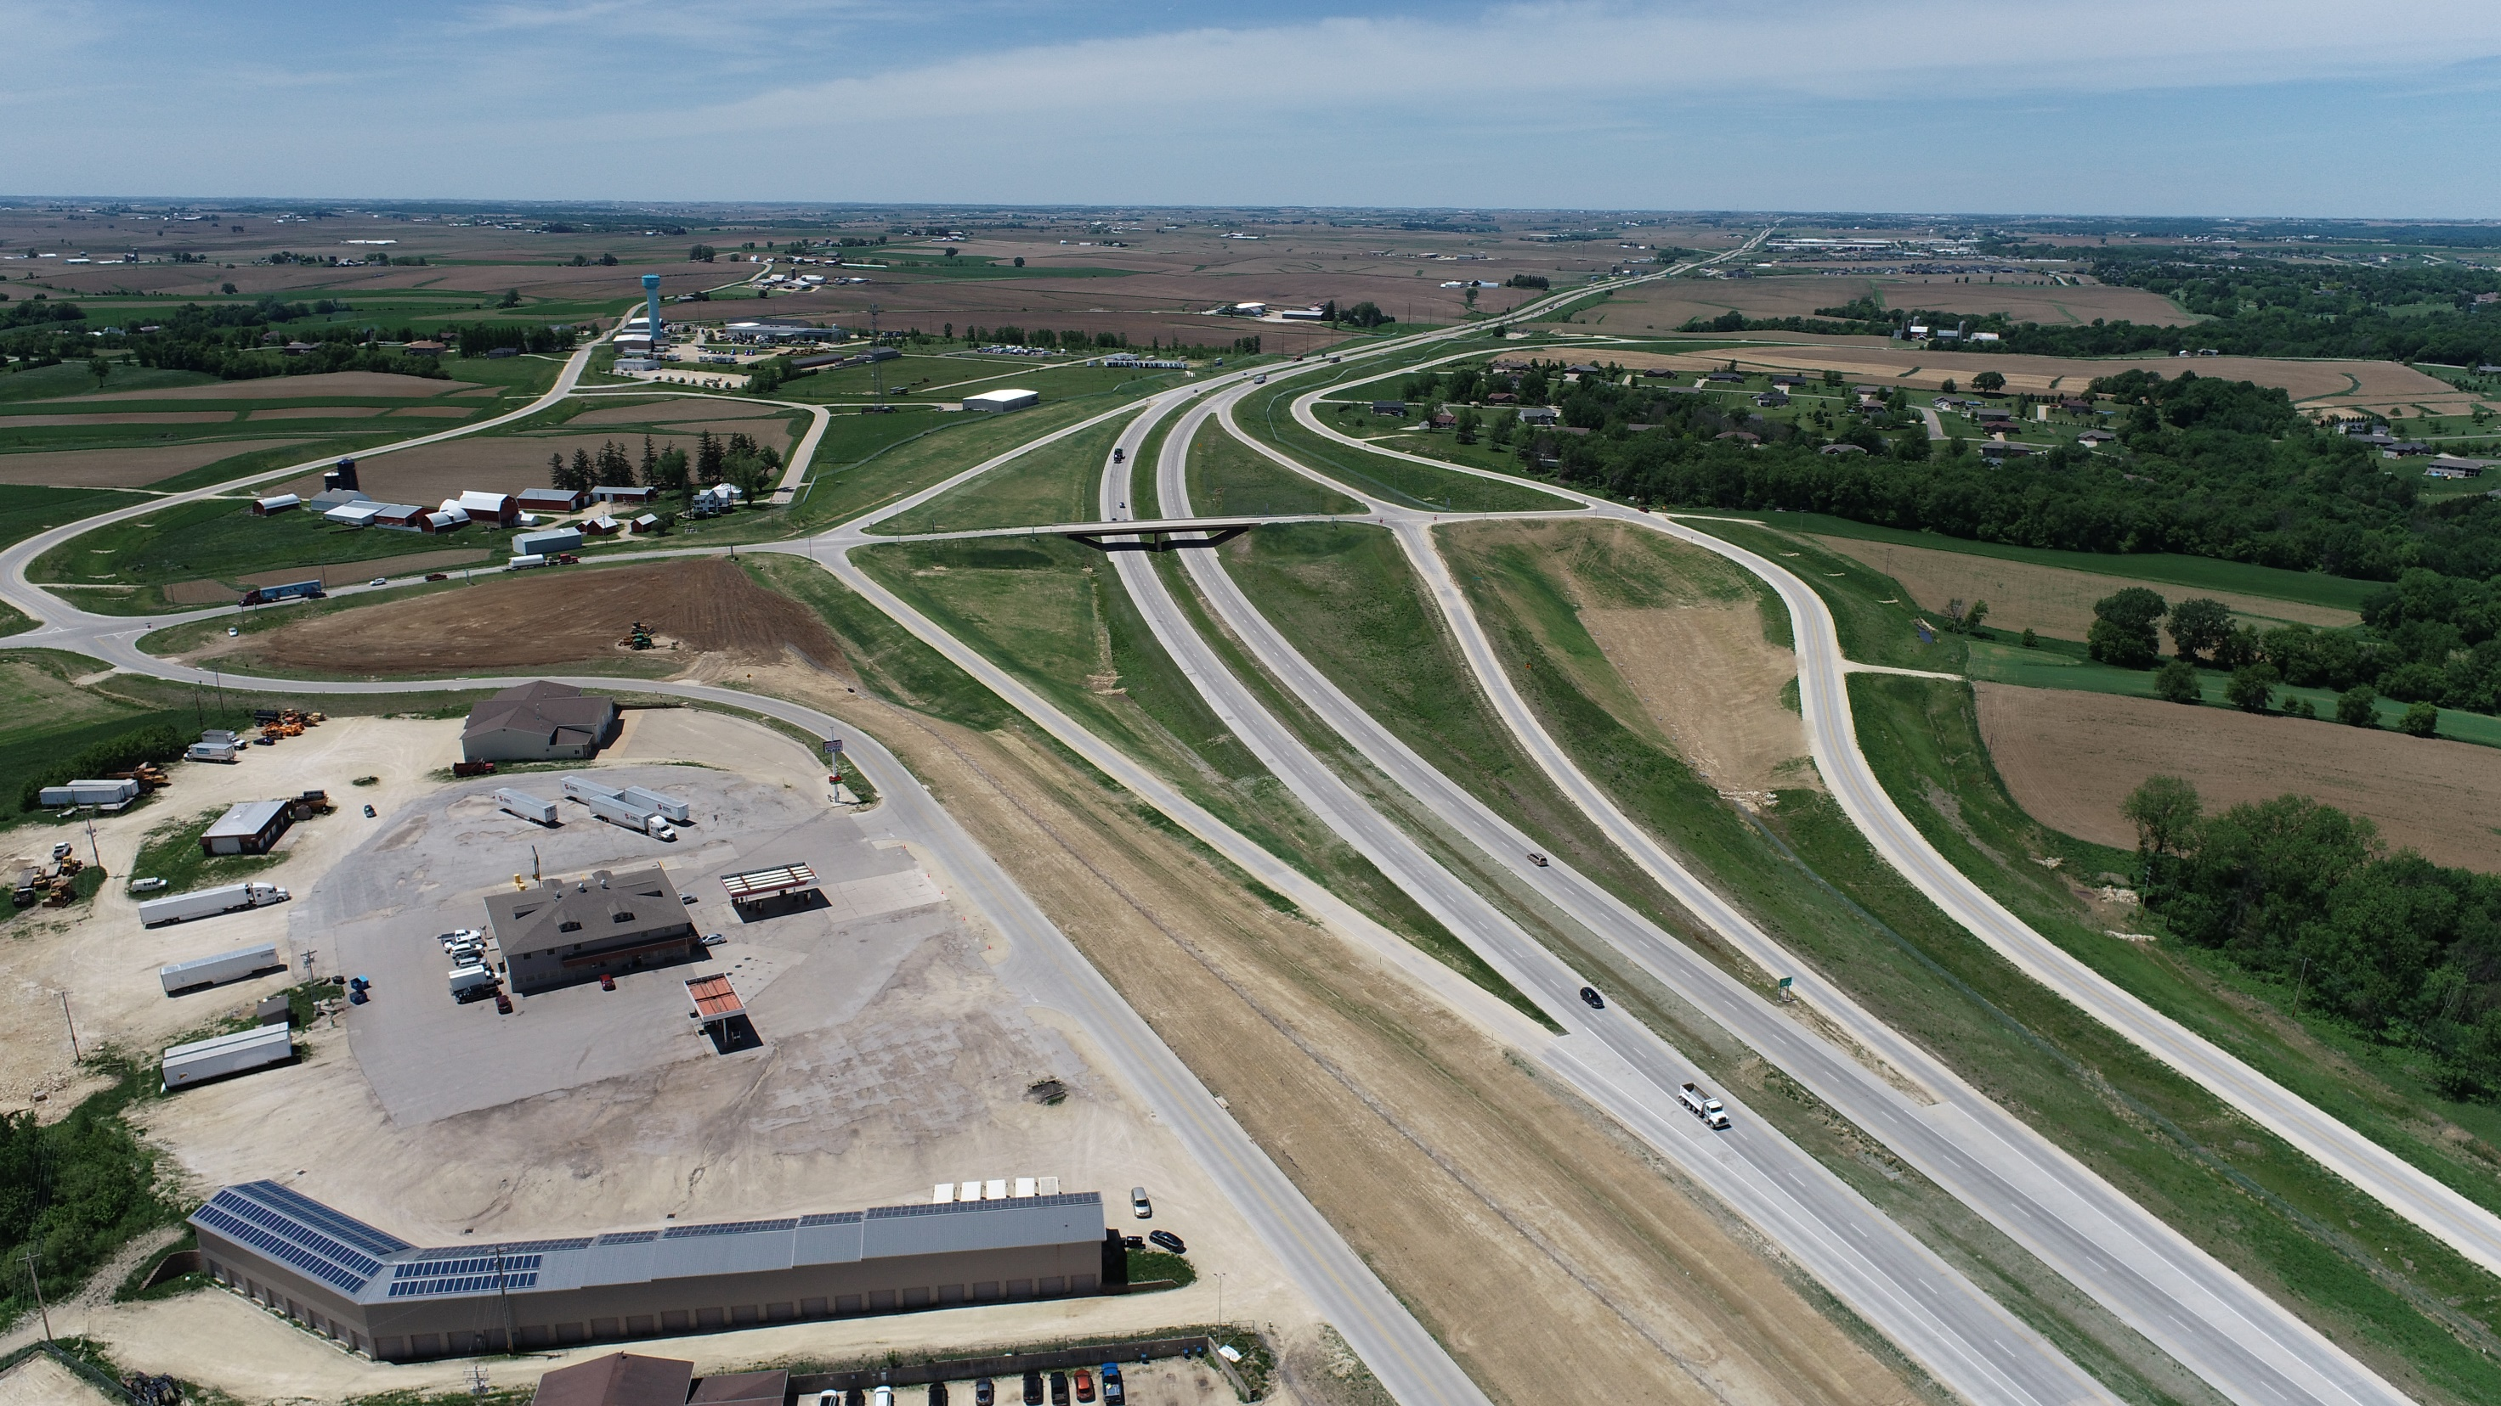






IADOT COMMISSION PRESENTATION
US 20 / SWISS VALLEY INTERCHANGE
Dubuque Metropolitan Area Transportation Study (DMATS)
08/08/2023

Slide 2
THIS PRESENTATION WILL COVER
Partnerships
US 20 / NW Arterial Improvements
Impact of Merger of CP & KCS on DMATS
Building Bridges to Employment and Equity – RAISE Grant
2 | IADOT Commission Meeting 08-08-2023
DMATS

Slide 3






PARTNERHSIPS
3 | IADOT Commission Meeting 08-08-2023
DMATS

Slide 4
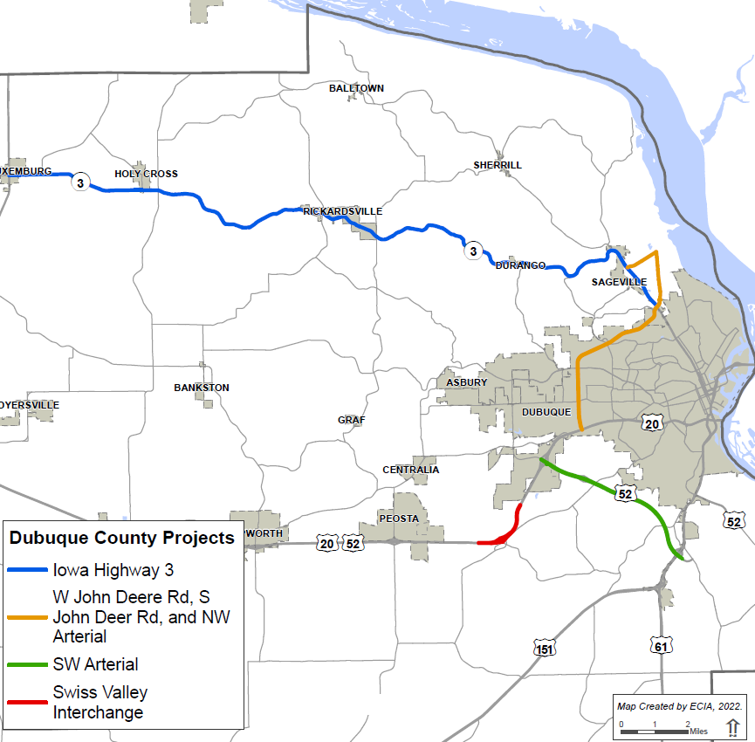
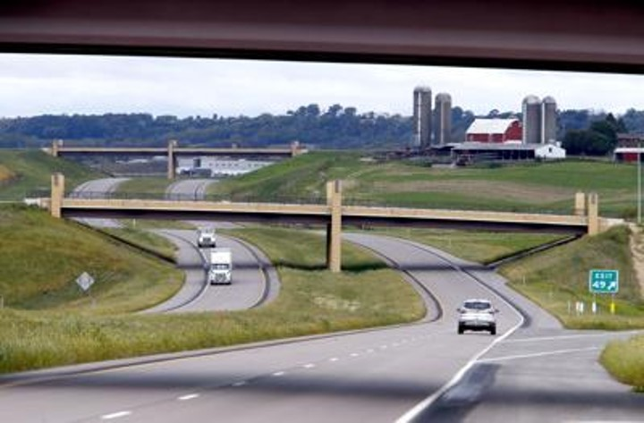
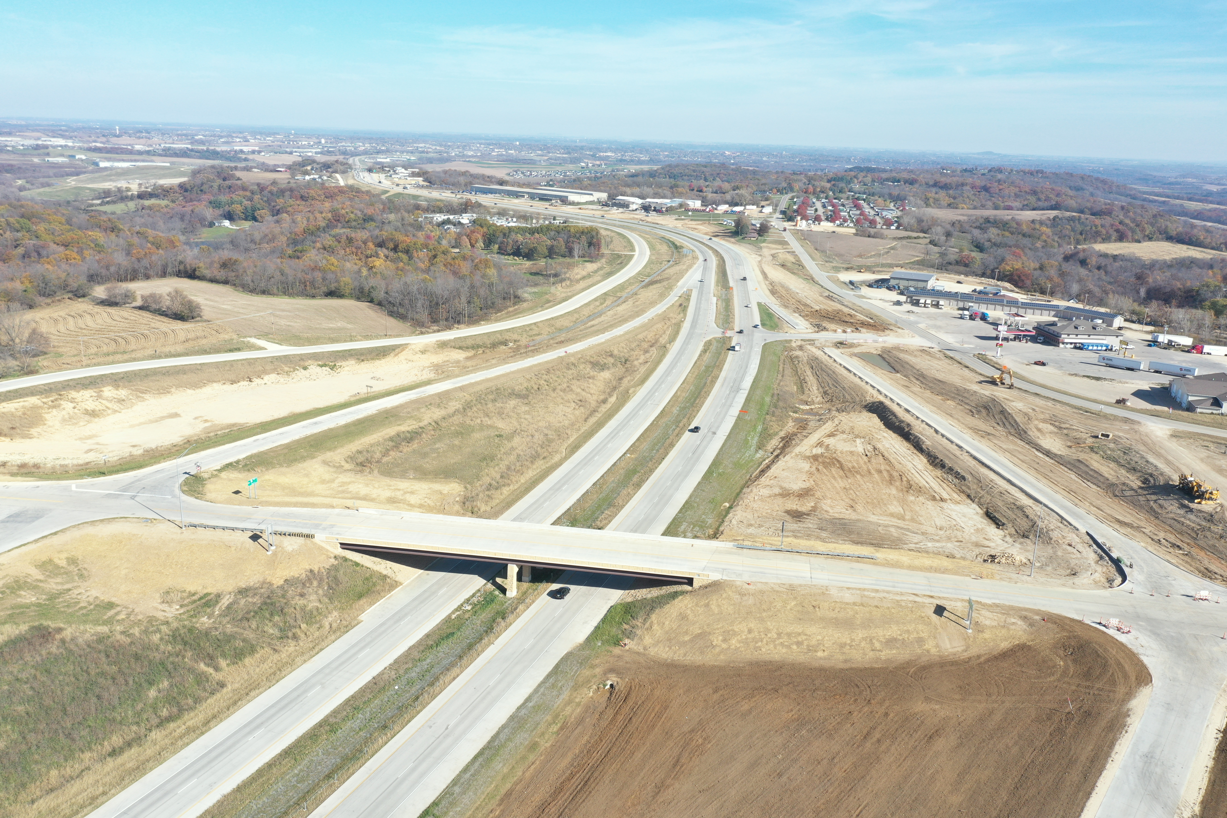
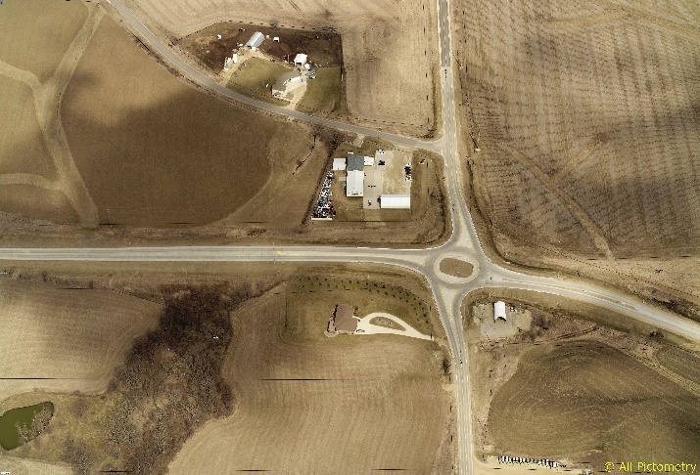
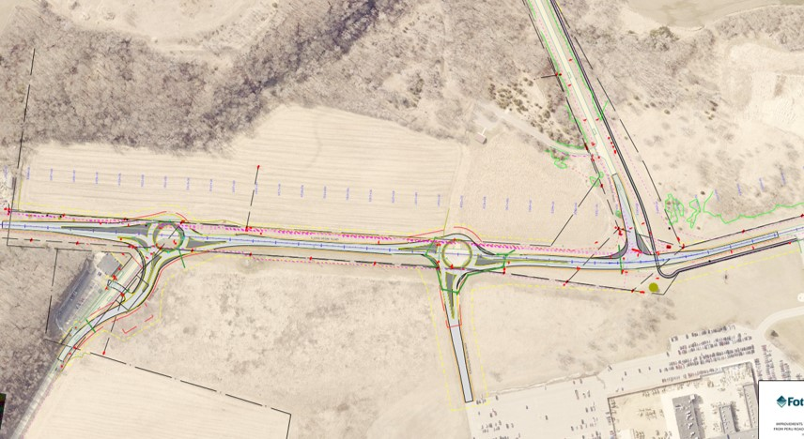
THANK YOU
US 52 / SW ARTERIAL
SWISS VALLEY
IA 3
JOHN DEERE
4 | IADOT Commission Meeting 08-08-2023
DMATS

Slide 5
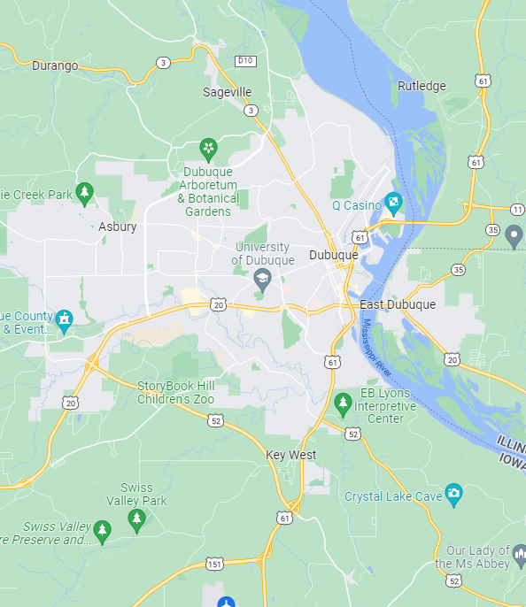
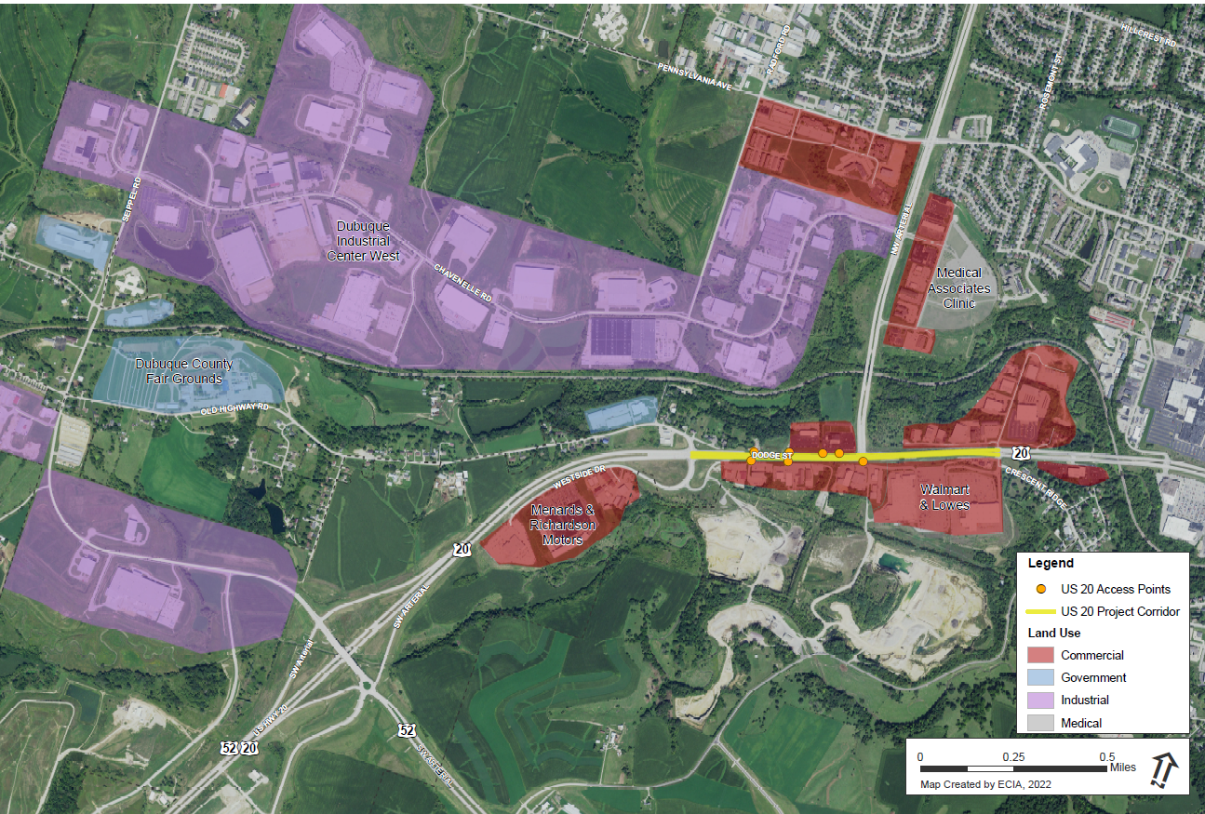

US 20 / NW ARTERIAL INTERSECTION
MAJOR INDUSTRIAL
HIGH SCHOOL
MAJOR
MEDICAL
MAJOR INDUSTRIAL
MAJOR COMMERCIAL
DMATS

Slide 6
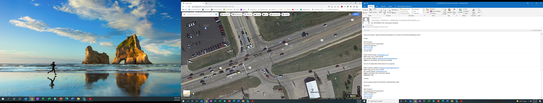
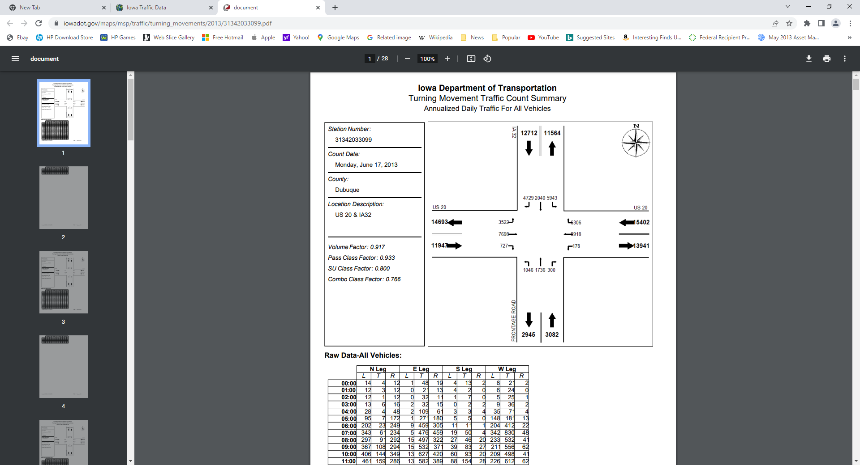
EXISTING CONDITION
Crash History
Congestion
DMATS

Slide 7
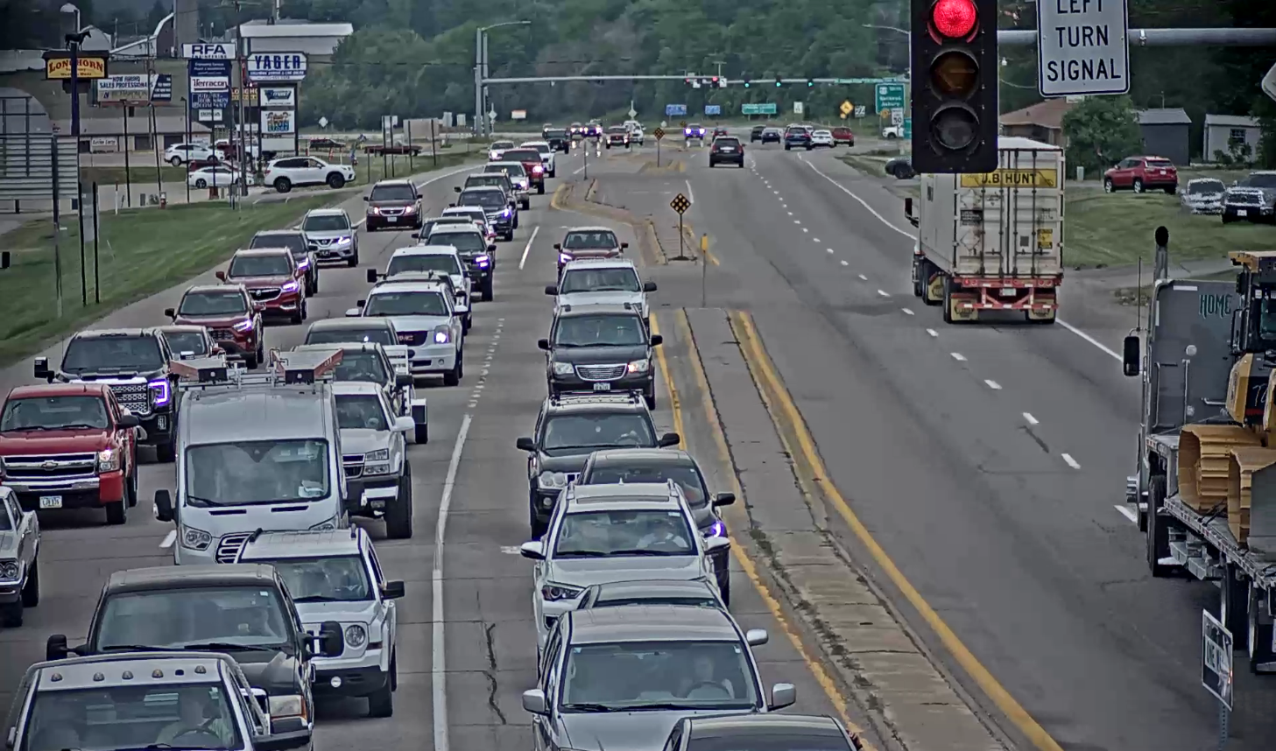
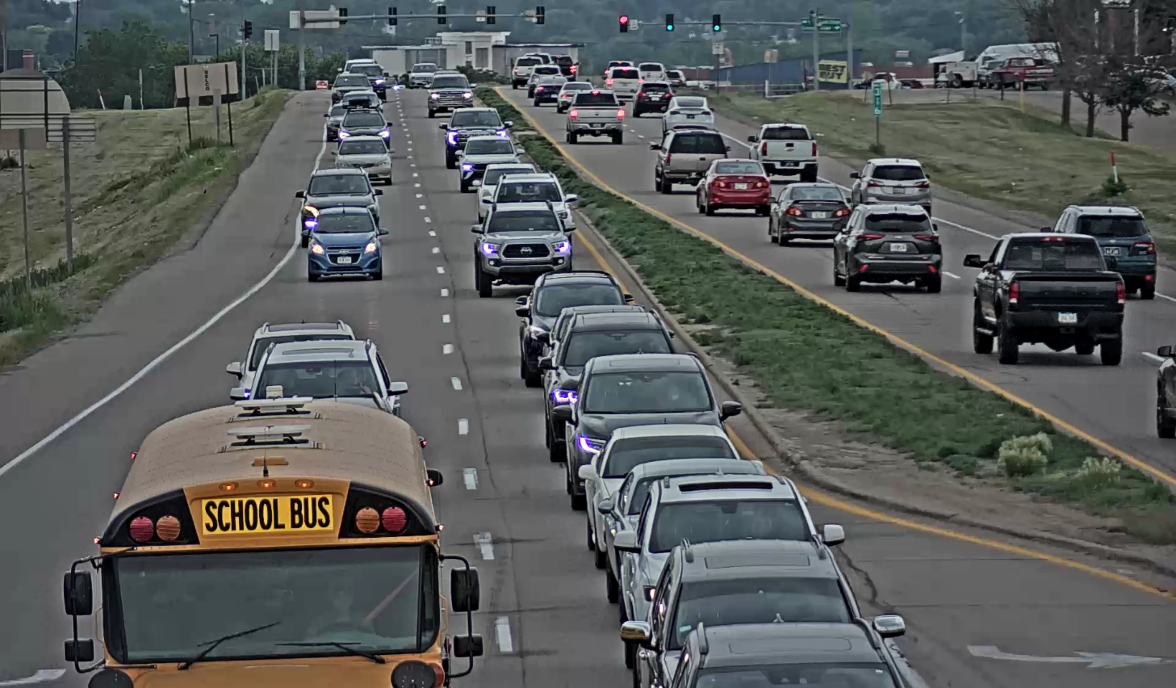
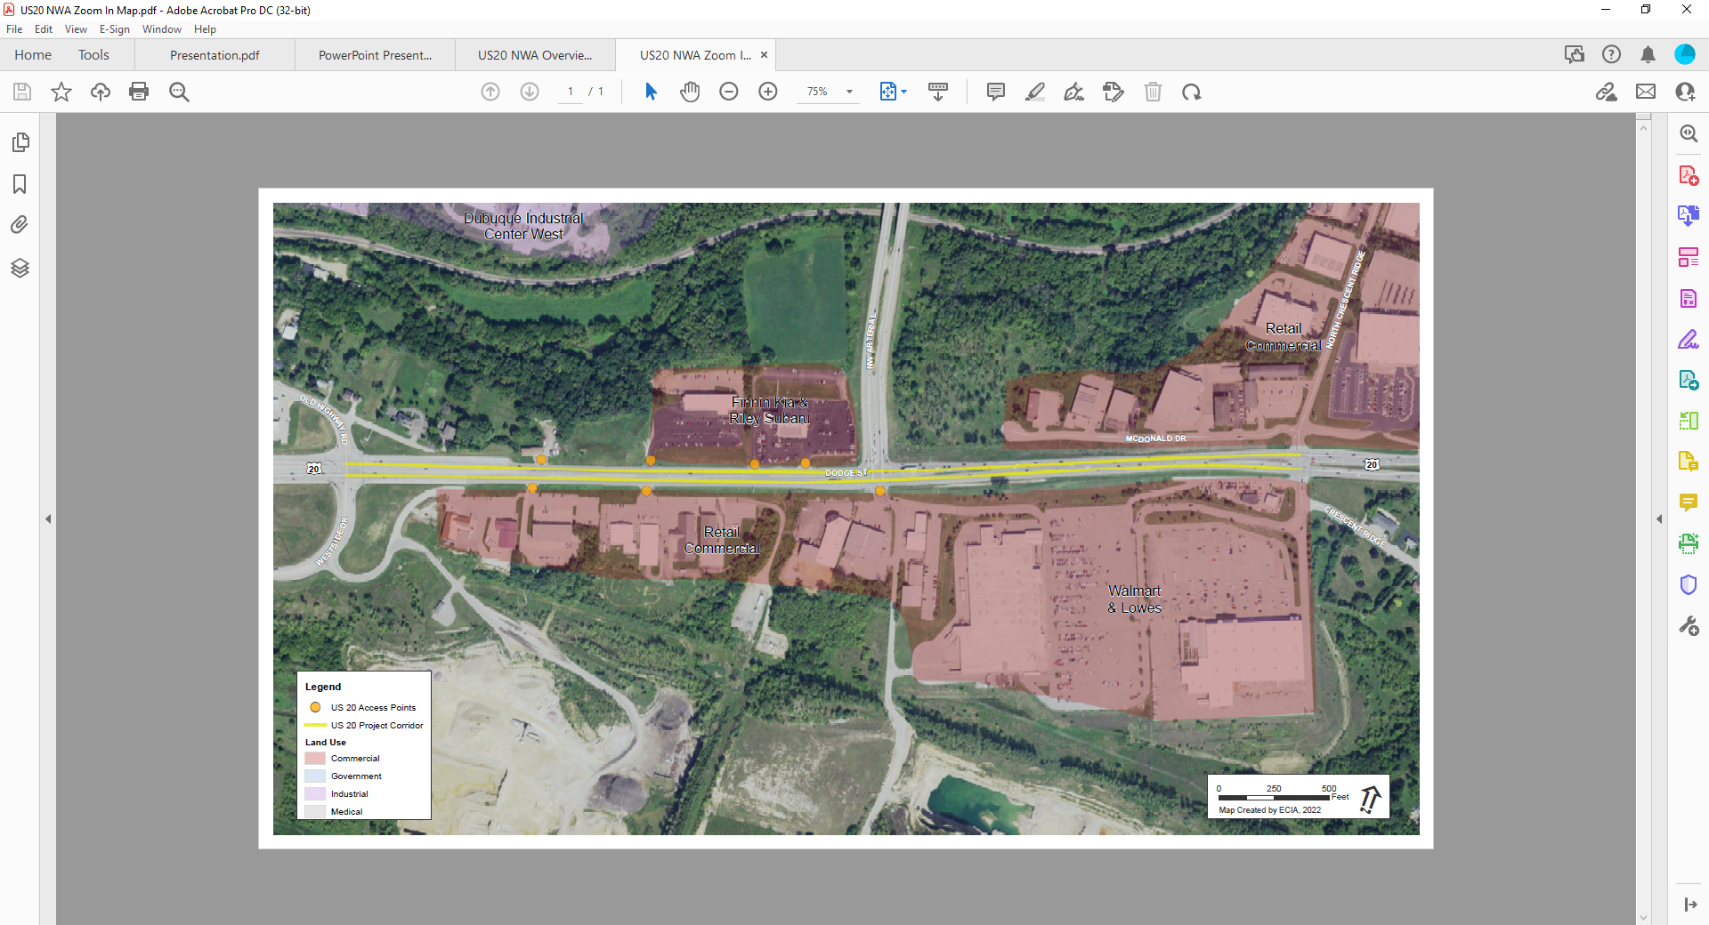
EXISTING CONDITION
East Bound
West Bound
Multiple Access Points
Crashes are primarily related to:
  Lack of capacity at this intersection / congestion
  Poor access management near the intersection
DMATS

Slide 8
PROJECT TIMELINE
IADOT Conducted a US 20 Location Study from SW Arterial to Middle Fork Catfish Creek (2014)
  Free Flow Alternative
  Partial Interchange Alternative
  Eight‐Lane Arterial Alternative
  Six‐Lane Arterial Alternative
Improvements at Old Highway (2018)
  Part of the improvements suggested in the Six‐Lane Arterial Alternative were addressed during construction of US 52/SW Arterial construction
Opening of US 52/SW Arterial to the public (2020)
City of Dubuque’s request IADOT to improve US 20 / NW Arterial Intersection (2020)
IADOT Conducted Location Study (2021)
        Four-Lane Arterial Alternative (Completed 2022)
DMATS

Slide 9
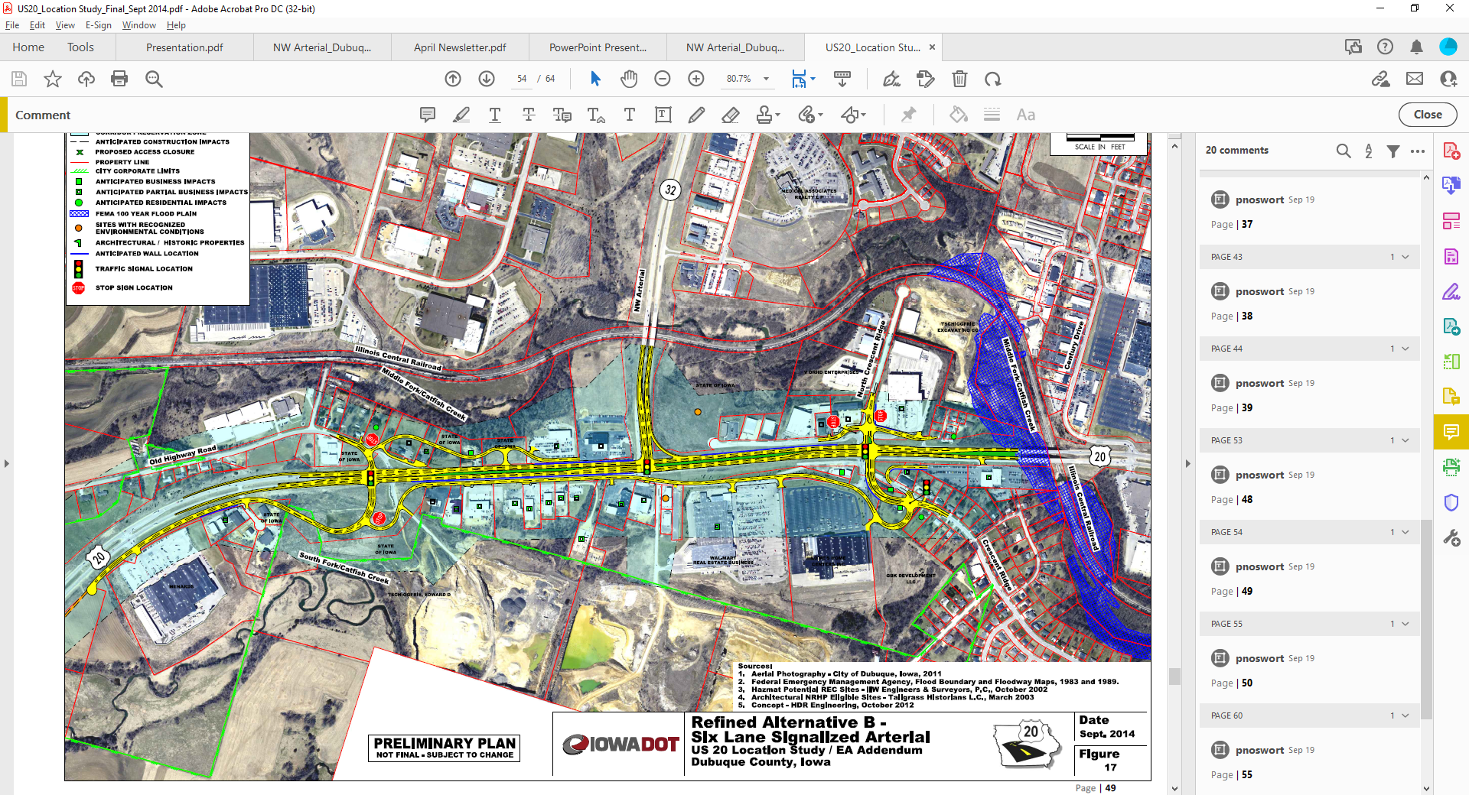
SIX LANE ARTERIAL ALTERNATIVE (Year 2014)
Two-way frontage roads serve existing mid-block access back to Old Highway Road
Three- leg intersection for US 20 and NW Arterial, eliminated south leg
Two-way frontage roads serve existing mid-block access back to Old Highway Road and Crescent Ridge
Design Features | Environmental Issues | Right-of-Way /Property Impacts ($ Million) | Order of Magnitude Cost ($Million) (Includes ROW)
6-Lane Signalized Arterial | 2 Recognized Environmental Conditions sites. Potential minor floodplain impact | 13.5 acres impacted 0 Full Residential 23 Partial Commercial 3 Full Commercial | $52 million in 2022 dollars
DMATS

Slide 10
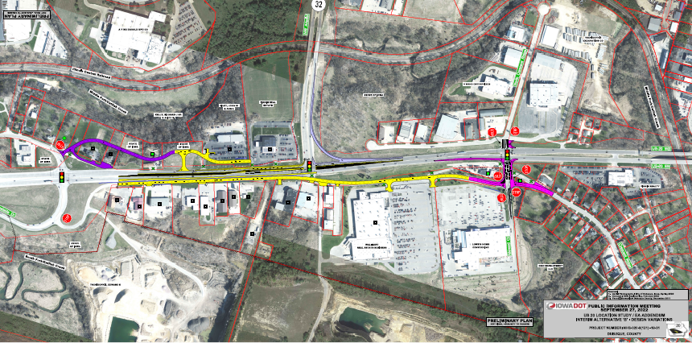
FOUR LANE ARTERIAL ALTERNATIVE (Year 2022)
Two-way frontage roads serve existing mid-block access back to Old Highway Road
Three- leg intersection for US 20 and NW Arterial, eliminated south leg
Two-way frontage roads serve existing mid-block access back to Old Highway Road and Crescent Ridge
Design Features | Environmental Issues | Right-of-Way /Property Impacts ($ Million) | Order of Magnitude Cost ($Million) (Includes ROW)
4-Lane Signalized Arterial | 9 Potential regulated materials sites 5 Low risk sites 4 Moderate risk sites | 9 Potential regulated materials sites 5 Low risk sites 4 Moderate risk sites | $17.5 million in 2022 dollars
DMATS

Slide 11
NEXT STEPS
Opened to Public Input
Consideration of Comments From Public
  Reviewed and responded to all comments
Selected Preferred Alternative
Consider Programming Project In IADOT Five Year Program
DMATS

Slide 12
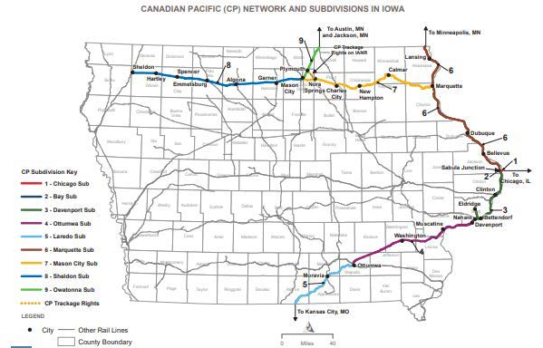
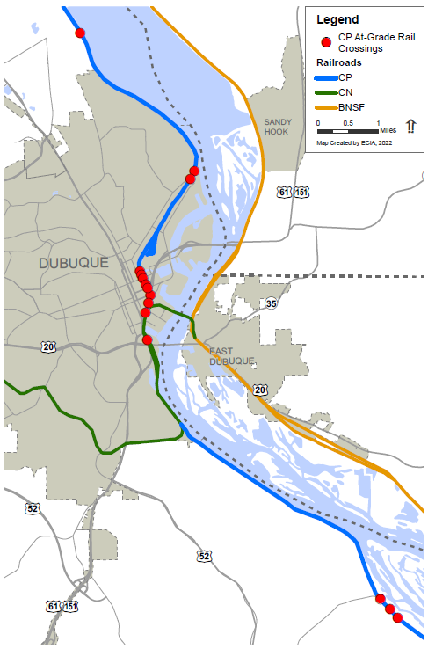

IMPACT OF CANADIAN PACIFIC AND KANSAS CITY SOUTHERN MERGER (KCS)
Route affected in Iowa
Intersections affected in DMATS
11 Intersections in the City of Dubuque
4 Intersections in Dubuque County
DMATS

Slide 13
NEXT STEPS
Conducting a Quiet Zone study
Will apply for Highway-Railroad Crossing Safety Program
DMATS

Slide 14
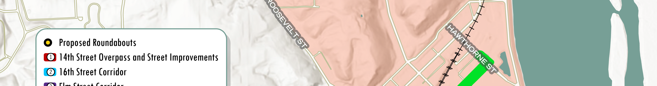
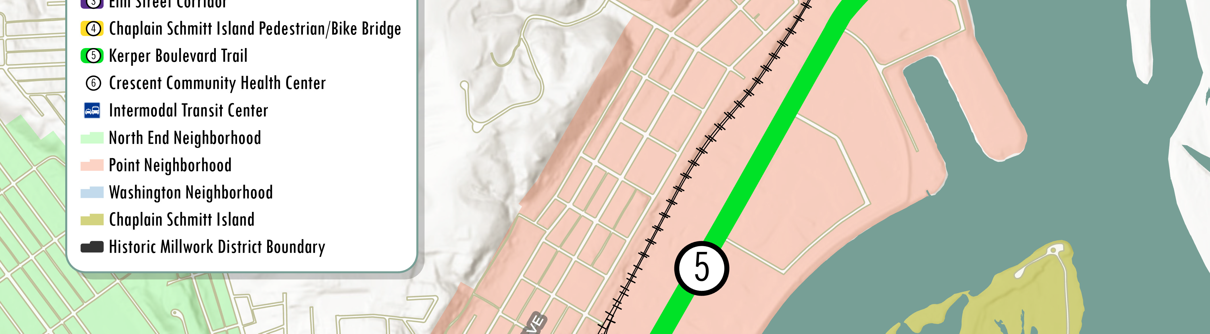
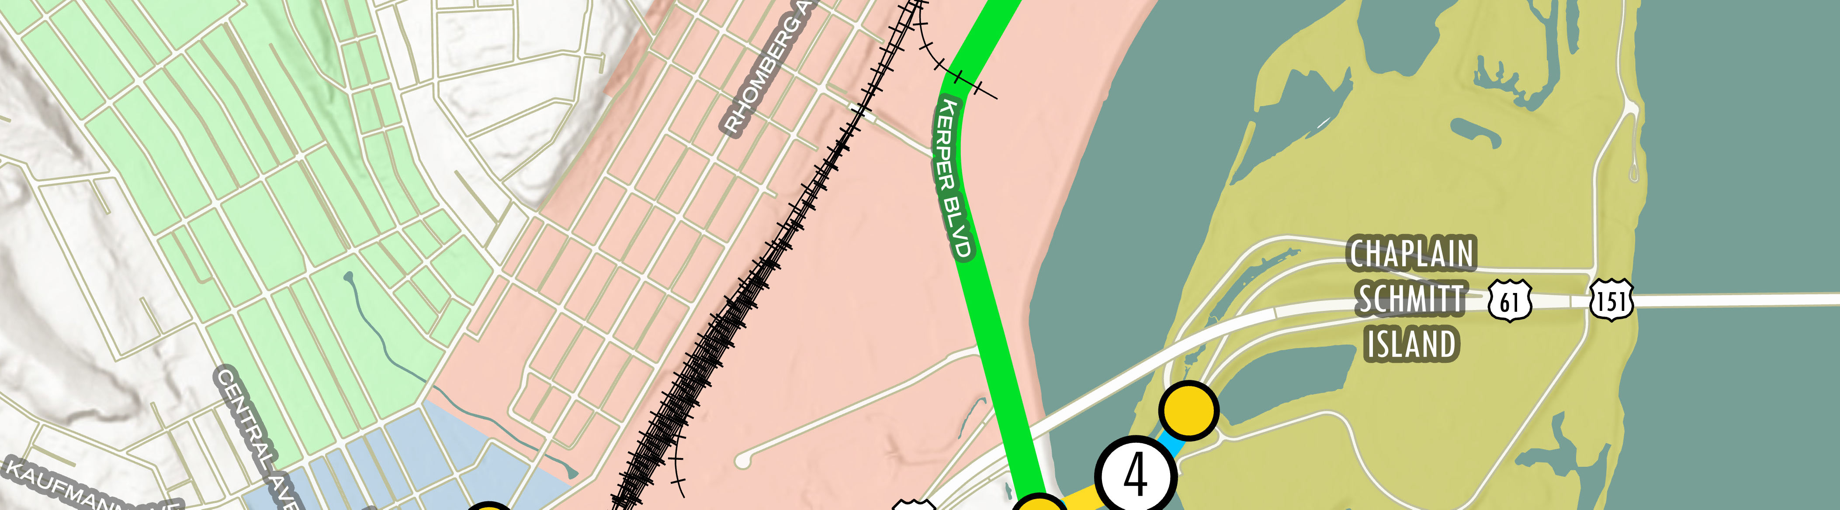
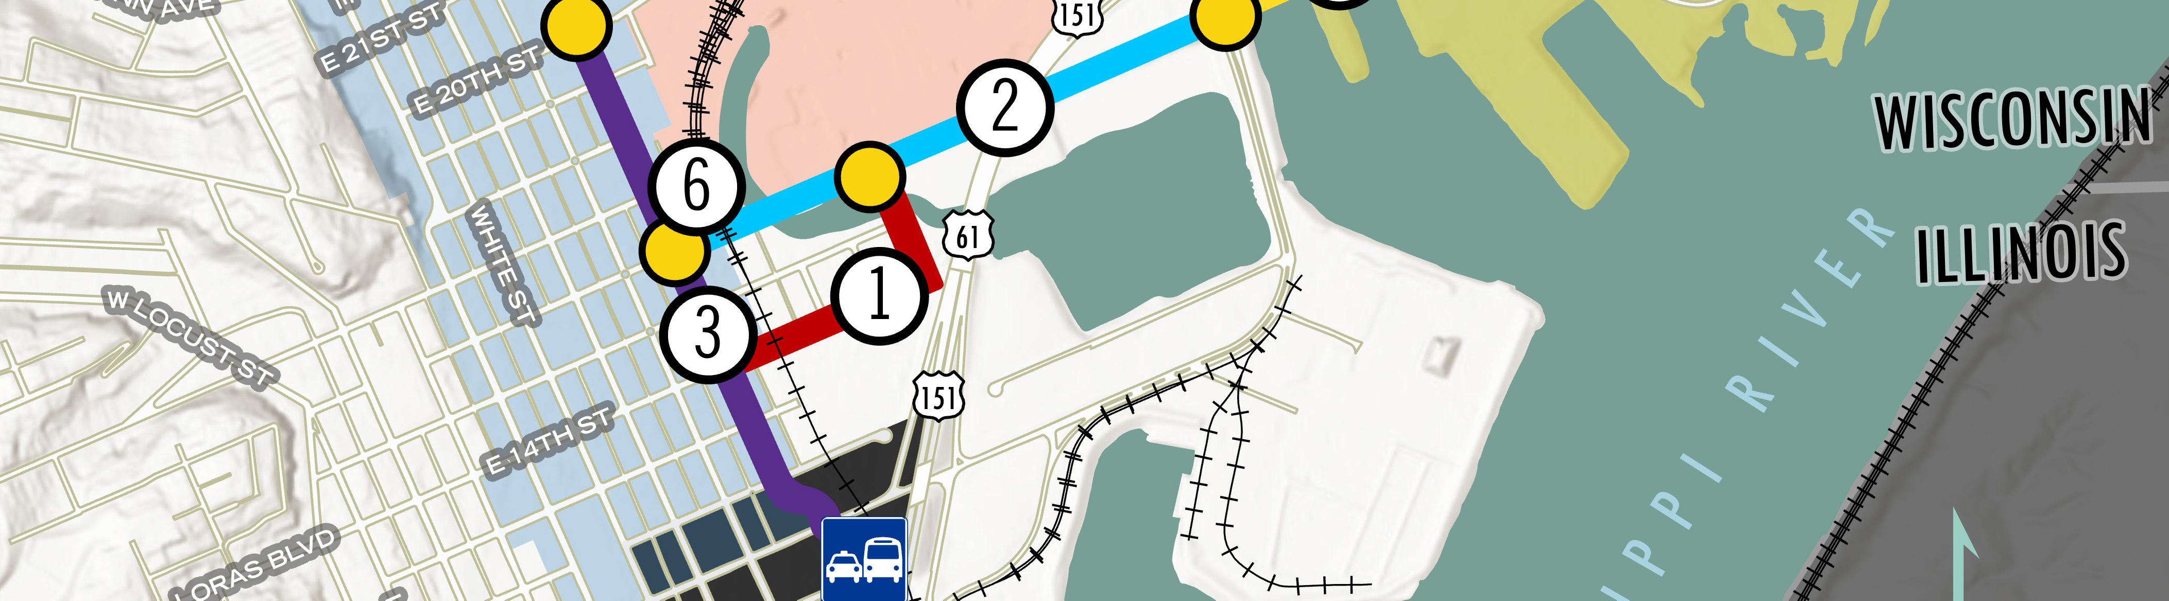
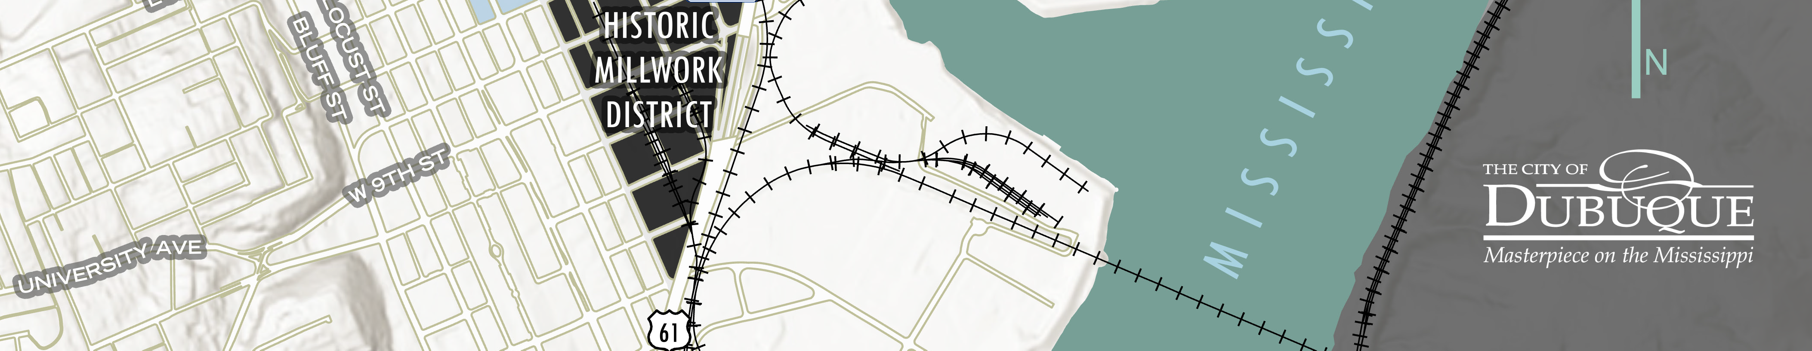



BUILDING BRIDGES TO EMPLOYMENT AND EQUITY
IMPROVEMENTS ON # 3
PROJECT AREA
14 | IADOT Commission Meeting 08-08-2023

Slide 15
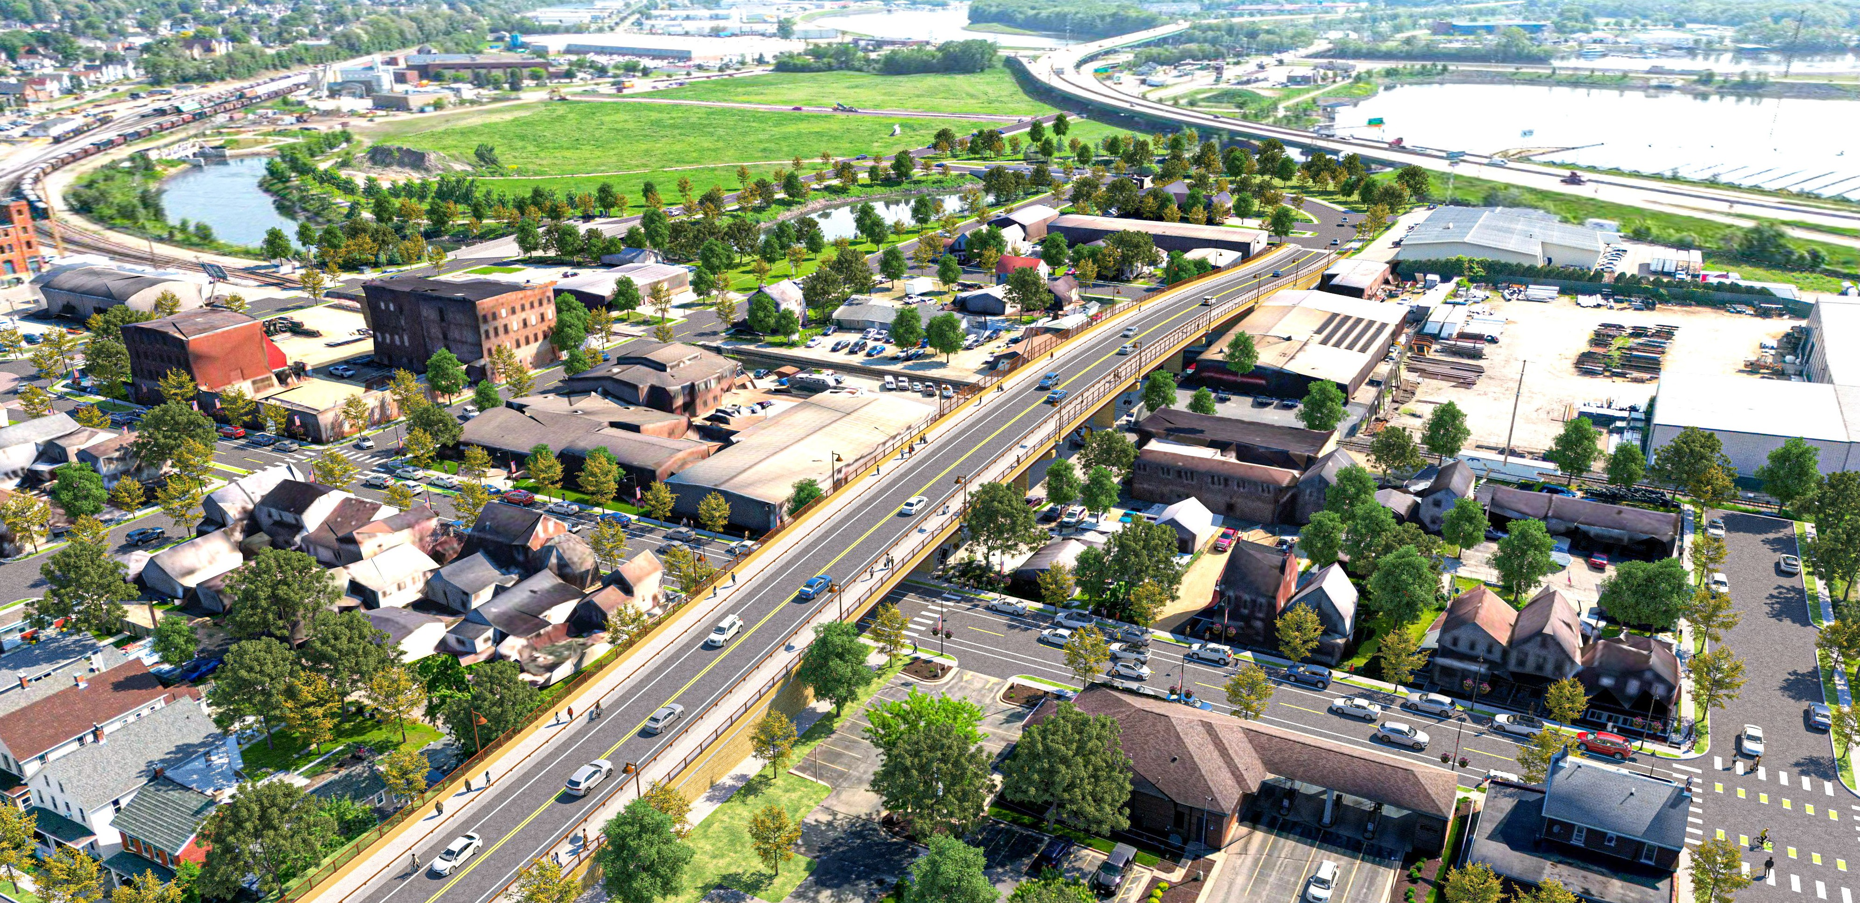
BUILDING BRIDGES TO EMPLOYMENT AND EQUITY
LEGEND
Bee Branch Bicycle & Pedestrian Trail
Future Redevelopment
Bee Branch Creek
16th Street Complete Street
14th Street CPKC Railroad Overpass
Connectivity to Chaplain Schmitt Island & Kerper Boulevard
Washington Street Neighborhood Revitalization
Dubuque’s 2 lowest income census tracts
8. Elm Street Complete Street
Connecting to Intermodal
Transportation Center.
To the Intermodal Transportation Center
Roundabouts
CPKC Railroad
10
6
1
2
10
1
4
3
11
10
11
5
7
8
9>
15 | IADOT Commission Meeting 08-08-2023

Slide 16
THANK YOU
16 | IADOT Commission Meeting 08-08-2023

