Slide 1
Revitalize Iowa’s Sound Economy Program
Iowa Transportation Commission Workshop
August 7, 2023

Slide 2
Revitalize Iowa’s Sound Economy Program
Created in 1985
Purpose: To promote economic development through roadway improvements.
Eligible development shall have value-adding activities that feed new dollars into the economy
Available to cities and counties through an application program

Slide 3
Available Funding and Application Summary
Available Funding
Funded annually with dedicated state motor fuel and special fuel tax revenues
Application Summary for SFY2024
Total number of projects awarded: 0
Total project costs: $0
Total amount awarded: $0
 | CITY | COUNTY
Average funding generated monthly | $972,227 | $486,114
SFY 2023 current Road Use Tax Revenue (as of 6/30/2023) | $11,759,666 | $5,879,833
Current Unobligated Balance (as of 6/30/2023) | $6,101,746 | ($4,422,124)

Slide 4
Local Development Project Evaluation Criteria
Development Potential (35 points)
Economic impact and Cost Effectiveness (20 points)
Local Commitment and Initiative (33 points)
Transportation Need and Justification (4 points)
Local Economic Need (6 points)

Slide 5
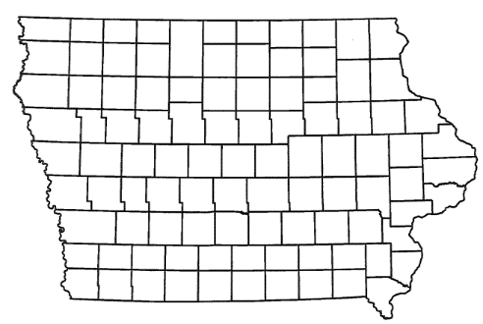
List of Local Development
Applications Recommended
PROJECT NAME
SPONSOR
SCORE
TOTAL PROJECT COST
PERCENT PARTICIPATION
RECOMMENDED AMOUNT
Construction of approximately 1,560 feet of Campus Drive, 2,180 feet of the relocated Pleasant Street and 2nd Street NE, and a 370-foot left turn lane on Campus Drive located on the east side of town. | Bondurant | 58 | $3,675,594 | 60% | $2,205,356

Slide 6
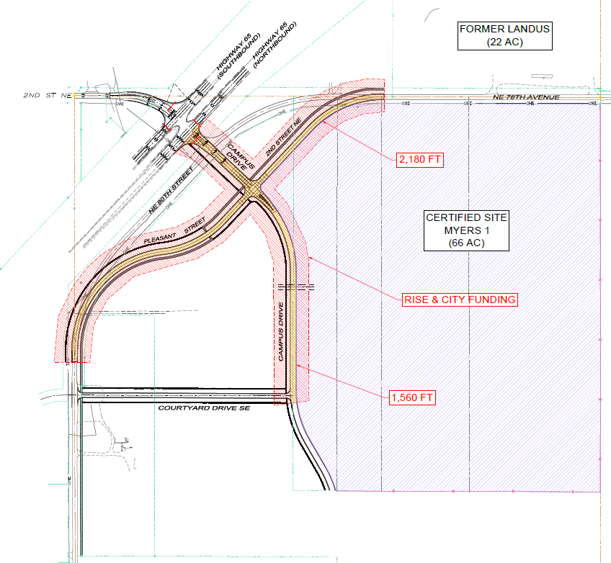
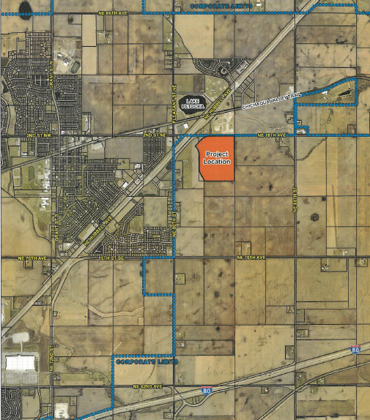
Bondurant
(Local Development – Certified Site)
Construction of approximately 1,560 feet of Campus Drive, 2,180 feet of the relocated Pleasant Street and 2nd Street NE, and a 370-foot left turn lane on Campus Drive located on the east side of town. This project is necessary to provide improved access to the Myers Industrial Site, an Iowa Economic Development Authority certified site of more than 66 acres.
Total Cost: $3,675,594
Requested: $2,205,356 (60%)

Slide 7
QUESTIONS?
Debra Arp, Systems Planning Bureau
Debra.Arp@iowadot.us
515-239-1681

