Slide 1
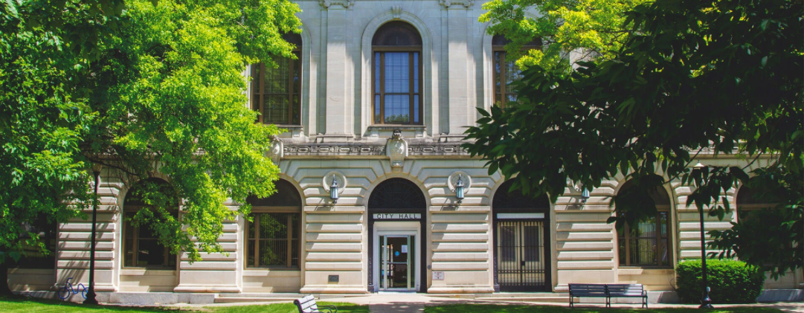
OTTUMWA

Slide 2
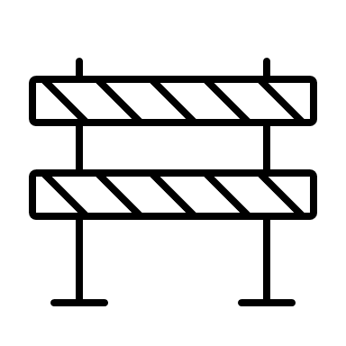
Ottumwa
Public and Commercial Investment – 2023 Through 2024
Largest and fastest growth in 35 years.
Largest Private Sector growth on record.
Expect at least $5M in new private funded projects in late 2024.

Slide 3
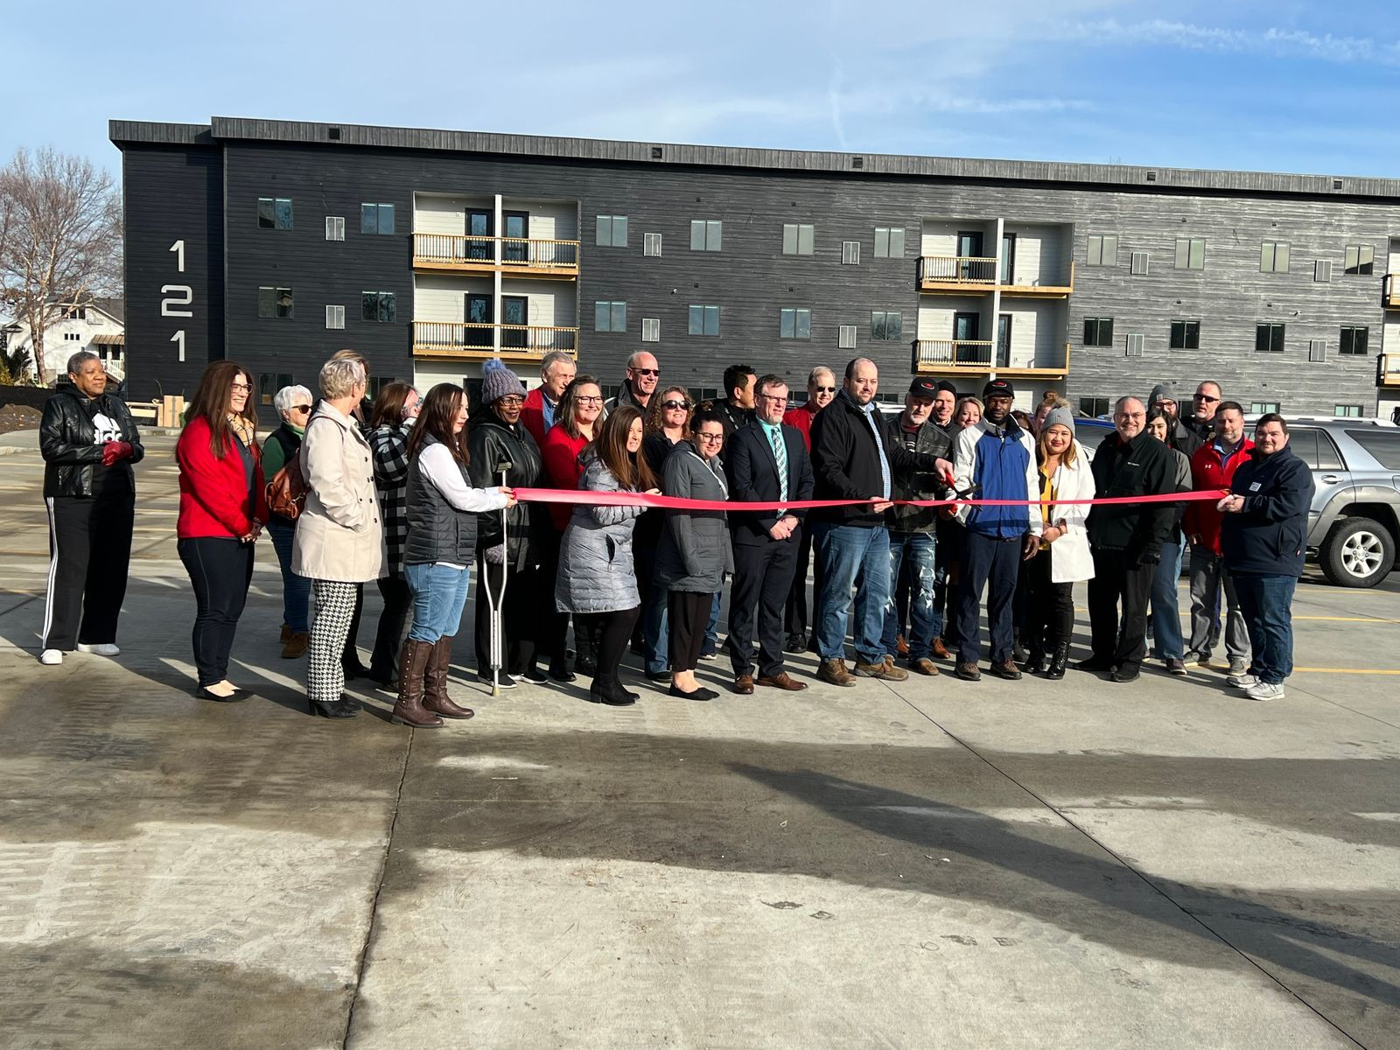
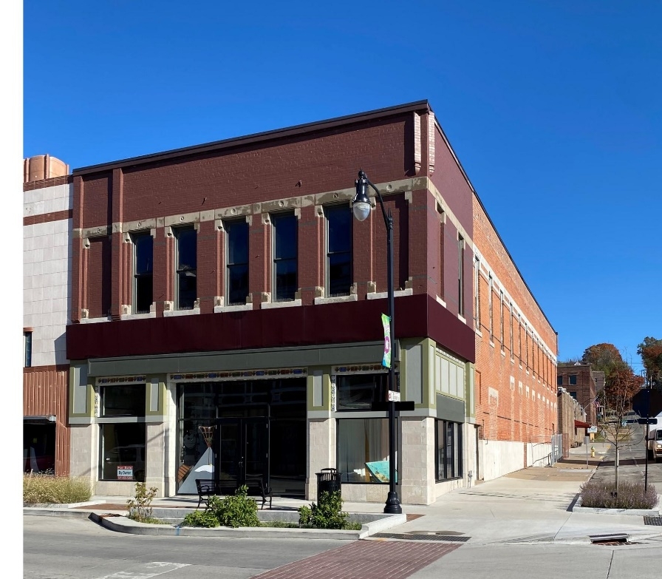
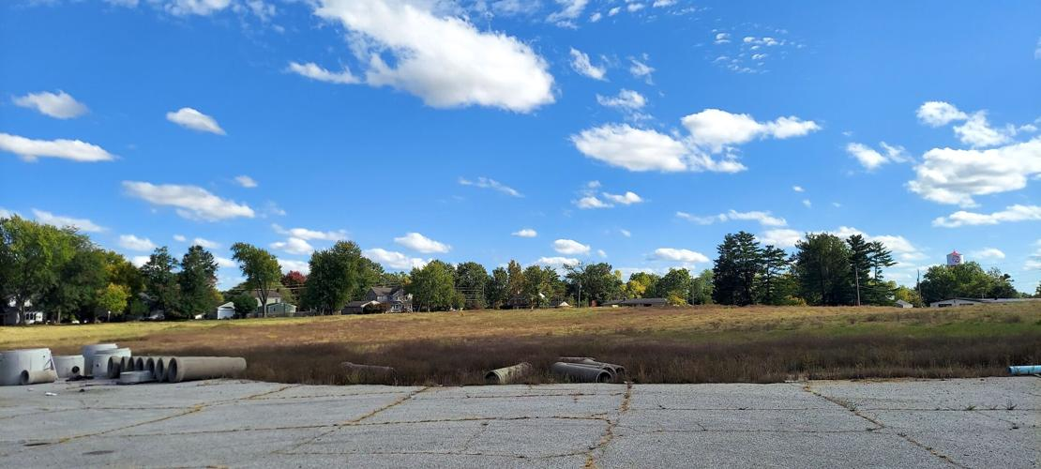
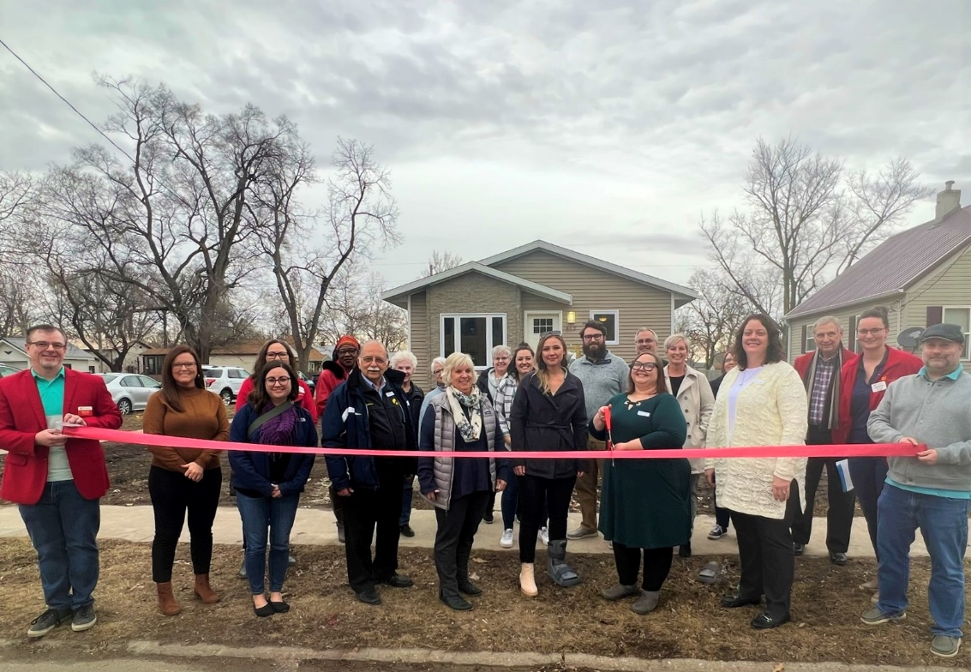
Ottumwa
Housing Development
2022-2024
$19.6M in new housing inventory
$17.6 Private Investment
Current Projects:
10 acre market rate housing site
Multiple infill development sites
Downtown upper-level rehabilitation

Slide 4
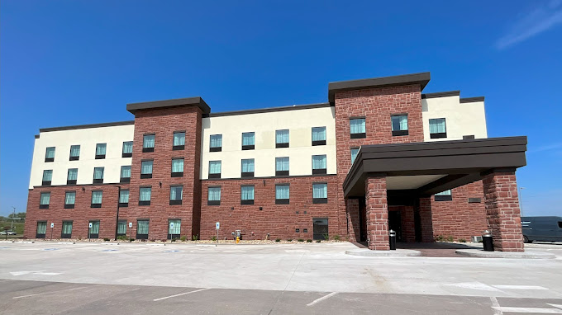
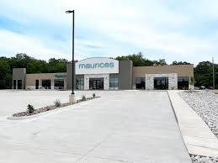
Ottumwa
Economic Growth – 2022 To 2024
Local Option Sales and Service Tax (LOSST) + 4%
Hotel/Motel Tax +16.17%
Overall Business Growth +1%

Slide 5
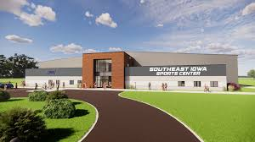
Ottumwa
The Future of Ottumwa - Tourism
70K sq ft Indoor Sports Complex
School District Competition Gymnasium and Tennis Courts
Competition Soccer Complex

Slide 6
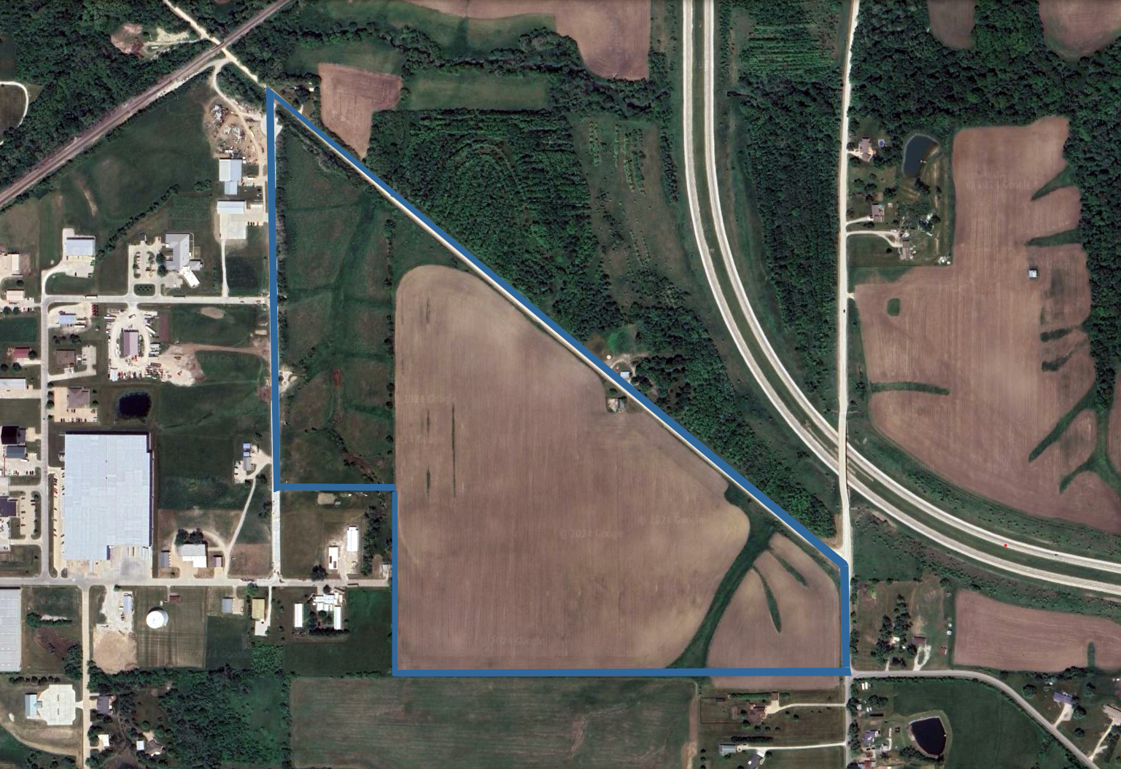
Ottumwa
The Future of Ottumwa – Commercial Development
Helgerson Flats
80 acres, Site Certified by Iowa Economic Development Authority
Adjacent to Ottumwa Industrial Park
Near access to Hwy 163

