Slide 1



Transportation Trends Update
August 12, 2024
3/2/2023

Slide 2
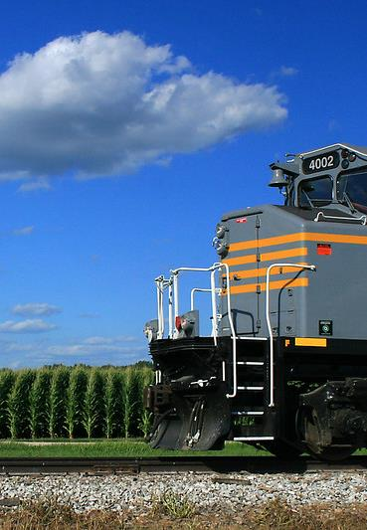

Agenda
US total rail carloads
Commercial air service passenger counts
Vehicular traffic
Mississippi River and Panama Canal

Slide 4
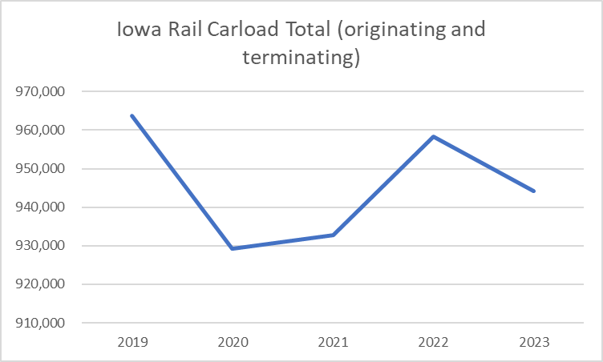

Slide 5
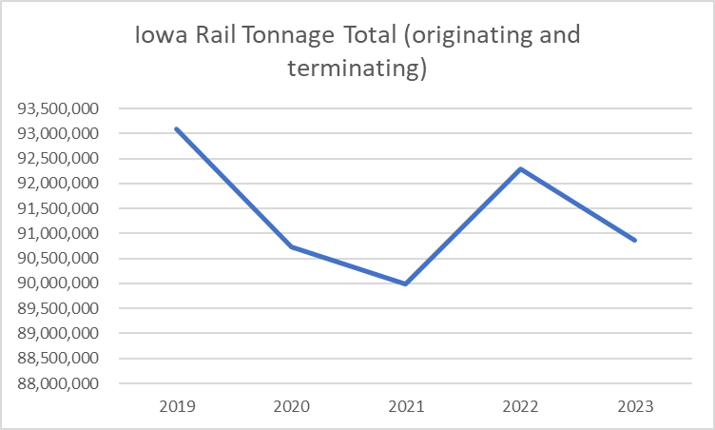

Slide 6
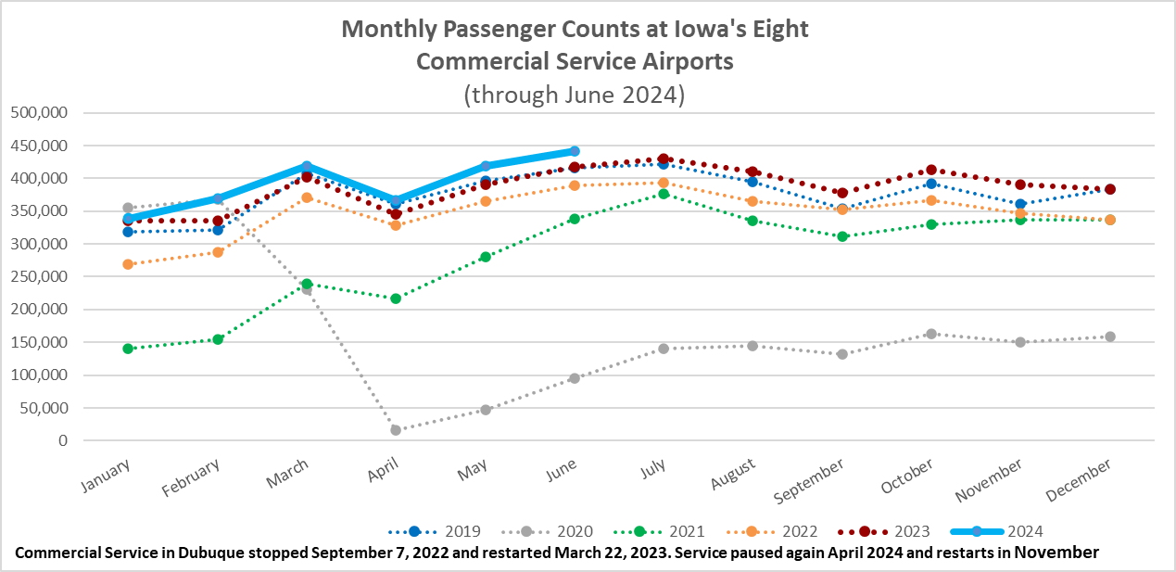

Slide 7
Monthly State Vehicle Miles of Travel
(through June 2024)

Slide 8
Water Transportation
Mississippi River
Flooding impacts have ended.
No locks closed due to high water levels.
Panama Canal
Rainy season arrived early and has continued.
Daily transits are at 35 and expected to increase to 36 in September. Normal levels - 36 to 38 ships per day.
Has been operating with draft limitations but that’s improving.
Forty percent of all US container traffic travels through the Panama Canal
Canal Authority intends to build a new $1.6 billion reservoir within next six years to reduce future drought impacts.

Slide 9
Questions?

