Slide 1
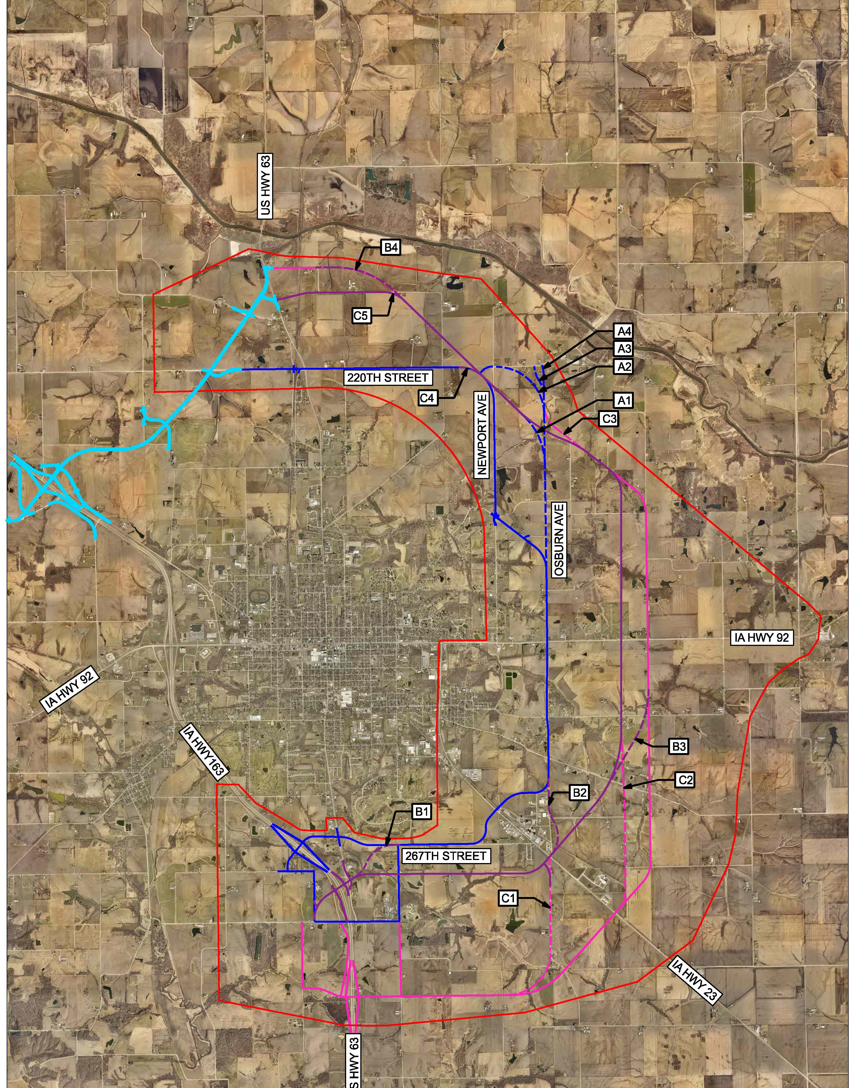
Iowa dot commission meeting
August 13, 2024
Pel/NEPA studies
progress update

Slide 2
Oskaloosa Innovation Park
~500 Ac Certified Site
SE area of Oskaloosa
Expansion of Oskaloosa Industrial Park

Slide 3
SE Connector RISE Project
$10,140,366 RISE Award June ‘23
PIM held 7/23/24
ROW Acquisitions begin Aug ‘24
Design Complete Late ’24/Early ‘25
Bid Letting Spring ’25
Construction Summer ‘25 – Spring ‘27

Slide 4
Oskaloosa Transload Facility
Site along IA 23 within Certified Site
Dual Track Concept
Feasibility Study findings to be presented August 28, 2024

Slide 5
PEL / NEPA Process
PEL Process
NEPA
Data Collection
Purpose & Need
Initial Alternatives
Reasonable Alternatives
Recommended Preferred Alternative(s)
Preferred Alternative(s) Environmental
Review
PUBLIC / STAKEHOLDER INVOLVEMENT

Slide 6
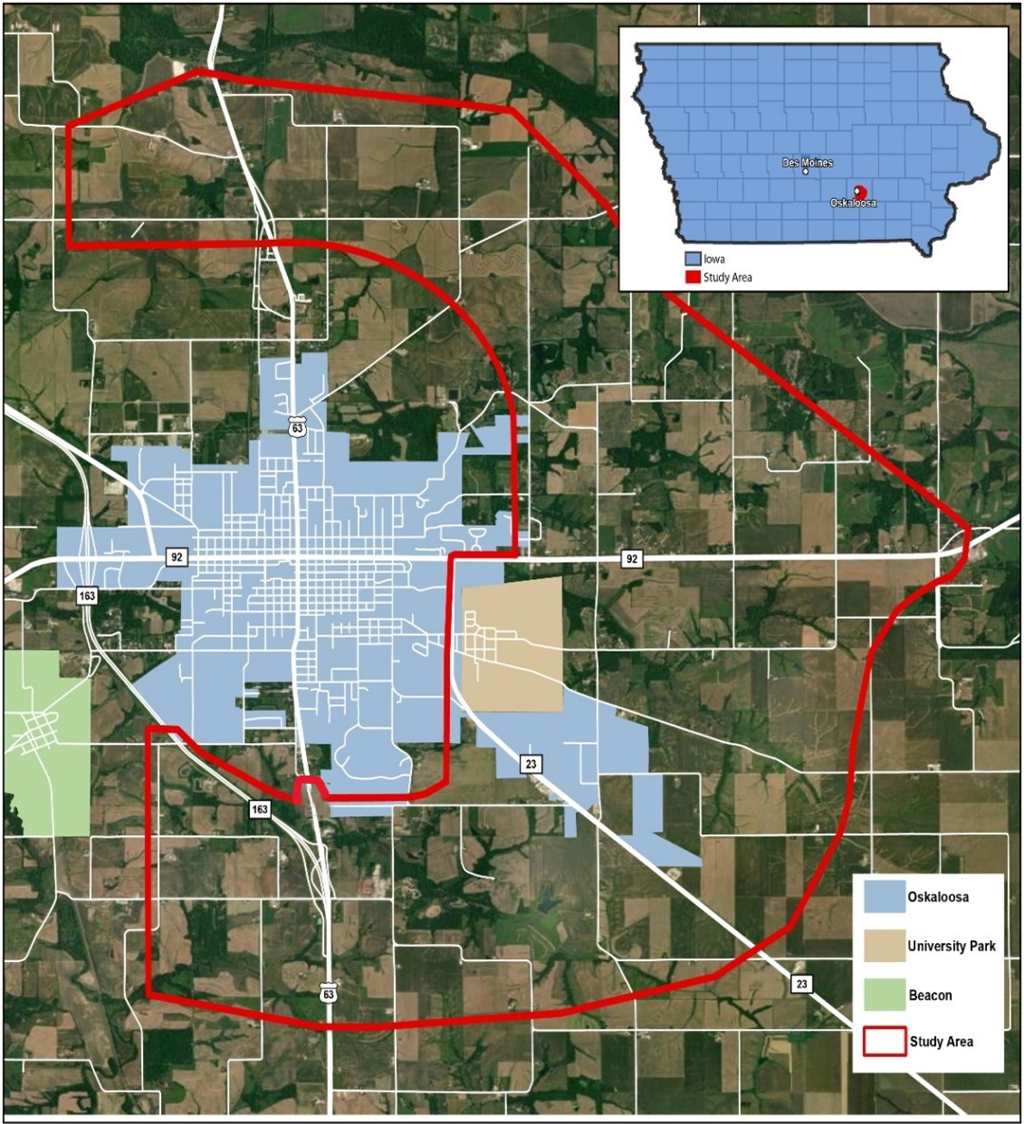
MODES PEL Project Study Area
Depicted in red outline
Focuses on east side of Oskaloosa
Includes connection point to NW Bypass north of Oskaloosa
Includes connection points on US 63 (north and south)
Includes a connection to IA 23
Includes a connection to IA 92
Studies an area 12 miles in circumferential length and up to four miles wide

Slide 7
Stakeholder Involvement
35 stakeholders over 11 meetings in June/Sept 2023
#1 Concern
Trucks – downtown and 15th/17th Aves
Stakeholders engaged
Land impacts
IA 23, IA 92, and US 63 after
Development / growth impacts – (i.e., Industrial Park)
Diverting traffic from downtown (negative impacts?)
What to be aware of
Mining
Plan for growth with new corridor
Work well with land uses in study area
NW Bypass and airport
Pioneer farm and cemeteries
Existing roadway geometric deficiencies
#1 Thing to accomplish
Pull trucks out of downtown and off gravel roads
Improve safety of US 63, IA 92 and 15th/17th Aves
Opportunities for growth and support Industrial Park
Quality of life improvement (housing, recreation, modal expansion)
Demonstrate we all work well together
Is this project worth our time? 100% YES
Is there a project of higher importance?
1 said sewer system improvements
1 said housing improvements/expansion
Remainder said “no”

Slide 8
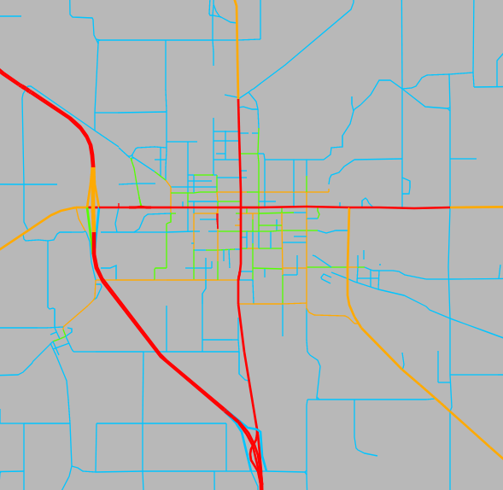
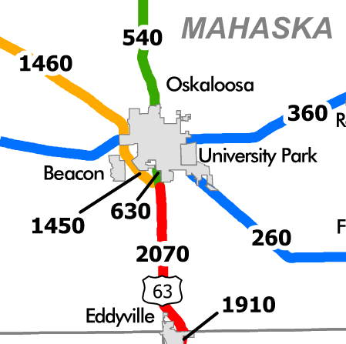
2022 (Existing) Traffic
US 63 (6,500-7,100 vpd)
US 63 (600-650 tpd)
IA 92 (7,000-12,600 vpd)
Truck traffic on US 63 south of Oskaloosa provides connectivity from southeastern Iowa to I-80 and Des Moines.
4,190
10,700
7,100
12,600
8,700
6,800
6,500
2,350
7,800
420
Daily Traffic Levels
Daily Heavy Truck Levels

Slide 9
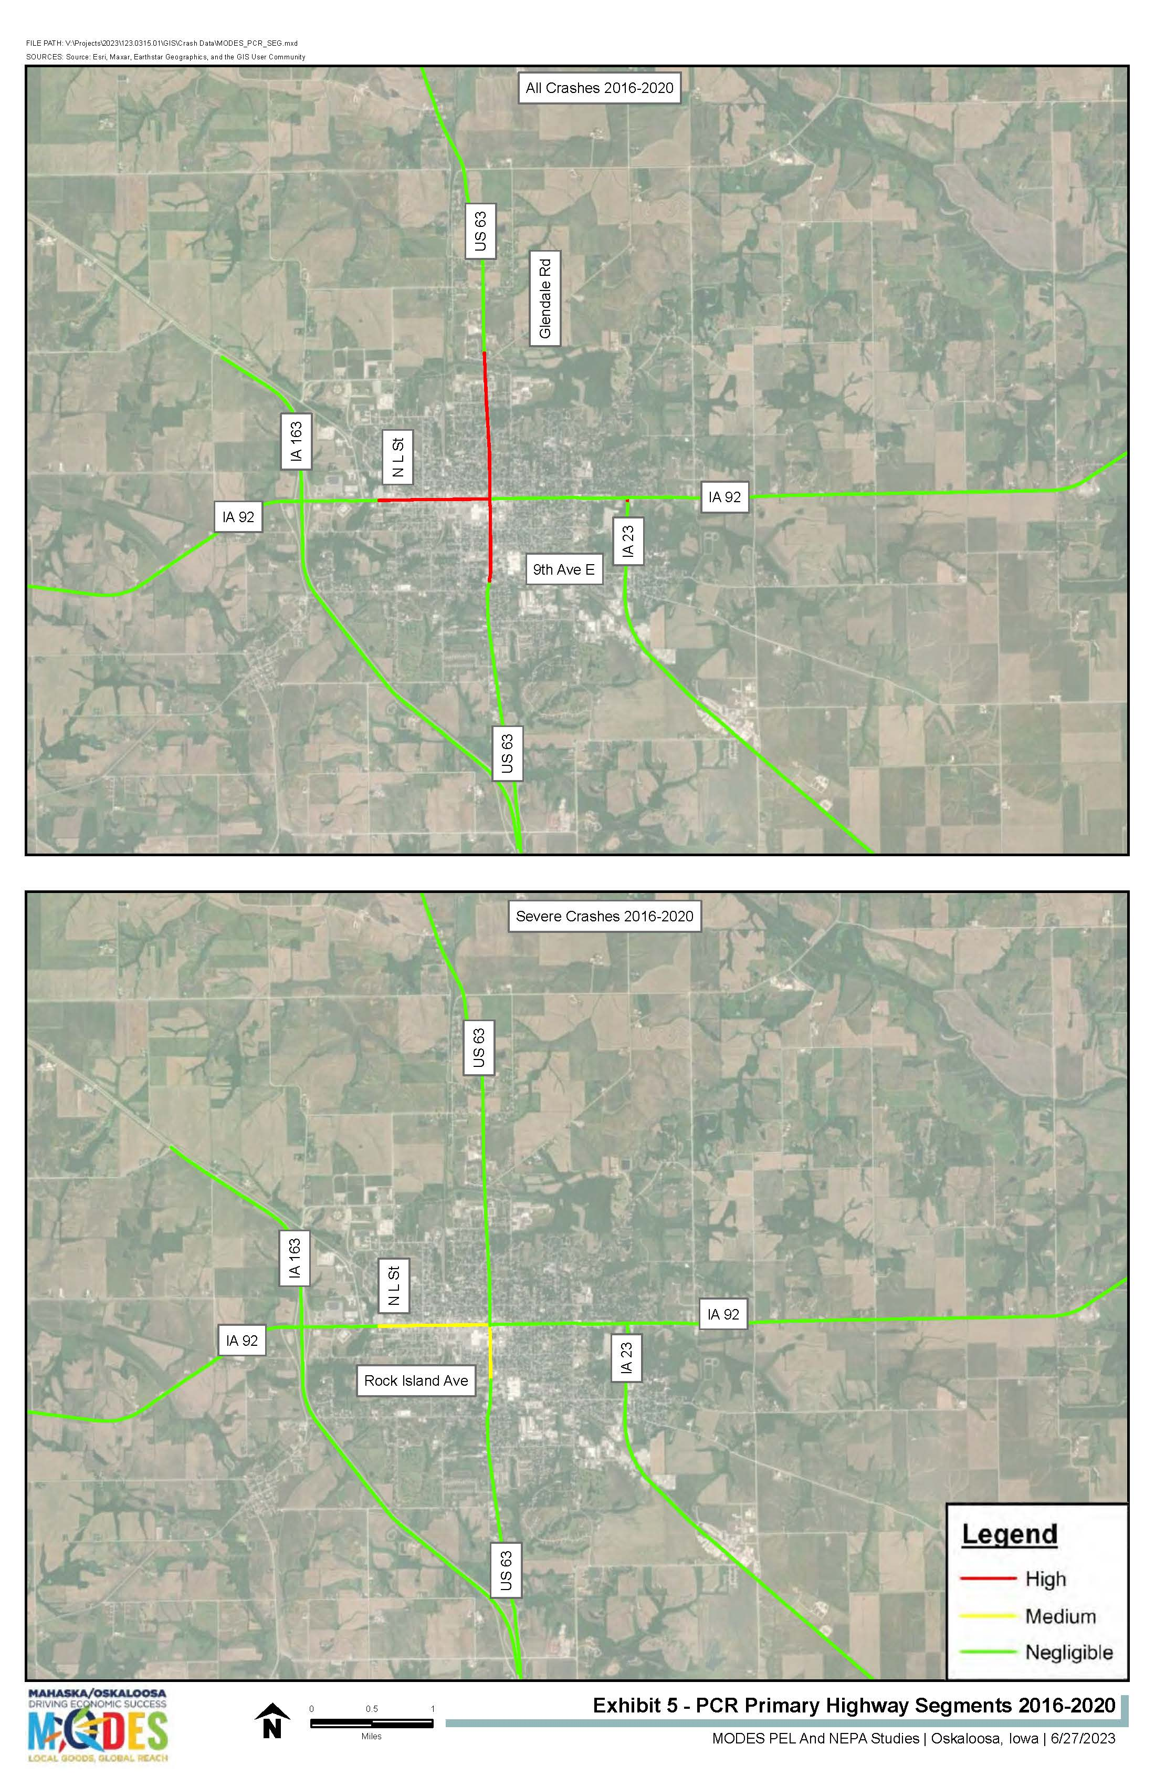
2018-2022 Crash History
519 reported crashes in US 63, IA 23, and IA 92.
Approximately ½ were at intersections.
Severity (132 injury crashes with 179 injuries)
Two fatal
Six major injury
45 minor injury
79 possible injury.
40 truck crashes with most at US 63/IA 92 intersection.
Eight ped/bike crashes.
Oskaloosa crash rate is high.

Slide 10
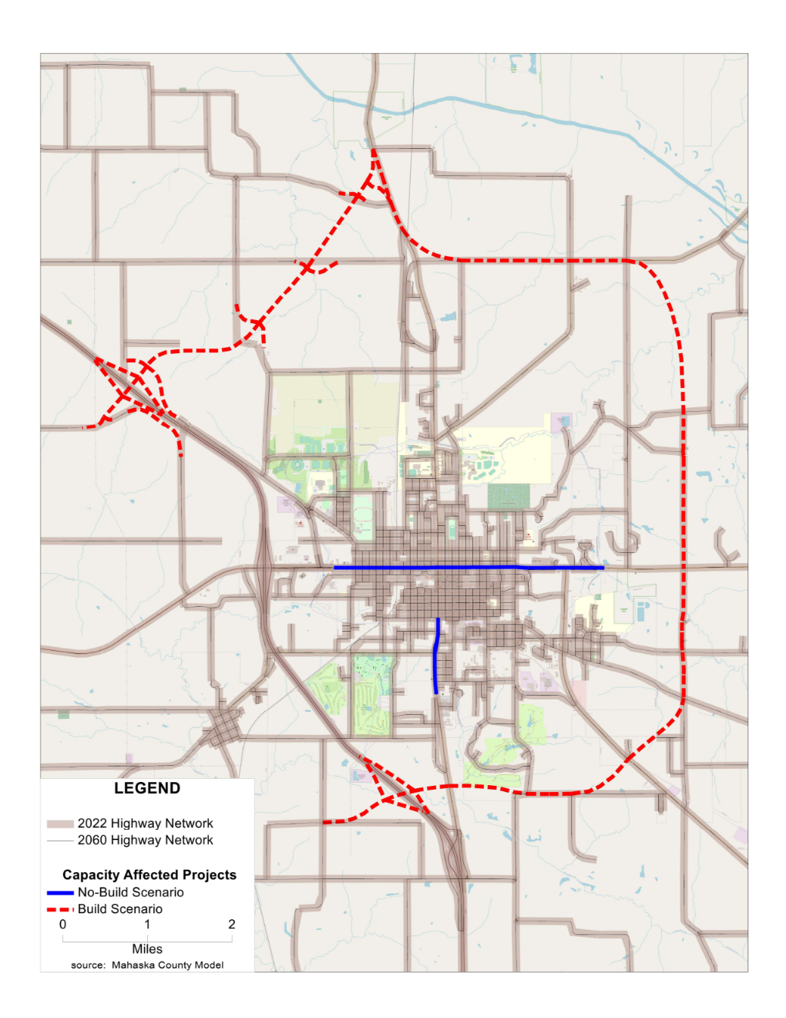
Iowa DOT Traffic Forecast Model Updates
Projects assumed in No-build modeling that are either completed or planned/ programmed to be constructed.
Includes projects that change the capacity of a roadway (i.e., how many vehicles the roadway can handle).
NW Bypass
2023 ‐ 2027 Iowa Highway Program
Programmed
New Traffic Signal Completed
3-Lane Conversion Completed
New SE Connector Roadway In Design
Planned/Programmed/Completed

Slide 11
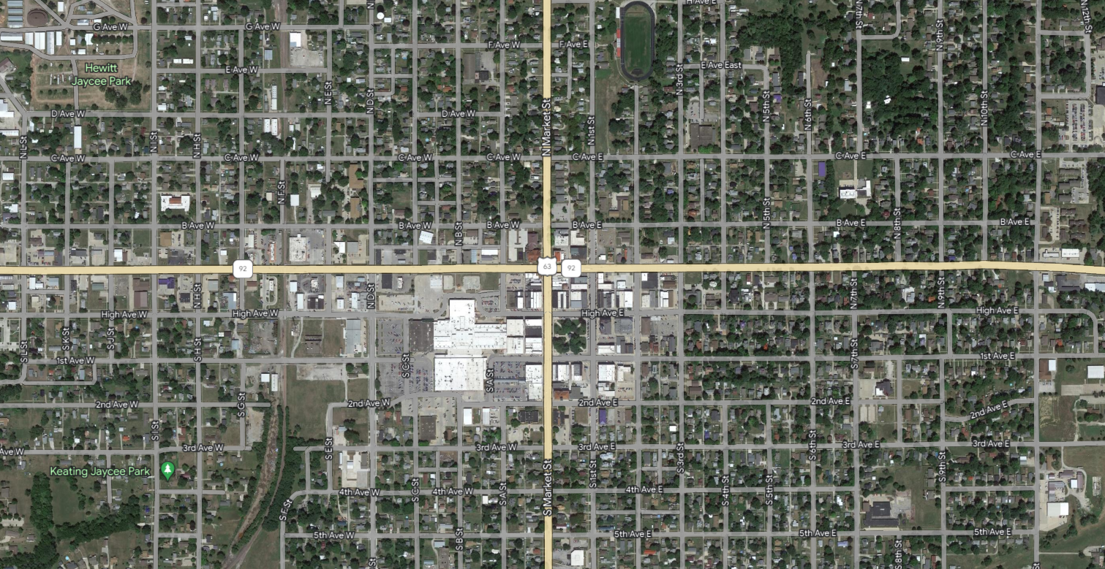
Traffic Analysis (2060 No-build)
Draft – Subject to Change
Intersection Over Capacity
Movements At Capacity
Side Street Movements At Capacity

Slide 12
Purpose of the Project
Provide the traveling public and freight movements with safe and efficient transportation facilities for users of the highway system in the vicinity of Oskaloosa.

Slide 13
Project Goals
Improve Quality of Life
Improve Future Traffic Operations and Safety of Downtown
Support New Economic Development (Innovation Park)
Improve Regional Access for Freight

Slide 14
MODES PEL Logical Termini
Three Segments with logical termini:
IA 163/US 63 to IA 23
IA 23 to IA 92
IA 92 to US 63/NW Bypass
Segment 3
Segment 2
Segment 1

Slide 15
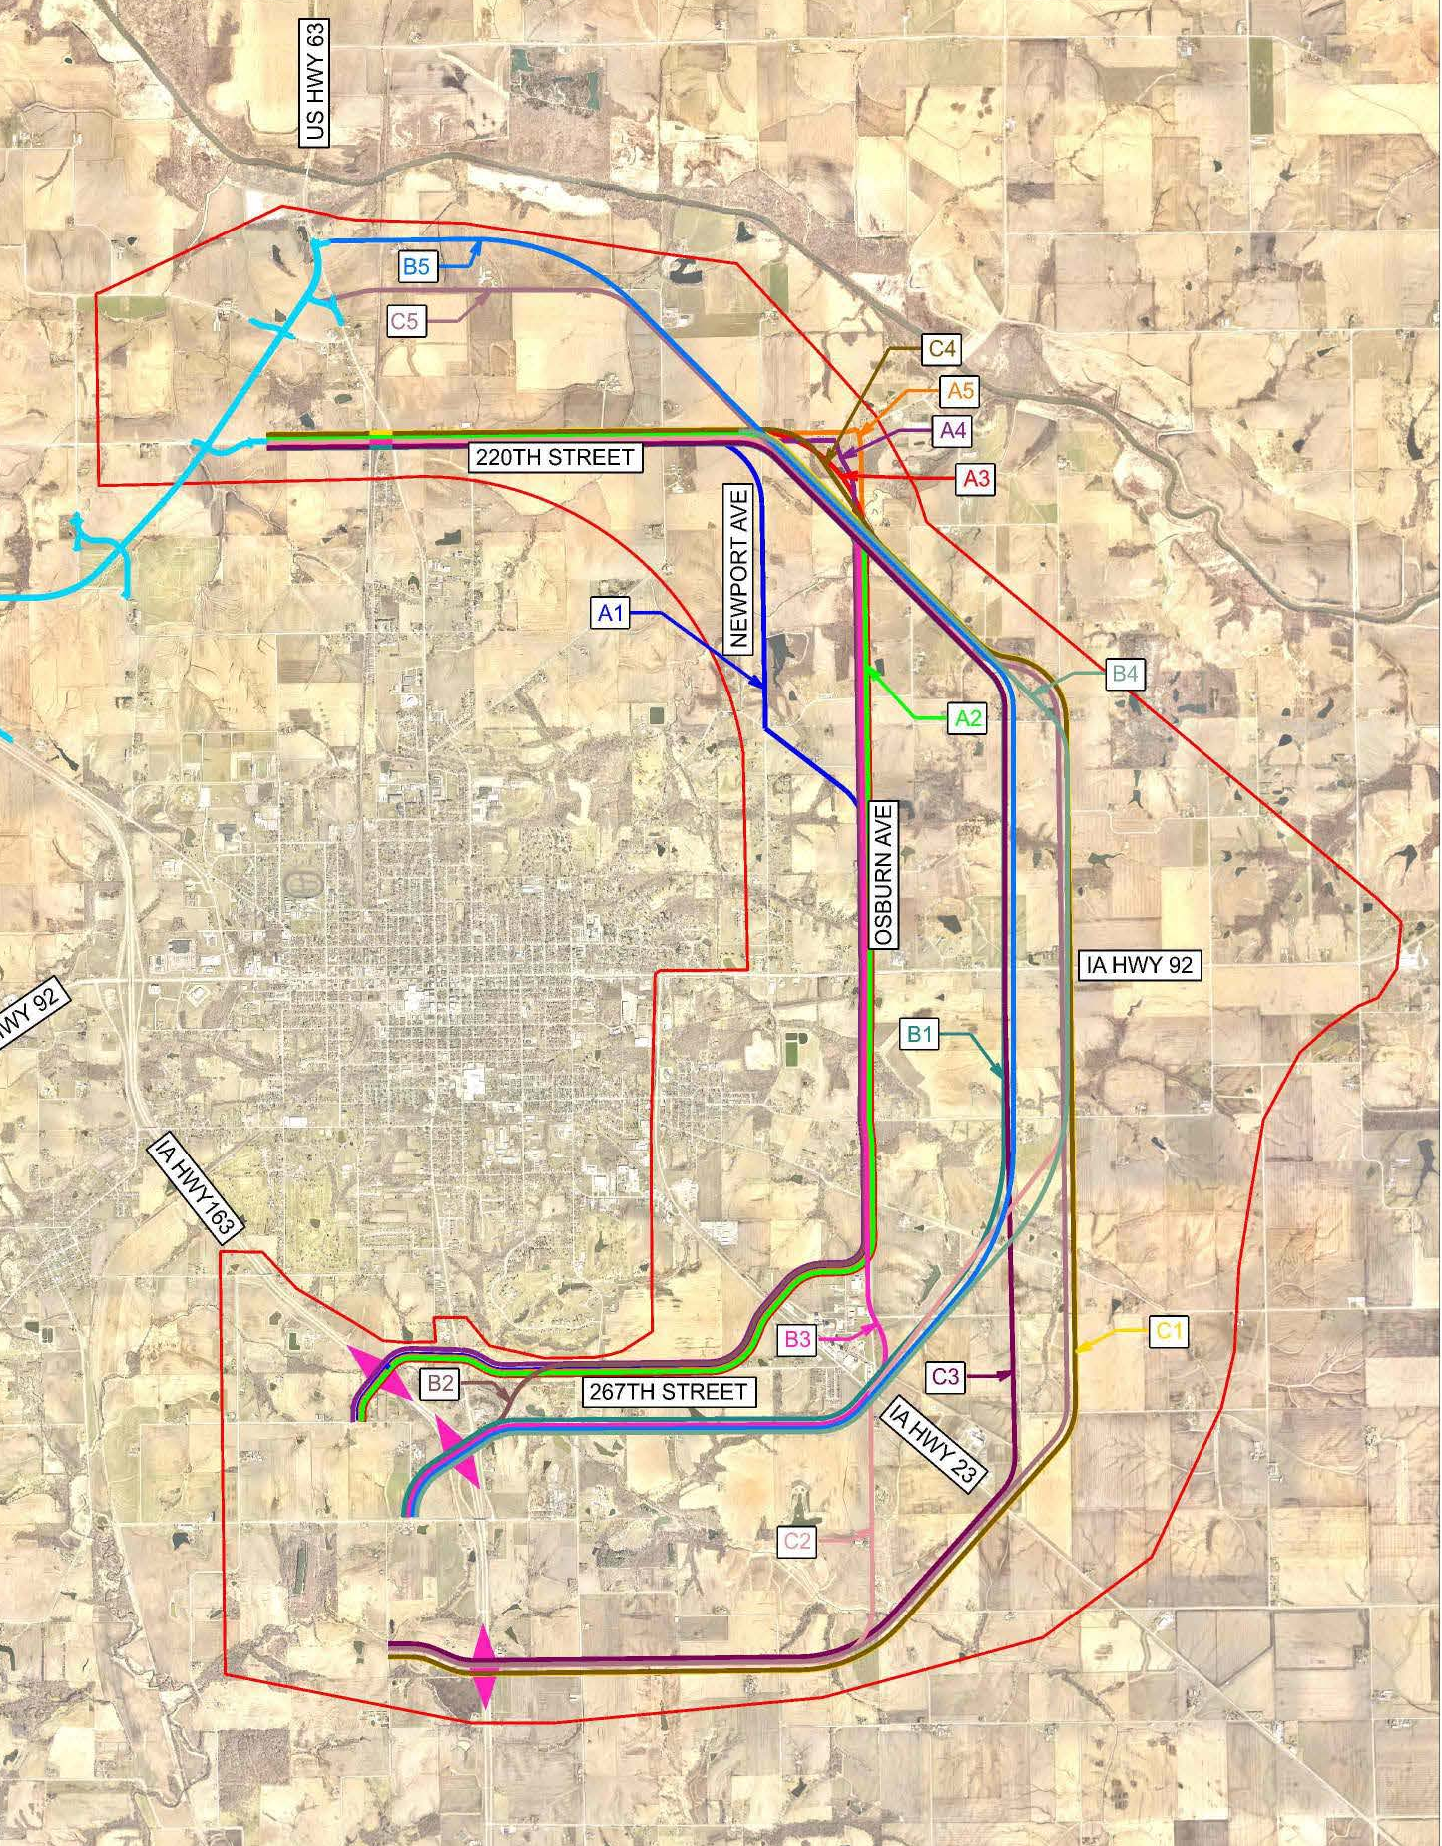
Initial Alternatives
2-lane road with turn lanes at key intersections
Existing roads vs. new routes
New alignment options

Slide 16
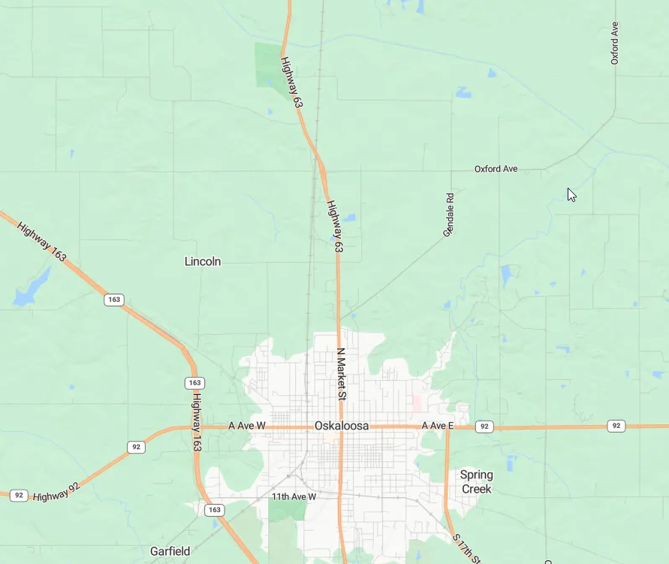
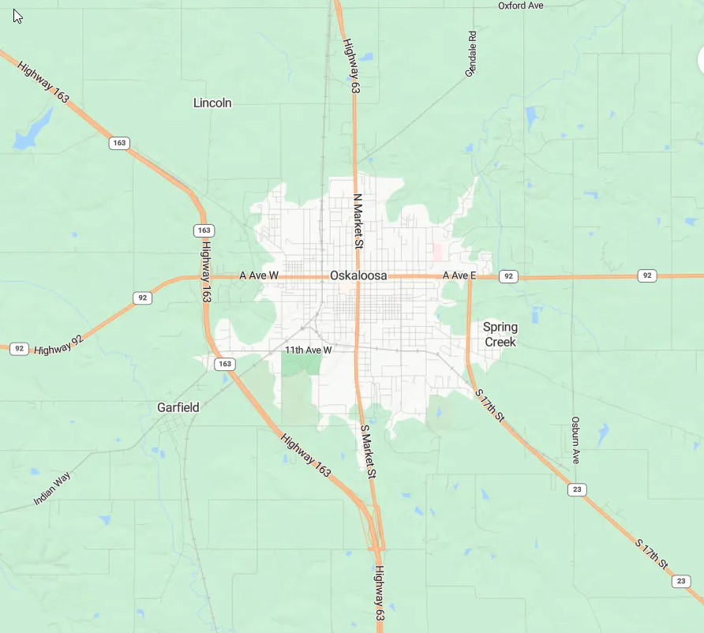
Anticipated Traffic Levels (Future 2060 Traffic Volumes)
The reduction in traffic levels at the IA 92/US 63 intersection and along IA 23 are expected to be about 10%.
Several roadways in town south and east of IA 92/ US 63 are expected to have reductions in traffic levels as well, ranging from about 20-30%.
New connections help reduce heavy truck levels through town and at the IA 92/US 63 intersection.
Future traffic volumes on eastern connection are highly influenced by the roadway type and its proximity to the city core.
1,200 to 1,600 vehicles per day
800 to 1,000 vehicles per day
10% reduction in traffic levels
20-30% reduction in traffic levels
800 to 1,700 vehicles per day
>50% reduction in traffic levels
(with SE Collector)
2,000 to 3,600 vehicles per day

Slide 17
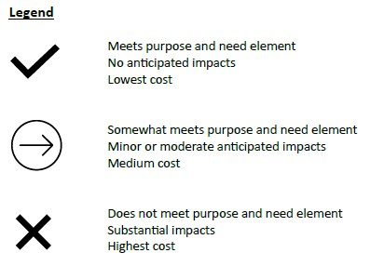
Alternatives Screening
Three base alignments
A = closest to Oskaloosa
B = middle alignment
C = furthest from Oskaloosa
15 alternatives developed and screened
Three segments of independent utility
IA 163/US 63 to IA 23
IA 23 to IA 92
IA 92 to NW Bypass

Slide 18
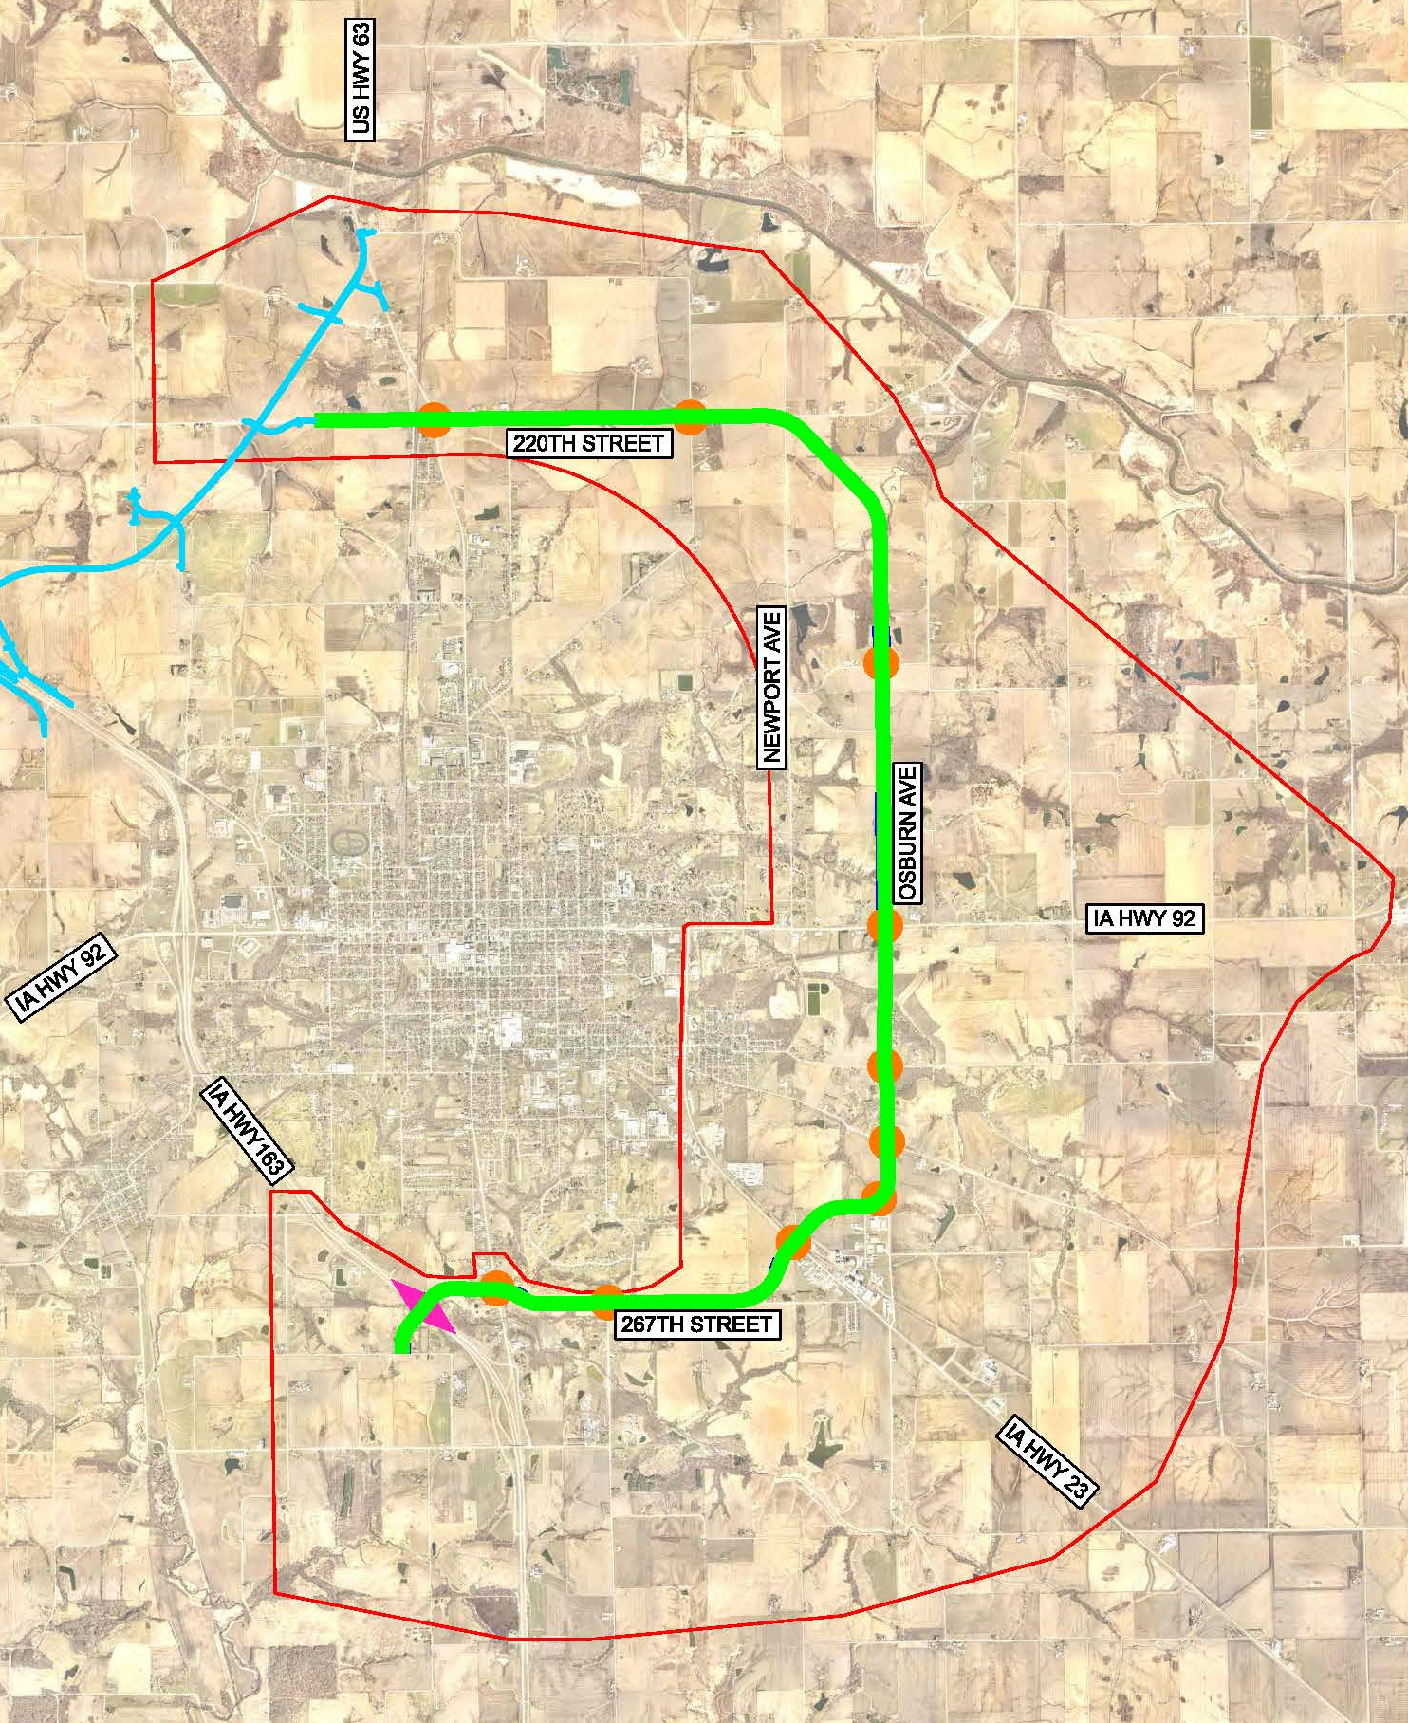
Technically Feasible Alternatives
Alternatives A2/A3
New interchange on IA 163
Uses SE Connector RISE corridor
Uses newly paved Osburn Ave between IA 23 and IA 92
Continues north using Osburn Ave and extends north to 220th Street
Uses newly paved 220th Street to US 63
Extends 220th Street west over UP RR to NW Bypass
Slight modification at north end where it ties into 220th Street near Newport Ave

Slide 19
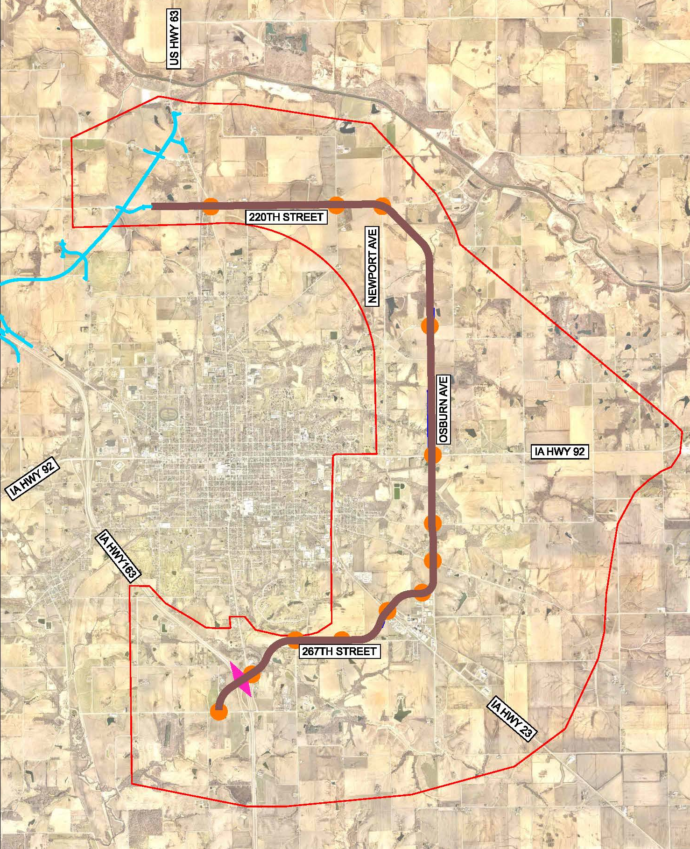
Technically Feasible Alternatives
Alternative B2
Reconfigures interchange at IA 163/US 63
Connects into SE Connector RISE corridor at Merino Ave
Same alignment as A2 north of IA 23

Slide 20
PEL / NEPA Studies Next Steps
Finish Draft PEL Document
PIM #2 – Fall 2024
NEPA Study
Preliminary NEPA Document
PIM #3 – Spring 2025
Final NEPA Document – Summer 2025

Slide 21
THANK YOU!
www.modesiowa.com

