Slide 1
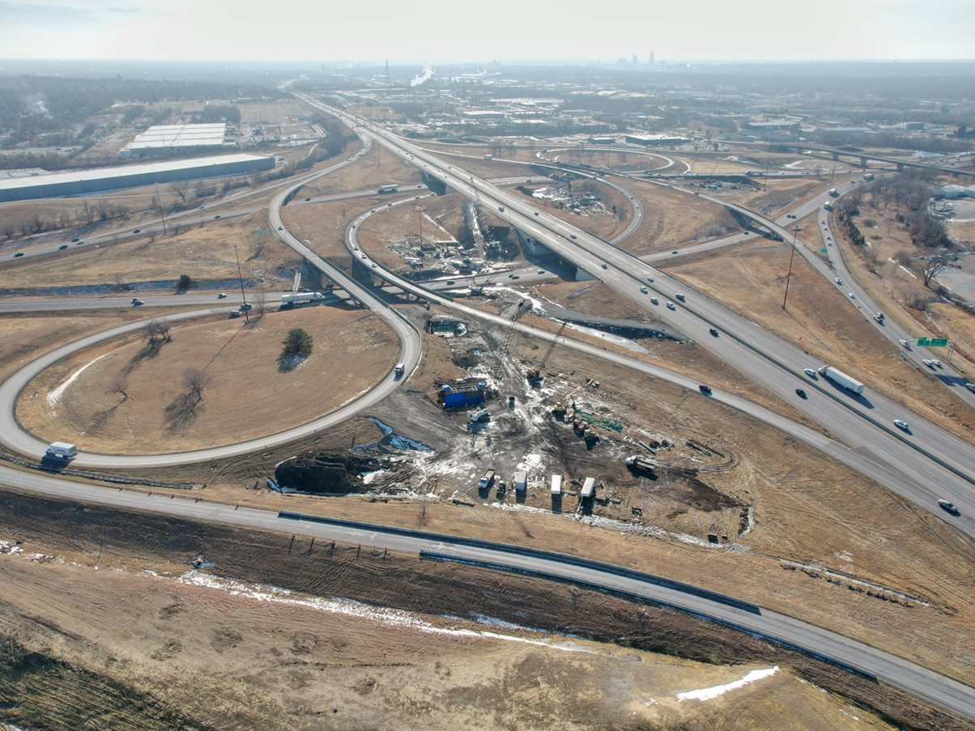
Proposed 2025-2029 Highway Program Amendment
August 12, 2024
3/2/2023

Slide 2
Background
Severe flooding in northwest Iowa impacted many primary highways and bridges
Recommend amending the FY 2025 Highway Program to advance two bridge projects that were already programmed in order to accelerate replacement and enhance resiliency for future flood events.

Slide 3
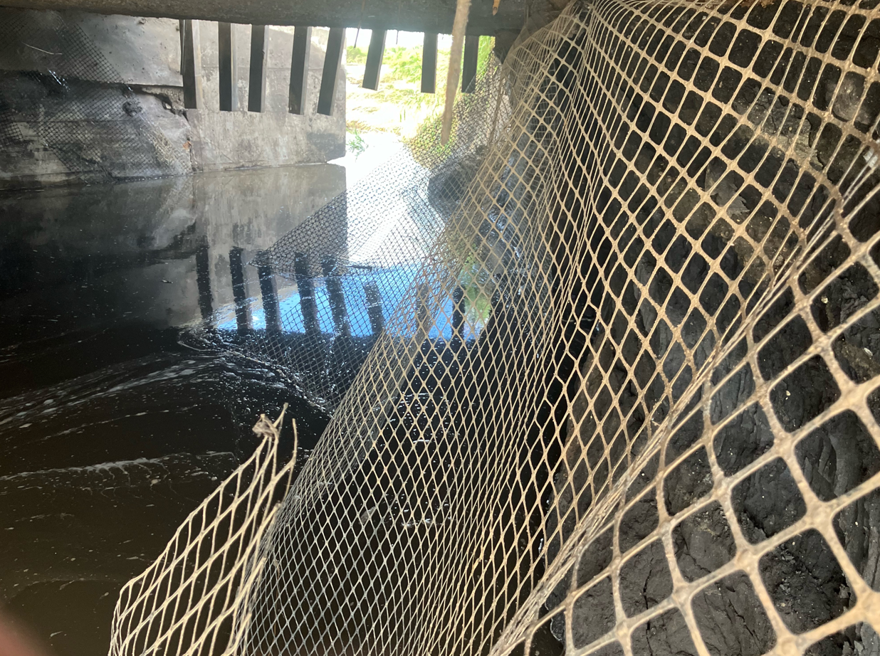
US 18

Slide 4
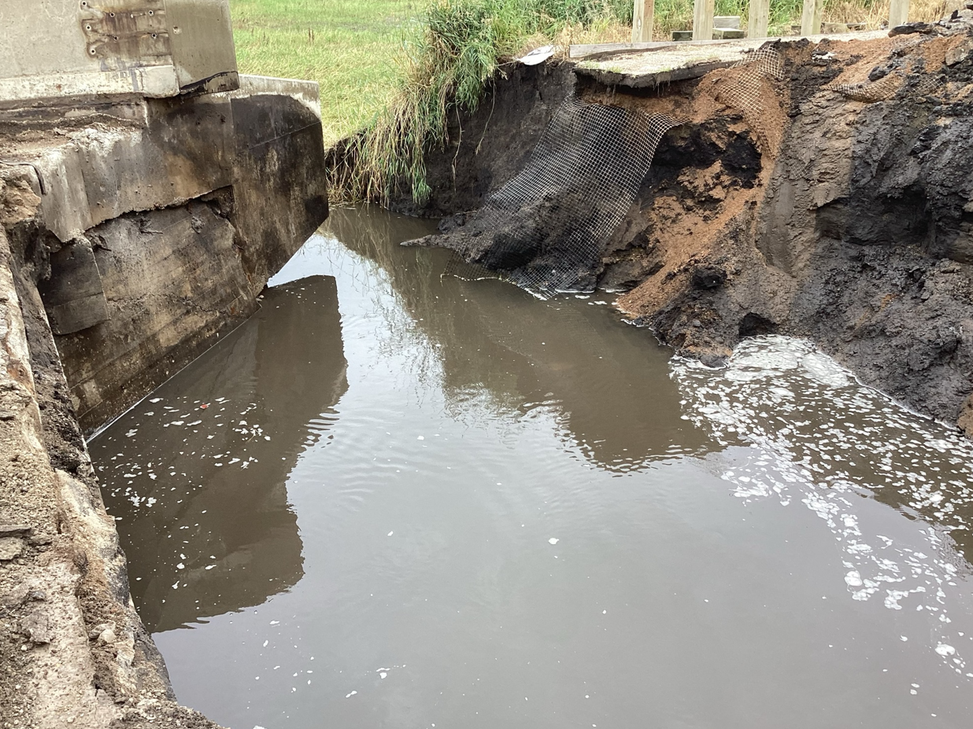
US 18

Slide 5
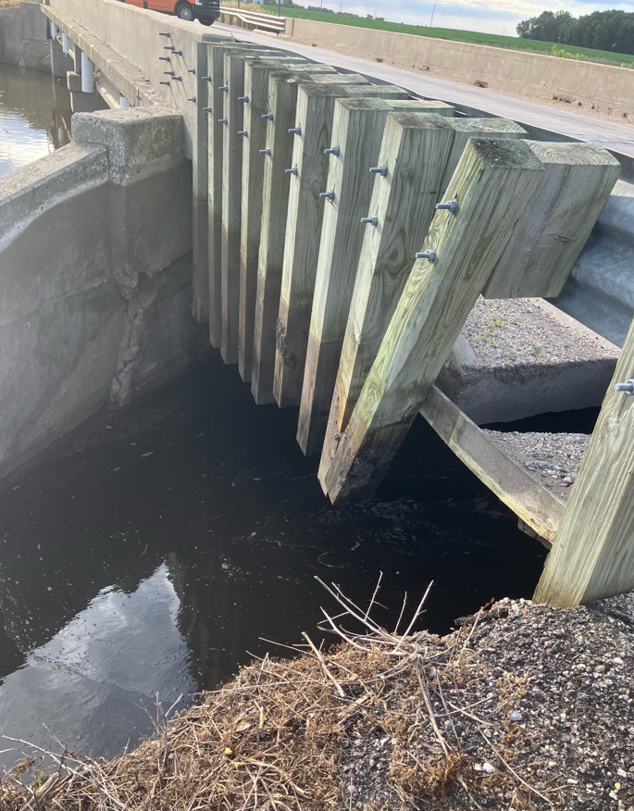
US 18

Slide 6
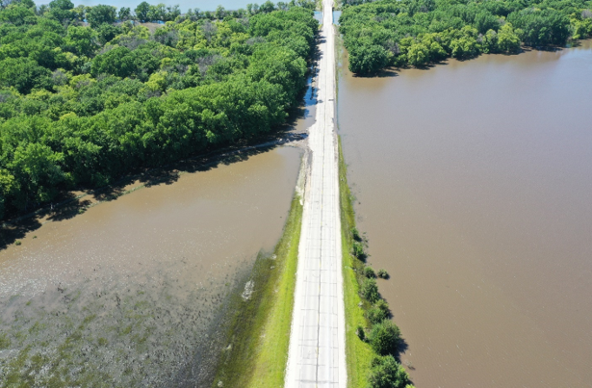
IA 3

Slide 7
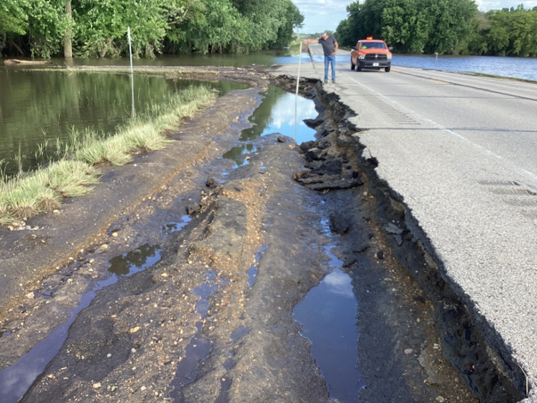
IA 3

Slide 8
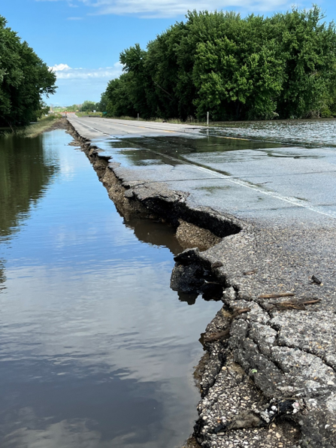
IA 3

Slide 9
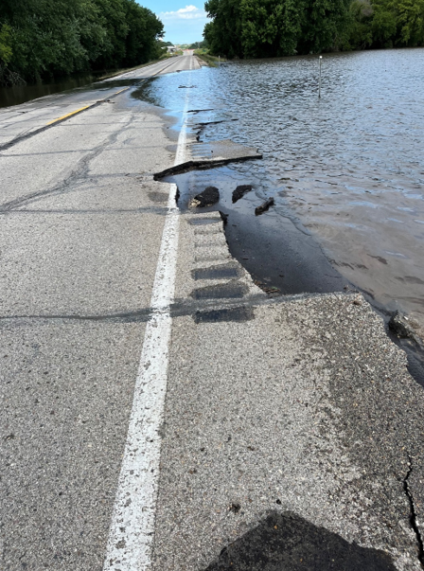
IA 3

Slide 10
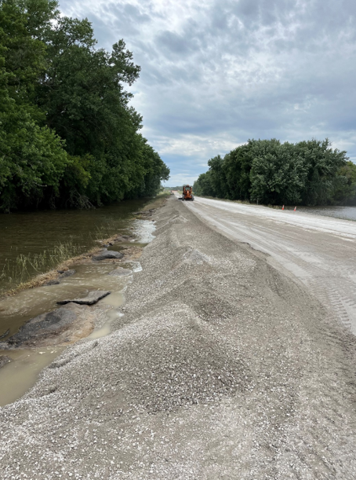
IA 3

Slide 11
Proposed FY 2025-2029 Iowa Highway Program Revisions
County | Route | Location | Estimated Project Costs x $1,000
County | Route | Location | 2025 | 2026 | 2027
Cherokee | 3 | 1.3 mi E of US 59 to 1.8 mi E of US 59 | 12,260 | (12,812)
Clay | 18 | Stony Creek 5.3 mi W of W Jct US 71 | 3,426 |  | (3,741)
 |  | Total change to the highway program | 15,686 | (12,812) | (3,741)
Proposed Highway Program Amendment Projects

Slide 12
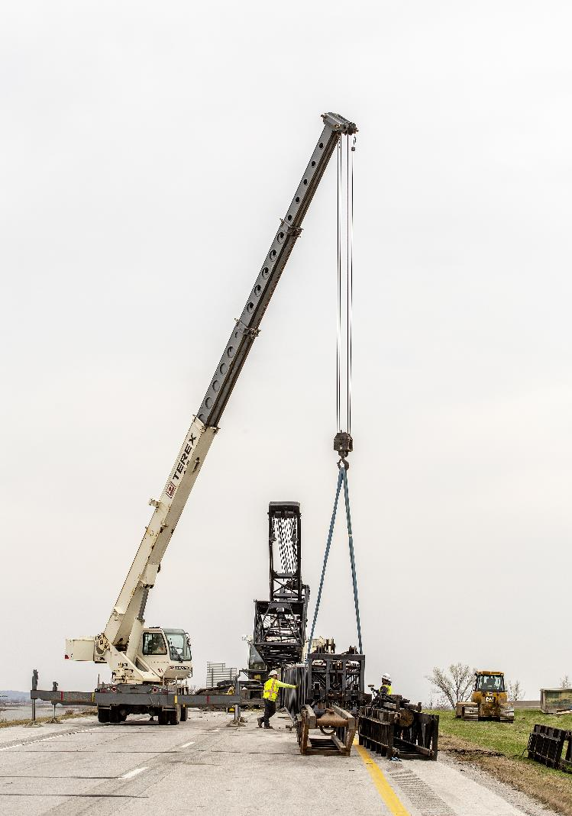
Next Steps
Amendment is on the agenda for the business meeting of August 13
Commission can act on the action item or defer for future consideration

Slide 13
Questions?

