Slide 1
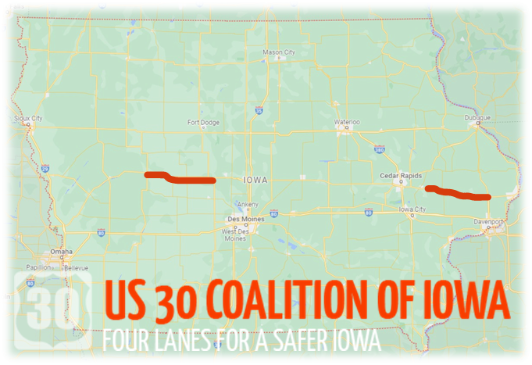
Iowa dot commission meeting
aUGUST13, 2024
U.S. 30 Four-lane study

Slide 2
U.S. 30 4-Lane
Study Scope
Economic Analysis (SEG)
  IA Economy and Highways
  Comparison of Major East-West Highways
  Detailed County Analysis for U.S. 30
  Development Prospects for U.S. 30
Concept Layouts
  4 Lanes Carroll – Ogden
  4 Lanes Lisbon - DeWitt
Cost Opinions
  Carroll – Ogden
  Lisbon – DeWitt
Simple Benefit/Cost Analysis
  2027 – 2067
Final Report

Slide 3
U.S. 30 Economic Analysis summary

Slide 4
Economic Analysis Objectives
Examine economic trends for Iowa and its counties in relation to three major east-west highway corridors – U.S. 20, U.S. 30, and I-80
Complete detailed analyses of demographic and economic characteristics of the counties that comprise the U.S. 30 corridor
Identify factors that have influenced population, employment, and economic growth over the past two decades and assess how these three measures may be expected to grow over the next three decades
Identify major factors the have disrupted county growth trends and how these factors may impact future growth
Estimate how future population and economic growth may impact traffic on U.S. 30

Slide 5
Economic Analysis Conclusions
Expanding U.S. 30 to 4-lanes across Iowa is an important element of a comprehensive economic development strategy for counties located in the corridor and for all of Iowa.
Expanding U.S. 30 to 4-lanes across Iowa will continue to require the support from local governments and businesses. Critical needs include a growing workforce, affordable housing, good schools, and access to health care, recreation and shopping opportunities. Most importantly, local economic development requires strong local leadership, plus technical and financial support from the state.
Anticipated economic growth in the counties that comprise the U.S. 30 corridor based on population, employment, and economic output forecasts justifies expansion of the highway to 4-lanes across Iowa.

Slide 6
U.S. 30 concept design information

Slide 7
Iowa DOT – Traffic Volumes by County
County | Year | Ave Annual Daily Traffic
Carroll | 2016 | 8,000 / 7,100 / 4,170
Greene | 2016 | 3,270 / 4,240 / 5,000
Boone | 2019 | 4,000 / 6,000
Cedar | 2018 | 6,000 / 4,150 / 2,920 / 2,750
Clinton | 2018 | 2,750 / 3,520 / 4,980
Note: AADT for 2020 and 2021 was not used due to pandemic influences.

Slide 8
U.S. 30 Concept Design Criteria
Design speed = 70 MPH with 65 MPH posted
2 – 12’ lanes in each direction w/ paved shoulders
Structures (bridges and culverts) assumed to be same size as existing
All active rail crossings assumed to be grade separated
1 interchange proposed for each bypass

Slide 9
U.S. 30 Alternatives – Communities
3- lane urban roadway w/ two-way left-turn lane through town on existing alignment
5-lane urban roadway w/ two-way left-turn lane through town on existing alignment
4-lane rural bypasses considered
  Glidden
  Grand Junction
  Clarence
  Calamus

Slide 10
Concept layouts
Carroll to Ogden

Slide 11
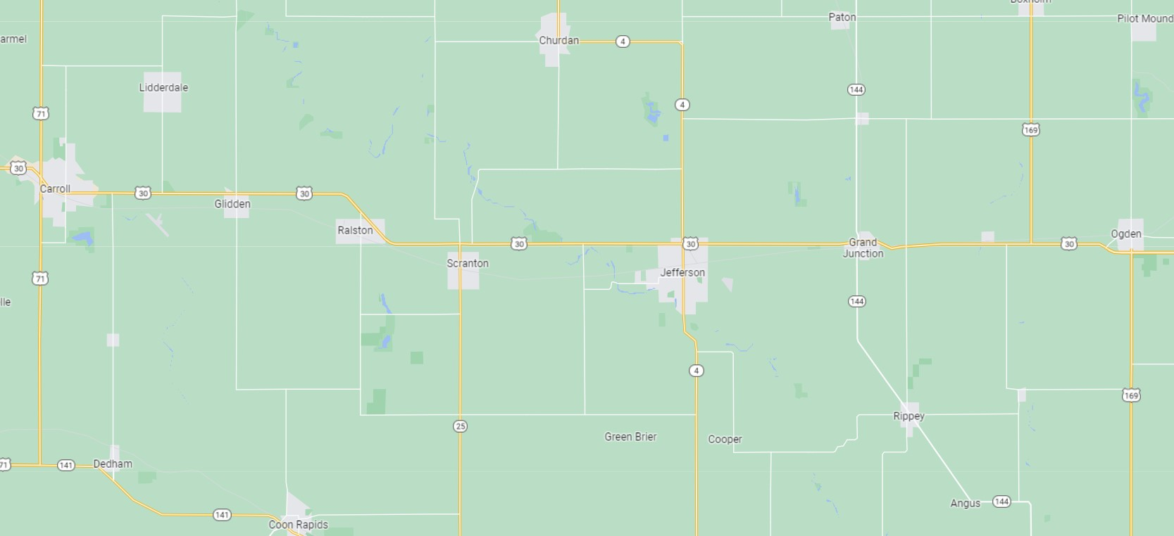
U.S. 30 West 40-mile Sub-Segments
1
2
3
4
5
Five sub-segments determined for cost estimating purposes
Based upon original construction segments of U.S. 30 (constructability review)

Slide 12
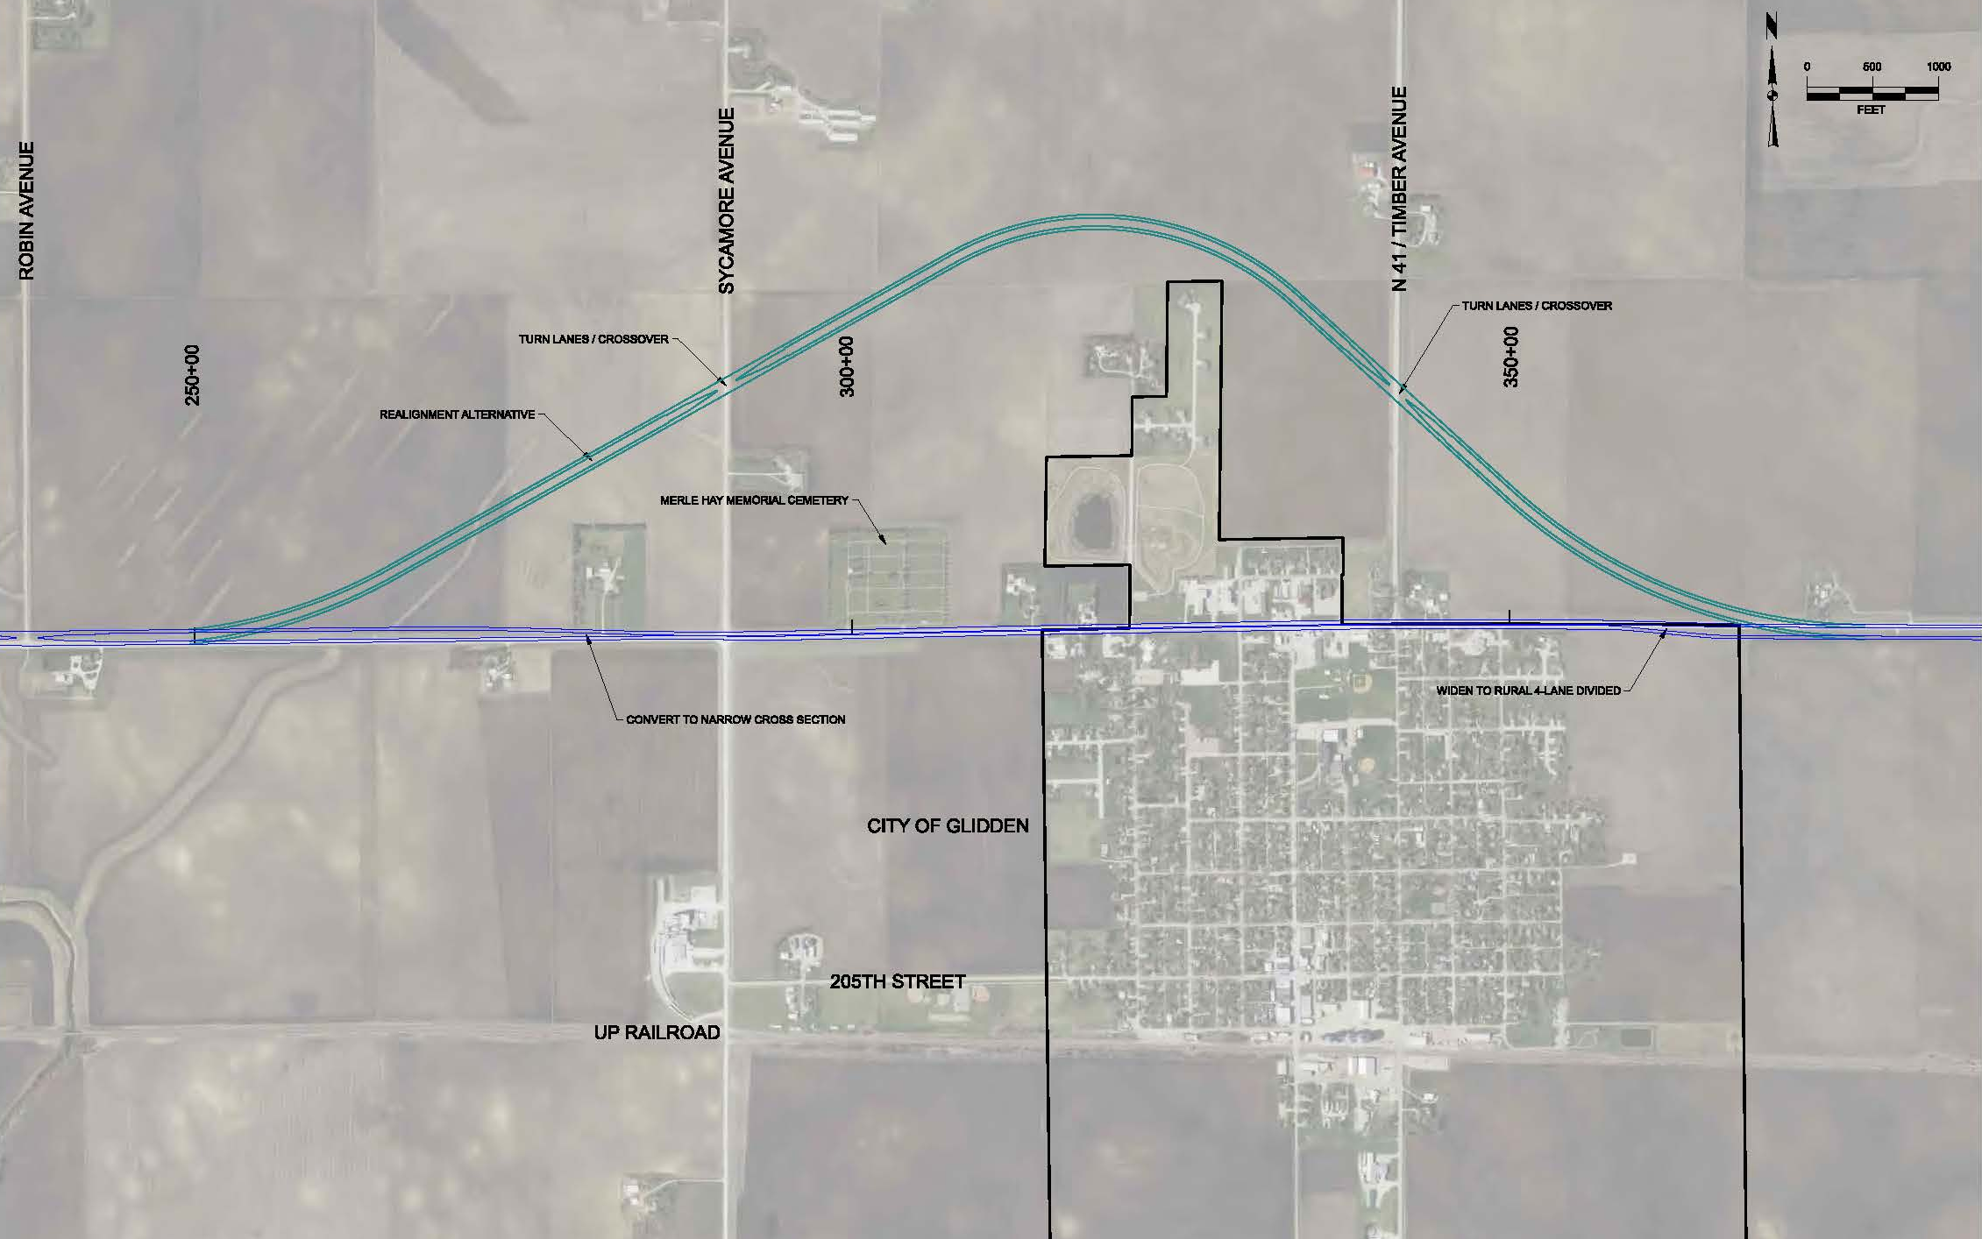
U.S. 30 - Glidden

Slide 13
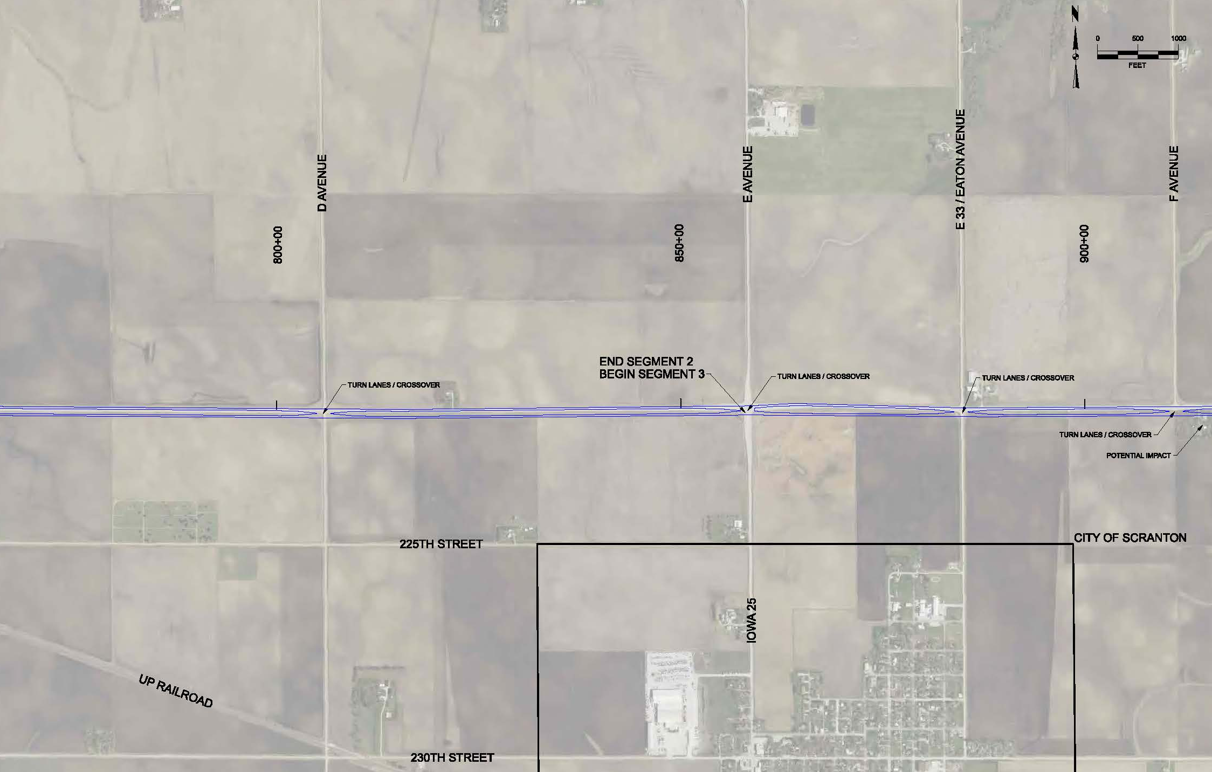
U.S. 30 - Scranton

Slide 14
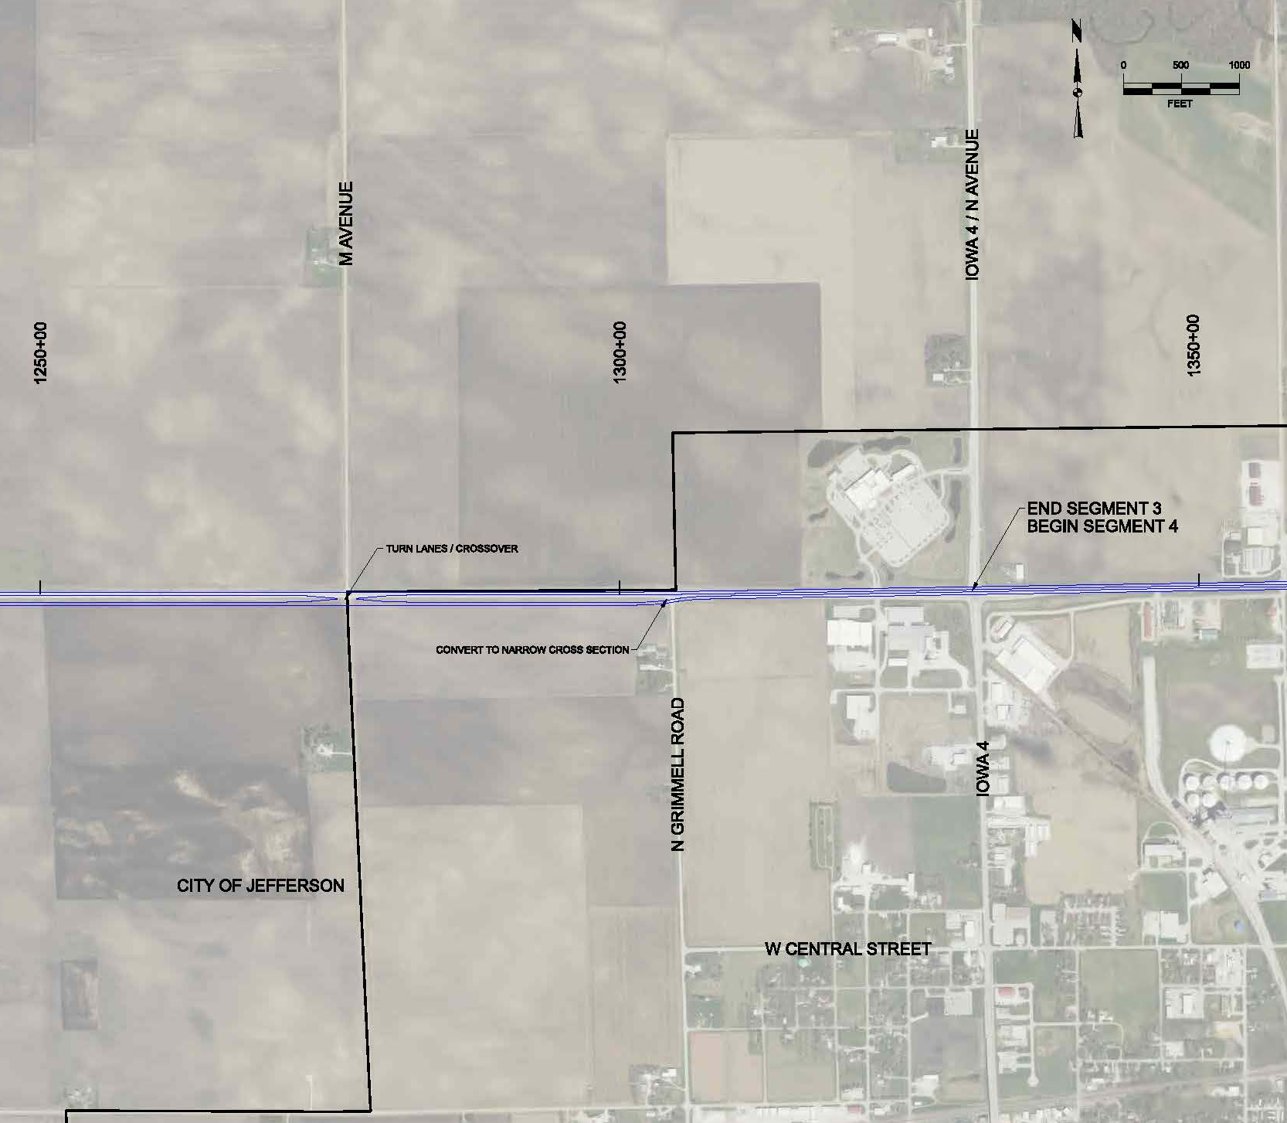
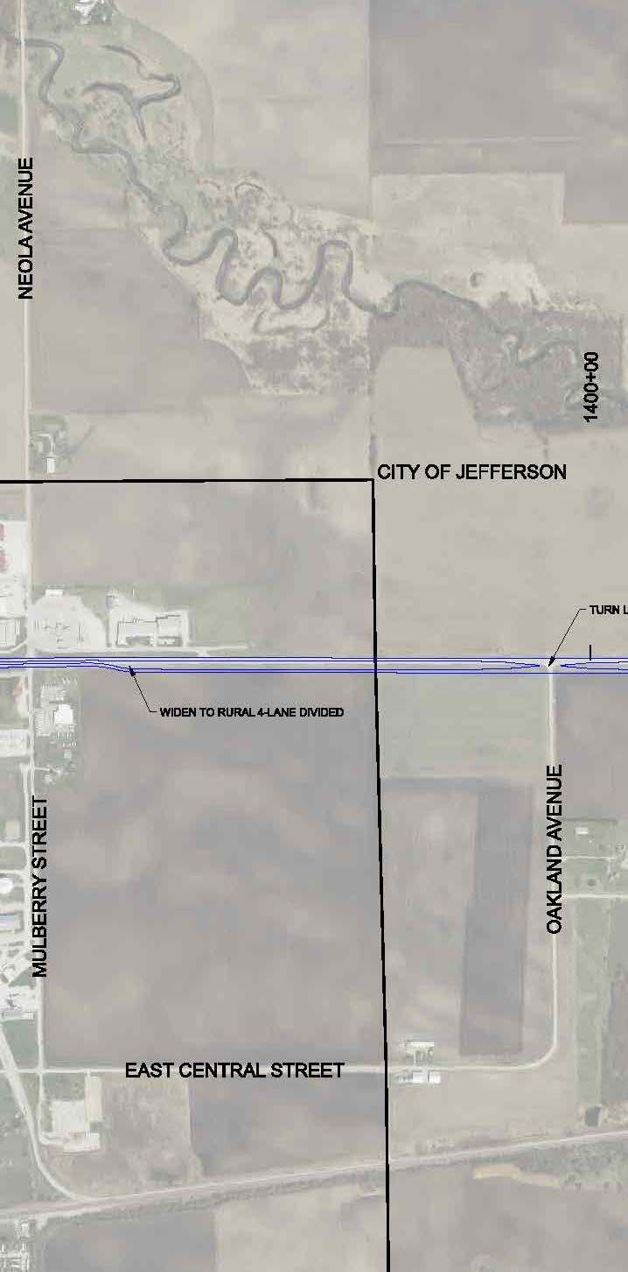
U.S. 30 - Jefferson

Slide 15
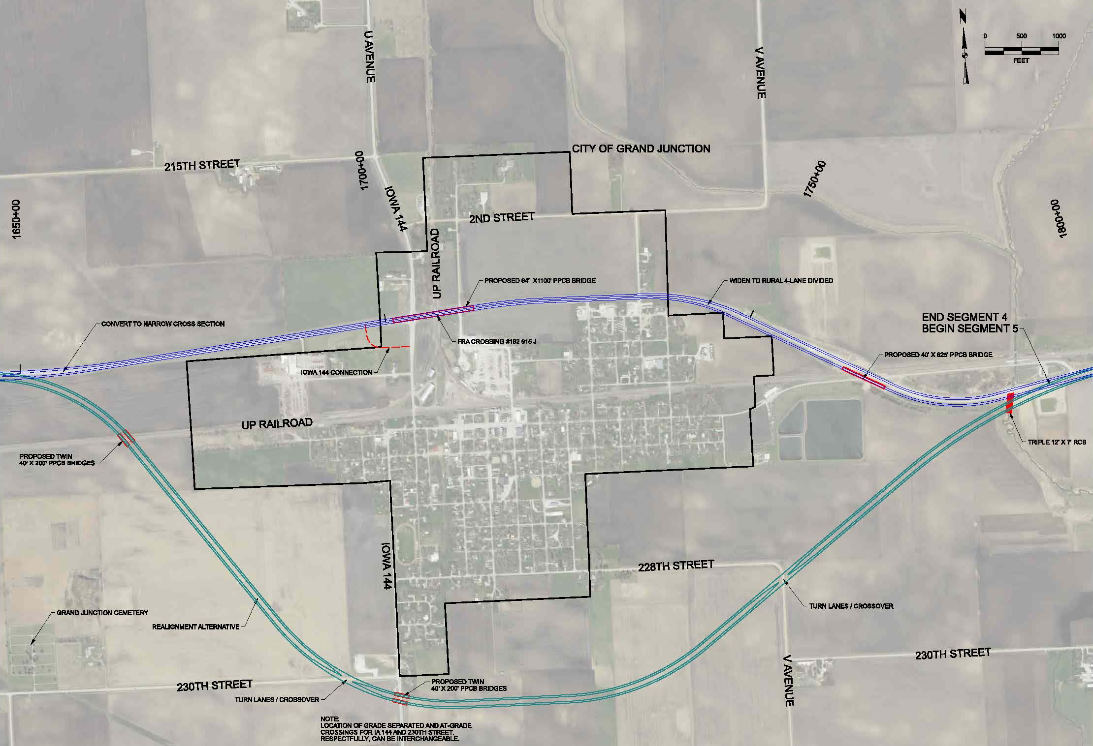
U.S. 30 – Grand Junction

Slide 16
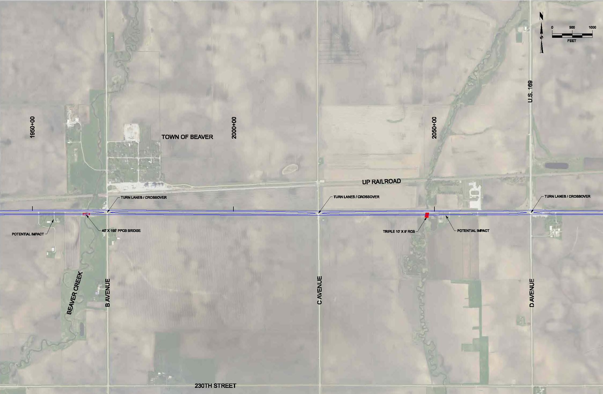
U.S. 30 - Beaver

Slide 17
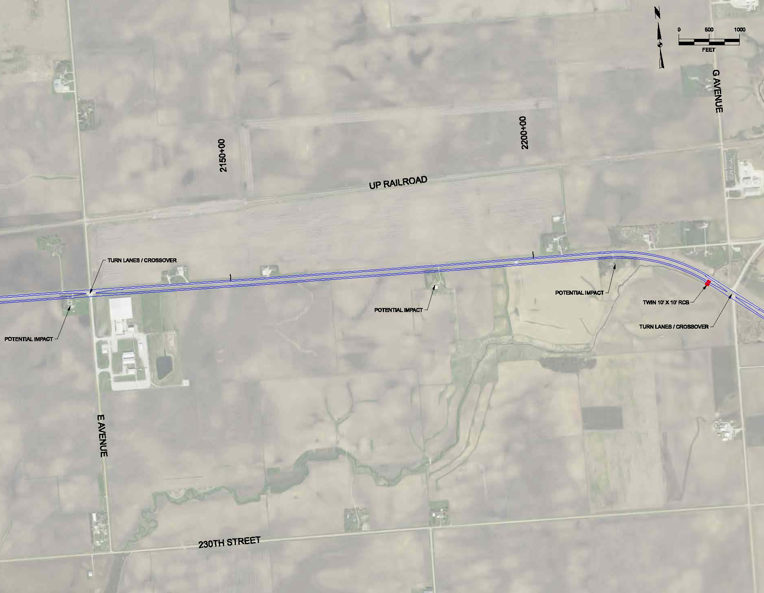
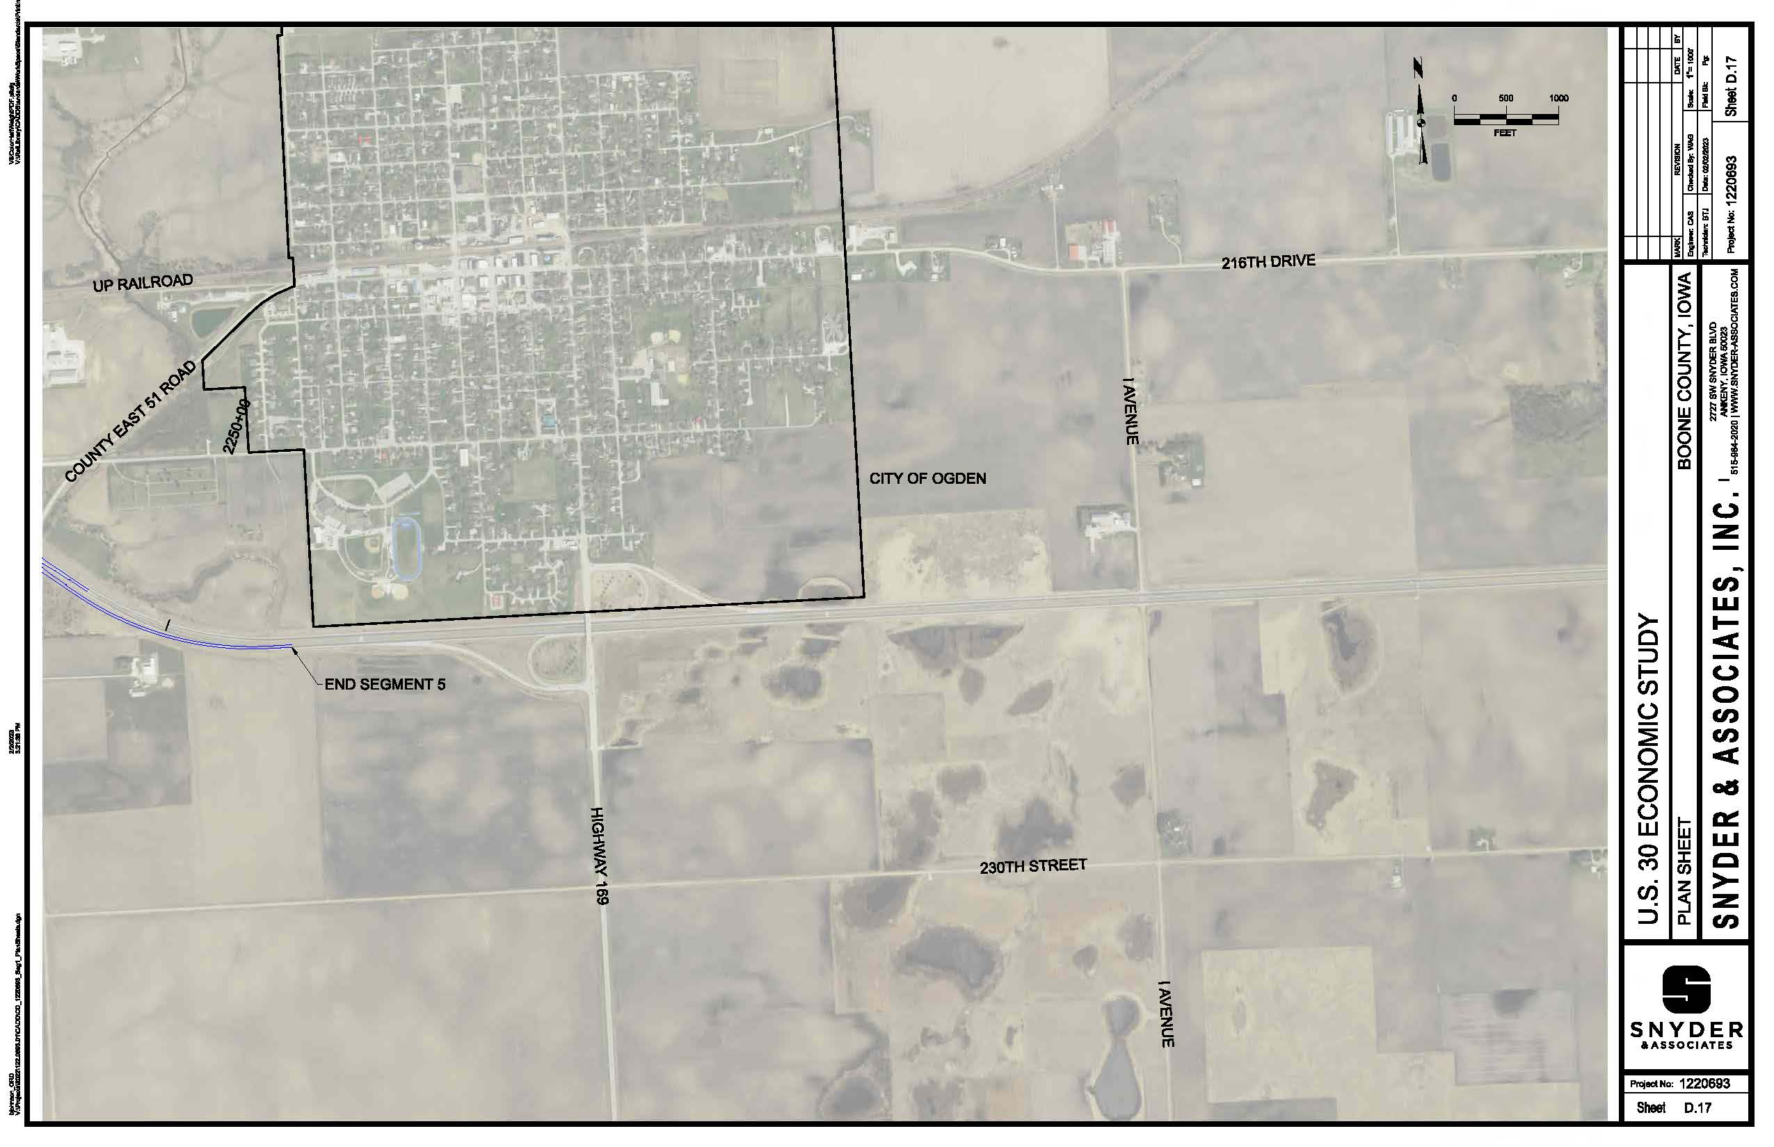
U.S. 30 - Ogden

Slide 18
Concept layouts
Lisbon to DeWitt

Slide 19
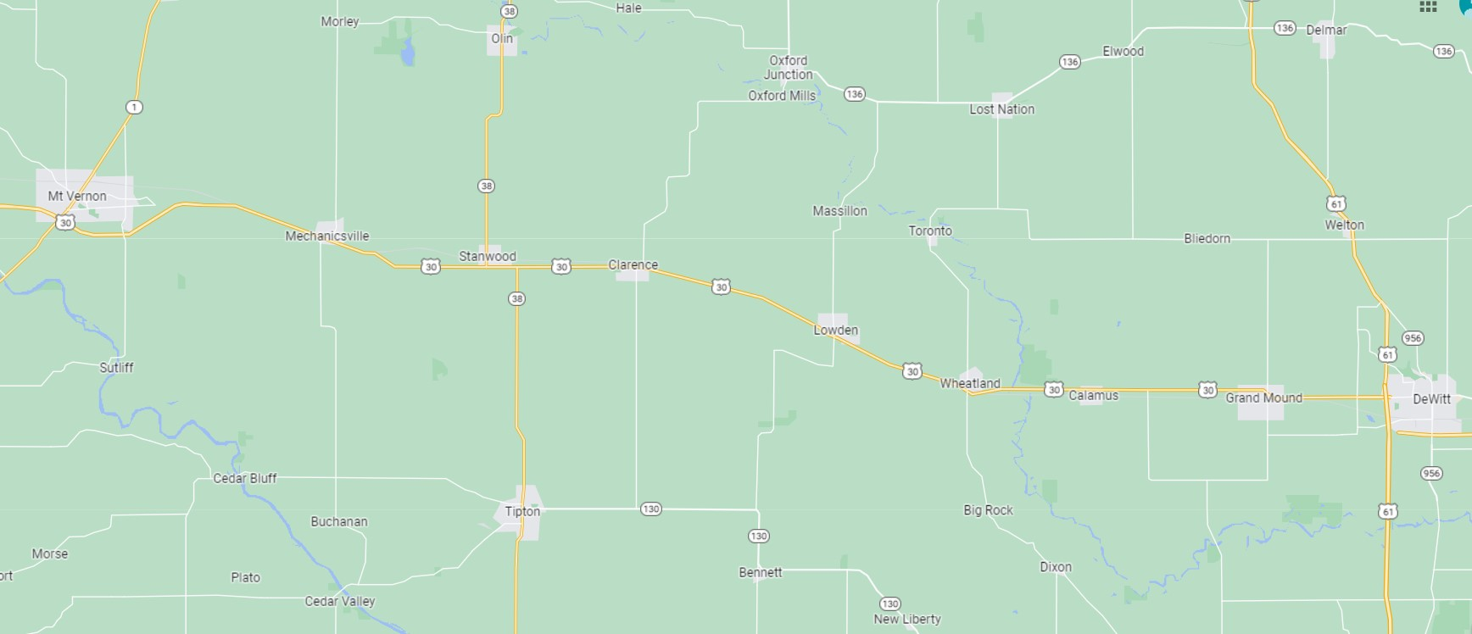
U.S. 30 East 40-mile Sub-Segments
6
7
8
9
Four sub-segments determined for cost estimating purposes
Based upon original construction segments of U.S. 30 (constructability review)

Slide 20
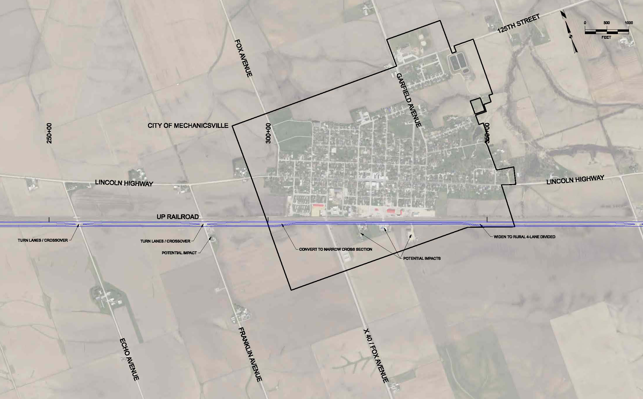
U.S. 30 - Mechanicsville

Slide 21
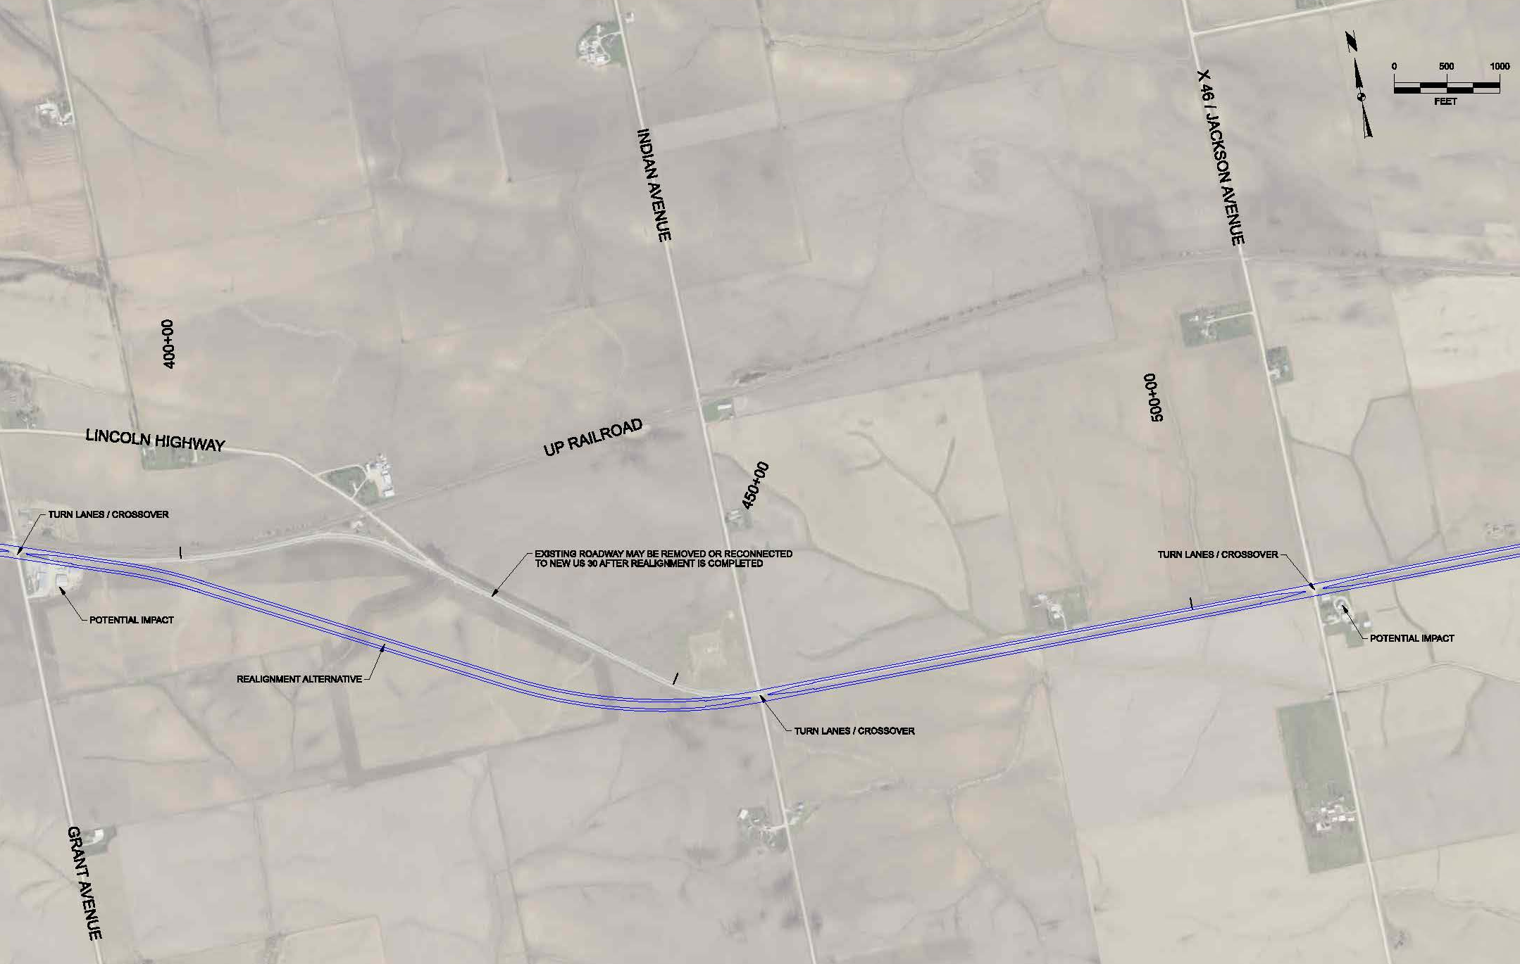
U.S. 30 – East of Mechanicsville

Slide 22
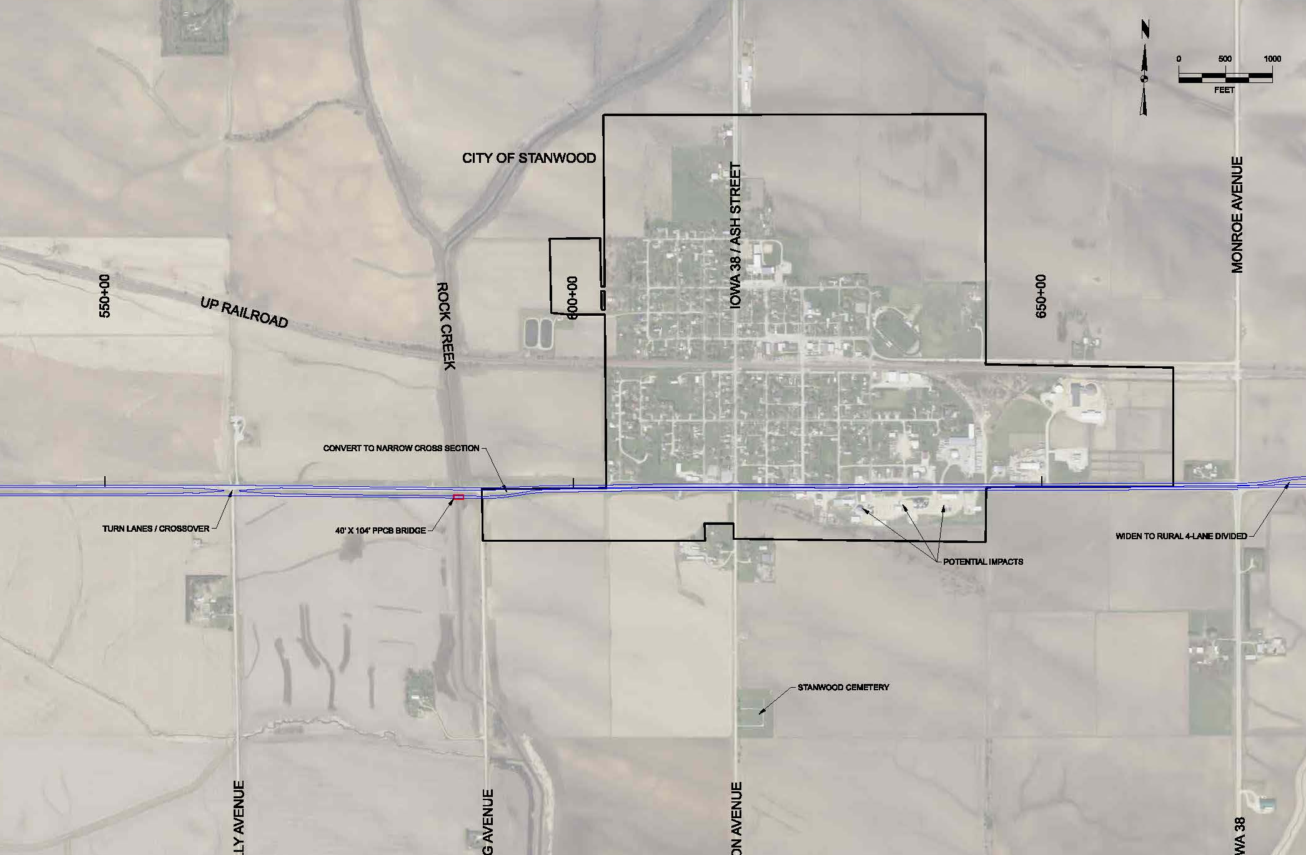
U.S. 30 - Stanwood

Slide 23
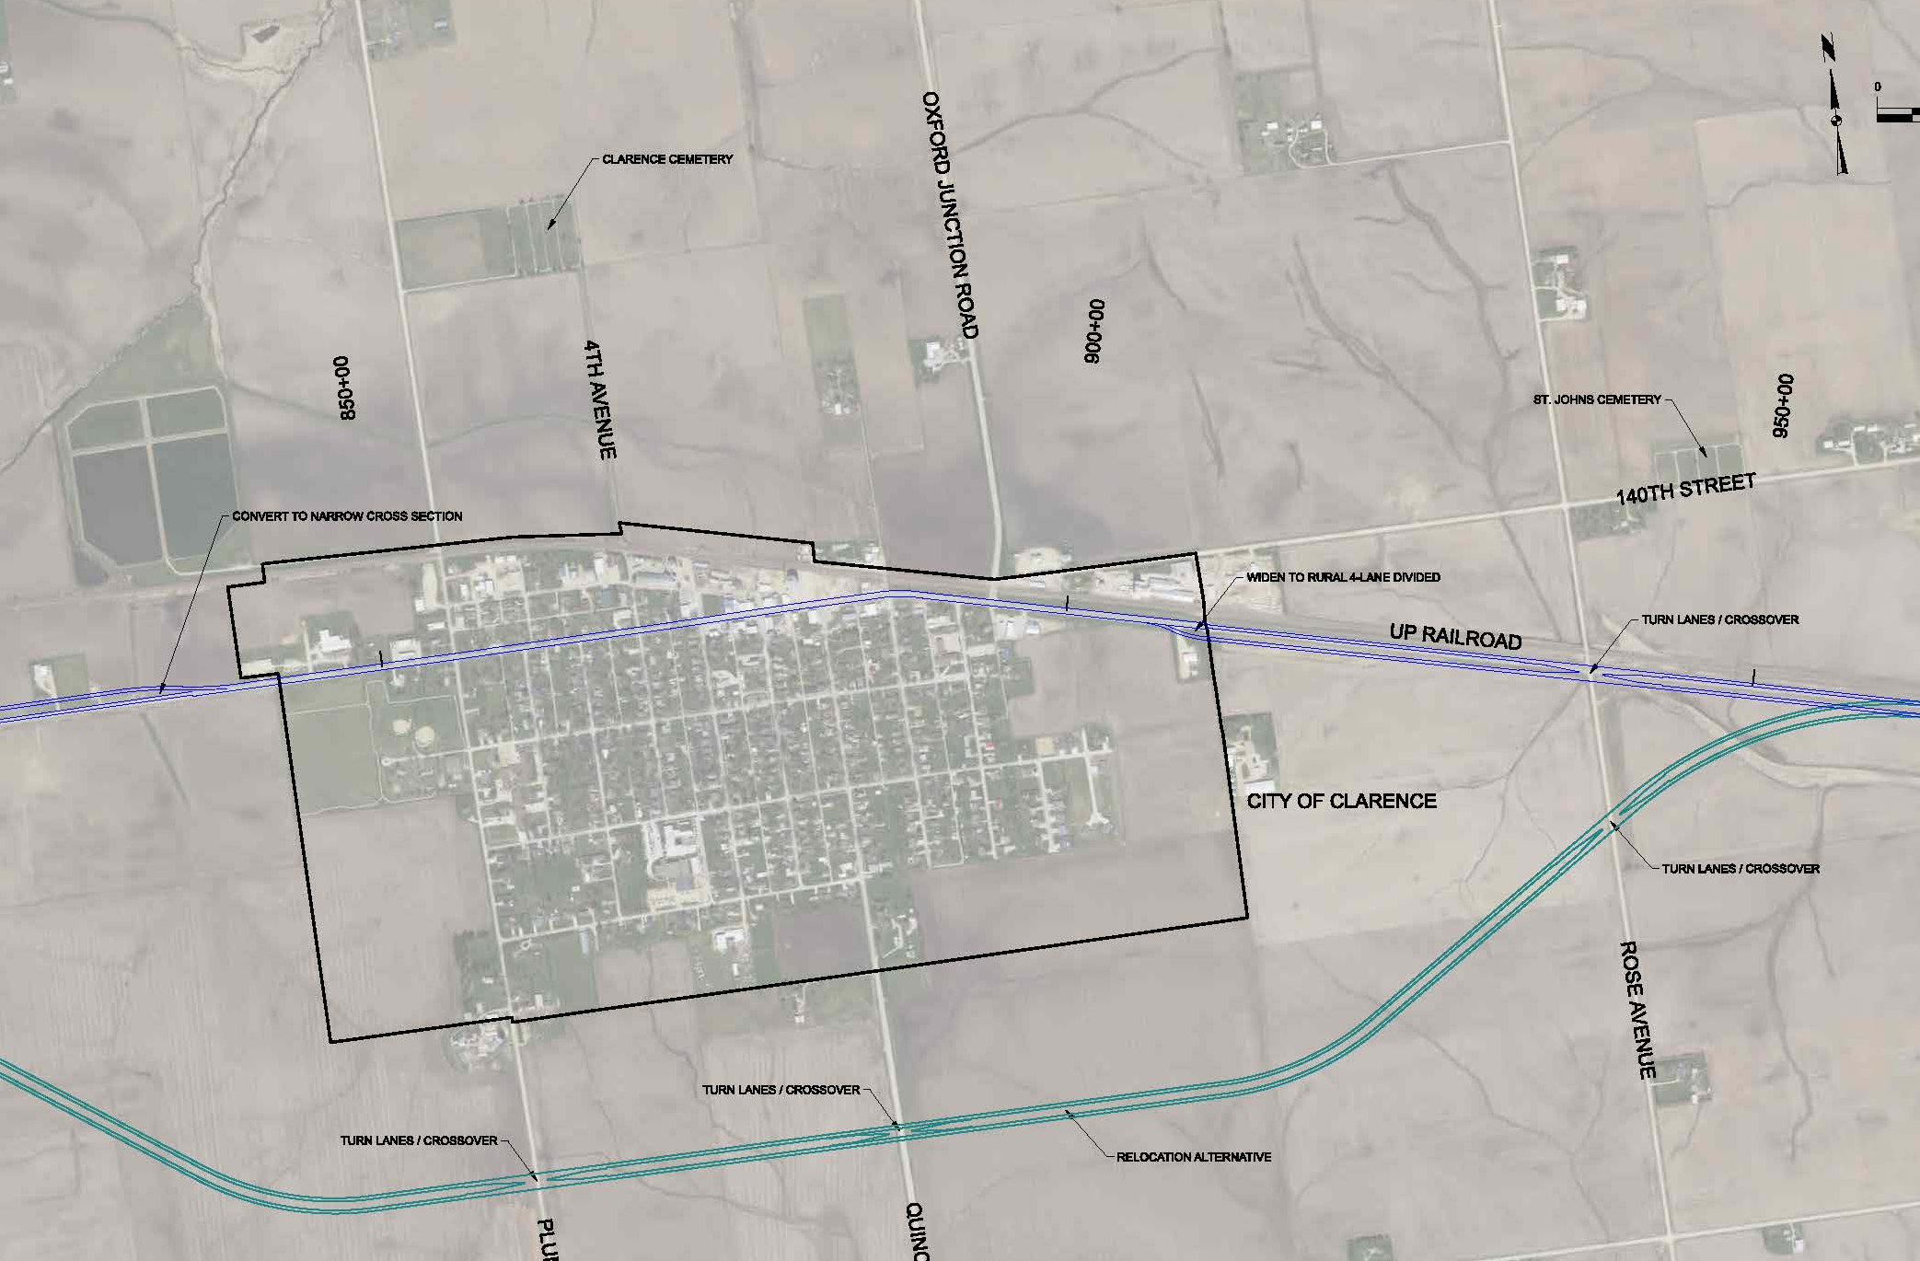
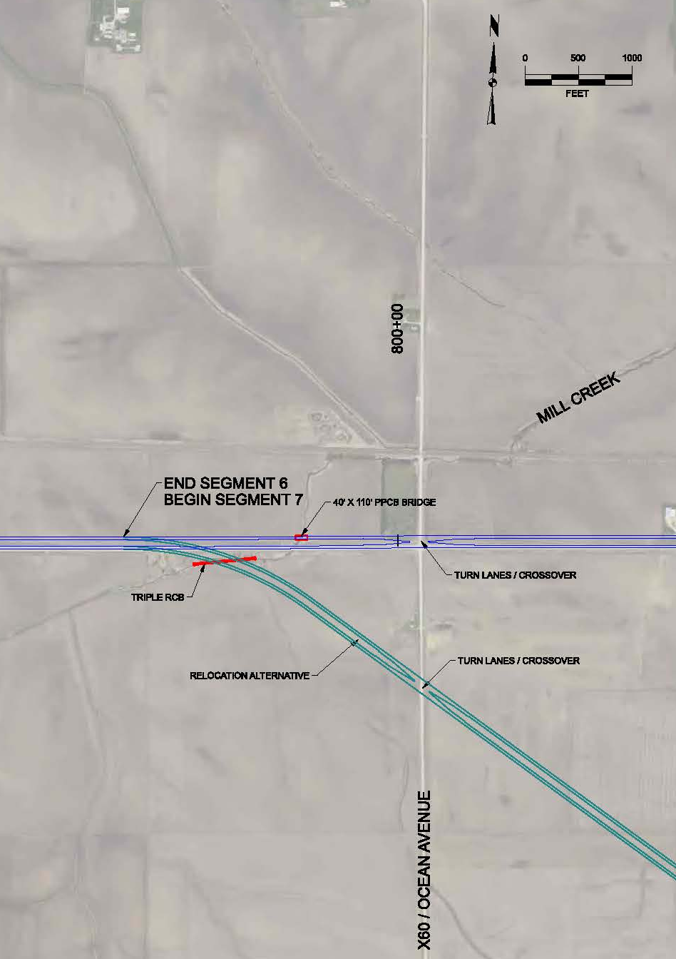
U.S. 30 - Clarence

Slide 24
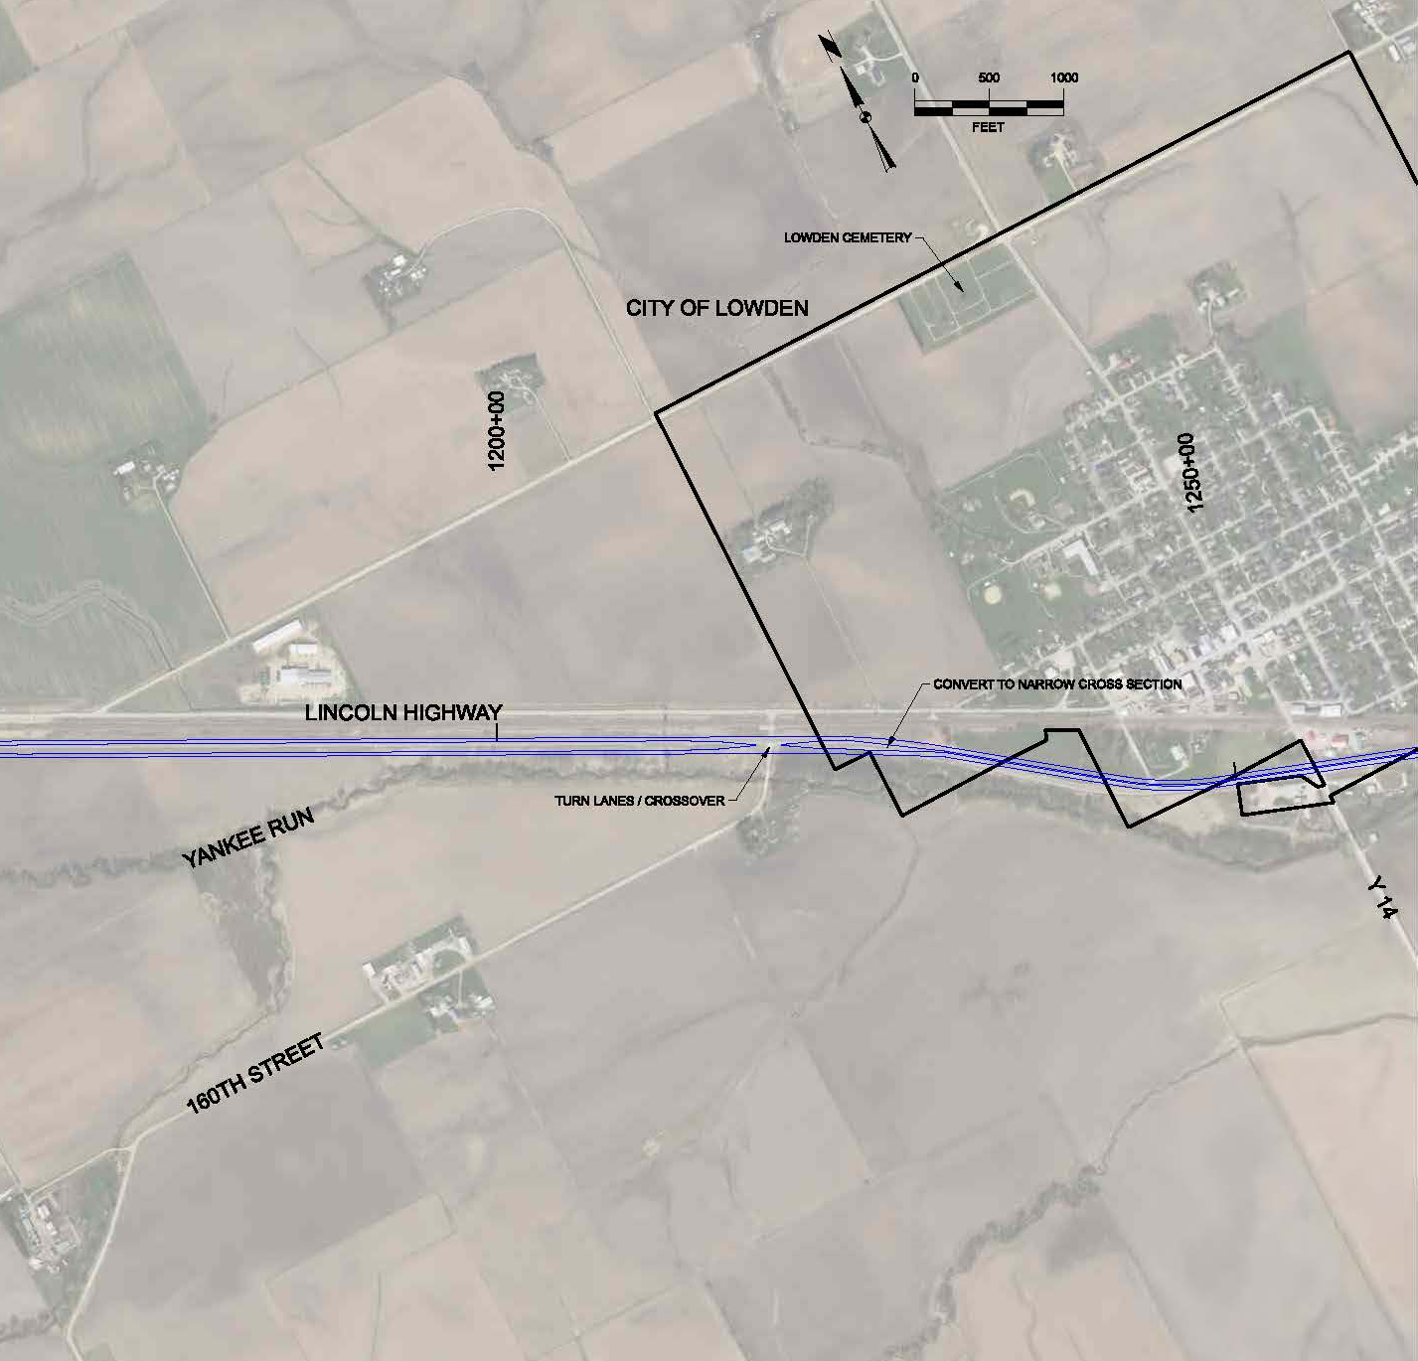
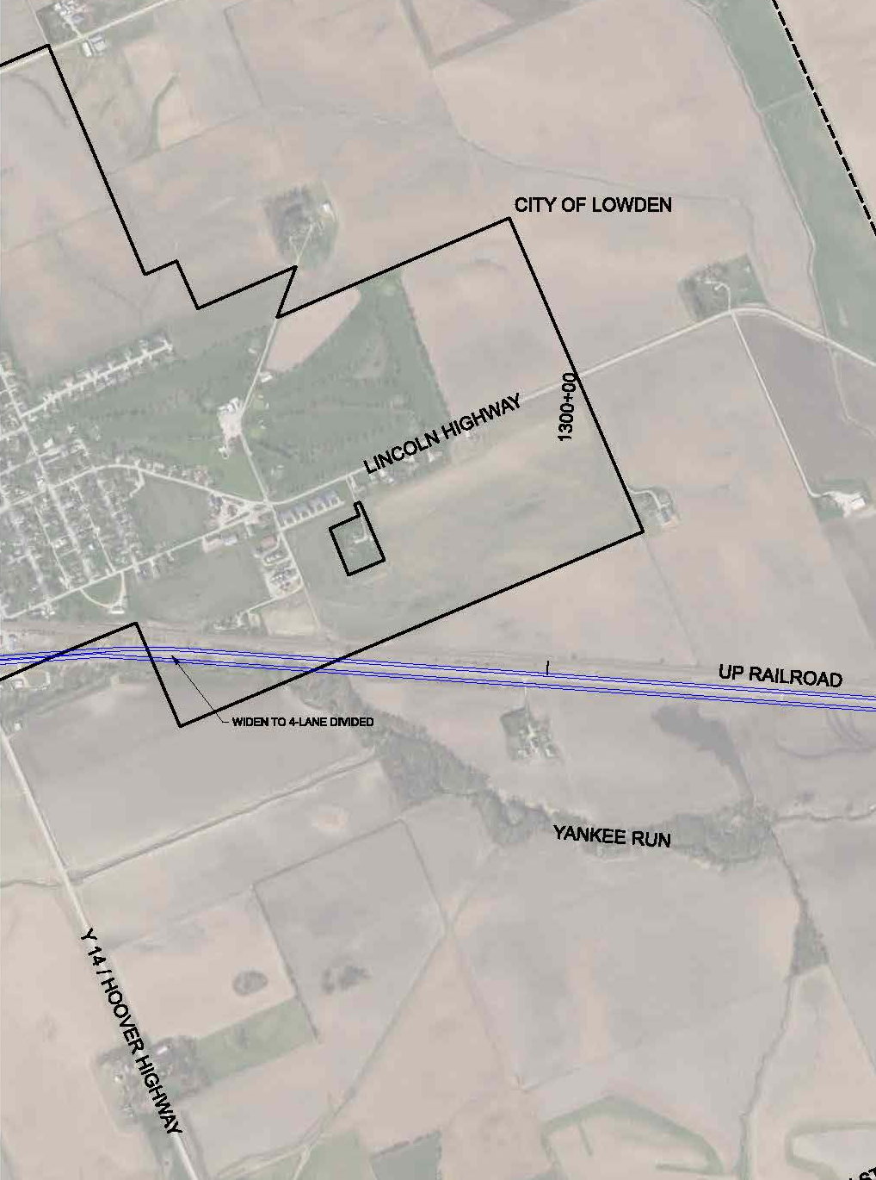
U.S. 30 - Lowden

Slide 25
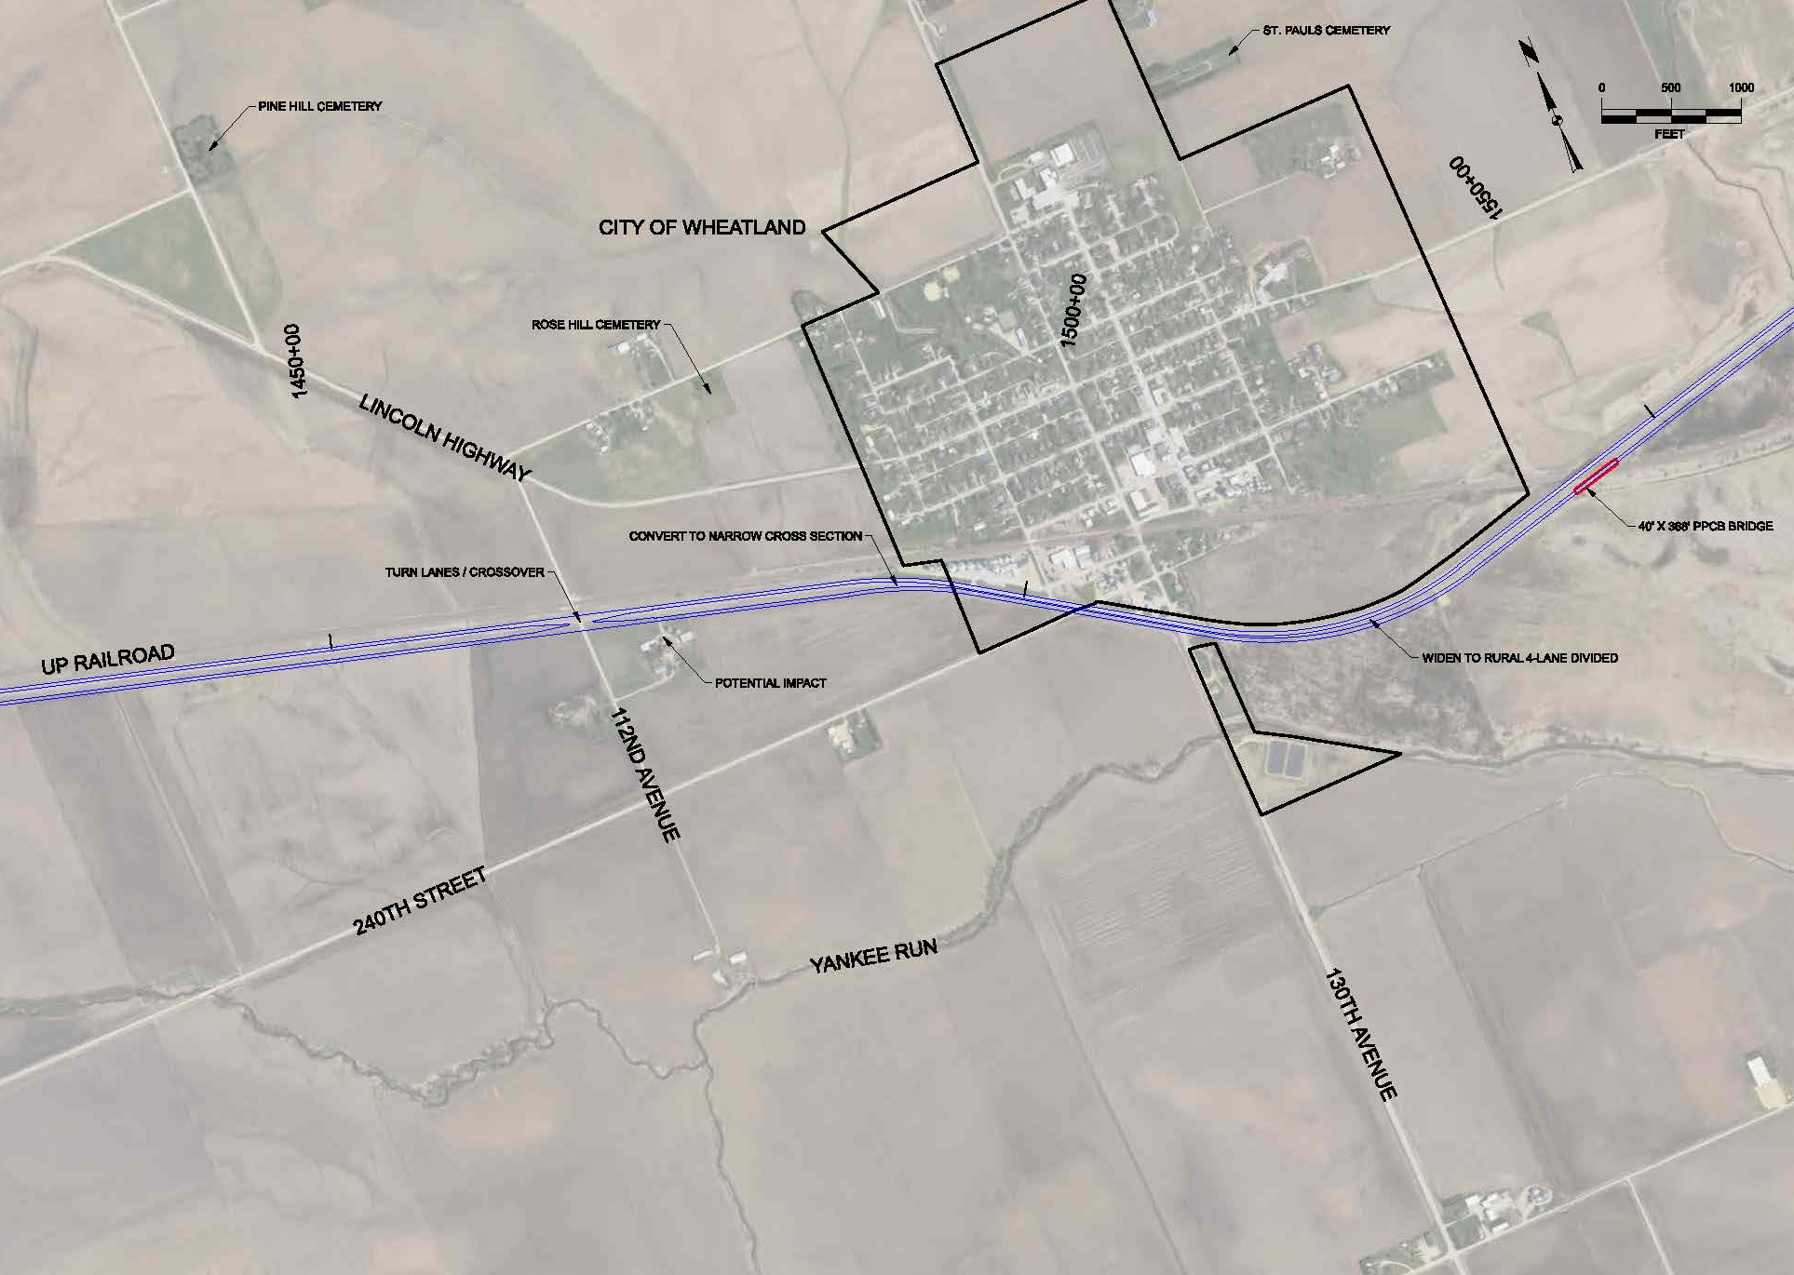
U.S. 30 - Wheatland

Slide 26
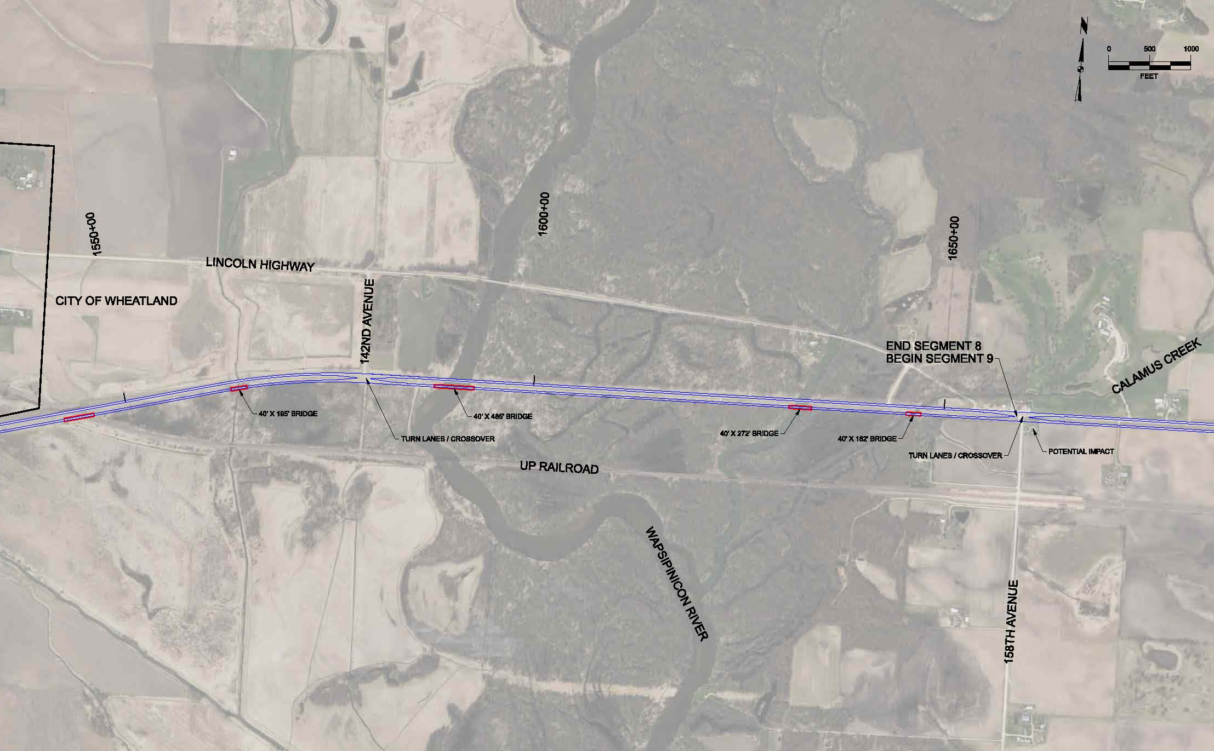
U.S. 30 – Wapsipinicon River

Slide 27
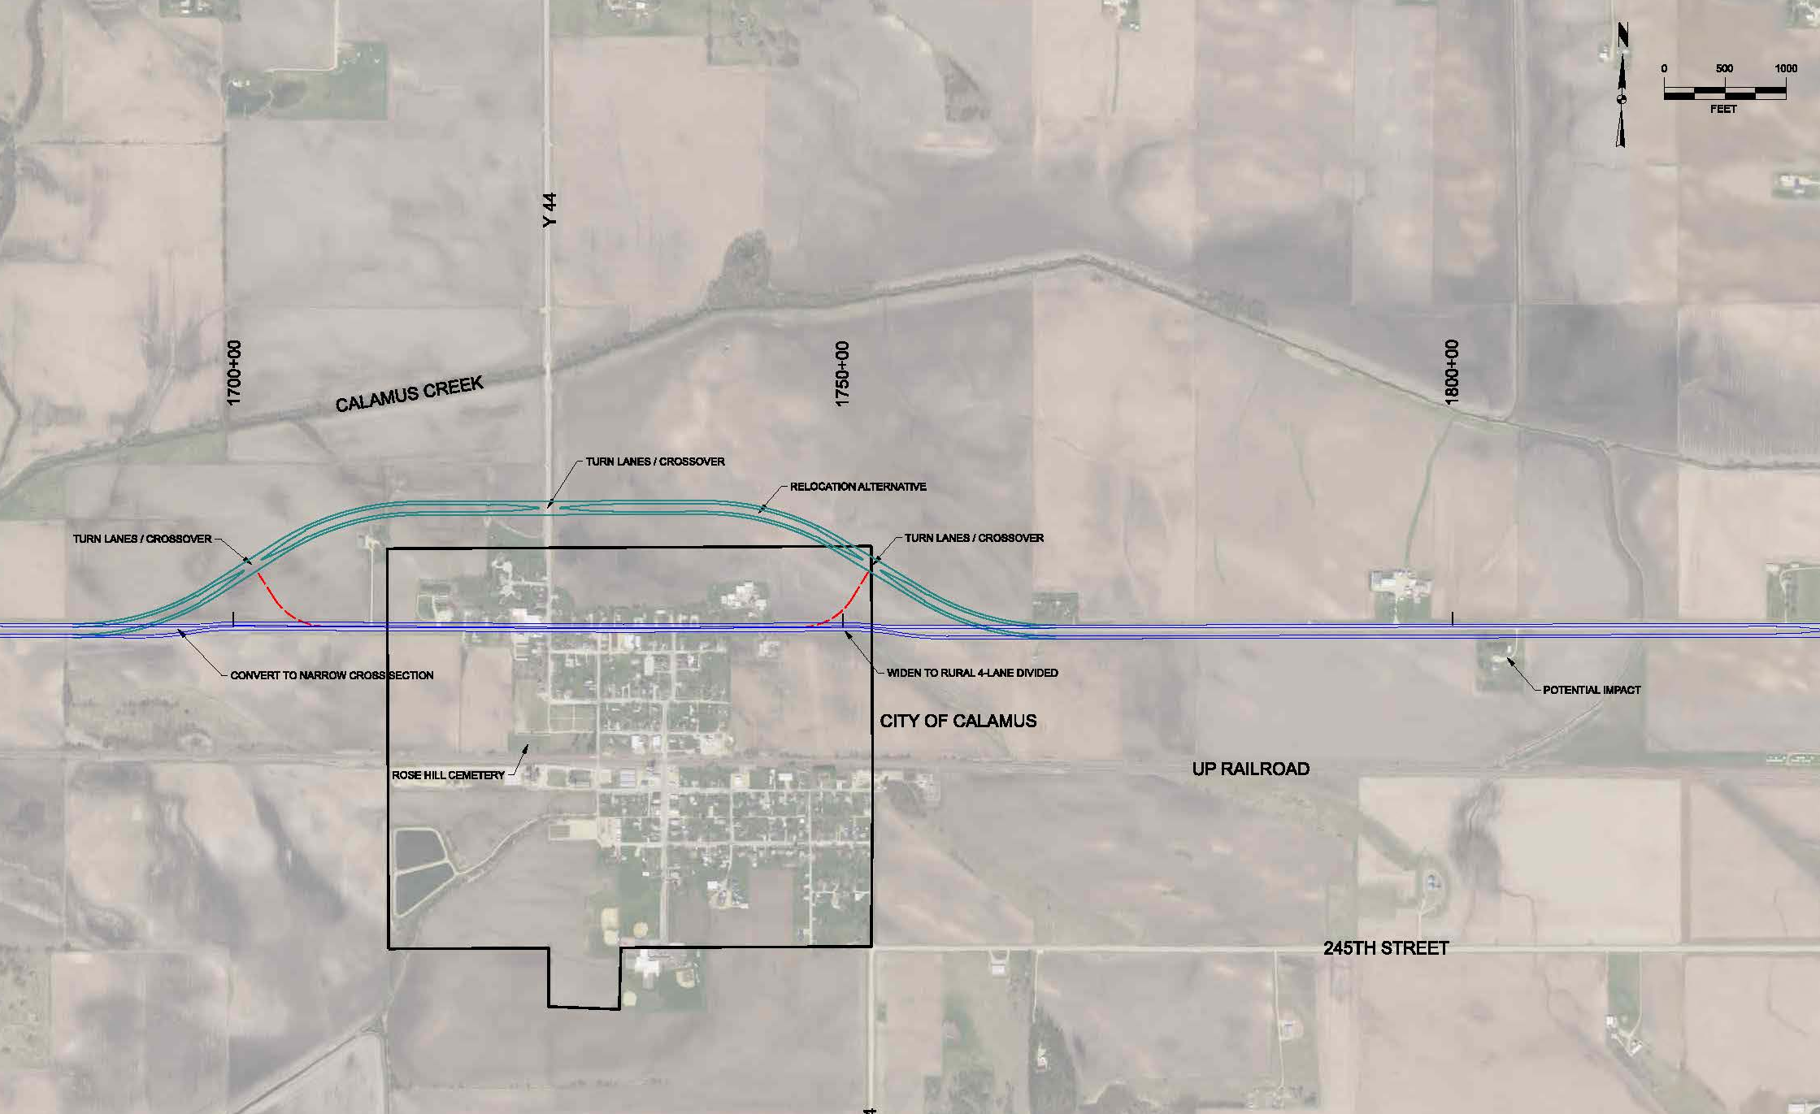
U.S. 30 – Calamus

Slide 28
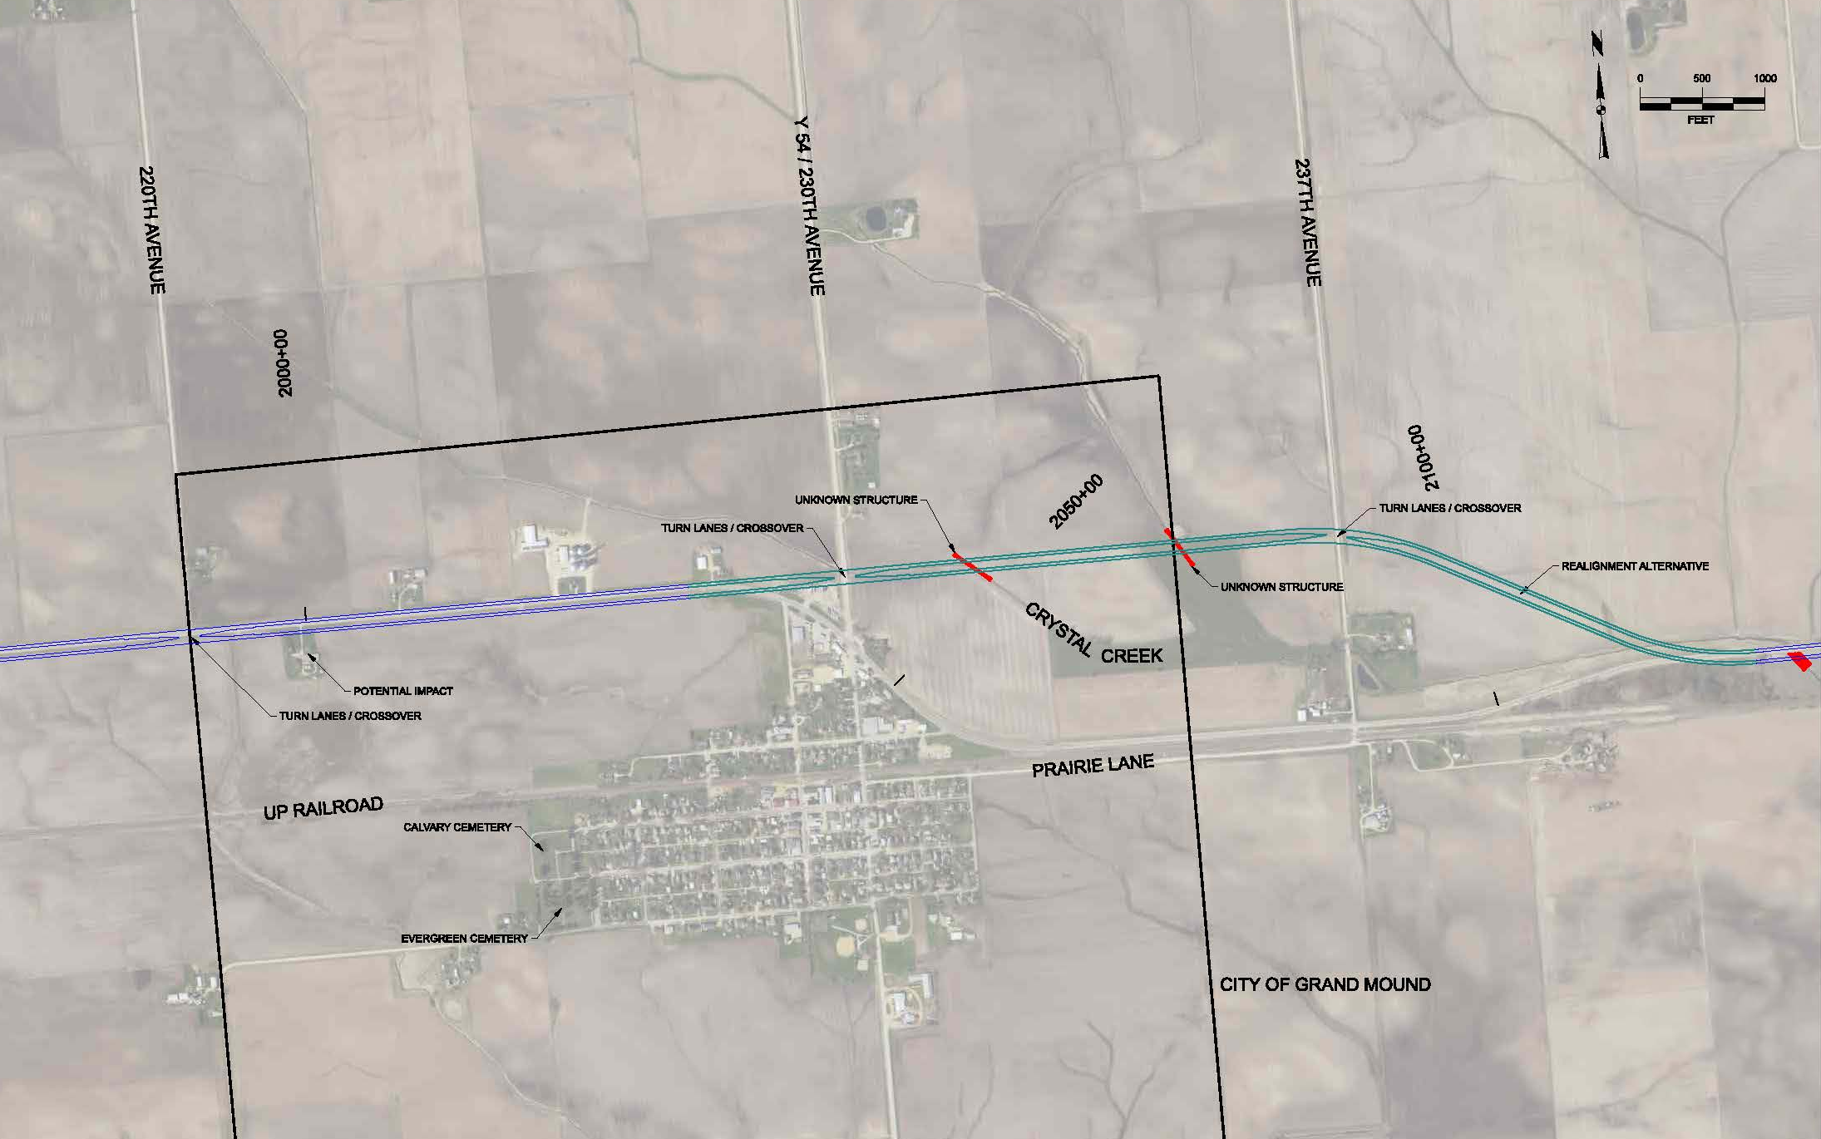
U.S. 30 – Grand Mound

Slide 29
Cost opinions & benefit-cost analysis

Slide 30
Cost Opinion Per Roadway Station
Section Type | Cost per 100’ (per Station)
Add 2 lanes – depressed median | $93,068
Add 2 lanes – center barrier | $187,930
New 4-lane roadway – 64’ median | $138,956
Urban 3-lane section | $100,312
Urban 5-lane section | $142,255
Notes:
Costs above are for construction only.
Design, NEPA, ROW, turn lanes at existing intersections, and structures (bridges and box culverts) were added to these costs to represent full project cost opinions for each sub-section alternative.
Environmental permitting costs (environmental mitigation and railroad) were not included.

Slide 31
U.S. 30 BCA Constructability Phasing
Sub-Segment | Design/NEPA/ROW Years | Construction Years
1(W) & 6(E) | 2027-2029 | 2030-2031
2(W) & 5(W) & 8(E) | 2029-2031 | 2032-2033
3(W) & 7(E) | 2031-2033 | 2034-2035
4(W) & 9(E) | 2033-2035 | 2036-2037
Concept Layouts
  4 Lanes Carroll - Ogden
    3 Lanes thru Glidden
    Grand Junction bypass
  4 Lanes Lisbon - DeWitt
    Clarence bypass
    Realign Grand Mound
Notes:
Design/ROW/NEPA assumed to take 3 years for each sub-segment. Construction assumed to take 2 years.

Slide 32
U.S. 30
Study Results
Year | Design/NEPA/ROW | Construction/ Const Admin | Total
2027 | $7,647,667 | $0 | $7,647,667
2028 | $7,647,667 | $0 | $7,647,667
2029 | $14,024,667 | $0 | $14,024,667
2030 | $6,337,000 | $62,707,000 | $69,084,000
2031 | $12,272,333 | $62,707,000 | $74,979,333
2032 | $5,895,333 | $59,815,500 | $65,710,833
2033 | $11,742,667 | $59,815,500 | $71,558,167
2034 | $5,847,333 | $70,600,000 | $76,447,333
2035 | $5,847,333 | $70,600,000 | $76,447,333
2036 | $0 | $75,003,000 | $75,003,000
2037 | $0 | $75,003,000 | $75,003,000
 | $77,302,000 | $536,251,000 | $613,553,000
Cost Opinions and Timing of Sub-Sections
  Carroll to Ogden = $301,711,000
  Lisbon to DeWitt = $311,842,000

Slide 33
U.S. 30
Study Results
Benefit/Cost Analysis
  2027 – 2067
  Added maintenance = $22.6M
  Travel Time Saved = $701.3M
  Residual Value = $107.3M
  $808.6M benefit to $636.3M cost
Notes:
Benefits not included for crash reductions, economic development, emissions reductions, or out of distance travel reductions for the region.
Travel Time calculated from USDOT’s 2023 B/C Analysis Guidance for Discretionary Grants.
Straight line depreciation over 50 years – residual value remaining after 40-year analysis period.
B/C ratio of Travel Time Costs Saved alone results in 1.10:1.

Slide 34
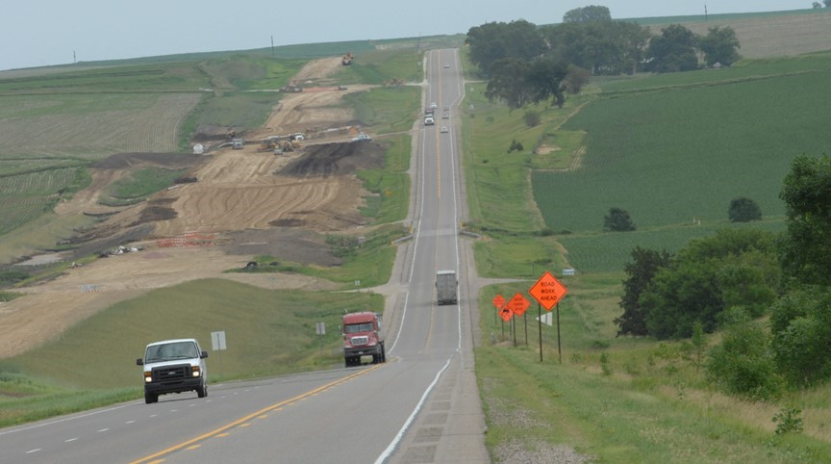
THANK YOU

Slide 35
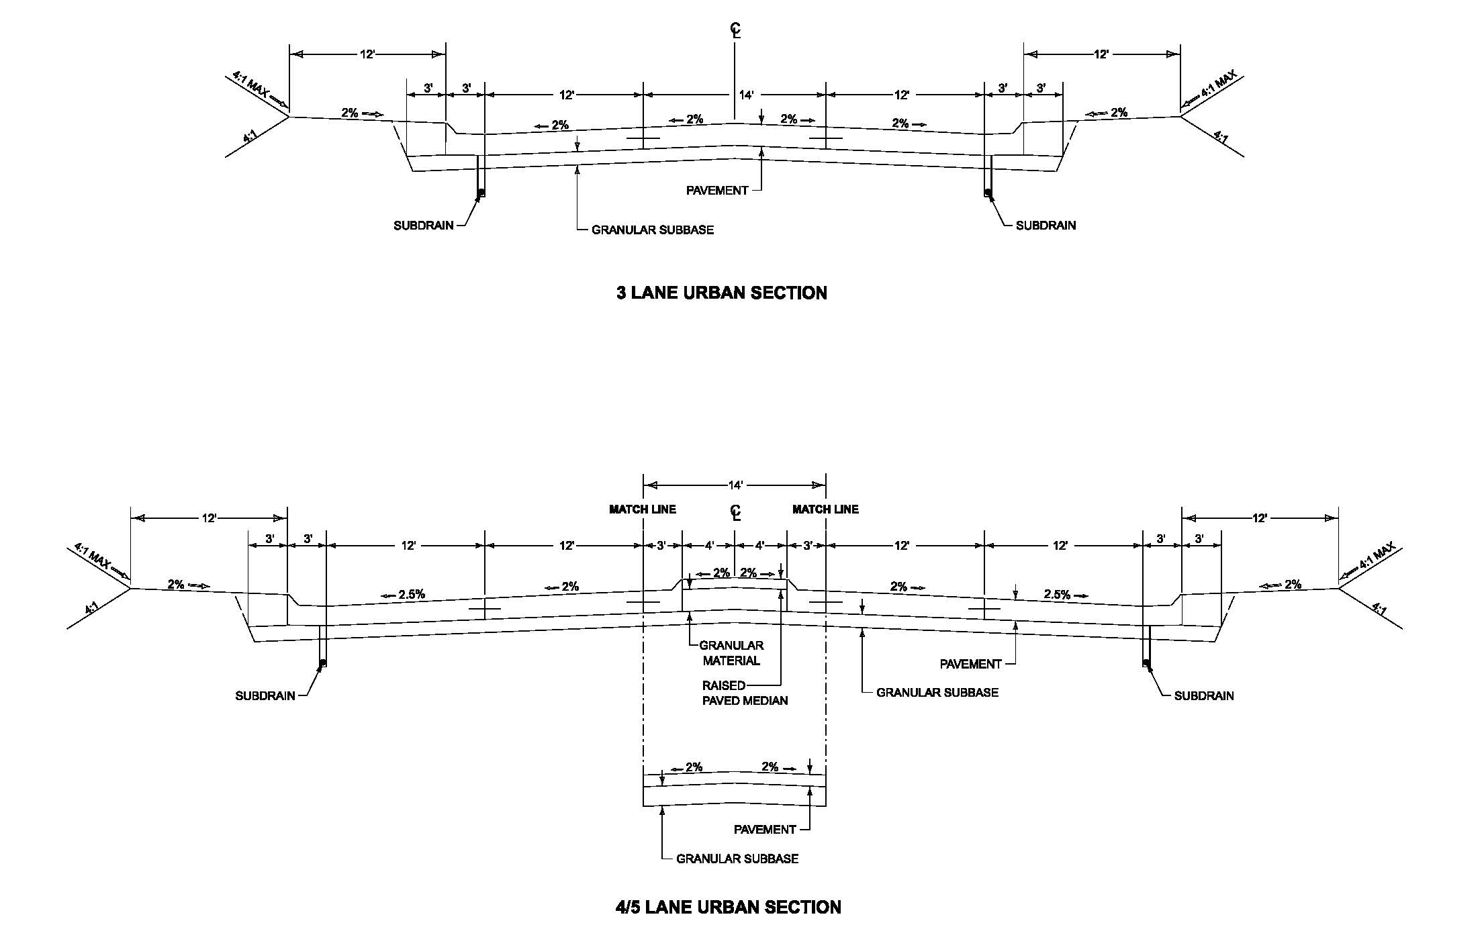
U.S. 30 Typical Cross Sections

Slide 36
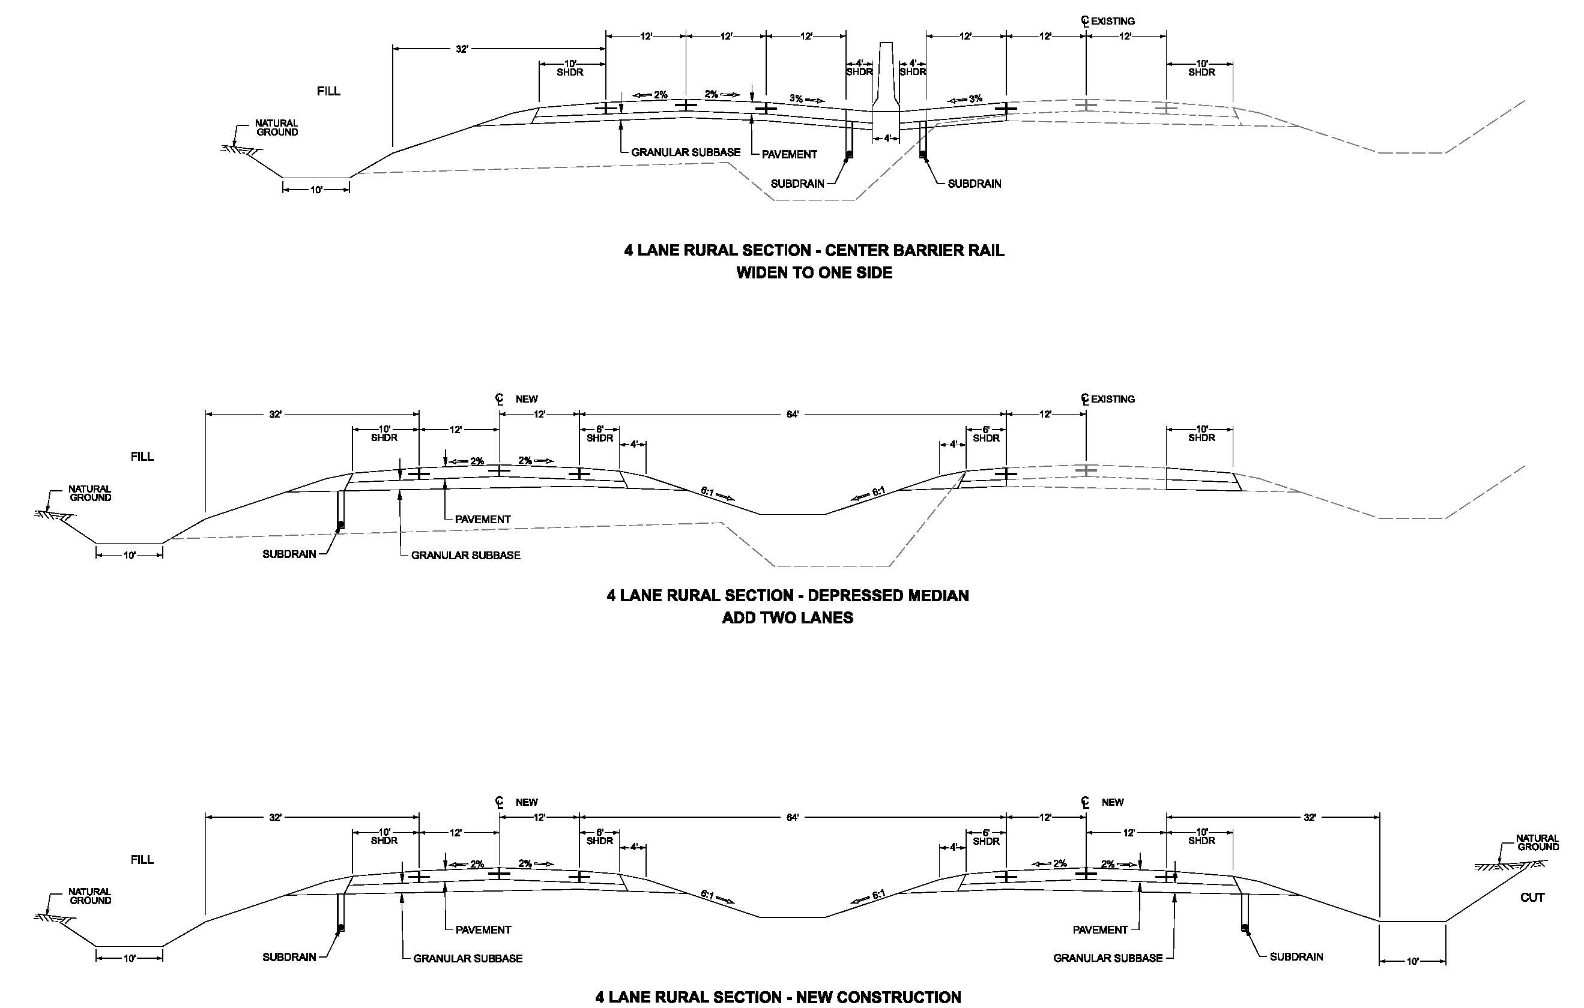
U.S. 30 Typical Cross Sections

