Slide 1
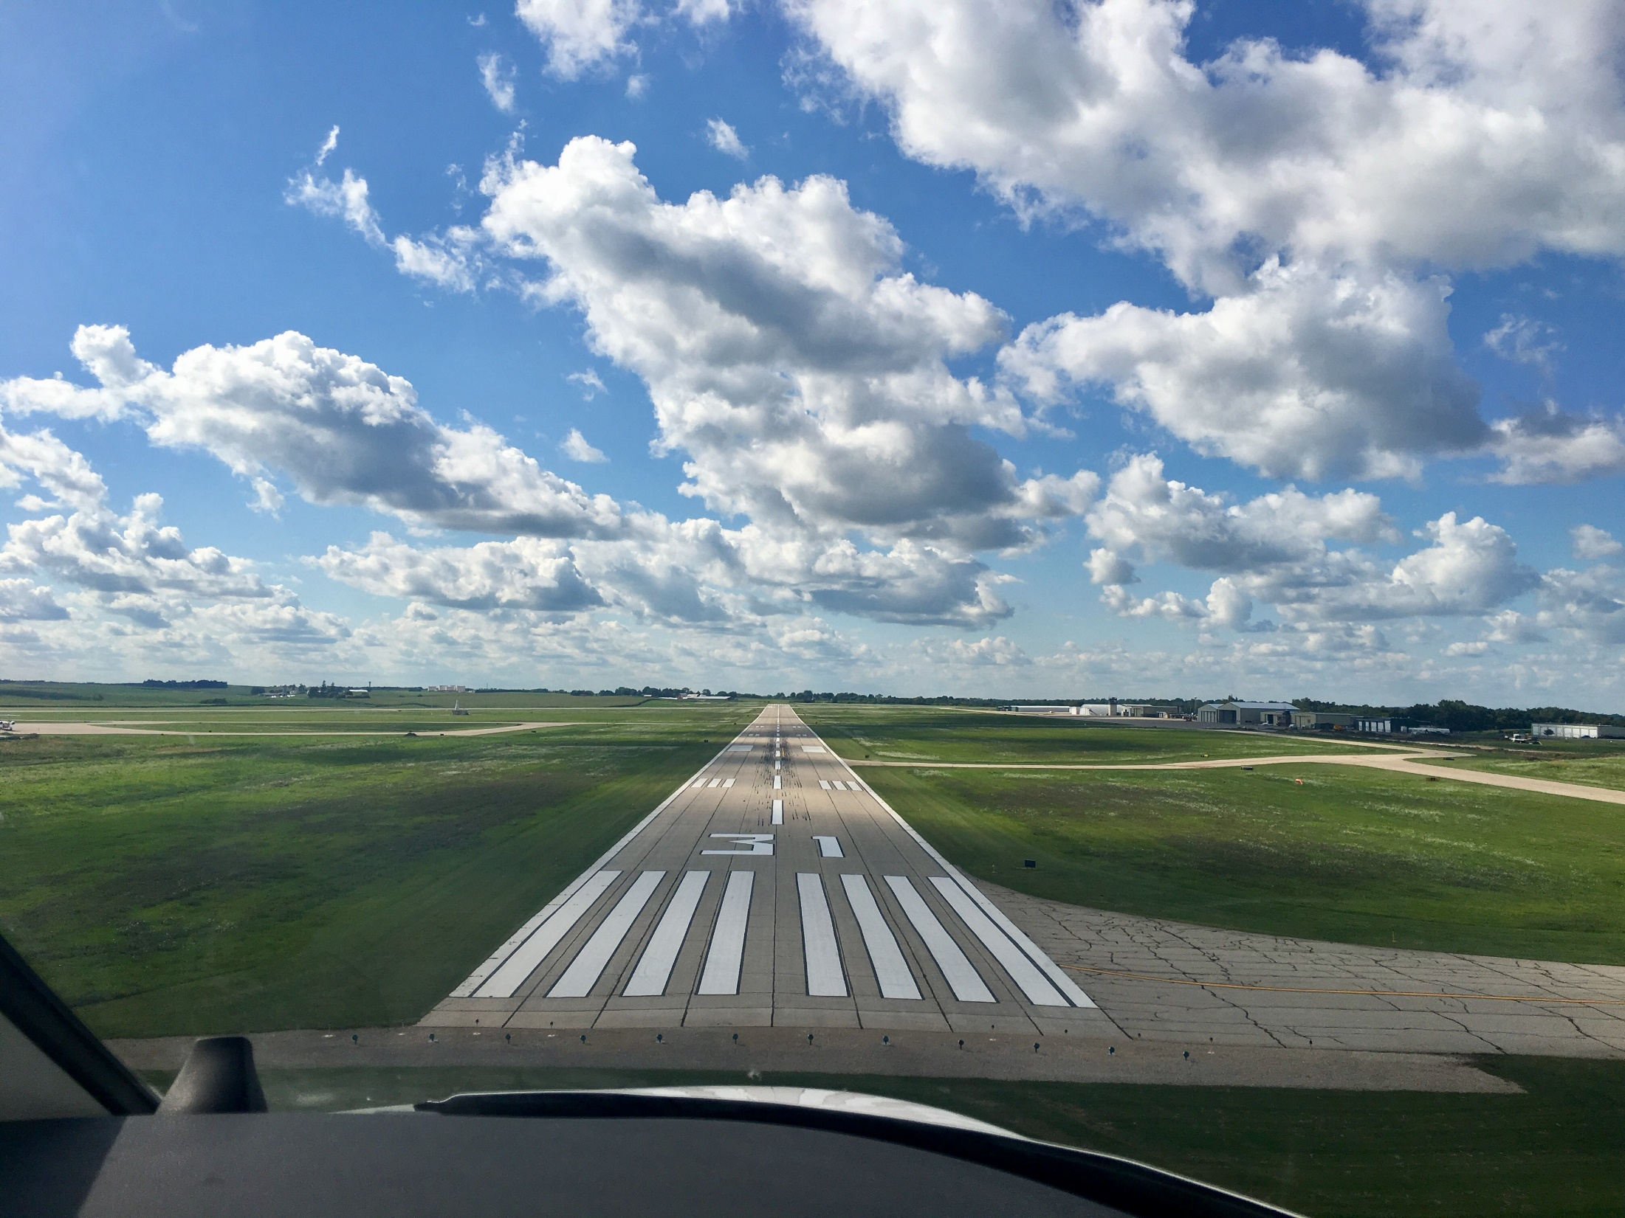

FY2025 State Aviation Program
Funding Recommendation
Shane Wright
Aviation Program Manager
8/12/2024

Slide 2
State Aviation Programs - Overview
Three state programs for review
Airport Improvement Program (AIP)
Funded through Aviation Fuel Taxes and Aircraft Registration fees deposited into the State Aviation Fund
General Aviation Vertical Infrastructure (GAVI)
Funded through Rebuild Iowa Infrastructure (RIIF) appropriation
Commercial Service Vertical Infrastructure (CSVI)
Funded through Rebuild Iowa Infrastructure (RIIF) appropriation
Commission Role
The commission is responsible for approving the projects to be funded in all three of these programs
Process
Projects were presented for review at the July meeting and commission action is being requested at the August meeting

Slide 3
State Aviation Programs - Overview
Changes since July workshop
Boone Municipal Airport withdrew applications in the AIP and GAVI programs
The next highest priority applications were selected and inserted into the recommendation.
No changes to the CSVI program

Slide 4
List of Applications Recommended
PROJECT NAME | SPONSOR | SCORE | TOTAL PROJECT COST | REQUESTED AMOUNT (% of Total Project Cost) | RECOMMENDED AMOUNT (% of Total Project Cost)
North GA Apron Reconstruction | Des Moines International Airport | 85 | 850,770 | 382,846(45%) | 382,846(45%)
Taxiway Repair | Carroll Arthur N Neu Airport | 75 | 17,988 | 13,491(75%) | 13,491(75%)
Remove Underground Storage Tanks | Denison Municipal Airport | 75 | 67,000 | 33,500(50%) | 33,500(50%)
South Apron Reconstruction | Sioux Gateway Airport | 75 | 600,000 | 400,000(67%) | 400,000(67%)
Fuel System Improvements | Spencer Municipal Airport | 75 | 185,500 | 139,125(75%) | 139,125(75%)
Construct Hangar Development Taxilane | Mason City Municipal Airport | 75 | 546,800 | 382,760(70%) | 382,760(70%)
South Apron Utility Expansion | Sioux County Regional Airport | 75 | 117,500 | 88,125(75%) | 88,125(75%)
Construct Taxilane, Apron, and Demo Armory | The Eastern Iowa Airport | 70 | 1,201,000 | 605,000(50%) | 400,000(33%)
Rehabilitate Taxiway D | Fort Dodge Regional Airport | 70 | 535,200 | 428,160(80%) | 375,000(70%)
T-Hangar Approach and Taxilane Extension | Boone Municipal Airport | 70 | 500,000 | 375,000(75%) | 375,000(75%)
Obstruction Mitigation | Creston Municipal Airport | 70 | 65,000 | 55,250(85%) | 55,250(85%)
Taxilane Extension, Apron Expansion, and Site Improvements | Le Mars Municipal Airport | 70 | 500,000 | 350,000(70%) | 350,000(70%)
Construct Taxiway/Aprons for Hangar | Mount Pleasant Municipal Airport | 70 | 370,000 | 292,300(70%) | 292,300(70%)
Apron Expansion | Newton Municipal Airport | 70 | 400,000 | 340,000(79%) | 340,000(79%)
Airfield Lighting Replacement | Rock Rapids Municipal Airport | 70 | 570,000 | 400,000(85%) | 400,000(85%)
Runway 34 Obstruction Mitigation | Vinton Veterans Memorial | 70 | 200,000 | 170,000(70%) | 170,000(70%)
Runway Markings Improvement | Dubuque Regional Airport | 70 | 412,000 | 329,600(85%) | 329,600(85%)
Terminal Area Utility Improvements | Knoxville Municipal Airport | 70 | 250,000 | 200,000(80%) | 200,000(80%)
Construct Taxilane | Northeast Iowa Regional Airport | 70 | 583,870 | 400,000(69%) | 400,000(69%)
Construct Hangar Aprons | Ankeny Regional Airport | 70 | 222,850 | 111,425(50%) | 111,425(50%)
Hangar Apron and Site Improvement | Washington Municipal Airport | 70 | 300,000 | 225,000(75%) | 225,000(75%)
Terminal Area Access and Taxiway | Milford Municipal Airport | 65 | 76,600 | 38,300(50%) | 38,300(50%)
Airport Layout Plan and Narrative | Osage Municipal Airport | 65 | 67,900 | 54,320(80%) | 54,320(80%)
Runway 31 Obstruction Mitigation | Rockwell City Municipal Airport | 60 | 180,000 | 153,000(85%) | 153,000(85%)
Jump to applications not recommended for funding

Slide 5
List of GAVI Applications Recommended
PROJECT NAME | SPONSOR | SCORE | TOTAL PROJECT COST | REQUESTED AMOUNT (% of Total Project Cost) | RECOMMENDED AMOUNT (% of Total Project Cost)
Construct Box Hangars | Ankeny Regional Airport | 90 | 985,000 | 300,000(30%) | 300,000(30%)
Construct T-Hangar | Boone Municipal Airport | 85 | 720,000 | 300,000(42%) | 300,000(42%)
Construct T-Hangar | Northeast Iowa Regional Airport | 80 | 540,000 | 300,000(56%) | 300,000(56%)
Construct Hangar and Terminal | Decorah Municipal Airport | 75 | 416,667 | 300,000(72%) | 300,000(28%)
Hangar Structural Improvement | Mount Pleasant Municipal Airport | 75 | 66,000 | 45,600(69%) | 45,600(69%)
Hangar Roof Replacement and Rehab | Keokuk Municipal Airport | 75 | 101,000 | 80,750(80%) | 80,750(80%)
Hangar HVAC and Restroom Improvements | Knoxville Municipal Airport | 70 | 40,000 | 32,000(80%) | 32,000(80%)
Jump to applications not recommended for funding

Slide 7


Questions?
shane.wright@iowadot.us
515-239-1048

Slide 8
List of AIP Applications Not Recommended
PROJECT NAME | SPONSOR | SCORE | TOTAL PROJECT COST | REQUESTED AMOUNT (% of Total Project Cost) | RECOMMENDED AMOUNT (% of Total Project Cost)
Reconstruct Apron Pavement | Southeast Iowa Regional Airport | 70 | 476,190 | 400,000(84%) | 0
Expand AvGas Fuel System | Estherville Municipal Airport | 65 | 300,000 | 240,000(80%) | 0
Reconstruct Parking Apron | Grinnell Regional Airport | 65 | 375,000 | 300,000(80%) | 0
East Taxilane Extension | Atlantic Municipal Airport | 60 | 120,000 | 102,000(85%) | 0
Construct Terminal Area Fencing | Denison Municipal Airport | 60 | 113,500 | 95,340(84%) | 0
AvGas Fuel System Improvements | Jefferson Municipal Airport | 60 | 450,000 | 360,000(80%) | 0
Reconstruct North T-Hangar Taxilane | Waverly Municipal Airport | 60 | 402,650 | 330,173(82%) | 0
Fuel Facility Improvement | Guthrie County Regional Airport | 55 | 310,000 | 248,000(80%) | 0
Avgas Fuel System | New Hampton Municipal Airport | 55 | 70,000 | 52,500(75%) | 0
T-Hangar Approach and Taxilane Extension | Boone Municipal Airport | Withdrawn | 500,000 | 375,000(75%) | 0
 |  |  |  |  | 0
 |  |  |  |  | 0
 |  |  |  |  | 0
 |  |  |  |  | 0
 |  |  |  |  | 0
 |  |  |  |  | 0
 |  |  |  |  | 0
 |  |  |  |  | 0
Jump to applications recommended for funding

Slide 9
List of GAVI Applications Not Recommended
PROJECT NAME | SPONSOR | SCORE | TOTAL PROJECT COST | REQUESTED AMOUNT (% of Total Project Cost) | RECOMMENDED AMOUNT (% of Total Project Cost)
Install New Hangar Doors | Harlan Municipal Airport | 70 | 150,000 | 125,000(83%) | 0
Construct T-Hangar | Mount Pleasant Municipal Airport | 70 | 375,000 | 300,000(80%) | 0
Construct T-Hangar | Boone Municipal Airport | Withdrawn | 720,000 | 300,000(42%) | 0
Jump to applications recommended for funding

