Slide 1
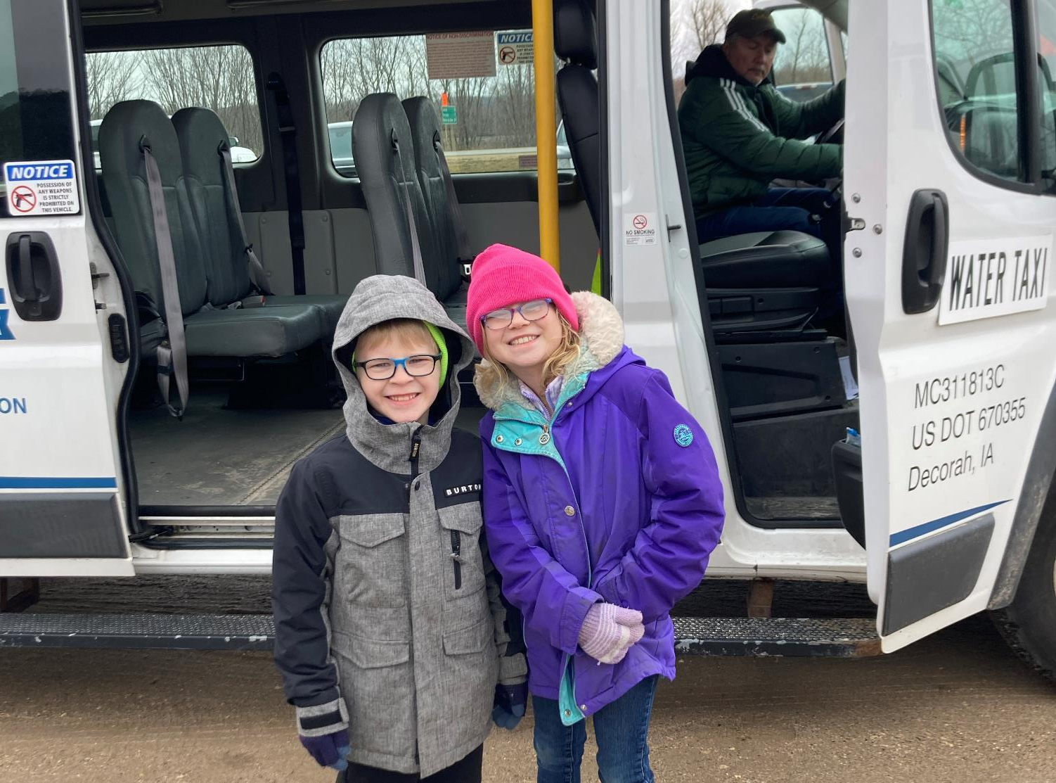
FY 2025 Public Transit Infrastructure
Grant Program
3/2/2023
Brent Paulsen
Transit Programs Manager
Commission Workshop August 12, 2024

Slide 2
Public Transit Infrastructure Grant Program
Program created by 2006 General Assembly
Funds vertical infrastructure projects for public transit
All 35 public transit systems are eligible
Notes:
The Public Transit Infrastructure Grant Program (PTIwas created in 2006 by the General Assembly. This program funds vertical infrastructure projects for public transit. All 35 transit systems are eligible. Projects can involve new construction, reconstruction or remodeling.

Slide 3
Project Evaluation Criteria
No more than 40-percent of the appropriation can be awarded to an individual transit system
Structural integrity of existing facilities
Safety enhancements to existing facilities
New facilities that enhance the life of the transit fleet or optimize transit service
Projects should be “shovel ready” and capable of completion in 18 months
Notes:
For this program, no more than 40-percent of the appropriation can be awarded to an individual transit system. The PTIG share is up to 80 percent of the project cost. The structural integrity of existing facilities, potential safety enhancements to existing facilities, as well as new facilities that will enhance the life of the transit fleet or optimize service are project considerations. Projects should be “shovel ready” and capable of completion within 18 months. Projects may include but are not limited to facilities for the administration of public transit operations, facilities for servicing, maintenance or storage of public transit vehicles, transit vehicle fueling facilities, bus wash bays, passenger waiting facilities.

Slide 4
Available Funding and Application Summary
Annual appropriation: $1,500,000
Underrun/withdrawals: $220,923
Funds available: $1,720,923
Total number of projects: 5
Total project costs: $2,427,000
Total amount requested: $1,873,600
Notes:
The PTIG annual appropriation for FY25 is $1.5 million. There are $220,923 in underrun/withdrawal funds to add to the annual appropriation totaling $1,720,923 in available funding. Five projects were submitted totaling $2,427,000 in federal, state, and local project costs. The total amount of PTIG requested is $1,873,600.

Slide 5
Table of Projects Recommended For Award
Project Name | Sponsor | Total Project Cost | Requested Amount (% of Total Project Cost) | Recommended Amount (% of Total Project Cost)
Heat Pump Condenser Water Piping Replacement Project | Sioux City Transit | $835,000 | $600,000 (72%) | $600,000 (72%)
Two Bay Parking Garage for Indoor Storage | North Iowa Area Council of Governments | $625,000 | $500,000 (80%) | $500,000 (80%)
Bus Storage Facility Project | River Bend Transit | $137,000 | $109,600 (80%) | $109,600 (80%)
Phase 1: Bus Storage Fire Mitigation Upgrade | Ames Transit Agency | $750,000 | $600,000 (80%) | $511,323 (68%)
Jump to Projects Not Recommended For Award
Notes:
Four projects were recommended for Award. The first project is Heat Pump Condenser Water Piping Replacement Project for Sioux City Transit. It has a total project cost of $835,000, with a requested and recommended funding amount of $600,000 or 72% of the total project cost. The second project is a Two Bay Parking Garage for Indoor Storage of Winnebago County Transit and Forest City Transit buses. The total project cost is $625,000, with a requested and recommended amount of $500,000 or 80% of the total project cost. The third project is Bus Storage Facility for River Bend Transit The total funds requested is $137,000 with a requested and recommended amount of $109,600 or 80% of the total project cost. The fourth project is Phase 1: Bus Storage Fire Mitigation Upgrade for Ames Transit Agency. The total project costs is 750,000 with a requested amount of $600,000 and recommended amount of $511,323.

Slide 6
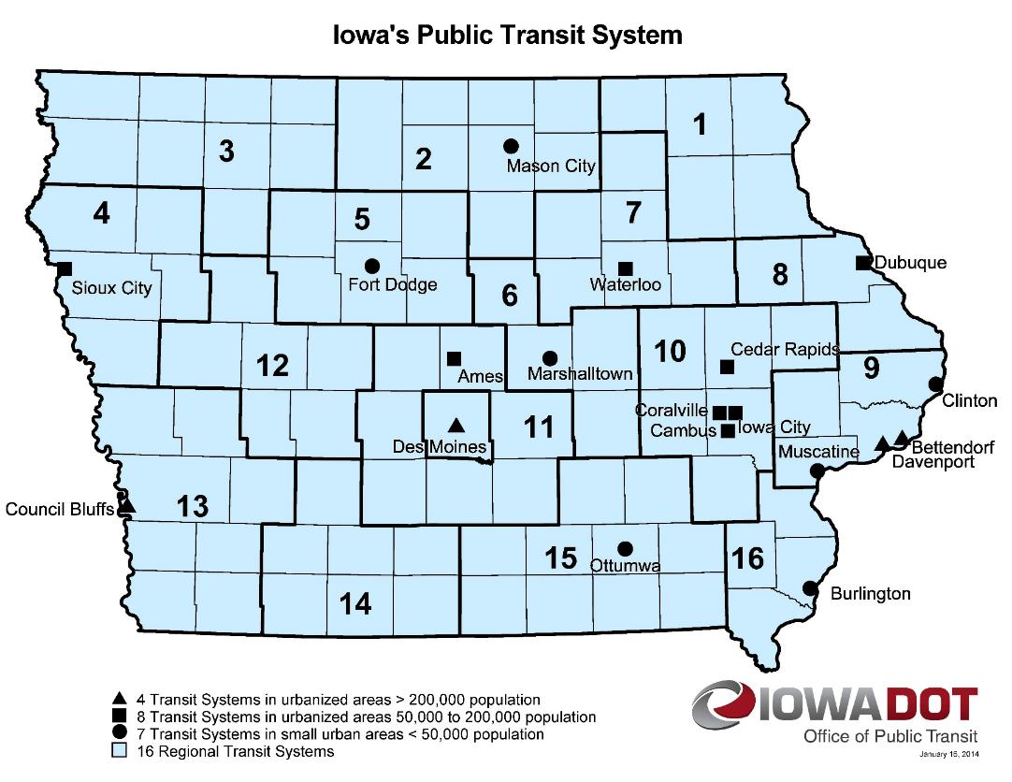
Questions?
CONTACT NAME
###-###-####
email@iowadot.gov​
iowadot.gov

Slide 7
Questions?
Brent Paulsen
515-239-1132
Brent.Paulsen@iowadot.gov​
iowadot.gov
For more information on Iowa’s public transit and intercity bus programs, visit
www.iowadot.gov/transit

Slide 8
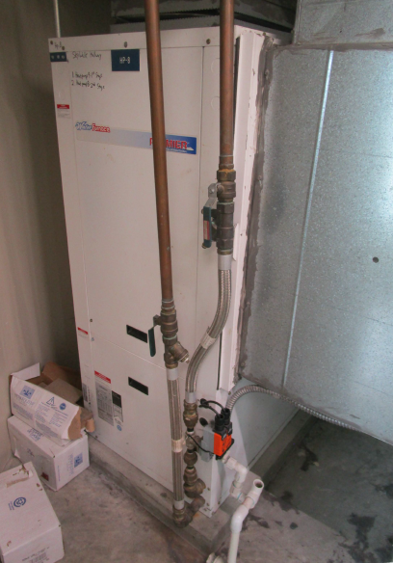
Project Recommended
for Award
Sioux City Transit
Heat Pump Condenser Water Piping Replacement Project
This project will replace heat pumps and related piping at the Martin Luther King Jr. Transportation Center
Funding Request: $625,000
Recommended: $500,000 (80%)
Return to Table of Projects Recommended for Award

Slide 9
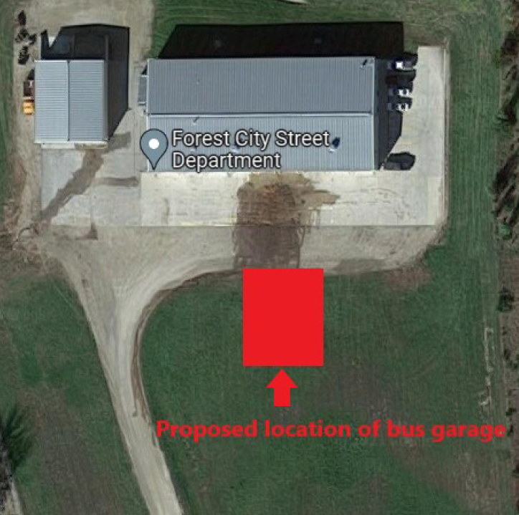
Project Recommended
for Award
North Iowa Area Council of Governments
Two Bay Parking Garage for Indoor Storage
This project will provide indoor vehicle storage for NIACOG buses operated in the City of Forest City and Winnebago County.
Funding Request: $625,000
Recommended: $500,000 (80%)
Return to Table of Projects Recommended for Award

Slide 10
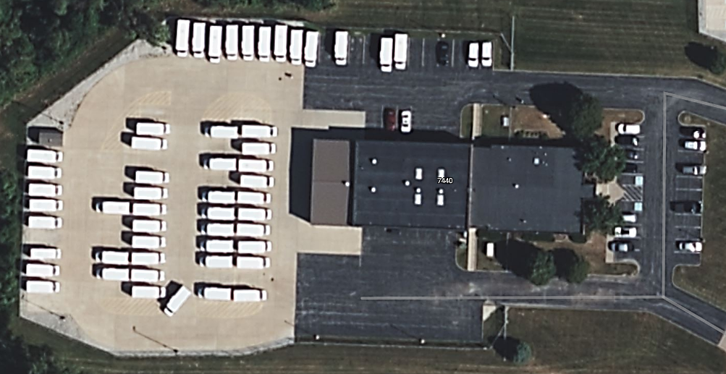
Project Recommended
for Award
River Bend Transit
Bus Storage Facility Project
This project will provide funding to cover cost increases associated with a Bus Storage Facility project awarded in FY23 through FTA’s Low-No Emission Program.
Funding Request: $137,000
Recommended: $109,600 (80%)
Return to Table of Projects Recommended for Award

Slide 11
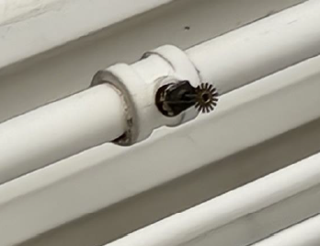
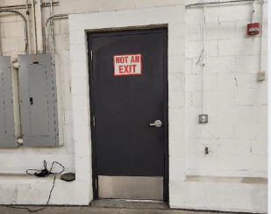
Project Recommended
for Award
Ames Transit Agency
Phase 1: Bus Storage Fire Mitigation Upgrade
This project will increase sprinkler capacity and install fire doors for the portion of the CyRide Transit Facility that stores and services the battery electric bus fleet.
Funding Request: $600,000
Recommended: $511,323 (68%)
Return to Table of Projects Recommended for Award

Slide 12
Projects Not Recommended For Award
Project Name | Sponsor | Total Project Cost | Requested Amount (% of Total Project Cost) | Recommended Amount (% of Total Project Cost)
Paved Parking Lot | Southeast Iowa Regional Planning Commission | $80,000 | $64,000 (80%) | $0
Notes:
There was one application not recommended for funding – Paved Parking Lot from Southeast Iowa Regional Planning Commission.

