Slide 1
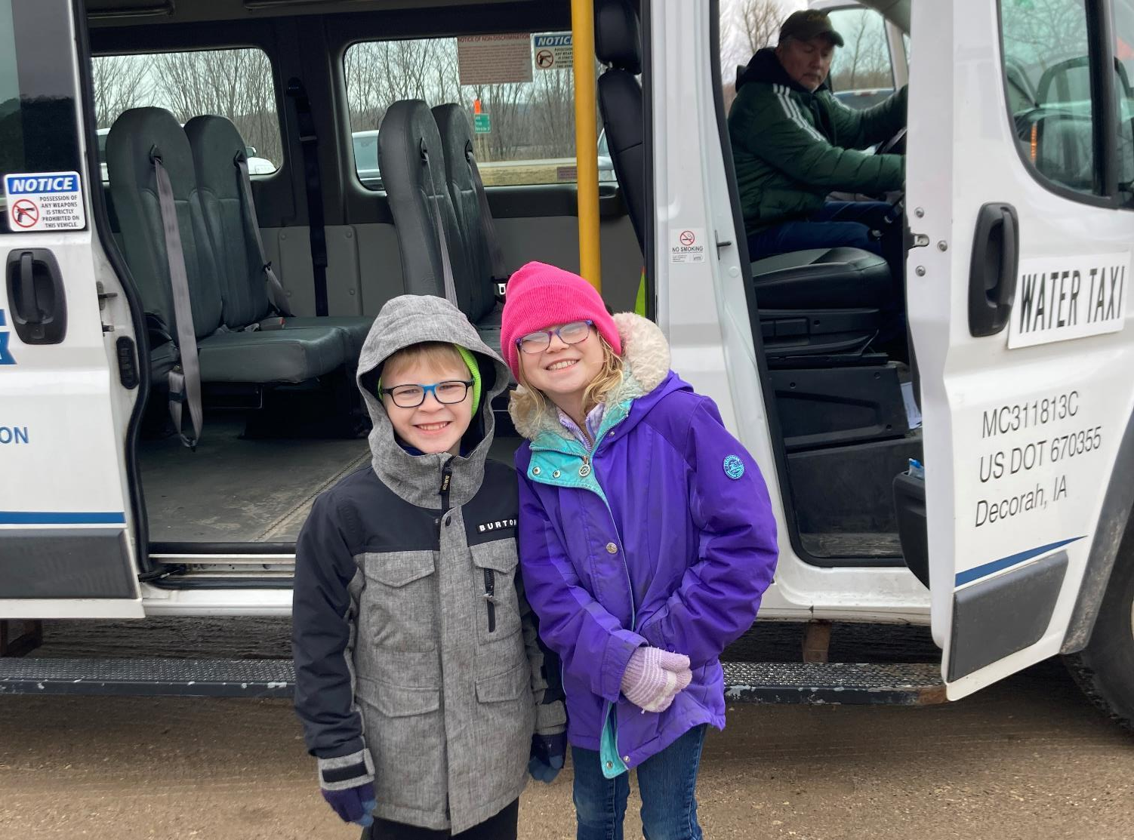
Federal Fiscal Year (FFY) 2024
Transit Program (Vehicle Replacement)
3/2/2023
Brent Paulsen
Transit Programs Manager
Commission Workshop August 12, 2024

Slide 2
Summary of Available Funding for FFY 2024
5339 State Apportionments + CRP:
– 5339 Urban (50-200K population) – $1,227,451
– 5339 Statewide Non-urban – $4,000,000
– Carbon Reduction Program – $3,000,000
– Total Available – $8,227,451

Slide 3
Section 5339 Grants for Bus and Bus Facilities Formula Program
Purpose: Federal Transit Administration (FTA) program that provides funding to states and transit agencies through a statutory formula to replace, rehabilitate and purchase buses and related equipment and to construct bus-related facilities.
– 5339 Urban (50-200K population) – $1,227,451
– 5339 Statewide Non-urban – $4,000,000
Ten transit systems, thirty vehicles

Slide 4
Carbon Reduction Program (CRP)
Purpose: To develop carbon reduction strategies and for projects to reduce transportation carbon dioxide emissions, including traffic management, public transportation, pedestrian facilities, alternative fuels, and port electrification.
– Carbon Reduction Program – $3,000,000
Six transit systems, nine vehicles

Slide 5
Project Distribution Criteria
Funds are distributed for bus replacement based on the Public Transit Management System (PTMS) process and the availability of local match
Prioritizes vehicle replacements based on the degree to which each vehicle exceeds the useful life for that particular vehicle type in terms of both age and accumulated mileage
The age, vehicle type, and mileage are maintained for all vehicles within the PTMS database

Slide 6
Summary
Funds are distributed for bus replacement based on the Public Transit Management System (PTMS) process and the availability of local match
Eleven transit systems will be able to purchase 39 vehicles
A detailed list of vehicles is included in the Federal Fiscal Year (FFY) 2024 Transit Program (Vehicle Replacements) Handout

Slide 7
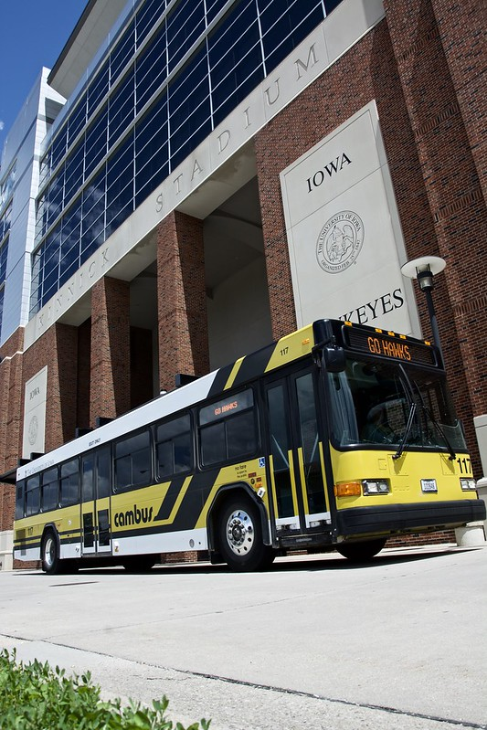
Recommendation
Total capital funds available and recommended for reprogramming: $8,227,451
Eleven transit systems will be able to purchase 39 vehicles
A list of vehicles is included in the Federal Fiscal Year (FFY) 2024 Transit Program (Vehicle Replacements) Handout

Slide 8
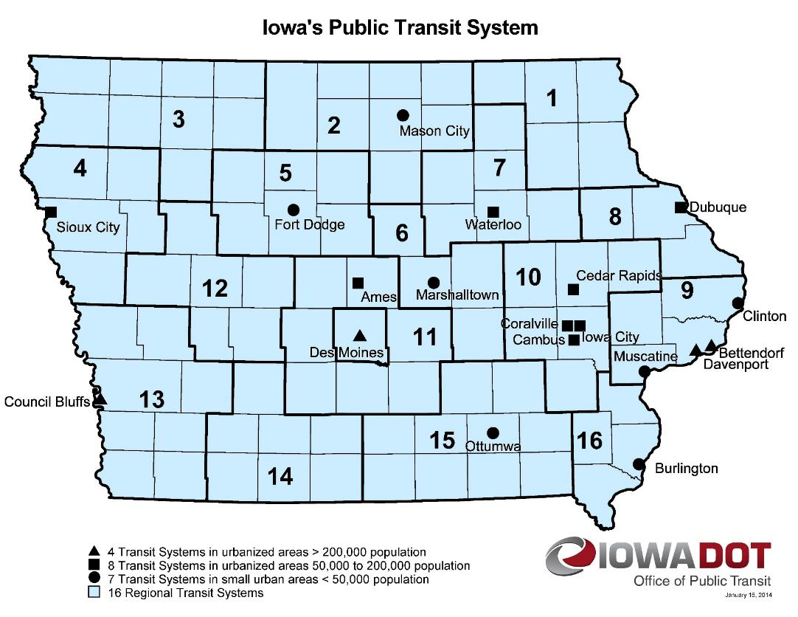
Questions?
CONTACT NAME
###-###-####
email@iowadot.gov​
iowadot.gov

Slide 9
Questions?
Brent Paulsen
515-239-1132
Brent.Paulsen@iowadot.gov​
iowadot.gov
For more information on Iowa’s public transit and intercity bus programs, visit
www.iowadot.gov/transit

