Slide 1
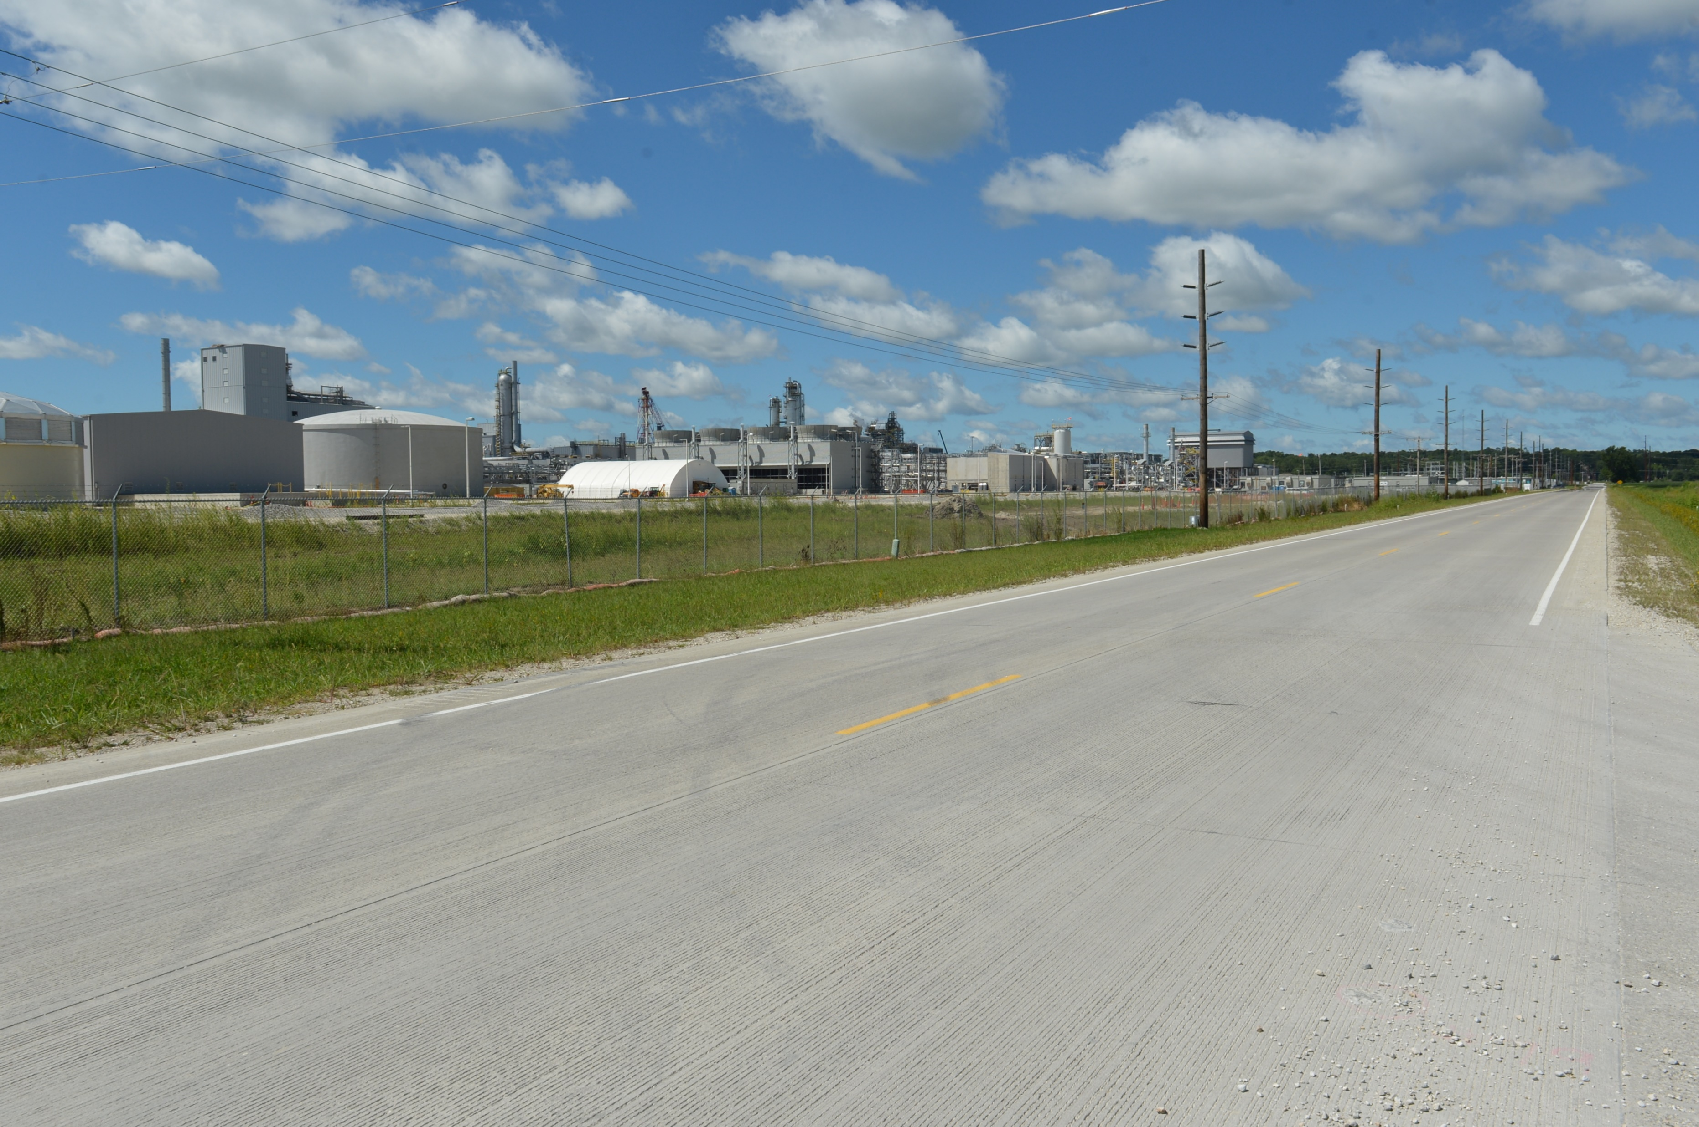
Revitalize Iowa’s Sound Economy
Disaster Recovery Local Development Program
Draft Proposal
Debra Arp
Grant Program Administration Team Lead
8/12/2024

Slide 2
Purpose of RISE
Created in 1985 to promote economic development through roadway improvements
For use in the establishment, construction, and maintenance of roads and streets which promote economic development in the state
2
2

Slide 3
Statutes, Regulations, Policies
Iowa Code Chapter 315
Iowa Administrative Rules 761 – 163
Iowa Transportation Commission Policies
3
3

Slide 4
Types of Projects
Immediate Opportunity
Local Development
Standard
Certified Sites
Airport
University Research Parks
4
4

Slide 5
How does the purpose of RISE apply today?
Economic development issue where the provision of transportation networks plays a role
Flexibility to be reactive to conditions on the ground
5
5

Slide 6
Proposal
RISE Disaster Recovery Local Development Program
Leveraging experience from innovation of the program over last 10 years
Responsive to current needs and available for redeployment if successful
6
6

Slide 7
Community Eligibility
Existing Local Development – Any Iowa city or county is an eligible applicant
Proposed Disaster Recovery Local Development – Within county included in proclamation of disaster emergency by the Governor AND a Presidential Disaster Declaration within the last 12 months AND sustained significant damage affecting businesses requiring relocation
Action Recommended to Implement – Add definition of Disaster Recovery Local Development to Commission Policies
7
7

Slide 8
Application Deadlines
Existing Local Development – Administrative Rule 163.11(3)(a) defines two annual deadlines: February 1 and September 1
Proposed Disaster Recovery Local Development – Same as existing
Action Recommended to Implement – None needed; however, Administrative Rule 163.11(3)(a) could be temporarily suspended by proclamation by the Governor to allow applications outside deadlines
8
8

Slide 9
RISE Participation
Existing Local Development – Limited to 50% RISE participation by Commission Policies (other % allowed for certified site and university research parks)
Proposed Disaster Recovery Local Development – Allow up to 80% RISE participation
Action Recommended to Implement – Add definition of Disaster Recovery Local Development to Commission Policies including maximum RISE % subject to request/Commission approval consistent with Administrative Rule 163.6(2)
9
9

Slide 10
RISE-Eligible Development
Existing Local Development – Contingent on majority of area being developed with typical RISE-eligible uses
Proposed Disaster Recovery Local Development – Purpose to retain jobs, sustain local business, stimulate investment, promote future growth, preserve economic viability contributing to economic vitality of the state
Action Recommended to Implement – Add definition of Disaster Recovery Local Development to Commission Policies including statement of purpose
10
10

Slide 11
Area Business Support & Justification
Existing Local Development – None required (airport development does require support from businesses hinging on airport access)
Proposed Disaster Recovery Local Development – Should include letters of interest from businesses considering relocation and support from others
Action Recommended to Implement – Add definition of Disaster Recovery Local Development to Commission Policies including letters of interest or support
11
11

Slide 12
Application Scoring/Review
Existing Local Development – Competitive review and scoring per Administrative Rules 163.1; 163.11(6); 163.11(7)
Proposed Disaster Recovery Local Development – Same as existing
Action Recommended to Implement – None needed
12
12

Slide 13
Incurring Reimbursable Costs
Existing Local Development – Limited to those incurred post-award and post-agreement execution per Administrative Rule 163.12(3) with exceptions of 163.9
Proposed Disaster Recovery Local Development – Same as existing with staff working closely with city or county project sponsor to accelerate schedule as allowed
Action Recommended to Implement – None needed
13
13

Slide 14
Reporting
Existing Local Development – Accomplishment Report at 3 years addressing development, retained/created jobs, capital investment
Proposed Disaster Recovery Local Development – Same as existing plus additional development in the area
Action Recommended to Implement – Add definition of Disaster Recovery Local Development to Commission Policies including description of reporting requirements
14
14

Slide 15
Project Settlement
Existing Local Development – May be subject to settlement if development does not meet contingency
Proposed Disaster Recovery Local Development – Project monitoring to gauge program effectiveness and not as basis for settlement
Action Recommended to Implement – Add definition of Disaster Recovery Local Development to Commission Policies including description of reporting requirements
15
15

Slide 16
Next Steps
Commission questions & input
Outreach to partner agencies and prospective applicants
September Commission Workshop and Business Meeting
Consideration of applications received September 1
Solicitation of applications for February 1 deadline
16
16

Slide 17
Monthly Program Financial Report
Funded annually with dedicated state motor fuel and special fuel tax revenues
 | City RISE Fund | County RISE Fund
FY2024 Projected Total RISE Road Use Tax Fund (RUTF) Revenue ¹ | $11,759,666 | $5,879,833
Actual RISE Revenue Received as of 6/30/2024 ² (% of FY2024 Projected Revenue) | $11,910,181 (101.3%) | $5,805,967 (98.7%)
FY2024 RISE Funds Awarded as of 6/30/2024 (% of Projected Total RUTF committed) | $9,277,297 (78.9%) | $0 (0%)
Fund Balance as of 6/30/2024 | $54,491,279 | $20,931,080
Outstanding Commitments as of 6/30/2024 | ($40,958,641) | ($17,160,520)
Uncommitted Balance as of 6/30/2024 | $13,532,638 | $3,770,560
¹ Calculation based on FY2023 average monthly RISE RUTF revenue of $979,972 to the city RISE fund and $489,986 to the county RISE fund. As of 6/30/2024, FY2024 is 100% complete.
² Actual RISE revenue includes RUTF revenue, loan repayments, and project settlements. These revenue sources are variable and are not included in projections.
17
17

Slide 18
County RISE Fund Reversion
Iowa Code 315.4:
All uncommitted moneys in the RISE fund on June 30 of each year which are allocated for the use of counties on secondary road projects shall be credited to the secondary road fund. Purpose: To promote economic development through roadway improvements
FY24 County RISE Fund revenue = $5,805,967
Zero awards in FY2024
$3,770,560 will be reverted following overcommitment in FY2023
18
18

