Slide 2
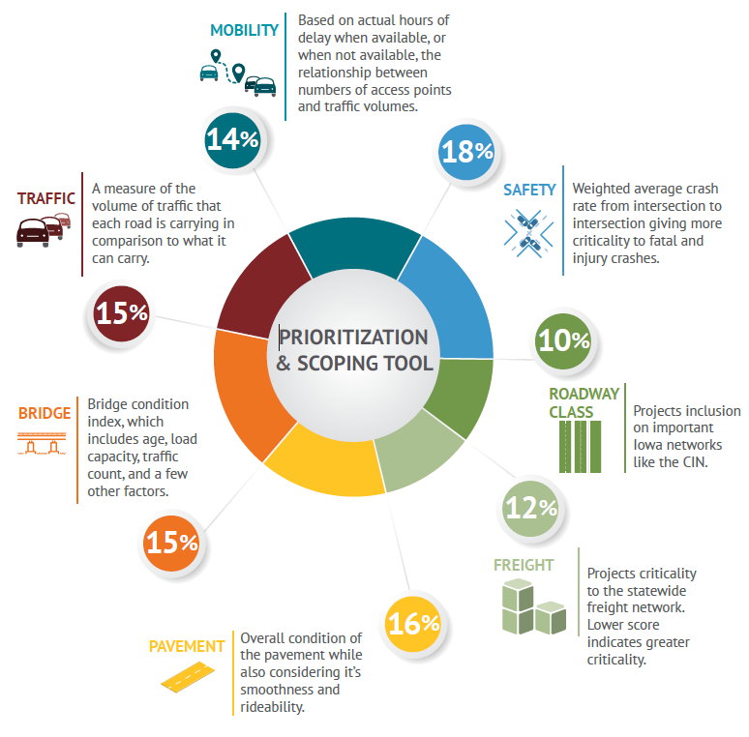
Prioritization & Scoping
SAFETY – 18%
ROAD CLASS – 10%
FREIGHT – 12%
PAVEMENT – 16%
BRIDGE – 15%
TRAFFIC – 15%
MOBILITY – 14%
100%

Slide 3
Prioritization & Scoping
Criteria | Weight | Basis for scoring
Safety | 18% | Score based on average crashes per mile adjusted for fatalities and major injuries
Roadway Class | 10% | Score is based on the projects inclusion on important Iowa networks like the CIN
Freight | 12% | Score is based on truck percentage, normalized by AADT and adjusted for freight bottlenecks
Pavement | 16% | Structural condition of the pavement adjusted for smoothness & rideability
Bridge | 15% | Bridge condition index, which includes age, load capacity, traffic count, and a few other factors
Traffic | 15% | A weighted measure of the volume of traffic that each road is carrying in comparison to what it can carry
Mobility | 14% | Based on actual hours of delay when available, or when not available, the relationship between incidents, numbers of access points, and traffic volumes

Slide 4
Current criteria that correlate to
economic development & growth
Freight
Traffic
Mobility
Road Class

Slide 5
Correlating Data Relationships
ECONOMIC DEVELOPMENT
Transportation
Indicators
Traffic
Freight
Mobility
Population growth
Presence of an educated workforce
Proximity to markets
Community and county interlinkages
Local economic development policies
Amenities
Road Class

Slide 6
Existing Weighting Correlation
Criteria | Weight | Basis for scoring
Safety | 18% | Score based on average crashes per mile adjusted for fatalities and major injuries
Roadway Class | 10% | Score is based on the projects inclusion on important Iowa networks like the CIN
Freight | 12% | Score is based on truck percentage, normalized by AADT and adjusted for freight bottlenecks
Pavement | 16% | Structural condition of the pavement adjusted for smoothness & rideability
Bridge | 15% | Bridge condition index, which includes age, load capacity, traffic count, and a few other factors
Traffic | 15% | A weighted measure of the volume of traffic that each road is carrying in comparison to what it can carry
Mobility | 14% | Based on actual hours of delay when available, or when not available, the relationship between incidents, numbers of access points, and traffic volumes

Slide 7
Weighting Workshop
Matt Haubrich Transportation Asset Management Administrator

Slide 8
Multi-Criteria Decision Analysis
When we have multiple criteria, how do we decide?
Multi-Criteria Decision Analysis (MCDA) is a type of Decision Analysis that is best suited to resources allocation questions.
There are many different MCDA approaches, but they typically result in a weights that can be applied to each attribute to create an overall score.
For our case, Swing Weighting was selected because it is relatively straightforward and easy to understand.

Slide 9
Swing Weighting
Weights depend on context (importance AND variability)
Consider house style and neighborhood
Great layout!
Perfect size!
Easy access to downtown!
Priced 5% below market!

Slide 10
Swing Weighting
Great neighborhood?

Slide 11
Swing Weighting Process
Assess how much value would result if you could “swing” each criterion from its worst feasible outcome to its best feasible outcome
Rank criteria according to the swing in value that results when moving from the worst feasible outcome to the best
Consider a “worst case” project where all criteria are set to their worst feasible outcome
Which criterion would you swing first to its best feasible outcome?
Which would you swing second? and so on
OK to have ties (i.e., if two criteria are of equal importance)

Slide 12
Swing Weighting Process
Weight the criteria.
Assign a weight of 100 points to the highest ranked criterion
Assign a weight (between 0-100) to the next highest ranked criterion, and so on
The weights should be proportional to that of the highest ranked criterion (i.e., assign a weight of 50 if the swing in value is half as great as that of the highest ranked criterion)
Once you have weights for each criterion, review them for consistency and validity
Compare highs vs. lows to ensure the relative weightings make sense

Slide 13
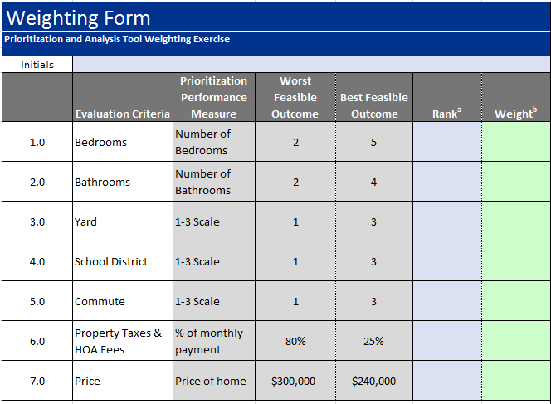
Swing Weighting Example – Home Purchase

Slide 14
Swing Weighting Example – Home Purchase

Slide 15
Swing Weighting Example – Home Purchase

Slide 16
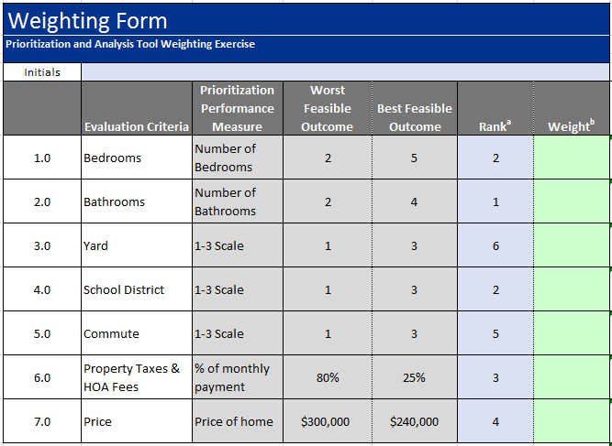
Swing Weighting Example – Home Purchase

Slide 17
Swing Weighting Example – Home Purchase Establishing the Weights

Slide 18
Swing Weighting Example – Home Purchase Establishing the Weights

Slide 19
Swing Weighting Example – Home Purchase Establishing the Weights

Slide 20
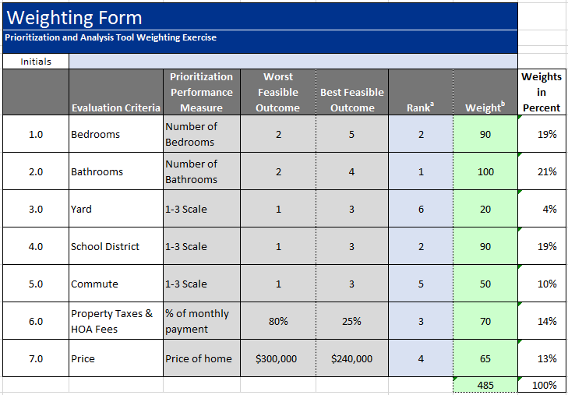
Swing Weighting Example – Home Purchase Weights Scaled to Percent

Slide 21
Swing Weighting Example – Home Purchase Bringing Weights Together

Slide 22
Summary
MODA method called “Swing Weighting” allows for the generation of weights to bring multiple factors together.
Discussion of weights allows people to better express their own preferences as well as understand the preferences of others.

Slide 23
Swing Weighting Example – Home Purchase Establishing the Weights

Slide 24
BRAD HOFER
DEPUTY DIRECTOR/ LOCATION ENGINEER
LOCATION & ENVIRONMENT BUREAU
Brad.hofer@iowadot.us
Office: 515-239-1787
QUESTIONS ???
MATT HAUBRICH
TRANSPORTATION ASSET MANAGEMENT ADMINSTRATOR
STRATEGIC PERFORMANCE DIVISION
Matthew.Haubrich@iowadot.us
Office: 515-233-7902

