Slide 1
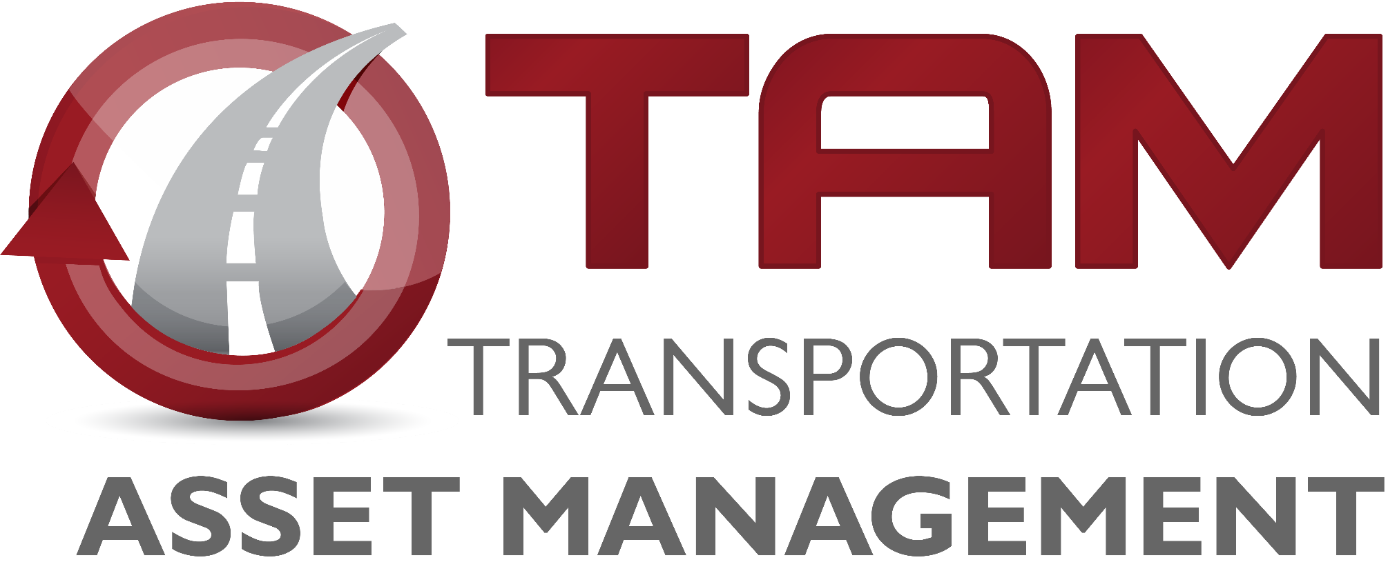
Iowa Interstate Investment Plan
2040
I
P
3
Commission Update
December 9, 2019
Phil Mescher
Project Management Bureau

Slide 2
Goal for Today:
Iowa Interstate Investment Plan for 2040
Iowa Interstate Investment Plan
2040
I
P
A fiscally-constrained plan to address all Interstate system needs through the year 2040.
3
Present Proposed Changes to the Interstate Plan
Gain feedback from the Commission
No Formal Actions

Slide 3
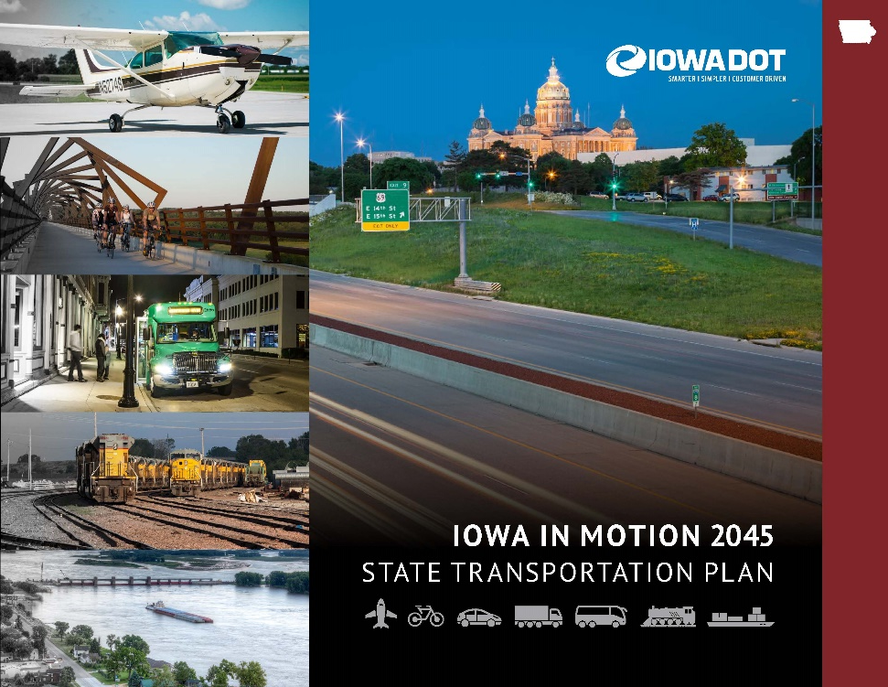
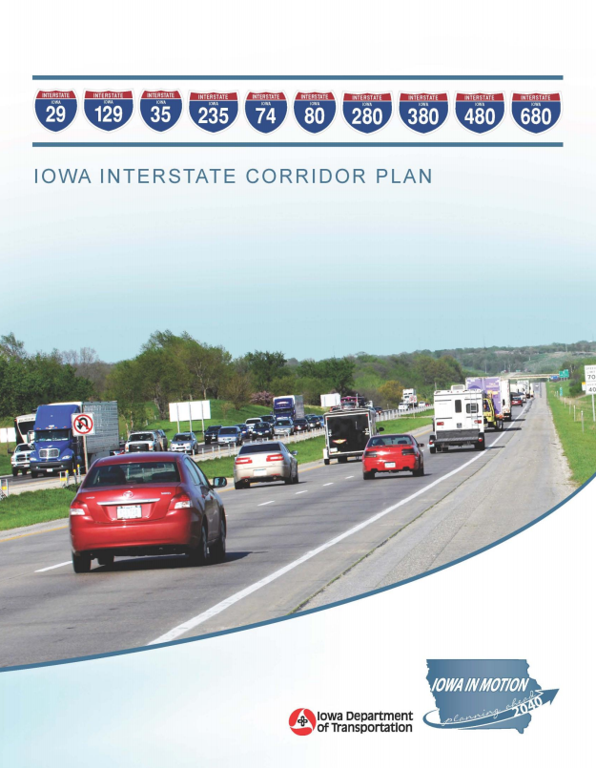
Planning Efforts Highlight that Transportation Needs Exceed Funding
I-80 PEL alone calls for ¾ Interstate Funds to complete VISION by 2040.

Slide 4
Genesis of the I3P-2040
Desire to develop a “Plan for Every Section”
Need to be fiscally constrained
$330 million – ½ of the annual program identified for the Interstate System
How to “right size” the interstate system?
How to get the biggest return on investment?
How to account for an uncertain future?
Connected/Autonomous Vehicles
Funding Availability
Construction Costs
Process: Leverage data and collective wisdom of the Iowa DOT to develop a new plan
Charette Workshop (Summer 2018)
Develop Plan
Implementation & monitoring
Revision of Priorities

Slide 5
Charette Workshop
Stewardship - Focus should be on preservation to maintain state of good repair.
$80m of pavement stewardship was included each year
Widening Options – Take advantage of good pavement.
Limit Adding Capacity - Some areas are not warranted for additional capacity by 2040.
Delay with Technology - Expansion projects in urban corridors will be limited and focus on technology solutions and other management strategies first
Commissioners Tom Rylie and Kathy Fehrman Participated

Slide 6
Initial Plan Result
Capacity projects given very tight budgets. Project teams asked to find ways to meet the budget.

Slide 7
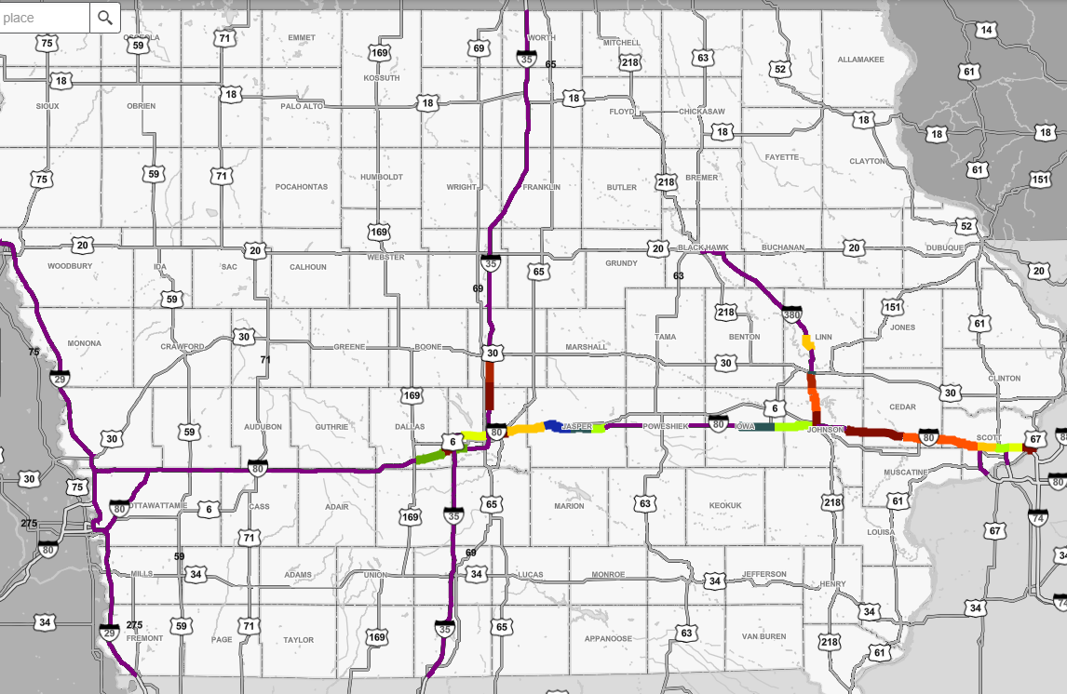
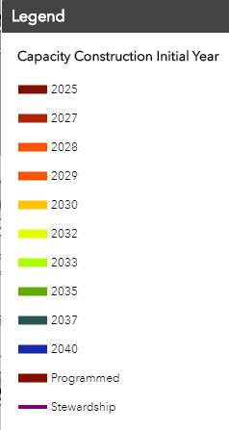
Initial Plan in Place
Note: I-80 Poweshiek Co. moved beyond 2040 Plan Horizon
Notes:
Change map to begin year and update data. PROVIDE TO MITCH for this Asphalt presentation next week.

Slide 8
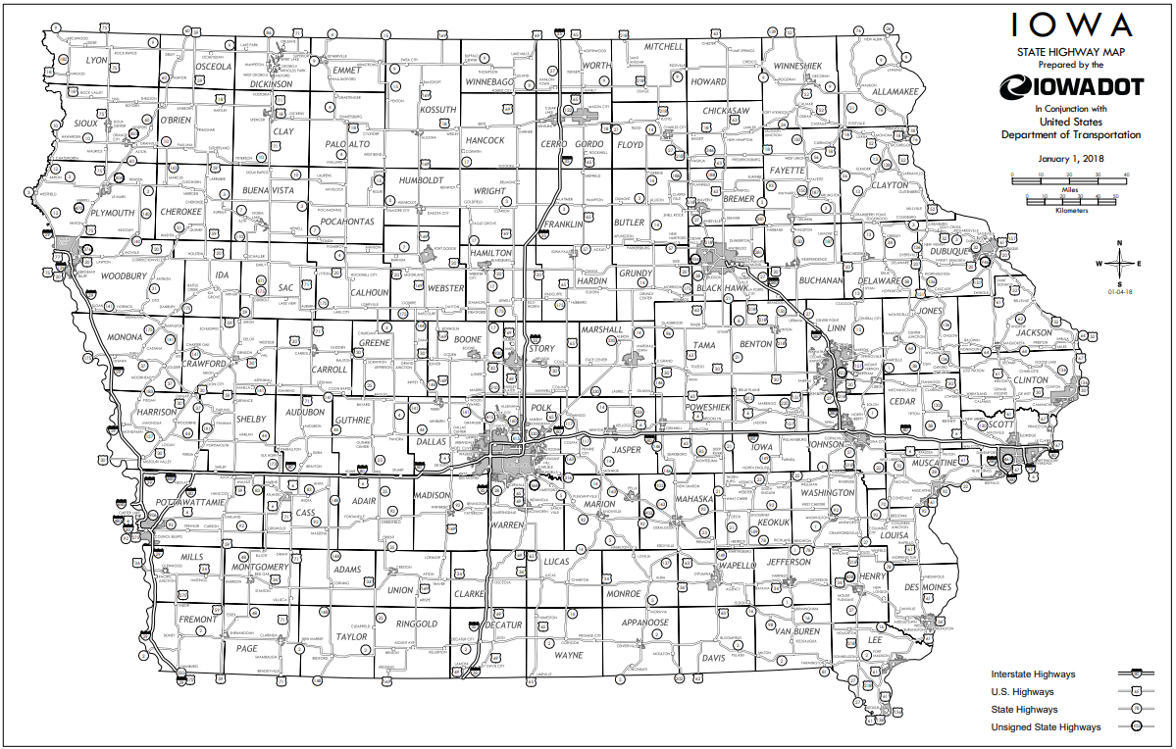
Changes in Priority of Needs
Input from District Engineers
Changing Infrastructure Needs
Notes:
Mention relation to the change. Changes presented are to updated baseline that takes into account new 5-year program.

Slide 9
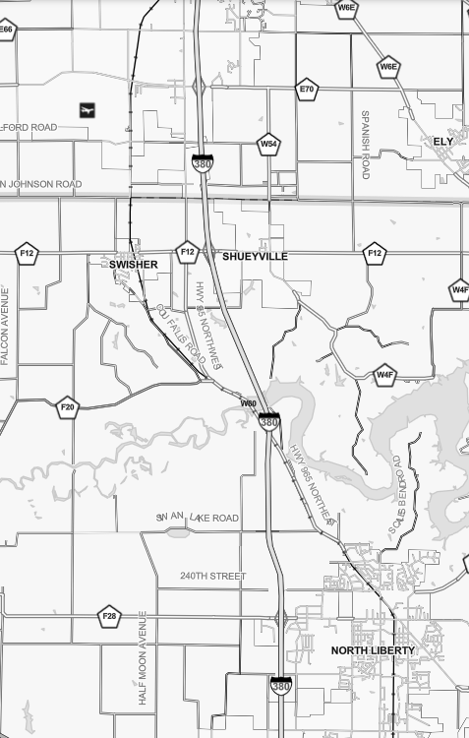
I-380 – I-80 to US 30
Schedule Adjustments Relate to Original Plan
Johnson/Linn County Line to US 30
Adjust 1 year later (from 2026 to 2027)
Shueyville Interchange Area
Adjust 2 years later (from 2026 to 2028)
Coralville Reservoir Area
Adjust 1 year later (from 2028 to 2029)
Penn St. Interchange Area
Adjust 5 years sooner (from 2028 to 2023)
Schedule Adjusted Sooner than Original Plan
Schedule Adjusted Later than Original Plan

Slide 10
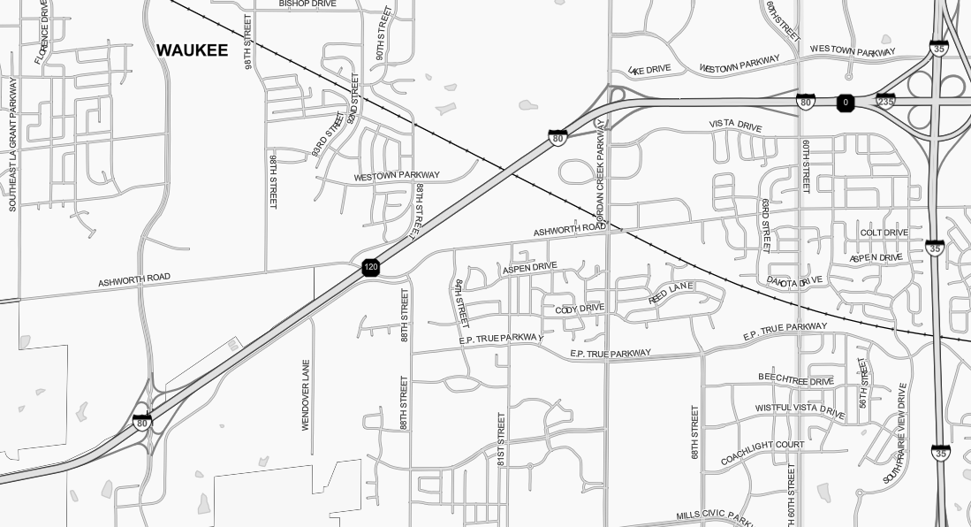
I-80 – Grand Prairie Parkway to Jordan Creek Parkway
UP RR Bridge
Adjust 9 years sooner (from 2032 to 2023)
Addresses Growing Capacity Issues
11,000 ADT Increase Last 4 Years
Addresses Pavement and Bridge Needs sooner (High Cost Bridge over UP RR)
Remaining section to JCP to SWMM will start in 2032 as originally planned
Schedule Adjusted Sooner than Original Plan
Schedule Adjusted Later than Original Plan
Schedule As Originally Planned

Slide 11
I-80 – Altoona to Mitchellville
Schedule Adjusted Sooner than Original Plan
Maintain Project Start in 2031
Project is ready to go (Low cost)
Take advantage of existing full-width concrete shoulders to widen to outside
Remaining section Mitchellville to Colfax adjusted to begin later in 2038
Schedule Adjusted Later than Original Plan

Slide 12
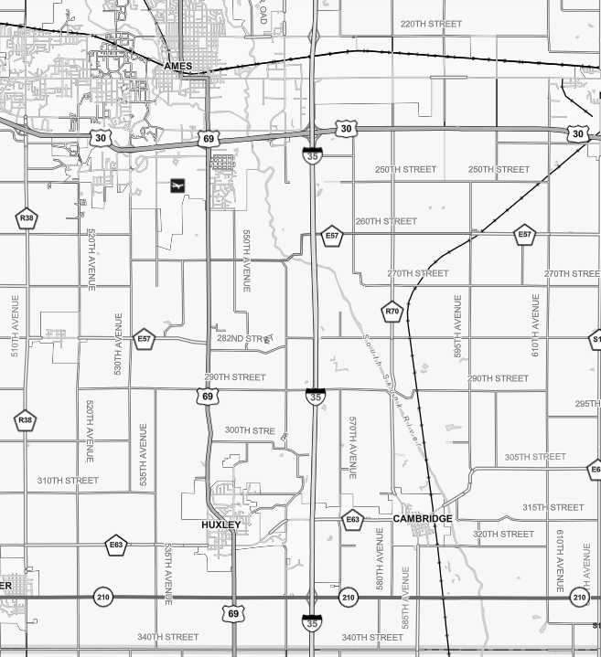
I-35 - Iowa 210 to Ames
Adjusted 4 years sooner (from 2032 to 2028)
Completes I-35 Section between Ankeny and Ames
Follows the 2025 Completion of Ankeny to Iowa 210
Schedule Adjusted Sooner than Original Plan
Schedule Adjusted Later than Original Plan

Slide 13
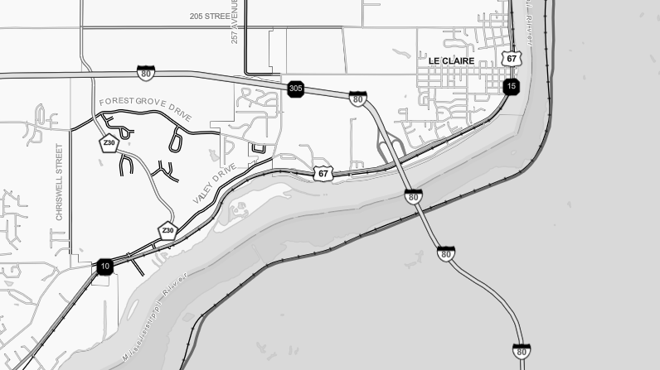
I-80 – Mississippi River Bridge
Illinois DOT 6-year Program Includes Funds for new I-80 Bridge
Iowa DOT has added $150 Million to Interstate Plan ($50M 2025-2027)
Notes:
Extend green line.

Slide 14
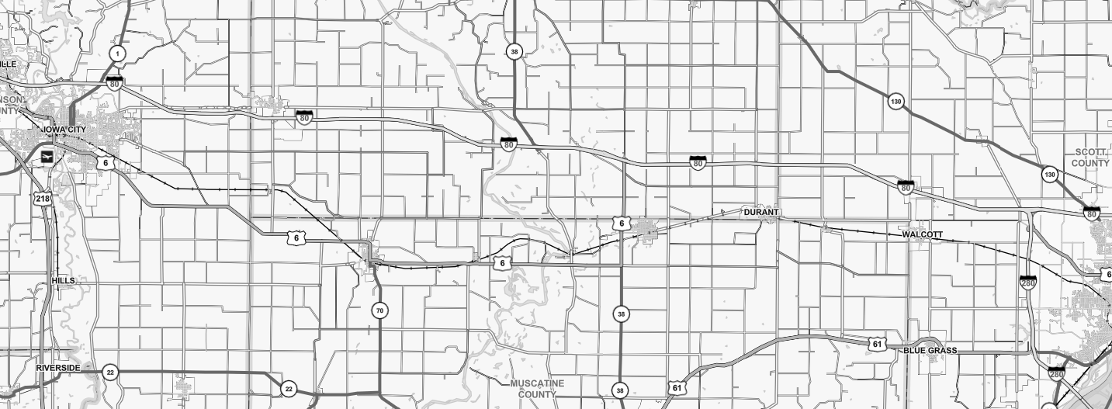
I-80 – Iowa City to Davenport
Sugar Creek Bridges
Y26
Schedule Adjusted Sooner than Original Plan
Schedule Adjusted Later than Original Plan
I-80 bridges over Sugar Creek schedule adjusted to take place 6 years sooner (moved from 2029 to 2023).
I-80 Cedar River to Y26 (Currently In Program 2023) Adjusted to take place later in 2029.
Able to adjust West Branch to Cedar River schedule sooner by 2 years (moved from 2028 to 2026).
Scott/Cedar Co Line to I-280 in Davenport adjusted to take place later by 2 years (moved from 2030 to 2032).
Now proceeding with one I-80 section at a time.
Notes:
Put in years delayed for last bullet
Put in that Sugar Creek in program at 2023 – not advanced.

Slide 15
Adjusted Plan Result
Approved 2020-2024
5-Year Program
Budget Bubble Moved Beyond Initial Year of 2031
Notes:
Mention budget bubble moved out as compared to initial plan

Slide 16
Questions?
Phil Mescher
Project Management Bureau

