Slide 1


Bridge Asset Management
Scott Neubauer, PE
Iowa DOT Bridges and Structures Bureau
Transportation Commission Workshop
December 9, 2019

Slide 2


Presentation Overview
How we assess bridges
Condition summary
Funding scenarios

Slide 3
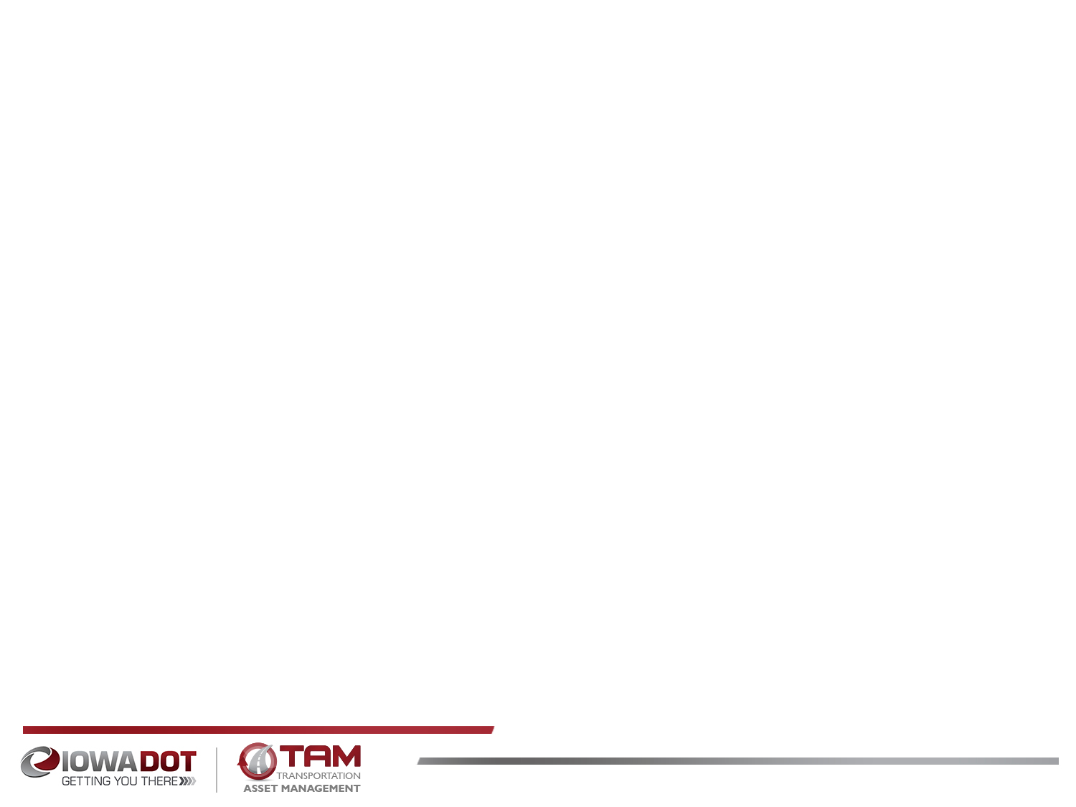
Bridge Inventory
The primary system includes 4,161 bridges and large culverts
  708, or about 17% on the Interstate
Added together, the deck area of all primary system bridges is over 45 million square feet – that’s over 1½ square miles.
If we had to build all of these bridges from scratch today, the cost would exceed $16 billion.
Notes:
2564 bridges on the NHS. 39 Poor. 708 interstate bridges. 3453 non-interstate bridges. 4161 total bridges.
17.0% of bridges are on the interstate. 24.1% of the total deck area in on the interstate.

Slide 4
Bridge Inspection Overview
All bridges are inspected every 24 months or less.
Fracture Critical bridges are inspected in more detail.
Inspection data is collected in a central database for all 4,161 primary system bridges.
Inspection documentation is used to evaluate the need for replacement, rehab, or repair.
Load capacity of every bridge is calculated based on the inspection findings and used to review heavy load truck permits in an automated system.
Notes:
99 FC bridges. 4161 bridges on state highways. 708 interstate (92 culverts, 28 FC), 3453 non-interstate (716 culverts, 71 FC).
Mention Scour Critical bridge inspection and how we have mitigated the scour critical bridges.

Slide 6
Condition Evaluation and Terms
New terms adopted by FHWA:
Good – Deck, Superstructure, and Substructure condition ratings are 7, 8, or 9
Fair – One or more condition ratings for the Deck, Superstructure, or Substructure are 5 or 6
Poor - One or more condition ratings for the Deck, Superstructure, or Substructure are 4 or less
Notes:
Poor is the same as SD.
Condition Ratings range from 0 to 9. 0= failed. 9=excellent

Slide 7
Condition Forecast Process
Condition forecasts are performed using software to predict the funding required to achieve a system wide bridge condition.
Models are developed based on past bridge performance to predict future performance of the system.
Viable treatment alternatives are evaluated for each bridge.
Model-based optimization is used to predict how much funding is needed to achieve a desired condition.

Slide 8
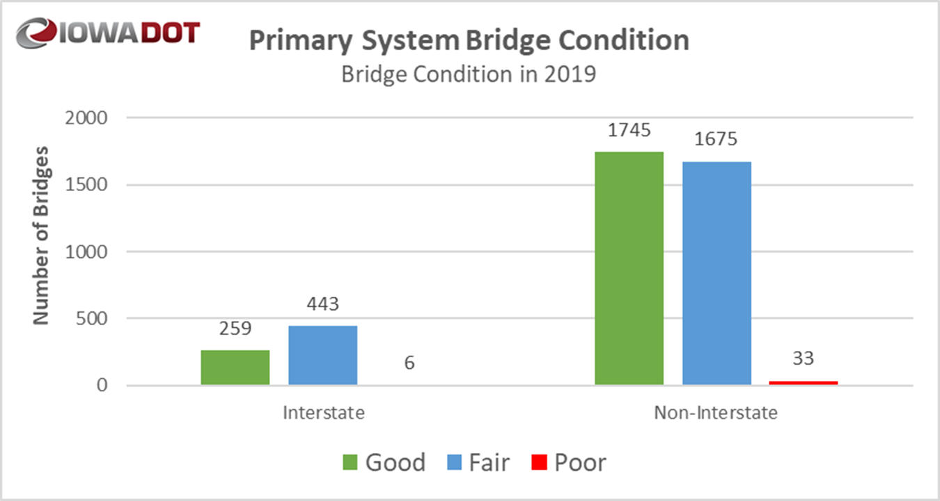
Notes:
W:\Highway\Bridge\RatingSection\FHWA Data\March 2019 submittalNBITapeConversionMacro_03_14_2019.xlsm

Slide 9
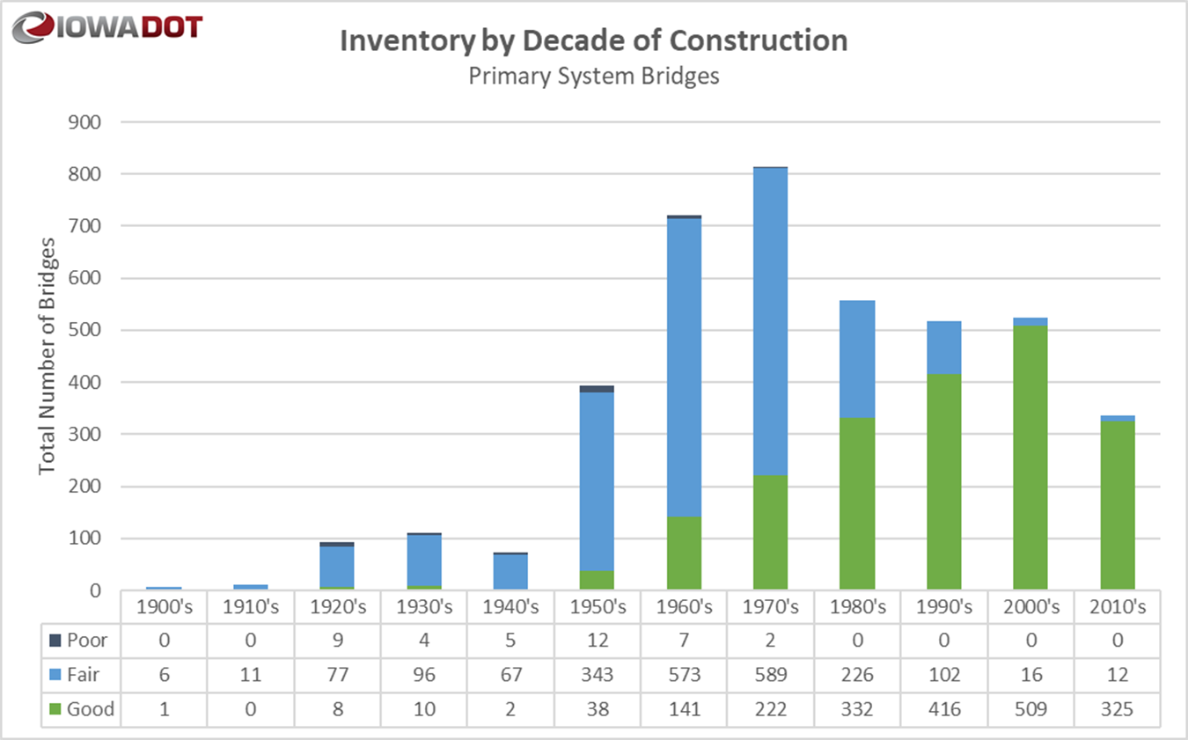
Notes:
W:\Highway\Bridge\RatingSection\FHWA Data\March 2019 submittalNBITapeConversionMacro_03_14_2019.xlsm
1351 bridges are over 50 years old. 32.5% of states bridges and 22.7% of state deck area.

Slide 10
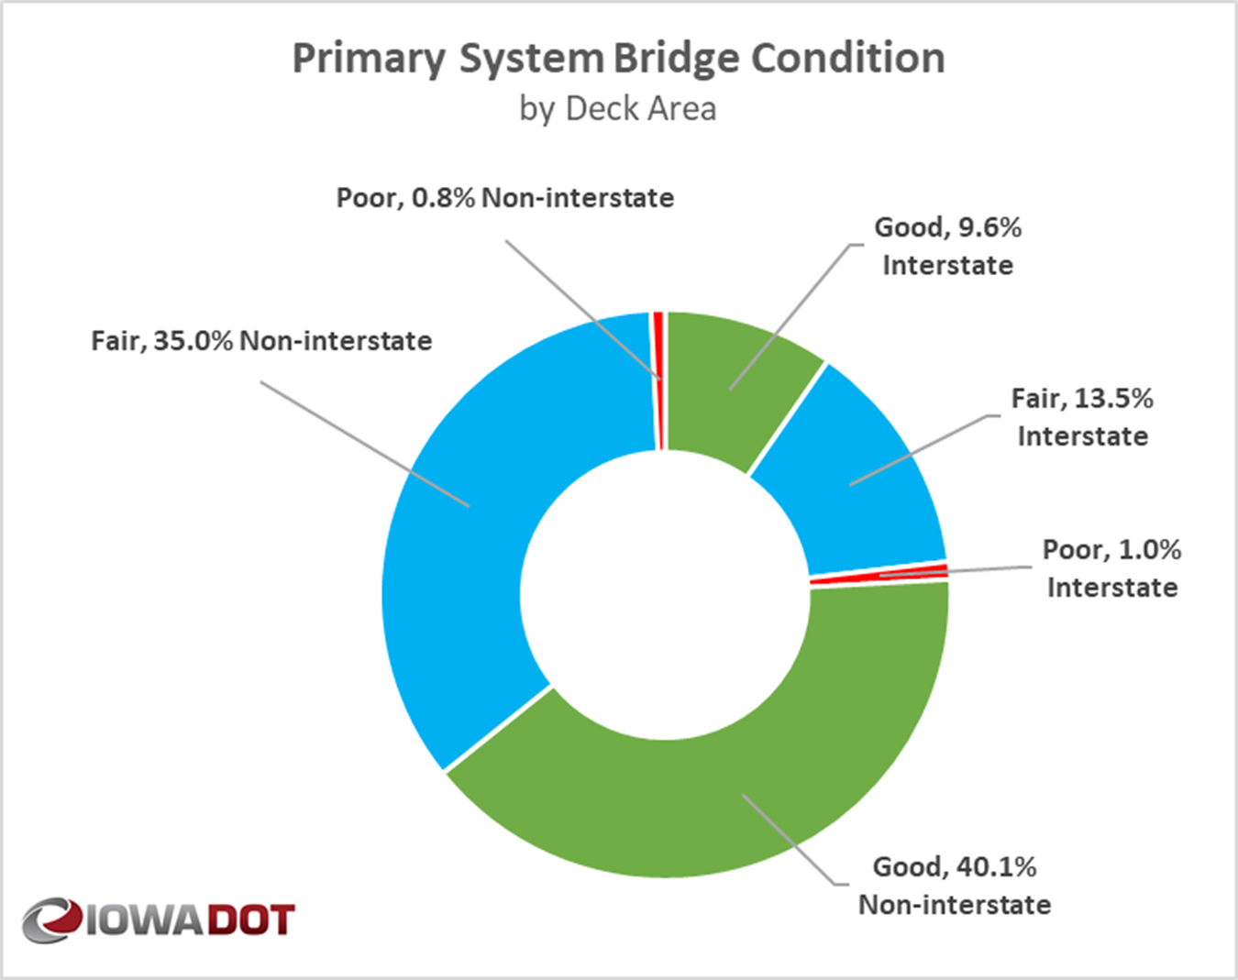
Notes:
W:\Highway\Bridge\RatingSection\FHWA Data\March 2019 submittalNBITapeConversionMacro_03_14_2019.xlsm

Slide 11
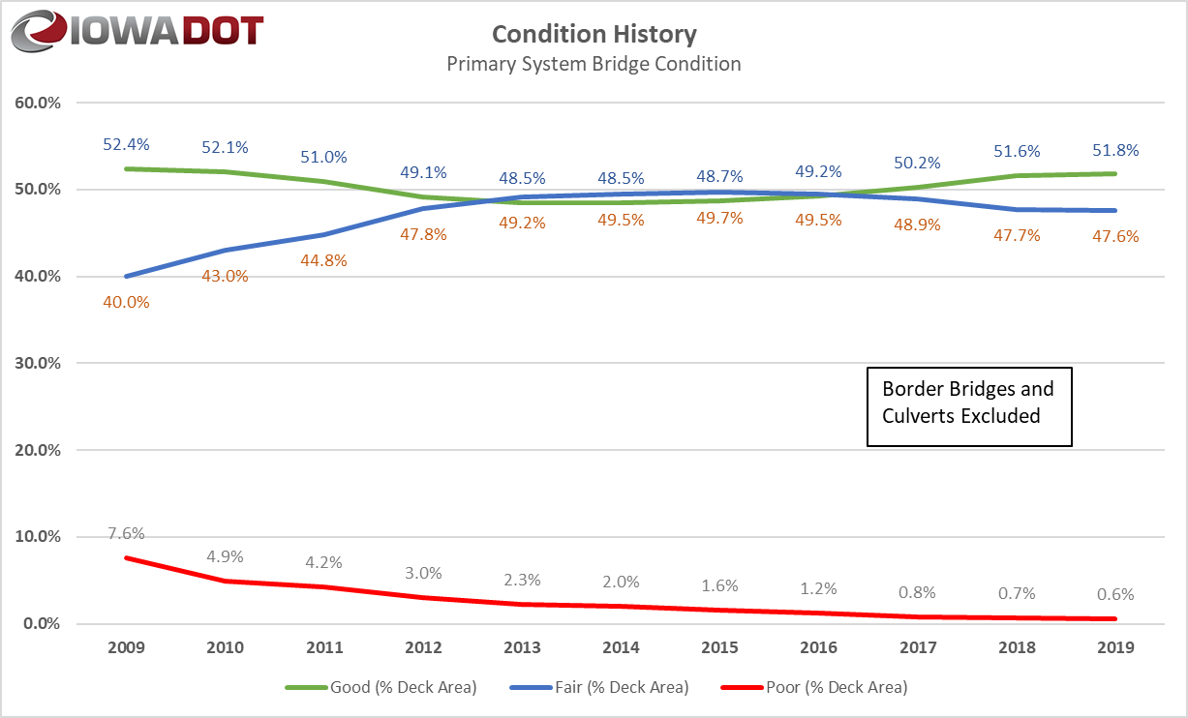
Notes:
Highway\bridge\bridgeinspection\Neubauer\asset management\2008-2017 NHS data.xlsx

Slide 12
Minimum Condition Level
FHWA requirement:
On the National Highway System (NHS), the total deck area of Structurally Deficient (Poor) bridges must not exceed 10% of the total deck area.
Currently, the % Structurally Deficient (Poor) on the NHS is 2.3%
Currently, on the NHS excluding Border Bridges, the % Structurally Deficient (Poor) is 0.74%
Notes:
MAP21 requires <10% SD on NHS.
2606 bridges on the NHS. 42 LPA bridges. 62% of state bridges on NHS.
Primary Highways = 33,396,368 ft^2 on NHS. 45,533,247 ft^2 (1.63 sq. miles) total DOT deck area. 73% of deck area is NHS.

Slide 13
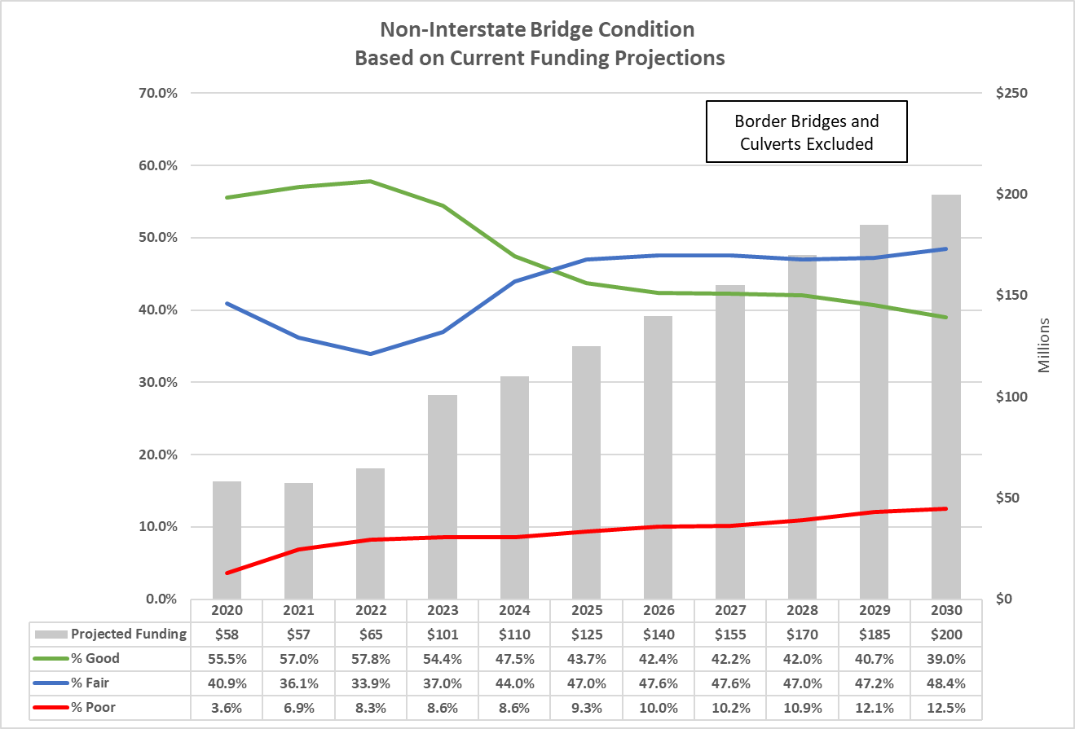
Condition Forecast
Notes:
W:\Highway\Bridge\BridgeInspection\Deterioration Modeling\IDS Project\Phase VI 2019\Non-Interstate\Non-Interstate Current budget limits corrected.xlsx

Slide 14
Condition Index
The Condition Index is a value derived from the rating values given to the Deck, Superstructure, Substructure, and Load Carrying Capacity.
The value ranges from 0 to 100.
  0 = Severe Deterioration
  100 = No deterioration
The current average Condition Index for the Non-Interstate highway system is 77.3. (Excluding border bridges and culverts)

Slide 15
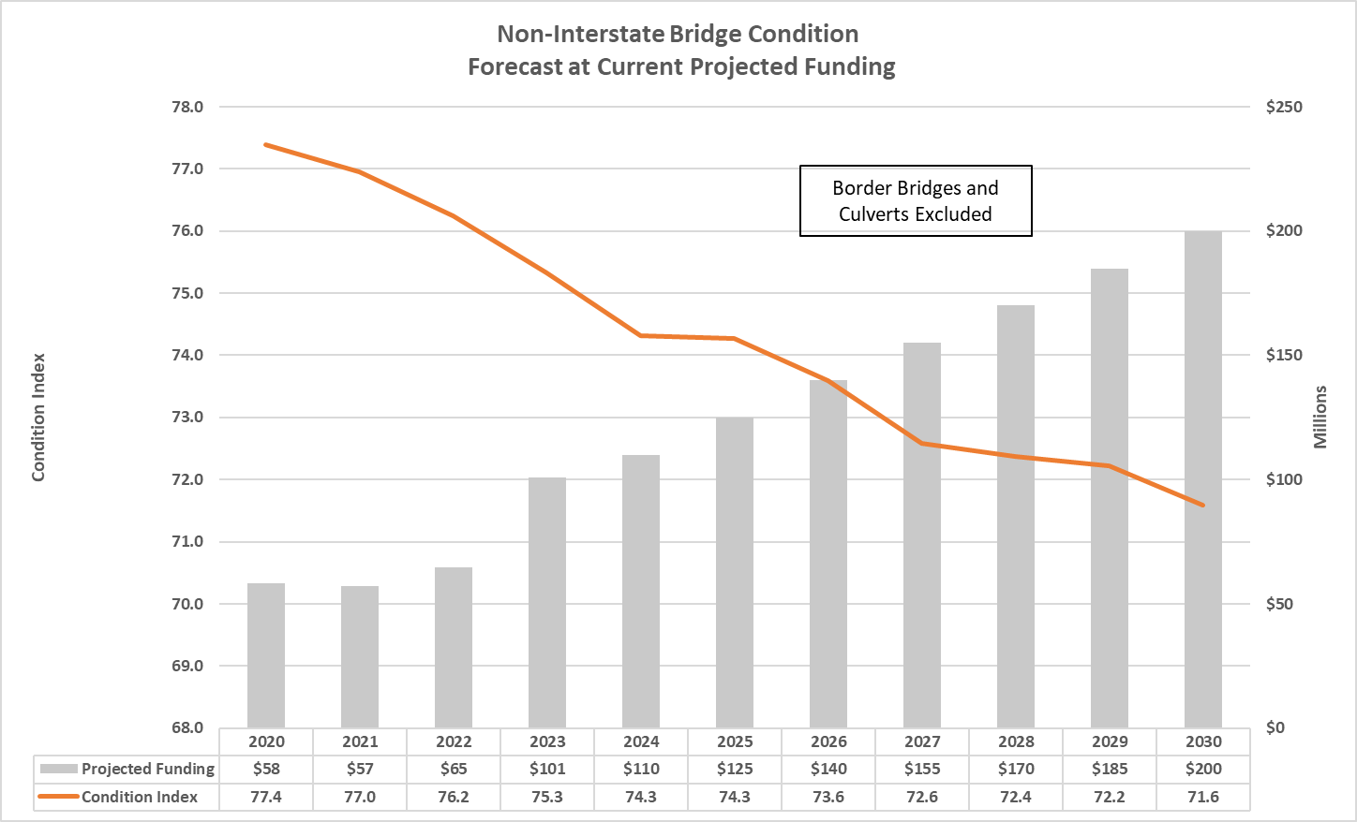
Condition Forecast
Notes:
W:\Highway\Bridge\BridgeInspection\Deterioration Modeling\IDS Project\Phase VI 2019\Non-Interstate\Non-Interstate Current budget limits corrected.xlsx

Slide 16
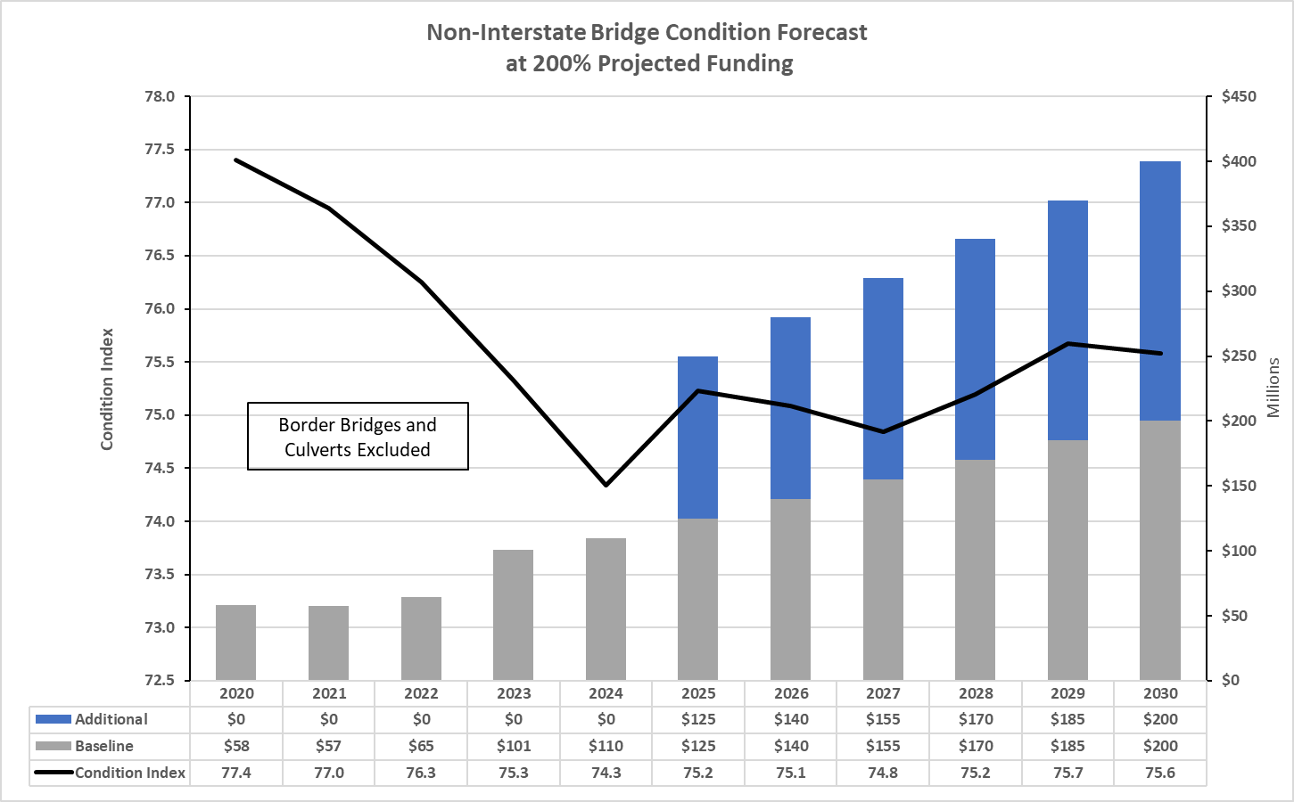
Condition Forecast Scenario
Notes:
W:\Highway\Bridge\BridgeInspection\Deterioration Modeling\IDS Project\Phase VI 2019\Non-Interstate\200 percent of Non-Interstate current budget corrected.xlsx

Slide 17
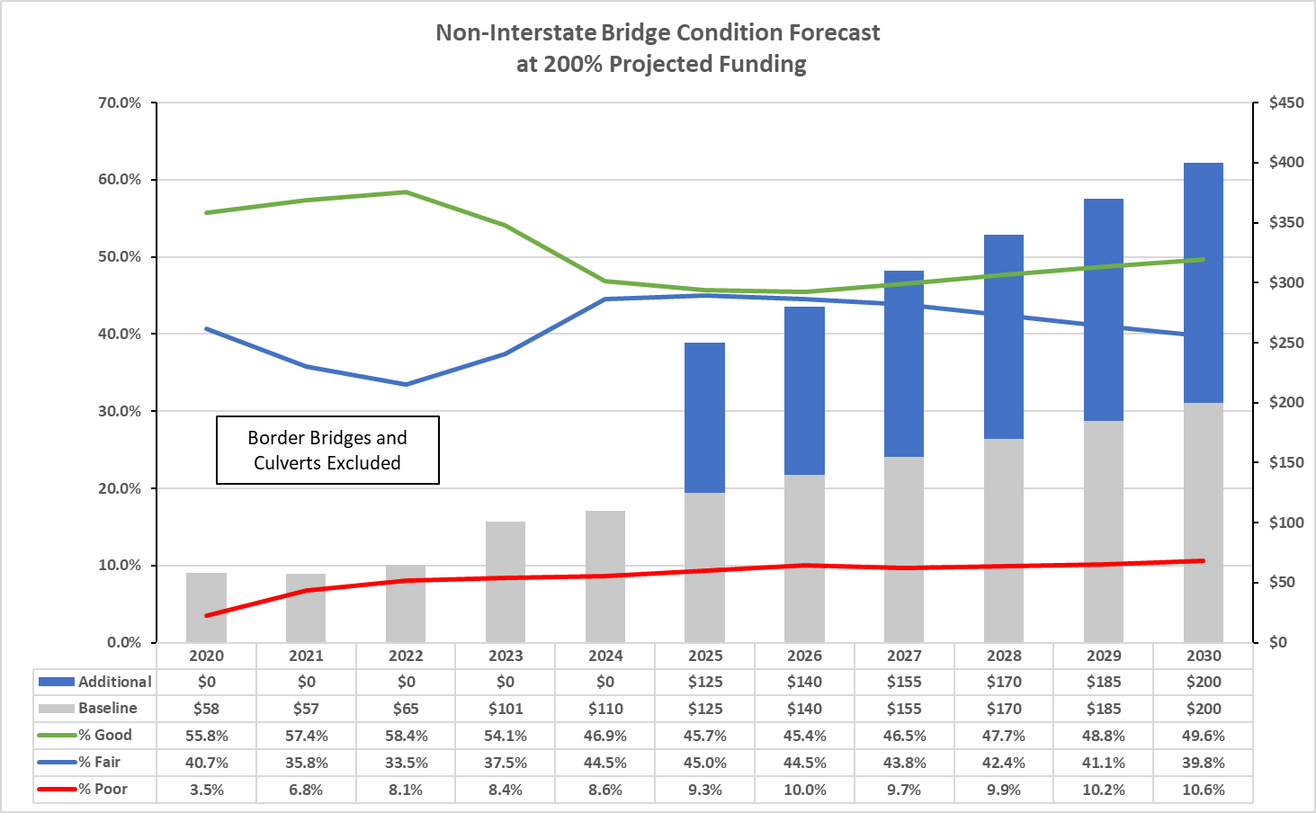
Condition Forecast Scenario
Notes:
W:\Highway\Bridge\BridgeInspection\Deterioration Modeling\IDS Project\Phase VI 2019\Non-Interstate\200 percent of Non-Interstate current budget corrected.xlsx

Slide 18
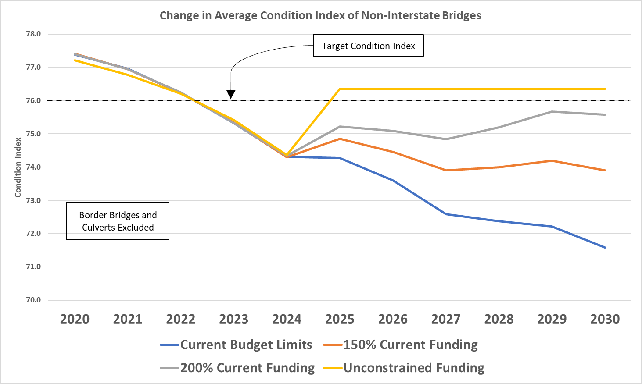
Condition Forecast Scenario
Notes:
W:\Highway\Bridge\BridgeInspection\Deterioration Modeling\IDS Project\Phase VI 2019\Non-Interstate\Combined budget outcomes.xlsx

Slide 19
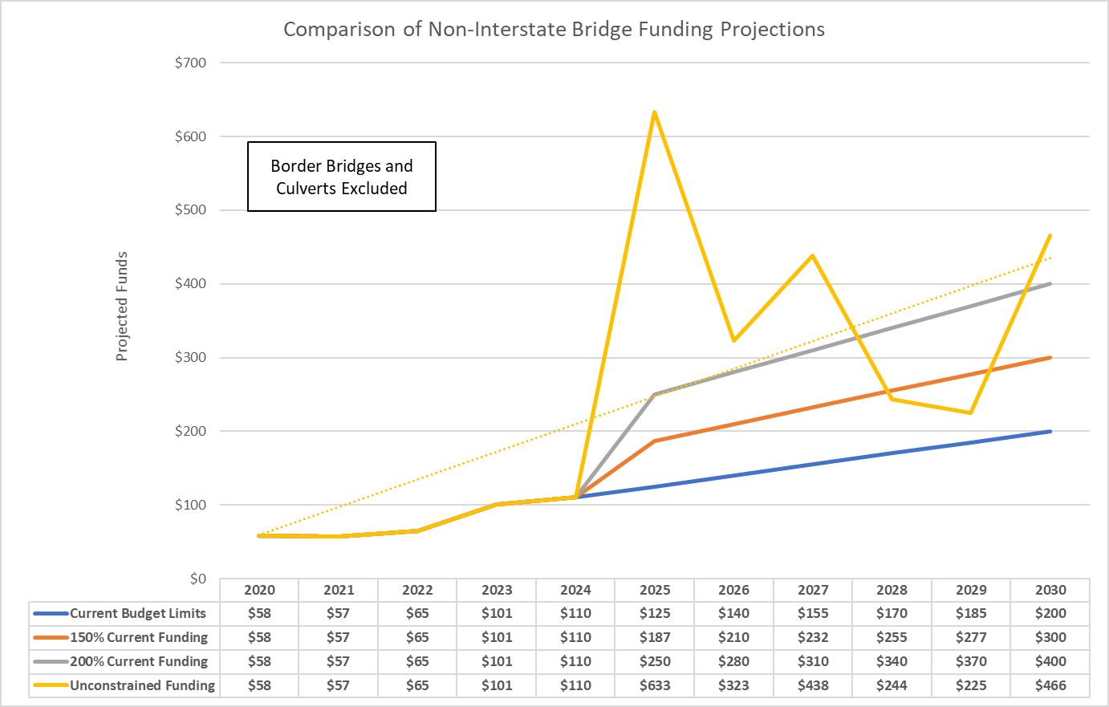
Condition Forecast Scenario
Notes:
W:\Highway\Bridge\BridgeInspection\Deterioration Modeling\IDS Project\Phase VI 2019\Non-Interstate\Combined budget outcomes.xlsx

Slide 20


Additional Needs
There is a need to replace or rehabilitate several large bridges over the next 20 years.
  I-280: Rock Island over the Mississippi River (re-deck in FY2021, $17 million)
  I-129: Sioux City over the Missouri River (deck overlay in FY2021, $4.97 million)
  IA-9: Lansing over the Mississippi River (replace in FY2024, $40 million)
  I-80: Le Claire over the Mississippi River (replace in FY2026, $150 million)
  IA-12: Sioux City Gordon Drive Viaduct (replace in FY2027, $105 million)
  US-67: Davenport over the Mississippi River (replace beyond 2028, $110 million)
  IA-175: Decatur over the Missouri River (replace - $60 million )
  US-20: Dubuque over the Mississippi River (replace - $175 million )
  US-30: Clinton over the Mississippi River (replace - $125 million )
  US-63: Ottumwa Viaduct (replace - $80 million)
Note: the costs shown above represent Iowa’s estimated share.
In 10 Years
In 15 Years
In 20 Years
20

Slide 21
Key Take-aways
Bridges are inspected routinely at least every 24 months. Changes in condition are documented.
There is a large inventory of bridges built in the 1960’s and 1970’s.
Good progress has been made reducing the number of bridges classified as poor. This trend is likely to reverse due to the large number of aging bridges.
In the near future some of our spending may be dictated by the FHWA if the total deck area on the NHS exceeds 10% classified as poor.
Border bridges represent large capital improvement projects that need to be planned for far in advance.
A sustained focus on stewardship is critical.

Slide 22
Bridge Preservation and Maintenance
What are some of the things we’re doing to preserve and maintain bridges?
Replace aging deck joints
Overlay decks with new wearing surface
  Dense concrete layer
  Polyester Polymer layer
  Latex modified concrete layer
  Epoxy polymer layer
  Repair beams ends
  Patch deteriorated deck areas
  Install berm and bank protection
  Use stainless steel reinforcing in areas with high potential for corrosion
  Use High Performance Concrete (HPC) in new bridge decks
  Use fewer or no deck joints
  Use of None Destructive Evaluation (NDE) methods to assess condition

Slide 23
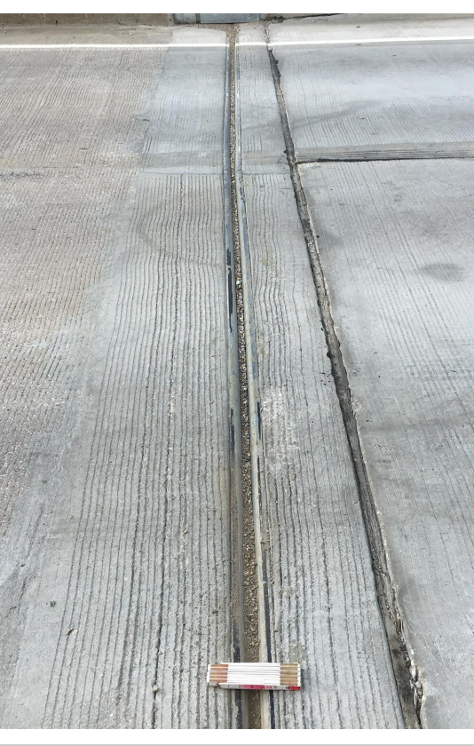
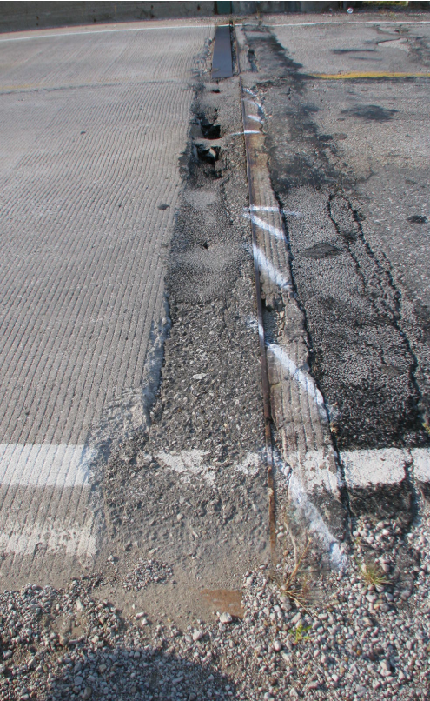
Notes:
Bridge 7834.9S092

Slide 24
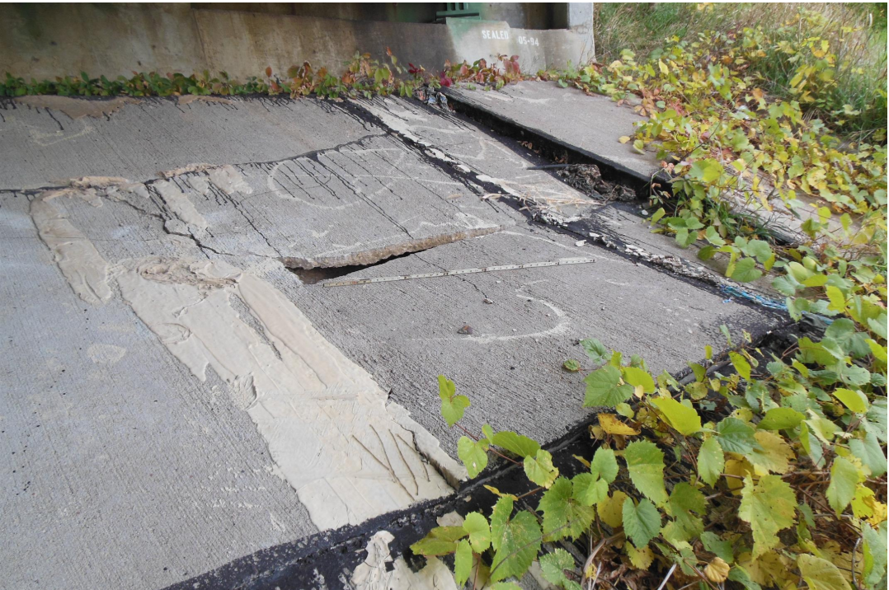
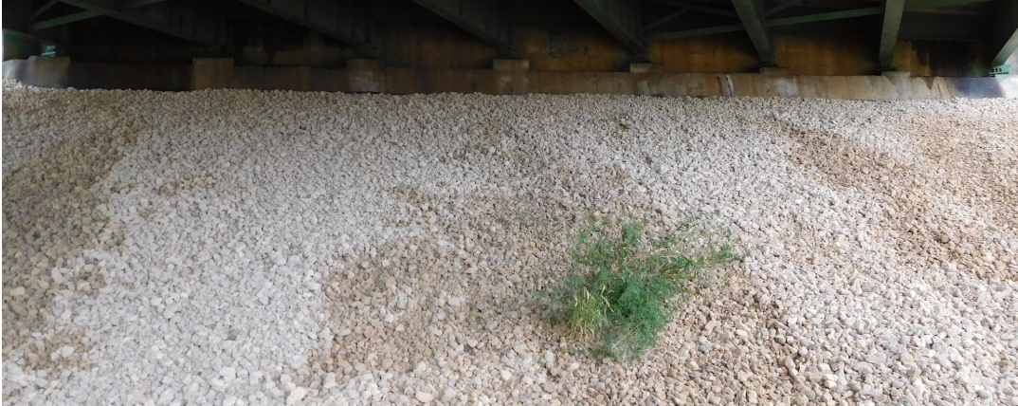
Notes:
Macadam stone – uniform crushed stone.

Slide 25
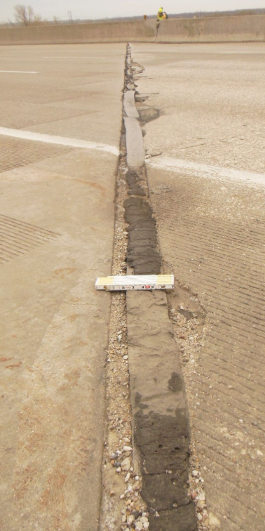
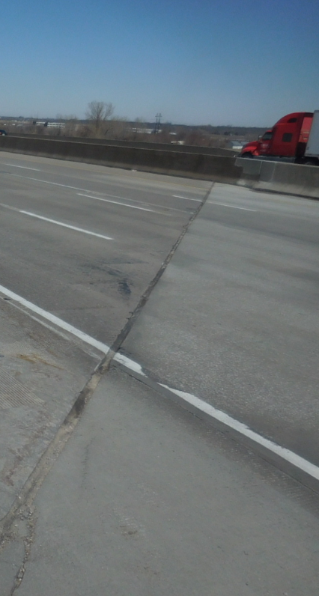
Notes:
Bridge 7788.3L035

Slide 26
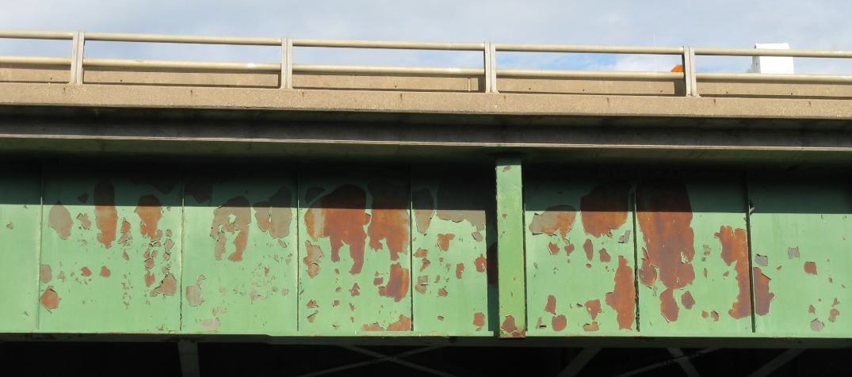
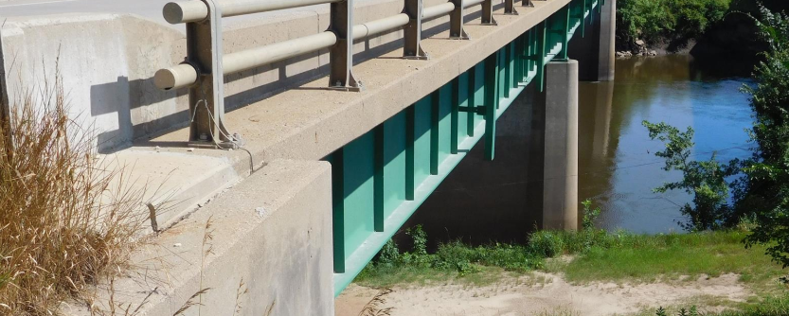
Notes:
Bridge 032220
Three coat paint system for field painting. Epoxy system or Moisture cured Urethane system. The two coat Zinc Silicate is not used in the field. Prime coat, Intermediate coat, and Finish coat.

Slide 27
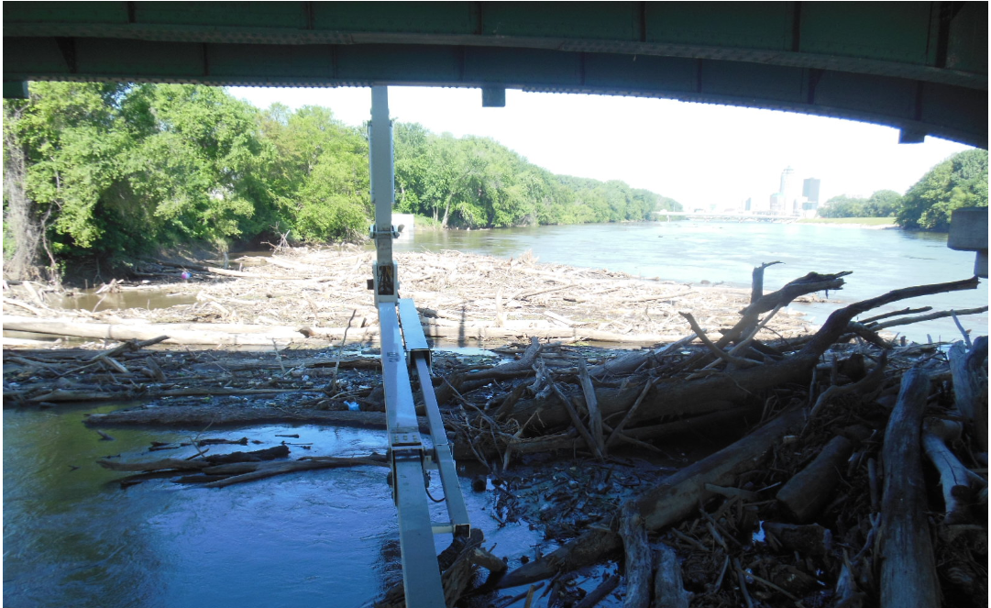
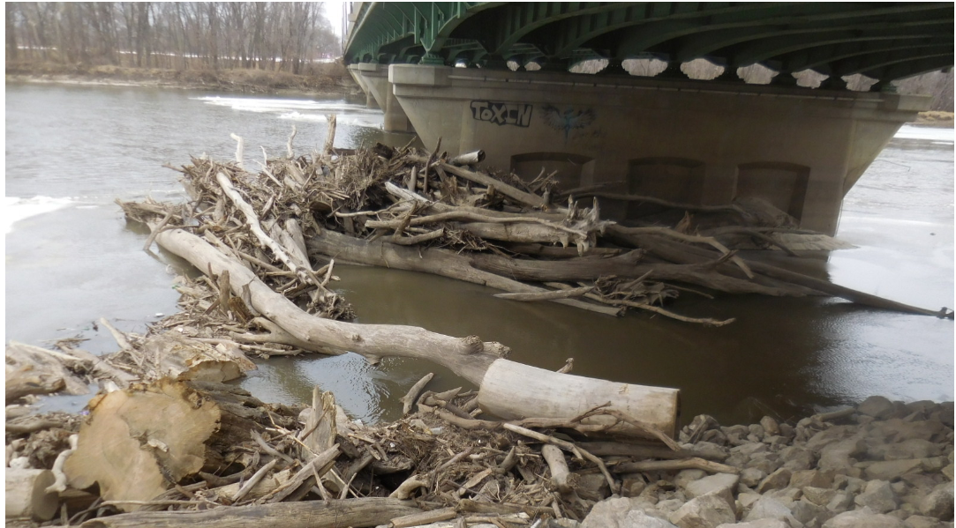
Notes:
Bridge 7784.2S069

Slide 28
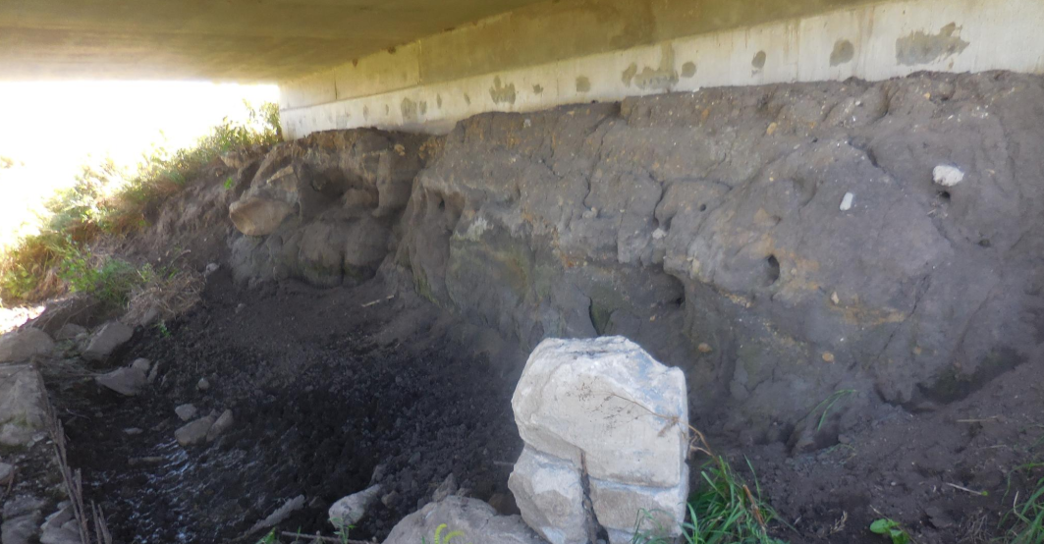
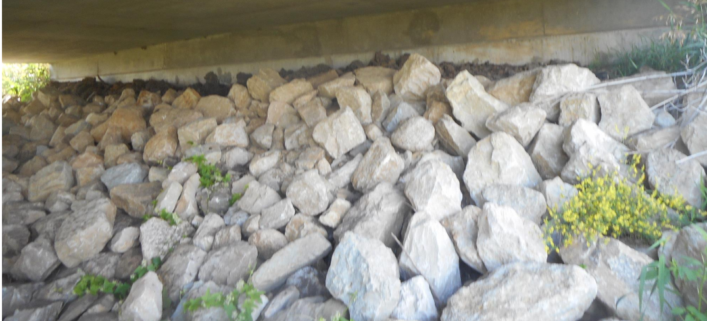
Notes:
Bridge 6669.0S218

Slide 29
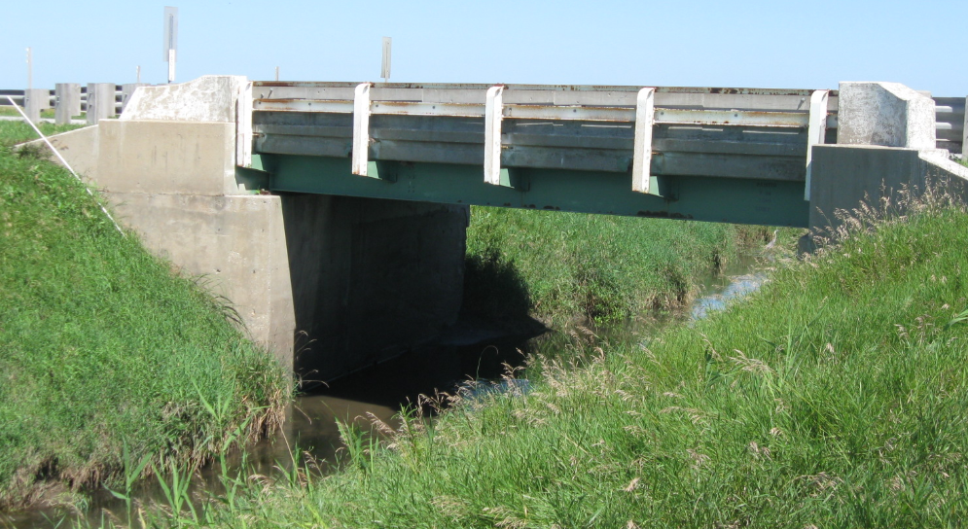
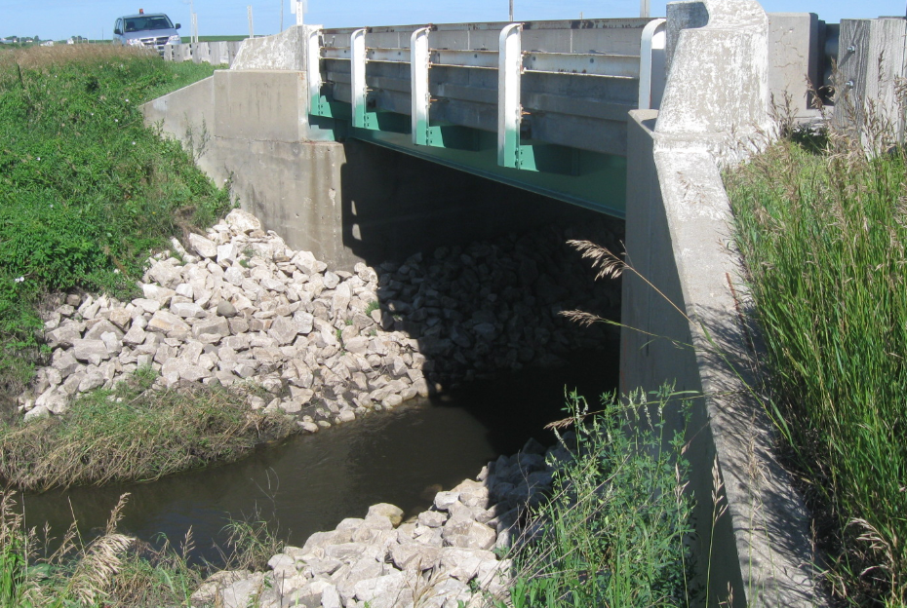
Notes:
7601.2S003

Slide 30
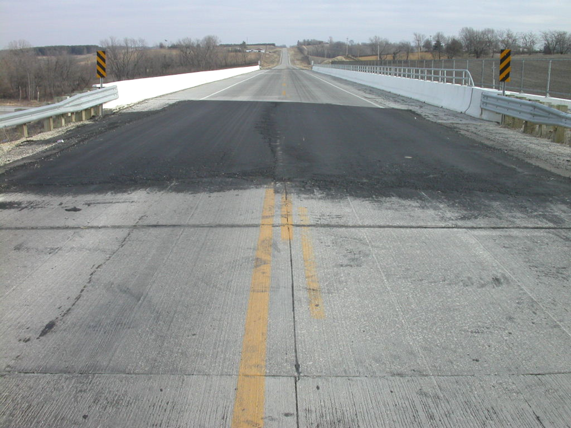
Notes:
Bridge 7767.7O035

Slide 31
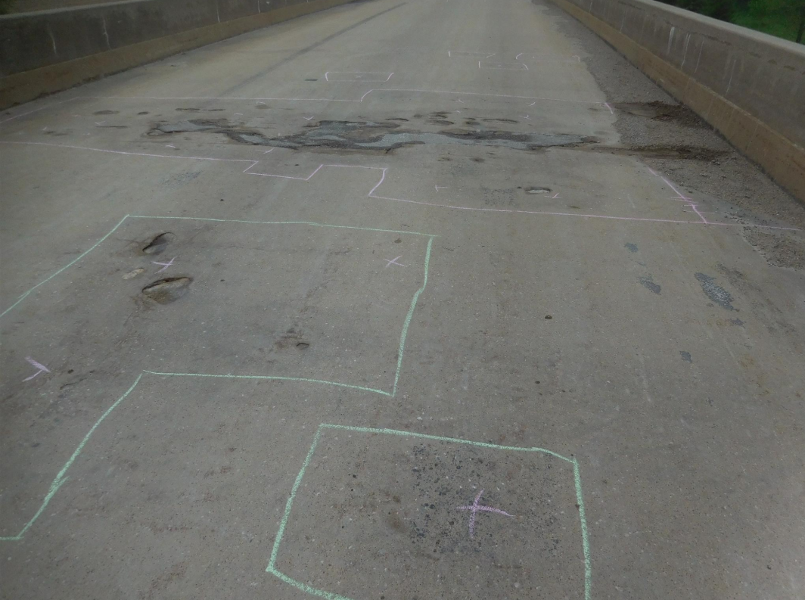
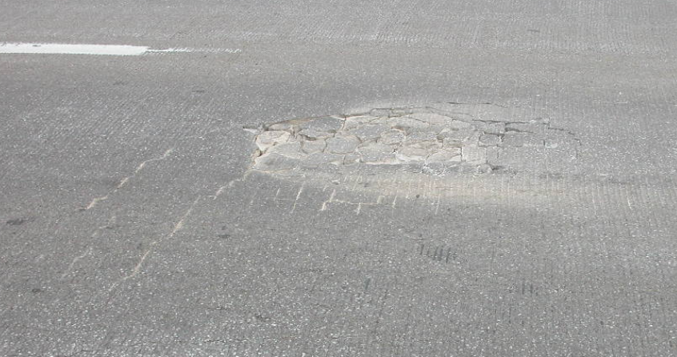
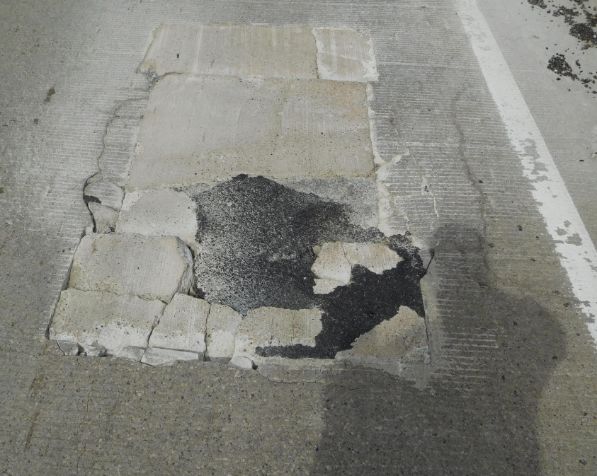
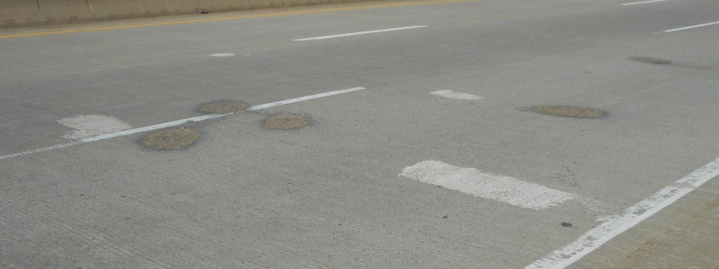
Notes:
5233.0O080
8295.9R080
3190.2S061 Peosta Channel
0625.7S030

Slide 32
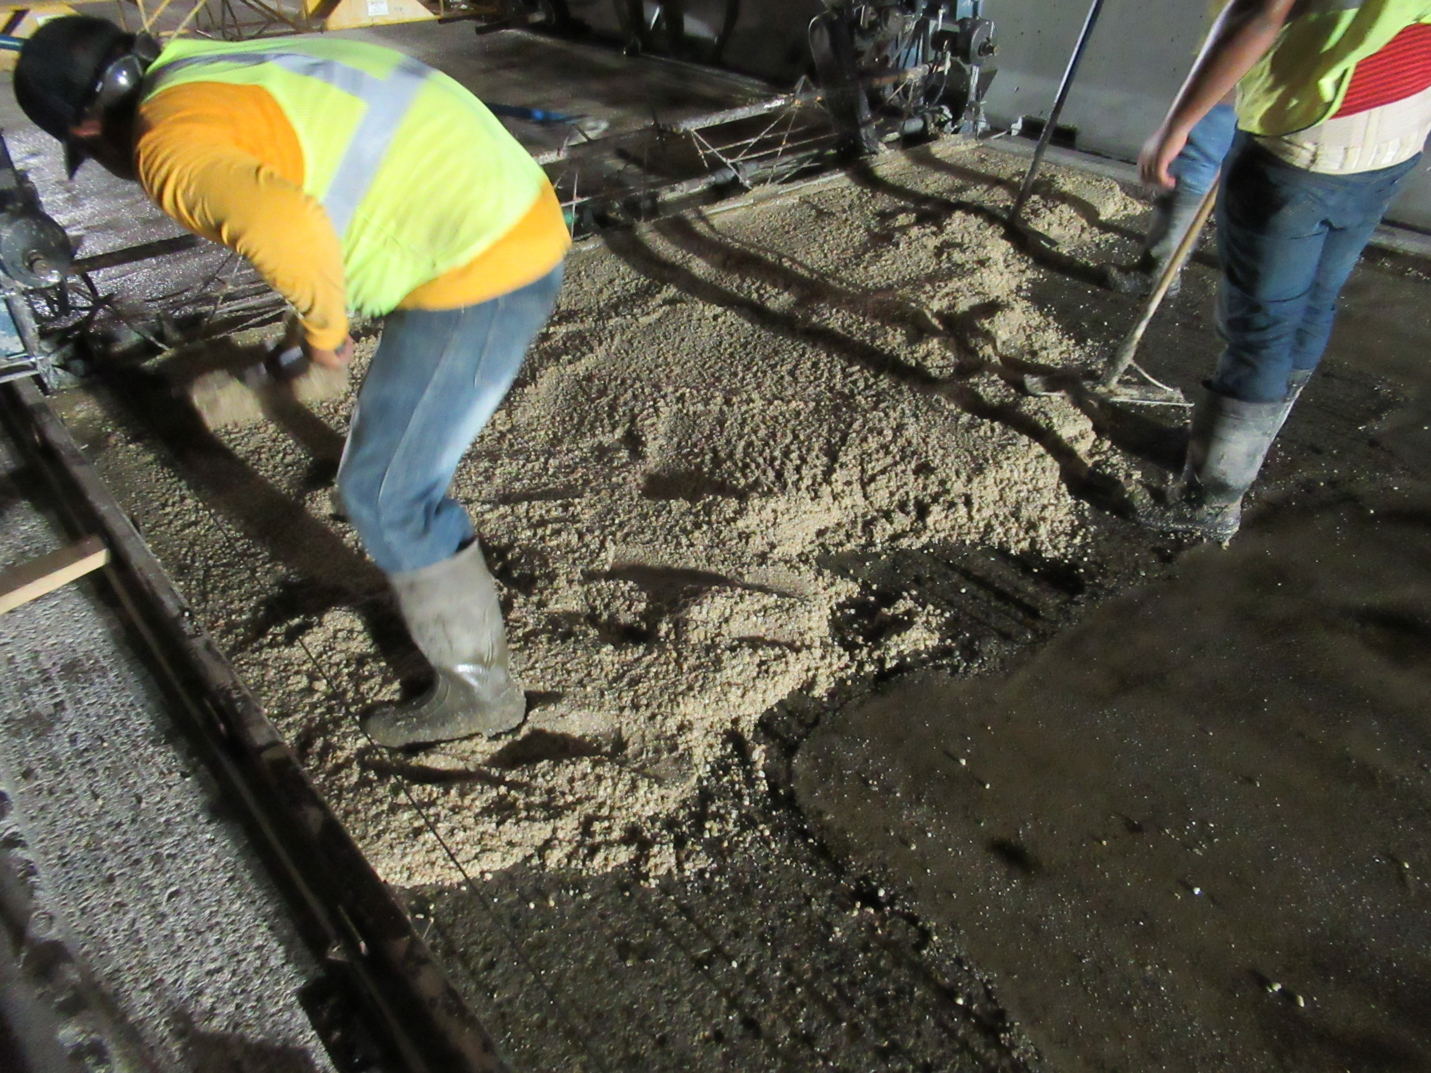
Notes:
Polyester Polymer overlay
Cedar Rapids over I-380 – 5720.8O380 8th st.

Slide 33
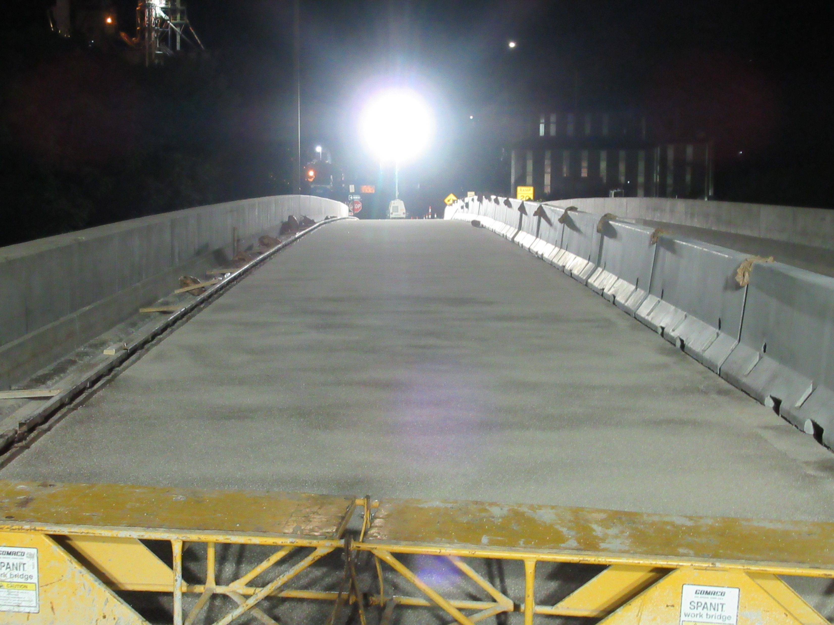
Notes:
Polyester Polymer overlay
Cedar Rapids over I-380
Second bridge on I-80 in Jasper county – 5063.9R080 over RR

Slide 34
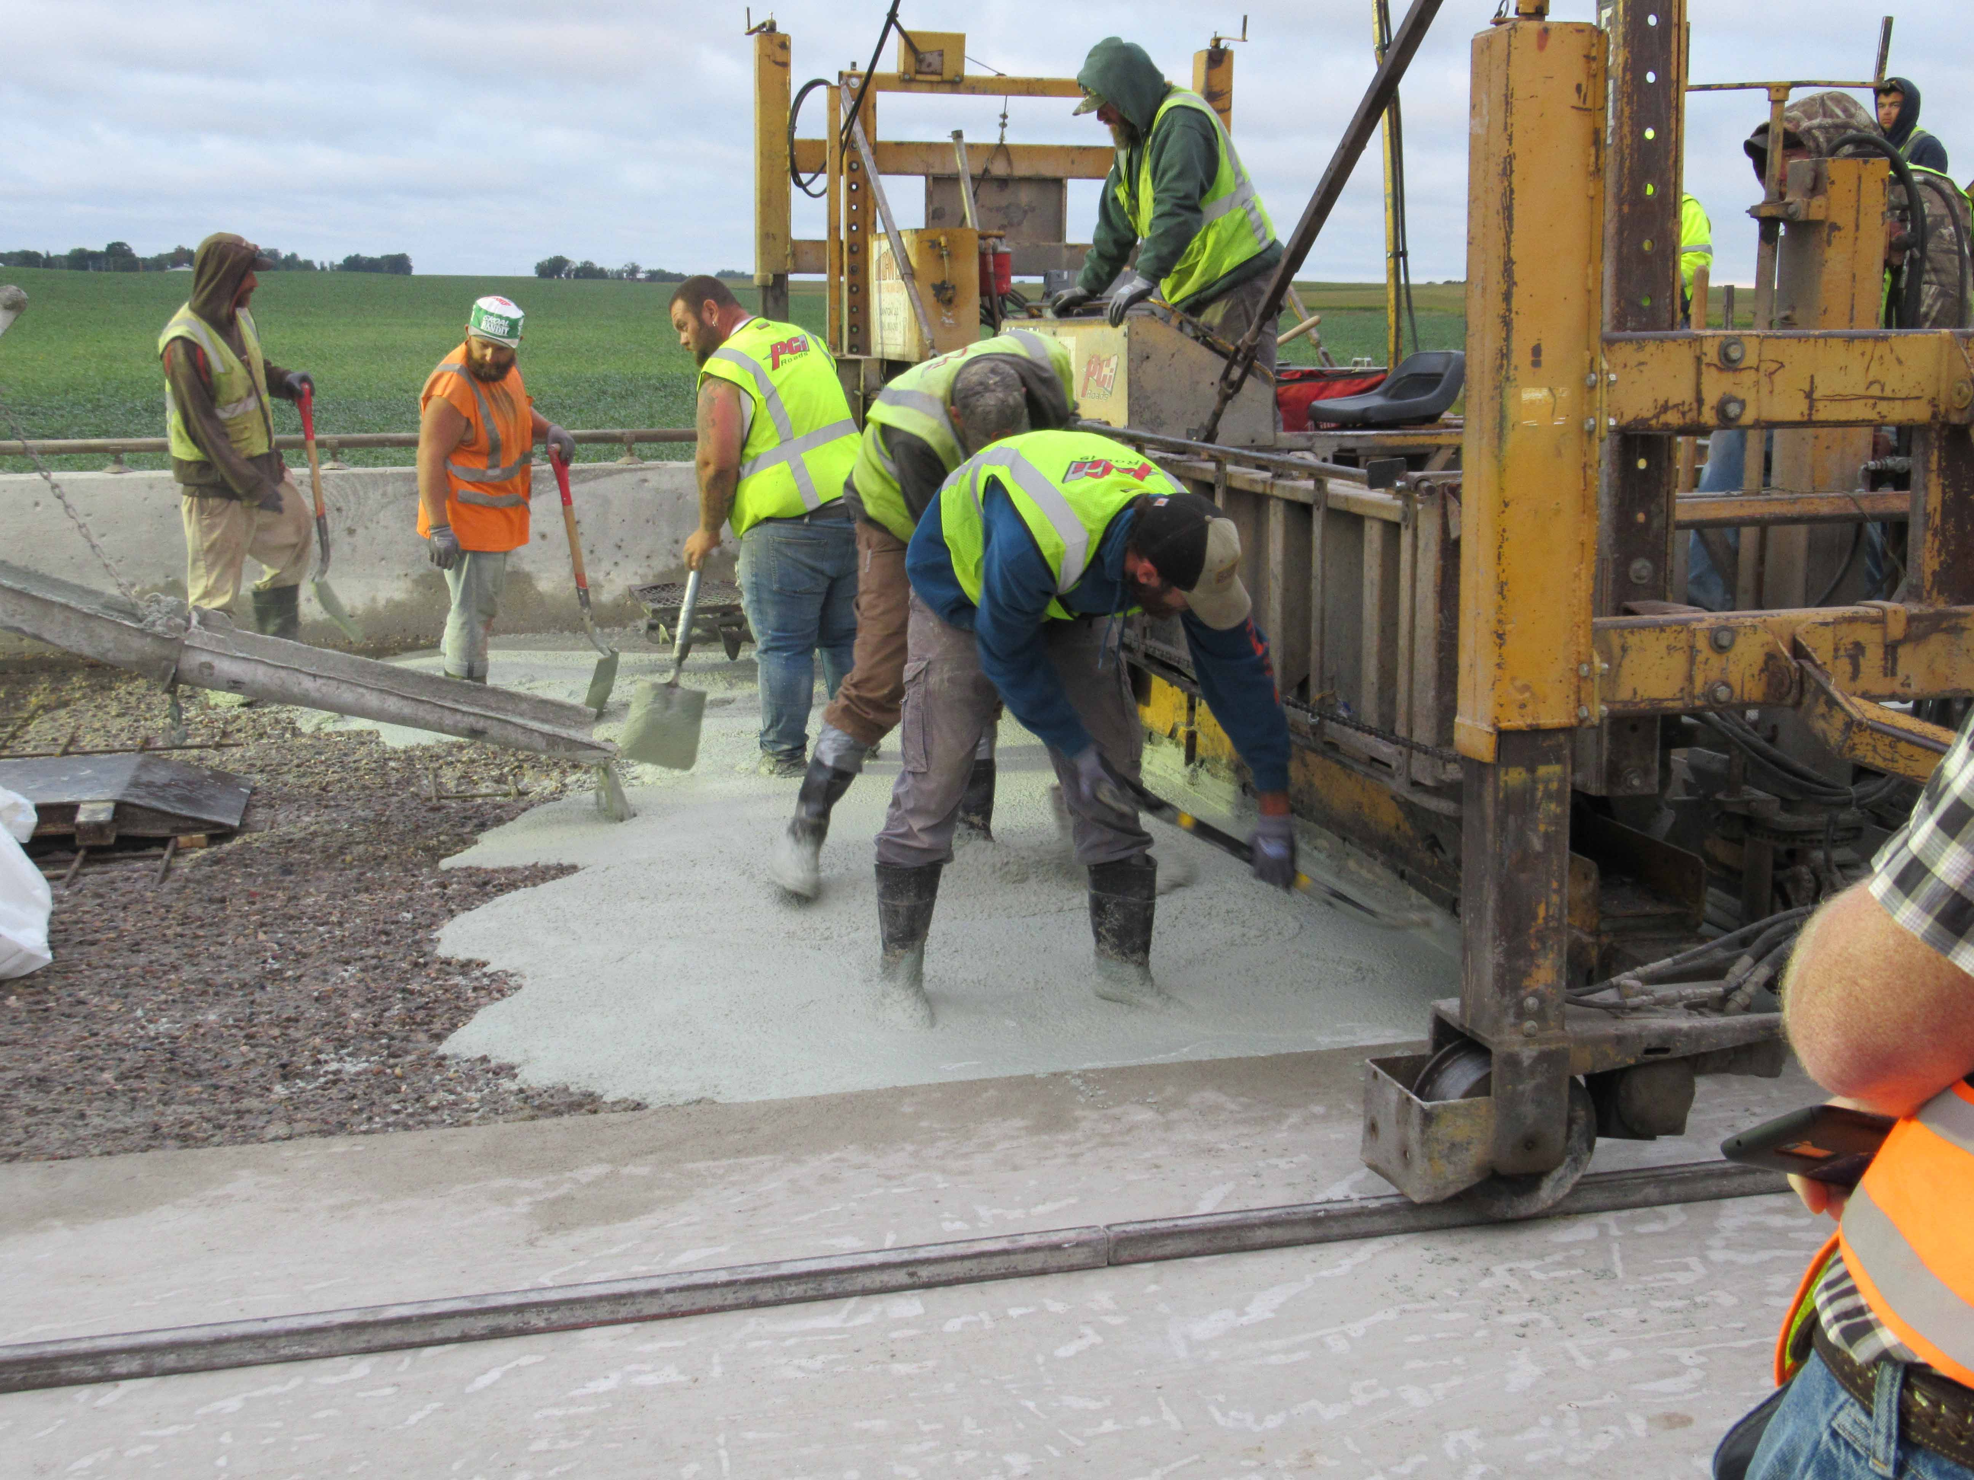
Notes:
VE-LMC
Emmet County on IA-15 – 3248.5S015 over Black cat creek

Slide 35
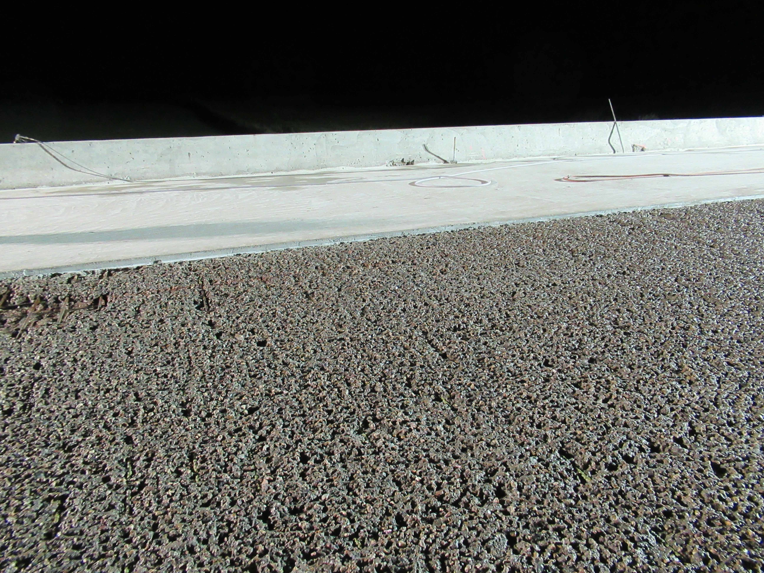
Notes:
VE-LMC
Emmet County on IA-15

