Slide 1
Revitalize Iowa’s Sound Economy Program

Slide 2
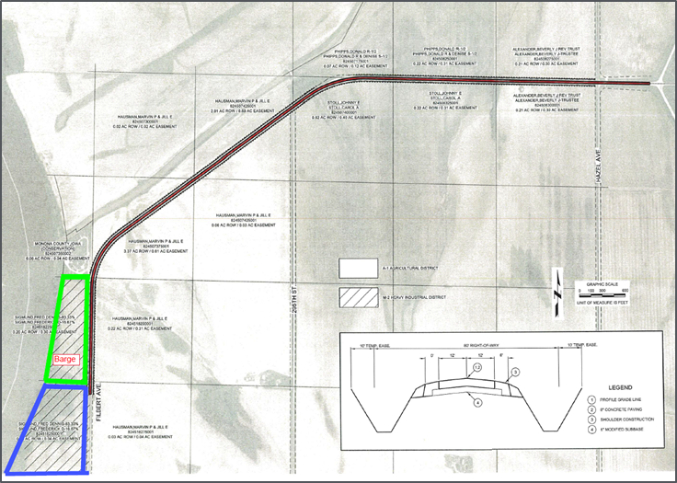
Local Development Application Recommended for Award
PROJECT NAME
SPONSOR
SCORE
TOTAL PROJECT COST
PERCENT PARTICIPATION
RECOMMENDED AMOUNT
Construction and roadway improvements of approximately 9,715 feet of Filbert Avenue located southwest of Blencoe. | Monona County | 64 | $3,127,190 | 50% | $1,563,595

