Slide 1

Iowa 2 Fremont County
Resiliency Options Overview
Commission Update
December 10, 2019
Notes:
Key Message

Slide 2

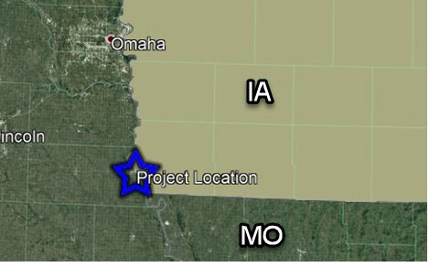
Project Location
Fremont County
Notes:
Key Message

Slide 3
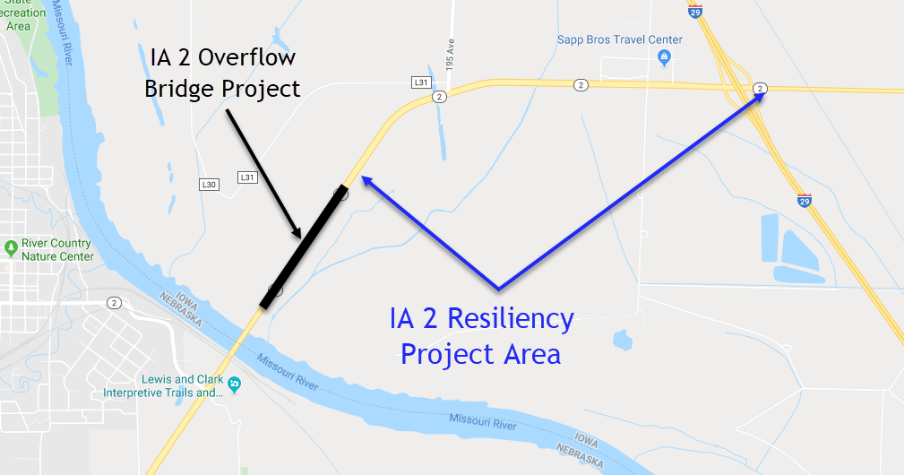
Project Site

Slide 4
Developing the Initial Concepts
The Challenge:
  Keep Iowa 2 open during a severe flood event.
Potential Ways to Meet the Challenge:
  Raise Iowa 2
  Allow water to pass under Iowa 2
  Keep water away from the highway
Notes:
Key Message

Slide 5
Proof Steps
Engineering Steps
  Hydraulic Analysis
    Should handle the amount of flow in the flood plain that occurred during June 2019 and Summer 2011
  Preliminary Bridge and Roadway Design
    The combination of design elements must meet acceptable design practices
  Preliminary Environmental Reviews
Non-Engineering Steps
  Evaluate Public Acceptance
Notes:
Key Message

Slide 6
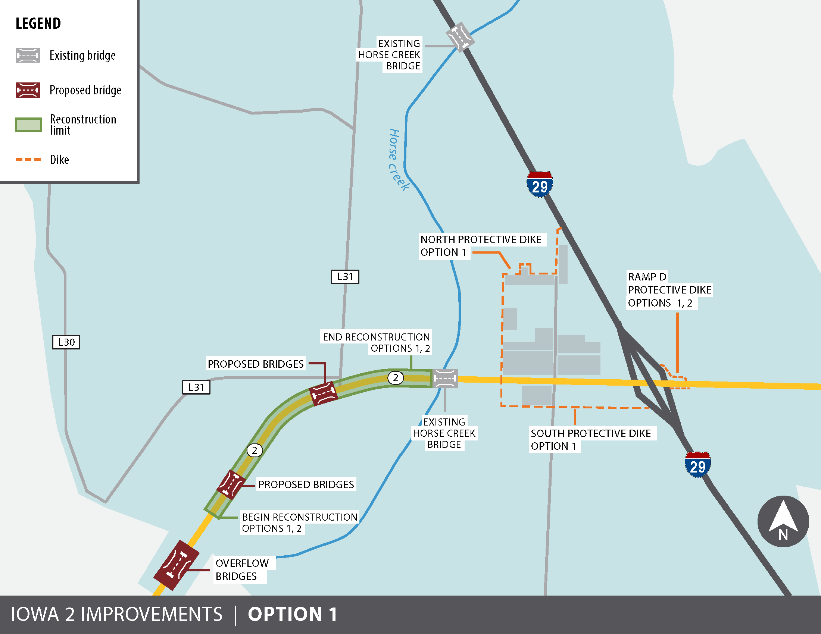
Ia 2 Resiliency Option 1
Notes:
Key Message

Slide 7
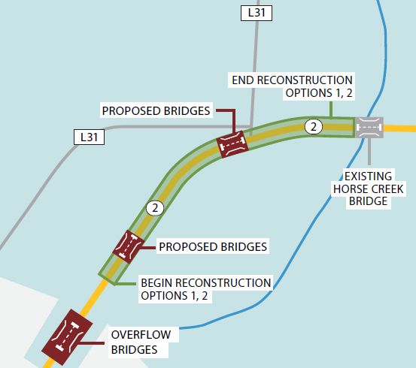
Option 1,2 Overflow Bridges to Horse Creek Bridges
Key Elements
Reconstruct Iowa 2 to a higher elevation
Add two sets of bridges to convey water under Ia 2
Anticipated Cost
  Grade & Pave $2.2-$3.0
  Bridge $6.2-$7.0
Notes:
Key Message

Slide 8
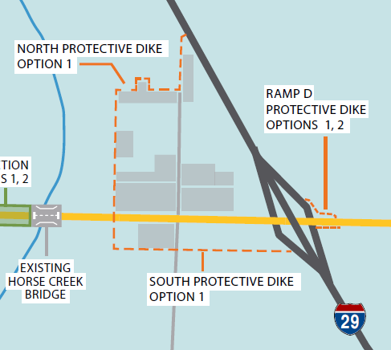
Option 1 East of Horse Creek
Key Elements
Construct dikes to prevent water from overtopping Iowa 2
Anticipated Cost
  Dike $0.8-$1.5
  Total Project $9.2-$11.5
Notes:
Key Message

Slide 9
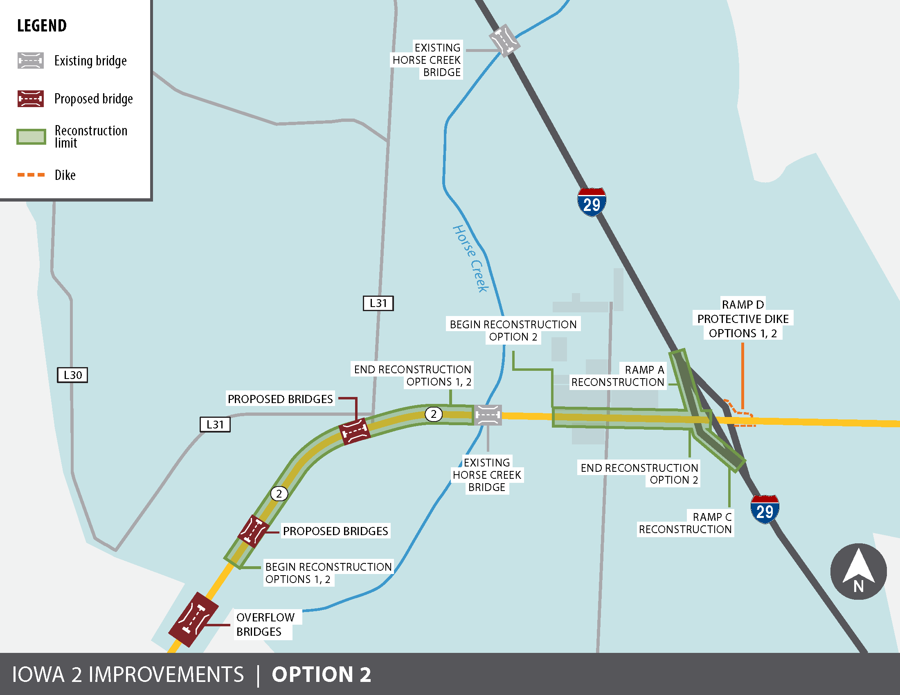
Ia 2 Resiliency Option 2
Notes:
Key Message

Slide 10
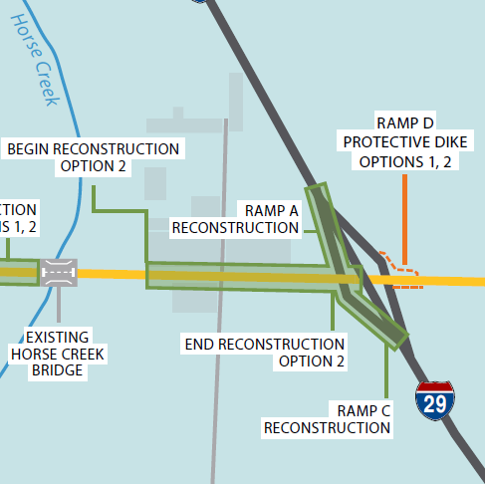
Option 2 East of Horse Creek
Key Elements
Reconstruct Iowa 2 to a higher elevation
Reconstruct the west ramps of the interchange
Anticipated Cost
  Grade & Pave $2.0-$2.5
  Total Project $10.4-$12.5
Notes:
Key Message

Slide 11

Public Outreach
Explore the Viability of the Options 1 & 2
Stakeholders Meetings
DOT Management Team
Governor’s Office
Levee and Drainage District Representatives
Business Owners
Notes:
Key Message

Slide 12
Additional Considerations
Option 1 – Reconstruction with Dike
  Ownership & Maintenance of Dike
Phased Construction Approach
  Grade Raise west of Horse Creek could proceed work to east
Funding Considerations
  Build Grant application submitted in July 2019
  Partial Reimbursement from FHWA Emergency Repair Program
  Consideration for next Highway Program
Notes:
Key Message

Slide 13
Commission Input
Notes:
Key Message

Slide 14
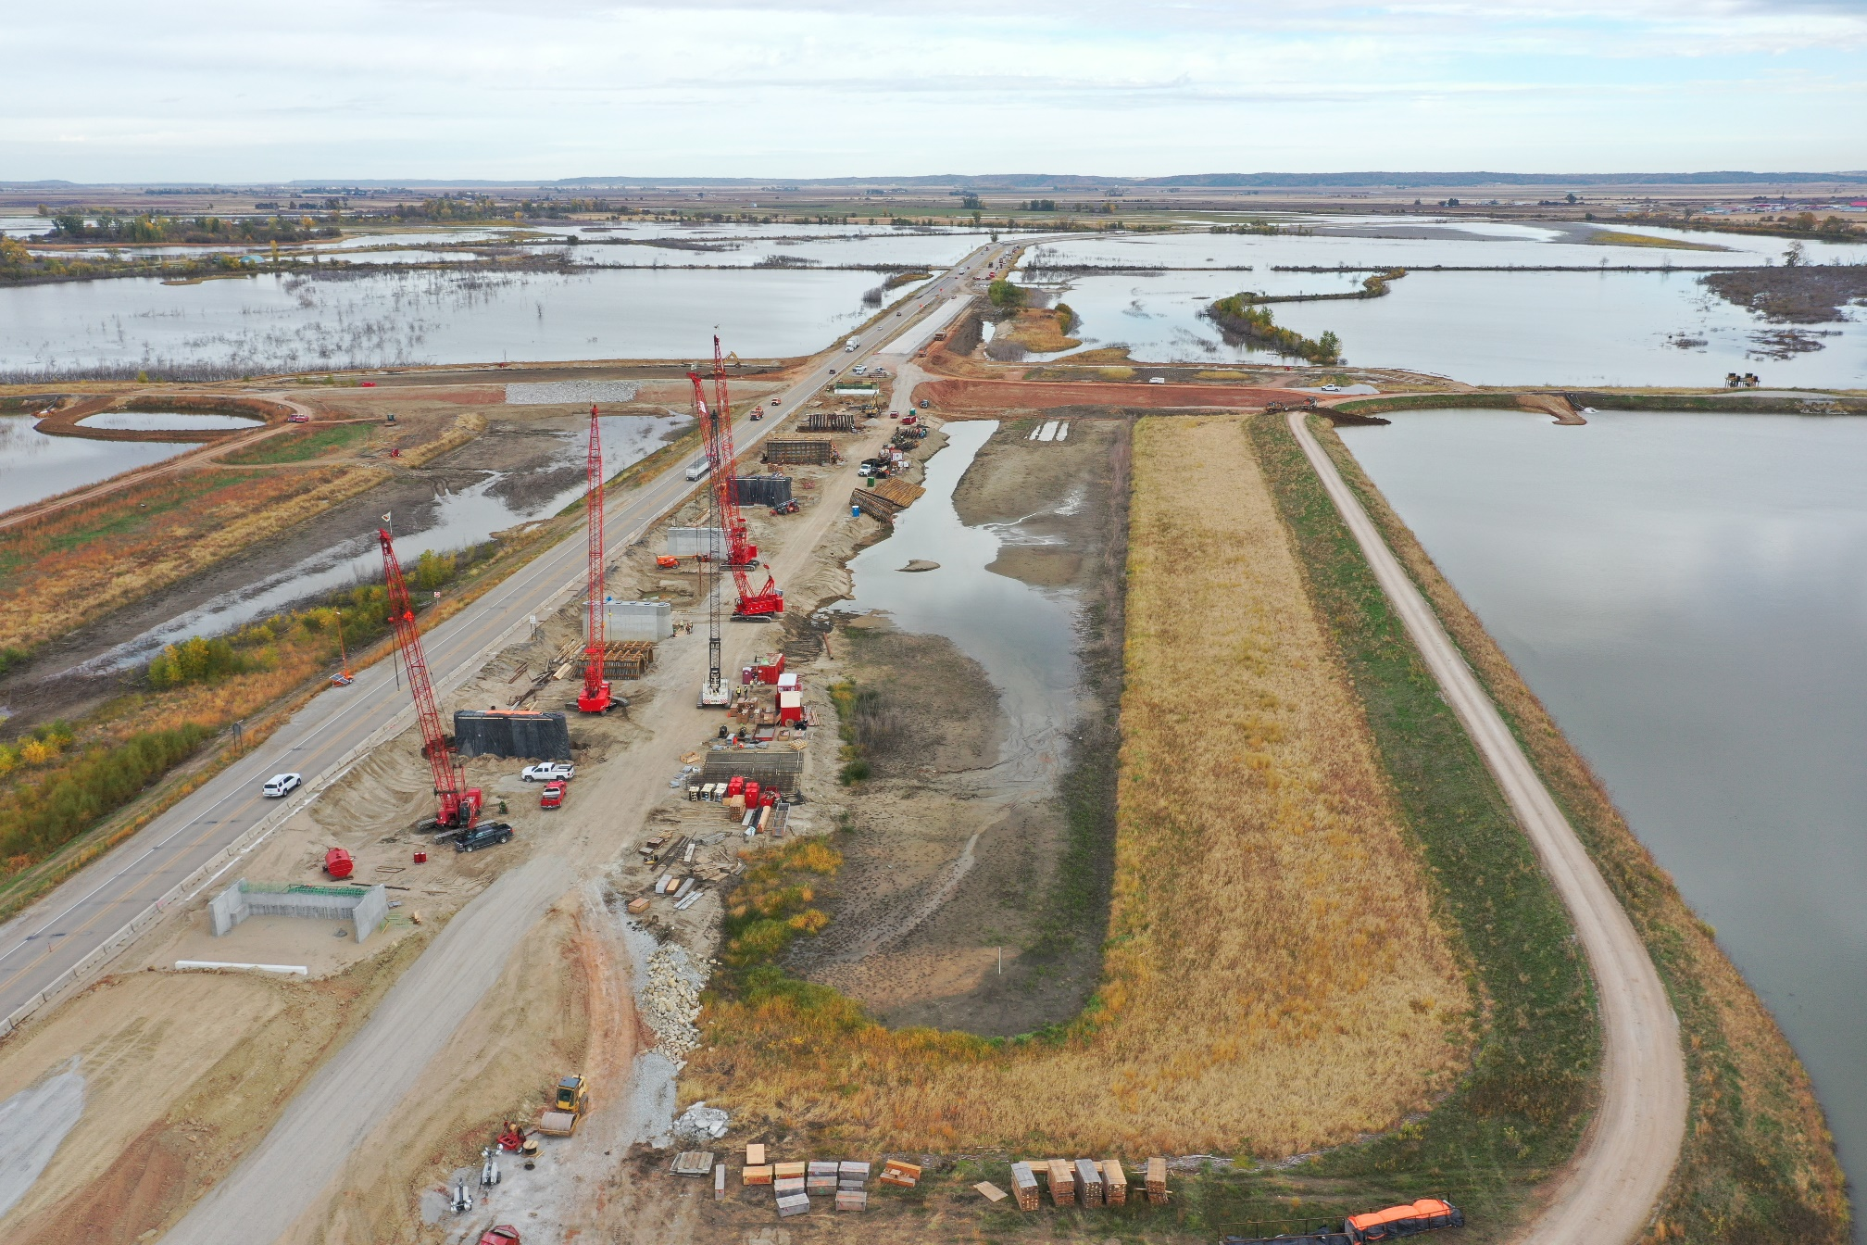
Overflow Bridge Progress

Slide 15
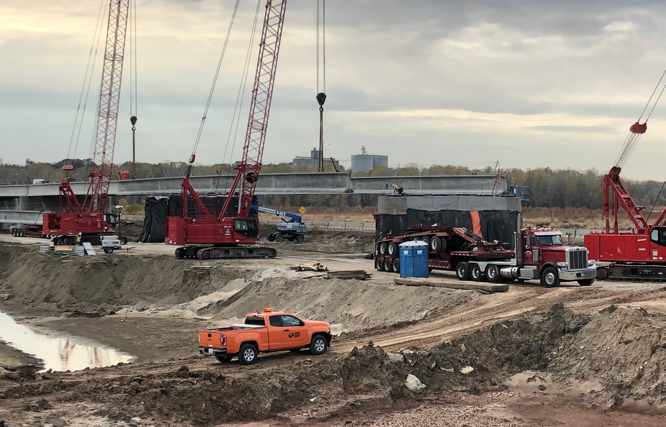
Overflow Bridge Progress

Slide 16
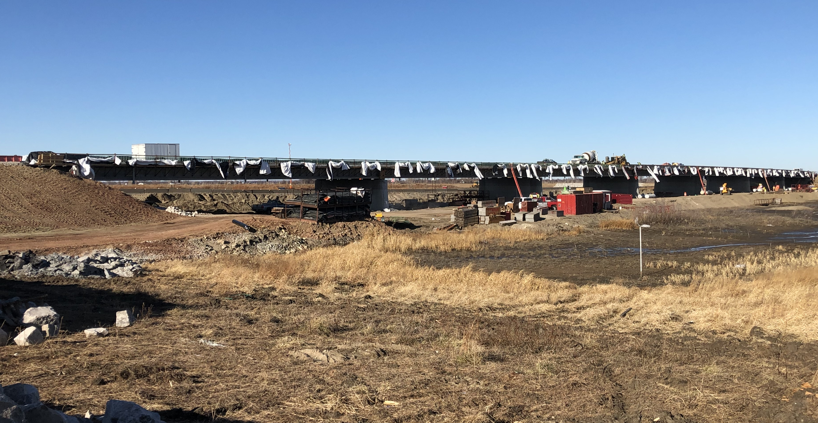
Overflow Bridge Progress

Slide 17
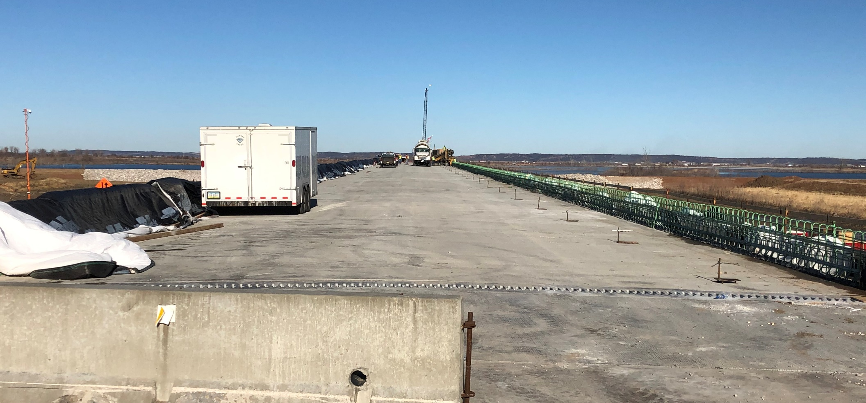
Overflow Bridge Progress

