Slide 1
Iowa’s Clean Air Attainment Program
Funding Recommendation

Slide 2
Iowa’s Clean Air Attainment Program
Iowa’s Clean Air Attainment Program (ICAAP) was created in 1994.
Modeled after the federal Congestion Mitigation and Air Quality Improvement Program established in 1991.
Available to cities, counties, public transit agencies, MPOs, RPAs, and state agencies. Private non-profit or for-profit entities when co-sponsored by an eligible public agency through an annual application program.
Purpose is to award funds to projects with the highest potential for reducing transportation-related congestion and air pollution.

Slide 3
Project Evaluation Criteria
Vehicle traffic flow improvements (25 points)
Vehicle miles of travel (VMT) or single-occupant vehicle (SOV) reduction (25 points)
Estimated vehicle emission reduction (20 points)
Degree of transportation-related air pollution or traffic congestion (15 points)
Project cost effectiveness relative to air quality benefits (30 points)

Slide 4
Available Funding and Application Summary
Available Funding:
Iowa’s Clean Air Attainment Program funds available: $4,000,000
Application Summary:
Total number of projects: 10
Total project costs: $14,785,900
Total amount requested: $6,022,630

Slide 5
List of Applications Recommended
PROJECT NAME | SPONSOR | SCORE | TOTAL PROJECT COST | REQUESTED AMOUNT (% of Total Project Cost) | RECOMMENDED AMOUNT (% of Total Project Cost)
West Ames Changes: (New Expansion Route #12 Lilac & Bus; Added frequency (#1 Red, #11 Cherry, #7 Purple) – Year 2 | Ames Transit Agency | 88.0 | $424,957 | $339,965 (80%) | $339,965 (80%)
First Phase Deployment Ames Traffic Signal Master Plan | City of Ames | 77.4 | $1,470,648 | $1,176,518 (80%) | $1,176,518 (31%)
Euclid/Douglas Avenue Crosstown (Route 50) Year 3 | Des Moines Area Regional Transit Authority | 76.2 | $392,186 | $313,749 (80%) | $313,749 (80%)
#11 Cherry, Add Night Service – Year 1 | Ames Transit Agency | 74.0 | $40,703 | $32,562 (80%) | $32,562 (80%)
Jump to applications not recommended for funding

Slide 6
List of Applications Recommended
PROJECT NAME | SPONSOR | SCORE | TOTAL PROJECT COST | REQUESTED AMOUNT (% of Total Project Cost) | RECOMMENDED AMOUNT (% of Total Project Cost)
Iowa 17 (S. Avenue) Railroad Overpass and 200th St Connection | Boone County | 73.4 | $2,578,300 | $800,000 (31%) | $800,000 (31%)
#12 Lilac, Add Midday Service – Year 1 | Ames Transit Agency | 71.0 | $38,411 | $30,728 (80%) | $30,728 (80%)
#6 Brown, Add Night Service – Year 1 | Ames Transit Agency | 69.6 | $36,385 | $29,108 (80%) | $29,108 (80%)
Roundabout at Warrior Lane, Ashworth Dr, and Northview Dr | Waukee | 66.1 | $1,900,000 | $1,400,000 (74%) | $1,277,370 (67%)
Jump to applications not recommended for funding

Slide 7
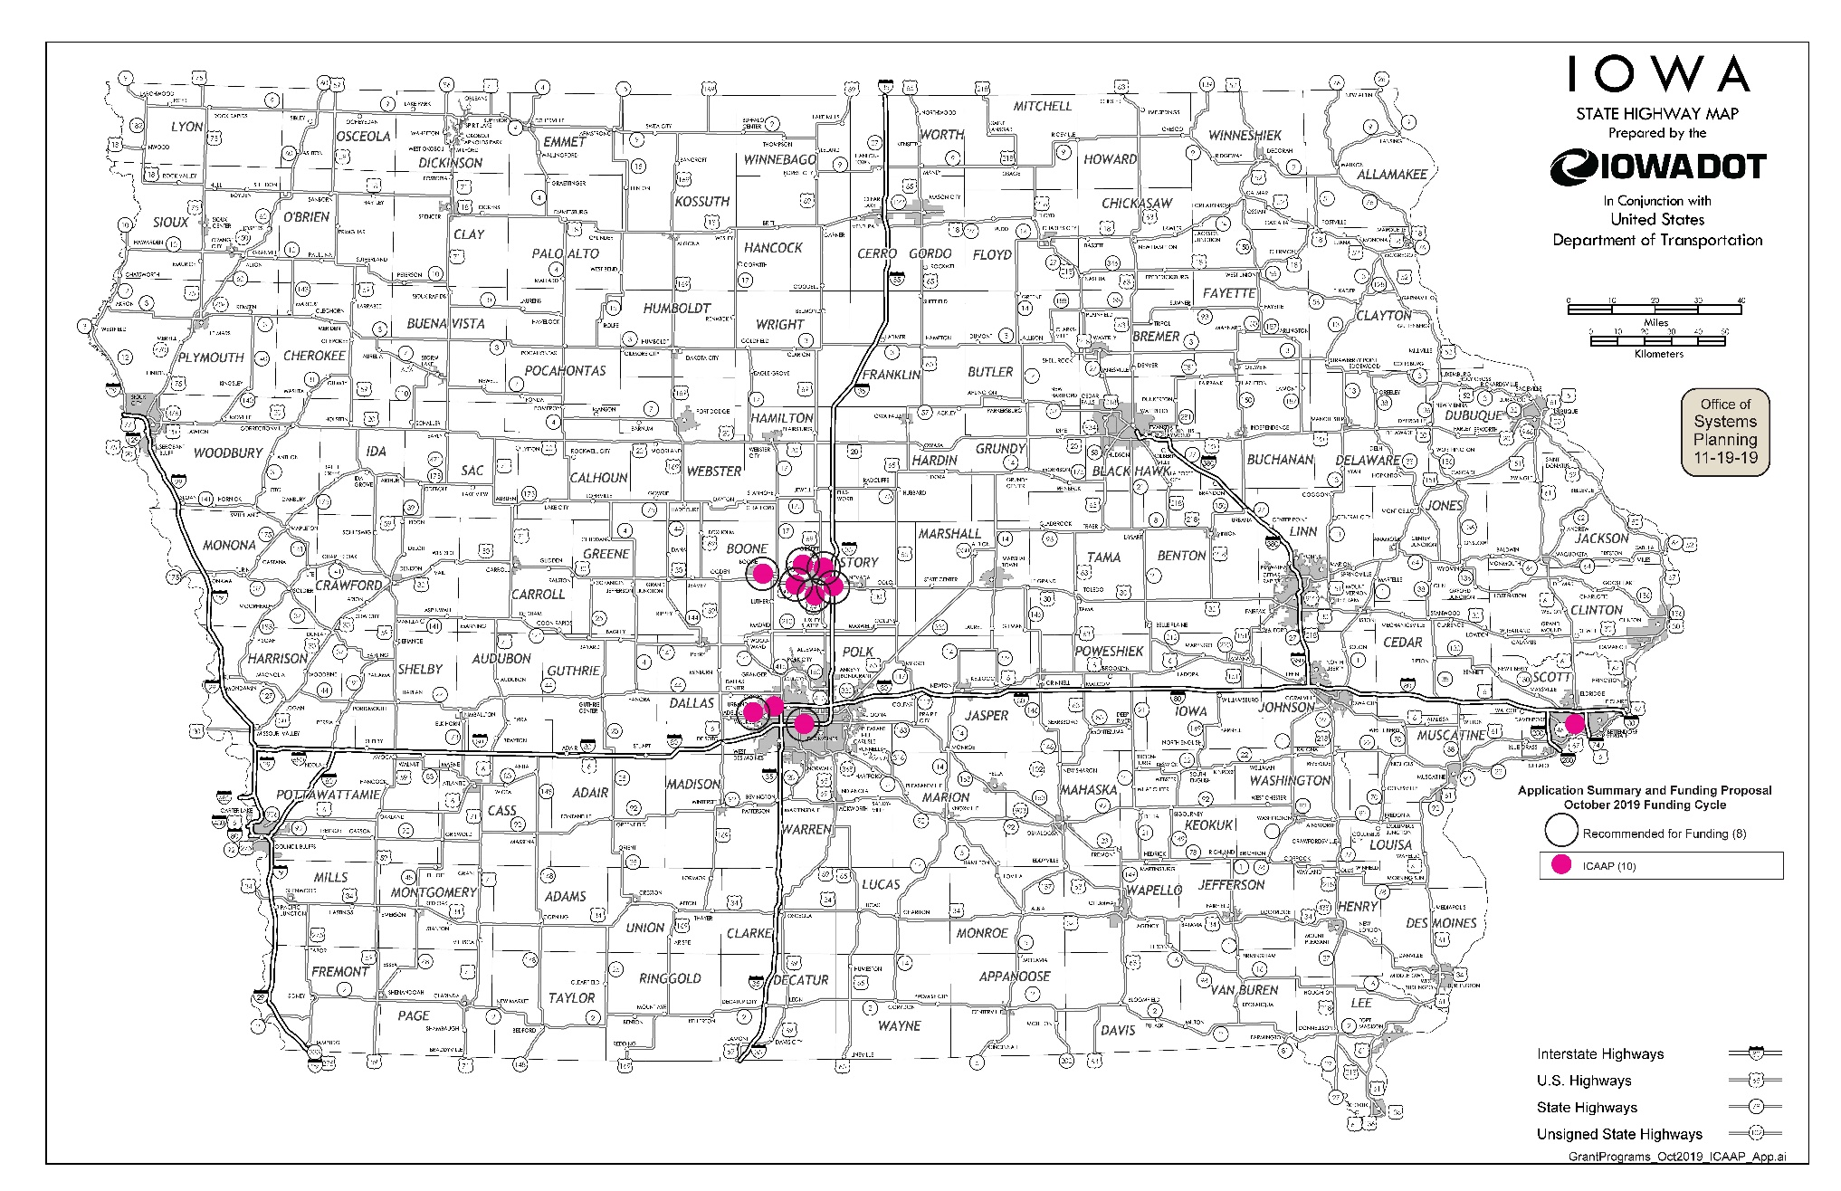
Map of Applications Received

Slide 8
Estimated Annual Benefits of Recommended Projects
Reduction of Vehicle Hours of Travel: 659,157
Reduction of Vehicle Miles of Travel: 5,131,535
Improved Air Quality
Reduced CO, VOCs, & NOx Emissions: 239,746 lbs.

Slide 9
QUESTIONS?
Zac Bitting
Iowa’s Clean Air Attainment program manager
Zachary.bitting@iowadot.us

Slide 10
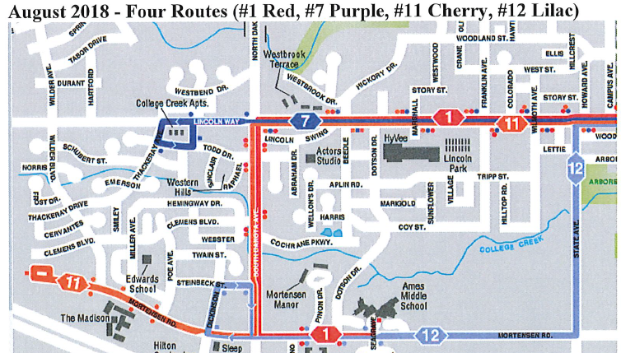
West Ames Changes (Ames Transit Agency)
New expansion route for #12 Lilac, additional frequency to route #1 Red, additional frequency to route #11 Cherry, and additional frequency to route #7 Purple.
Total Cost: $424,957
Requested: $339,965 (80%)
Return to List of Applications Recommended

Slide 11
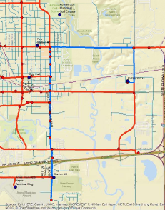
First Phase Deployment Ames Traffic Signal Master Plan (Ames)
Install fiber optic cable and network switching equipment, traffic signal cabinets, Advanced Traffic Controllers, Advanced Traffic Management System, and software to provide communication and traffic management capabilities for the Duff Avenue Corridor.
Total Cost: $1,470,648
Requested: $1,176,518 (80%)
Return to List of Applications Recommended

Slide 12
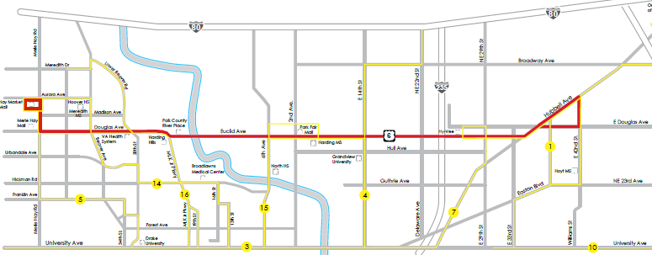
Euclid Ave/Douglas Ave Crosstown – Year Two (Des Moines Area Regional Transit Authority)
Final year funding request of an all-day crosstown transit service that travels along Euclid Avenue/Douglas Avenue from East 42nd Street to Merle Hay Road.
Total Cost: $392,186
Requested: $313,749 (80%)
Return to List of Applications Recommended

Slide 13
#11 Cherry, Add Night Service – Year 1 (Ames Transit Agency)
Add new night service trips to the #11 Cherry route to improve safety and due to residential demand.
Total Cost: $40,703
Requested: $32,562 (80%)
Return to List of Applications Recommended

Slide 14
IA 17 (S Ave) Railroad Overpass and 200th Street Connection (Boone County)
Pave 1.5 mile segment of 200th Street in Boone County from Boone Industrial Park to realigned IA 17 as a result of closing at-grade railroad crossings at Quartz Avenue and R Avenue.
Total Cost: $2,578,300
Requested: $800,000 (31%)
Return to List of Applications Recommended

Slide 15
#12 Lilac, Add Midday Service – Year 1 (Ames Transit Agency)
Add new midday service trips to the #12 Lilac route due to residential demand.
Total Cost: $38,411
Requested: $30,728 (80%)
Return to List of Applications Recommended

Slide 16
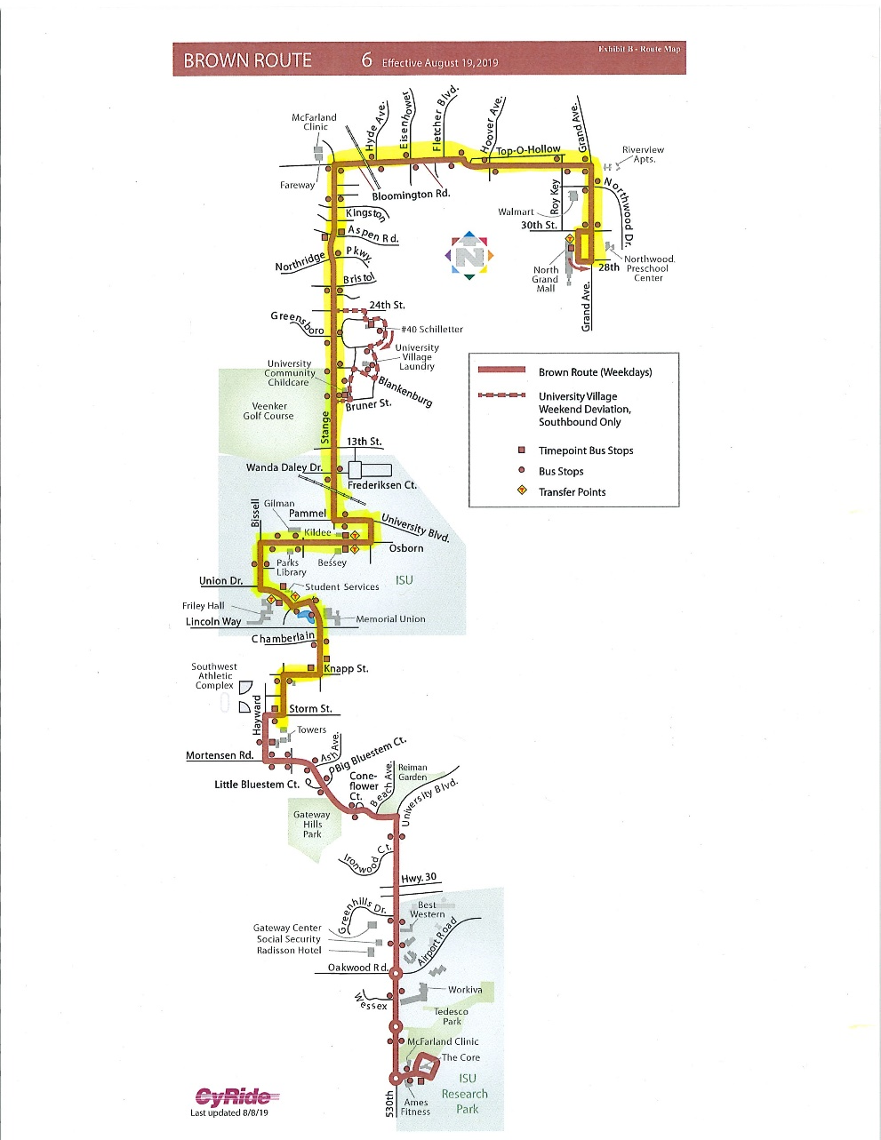
#6 Brown, Add Night Service – Year 1 (Ames Transit Agency)
Add new night service trips to the #6 Brown route to improve safety and due to residential demand.
Total Cost: $36,385
Requested: $29,108 (80%)
Return to List of Applications Recommended

Slide 17
Roundabout at Warrior Lane, Ashworth Dr., and Northview Dr. (Waukee)
Reconstruct an existing 5-way stop-controlled intersection into a 4-leg roundabout at Warrior Lane, Ashworth Drive, and Northview Drive in Waukee.
Total Cost: $1,900,000
Requested: $1,400,000 (74%)
Return to List of Applications Recommended

Slide 18
List of Applications Not Recommended for Award
PROJECT NAME | SPONSOR | SCORE | TOTAL PROJECT COST | REQUESTED AMOUNT (% of Total Project Cost) | RECOMMENDED AMOUNT (% of Total Project Cost)
University Avenue Improvements | Windsor Heights | 41.7 | $5,404,310 | $400,000 (7%) | $0
Elm Street Bridge Replacement over Canadian Pacific Railway | Davenport | Ineligible | $2,500,000 | $1,500,000 (60%) | $0
Return to List of Applications Recommended

