Slide 1
Federal Recreational Trails Program
Funding Recommendation

Slide 2
Federal Recreational Trail Program
Federal program created in 1991
Available to federal, state, and local government agencies. Private individuals and organizations may apply with a government co-sponsor.
Purpose is to develop and maintain recreational trails and trail related facilities for both motorized and non-motorized trail users.
Eligible projects include:
Maintenance and restoration of existing trails, development of trailside and trailhead facilities, purchase of trail construction and maintenance equipment, construction of new trails, and acquisition of land for trails.

Slide 3
Project Evaluation Criteria
Degree to which motorized and non-motorized trail use are accommodated. (10 points)
Greatest number of compatible multi-purpose uses. (10 points)
Access and use for persons with disabilities, older citizens, economically challenged and other special populations or groups. (10 points)
Provides development of trail linkages. (10 points)
Opportunities for new partnerships between trail users and private interests. (10 points)
Identified in or furthers a specific goal of a state, regional, or local plan. (10 points)
Leverages greater public or private investments. (10 points)
Citizen involvement in the project’s conception and implementation (10 points)
Degree to which project ties in to other trails. (10 points)
Public/private partnerships to continue operation and maintenance. (15 points)
Trails with national designation or resulting in the cleanup of an area. (10 points)

Slide 4
Available Funding and Application Summary
Available Funding:
Annual appropriation: $1,300,000
Underrun/withdrawals: $ 83,485
Funds awarded: $1,383,485
Application Summary:
Total number of projects: 20
Total project costs: $19,694,284
Total amount requested: $7,226,756

Slide 5
List of Motorized Applications Recommended
PROJECT NAME | SPONSOR | SCORE | TOTAL PROJECT COST | REQUESTED AMOUNT (% of Total Project Cost) | RECOMMENDED AMOUNT (% of Total Project Cost)
Bluff Creek OHV Park Bridge Replacements | Iowa DNR | 65.83 | $408,200 | $326,560 (80%) | $326,560 (80%)
Jump to applications not recommended for funding

Slide 6
List of Non-motorized Applications Recommended
PROJECT NAME | SPONSOR | SCORE | TOTAL PROJECT COST | REQUESTED AMOUNT (% of Total Project Cost) | RECOMMENDED AMOUNT (% of Total Project Cost)
Support for Program and Bicycle Summit | Iowa DOT | N/A | $8,750 | $7,000 (80%) | $7,000 (80%)
Cedar Valley Nature Trail Phase 5, Segment 2 | Linn County Conservation Board | 80.71 | $1,500,000 | $700,000 (47%) | $500,000 (33%)
Tatonka Ska Trace Rail Trail Phase IV(a) | Dickinson County Trails Board | 79.29 | $883,680 | $221,750 (25%) | $221,750 (25%)
Raccoon River Valley Trail to High Trestle Trail Connector Phase IV | Dallas County Conservation Board | 77.29 | $664,000 | $441,560 (67%) | $328,175 (49%)
Jump to applications not recommended for funding

Slide 7
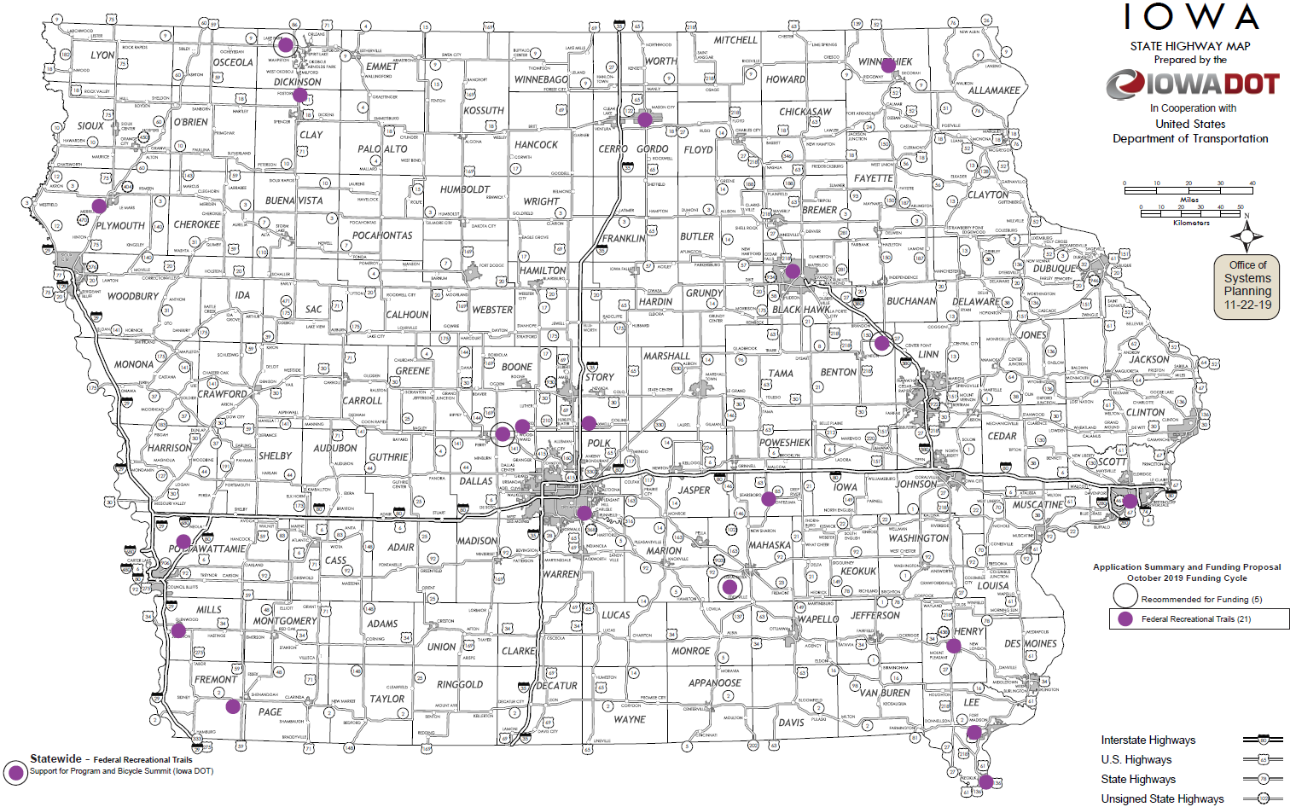
Map of Applications Received

Slide 8
QUESTIONS?
Debra Arp
Grant Program Administration Team Leader
Debra.arp@iowadot.us

Slide 9
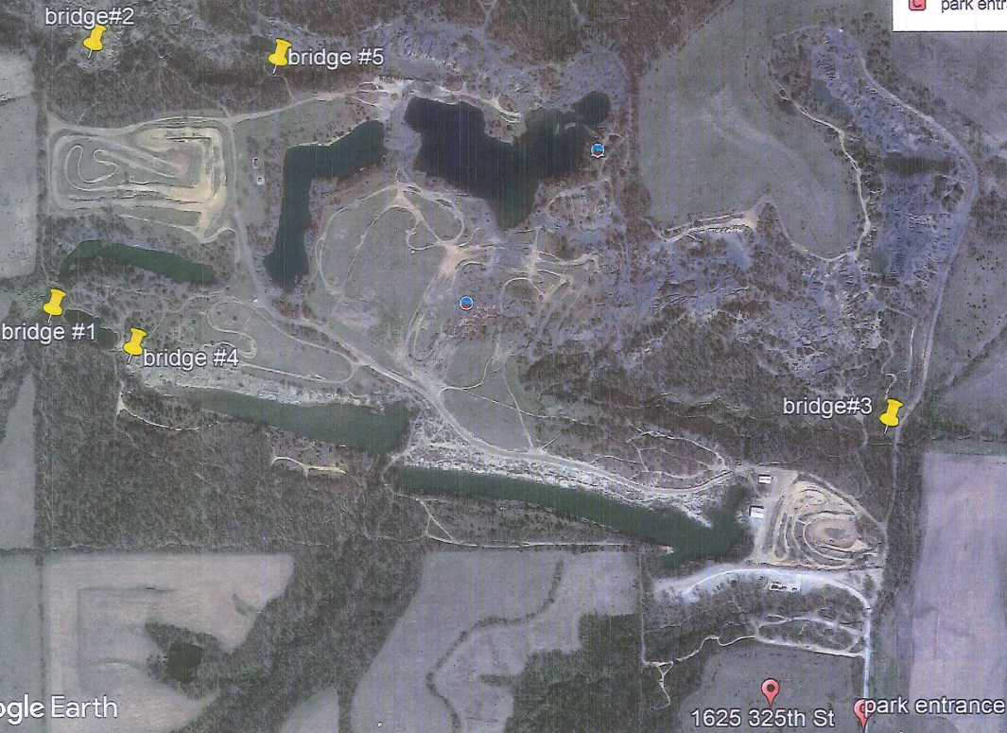
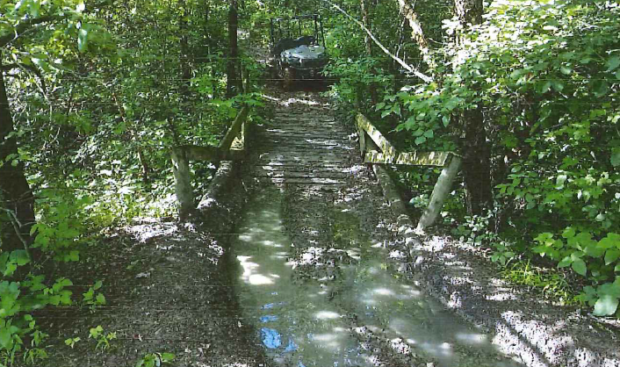
Bluff Creek OHV Park Bridge Replacements (Iowa DNR)
This project replaces of five existing bridge and culvert structures at Bluff Creek OHV Park near Eddyville.
Total Cost: $408,200
Requested: $326,560 (80%)
Return to List of Applications Recommended

Slide 10
Support for Program and Bicycle Summit (Iowa DOT)
This project provides funding to pay for costs related to operation of the Federal Recreational Trails Program for 2021 and for the 2021 Iowa Bicycle Summit. The Iowa Bicycle Summit is an annual conference providing education on the latest bicycle facilities, technology, and programming. It brings national speakers to Iowa to share bicycle facility successes and best practices from around the United States. Many of the lessons learned at the Summit have manifested into trail facilities and safety.
Total Cost: $8,750
Requested: $7,000 (80%)
Return to List of Applications Recommended

Slide 11
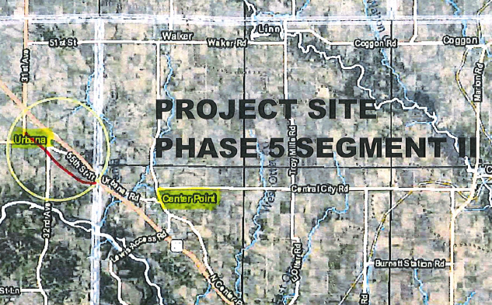
Cedar Valley Nature Trail Phase 5, Segment 2
(Linn County Conservation Board)
This project will reconstruct and pave a 3.5-mile segment of the Cedar Valley Nature Trail from 56th Street Drive in Benton County to Iowa 150 at Urbana.
Total Cost: $1,500,000
Requested: $700,000 (47%)
Recommended: $500,000 (33%)
Return to List of Applications Recommended

Slide 12
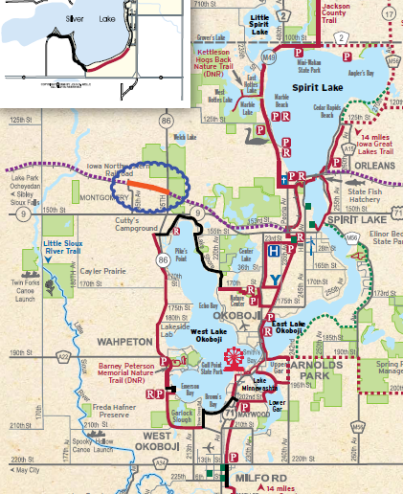
Tatonka Ska Trace Rail Trail Phase IV(a)
(Dickinson County Trails Board)
This project will construct a 1.15-mile paved trail on the former Iowa & Northwestern Railroad from Iowa 86 west of Spirit Lake to 193rd Avenue in Montgomery. This project is part of a multi-phase rail trail that will span 37 miles and connect eight northwest Iowa towns joining the Ed Winkel Memorial Trail west of Allendorf and continuing to Sibley for a total of 43 miles.
Total Cost: $883,680
Requested: $221,750 (25%)
Return to List of Applications Recommended

Slide 13
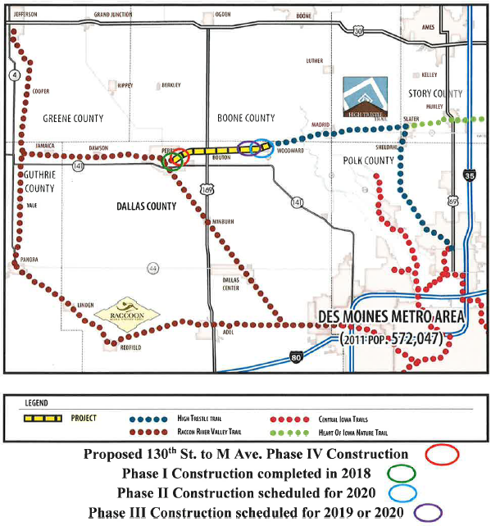
Raccoon River Valley Trail to High Trestle Trail Connector Phase IV
(Dallas County Conservation Board)
This project is a 1,780-feet paved segment of the connector trail and bridge over Beaver Creek east of Perry. Upon completion of all phases of construction, the 9-mile connector trail will link the Raccoon River Valley Trail and the High Trestle Trail between Perry and Woodward.
Total Cost: $664,000
Requested: $441,560 (67%)
Recommended: $328,175 (49%)
Return to List of Applications Recommended

Slide 14
List of Applications Not Recommended for Award
PROJECT NAME | SPONSOR | SCORE | TOTAL PROJECT COST | REQUESTED AMOUNT (% of Total Project Cost) | RECOMMENDED AMOUNT (% of Total Project Cost)
Heart of Iowa Nature Trail Paving from South Skunk River Bridge to County Road S-14 | Story County Conservation Board | 70.83 | $1,006,000 | $420,000 (42%) | $0
Carlisle Trail Connection | Des Moines | 70.29 | $2,500,000 | $400,000 (16%) | $0
First Bridge Replica Pedestrian/Bicycle Trail Bridge | River Action, Inc. | 69.14 | $3,001,236 | $750,000 (25%) | $0
Let's Konnect! Riverfront Trail | Keokuk | 68.57 | $808,528 | $253,198 (31%) | $0
George Wyth State Park Trail Replacement Phase I | Iowa Department of Natural Resources | 68.50 | $335,000 | $268,000 (80%) | $0
Return to List of Applications Recommended

Slide 15
List of Applications Not Recommended for Award
PROJECT NAME | SPONSOR | SCORE | TOTAL PROJECT COST | REQUESTED AMOUNT (% of Total Project Cost) | RECOMMENDED AMOUNT (% of Total Project Cost)
Connecting Fort Madison! Phase IV | Fort Madison | 67.86 | $415,180 | $260,000 (63%) | $0
Iowa Great Lakes Connection Trail Phase III | Clay County | 65.29 | $458,394 | $366,715 (80%) | $0
High Trestle Trail to City of Boone Trail Phase 1 | Boone County Conservation Board | 64.29 | $418,000 | $234,400 (56%) | $0
Admiral Trail Phase 2 | Farragut | 58.57 | $421,500 | $337,200 (80%) | $0
Glenwood Trail System | Glenwood | 57.29 | $1,488,663 | $300,000 (20%) | $0
Return to List of Applications Recommended

Slide 16
List of Applications Not Recommended for Award
PROJECT NAME | SPONSOR | SCORE | TOTAL PROJECT COST | REQUESTED AMOUNT (% of Total Project Cost) | RECOMMENDED AMOUNT (% of Total Project Cost)
High Line Trail Phase I | Mason City | 56.29 | $328,903 | $258,903 (79%) | $0
Saunders Park Trail Connection | Mount Pleasant | 53.86 | $539,950 | $175,000 (32%) | $0
Bluffton Road (County Road W20) Shoulder Paving | Winneshiek County | 49.86 | $300,000 | $240,000 (80%) | $0
Plywood Trail Stage 1 | Le Mars | 47.00 | $3,250,000 | $500,000 (15%) | $0
Bonham Memorial Park Trail Linkup | Montezuma | 44.86 | $16,650 | $13,150 (79%) | $0
Underwood Trail Connector along Railroad Highway Trail | Underwood | 31.86 | $950,400 | $760,320 (80%) | $0
Return to List of Applications Recommended

