Slide 1
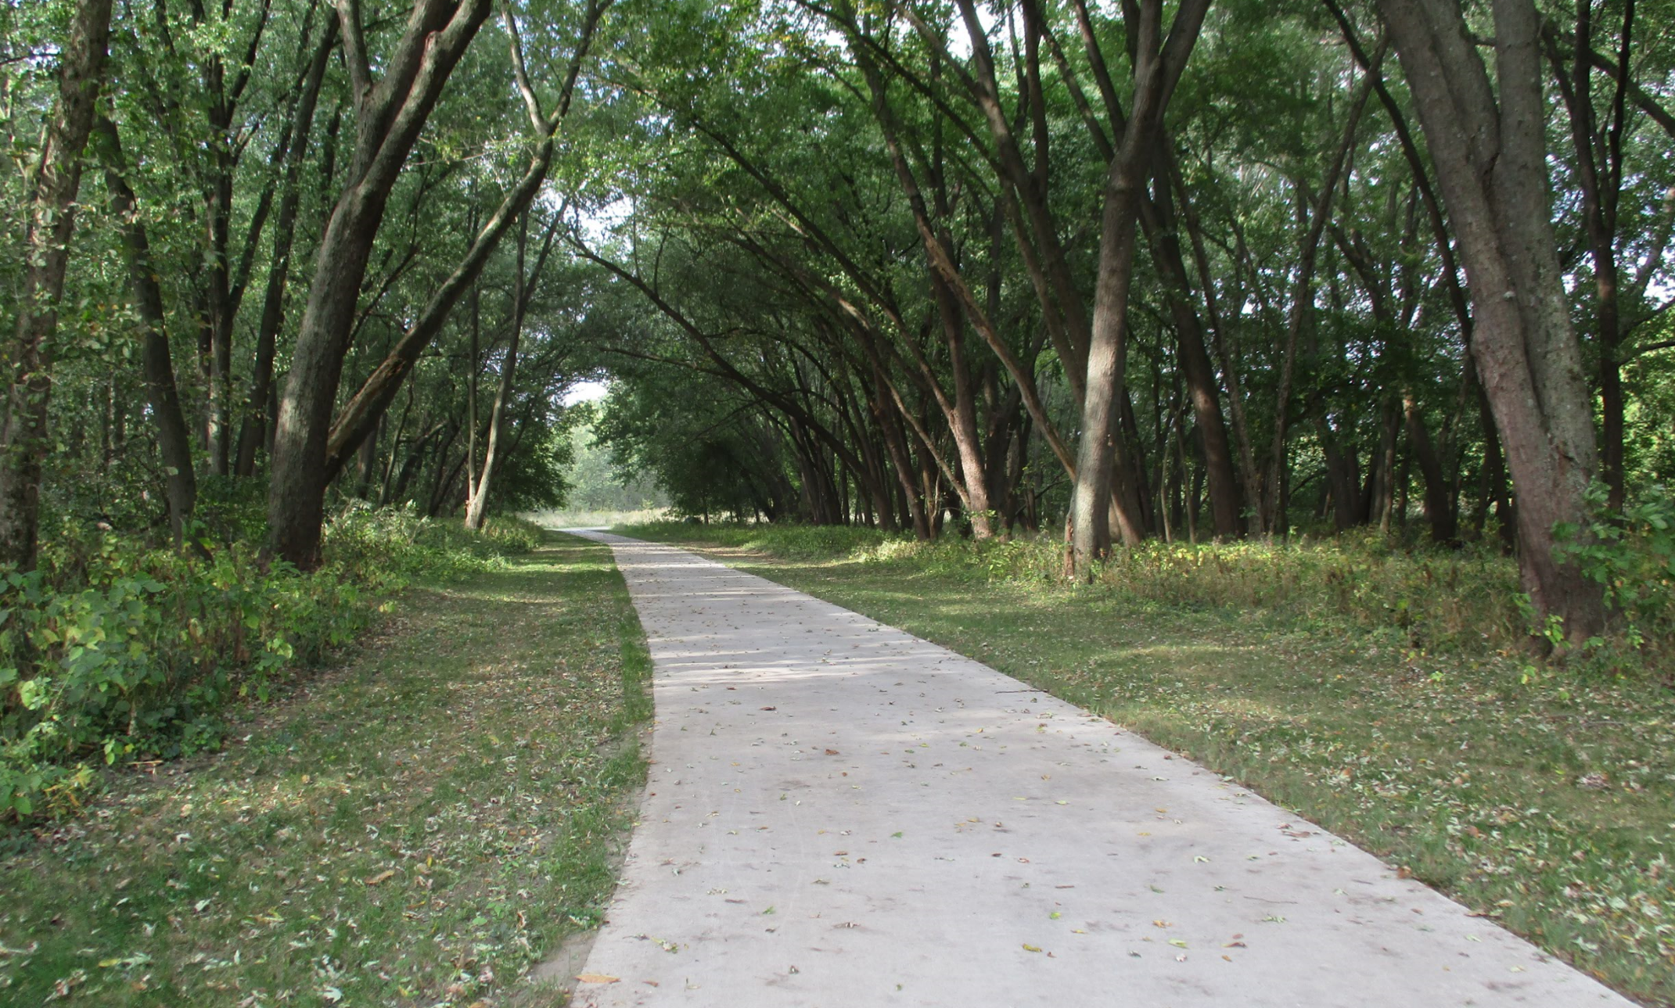

Statewide Iowa’s Transportation Alternatives Program
Funding Recommendation

Slide 2
Statewide Iowa’s Transportation Alternatives Program
Current version of former Transportation Enhancement program that has existed since 1991.
Majority of funding is distributed to Iowa’s RPAs and MPOs with $1 million reserved for statewide projects
Eligible activities include:
On-road and off-road non-motorized trail facilities, safe routes for non-drivers, conversion of abandoned rail corridors for trails, preservation/rehabilitation of historic transportation facilities among others
Federal Recreational Trails Program eligible activities
Infrastructure-related or non-infrastructure related Safe Routes to School Projects (if local TAP funds are used as well)
Scenic Byways (if local TAP funds are used as well)

Slide 3
Project Evaluation Criteria
Statewide or multi-regional impact of the project (35 points)
Degree of enhancement of the quality or utility of the state surface transportation system (20 points)
State or multi-regional tourism benefits( 10 points)
Degree of statewide or multi-regional planning implemented (35 points)

Slide 4
Available Funding and Application Summary
Estimated FY 2020 Appropriation: $10,764,227
$1,374,817 set aside for Recreational Trails.
Half ($4,694,705) reserved for local projects, half stays at the state level.
The set-aside for Statewide TAP is $1,000,000
Remaining $3,694,705 of state level funding is reserved for eligible local projects:
Transportation Alternatives Program
Highway
Bridge
Transit

Slide 5
Available Funding and Application Summary
Available Funding:
Statewide Iowa’s TAP funds available: $1,000,000 plus previous years under runs
Application Summary
Total number of projects: 5
Total project costs: $4,677,706
Total amount requested: $1,721,055

Slide 6
List of Applications Recommended
PROJECT NAME | SPONSOR | SCORE | TOTAL PROJECT COST | REQUESTED AMOUNT (% of Total Project Cost) | RECOMMENDED AMOUNT (% of Total Project Cost)
US 65 Underpass | Bondurant | 90 | $2,679,574 | $536,000 (20.00%) | $536,000 (20.00%)
Integrated Roadside Vegetation Management | University of Northern Iowa/Tallgrass Prairie Center | 90 | $1,077,651 | $541,400 (50.24%) | $541,400 (50.24%)
Iowa Safe Routes to School Partnership | Iowa Northland Regional Council of Governments | 85 | $264,728 | $201,055 (75.95%) | $201,055 (75.95%)
Manning Safe Routes to School – South Phase I | Manning | 20 | $164,000 | $49,200 (30.00%) | $49,200 (30.00%)
Jump to applications not recommended for funding

Slide 7
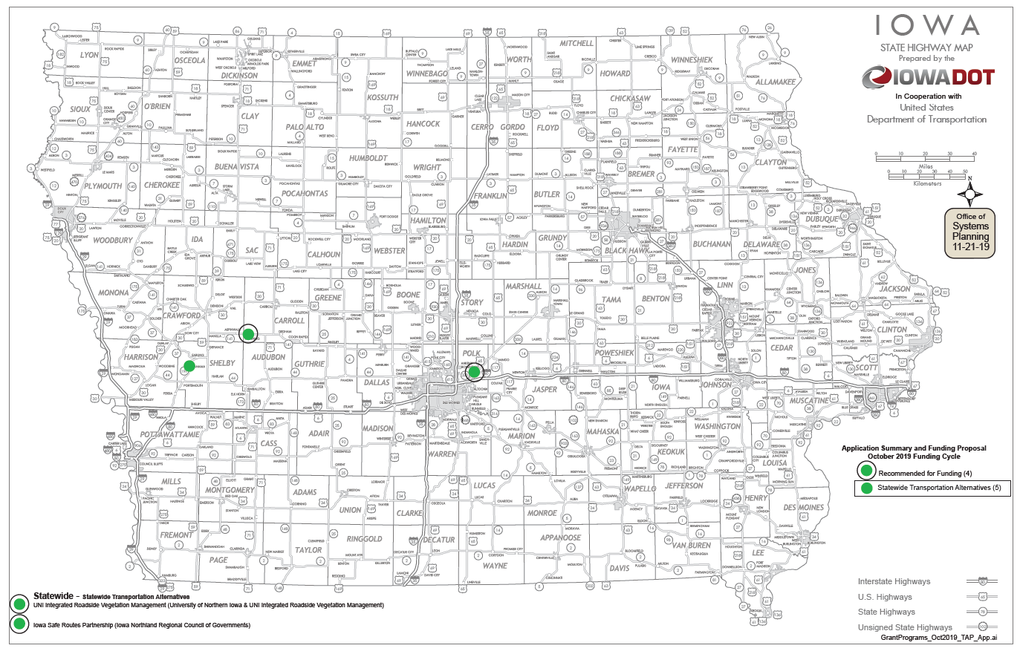
Map of Applications Received

Slide 8

QUESTIONS?
Pamella Lee
Transportation Alternatives program manager
Pamella.lee@iowadot.us

Slide 9
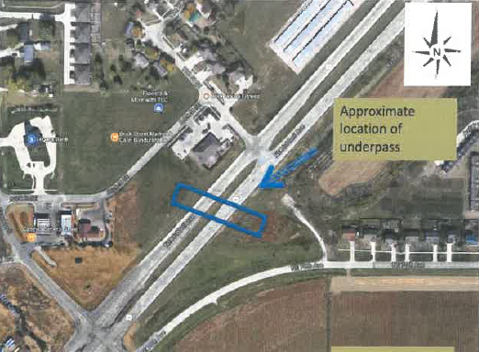
US 65 Underpass (Bondurant)
Construction of a underpass under US65 to allow safe passage of pedestrians across this busy highway.
Total Cost: $2,679,574
Requested: $536,000 (20%)
Return to List of Applications Recommended

Slide 10
Integrated Roadside Vegetation Management (University of Northern Iowa/Tallgrass Prairie Center)
Native grass and wildflower seed are to be planted in county road or city (population >10,000) rights-of-way. This allows counties and cities that apply Integrated Roadside Vegetation Management to more cost effectively establish native roadside vegetation for habitat, biodiversity, erosion control and improved hydrology across Iowa's landscape.
Total Cost: $1,077,651
Requested: $ 541,400 (50.24%)
Return to List of Applications Received

Slide 11

Iowa Safe Routes to School Partnership (Iowa Northland Regional Council of Governments and Upper Explorerland Regional Planning Commission)
A comprehensive program that provides support to communities by implementing SRTS initiatives, including pedestrian and bicycle safety education through encouragement activities both inside and outside the classroom.
Total Cost: $264,728
Requested: $201,055 (80%)
Return to List of Applications Recommended

Slide 12
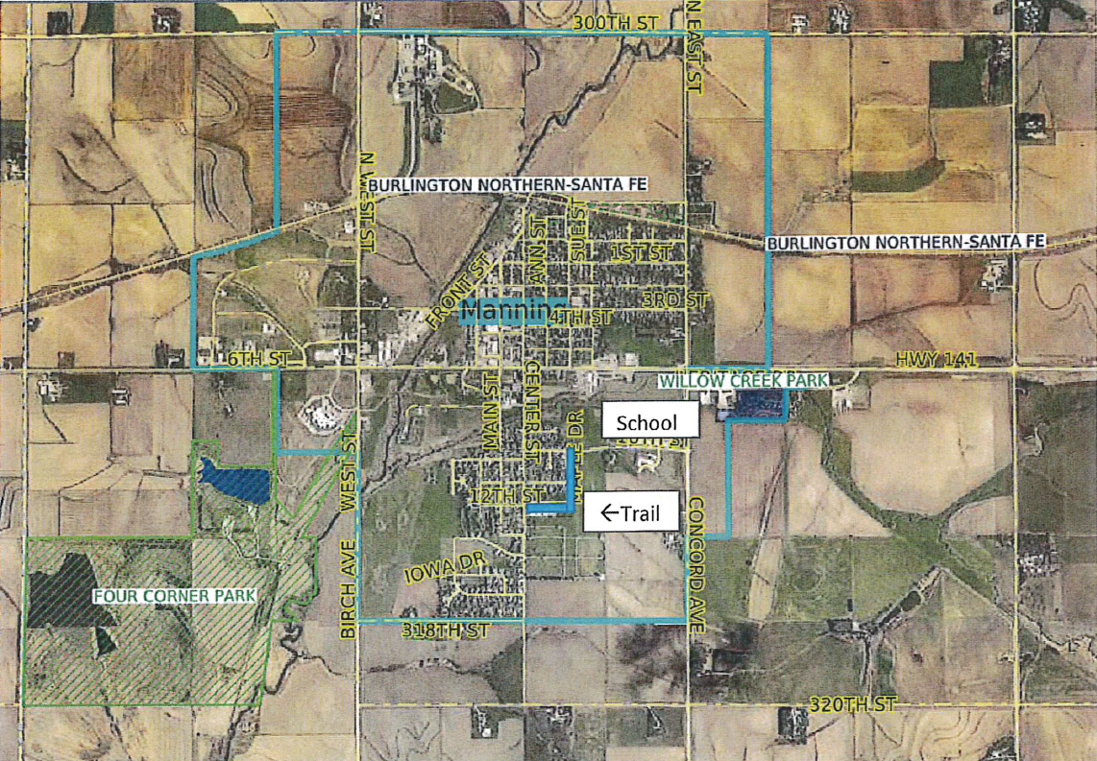
Safe Routes to School – South Phase I (Manning)
Construct a 1,500 ft. paved trail from the from the existing School Trail South to Manning neighborhoods.
Total Cost: $164,000
Requested: $ 49,200 (20.00%)
Return to List of Applications Recommended

Slide 13
List of Applications Not Recommended for Award
PROJECT NAME | SPONSOR | SCORE | TOTAL PROJECT COST | REQUESTED AMOUNT (% of Total Project Cost) | RECOMMENDED AMOUNT (% of Total Project Cost)
Shelby County Phase 1 Ballpark to Ballpark | Shelby County | Not Eligible | $491,750 | $393,400 (80%) | $0
Return to List of Applications Recommended

Slide 14
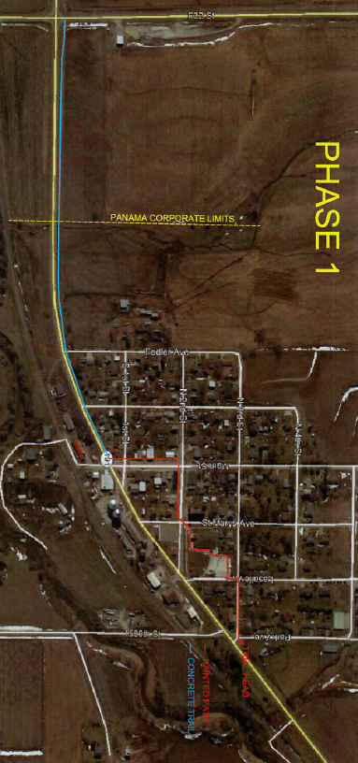
Comprehensive Trails Project Phase 1, Ballpark to Ballpark (Shelby County)
Construct a 0.9 mile paved trail between the baseball field in Panama and Street F32.
Total Cost: $491,750
Requested: $393,400 (80%)
Return to List of Applications Recommended

