Slide 1
Revitalize Iowa’s Sound Economy Program

Slide 2
Revitalize Iowa’s Sound Economy Program
Created in 1985
Purpose: To promote economic development through roadway improvements.
Eligible development shall have value-adding activities that feed new dollars into the economy
Available to cities and counties through an application program

Slide 3
Available Funding and Application Summary
Available Funding
Funded annually with dedicated state motor fuel and special fuel tax revenues
Application Summary for SFY2020
Total number of projects awarded: 8
Total project costs: $11,612,617
Total amount awarded: $5,278,319
 | CITY | COUNTY
Average funding generated monthly | $997,556 | $498,778
SFY 2020 current Road Use Tax Revenue (as of 10/28/2019) | $4,003,791.25 | $2,001,895.64
Current Unobligated Balance (as of 10/28/2019) | $16,035,493.12 | $1,515,500.06

Slide 4
Local Development Project Evaluation Criteria
Development Potential (35 points)
Economic impact and Cost Effectiveness (20 points)
Local Commitment and Initiative (33 points)
Transportation Need and Justification (4 points)
Local Economic Need (6 points)

Slide 5
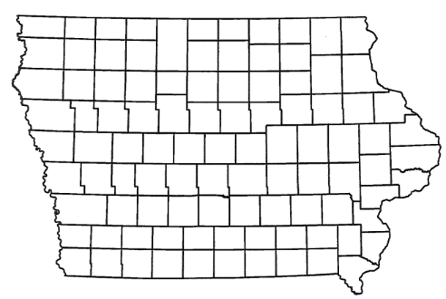
List of Local Development Applications Recommended
PROJECT NAME
SPONSOR
SCORE
TOTAL PROJECT COST
PERCENT PARTICIPATION
RECOMMENDED AMOUNT
Construction and roadway improvements of approximately 9,715 feet of Filbert Avenue located southwest of Blencoe. | Monona County | 64 | $3,127,190 | 50% | $1,563,595

Slide 6
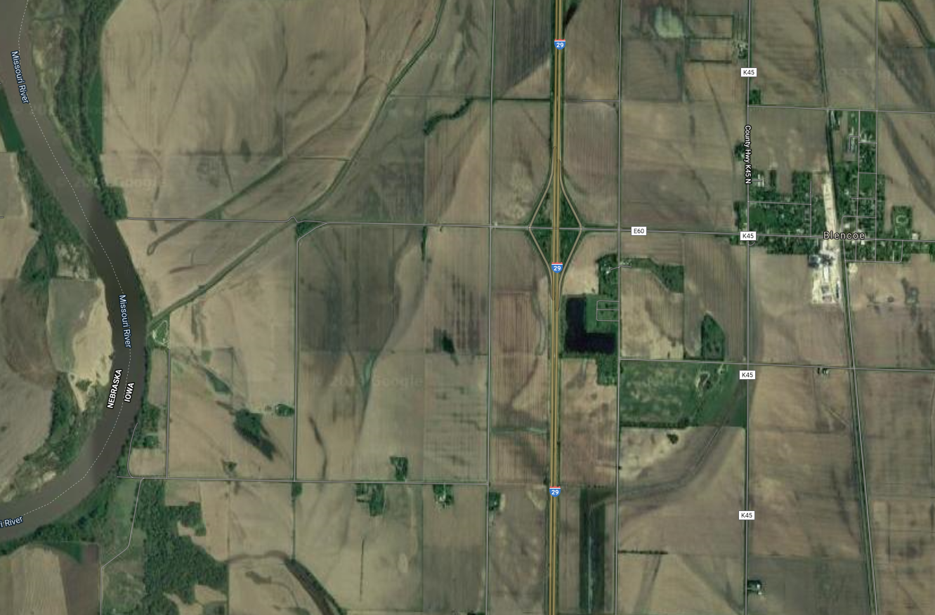
Monona County
(Local Development)
Construction and roadway improvements of approximately 9,715 feet of Filbert Avenue located southwest of Blencoe. This project will provide improved access to two lots totaling more than 38 acres for heavy industrial purposes.
Total Cost: $3,127,190
Requested: $1,563,595 (50%)

Slide 7
QUESTIONS?
Craig Markley, Systems Planning Bureau
craig.markley@iowadot.us
515-239-1027

